Slide 1
Planning 1
13.pdf
Chapter 11.1-11.3
Some material adopted from notes by Andreas Geyer-Schulz
and Chuck Dyer

Slide 2
Blocks World Planning
A
C
B
A
B
C

Slide 3
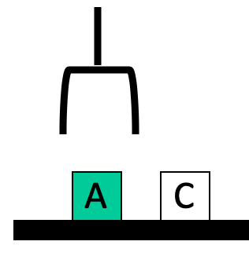
Blocks world
The blocks world is a micro-world with a
table, a set of blocks, and a robot hand
Some constraints for a simple model:
  Only one block can be on another block
  Any number of blocks can be on the table
  The hand can only hold one block
Typical representation uses a logic notation:
  ontable(b) ontable(d)
  on(c,d) holding(a)
  clear(b) clear(c)

Slide 4
Typical BW planning problem
Initial state:
  clear(a)
  clear(b)
  clear(c)
  ontable(a)
  ontable(b)
  ontable(c)
  handempty
Goal:
  on(b,c)
  on(a,b)
  ontable(c)
A
C
B
A
B
C

Slide 5
Typical BW planning problem
Logical assertions
describing initial &
final states
Sequence of robot actions
Initial state:
  clear(a)
  clear(b)
  clear(c)
  ontable(a)
  ontable(b)
  ontable(c)
  handempty
Goal state:
  on(b,c)
  on(a,b)
  ontable(c)
Plan:
  pickup(b)
  stack(b,c)
  pickup(a)
  stack(a,b)
A
C
B
A
B
C

Slide 6
Planning problem
Find sequence of actions to achieve goal state when executed from initial state given
  set of possible primitive actions, including their preconditions and effects
  initial state description
  goal state description
Compute plan as a sequence of actions that, when executed in initial state, achieves goal state
States specified as a KB , i.e. conjunction of conditions
  e.g., ontable(a) ∧ on(b, a)

Slide 7
Planning vs. problem solving
Problem solving methods can solve similar problems
Planning is more powerful and efficient because of the representations and methods used
States, goals, and actions are decomposed into sets of sentences (usually in first-order logic)
Search often proceeds through plan space rather than state space (though there are also state-space planners)
Sub-goals can be planned independently, reducing the complexity of the planning problem

Slide 8
Typical simplifying assumptions
Atomic time: Each action is indivisible
No concurrent actions: but actions need not be ordered w.r.t. each other in the plan
Deterministic actions: action results completely determined — no uncertainty in their effects
Agent is the sole cause of change in the world
Agent is omniscient with complete knowledge of the state of the world
Closed world assumption: everything known to be true in world is included in state description and anything not listed is false

Slide 9
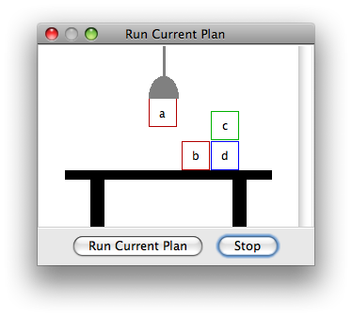
Blocks world
The blocks world consists of a table, a set of blocks and a robot hand
Some domain constraints:
  Only one block can be on another block
  Any number of blocks can be on
  the table
  The hand can only hold one block
Typical representation:
  ontable(b) ontable(d)
  on(c,d) holding(a)
  clear(b) clear(c)
Meant to be a simple model!

Slide 10
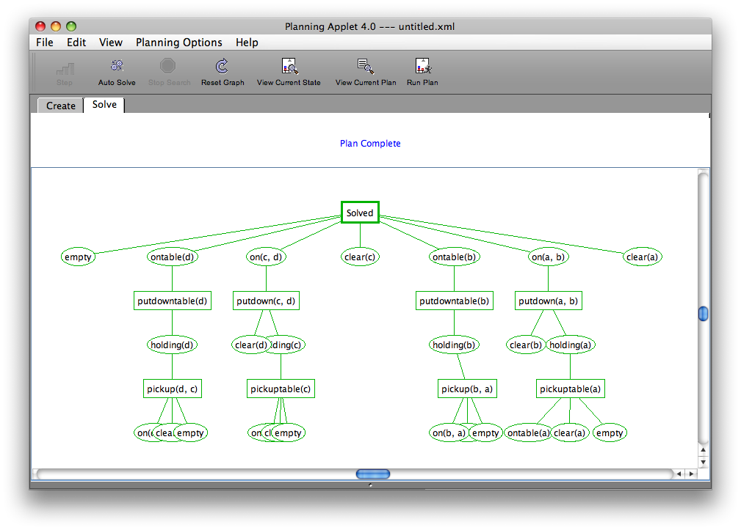

Slide 11
Typical BW planning problem
Initial state:
  clear(a)
  clear(b)
  clear(c)
  ontable(a)
  ontable(b)
  ontable(c)
  handempty
Goal:
  on(b,c)
  on(a,b)
  ontable(c)
A plan:
  pickup(b)
  stack(b,c)
  pickup(a)
  stack(a,b)
A
C
B
A
B
C

Slide 12
Another BW planning problem
Initial state:
  clear(a)
  clear(b)
  clear(c)
  ontable(a)
  ontable(b)
  ontable(c)
  handempty
Goal:
  on(a,b)
  on(b,c)
  ontable(c)
A plan:
  pickup(a)
stack(a,b)
unstack(a,b)
putdown(a)
pickup(b)
stack(b,c)
pickup(a)
stack(a,b)
A
C
B
A
B
C

Slide 13
Another BW planning problem
Initial state:
  clear(a)
  clear(b)
  clear(c)
  ontable(a)
  ontable(b)
  ontable(c)
  handempty
Goal:
  on(a,b)
  on(b,c)
  ontable(c)
A plan:
  pickup(a)
stack(a,b)
unstack(a,b)
putdown(a)
pickup(b)
stack(b,c)
pickup(a)
stack(a,b)
A
C
B
A
B
C
Note: Goals in a different order!

Slide 14
Yet Another BW planning problem
Plan:
  unstack(c,b)
  putdown(c)
  unstack(b,a)
  putdown(b)
  pickup(a)
  stack(a,b)
  unstack(a,b)
  putdown(a)
  pickup(b)
  stack(b,c)
  pickup(a)
  stack(a,b)
Initial state:
  clear(c)
  ontable(a)
  on(b,a)
  on(c,b)
  handempty
Goal:
  on(a,b)
  on(b,c)
  ontable(c)
C
B
A
A
B
C
Note: not very efficient!

Slide 15
Major approaches
Planning as search
GPS / STRIPS
Situation calculus
Partial order planning
Hierarchical decomposition (HTN planning)
Planning with constraints (SATplan, Graphplan)
Reactive planning

Slide 16


Shakey the robot
First general-purpose mobile robot to be able to reason about its own actions
Shakey the Robot: 1st Robot to Embody Artificial Intelli-gence (2017, 6 min.)
Shakey: Experiments in Robot Plan-ning and Learning (1972, 24 min)

Slide 17
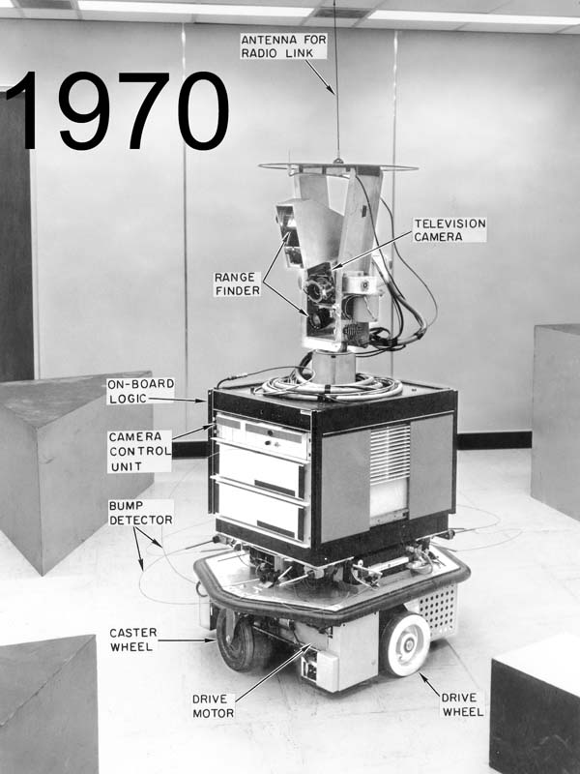
Strips planning representation
Classic approach first used in the STRIPS
(Stanford Research Institute Problem Solver) planner
A State is a conjunction of ground literals
  at(Home) ∧ ¬have(Milk) ∧ ¬have(bananas) ...
Goals are conjunctions of literals, but may have
variables, assumed to be existentially quantified
  at(?x) ∧ have(Milk) ∧ have(bananas) ...
Need not fully specify state
  Non-specified conditions either don’t-care or assumed false
  Represent many cases in small storage
  May only represent changes in state rather than entire situation
Unlike theorem prover, not seeking whether goal is true, but is there a sequence of actions to attain it
Shakey the robot

Slide 18
Blocks world operators
Classic basic operations for the blocks world
  stack(X,Y): put block X on block Y
  unstack(X,Y): remove block X from block Y
  pickup(X): pickup block X
  putdown(X): put block X on the table
Each represented by
  list of preconditions
  list of new facts to be added (add-effects)
  list of facts to be removed (delete-effects)
  optionally, set of (simple) variable constraints
For example stack(X,Y):
  preconditions(stack(X,Y), [holding(X), clear(Y)])
  deletes(stack(X,Y), [holding(X), clear(Y)]).
  adds(stack(X,Y), [handempty, on(X,Y), clear(X)])
  constraints(stack(X,Y), [X≠Y, Y≠table, X≠table])

Slide 19
STRIPS planning
STRIPS maintains two additional data structures:
  State List - all currently true predicates.
  Goal Stack - push down stack of goals to be solved, with current goal on top
If current goal not satisfied by present state, find operator that adds it and push operator and its preconditions (subgoals) on stack
When a current goal is satisfied, POP from stack
When an operator is on top stack, record application of that operator on plan sequence and use operator’s add and delete lists to update current state

Slide 20
Typical BW planning problem
Initial state:
  clear(a)
  clear(b)
  clear(c)
  ontable(a)
  ontable(b)
  ontable(c)
  handempty
Goal:
  on(b,c)
  on(a,b)
  ontable(c)
A plan:
  pickup(b)
  stack(b,c)
  pickup(a)
  stack(a,b)
A
C
B
A
B
C

Slide 21
Another BW planning problem
Initial state:
  clear(a)
  clear(b)
  clear(c)
  ontable(a)
  ontable(b)
  ontable(c)
  handempty
Goal:
  on(a,b)
  on(b,c)
  ontable(c)
A plan:
  pickup(a)
stack(a,b)
unstack(a,b)
putdown(a)
pickup(b)
stack(b,c)
pickup(a)
stack(a,b)
A
C
B
A
B
C

Slide 22
Yet Another BW planning problem
Plan:
  unstack(c,b)
  putdown(c)
  unstack(b,a)
  putdown(b)
  pickup(b)
  stack(b,a)
  unstack(b,a)
  putdown(b)
  pickup(a)
  stack(a,b)
  unstack(a,b)
  putdown(a)
  pickup(b)
  stack(b,c)
  pickup(a)
  stack(a,b)
Initial state:
  clear(c)
  ontable(a)
  on(b,a)
  on(c,b)
  handempty
Goal:
  on(a,b)
  on(b,c)
  ontable(c)
C
B
A
A
B
C

Slide 23
Yet Another BW planning problem
Initial state:
  ontable(a)
  ontable(b)
  clear(a)
  clear(b)
  handempty
Goal:
  on(a,b)
  on(b,a)
Plan:
  ??
A
B

Slide 24
Goal interaction
Simple planning algorithms assume independent sub-goals
  Solve each separately and concatenate the solutions
The “Sussman Anomaly” is the classic example of the goal interaction problem:
  Solving on(A,B) first (via unstack(C,A), stack(A,B)) is undone when solving 2nd goal on(B,C) (via unstack(A,B), stack(B,C))
  Solving on(B,C) first will be undone when solving on(A,B)
Classic STRIPS couldn’t handle this, although minor modifications can get it to do simple cases
A
C
B
A
B
C
Initial state
Goal state

Slide 25
Fin

