Slide 1
From Strings to Things
Populating Knowledge Bases from Text

Slide 2

The Web is our greatest knowledge source
Notes:
The Web is the greatest source of general knowledge available today.

Slide 3
But it has limitations
Notes:
The Web is the greatest source of general knowledge available today.

Slide 4

It was designed for people, not machines

Slide 5
It was designed for people, not machines
Its content is mostly text, spoken language, images and videos
These are easy for people to understand
But hard for machines
Machines need access to this knowledge too

Slide 6
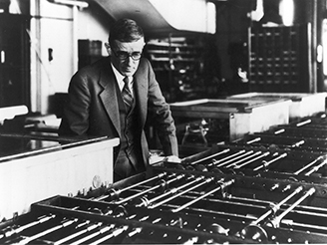
Access is primarily via information retrieval
Vannevar Bush envisioned a hypertext/IR system in 1945

Slide 7
Access is primarily via information retrieval
Key-word queries→ranked document list
We still need to read the documents or watch the videos
We often want an answer to a question
And so do our machines and apps
Vannevar Bush envisioned a hypertext/IR system in 1945

Slide 8
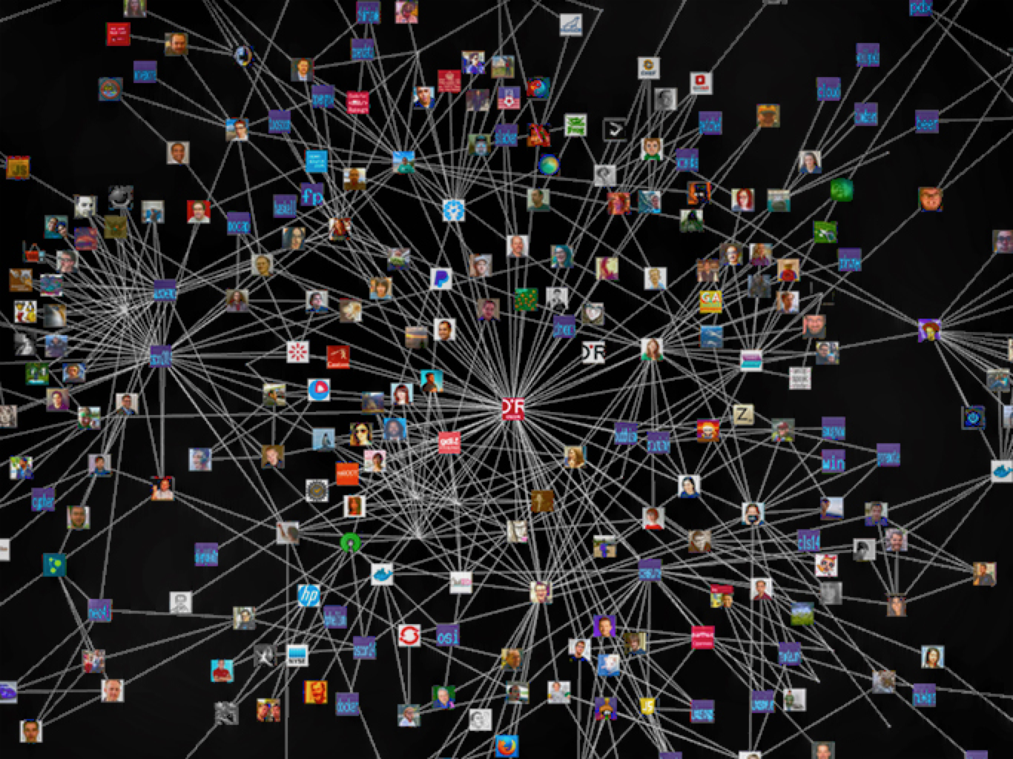
We need to add knowledge graphs
Notes:
I’m using knowledge graph here as being synonymous with knowledge base

Slide 9
We need to add knowledge graphs
High quality semi-structured information about entities, events and relations
Represented & accessed via standard APIs
Easily integrated, fused and reasoned with
Notes:
Knowledge graphs are essential to the new cognitive services being developed and supported by companies like IBM, Google, Facebook, Amazon and Apple

Slide 10

State of the Art?
Google is a good example, but Microsoft, IBM, Apple and Facebook all have similar capabilities
2010 Google acquired MediaWeb and its Freebase KB
2014: Freebase: 1.2B facts about 43M entities
2015+: Google knowledge graph, updated by text IE
DBpedia open source RDF KB is another
800M facts about 4.6M subjects from English Wikipedia, data also available in 21 other languages
Helps integrate 90B facts from 1000 RDF datasets in the linked data cloud

Slide 11
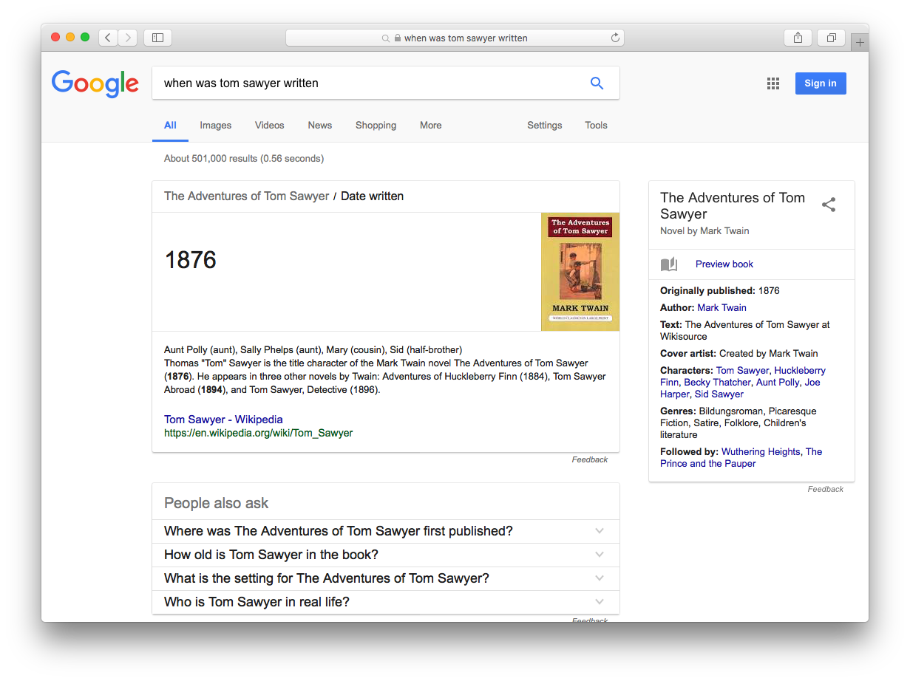
Ask: When was Tom Sawyer written?

Slide 12
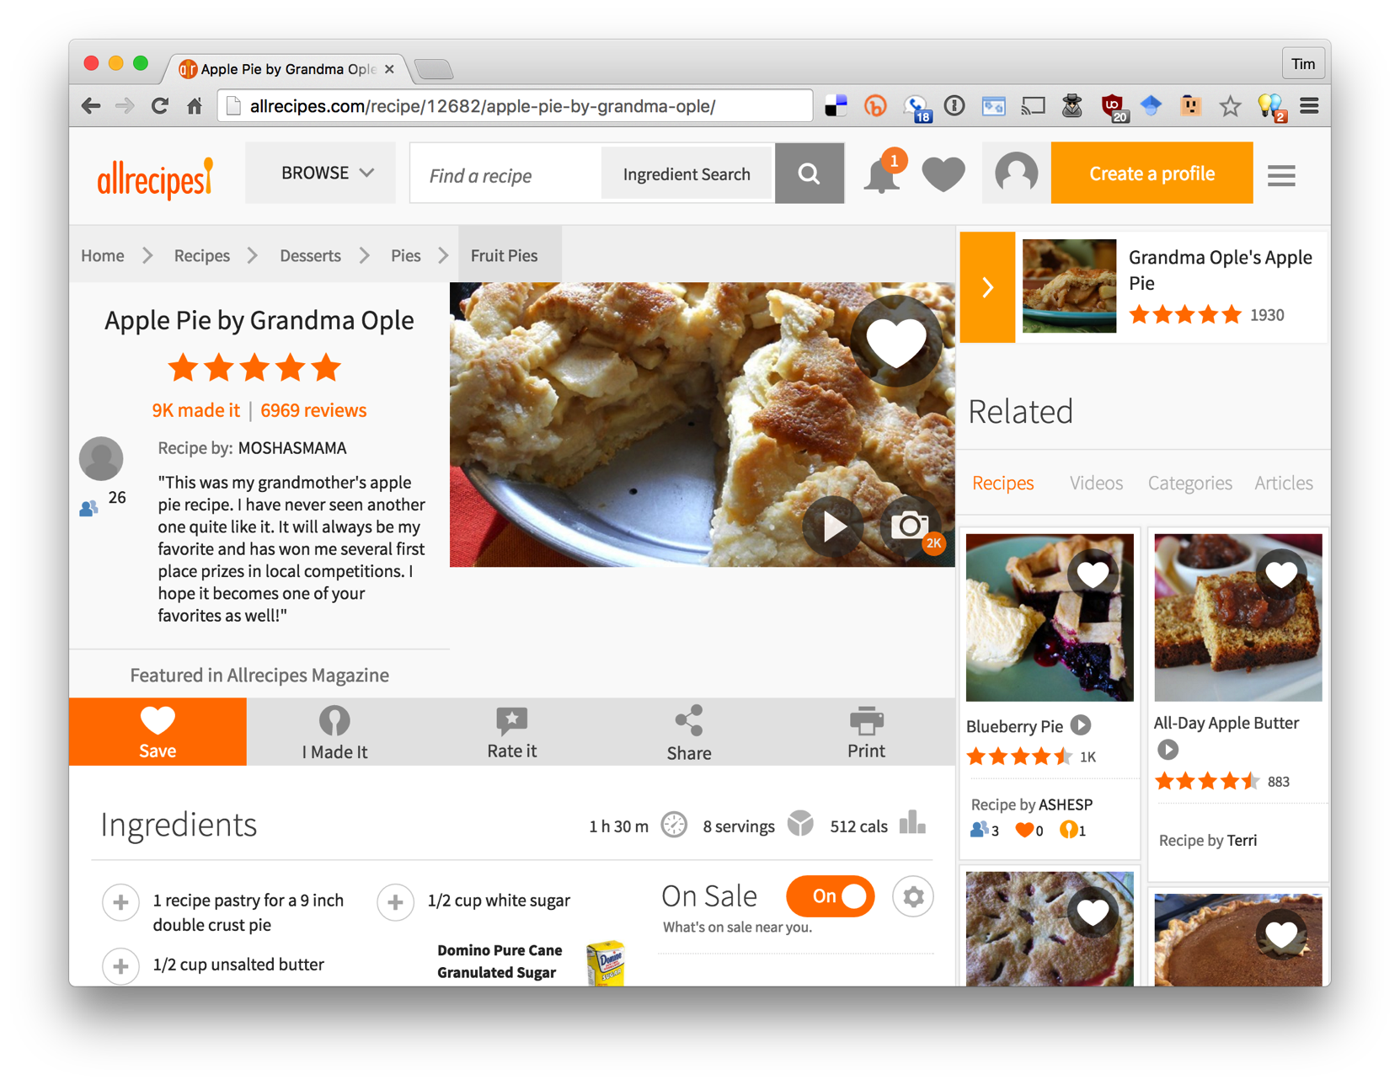
Notes:
As a separate, but related example of using data on the web, many sites not embed semantic data on web pages. The data is represented in an RDF-compatible graph format using terms defined in common ontologies found at schema.org.

Slide 13
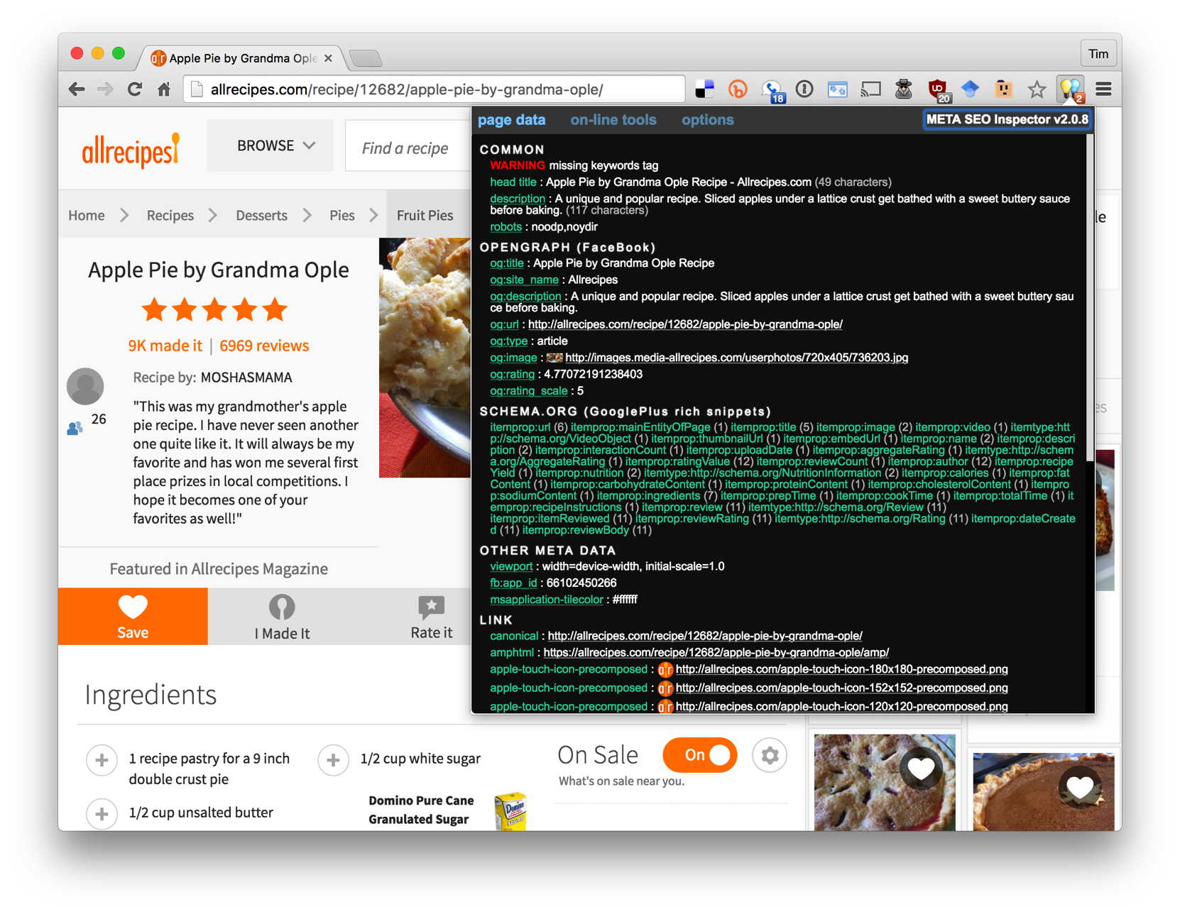
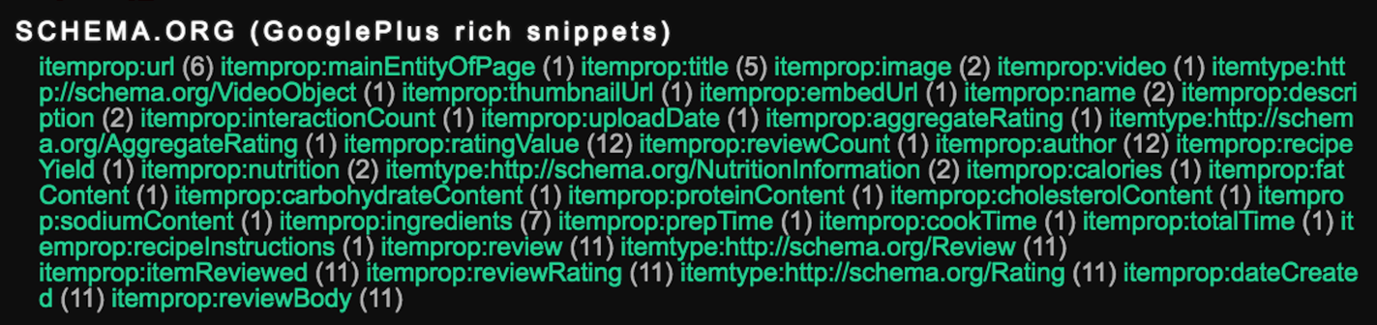
Almost all commercial recipe sites embed semantic data about their recipes in an RDF-compatible form using terms from the schema.org ontology.
Search engines read and use this data to better under-stand the semantics of the page content

Slide 14
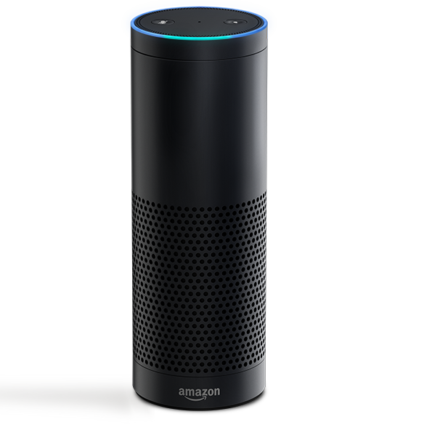
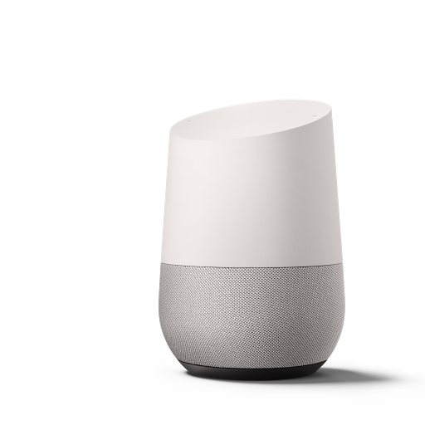

Conversational Bots
Voice-driven conversational systems like Amazon Echo and Google Home use knowledge graphs to help understand our requests

Slide 15
Where does the knowledge come from?
Initial knowledge graphs like DBpedia and Freebase started with data from Wikipedia and encoded it in custom ontologies
Current focus is on extracting information from text of source documents, e.g., journal articles, Newswire, social media, etc.

Slide 16

NIST Text Analysis Conference
Annual evaluation workshops since 2008 on natural language processing & related applications with large test collections and common evaluation procedures
Knowledge Base Population (KBP) tracks focus on building KBs from information extracted from text
  Cold Start KBP: construct a KB from text
  Entity discovery & linking: cluster and link entity mentions
  Slot filling
  Slot filler validation
  Sentiment
  Events: discover and cluster events in text
http://nist.gov/tac

Slide 17
2016 TAC Cold Start KBP
Read 90K documents: newswire articles & social media posts in English, Chinese and Spanish
Find entity mentions, types and relations
Cluster entities within and across documents and link to a reference KB when appropriate
Remove errors (Obama born in Illinois), draw sound inferences (Malia and Sasha sisters)
Create knowledge graph with provenance data for entities, mentions and relations

Slide 18
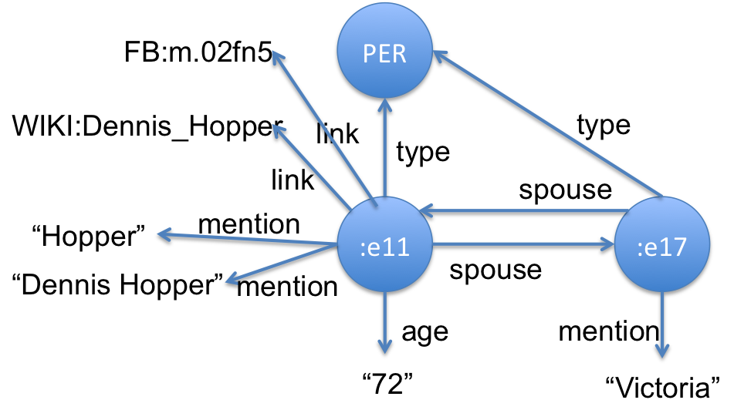
2016 TAC Cold Start KBP
Read 90K documents: newswire articles & social media posts in English, Chinese and Spanish
Find entity mentions, types and relations
Cluster entities within and across documents and link to a reference KB when appropriate
Remove errors (Obama born in Illinois), draw sound inferences (Malia and Sasha sisters)
Create knowledge graph with provenance data for entities, mentions and relations
<DOC id="APW_ENG_20100325.0021" type="story" >
<HEADLINE>
Divorce attorney says Dennis Hopper is dying
</HEADLINE>
<DATELINE>
LOS ANGELES 2010-03-25 00:15:51 UTC
</DATELINE>
<TEXT
<P>
Dennis Hopper's divorce attorney says in a court filing that the actor is dying and can't undergo chemotherapy as he battles prostate cancer.
</P>
<P>
Attorney Joseph Mannis described the "Easy Rider" star's grave condition in a declaration filed Wednesday in Los Angeles Superior Court.
</P>
<P>
Mannis and attorneys for Hopper's wife Victoria are fighting over when and whether to take the actor's deposition.
</P> …
…
:e00211 type PER
:e00211 link FB:m.02fn5
:e00211 link WIKI:Dennis_Hopper
:e00211 mention "Dennis Hopper" APW_021:185-197
:e00211 mention "Hopper" APW_021:507-512
:e00211 mention "Hopper" APW_021:618-623
:e00211 mention "丹尼斯·霍珀” CMN_011:930-936
:e00211 per:spouse :e00217 APW_021:521-528
:e00217 per:spouse :e00211 APW_021:521-528
:e00211 per:age "72" APW_021:521-528
…

Slide 19
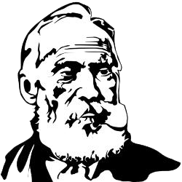
Kelvin
KELVIN: Knowledge Extraction,
Linking, Validation and Inference
Developed at the Human Language Technology Center of Excellence at JHU and used in TAC KBP (2010-16), EDL (2015-16) and other projects
Takes English, Chinese & Spanish documents and produce a knowledge graph in several formats
We’ll review its monolingual processing, look at the multi-lingual use case

Slide 20

1 Information Extraction
1
documents
1
IE
Process documents in parallel on a grid, applying information extraction tools to find mentions, entities, relations and events
Produce an Apache Thrift object for each document with text and relevant data produced by tools using a common Concrete schema for NLP data
2
TAC
3
CR
4
KB
5
MAT
KBs

Slide 21
2 Integrating NLP data
2
documents
IE
Process Concrete objects in parallel to:
Integrate data from tools (e.g., Stanford, Serif)
Fix problems, e.g., trim mentions, find missed mentions, deconflict tangled mention chains, …
Extract relations from events (life.born => date and place of birth)
Map schema to extended TAC ontology
30K ENG: 430K entities; 1.8M relations
1
2
TAC
3
CR
4
KB
5
MAT
KBs

Slide 22
3 Kripke: Cross-Doc Coref
3
documents
IE
Cross-document co-reference creates initial KB from a set of single-document KBs
  Identify that Barack Obama entity in DOC32 is same individual as Obama in DOC342, etc.
Language agnostic; works well for ENG, CMN, SPA document collections
Only uses entity mention strings
Untrained, agglomerative clustering
30K ENG: 210K entities; 1.2M relations
1
2
TAC
3
CR
4
KB
5
MAT
KBs
Notes:
Superkripke == True => use nominal mentions

Slide 23
4 Inference and adjudication
4
documents
IE
Reasoning to
Delete relations violating ontology constraints
  Person can’t be born in an organization
  Person can’t be her own parent or spouse
Infer missing relations
  Two people sharing a parent are siblings
  X born in place P₁, P₁ part of P₂ => X born in P₂
  Person probably citizen of their country of birth
  A CFO is a per:top_level_employee
1
2
TAC
3
CR
4
KB
5
MAT
KBs
Notes:
Overview of pipeline step 3 – note that the number of facts is reduced still more.

Slide 24

Entity Linking
4
documents
1
IE
Try to links entities to reference KB, a subset of Freebase in 2016 with
  ~4.5M entities and ~150M triples
  Names and text in English, Spanish and Chinese
Don’t link if no matches, poor matches or ambiguous matches
2
TAC
3
CR
4
KB
5
MAT
KBs

Slide 25

KB-level merging rules
4
documents
Merge entities of same type linked to same KB entity
Merge cities in same region with same name
Highly discriminative relations give evidence of sameness
  per:spouse is few to few
  org:top_level_employee is few to few
Merge PERs with similar names who were
  Both married to the same person, or
  Both CEOs of the same company, or …
1
IE
2
TAC
3
CR
4
KB
5
MAT
KBs

Slide 26
Slot Value Consolidation
4
documents
Problem: too many values for some slots, especially for ‘popular’ entities, e.g.
  An entity with four different per:age values
  Obama has ~100 per:employee_of values
Strategy: rank values and select best
  Rank values by # of attesting docs and probability
  Choose best N value depending on relation type
30K ENG: 183K entities; 2.1M relations
1
IE
2
TAC
3
CR
4
KB
5
MAT
KBs
Notes:
Understudied problem: oral surgeon vs. dentist; how many subsidiary orgs does the USG have?
-13% entities, +25+ relations

Slide 27
Materialize KB versions
5
documents
1
IE
Encode KB in your favorite database or graph store
We like the RDF/OWL Semantic Web technology stack
2
TAC
3
CR
4
KB
5
MAT
KBs
Notes:
Entities + 31% df (post authors)

Slide 28
Multilingual KBP
Many examples where facts from different languages combine to answer queries or support inference
  Q: Who lives in the same city as Bodo Elleke?
  A: Frank Ribery aka Franck Ribéry aka 里贝里
Why we know both live in Munich:
  :e8 gpe:residents_of_city :e23 ENG_3:3217-3235
  ...said the younger Bodo Elleke, who was born in Schodack in 1930 and is now a retired architect who lives in Munich.
  :e8 gpe:residents_of_city :e25 CMN…0UTJ:292-361
  拉霍伊在接受西班牙国家电台的采访时肯定，今年的三位金球奖热门候选人中，梅西“度过了一个出色的赛季”，而拜仁慕尼黑球员里贝里则“赢得了一切”
Kripke merged entities with mentions Frank Ribery, Franck Ribéry & 里贝里
BE
M
FR
Notes:
Kripke’s evidence for the merging was using translations & name similarity
This entity is in freebase, so tahat provides more evidence for merging

Slide 29

2016 TAC KBP Results
For the 2016 KBP submissions, depending on metric, we placed
  1st or 2nd on XLING and were the only team to do all three languages
  2nd or 4th on ENG depending on metric
  1st or 2nd on CMN depending on metric
  We did poorly on SPA, finding few relations
  Lots of room for improvement for both precision and recall

Slide 30

An application:
Cybersecurity strings to things
UMBC is working with IBM to develop systems
to extract cybersecurity information from text
Find entities and their properties, relations & events
Encode as knowledge graphs with evidence & certainty
Recognize entities & events referring to same things and link to background knowledge graphs if possible
Reason over graphs to improve and assess accuracy, coherence and trustworthiness
Support analytics and machine learning systems

Slide 31
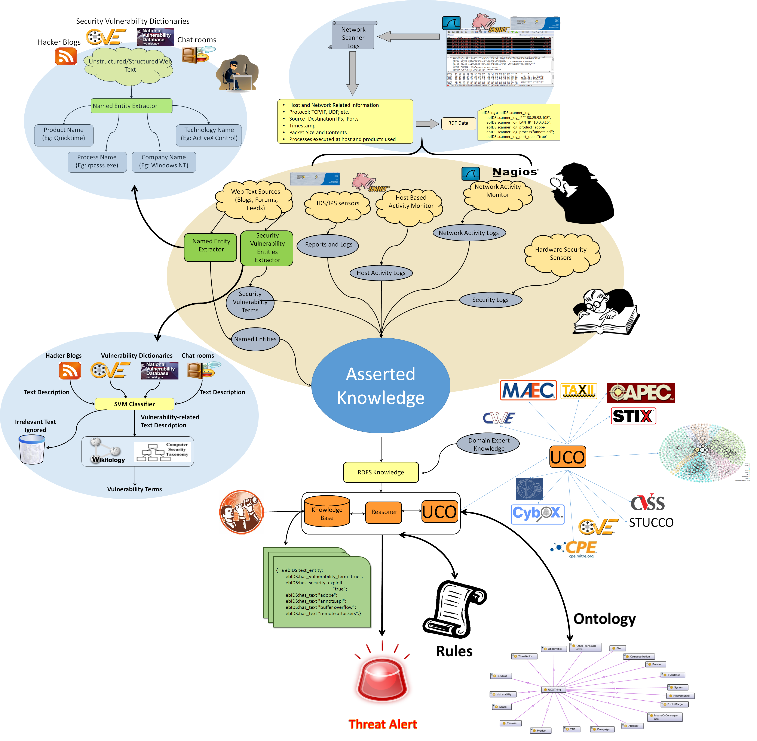
Cyber situational awareness
Most IDS systems are point-based & driven
by known signatures
Our situationally-aware system maps multiple sensors to a common ontology,
Reasons over the resulting knowledge,
Detecting possible intrusions missed by standard systems

Slide 32
Approach
Leverage existing and new tools for information extraction, semantic similarity, inference, etc.
Evolve our Unified Cyber Ontology as the underlying semantic model
Develop, curate & annotate cybersecurity corpora from alerts, newswire, social media & chatrooms
Train systems for knowledge graph population, concept spotting, entity recognition, relation and event extraction, word embeddings, topic modeling, etc.

Slide 33
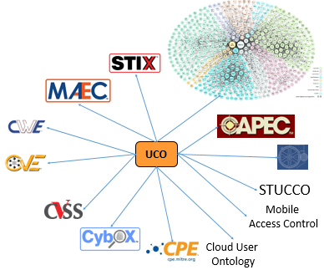
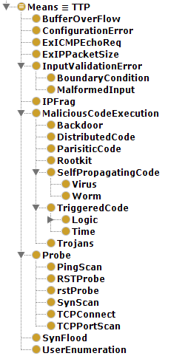
Unified Cybersecurity Ontology
Common semantic model for cyber-
security domain
  Data sharing, interoperability, integration
  and human understanding
  Links to background knowledge graphs
  Maps to common metadata schemas like Stix
  and Cybox
Uses semantically rich representation
  Grounded in formal semantics
Supports reasoning
  Infer/retrieve new information & detect dubious facts

Slide 34

Information extraction from text
Identify relationships
Link concepts to entities
ebqids:hasMeans
http://dbpedia.org/resource/Buffer_overflow
ebqids:affectsProduct
CVE-2012-0150
Buffer overflow in msvcrt.dll in Microsoft Windows Vista SP2, Windows Server 2008 SP2, R2, and R2 SP1, and Windows 7 Gold and SP1 allows remote attackers to execute arbitrary code via a crafted media file, aka ”Msvcrt.dll Buffer Overflow Vulnerability.”
http://dbpedia.org/resource/Arbitrary_code_execution
http://dbpedia.org/resource/Windows_7
We use information extraction techniques to identify entities, relations and concepts in security related text
These are mapped to terms in our ontology and the DBpedia knowledge base extracted from Wikipedia
http://ebiq.org/p/540

Slide 35
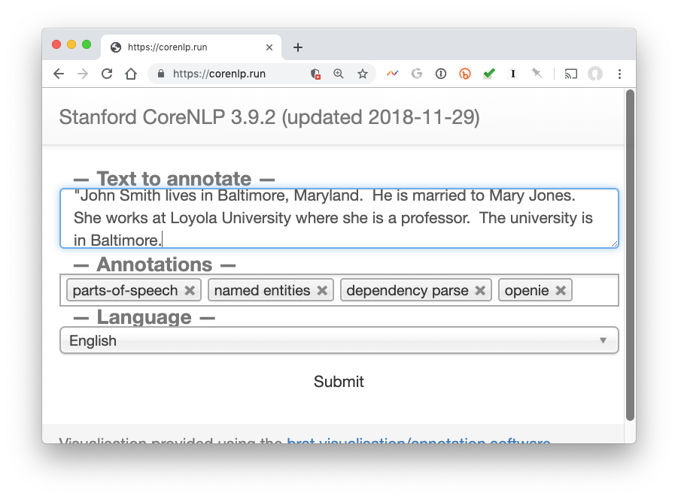
Stanford CoreNLP Tools

Slide 36
JSON/XML => KG triples
{ "text": "John Smith lives in Baltimore, Maryland. He is married to Mary Jones. She works at Loyola University where she is a professor. The university is in Baltimore.\n\n\n\n”,
"docid": "text1.txt",
"corefs": {
"9": [
{"endIndex": 6,
"animacy": "INANIMATE",
"text": "Baltimore",
"isRepresentativeMention": true,
"number": "SINGULAR",
"startIndex": 5,
"sentNum": 1,
"gender": "NEUTRAL",
"position": [1, 2q],
"headIndex": 5,
"type": "PROPER",
"id": 1
},
{ ....
##### :e_text1_1 LOCATION "Baltimore" #####
:e_text1_1 type LOCATION
:e_text1_1 canonical_mention "Baltimore" text1:20-29
:e_text1_1 mention "Baltimore" text1:20-29
:e_text1_1 mention "Baltimore" text1:151-160
##### :e_text1_2 ORGANIZATION "Loyola University" #####
:e_text1_2 type ORGANIZATION
:e_text1_2 canonical_mention "Loyola University" text1:85-102
:e_text1_2 mention "Loyola University" text1:85-102
:e_text1_2 mention "The university" text1:130-144
##### :e_text1_3 PERSON "John Smith" #####
:e_text1_3 type PERSON
:e_text1_3 canonical_mention "John Smith" text1:0-10
:e_text1_3 mention "John Smith" text1:0-10
:e_text1_3 mention "He" text1:42-44
:e_text1_3 mention "She" text1:72-75
:e_text1_3 mention "she" text1:109-112
:e_text1_3 openie:lives_in :e_text1_1 text1:0-3
:e_text1_3 per:spouse :e_text1_5 text1:42-43
:e_text1_3 openie:is_married_to :e_text1_5 text1:42-43
:e_text1_3 per:employee_of :e_text1_2 text1:72-74

Slide 37
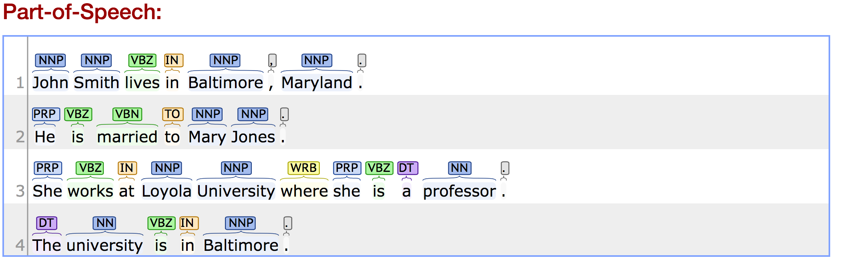
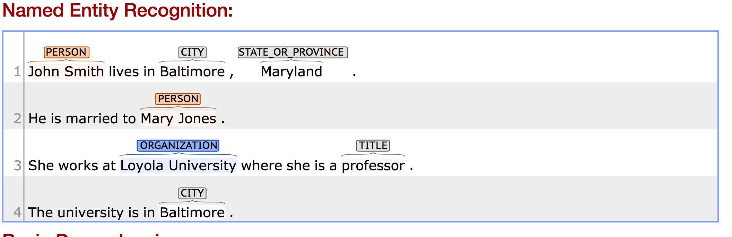

Slide 38
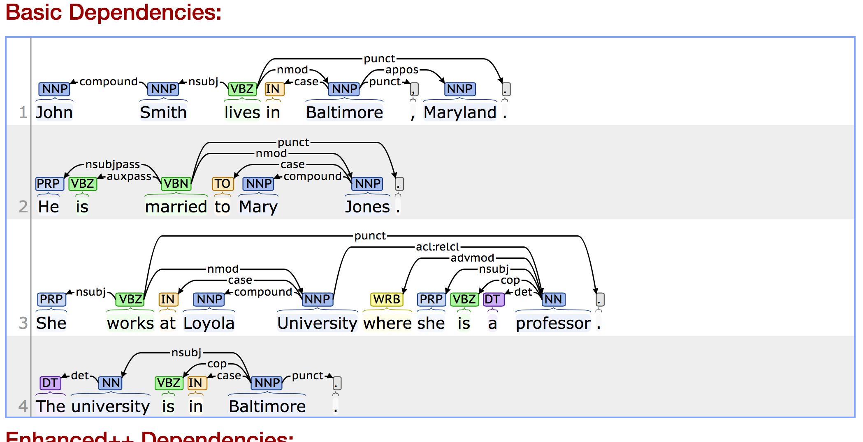

Slide 39
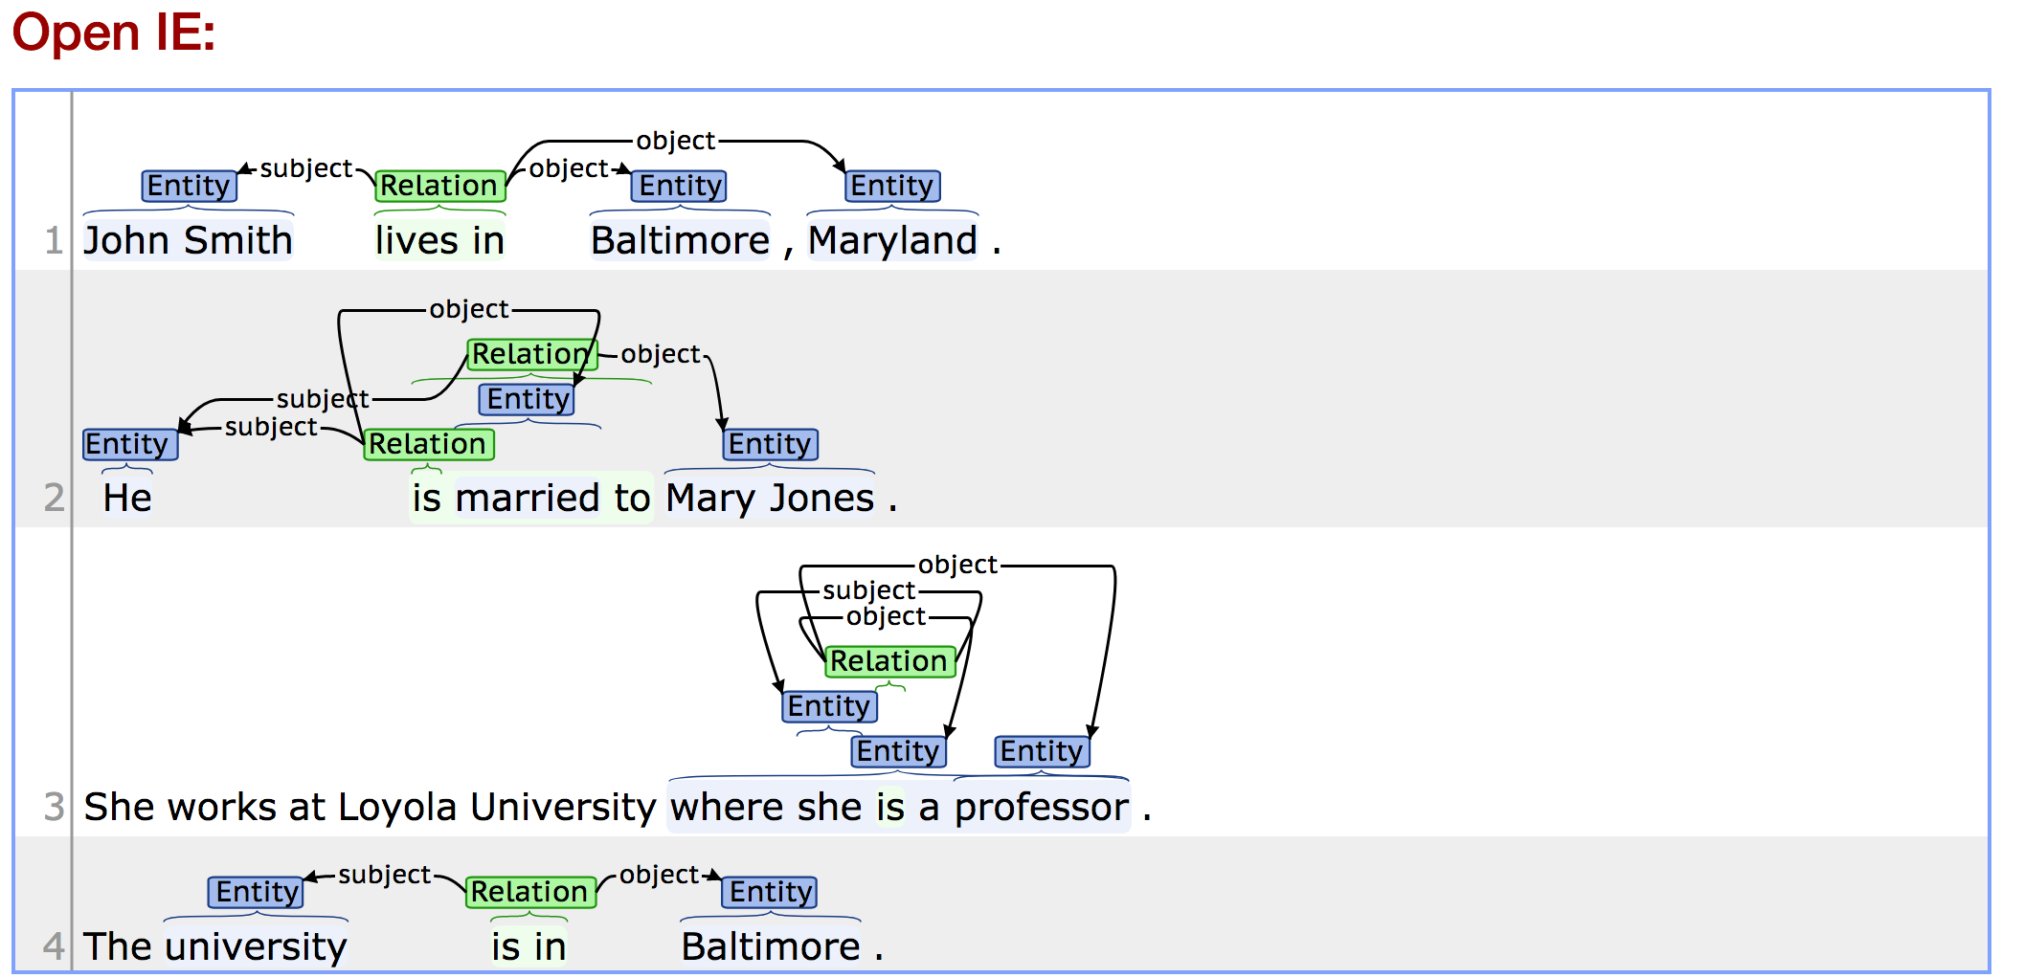

Slide 40
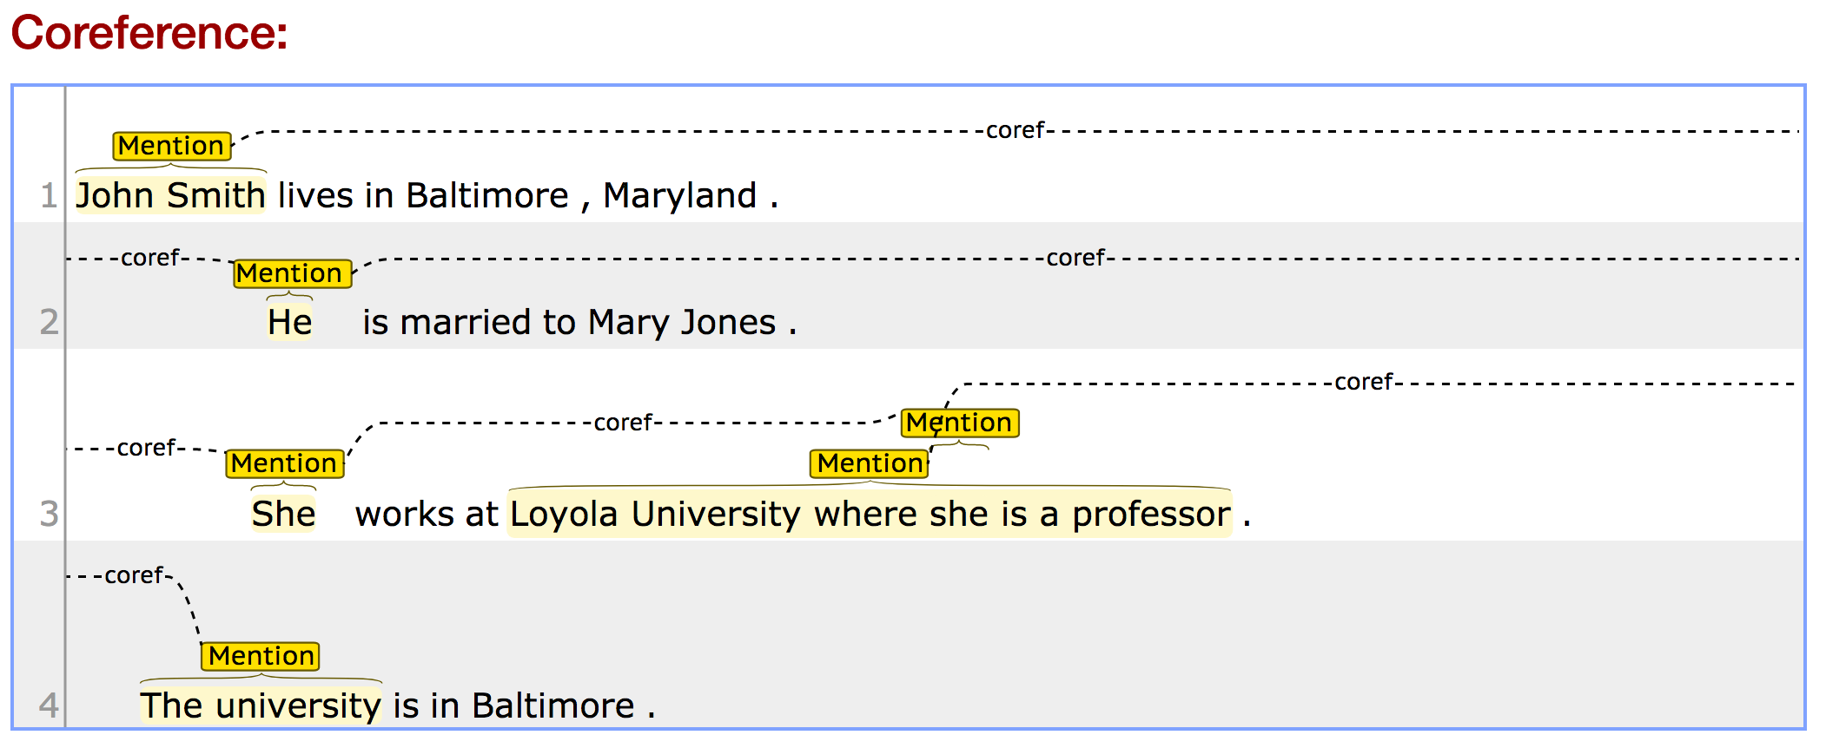

Slide 41
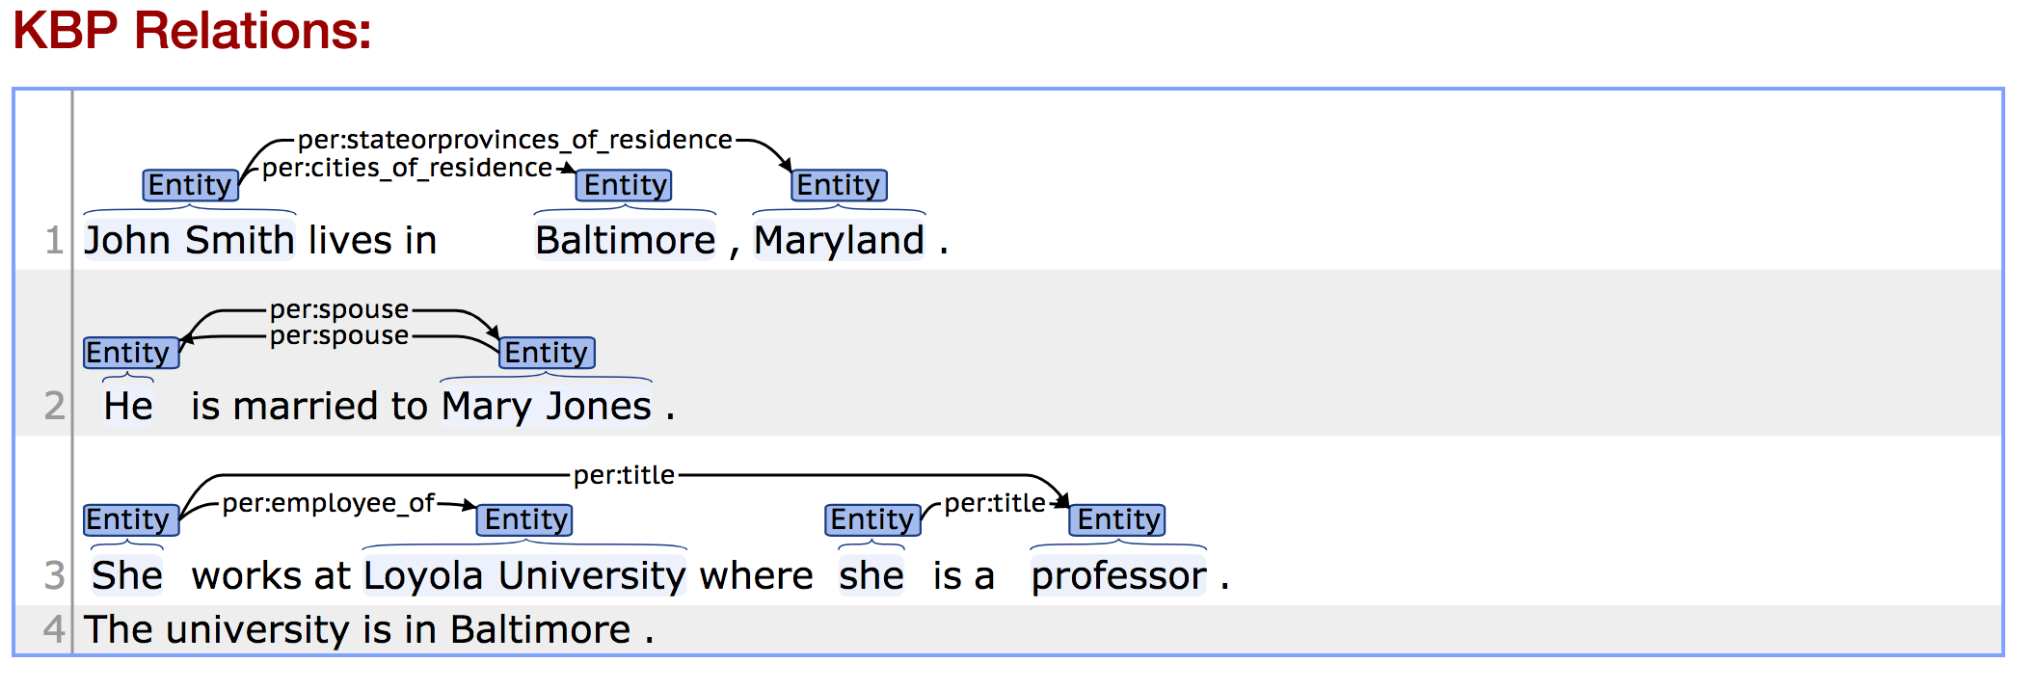

Slide 42

Conclusion
KGs help in extracting information from text
The information extracted can update the KGs
The KGs provide support for new tasks, such as question answering, speech interfaces and produce data useful in applications, like IDSs
There use will grow and evolve in the future
New machine learning frameworks will result in better accuracy

