Slide 1
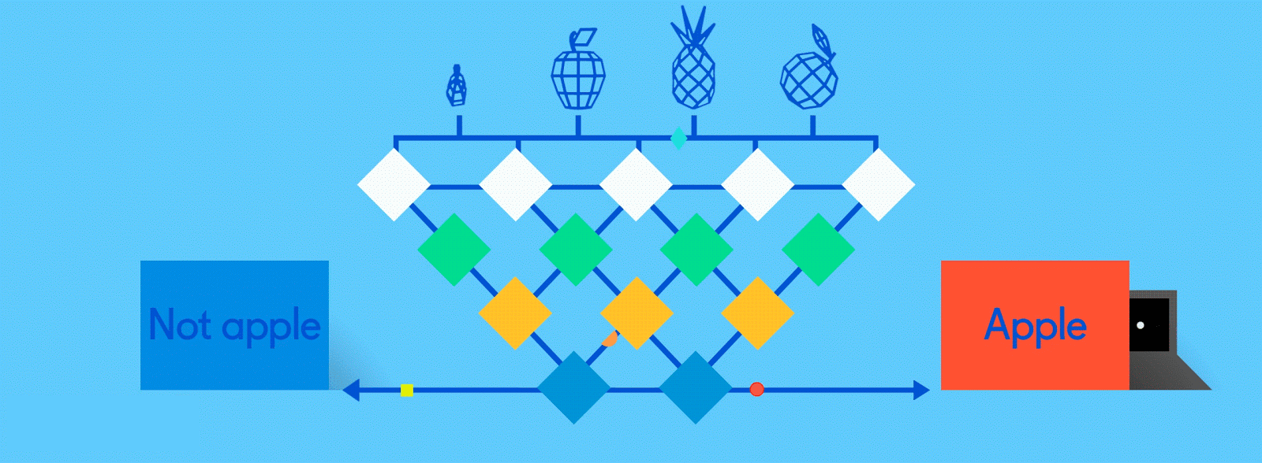
Neural Networks for Machine Learning tensorflow playground

Slide 2
TensorFlow Playground
Great javascript app demonstrating many basic neural network concepts
Doesn’t use TensorFlow software, but a lightweight js library
Runs in a Web browser
See http://playground.tensorflow.org/
Code also available on GitHub
Try the playground exercises in Google’s machine learning crash course

Slide 3
http://playground.tensorflow.org/

Slide 4
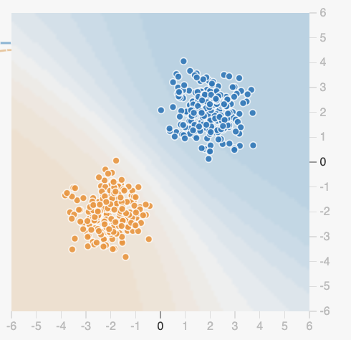
Datasets
Six datasets, each with 500 (x,y) points on a plane where x and y between -5 and +5
Points have labels of positive (orange) or negative (blue)
Two possible machine learning tasks:
Classification: Predict class of test points
Regression: find function to separate classes
Evaluation: split dataset into training and test, e.g., 70% training, 30% test

Slide 5
Available Input features
X₁ Point’s x value
X₂ Point’s y value
X₁² Point’s x value squared
X₂² Point’s y value squared
X₁X₂ Product of point’s x & y values
sin(X₁) Sine of point’s x value
sin(X₂) Sine of point’s y value

Slide 6
Typical Training Flow
Divide training data into batches of instances (e.g., batch size = 10)
For each epoch:
For each batch:
Instances run through network, noting difference between predicted and actual value
Backpropagation used to adjust connection weights
Stop when training loss flatten out
If test loss is high, then try
Adding additional hidden layers
Adding more features to inputs
Adjusting hyperparameters (e.g., learning rate)
Get more training data

Slide 7
Hyperparameters
Parameters whose values are set before the learning process begins
Basic neural network hyperparameters
Learning rate
Activation function
Regularization
Regularization rate

Slide 8
Learning rate
Gradient descent used in backpropagation to adjust weights to minimize the loss function
Learning rate determines how much weights are adjusted
If too high, we may miss some or most minima
If too low, learning will take too long

Slide 9
Activation Function
Determines a node’s output given its inputs
The ReLu (rectified linear unit) is simple and a good choice for most networks
Returns zero for negative values and its input for positive ones
f(x) = max(0,x)

Slide 10
Regularization
Parameter to control overfitting, i.e. when the model does well on training data but poorly on new, unseen data
L2 regularization is the most common
Using dropout is another common way of controlling overfitting in neural networks
At each training stage, some hidden nodes are temporarily removed

