Slide 1
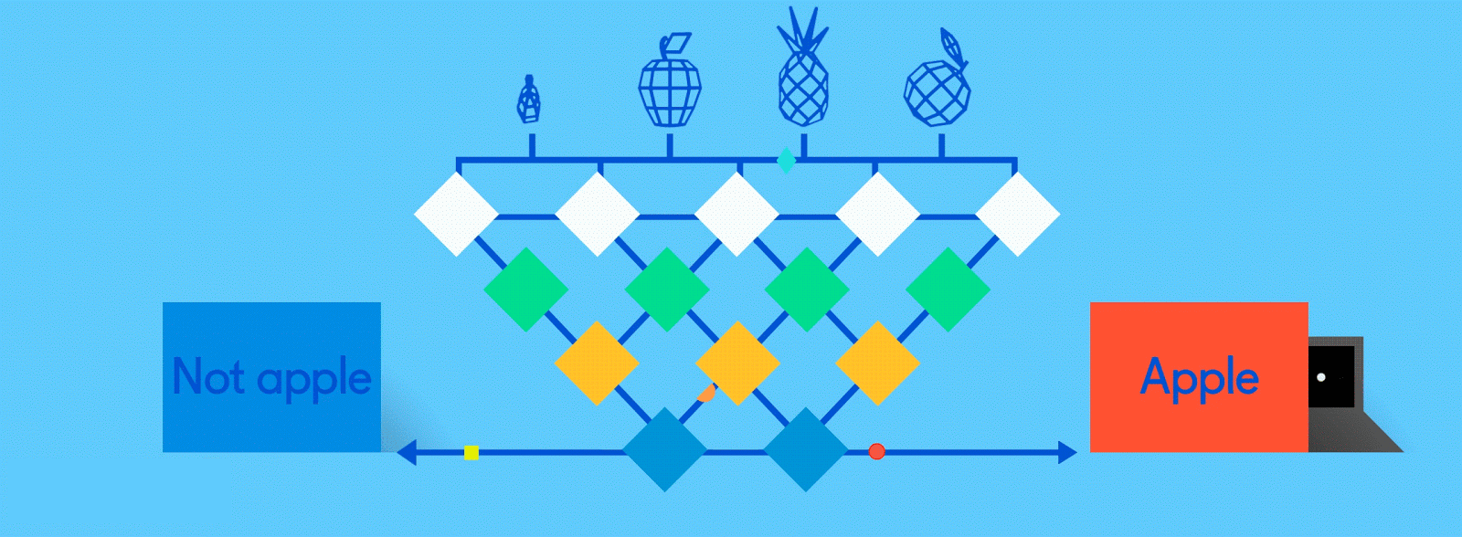
Neural Networks for Machine Learning introduction

Slide 2
Biological neural activity
Neurons have body, axon and many dendrites
In one of two states: firing and rest
They fire if total incoming stimulus > threshold
Synapse: thin gap between axon of one neuron and dendrite of another
Signal exchange

Slide 3
Artificial neural network
Set of nodes with inputs and outputs Node performs computation via its activation function
Weighted connections between nodes
Connectivity gives network architecture
NN computations depend on connections & weights
Notes:
Set of nodes
Node have inputs and outputs
Nodes performs computation via its activation function
Weighted connections between nodes
Connectivity gives structure/architecture of net
What can be computed by a NN determined by the connections and their weights
Simplified version of networks of neurons in animal nerve systems

Slide 4
Common Activation Functions
Choice of activation function depends on problem and available computational power

Slide 5
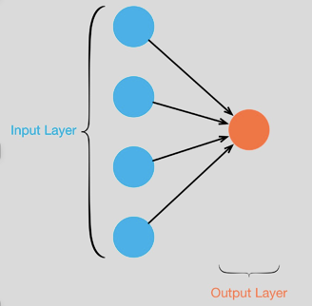
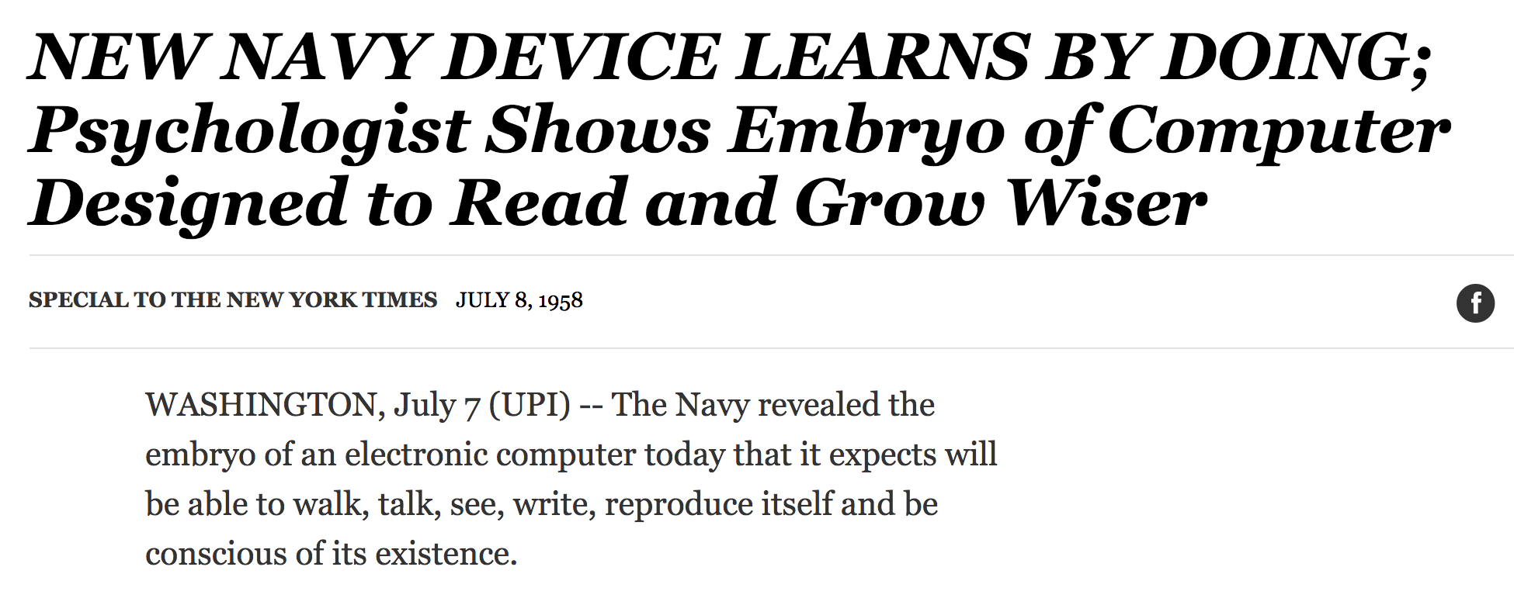
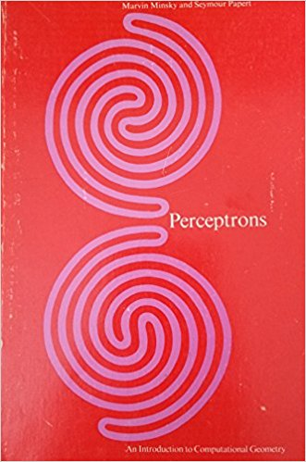
Single Layer Perceptron
Full 1958 NYT article above here
Rosenblatt: it can learn to compute functions by learning weights on inputs from examples
Not all functions ☹️, cf. Perceptrons

Slide 6
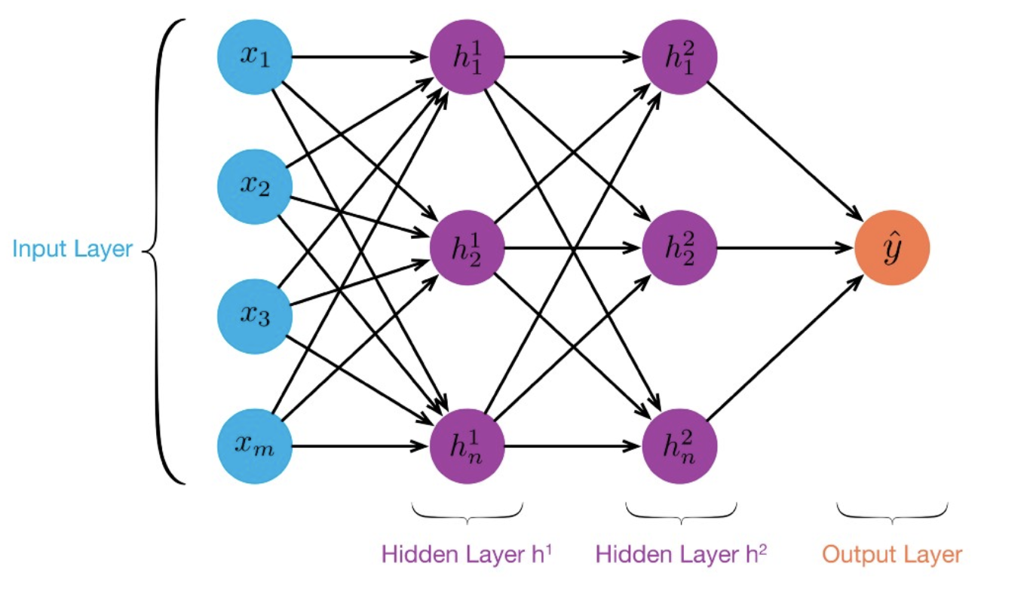
MLP: Multilayer Perceptron
≥ 1 “hidden layers” between inputs & output
Can compute non-linear functions
Training: adjust weights slightly to reduce error between output y and target value t; repeat
Introduced in 1980s, still used today

Slide 7
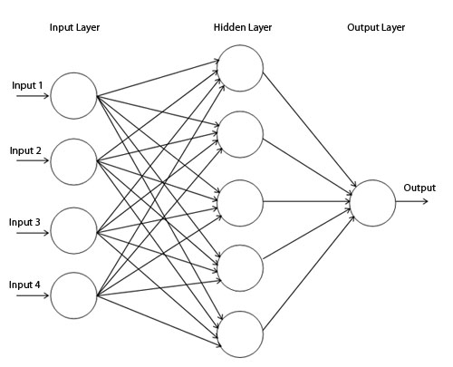
Backpropagation
Forward direction
Calculate network and error
Rumelhart, David E.; Hinton, Geoffrey E.; Williams, Ronald J. (8 October 1986). Learning representations by back-propagating errors. Nature. 323 (6088): 533–536.

Slide 8
Backpropagation
Backward direction
Backpropagate: from output to input, recursively compute and adjust weights
$$\frac{∂E}{∂w_{ij}}=∇_{w}E$$

Slide 9
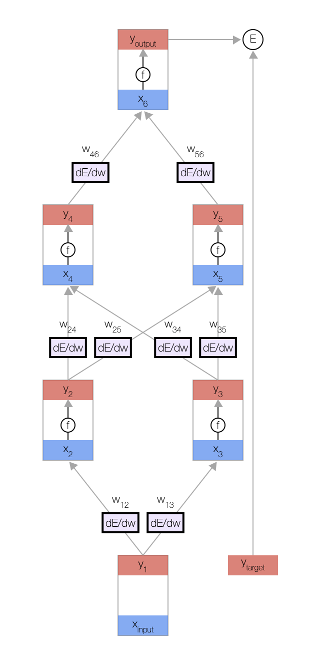
Backprop Explained
A simple animation shows how backprop works
A MLP with one input, two hidden layers and one output
Click on image or go to http://bit.ly/471bpd to view in your browser

Slide 10
Neural Network Architectures
Current focus on large networks with different “architectures” suited for different kinds of tasks
Feedforward Neural Network
CNN: Convolutional Neural Network
RNN: Recurrent Neural Network
LSTM: Long Short Term Memory
GAN: Generative Adversarial Network

Slide 11
Feedforward Neural Network
Connections allowed from a node in layer i only to nodes in layer i+1
i.e., no cycles or loops
Simple, widely used architecture.
downstream nodes tend to successively abstract features from preceding layers
http://playground.tensorflow.org/

Slide 12
CNN: Convolutional Neural Network
Good for image processing: classification, object recognition, automobile lane tracking, etc.
Classic demo: learn to recognize hand-written digits from MNIST data with 70K examples

Slide 13
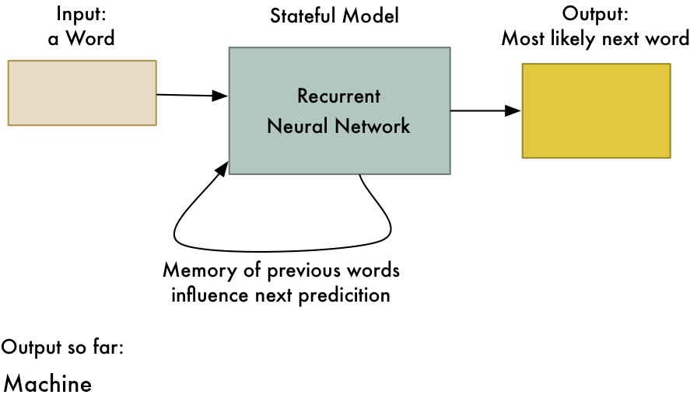
RNN: Recurrent Neural Networks
Good for learning over sequences of data, e.g., language understanding tasks
LSTM (Long Short Term Memory) a popular architecture
gif from Adam Geitgey

Slide 14
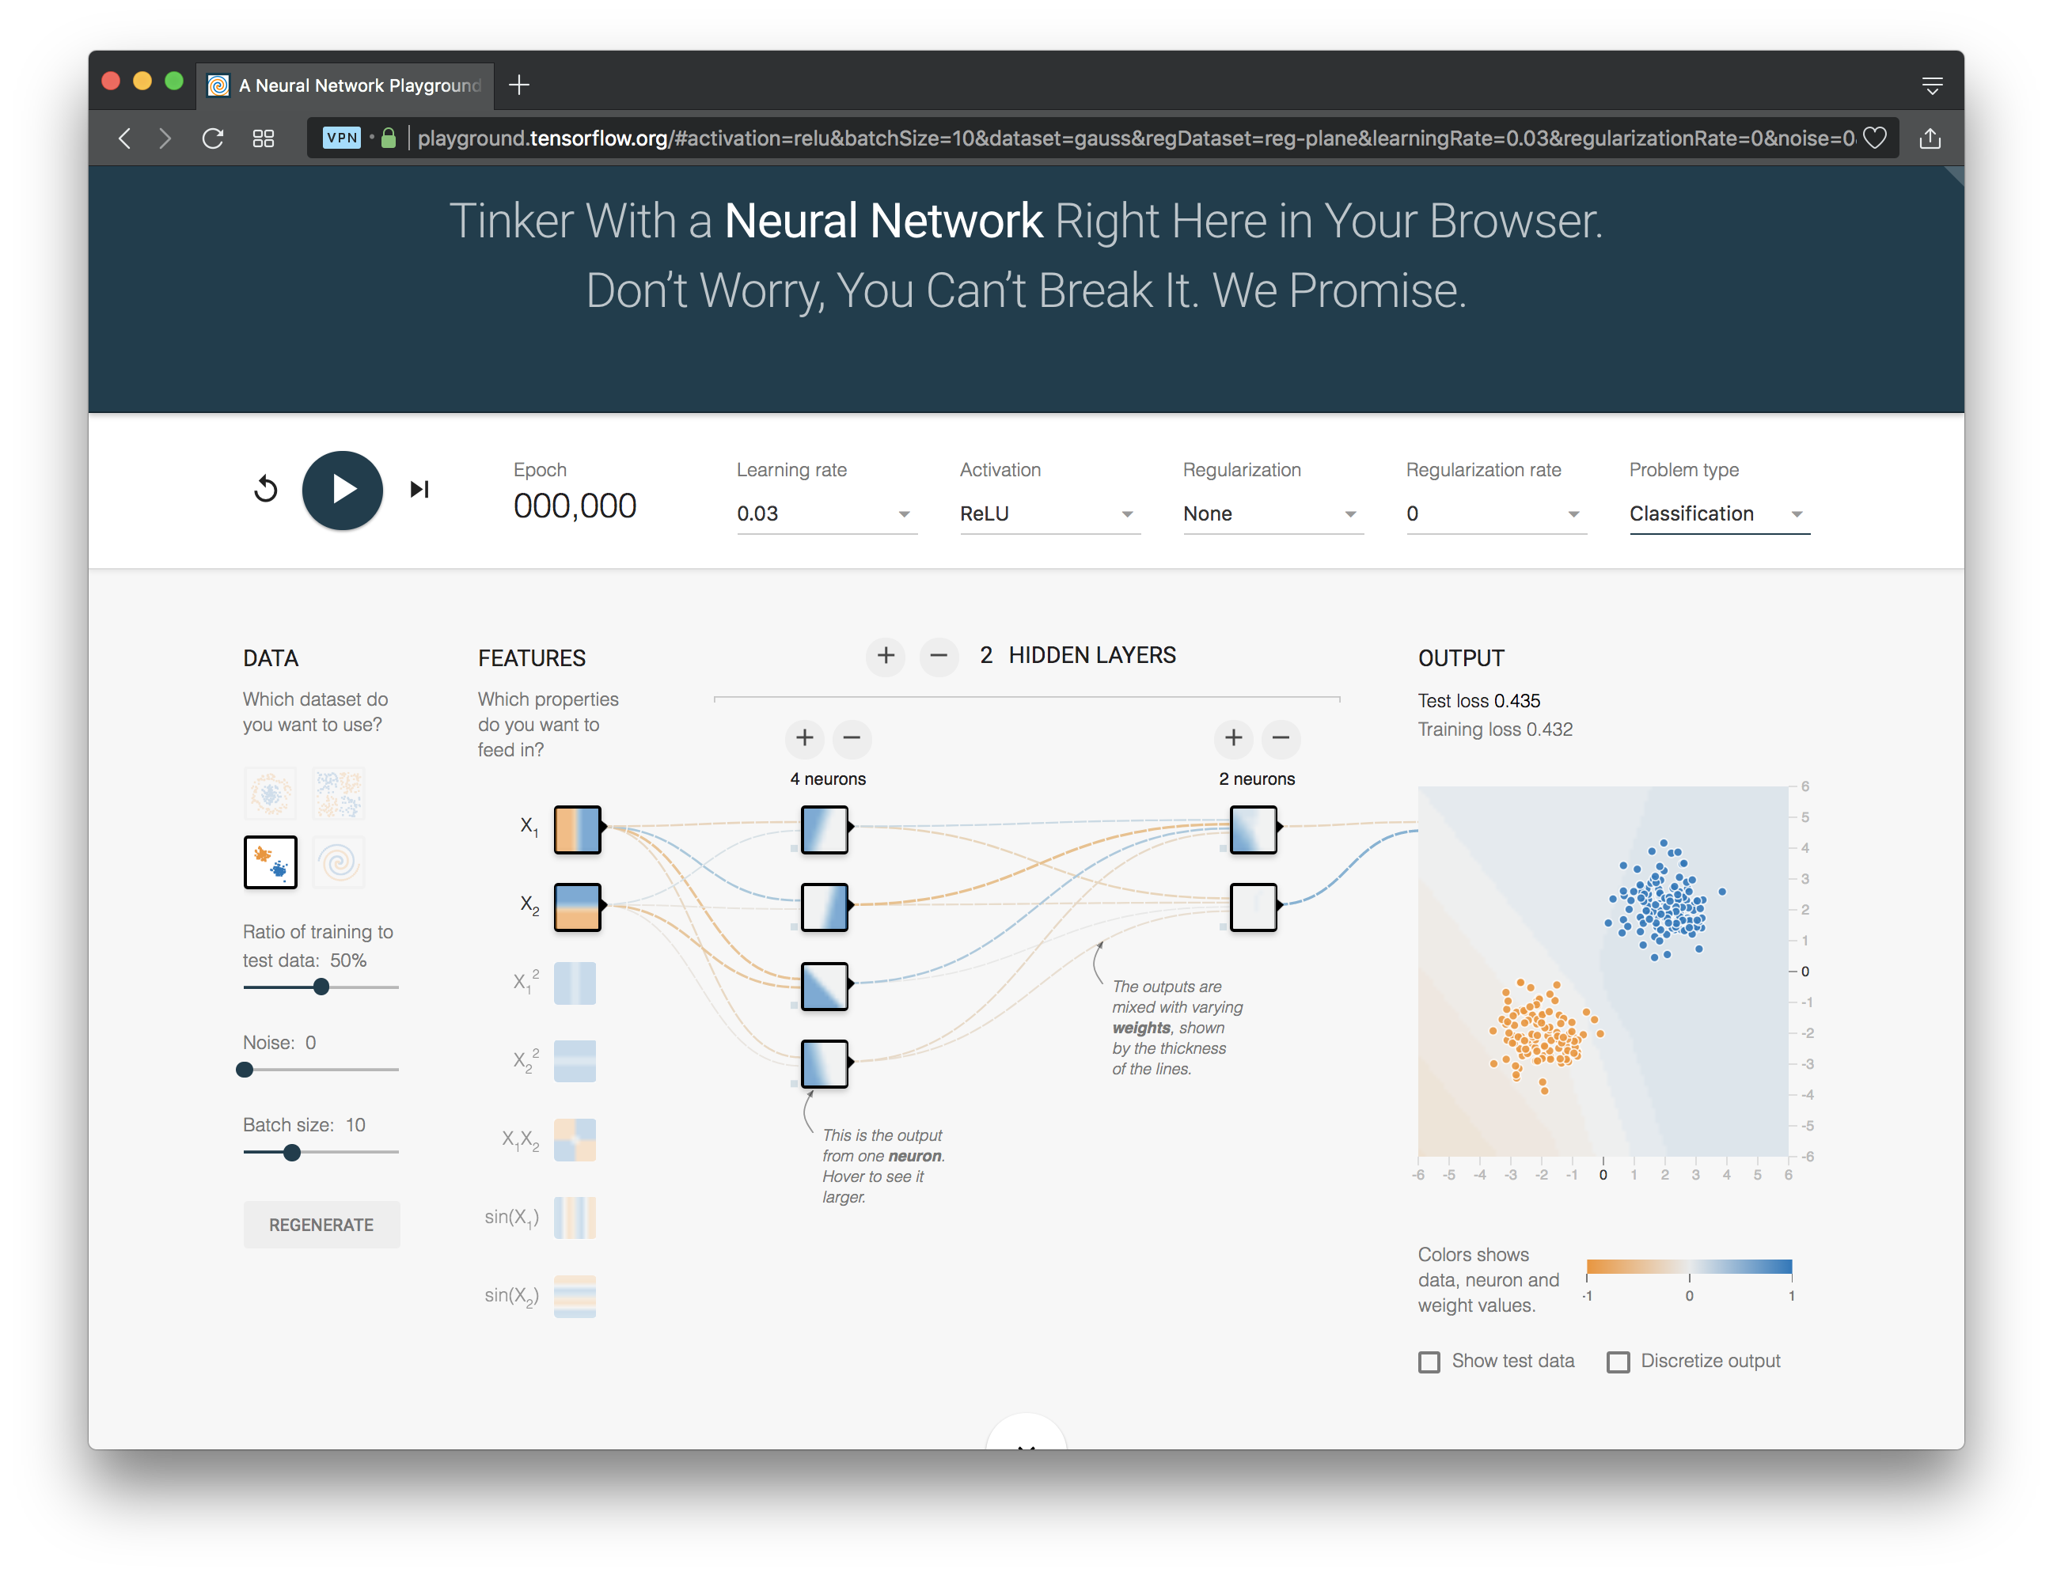
http://playground.tensorflow.org/

Slide 15
Deep Learning Frameworks
Popular open source deep learning frame-works use Python at top-level; C++ in backend
TensorFlow (via Google)
PyTorch (via Facebook)
MxNet (Apache)
Caffe (Berkeley)
Keras: popular API works with the first two and provides good support at architecture level
Notes:
Demo: MNIST CNN
Demo: RNN sentiment

Slide 16
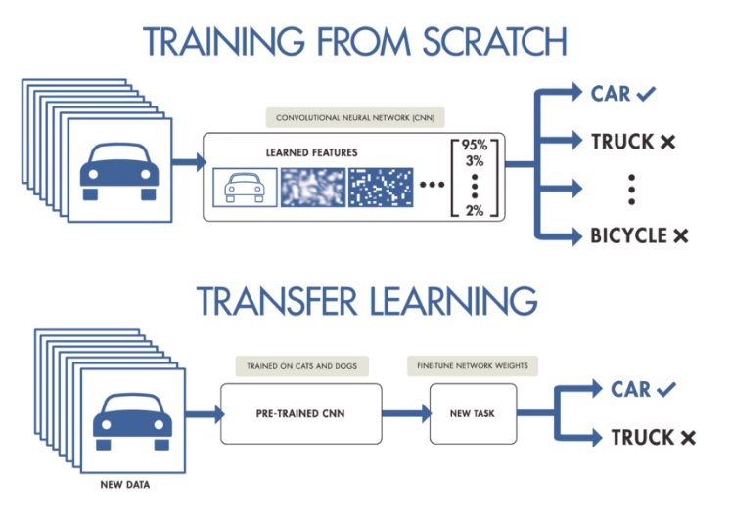
Good at Transfer Learning
Neural networks effective for transfer learning
Using parts of a model trained on a task as an initial model to train on a different task
Particularly effective for image recognition

Slide 17
Good at Transfer Learning
For images, the initial stages of a model learn high-level visual features (lines, edges) from pixels
Final stages predict task-specific labels
source:http://ruder.io/transfer-learning/

Slide 18
Conclusions
Quick introduction to neural networks and deep learning
Learn more by
taking UMBC’s machine learning class
Explore Google’s Machine Learning Crash Course
Try Miner/Kasch tutorial on applied deep learning
Work through examples
and then trying your own project idea

