Slide 1
What’s better than a tree?

Slide 2
Random Forest
Can often improve performance of decision tree classifiers using a set of decision trees (a forest)
Each tree trained on a random subset of training data
Classify a data instance using all trees
Combine answers to make classification
E.g., vote for most common class

Slide 3
Bagging
Idea can be used on any classifier!
Improve classification by combining classifications of randomly selected training subsets
Bagging = Bootstrap aggregating
An ensemble meta-algorithm that can improve stability & accuracy of algorithms for statistical classification and regression
Helps avoid overfitting

Slide 4
Choosing subsets of training data
Classic bagging: select random subset of training instances with replacement
Pasting: select random subset of training instances
Random Subspaces: use all training instances, but with a random subset of features
Random Patches: random subset of instances and random subset of features
What’s best? YMMV: depends on problem, training data, algorithm

Slide 5
Examples
Two examples using Weka
UCI Auto mpg prediction dataset
UCI Adult income prediction dataset
RandomForest improves over J48 for the smaller dataset, but not for the larger
Takeaway: more data is always best

Slide 6
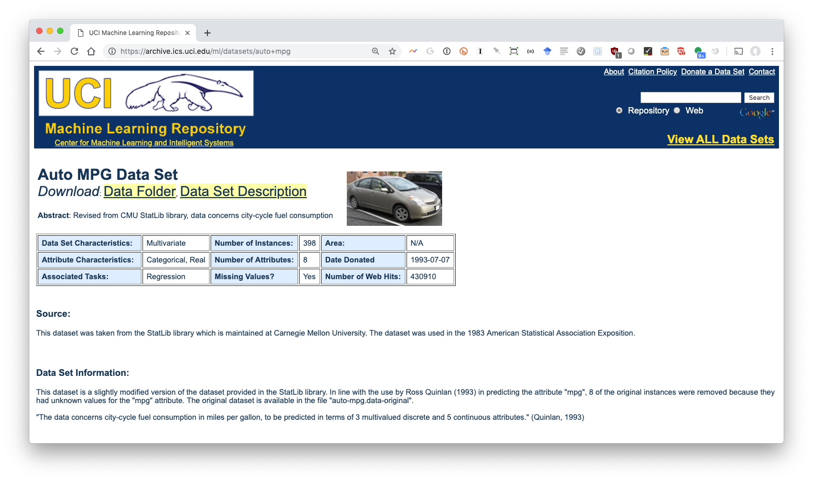
UCI Auto MGP Dataset (1)

Slide 7
UCI Auto MGP Dataset (2)
Data from 1983
398 instances
Predict auto mpg from seven attributes: cylinders, displacement, horsepower, weight, acceleration, model year, and origin

Slide 8
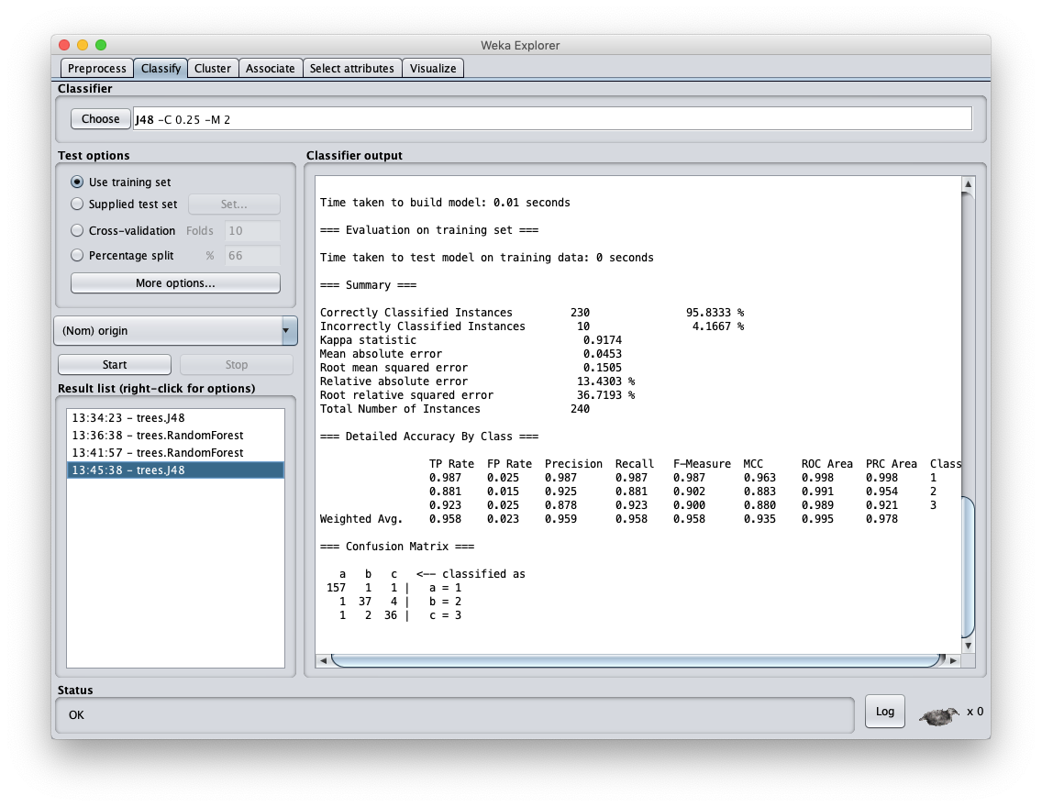

Slide 9
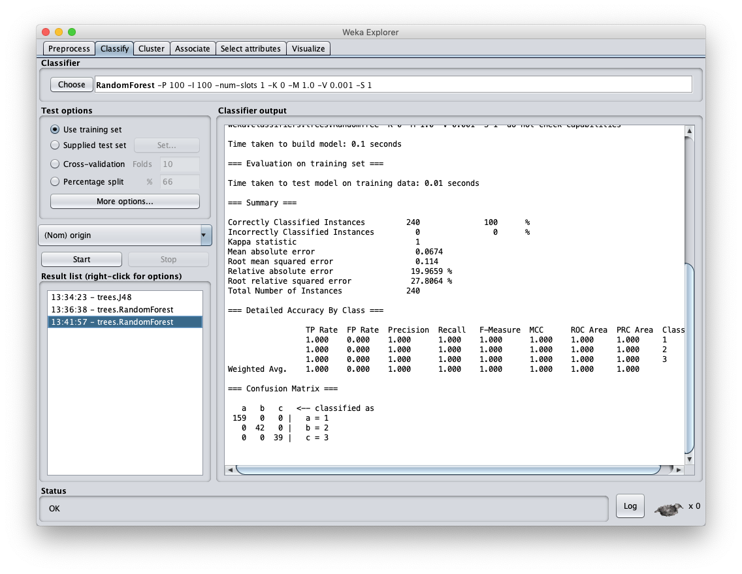

Slide 10
Results
Relatively small dataset allows construction of a DT model that does very well
Using Random Forest still improves on it
This is considered to be poor methodology since it overfits to the particular training set

Slide 11
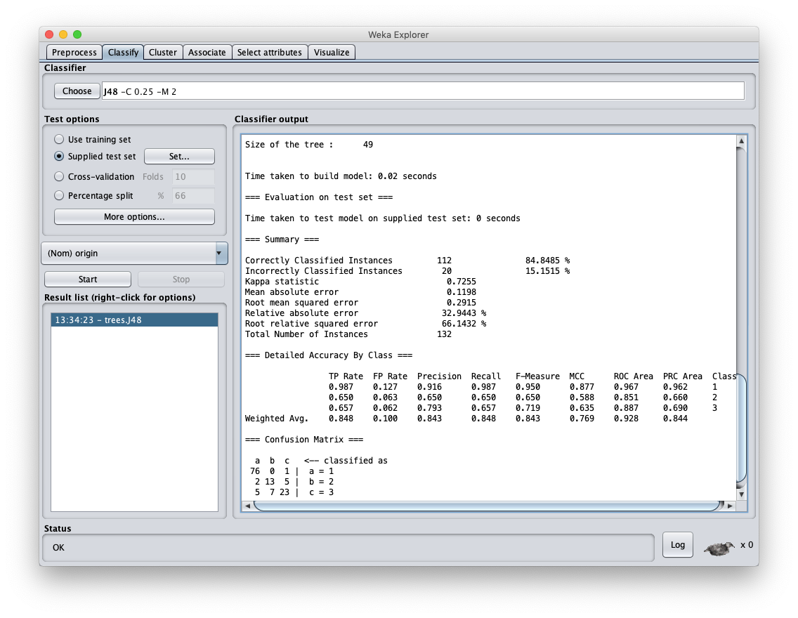

Slide 12
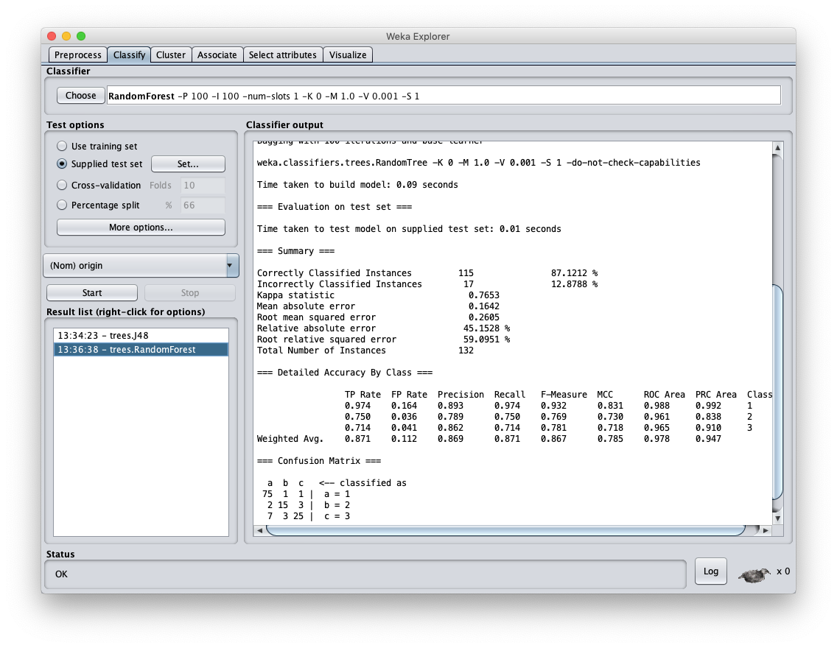

Slide 13
AUTO MPG Results (2)
Using an independent test set shows more realistic balanced F1 score of .843
Using Random Forest raises this to .867
While the increase is not large, it is probably statistically significant
F1 scores this tish are difficult to increase dramatically

Slide 14
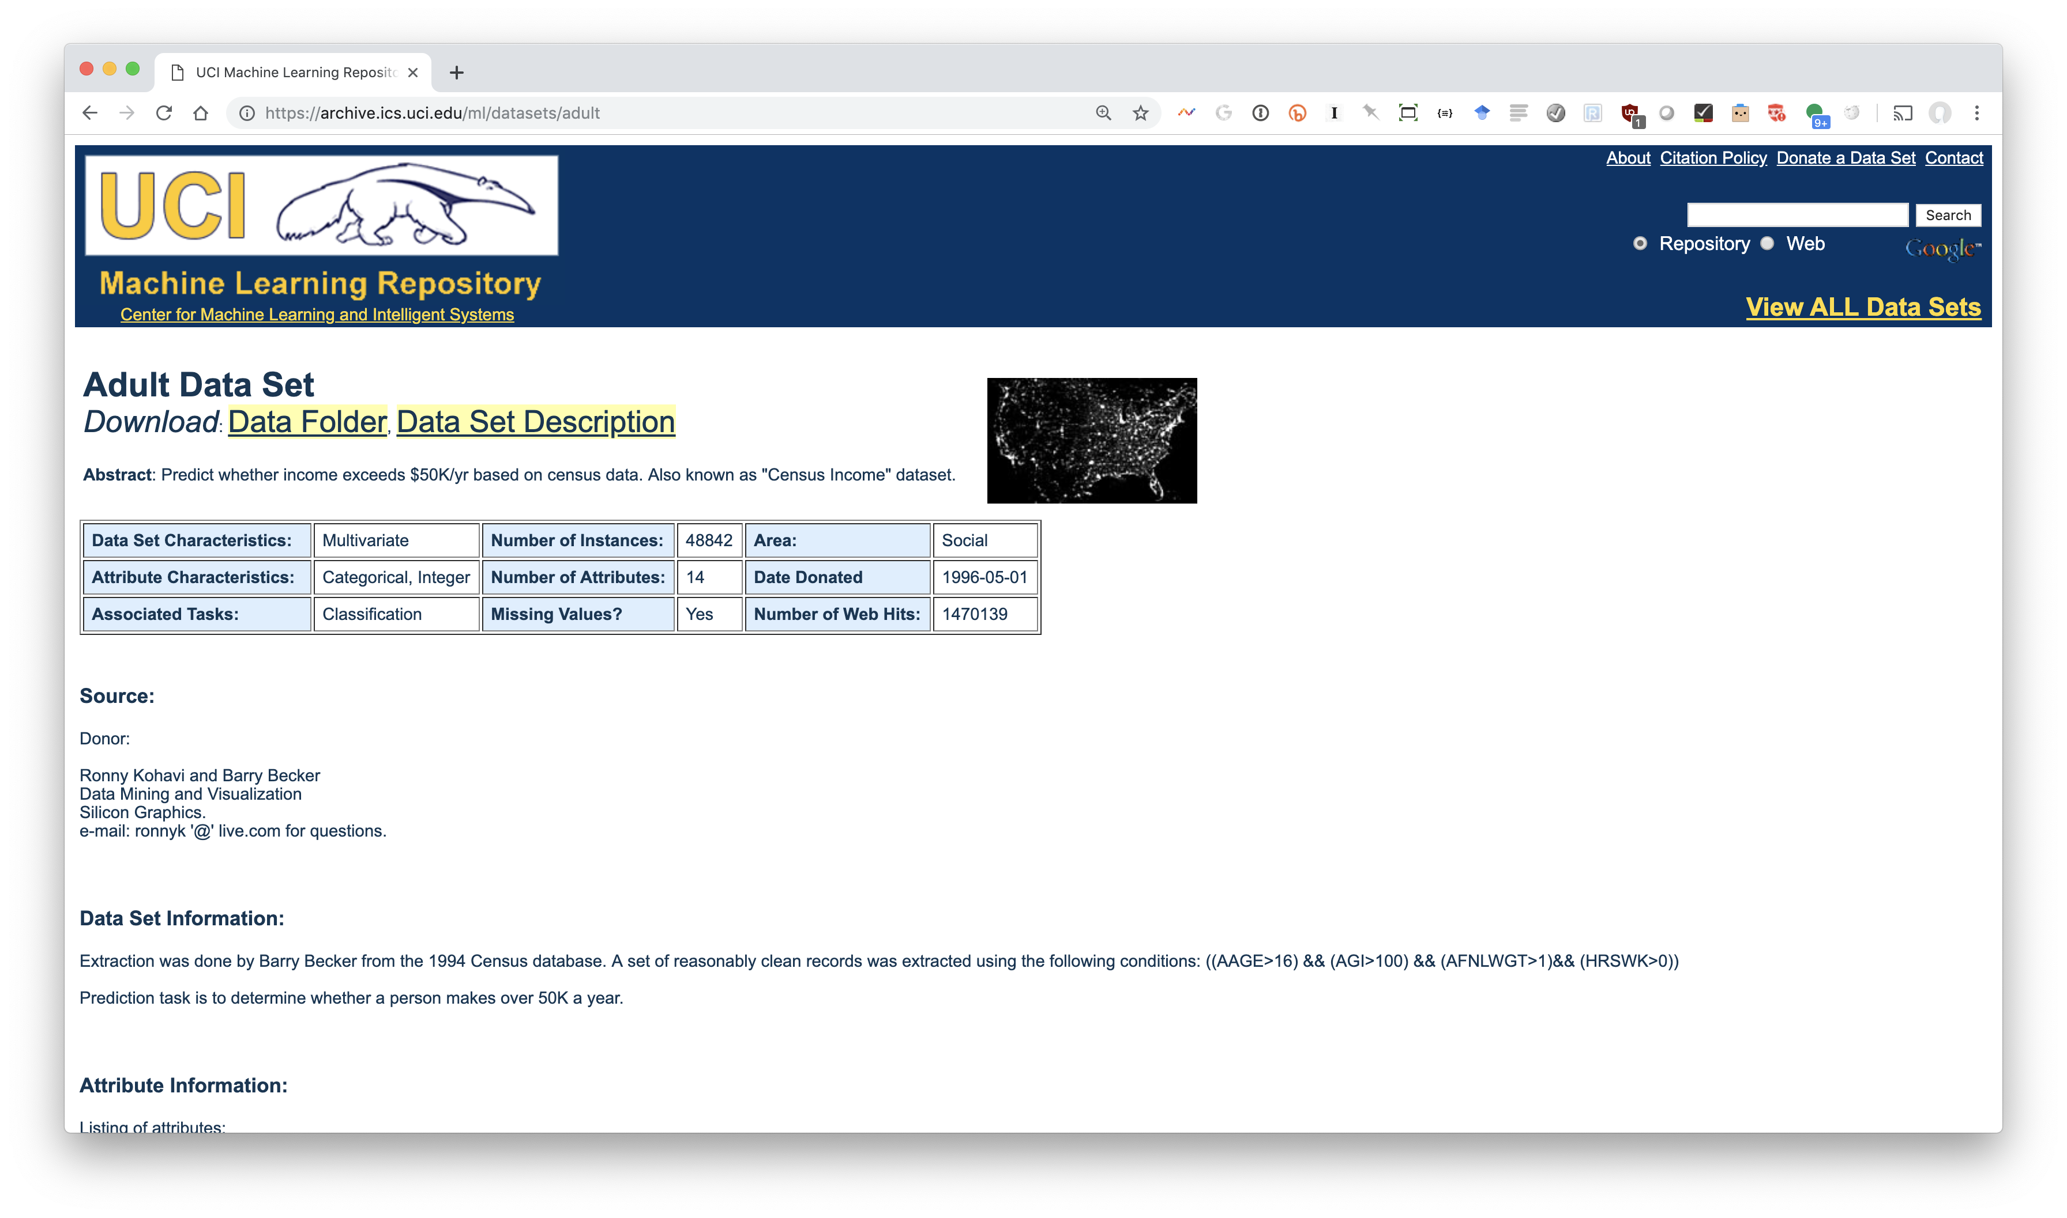
UCI Adult Dataset (1)

Slide 15
UCI Adult Dataset (2)
Data on adults from 1994 census data
48,842 instances
Predict if person makes over $50K/year
Equivalent to ~$86K/year today
14 features including age, education, marital status, occupation, race, sex, native country, …
Mixture of numeric (e.g., age) and nominal (e.g., occupation) values

Slide 18
Result
Significant increase on F1 scores when both trained and evaluated on training set
This is considered to be poor methodology since it overfits to the particular training set

Slide 19
Create train and test collection
Train has ~95% of data, test 5%
Trained models for J48 and random forest using train dataset
Tested on test data set
Results were that random forest was (at best) about the same as J48
Large dataset reduced problem of overfitting, so random Forest did not help

Slide 20
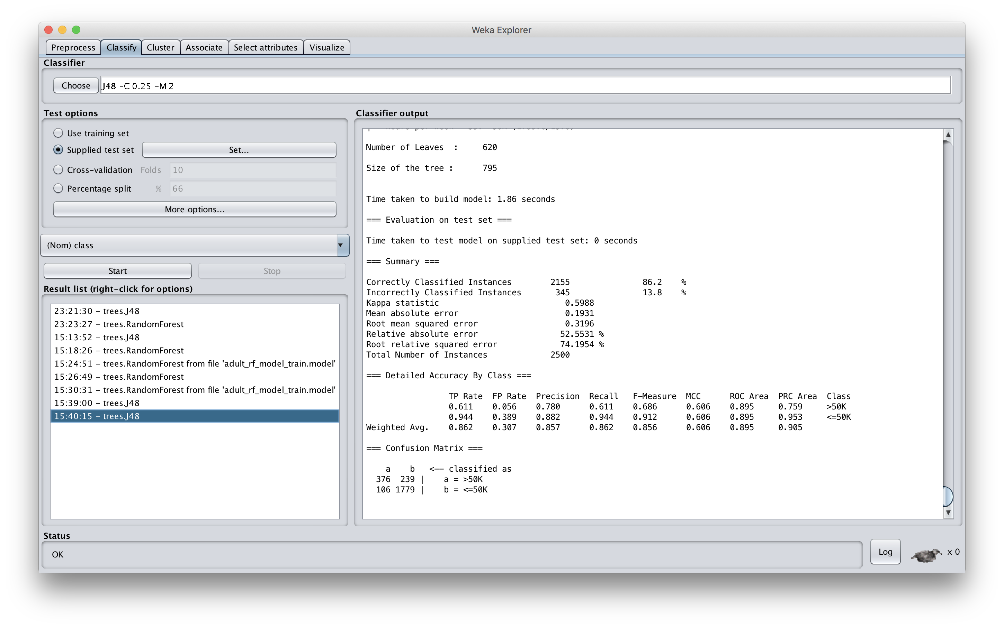

Slide 21
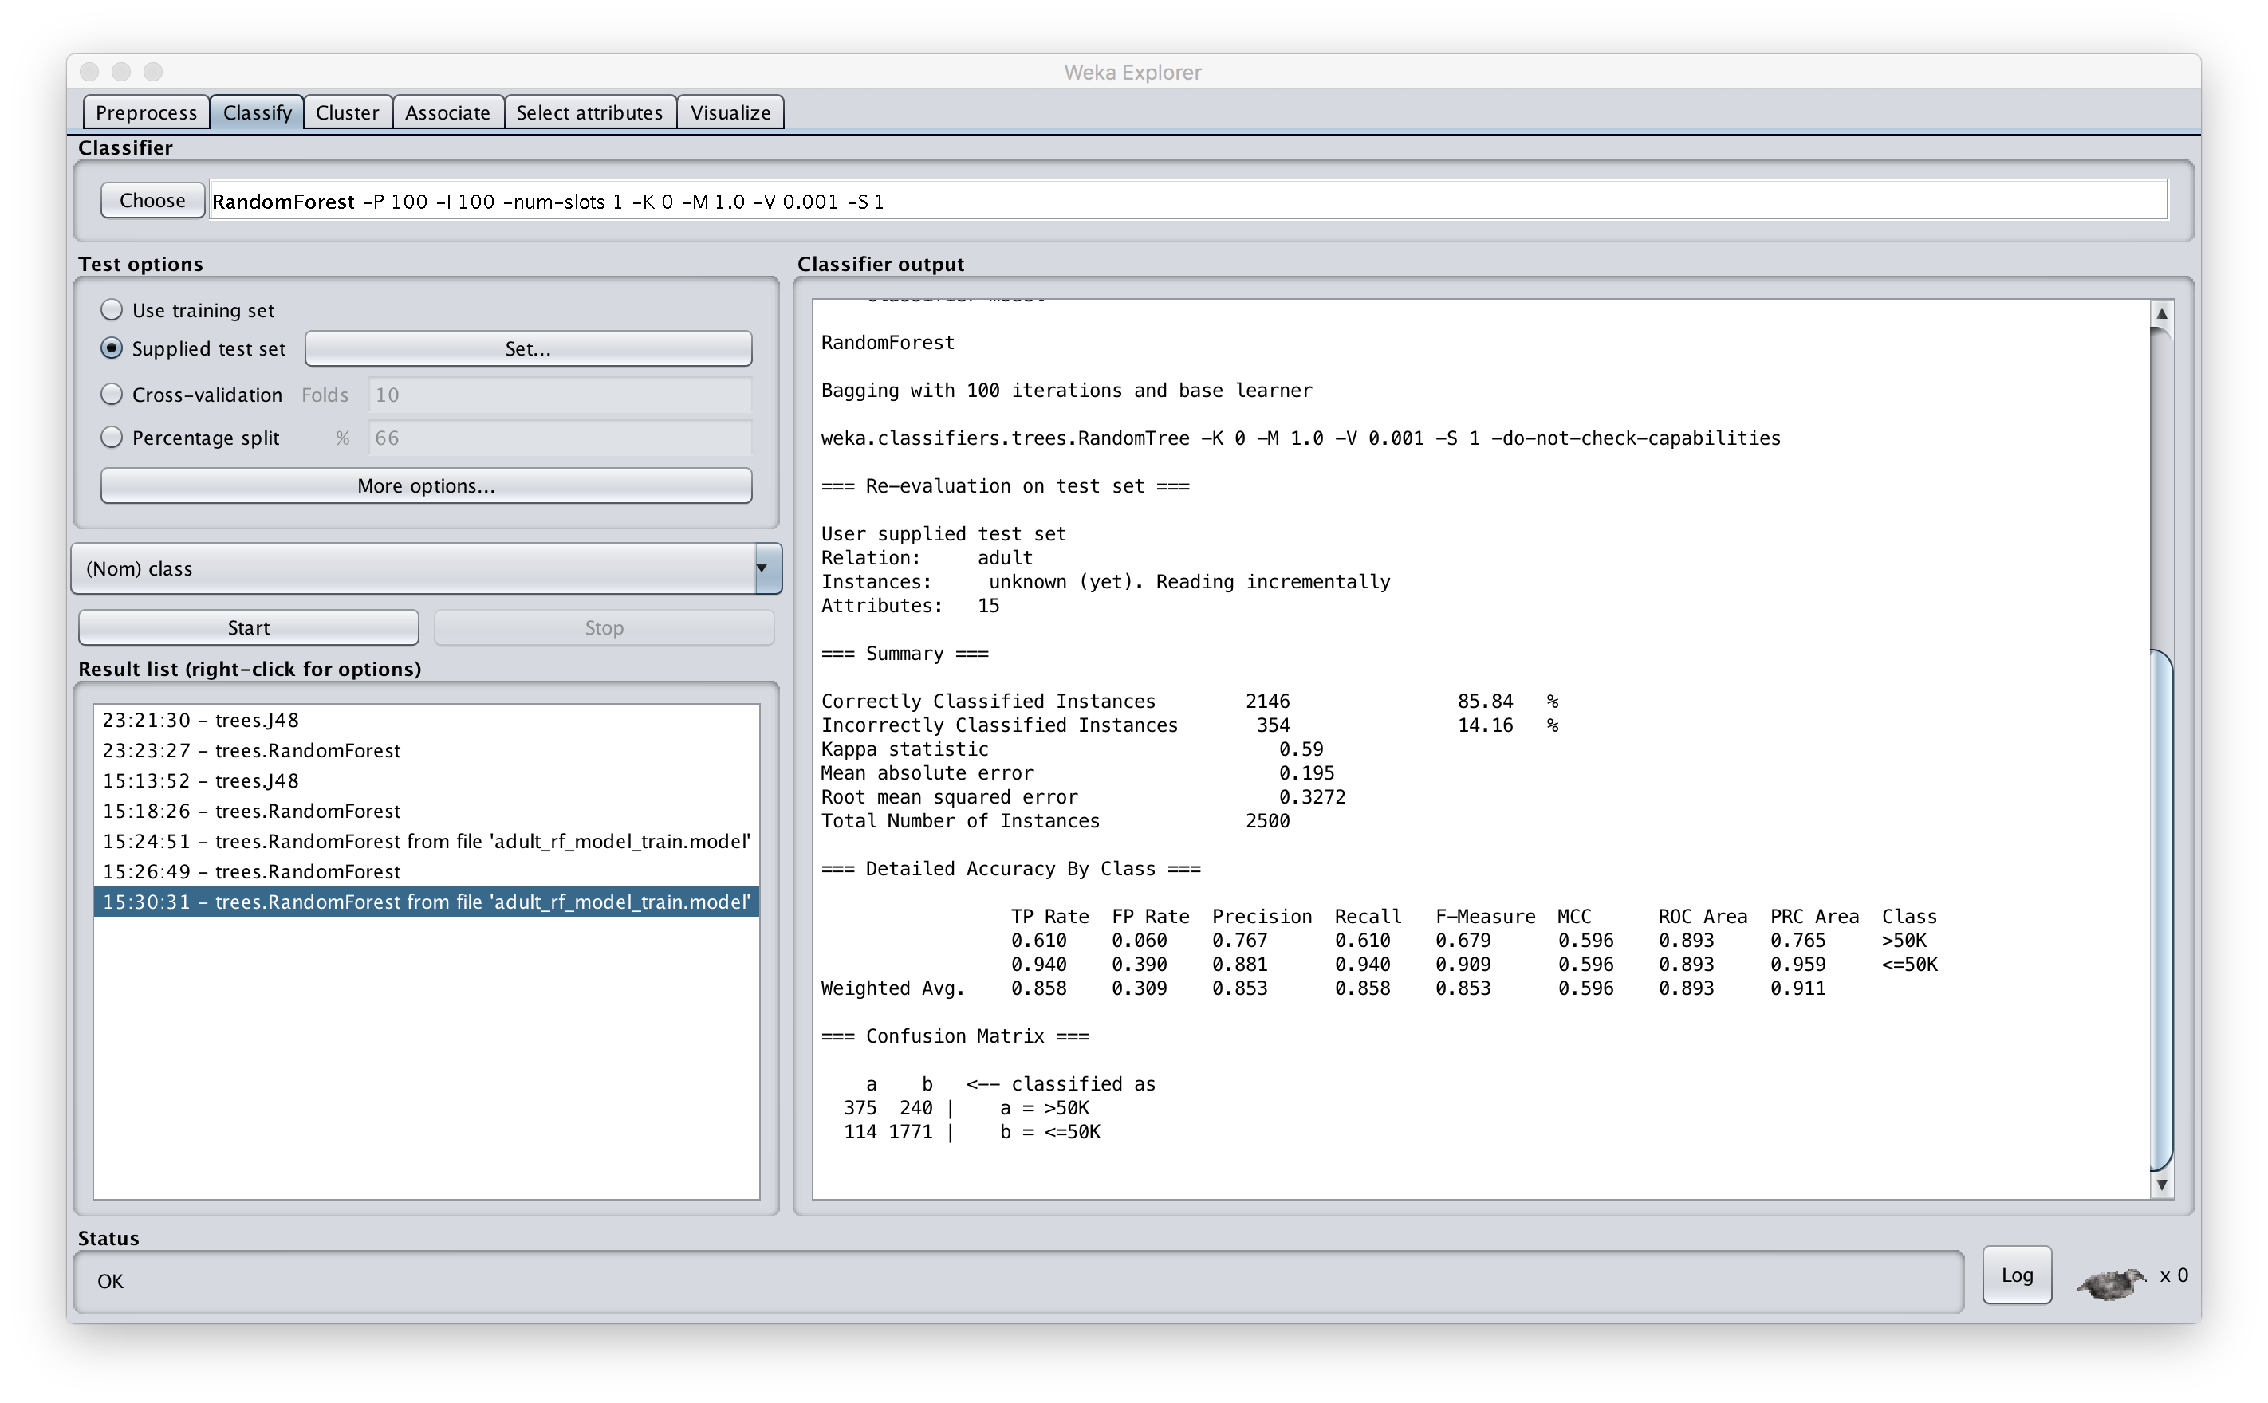

Slide 22
Conclusions
Bagging can help, especially of the amount of data is adequate but not as large as it should be
While we explore it using decision trees, it can be applied to any classifier
Scikit-learn has a general module for bagging
In general, using any of several ensemble approaches to classification is often very helpful

