Slide 1

Machine
Learning: Methodology
Chapter 18.1-18.3

Slide 2
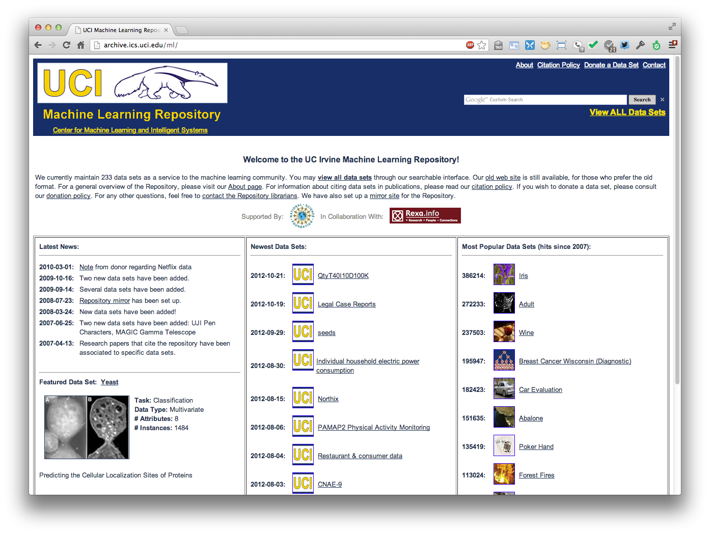
http://archive.ics.uci.edu/ml
233 data sets

Slide 3
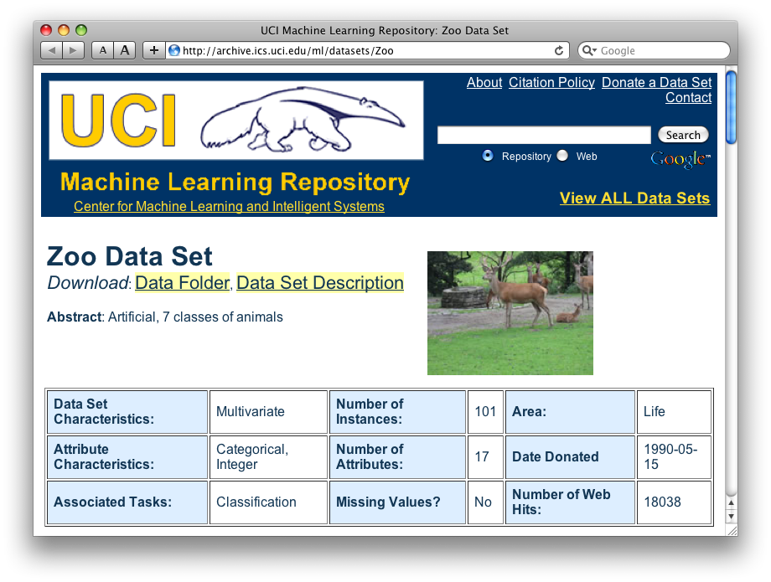
http://archive.ics.uci.edu/ml/datasets/Zoo

Slide 4
Zoo data
animal name: string
hair: Boolean
feathers: Boolean
eggs: Boolean
milk: Boolean
airborne: Boolean
aquatic: Boolean
predator: Boolean
toothed: Boolean
backbone: Boolean
breathes: Boolean
venomous: Boolean
fins: Boolean
legs: {0,2,4,5,6,8}
tail: Boolean
domestic: Boolean
catsize: Boolean
type: {mammal, fish, bird, shellfish, insect, reptile, amphibian}
101 examples
aardvark,1,0,0,1,0,0,1,1,1,1,0,0,4,0,0,1,mammal
antelope,1,0,0,1,0,0,0,1,1,1,0,0,4,1,0,1,mammal
bass,0,0,1,0,0,1,1,1,1,0,0,1,0,1,0,0,fish
bear,1,0,0,1,0,0,1,1,1,1,0,0,4,0,0,1,mammal
boar,1,0,0,1,0,0,1,1,1,1,0,0,4,1,0,1,mammal
buffalo,1,0,0,1,0,0,0,1,1,1,0,0,4,1,0,1,mammal
calf,1,0,0,1,0,0,0,1,1,1,0,0,4,1,1,1,mammal
carp,0,0,1,0,0,1,0,1,1,0,0,1,0,1,1,0,fish
catfish,0,0,1,0,0,1,1,1,1,0,0,1,0,1,0,0,fish
cavy,1,0,0,1,0,0,0,1,1,1,0,0,4,0,1,0,mammal
cheetah,1,0,0,1,0,0,1,1,1,1,0,0,4,1,0,1,mammal
chicken,0,1,1,0,1,0,0,0,1,1,0,0,2,1,1,0,bird
chub,0,0,1,0,0,1,1,1,1,0,0,1,0,1,0,0,fish
clam,0,0,1,0,0,0,1,0,0,0,0,0,0,0,0,0,shellfish
crab,0,0,1,0,0,1,1,0,0,0,0,0,4,0,0,0,shellfish
…

Slide 5
Zoo example
aima-python> python
>>> from learning import *
>>> zoo
<DataSet(zoo): 101 examples, 18 attributes>
>>> dt = DecisionTreeLearner()
>>> dt.train(zoo)
>>> dt.predict(['shark',0,0,1,0,0,1,1,1,1,0,0,1,0,1,0,0])
'fish'
>>> dt.predict(['shark',0,0,0,0,0,1,1,1,1,0,0,1,0,1,0,0])
'mammal’

Slide 6
Evaluation methodology (1)
Standard methodology:
  1. Collect large set of examples with correct classifications
  2. Randomly divide collection into two disjoint sets: training and test
  3. Apply learning algorithm to training set giving hypothesis H
  4. Measure performance of H w.r.t. test set

Slide 7
Evaluation methodology (2)
Important: keep the training and test sets disjoint!
Study efficiency & robustness of algorithm: repeat steps 2-4 for different training sets & training set sizes
On modifying algorithm, restart with step 1 to avoid evolving algorithm to work well on just this collection

Slide 8
Evaluation methodology (3)
Common variation on methodology:
  1. Collect set of examples with correct classifications
  2. Randomly divide it into two disjoint sets: development & test; further divide development into devtrain & devtest
  3. Apply algorithm to devtrain giving hypothesis H
  4. Measure performance of H wrt devtest set
  5. Modify approach, repeat 3-4 as needed
  6. Final test on test data
Ground truth data
DEV
TEST
devtrain
devtest

Slide 9
Zoo evaluation
train_and_test(learner, data, start, end) uses data[start:end] for test and the rest for train
  >>> dtl = DecisionTreeLearner
  >>> train_and_test(dtl(), zoo, 0, 10)
  1.0
  >>> train_and_test(dtl(), zoo, 90, 100)
  0.80000000000000004
  >>> train_and_test(dtl(), zoo, 90, 101)
  0.81818181818181823
  >>> train_and_test(dtl(), zoo, 80, 90)
  0.90000000000000002

Slide 10
K-fold Cross Validation
Problem: getting ground truth data expensive
Problem: Need different test data each time we test
Problem: experiments needed to find right feature space & parameters for ML algorithm
Goal: minimize training+test data needed
Idea: split training data into K subsets, use K-1 for training, and one for development testing
Repeat K times and average performance
Common K values are 5 and 10

Slide 11
Zoo evaluation
cross_validation(learner, data, K, N) does N iterations, each time randomly selecting 1/K data points for test, rest for train
  >>> cross_validation(dtl(), zoo, 10, 20)
  0.95500000000000007
leave1out(learner, data) does len(data) trials, each using one element for test, rest for train
  >>> leave1out(dtl(), zoo)
  0.97029702970297027

Slide 12
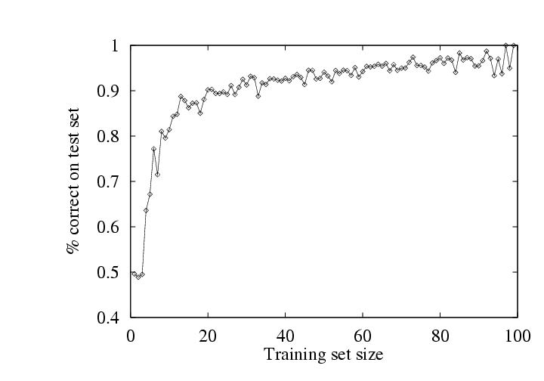
Learning curve
Learning curve: % correct on test set as function of training set size
Steeper curves are better

Slide 13
Zoo
>>> learningcurve(DecisionTreeLearner(), zoo)
[(2, 1.0), (4, 1.0), (6, 0.98333333333333339), (8, 0.97499999999999998), (10, 0.94000000000000006), (12, 0.90833333333333321), (14, 0.98571428571428577), (16, 0.9375), (18, 0.94999999999999996), (20, 0.94499999999999995), … (86, 0.78255813953488373), (88, 0.73636363636363644), (90, 0.70777777777777795)]

Slide 14
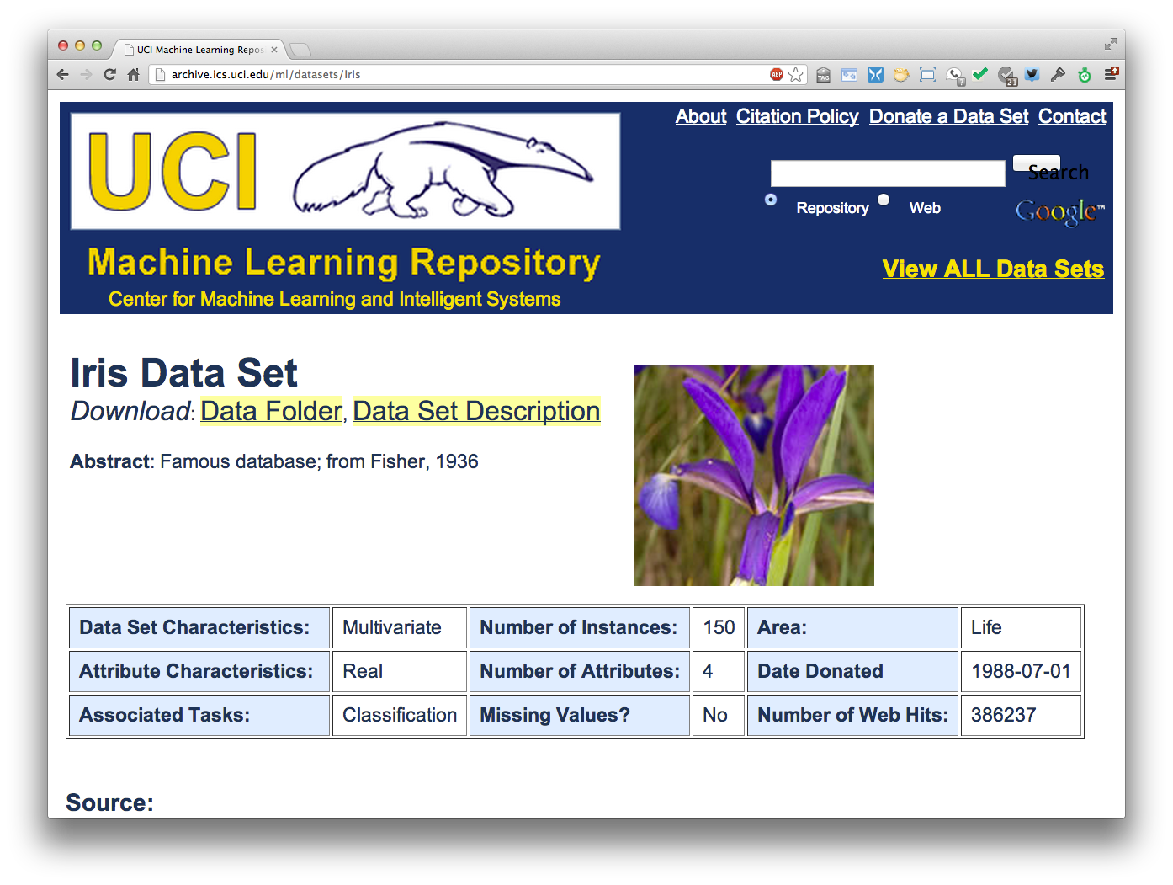
http://archive.ics.uci.edu/ml/datasets/Iris

Slide 15
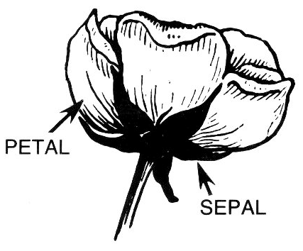
Iris Data
Three classes: Iris Setosa, Iris
Versicolour, Iris Virginica
Four features: sepal length and width, petal length and width
150 data elements (50 of each)
aima-python> more data/iris.csv
5.1,3.5,1.4,0.2,setosa
4.9,3.0,1.4,0.2,setosa
4.7,3.2,1.3,0.2,setosa
4.6,3.1,1.5,0.2,setosa
5.0,3.6,1.4,0.2,setosa
http://code.google.com/p/aima-data/source/browse/trunk/iris.csv

Slide 16
Comparing ML Approaches
The effectiveness of ML algorithms varies de-pending on the problem, data and features used
You may have intuitions, but run experiments
Average accuracy (% correct) is a standard metric
>>> compare([DecisionTreeLearner, NaiveBayesLearner, NearestNeighborLearner], datasets=[iris, zoo], k=10, trials=5)
iris zoo
DecisionTree 0.86 0.94
NaiveBayes 0.92 0.92
NearestNeighbor 0.85 0.96

Slide 17
Confusion Matrix (1)
A confusion matrix can be a better way to show results
For binary classifiers it’s simple and is related to type I and type II errors (i.e., false positives and false negatives)
There may be different costs
for each kind of error
So we need to understand
their frequencies
actual
 | C | ~C
C | True positive | False positive
~C | False negative | True negative
predicted

Slide 18
Confusion Matrix (2)
For multi-way classifiers, a confusion matrix is even more useful
It lets you focus in on where the errors are
actual
 | Cat | Dog | rabbit
Cat | 5 | 3 | 0
Dog | 2 | 3 | 1
Rabbit | 0 | 2 | 11
predicted

Slide 19
Accuracy, Error Rate, Sensitivity, Specificity
P/A | C | ¬C
C | TP | FP | P’
¬C | FN | TN | N’
 | P | N | All
Class Imbalance Problem:
  One class may be rare, e.g. fraud, HIV-positive, ebola
  Significant majority in negative class & rest in positive class
  Sensitivity: True Positive recognition rate
    Sensitivity = TP/P
  Specificity: True Negative recognition rate
    Specificity = TN/N
Classifier Accuracy, or recogni-tion rate: percentage of test set tuples that are correctly classified
  Accuracy = (TP + TN)/All
Error rate: 1 – accuracy, or
  Error rate = (FP + FN)/All

Slide 20
On Sensitivity and Specificity
High sensitivity: few false negatives
High specificity: few false positives
TSA security scenario:
  metal scanners set for high sensitivity and low specificity (e.g., trigger on keys) to reduce risk of missing dangerous objects

Slide 21
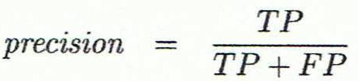
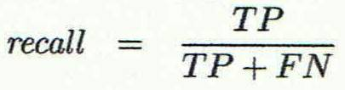
Precision and Recall
Information retrieval uses similar measures, precision & recall, to characterize retrieval effectiveness
  Precision: % of tuples classifier labels as positive that are actually positive
  Recall: % of positive tuples classifier labels as positive

Slide 22
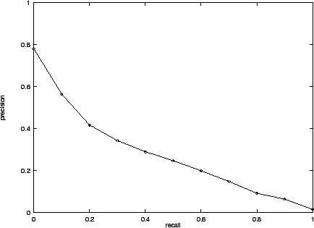
Precision and Recall
In general, increasing one causes the other to decrease
Studying the precision recall curve is informative

Slide 23
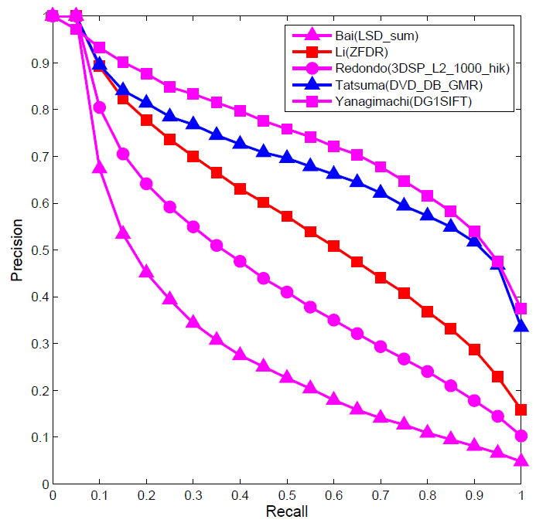
Precision and Recall
If one system’s curve is always above the other, it’s better

Slide 24
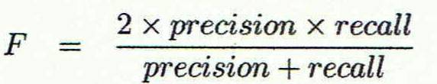
F1 measure
We often want just one measure to comare two systems
F1 measure combines both into a useful single metric
It’s the harmonic mean of precision & recall

Slide 25
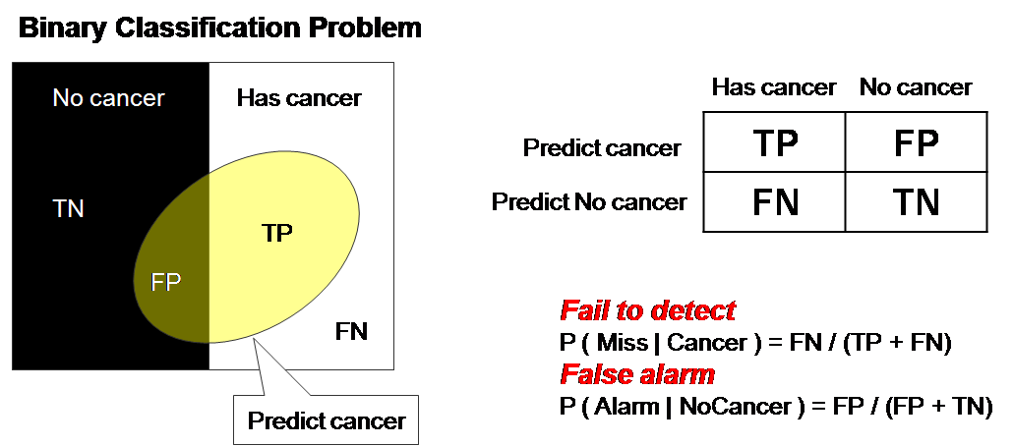
ROC Curve (1)
ROC = Receiver operating characteristic
Notes:
The ROC curve was first developed by electrical engineers and radar engineers during World War II for detecting enemy objects in battlefields and was soon introduced to psychology to account for perceptual detection of stimuli.

Slide 26
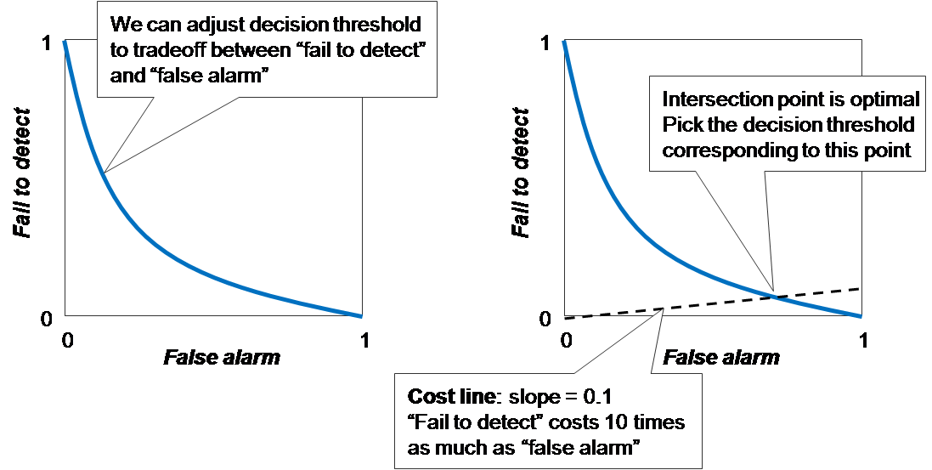
ROC Curve (2)
There is always a tradeoff between the false negative rate and the false positive rate

Slide 27
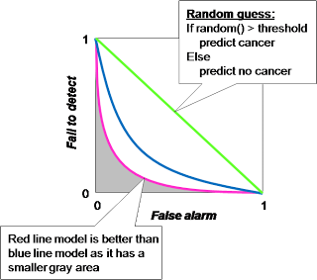
ROC Curve (3)
"Random guess" is worst prediction model and used as a baseline. The decision threshold of random guess is number in 0..1 in order to determine between positive and negative prediction.

Slide 28
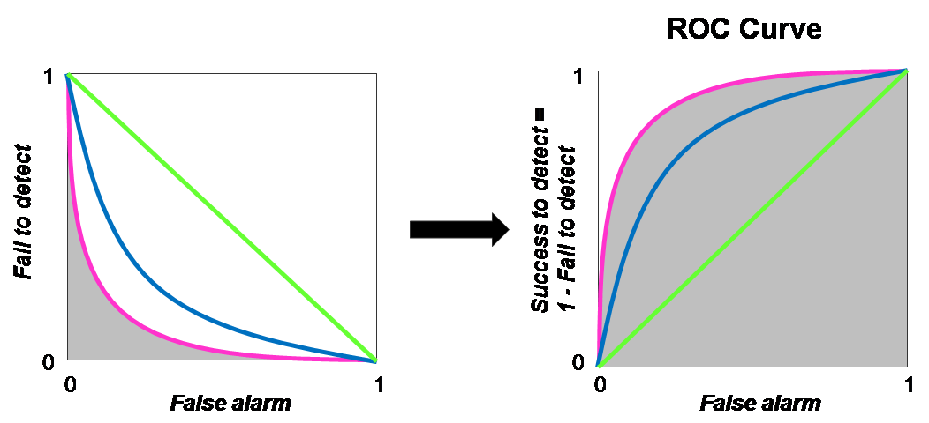
ROC Curve (4)
ROC Curve transforms the y-axis from "fail to detect" to 1 - "fail to detect”, i.e., "success to detect”

Slide 29
Precision at N
Ranking tasks return a set of results ordered from best to worst
  E.g., documents about “barack obama”
  Types for “Barack Obama”
Learning to rank systems can do this using a variety of algorithms (including SVM)
Precision at K is the fraction of top K answers that are correct

