Slide 1
Python ML Tools

Slide 2
Motivation
Python is a great language, but slow compared to Java, C, and many others
Python packages are available to represent and operate on matrices
We’ll briefly review numpy and scipy
You need some familiarity to be able to create or access datasets for training, evaluation and results

Slide 3
What is Numpy?
NumPy supports features needed for ML Typed multi-dimentional arrays (matrices)
Fast numerical computations (matrix math)
High-level math functions
Python does numerical computations slowly
1000 x 1000 matrix multiply
Python triple loop takes > 10 min.
Numpy takes ~0.03 seconds

Slide 4
NumPy Arrays Can Represent …
Structured lists of numbers
Vectors
Matrices
Images
Tensors
Convolutional Neural Networks
$$\left[\begin{matrix}p_{x} \\ p_{y} \\ p_{z}\end{matrix}\right]$$
$$\left[\begin{matrix}a_{11} & ⋯ & a_{1n} \\ ⋮ & ⋱ & ⋮ \\ a_{m1} & ⋯ & a_{mn}\end{matrix}\right]$$

Slide 5
NumPy Arrays Can Represent …
Structured lists of numbers
Vectors
Matrices
Images
Tensors
Convolutional Neural Networks

Slide 6
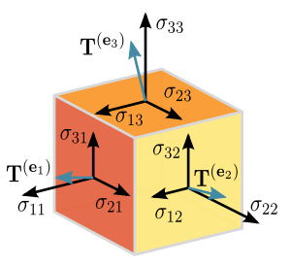
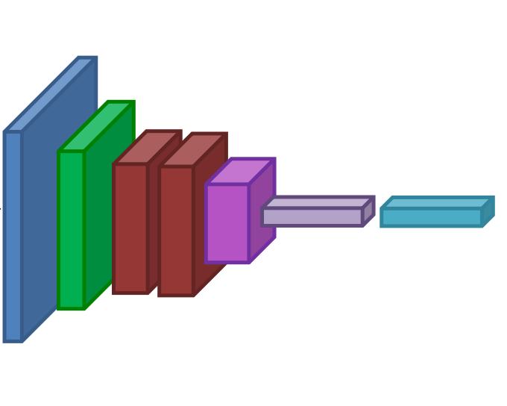
NumPy Arrays Can Represent …
Structured lists of numbers
Vectors
Matrices
Images
Tensors
Convolutional Neural Networks

Slide 7
NumPy Arrays, Basic Properties
import numpy as np
a = np.array([[1,2,3],[4,5,6]],dtype=np.float32)
print a.ndim, a.shape, a.dtype
Arrays can have any number of dimensions, including zero (a scalar).
Arrays are typed: np.uint8, np.int64, np.float32, np.float64
Arrays are dense. Each element of the array exists and has the same type.

Slide 8
NumPy Array Indexing, Slicing
x[0,0] # top-left element
x[0,-1] # first row, last column
x[0,:] # first row (many entries)
x[:,0] # first column (many entries)
Notes:
Zero-indexing
Multi-dimensional indices are comma-separated (i.e., a tuple)

Slide 9
SciPy
SciPy builds on the NumPy array object
Adds additional mathemaiical functions and sparse arrays
Sparse array is one where most elements = 0
An efficient representation only explicitly encode the non-zero values
Access to a missing element returns 0

Slide 10
SciPy Sparse Array Use Case (1)
NumPy and SciPy arrays are numeric
We can represent a document’s content by an vector of features
Each feature is a possible word
A feature’s value is:
TF: number of times it occurs in the document;
TF-IDF: … normalized by how common the word is
And maybe normalized by document length

Slide 11
SciPy Sparse Array Use Case (2)
We may be interested only in the 50,000 most frequent words found in a large document collection and ignore others
We assign each English word a number
The sentence “the dog chased the cat”
Would be a numPy vector of length 50,000
Or a sciPy sparse vector of length 4
A 800 words news article may only have 100 unique words; The Hobbit has about 8,000

