Slide 1
Planning
Chapter 11.1-11.3
Some material adopted from notes by Andreas Geyer-Schulz
and Chuck Dyer

Slide 2
Blocks World Planning
A
C
B
A
B
C

Slide 3
Blocks world
The blocks world is a micro-world consisting of a table, a set of blocks and a robot hand
Some constraints for a simple model:
Only one block can be on another block
Any number of blocks can be on the table
The hand can only hold one block
Typical representation uses a logic notation:
ontable(b) ontable(d)
on(c,d) holding(a)
clear(b) clear(c)

Slide 4
Typical BW planning problem
Initial state:
clear(a)
clear(b)
clear(c)
ontable(a)
ontable(b)
ontable(c)
handempty
Goal:
on(b,c)
on(a,b)
ontable(c)
A
C
B
A
B
C

Slide 5
Typical BW planning problem
assertions describing a state
atomic robot actions
Initial state:
clear(a)
clear(b)
clear(c)
ontable(a)
ontable(b)
ontable(c)
handempty
Goal state:
on(b,c)
on(a,b)
ontable(c)
Plan:
pickup(b)
stack(b,c)
pickup(a)
stack(a,b)
A
C
B
A
B
C

Slide 6
Planning problem
Find sequence of actions to achieve goal state when executed from initial state given
set of possible primitive actions, including their preconditions and effects
initial state description
goal state description
Compute plan as a sequence of actions that, when executed in initial state, achieves goal state
States specified as conjunction of conditions, e.g., ontable(a) ∧ on(b, a)

Slide 7
Planning vs. problem solving
Problem solving methods can often solve similar problems
Planning is more powerful and efficient because of the representations and methods used
States, goals, and actions are decomposed into sets of sentences (usually in first-order logic)
Search often proceeds through plan space rather than state space (though there are also state-space planners)
Sub-goals can be planned independently, reducing the complexity of the planning problem

Slide 8
Typical simplifying assumptions
Atomic time: Each action is indivisible
No concurrent actions: but actions need not be ordered w.r.t. each other in the plan
Deterministic actions: action results completely determined — no uncertainty in their effects
Agent is the sole cause of change in the world
Agent is omniscient with complete knowledge of the state of the world
Closed world assumption: everything known to be true in world is included in state description and anything not listed is false

Slide 9
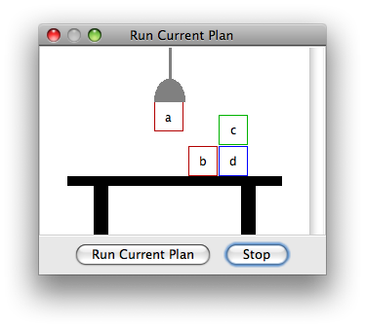
Blocks world
The blocks world consists of a table, a set of blocks and a robot hand
Some domain constraints:
Only one block can be on another block
Any number of blocks can be on the table
The hand can only hold one block
Typical representation:
ontable(b) ontable(d)
on(c,d) holding(a)
clear(b) clear(c)
Meant to be a simple model!

Slide 10
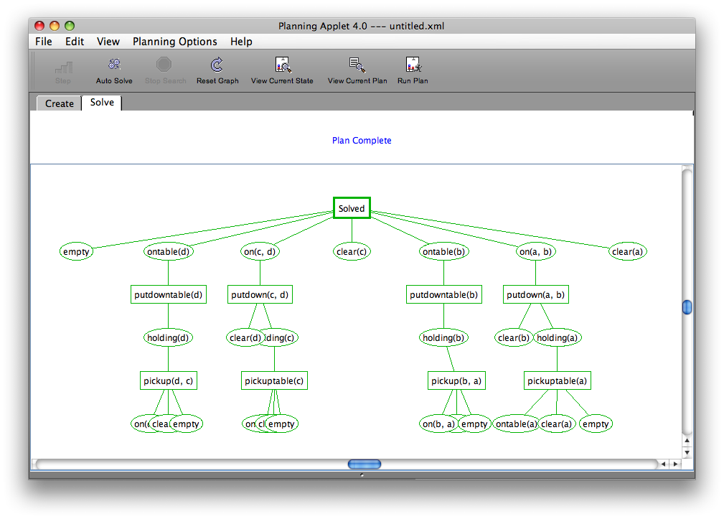

Slide 11
Typical BW planning problem
Initial state:
clear(a)
clear(b)
clear(c)
ontable(a)
ontable(b)
ontable(c)
handempty
Goal:
on(b,c)
on(a,b)
ontable(c)
A plan:
pickup(b)
stack(b,c)
pickup(a)
stack(a,b)
A
C
B
A
B
C

Slide 12
Another BW planning problem
Initial state:
clear(a)
clear(b)
clear(c)
ontable(a)
ontable(b)
ontable(c)
handempty
Goal:
on(a,b)
on(b,c)
ontable(c)
A plan:
pickup(a)
stack(a,b)
unstack(a,b)
putdown(a)
pickup(b)
stack(b,c)
pickup(a)
stack(a,b)
A
C
B
A
B
C

Slide 13
Yet Another BW planning problem
Plan:
unstack(c,b)
putdown(c)
unstack(b,a)
putdown(b)
pickup(a)
stack(a,b)
unstack(a,b)
putdown(a)
pickup(b)
stack(b,c)
pickup(a)
stack(a,b)
Initial state:
clear(c)
ontable(a)
on(b,a)
on(c,b)
handempty
Goal:
on(a,b)
on(b,c)
ontable(c)
C
B
A
A
B
C

Slide 14
Major approaches
Planning as search
GPS / STRIPS
Situation calculus
Partial order planning
Hierarchical decomposition (HTN planning)
Planning with constraints (SATplan, Graphplan)
Reactive planning

Slide 15
Planning as Search
Actions: generate successor states
States: completely described & only used for successor generation, heuristic fn. evaluation & goal testing
Goals: represented as goal test and using a heuristic function
Plan representation: unbroken sequences of actions forward from initial states or backward from goal state

Slide 16
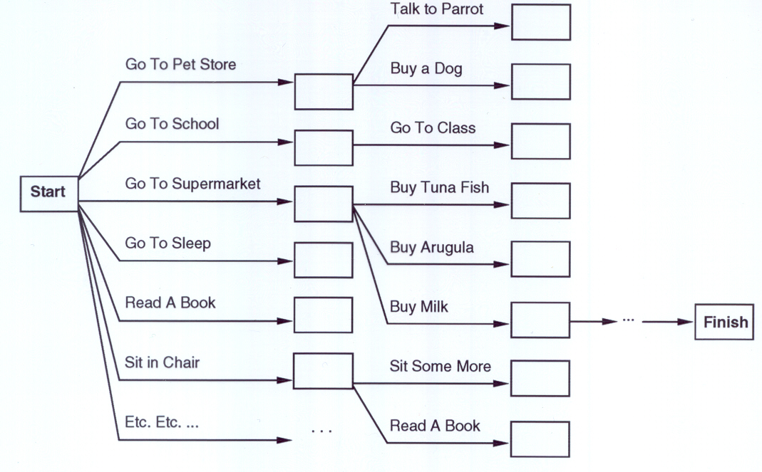
“Get a quart of milk, a bunch of bananas and a variable-speed cordless drill.”
Treating planning as a search problem isn’t very efficient

Slide 17
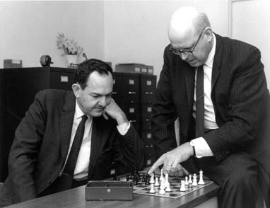
General Problem Solver
General Problem Solver (GPS) system was an early planner (Newell, Shaw, and Simon, 1957)
GPS generated actions that reduced difference between some state and a goal state
GPS used Means-Ends Analysis
Compare given to desired states; select best action to do next
Table of differences identifies actions to reduce types of differences
GPS was a state space planner: operated in domain of state space problems specified by initial state, some goal states, and set of operations
Introduced general way to use domain knowledge to select most promising action to take next

Slide 18
Situation calculus planning
Intuition: Represent planning problem using first-order logic
Situation calculus lets us reason about changes in the world
Use theorem proving to find action sequence, when applied to initial situation leads to desired result
How “neats” approach the problem

Slide 19
Situation calculus
Initial state: logical sentence about (situation) S₀
At(Home, S₀) ∧ ¬Have(Milk, S₀) ∧ ¬ Have(Bananas, S₀) ∧ ¬ Have(Drill, S₀)
Goal state:
(∃s) At(Home,s) ∧ Have(Milk,s) ∧ Have(Bananas,s) ∧ Have(Drill,s)
Actions describe how world changes:
∀(a,s) Have(Milk,Result(a,s)) ⇔ ((a=Buy(Milk) ∧ At(Grocery,s)) ∨ (Have(Milk, s) ∧ a ≠ Drop(Milk)))
Result(a,s) names situation resulting from doing action a in situation s
Action sequences: Result'(l,s) is result of executing list of actions (l) starting in s:
(∀s) Result'([],s) = s
(∀a,p,s) Result'([a|p]s) = Result'(p,Result(a,s))

Slide 20
Situation calculus II
Solution is plan that when applied to initial state yields situation satisfying the goal:
At(Home, Result'(p,S₀))
∧ Have(Milk, Result'(p,S₀))
∧ Have(Bananas, Result'(p,S₀))
∧ Have(Drill, Result'(p,S₀))
We expect a plan (i.e., variable assignment through unification) such as:
p = [Go(Grocery), Buy(Milk), Buy(Bananas), Go(HardwareStore), Buy(Drill), Go(Home)]

Slide 21
Situation calculus: Blocks world
A situation calculus rule for the blocks world
Clear (X, Result(A,S)) ↔ [Clear (X, S) ∧ (¬(A=Stack(Y,X) ∨ A=Pickup(X)) ∨ (A=Stack(Y,X) ∧ ¬(holding(Y,S)) ∨ (A=Pickup(X) ∧ ¬(handempty(S) ∧ ontable(X,S) ∧ clear(X,S))))] ∨ [A=Stack(X,Y) ∧ holding(X,S) ∧ clear(Y,S)] ∨ [A=Unstack(Y,X) ∧ on(Y,X,S) ∧ clear(Y,S) ∧ handempty(S)] ∨ [A=Putdown(X) ∧ holding(X,S)]
Translation: A block is clear if (a) in previous state it was clear & we didn’t pick it up or stack something on it, or (b) we stacked it on something else, or (c) something was on it that we unstacked, or (d) we were holding it and we put it down.
Whew!!! There’s gotta be a better way!

Slide 22
Situation calculus planning: Analysis
Fine in theory, but problem solving (search) is exponential in worst case
Resolution theorem proving only finds a proof (plan), not necessarily a good plan
So, restrict language and use special-purpose algorithm (a planner) rather than general theorem prover
Planning is a common task for intelligent agents, so it’s reasonable to have a special subsystem

Slide 23
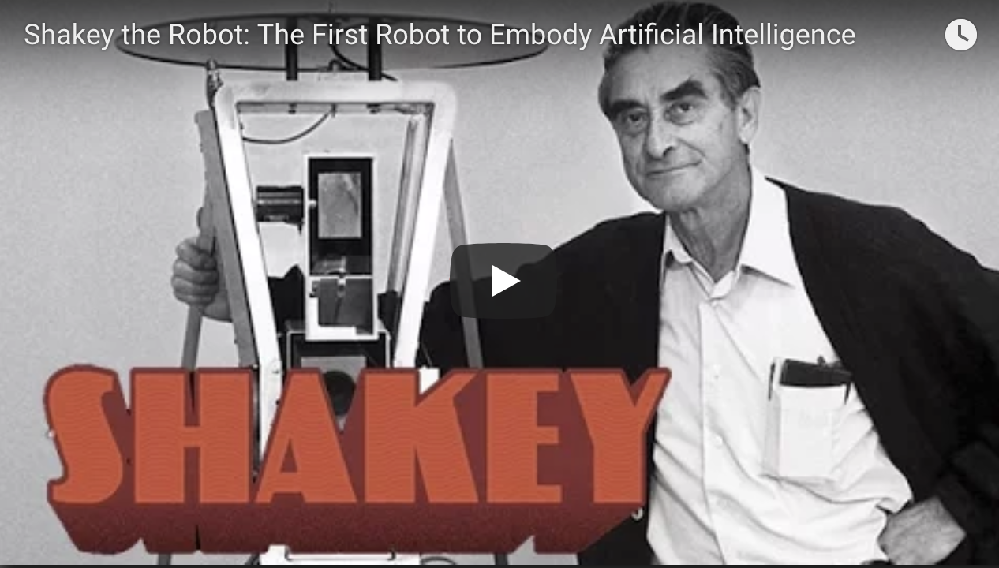

Shakey the robot
First general-purpose mobile robot to be able to reason about its own actions
Shakey the Robot: 1st Robot to Embody Artificial Intelli-gence (2017, 6 min.)
Shakey: Experiments in Robot Plan-ning and Learning (1972, 24 min)

Slide 24
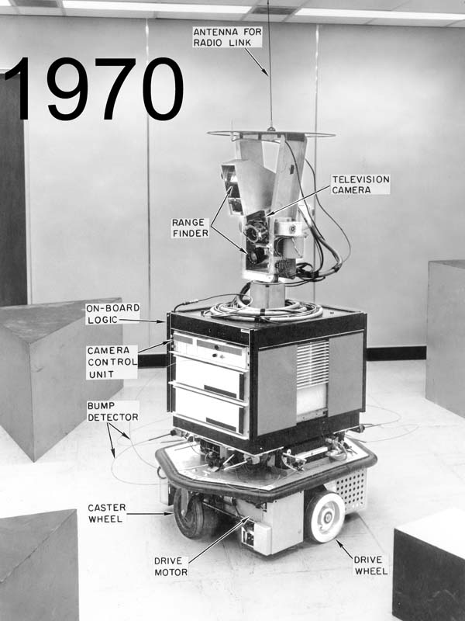
Strips planning representation
Classic approach first used in the STRIPS (Stanford Research Institute Problem Solver) planner
A State is a conjunction of ground literals
at(Home) ∧ ¬have(Milk) ∧ ¬have(bananas) ...
Goals are conjunctions of literals, but may have variables, assumed to be existentially quantified
at(?x) ∧ have(Milk) ∧ have(bananas) ...
Need not fully specify state
Non-specified conditions either don’t-care or assumed false
Represent many cases in small storage
May only represent changes in state rather than entire situation
Unlike theorem prover, not seeking whether goal is true, but is there a sequence of actions to attain it
Shakey the robot

Slide 25
Operator/action representation
Action operators have three components:
Action description
Precondition: conjunction of positive literals
Effect: conjunction of positive or negative literals describing how situation changes when operator is applied
Example:
Op[Action: Go(there),
Precond: At(here) ∧ Path(here,there),
Effect: At(there) ∧ ¬At(here)]
All variables are universally quantified
Situation variables are implicit
preconditions must be true in the state immediately before operator is applied; effects are true immediately after
At(here) ,Path(here,there)
Go(there)
At(there) , ¬At(here)

Slide 26
Blocks world operators
Classic basic operations for the blocks world
stack(X,Y): put block X on block Y
unstack(X,Y): remove block X from block Y
pickup(X): pickup block X
putdown(X): put block X on the table
Each represented by
list of preconditions
list of new facts to be added (add-effects)
list of facts to be removed (delete-effects)
optionally, set of (simple) variable constraints
For example stack(X,Y):
preconditions(stack(X,Y), [holding(X), clear(Y)])
deletes(stack(X,Y), [holding(X), clear(Y)]).
adds(stack(X,Y), [handempty, on(X,Y), clear(X)])
constraints(stack(X,Y), [X≠Y, Y≠table, X≠table])

Slide 27
Blocks world operators (Prolog)
operator(op, preconditions, adds, deletes, constraints)
operator(stack(X,Y),
[holding(X), clear(Y)],
[handempty, on(X,Y), clear(X)],
[holding(X), clear(Y)],
[X≠Y, Y≠table, X≠table]).
operator(pickup(X),
[ontable(X), clear(X), handempty],
[holding(X)],
[ontable(X), clear(X), handempty],
[X≠table]).
operator(unstack(X,Y),
[on(X,Y), clear(X), handempty],
[holding(X), clear(Y)],
[handempty, clear(X), on(X,Y)],
[X≠Y, Y≠table, X≠table]).
operator(putdown(X),
[holding(X)],
[ontable(X), handempty, clear(X)],
[holding(X)],
[X≠table]).

Slide 28
STRIPS planning
STRIPS maintains two additional data structures:
State List - all currently true predicates.
Goal Stack - push down stack of goals to be solved, with current goal on top
If current goal not satisfied by present state, find operator that adds it and push operator and its preconditions (subgoals) on stack
When a current goal is satisfied, POP from stack
When an operator is on top stack, record application of that operator on plan sequence and use operator’s add and delete lists to update current state

Slide 29
Typical BW planning problem
Initial state:
clear(a)
clear(b)
clear(c)
ontable(a)
ontable(b)
ontable(c)
handempty
Goal:
on(b,c)
on(a,b)
ontable(c)
A plan:
pickup(b)
stack(b,c)
pickup(a)
stack(a,b)
A
C
B
A
B
C

Slide 30
Strips in Prolog
strips(Goals, State, Plan, NewState, NewPlan):-
% Goal is an unsatisfied goal.
member(Goal, Goals),
(\+ member(Goal, State)),
% Op is an Operator with Goal as a result.
operator(Op, Preconditions, Adds, Deletes,_),
member(Goal,Adds),
% Achieve the preconditions
strips(Preconditions, State, Plan, TmpState1, TmpPlan1),
% Apply the Operator
diff(TmpState1, Deletes, TmpState2),
union(Adds, TmpState2, TmpState3).
% Continue planning.
strips(GoalList, TmpState3, [Op|TmpPlan1], NewState, NewPlan).
% strips(+Goals, +InitState, -Plan)
strips(Goal, InitState, Plan):-
strips(Goal, InitState, [], _, RevPlan),
reverse(RevPlan, Plan).
% strips(+Goals,+State,+Plan,-NewState, NewPlan )
% Finished if each goal in Goals is true
% in current State.
strips(Goals, State, Plan, State, Plan) :-
subset(Goals,State).

Slide 31
Trace (Prolog)
strips([on(b,c),on(a,b),ontable(c)],[clear(a),clear(b),clear(c),ontable(a),ontable(b),ontable(c),handempty],[])
Achieve on(b,c) via stack(b,c) with preconds: [holding(b),clear(c)]
strips([holding(b),clear(c)],[clear(a),clear(b),clear(c),ontable(a),ontable(b),ontable(c),handempty],[])
Achieve holding(b) via pickup(b) with preconds: [ontable(b),clear(b),handempty]
strips([ontable(b),clear(b),handempty],[clear(a),clear(b),clear(c),ontable(a),ontable(b),ontable(c),handempty],[])
Applying pickup(b)
strips([holding(b),clear(c)],[clear(a),clear(c),holding(b),ontable(a),ontable(c)],[pickup(b)])
Applying stack(b,c)
strips([on(b,c),on(a,b),ontable(c)],[handempty,clear(a),clear(b),ontable(a),ontable(c),on(b,c)],[stack(b,c),pickup(b)])
Achieve on(a,b) via stack(a,b) with preconds: [holding(a),clear(b)]
strips([holding(a),clear(b)],[handempty,clear(a),clear(b),ontable(a),ontable(c),on(b,c)],[stack(b,c),pickup(b)])
Achieve holding(a) via pickup(a) with preconds: [ontable(a),clear(a),handempty]
strips([ontable(a),clear(a),handempty],[handempty,clear(a),clear(b),ontable(a),ontable(c),on(b,c)],[stack(b,c),pickup(b)])
Applying pickup(a)
strips([holding(a),clear(b)],[clear(b),holding(a),ontable(c),on(b,c)],[pickup(a),stack(b,c),pickup(b)])
Applying stack(a,b)
strips([on(b,c),on(a,b),ontable(c)],[handempty,clear(a),ontable(c),on(a,b),on(b,c)],[stack(a,b),pickup(a),stack(b,c),pickup(b)])

Slide 32
Another BW planning problem
Initial state:
clear(a)
clear(b)
clear(c)
ontable(a)
ontable(b)
ontable(c)
handempty
Goal:
on(a,b)
on(b,c)
ontable(c)
A plan:
pickup(a)
stack(a,b)
unstack(a,b)
putdown(a)
pickup(b)
stack(b,c)
pickup(a)
stack(a,b)
A
C
B
A
B
C

Slide 33
Yet Another BW planning problem
Plan:
unstack(c,b)
putdown(c)
unstack(b,a)
putdown(b)
pickup(b)
stack(b,a)
unstack(b,a)
putdown(b)
pickup(a)
stack(a,b)
unstack(a,b)
putdown(a)
pickup(b)
stack(b,c)
pickup(a)
stack(a,b)
Initial state:
clear(c)
ontable(a)
on(b,a)
on(c,b)
handempty
Goal:
on(a,b)
on(b,c)
ontable(c)
C
B
A
A
B
C

Slide 34
Yet Another BW planning problem
Initial state:
ontable(a)
ontable(b)
clear(a)
clear(b)
handempty
Goal:
on(a,b)
on(b,a)
Plan:
??
A
B

Slide 35
Goal interaction
Simple planning algorithms assume independent sub-goals
Solve each separately and concatenate the solutions
The “Sussman Anomaly” is the classic example of the goal interaction problem:
Solving on(A,B) first (via unstack(C,A), stack(A,B)) is undone when solving 2nd goal on(B,C) (via unstack(A,B), stack(B,C))
Solving on(B,C) first will be undone when solving on(A,B)
Classic STRIPS couldn’t handle this, although minor modifications can get it to do simple cases
A
C
B
A
B
C
Initial state
Goal state

Slide 36
Sussman Anomaly
Achieve on(a,b) via stack(a,b) with preconds: [holding(a),clear(b)]
|Achieve holding(a) via pickup(a) with preconds: [ontable(a),clear(a),handempty]
||Achieve clear(a) via unstack(_1584,a) with preconds: [on(_1584,a),clear(_1584),handempty]
||Applying unstack(c,a)
||Achieve handempty via putdown(_2691) with preconds: [holding(_2691)]
||Applying putdown(c)
|Applying pickup(a)
Applying stack(a,b)
Achieve on(b,c) via stack(b,c) with preconds: [holding(b),clear(c)]
|Achieve holding(b) via pickup(b) with preconds: [ontable(b),clear(b),handempty]
||Achieve clear(b) via unstack(_5625,b) with preconds: [on(_5625,b),clear(_5625),handempty]
||Applying unstack(a,b)
||Achieve handempty via putdown(_6648) with preconds: [holding(_6648)]
||Applying putdown(a)
|Applying pickup(b)
Applying stack(b,c)
Achieve on(a,b) via stack(a,b) with preconds: [holding(a),clear(b)]
|Achieve holding(a) via pickup(a) with preconds: [ontable(a),clear(a),handempty]
|Applying pickup(a)
Applying stack(a,b)
From [clear(b),clear(c),ontable(a),ontable(b),on(c,a),handempty]
To [on(a,b),on(b,c),ontable(c)]
Do:
unstack(c,a)
putdown(c)
pickup(a)
stack(a,b)
unstack(a,b)
putdown(a)
pickup(b)
stack(b,c)
pickup(a)
stack(a,b)
Goal state
A
Initial state
C
B
A
B
C

Slide 37
Sussman Anomaly
Classic Strips assumed that once a goal had been satisfied it would stay satisfied
Simple Prolog version selects any currently unsatisfied goal to tackle at each iteration
This can handle this problem, at the expense of looping for other problems
e.g., achieving goal [on(a,b) , on (b,a)]
What’s needed? A notion of protecting a sub-goal so it’s not undone by later steps

Slide 38
State-space planning
STRIPS searches thru a space of situations (where you are, what you have, etc.)
Plan is a solution found by “searching” through situations to get to goal
Progression planners search forward from initial state to goal state
Usually results in a high branching factor
Regression planners search backward from goal
OK if operators have enough information to go both ways
Can reduce branching: you’re only considering things relevant to goal
Handling a conjunction of goals is difficult (e.g., STRIPS)

Slide 39
Plan-space planning
An alternative is to search through the space of plans, rather than situations
Start from a partial plan which is expanded and refined until a complete plan is generated
Refinement operators add constraints to the partial plan and modification operators for other changes
We can still use STRIPS-style operators:
Op(ACTION: RightShoe, PRECOND: RightSockOn, EFFECT: RightShoeOn)
Op(ACTION: RightSock, EFFECT: RightSockOn)
Op(ACTION: LeftShoe, PRECOND: LeftSockOn, EFFECT: LeftShoeOn)
Op(ACTION: LeftSock, EFFECT: leftSockOn)
could result in a partial plan of
[ … RightShoe … LeftShoe …]

Slide 40
Partial-order planning
Linear planners build plans as totally ordered sequences of steps
Non-linear planners (aka partial-order planners) build plans as sets of steps with temporal constraints
constraints like S1<S2 if step S1 must come before S2
One refines a partially ordered plan (POP) by either:
adding a new plan step, or
adding a new constraint to the steps already in the plan
A POP can be linearized (converted to a totally ordered plan) by topological sorting

Slide 41
Some example domains
We’ll use some simple problems with a real world flavor to illustrate planning problems and algorithms
Putting on your socks and shoes in the morning
Actions like put-on-left-sock, put-on-right-shoe
Planning a shopping trip involving buying several kinds of items
Actions like go(X), buy(Y)

Slide 42
A simple graphical notation
Start
Start
Initial State
Goal State
LeftShoeOn RightShoeOn
Finish
Finish
(a)
(b)

Slide 43
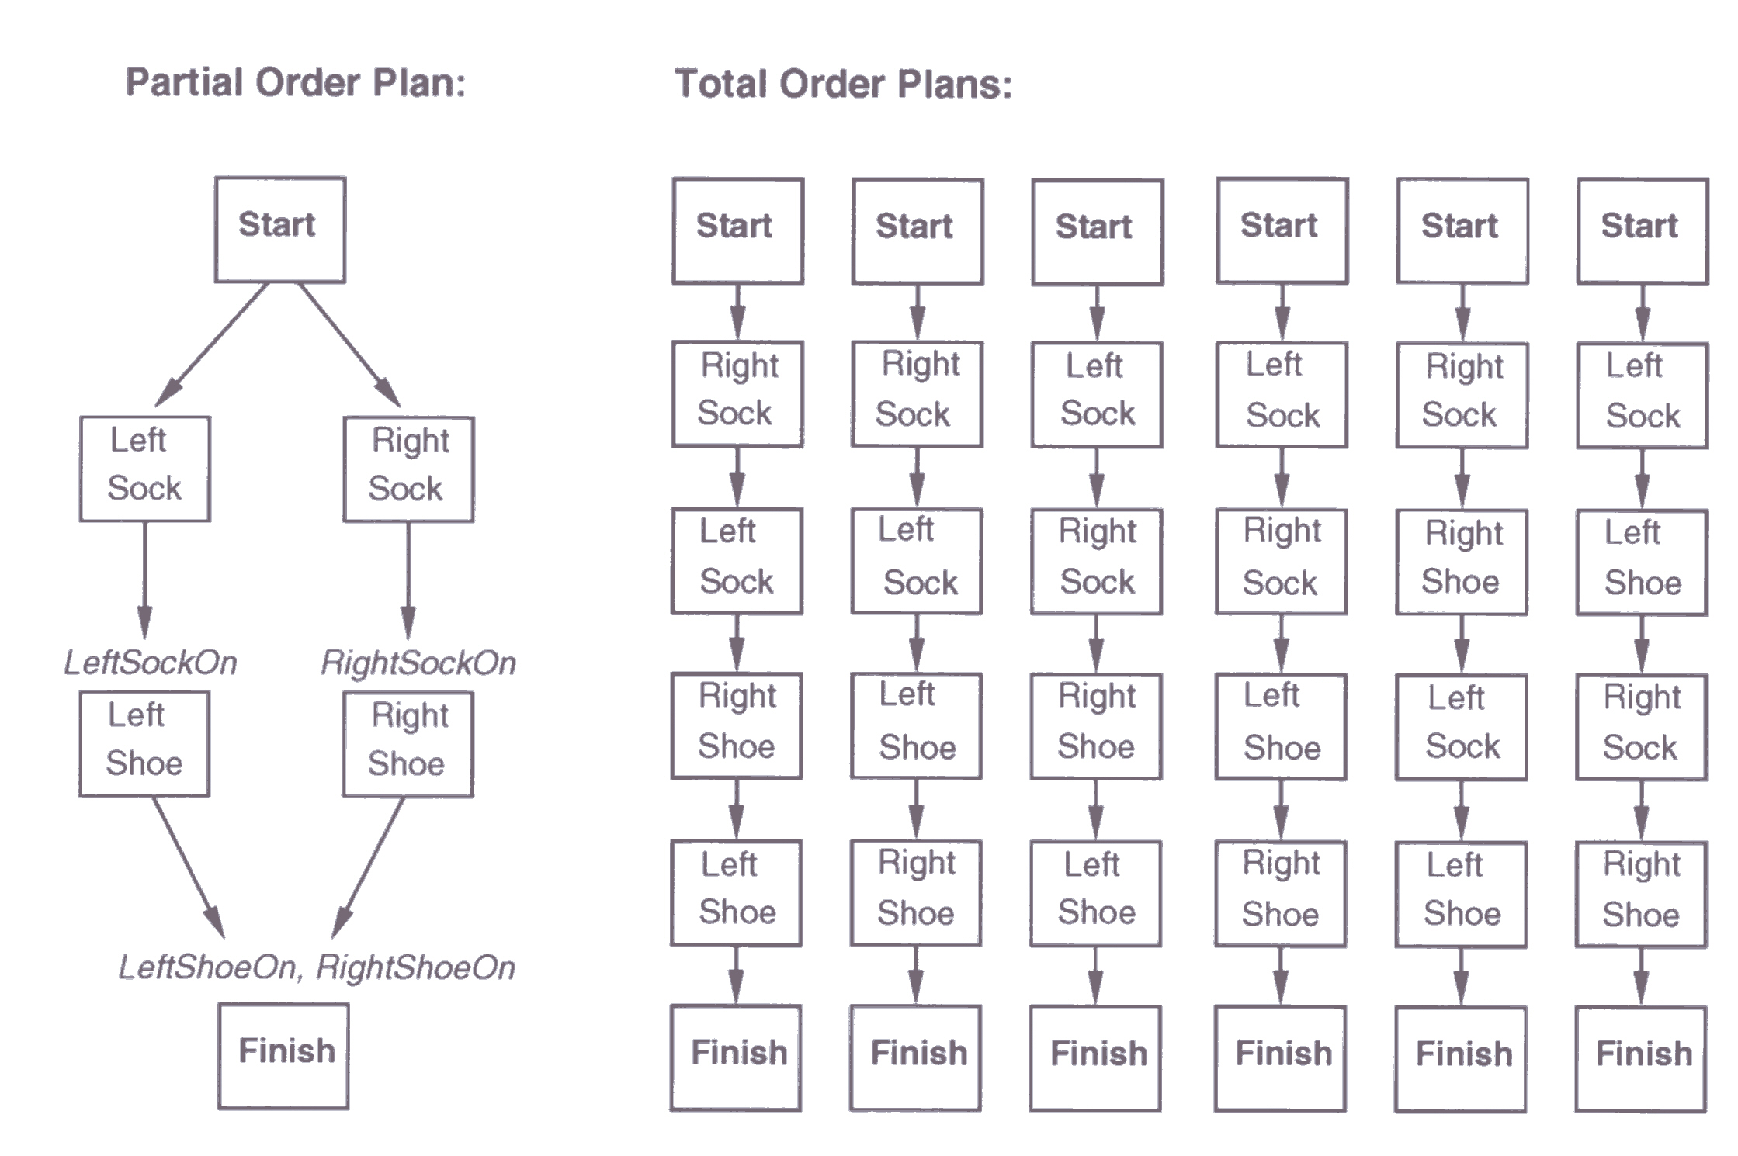
Partial Order Plan vs. Total Order Plan
The space of POPs is smaller than TOPs and hence involve less search

Slide 44
Least commitment
Non-linear planners embody the principle of least commitment
only choose actions, orderings & variable bindings absolutely necessary, postponing other decisions
avoids early commitment to decisions that don’t really matter
Linear planners always choose to add a plan step in a particular place in the sequence
Non-linear planners choose to add a step and possibly some temporal constraints

Slide 45
Real-world planning domains
Real-world domains are complex and don’t satisfy assumptions of STRIPS or methods
Some of the characteristics we may need to handle:
Modeling and reasoning about resources
Representing and reasoning about time
Planning at different levels of abstractions
Conditional outcomes of actions
Uncertain outcomes of actions
Exogenous events
Incremental plan development
Dynamic real-time re-planning
} Scheduling
} Planning under uncertainty
} HTN planning

Slide 46
Hierarchical decomposition
Hierarchical decomposition, or hierarchical task network (HTN) planning, uses abstract operators to incrementally decompose a planning problem from a high-level goal statement to a primitive plan network
Primitive operators represent actions that are executable, and can appear in the final plan
Non-primitive operators represent goals (equivalently, abstract actions) that require further decomposition (or operationalization) to be executed
There is no “right” set of primitive actions: One agent’s goals are another agent’s actions!

Slide 47
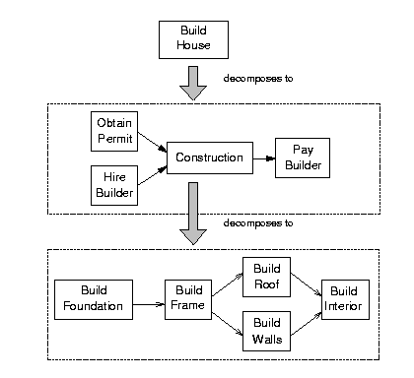
HTN planning: example

Slide 48
HTN operator: Example
OPERATOR decompose
PURPOSE: Construction
CONSTRAINTS:
Length (Frame) <= Length (Foundation),
Strength (Foundation) > Wt(Frame) + Wt(Roof)
+ Wt(Walls) + Wt(Interior) + Wt(Contents)
PLOT: Build (Foundation)
Build (Frame)
PARALLEL
Build (Roof)
Build (Walls)
END PARALLEL
Build (Interior)

Slide 49
Planning summary
Planning representations
Situation calculus
STRIPS representation: Preconditions and effects
Planning approaches
State-space search (STRIPS, forward chaining, ….)
Plan-space search (partial-order planning, HTN, …)
Constraint-based search (GraphPlan, SATplan, …)
Search strategies
Forward planning
Goal regression
Backward planning
Least-commitment
Nonlinear planning

