Slide 1
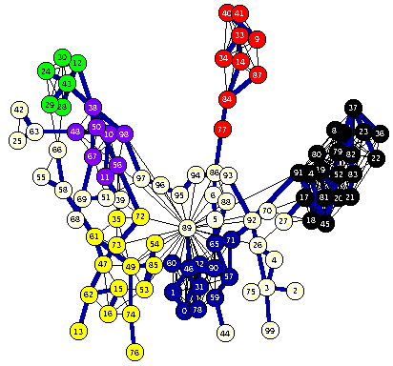
Constraint Satisfaction
Russell & Norvig Ch. 6

Slide 2
Overview
Constraint satisfaction is a powerful problem-solving paradigm
  Problem: set of variables to which we must assign values satisfying problem-specific constraints
  Constraint programming, constraint satisfaction problems (CSPs), constraint logic programming…
Algorithms for CSPs
  Backtracking (systematic search)
  Constraint propagation (k-consistency)
  Variable and value ordering heuristics
  Backjumping and dependency-directed backtracking

Slide 3
Motivating example: 8 Queens
Place 8 queens on a chess board such
That none is attacking another.
Generate-and-test, with no
redundancies → “only” 8⁸ combinations
8**8 is 16,777,216

Slide 4
Motivating example: 8-Queens
After placing these two queens, it’s trivial to mark the squares we can no longer use

Slide 5
What more do we need for 8 queens?
Not just a successor function and goal test
But also
  a means to propagate constraints imposed by one queen on others
  an early failure test
→ Explicit representation of constraints and constraint manipulation algorithms

Slide 6
Informal definition of CSP
CSP (Constraint Satisfaction Problem), given
  (1) finite set of variables
  (2) each with domain of possible values (often finite)
  (3) set of constraints limiting values variables can take
Solution: assignment of a value to each variable such that all constraints are satisfied
Possible tasks: decide if solution exists, find a solution, find all solutions, find best solution according to some metric (objective function)

Slide 7
Example: 8-Queens Problem
Eight variables Qi, i = 1..8 where Qi is the row number of queen in column i
Domain for each variable {1,2,…,8}
Constraints are of the forms:
  No queens on same row
  Qi = k ➔ Qj ≠ k for j = 1..8, j≠i
  No queens on same diagonal
  Qi=rowi, Qj=rowj ➔|i-j|≠|rowi-rowj| for j = 1..8, j≠i

Slide 8
Example: Task Scheduling
T1
T2
T4
T3
Examples of scheduling constraints:
T1 must be done during T3
T2 must be achieved before T1 starts
T2 must overlap with T3
T4 must start after T1 is complete

Slide 9
Example: Map coloring
Color this map using three colors (red, green, blue) such that no two adjacent regions have the same color
E
D
A
B
C

Slide 10
Map coloring
Variables: A, B, C, D, E all of domain RGB
Domains: RGB = {red, green, blue}
Constraints: A≠B, A≠C, A≠E, A≠D, B≠C, C≠D, D≠E
A solution: A=red, B=green, C=blue, D=green, E=blue
E
E
D
A
B
=>
D
A
B
C
C

Slide 11
Brute Force methods
Finding a solution by a brute force search is easy
  Generate and test is a weak method
  Just generate potential combinations and test each
Potentially very inefficient
  With n variables where each can have one of 3 values, there are 3^{n} possible solutions to check
There are ~190 countries in the world, which we can color using four colors
4¹⁹⁰ is a big number!
solve(A,B,C,D,E) :-
color(A),
color(B),
color(C),
color(D),
color(E),
not(A=B),
not(A=B),
not(B=C),
not(A=C),
not(C=D),
not(A=E),
not(C=D).
color(red).
color(green).
color(blue).
generate
test
4**190 is 2462625387274654950767440006258975862817483704404090416746768337765357610718575663213391640930307227550414249394176L

Slide 12
Example: SATisfiability
Given a set of logic propositions containing variables, find an assignment of the variables to {false, true} that satisfies them
For example, the two clauses:
  (A ∨ B ∨ ¬C) ∧ ( ¬A ∨ D)
  equivalent to (C → A) ∨ (B ∧ D → A)
are satisfied by
  A = false, B = true, C = false, D = false
Satisfiability is known to be NP-complete, so in worst case, solving CSP problems requires exponential time

Slide 13
Real-world problems
CSPs are a good match for many practical problems that arise in the real world
Scheduling
Temporal reasoning
Building design
Planning
Optimization/satisfaction
Vision
Graph layout
Network management
Natural language processing
Molecular biology / genomics
VLSI design

Slide 14
Definition of a constraint network (CN)
A constraint network (CN) consists of
Set of variables X = {x₁, x₂, … x_{n}}
  with associate domains {d₁,d₂,…d_{n}}
  domains are typically finite
Set of constraints {c₁, c₂ … c_{m}} where
  each defines a predicate that is a relation over a particular subset of variables (X)
  e.g., C_{i} involves variables {X_{i1}, X_{i2}, … X_{ik}} and defines the relation R_{i} ⊆ D_{i1} x D_{i2} x … D_{ik}

Slide 15

Running example: coloring Australia
NT
Q
WA
SA
NSW
V
T
Seven variables: {WA, NT, SA, Q, NSW, V, T}
Each variable has same domain: {red, green, blue}
No two adjacent variables can have same value:
WA≠NT, WA≠SA, NT≠SA, NT≠Q, SA≠Q, SA≠NSW,
SA≠V,Q≠NSW, NSW≠V

Slide 16
Unary & binary constraints most common
Binary constraints
T1
NT
Q
WA
T2
T4
SA
NSW
T3
V
T
Two variables are adjacent or neighbors if
connected by an edge or an arc
Possible to rewrite problems with higher-order
constraints as ones with just binary constraints

Slide 17
Formal definition of a CN
Instantiations
  An instantiation of a subset of variables S is an assignment of a value (in its domain) to each variable in S
  An instantiation is legal iff it violates no constraints
A solution is a legal instantiation of all variables in the network

Slide 18
Typical tasks for CSP
Solution related tasks:
  Does a solution exist?
  Find one solution
  Find all solutions
  Given a metric on solutions, find best one
  Given a partial instantiation, do any of above
Transform the CN into an equivalent CN that is easier to solve

Slide 19
Binary CSP
A binary CSP is a CSP where all constraints are binary or unary
Any non-binary CSP can be converted into a binary CSP by introducing additional variables
A binary CSP can be represented as a constraint graph, with a node for each variable and an arc between two nodes iff there’s a constraint involving them
  Unary constraints appear as self-referential arcs

Slide 20
Running example: coloring Australia
NT
Q
WA
SA
NSW
V
T
Seven variables: {WA, NT, SA, Q, NSW, V, T}
Each variable has same domain: {red, green, blue}
No two adjacent variables can have same value:
WA≠NT, WA≠SA, NT≠SA, NT≠Q, SA≠Q, SA≠NSW,
SA≠V,Q≠NSW, NSW≠V

Slide 21
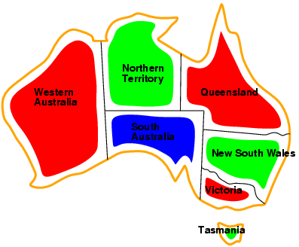
A running example: coloring Australia
NT
Q
WA
SA
NSW
V
T
Solutions: complete & consistent assignments
Here is one of several solutions
For generality, constraints can be expressed as relations, e.g., describe WA ≠ NT a
{(red,green), (red,blue), (green,red), (green,blue), (blue,red),(blue,green)}

Slide 22

Backtracking example

Slide 23
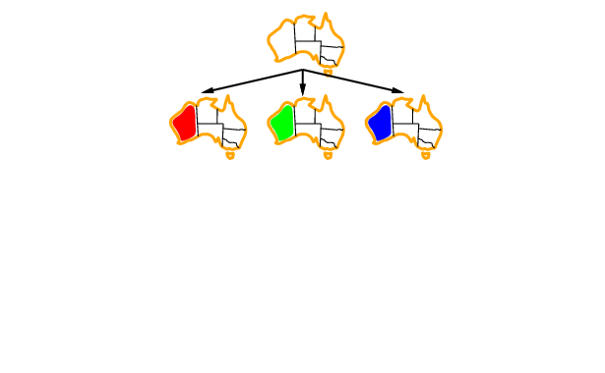
Backtracking example

Slide 24
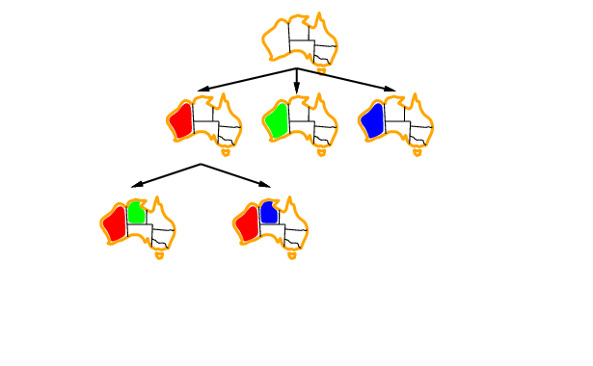
Backtracking example

Slide 25
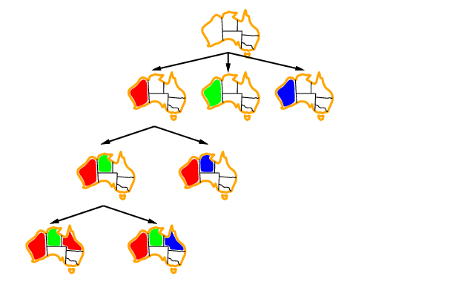
Backtracking example

Slide 26
Basic Backtracking Algorithm
CSP-BACKTRACKING(PartialAssignment a)
  If a is complete then return a
  X ← select an unassigned variable
  D ← select an ordering for the domain of X
  For each value v in D do
    If v is consistent with a then
      Add (X= v) to a
      result ← CSP-BACKTRACKING(a)
      If result ≠ failure then return result
      Remove (X= v) from a
  Return failure
Start with CSP-BACKTRACKING({})
Note: this is depth first search; can solve n-queens problems for n ~ 25

Slide 27
Problems with backtracking
Thrashing: keep repeating the same failed variable assignments
Things that can help avoid this:
  Consistency checking
  Intelligent backtracking schemes
Inefficiency: can explore areas of the search space that aren’t likely to succeed
  Variable ordering can help

Slide 28
Improving backtracking efficiency
Here are some standard techniques to improve the efficiency of backtracking
  Can we detect inevitable failure early?
  Which variable should be assigned next?
  In what order should its values be tried?

Slide 29
Forward Checking
After variable X is assigned to value v, examine each unassigned variable Y connected to X by a constraint and delete values from Y’s domain inconsistent with v
Using forward checking and backward checking roughly doubles the size of N-queens problems that can be practically solved

Slide 30
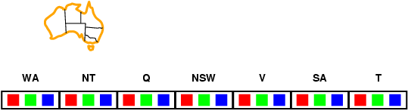
Forward checking
Keep track of remaining legal values for unassigned variables
Terminate search when any variable has no legal values

Slide 31
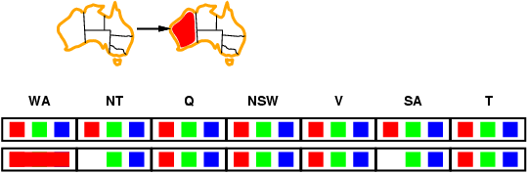
Forward checking

Slide 32
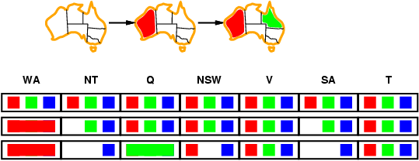
Forward checking

Slide 33
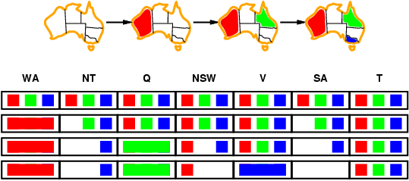
Forward checking
SA (South Australia)
domain is empty!

Slide 34
Constraint propagation
Forward checking propagates info.
from assigned to unassigned variables, but doesn't provide early detection for all failures
NT and SA cannot both be blue!
Can we detect
problem earlier?

Slide 35
Definition: Arc consistency
A constraint C_xy is arc consistent w.r.t. x if for each value v of x there is an allowed value of y
Similarly define C_xy as arc consistent w.r.t. y
Binary CSP is arc consistent iff every constraint C_xy is arc consistent w.r.t. x as well as y
When a CSP is not arc consistent, we can make it arc consistent by using the AC3 algorithm
  Also called “enforcing arc consistency”

Slide 36
Arc Consistency Example 1
Domains
  D_x = {1, 2, 3}
  D_y = {3, 4, 5, 6}
Constraint
  Note: for finite domains, we can represent a constraint as an set of legal value pairs
  C_xy = {(1,3), (1,5), (3,3), (3,6)}
C_xy isn’t arc consistent w.r.t. x or y. By enforcing arc consistency, we get reduced domains
  D'_x = {1, 3}
  D'_y={3, 5, 6}
x
y
C_xy

Slide 37
Arc Consistency Example 2
Domains
  D_x = {1, 2, 3}
  D_y = {1, 2, 3}
Constraint
  C_xy = lambda v1,v2: v1 < v2
C_xy is not arc consistent w.r.t. x or y. By enforcing arc consistency, we get reduced domains:
  D'_x = {1, 2}
  D'_y={2, 3}
x
y
C_xy

Slide 38
Aside: Python lambda expressions
Previous slide expressed constraint between two variables as an anonymous Python function taking two arguments
    lambda v1,v2: v1 < v2
>>> f = lambda v1,v2: v1 < v2
>>> f
<function <lambda> at 0x10fcf21e0>
>>> f(100,200)
True
>>> f(200,100)
False
Python uses lambda after Alonzo Church’s lambda calculus from the 1930s

Slide 39
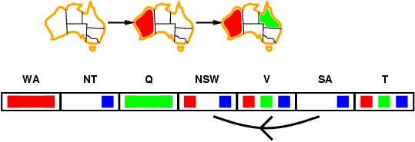
Arc consistency
Simplest form of propagation makes each arc consistent
X →Y is consistent iff for every value x_{i} of X there is some allowed value y_{j} in Y

Slide 40
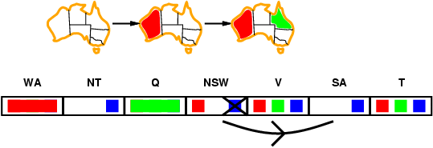
Arc consistency
Simplest form of propagation makes each arc consistent
X →Y is consistent iff for every value x_{i} of X there is some allowed value y_{j} in Y

Slide 41
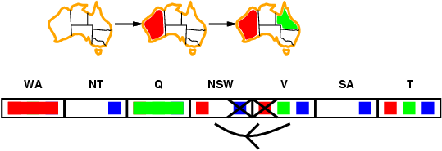
Arc consistency
If X loses a value, neighbors of X need to be rechecked

Slide 42
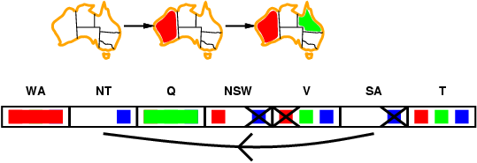
Arc consistency
Arc consistency detects failure earlier than
simple forward checking
WA=red and Q=green is quickly recognized as a deadend, i.e. an impossible partial instantiation
The arc consistency algorithm can be run as a preprocessor or after each assignment

Slide 43
General CP for Binary Constraints
Algorithm AC3
contradiction ← false
Q ← stack of all variables
while Q is not empty and not contradiction do
  X ← UNSTACK(Q)
  For every variable Y adjacent to X do
    If REMOVE-ARC-INCONSISTENCIES(X,Y)
      If domain(Y) is non-empty then STACK(Y,Q)
      else return false

Slide 44
Complexity of AC3
e = number of constraints (edges)
d = number of values per variable
Each variable is inserted in queue up to d times
REMOVE-ARC-INCONSISTENCY takes O(d²) time
CP takes O(ed³) time

Slide 45
Improving backtracking efficiency
Some standard techniques to improve the efficiency of backtracking
  Can we detect inevitable failure early?
  Which variable should be assigned next?
  In what order should its values be tried?
Combining constraint propagation with these heuristics makes 1000-queen puzzles feasible

Slide 46

Most constrained variable
Most constrained variable:
  choose the variable with the fewest legal values
a.k.a. minimum remaining values (MRV) heuristic
After assigning value to WA, both NT and SA have only two values in their domains
  – choose one of them rather than Q, NSW, V or T

Slide 47

Most constraining variable
Tie-breaker among most constrained variables
Choose variable involved in largest # of constraints on remaining variables
After assigning SA to be blue, WA, NT, Q, NSW and V all have just two values left.
WA and V have only one constraint on remaining variables and T none, so choose one of NT, Q & NSW

Slide 48
Most constraining variable
NT
Q
WA
SA
NSW
V
T
Tie-breaker among most constrained variables
Choose variable involved in largest # of constraints on remaining variables
After assigning SA to be blue, WA, NT, Q, NSW and V all have just two values left.
WA and V have only one constraint on remaining variables and T none, so choose one of NT, Q & NSW

Slide 49
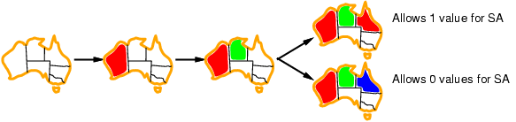
Least constraining value
Given a variable, choose least constraining value:
  the one that rules out the fewest values in the remaining variables
Combining these heuristics makes 1000 queens feasible
What’s an intuitive explanation for this?

Slide 50
Is AC3 Alone Sufficient?
Consider the four queens problem
X1
{1,2,3,4}
X2
{1,2,3,4}
1
2
3
4
1
2
3
4
X3
{1,2,3,4}
X4
{1,2,3,4}

Slide 51
Solving a CSP still requires search
Search:
  can find good solutions, but must examine non-solutions along the way
Constraint Propagation:
  can rule out non-solutions, but this is not the same as finding solutions
Interweave constraint propagation & search:
  perform constraint propagation at each search step

Slide 52
1
2
3
4
1
2
3
4
1
2
3
4
1
2
3
4
1
2
3
4
1
1
1
2
2
2
3
3
3
4
4
4

Slide 53
4-Queens Problem
X1
{1,2,3,4}
X2
{1,2,3,4}
1
2
3
4
1
2
3
4
X3
{1,2,3,4}
X4
{1,2,3,4}

Slide 54
4-Queens Problem
X1
{1,2,3,4}
X2
{1,2,3,4}
1
2
3
4
1
2
3
4
X3
{1,2,3,4}
X4
{1,2,3,4}

Slide 55
4-Queens Problem
X1
{1,2,3,4}
X2
{1,2,3,4}
1
2
3
4
1
2
3
4
X3
{1,2,3,4}
X4
{1,2,3,4}
X2=3 eliminates { X3=2, X3=3, X3=4 }
⇒ inconsistent!

Slide 56
4-Queens Problem
X1
{1,2,3,4}
X2
{1,2,3,4}
1
2
3
4
1
2
3
4
X3
{1,2,3,4}
X4
{1,2,3,4}
X2=4 ⇒ X3=2, which eliminates { X4=2, X4=3}
⇒ inconsistent!

Slide 57
4-Queens Problem
X1
{1,2,3,4}
X2
{1,2,3,4}
1
2
3
4
1
2
3
4
X3
{1,2,3,4}
X4
{1,2,3,4}
X1 can’t be 1, let’s try 2

Slide 58
4-Queens Problem
X1
{1,2,3,4}
X2
{1,2,3,4}
1
2
3
4
1
2
3
4
X3
{1,2,3,4}
X4
{1,2,3,4}
Can we eliminate any other values?

Slide 59
4-Queens Problem
X1
{1,2,3,4}
X2
{1,2,3,4}
1
2
3
4
1
2
3
X
4
X3
{1,2,3,4}
X4
{1,2,3,4}

Slide 60
4-Queens Problem
X1
{1,2,3,4}
X2
{1,2,3,4}
1
2
3
4
1
2
3
X
4
X3
{1,2,3,4}
X4
{1,2,3,4}
Arc constancy eliminates x3=3 because it’s not
consistent with X2’s remaining values

Slide 61
4-Queens Problem
X1
{1,2,3,4}
X2
{1,2,3,4}
1
2
3
4
1
2
3
4
X3
{1,2,3,4}
X4
{1,2,3,4}
There is only one solution with X1=2

Slide 62
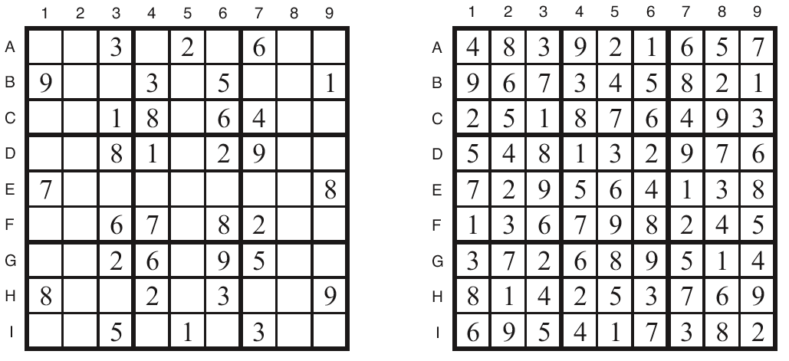
Sudoku Example
initial problem
a solution
How can we set this up as a CSP?

Slide 63
Sudoku
Digit placement puzzle on 9x9 grid with unique answer
Given an initial partially filled grid, fill remaining squares with a digit between 1 and 9
Each column, row, and nine 3×3 sub-grids must contain all nine digits
Some initial configurations are easy to solve and some very difficult

Slide 64
def sudoku(initValue):
p = Problem()
# Define a variable for each cell: 11,12,13...21,22,23...98,99
for i in range(1, 10) :
p.addVariables(range(i*10+1, i*10+10), range(1, 10))
# Each row has different values
for i in range(1, 10) :
p.addConstraint(AllDifferentConstraint(), range(i*10+1, i*10+10))
# Each column has different values
for i in range(1, 10) :
p.addConstraint(AllDifferentConstraint(), range(10+i, 100+i, 10))
# Each 3x3 box has different values
p.addConstraint(AllDifferentConstraint(), [11,12,13,21,22,23,31,32,33])
p.addConstraint(AllDifferentConstraint(), [41,42,43,51,52,53,61,62,63])
p.addConstraint(AllDifferentConstraint(), [71,72,73,81,82,83,91,92,93])
p.addConstraint(AllDifferentConstraint(), [14,15,16,24,25,26,34,35,36])
p.addConstraint(AllDifferentConstraint(), [44,45,46,54,55,56,64,65,66])
p.addConstraint(AllDifferentConstraint(), [74,75,76,84,85,86,94,95,96])
p.addConstraint(AllDifferentConstraint(), [17,18,19,27,28,29,37,38,39])
p.addConstraint(AllDifferentConstraint(), [47,48,49,57,58,59,67,68,69])
p.addConstraint(AllDifferentConstraint(), [77,78,79,87,88,89,97,98,99])
# add unary constraints for cells with initial non-zero values
for i in range(1, 10) :
for j in range(1, 10):
value = initValue[i-1][j-1]
if value:
p.addConstraint(lambda var, val=value: var == val, (i*10+j,))
return p.getSolution()
# Sample problems
easy = [
[0,9,0,7,0,0,8,6,0],
[0,3,1,0,0,5,0,2,0],
[8,0,6,0,0,0,0,0,0],
[0,0,7,0,5,0,0,0,6],
[0,0,0,3,0,7,0,0,0],
[5,0,0,0,1,0,7,0,0],
[0,0,0,0,0,0,1,0,9],
[0,2,0,6,0,0,0,5,0],
[0,5,4,0,0,8,0,7,0]]
hard = [
[0,0,3,0,0,0,4,0,0],
[0,0,0,0,7,0,0,0,0],
[5,0,0,4,0,6,0,0,2],
[0,0,4,0,0,0,8,0,0],
[0,9,0,0,3,0,0,2,0],
[0,0,7,0,0,0,5,0,0],
[6,0,0,5,0,2,0,0,1],
[0,0,0,0,9,0,0,0,0],
[0,0,9,0,0,0,3,0,0]]
very_hard = [
[0,0,0,0,0,0,0,0,0],
[0,0,9,0,6,0,3,0,0],
[0,7,0,3,0,4,0,9,0],
[0,0,7,2,0,8,6,0,0],
[0,4,0,0,0,0,0,7,0],
[0,0,2,1,0,6,5,0,0],
[0,1,0,9,0,5,0,4,0],
[0,0,8,0,2,0,7,0,0],
[0,0,0,0,0,0,0,0,0]]

Slide 65
Local search for constraint problems
Remember local search?
There’s a version of local search for CSP problems
Basic idea:
  generate a random “solution”
  Use metric of “number of conflicts”
  Modifying solution by reassigning one variable at a time to decrease metric until solution found or no modification improves it
Has all features and problems of local search
  like….?

Slide 66
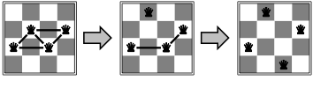
Min Conflict Example
States: 4 Queens, 1 per column
Operators: Move a queen in its column
Goal test: No attacks
Evaluation metric: Total number of attacks
How many conflicts does each state have?

Slide 67
Basic Local Search Algorithm
Assign one domain value d_{i} to each variable v_{i}
while no solution & not stuck & not timed out:
bestCost ← ∞; bestList ← [ ];
for each variable v_{i} | Cost(Value(v_{i})) > 0
for each domain value d_{i} of v_{i}
if Cost(d_{i}) < bestCost
bestCost ← Cost(d_{i}); bestList ← [d_{i}];
else if Cost(d_{i}) = bestCost
bestList ← bestList ∪ d_{i}
Take a randomly selected move from bestList

Slide 68
Eight Queens using Backtracking
Backtrack and
undo last move
for Queen 4
Try Queen 1
Try next value
for Queen 5
Still Stuck
Undo move
for Queen 5
no move left
Try next value
for Queen 4
Undo move
for Queen 7
and so on...
Try Queen 2
Try Queen 3
Try Queen 4
Try Queen 5
Stuck!
Undo move
for Queen 5
Try Queen 5
Try Queen 6
Try Queen 7
Stuck Again

Slide 69
Eight Queens using Local Search
Take least cost
move then try
another Queen
Place 8 Queens
randomly on
the board
3
2
2
1
1
1
3
2
0
3
1
1
2
2
3
4
3
1
2
2
2
2
2
1
3
1
Answer Found
2
Pick a Queen:
Calculate cost
of each move
2
3
1
1
2
1
3
2
3
3
1
4
1
5
1
0
1
1
4
1
3
1
1
4
1
3
0
1
4
1
4
1
4
1
1
2
3
3
2
3
1
1
3
1
4
3
2
1
3
1
3
4
2
2
1
2
3
3
2
3
0
2
2
2
2
2
3
2
2
3
2
2
2
1
4
3
1
3
1
2
2
1
2
3
3
1
2
1

Slide 70
Backtracking Performance
5000
4000
3000
Time in seconds
2000
1000
0
0
4
8
12
16
20
24
28
32
Number of Queens

Slide 71
Local Search Performance
2500
2000
1500
Time in seconds
1000
500
0
0
5000
10000
15000
20000
Number of Queens

Slide 72
Min Conflict Performance
Performance depends on quality and informativeness of initial assignment; inversely related to distance to solution
Min Conflict often has astounding performance
Can solve arbitrary size (i.e., millions) N-Queens problems in constant time
Appears to hold for arbitrary CSPs with the caveat…

Slide 73
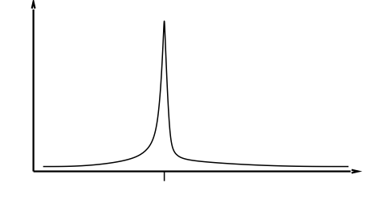
Min Conflict Performance
Except in a certain critical range of the ratio constraints to variables.

Slide 74
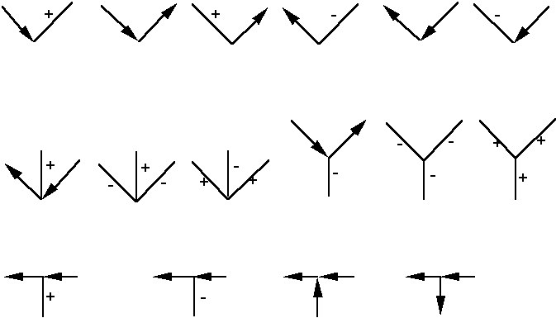
Famous example: labeling line drawings
Waltz labeling algorithm, earliest AI CSP application (1972)
  Convex interior lines labeled as +
  Concave interior lines labeled as –
  Boundary lines labeled as with background to left
208 labeling possible labelings, but only 18 are legal

Slide 75
Labeling line drawings II
Here are some illegal labelings
-
-
+
+
-

Slide 76
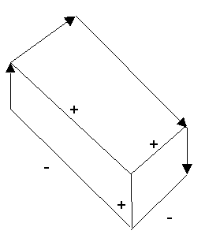

Labeling line drawings
Waltz labeling algorithm: propagate constraints repeatedly until a solution is found
solution for one labeling problem
labeling problem with no solution

Slide 77
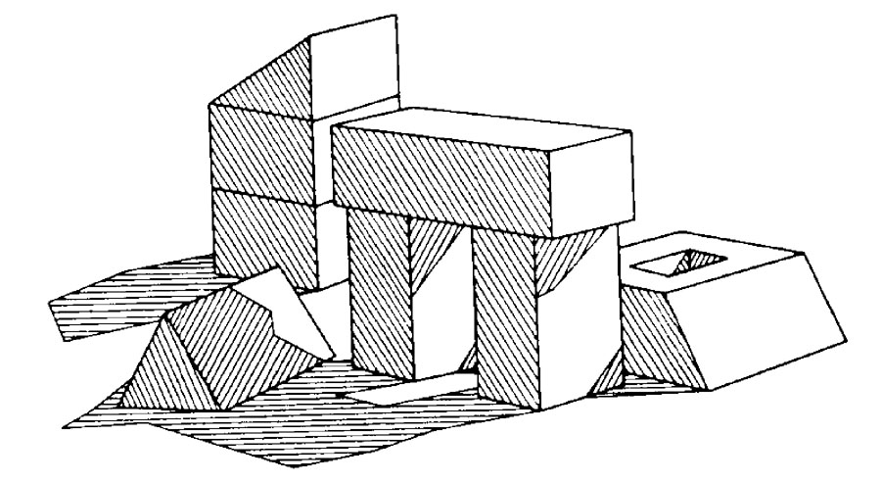
Shadows add complexity
CSP was able to label scenes where some
of the lines were caused by shadows

Slide 78
K-consistency
K-consistency generalizes arc consistency to sets of more than two variables.
  A graph is K-consistent if, for legal values of any K-1 variables in the graph, and for any Kth variable V_{k}, there is a legal value for V_{k}
Strong K-consistency = J-consistency for all J<=K
Node consistency = strong 1-consistency
Arc consistency = strong 2-consistency
Path consistency = strong 3-consistency

Slide 79
Why do we care?
If we have a CSP with N variables that is known to be strongly N-consistent, we can solve it without backtracking
For any CSP that is strongly K-consistent, if we find an appropriate variable ordering (one with “small enough” branching factor), we can solve the CSP without backtracking

Slide 80
Intelligent backtracking
Backjumping: if V_{j} fails, jump back to the variable V_{i} with greatest i such that the constraint (V_{i}, V_{j}) fails (i.e., most recently instantiated variable in conflict with V_{i})
Backchecking: keep track of incompatible value assignments computed during backjumping
Backmarking: keep track of which variables led to the incompatible variable assignments for improved backchecking

Slide 81
Challenges for constraint reasoning
What if not all constraints can be satisfied?
  Hard vs. soft constraints vs. preferences
  Degree of constraint satisfaction
  Cost of violating constraints
What if constraints are of different forms?
  Symbolic constraints
  Logical constraints
  Numerical constraints [constraint solving]
  Temporal constraints
  Mixed constraints

Slide 82
Challenges for constraint reasoning
What if constraints are represented intentionally?
  Cost of evaluating constraints (time, memory, resources)
What if constraints, variables, and/or values change over time?
  Dynamic constraint networks
  Temporal constraint networks
  Constraint repair
What if multiple agents or systems are involved in constraint satisfaction?
  Distributed CSPs
  Localization techniques

