Slide 1

Informed
Search
Chapter 4 (a)
Some material adopted from notes by Charles R. Dyer, University of Wisconsin-Madison

Slide 2
Today’s class
Heuristic search
Best-first search
  Greedy search
  Beam search
  Algorithms A and A*
  Examples
Memory-conserving variations of A*
Heuristic functions

Slide 3
Big idea: heuristic
Merriam-Webster's Online Dictionary
  Heuristic (pron. \hyu-’ris-tik\): adj. [from Greek heuriskein to discover] involving or serving as an aid to learning, discovery, or problem-solving by experimental and especially trial-and-error methods
The Free On-line Dictionary of Computing (15Feb98)
  heuristic 1. <programming> A rule of thumb, simplification or educated guess that reduces or limits the search for solutions in domains that are difficult and poorly understood. Unlike algorithms, heuristics do not guarantee feasible solutions and are often used with no theoretical guarantee. 2. <algorithm> approximation algorithm.
From WordNet (r) 1.6
  heuristic adj 1: (CS) relating to or using a heuristic rule 2: of or relating to a general formulation that serves to guide investigation [ant: algorithmic] n : a commonsense rule (or set of rules) intended to increase the probability of solving some problem [syn: heuristic rule, heuristic program]

Slide 4
Informed methods add domain-specific information
Add domain-specific information to select best path along which to continue searching
Define heuristic function, h(n), that estimates goodness of node n
h(n) = estimated cost (or distance) of minimal cost path from n to a goal state.
Based on domain-specific information and computable from current state description that estimates how close we are to a goal

Slide 5
Heuristics
All domain knowledge used in search is encoded in the heuristic function, h(<node>)
Examples
  Missionaries & Cannibals: # people on starting river bank
  8-puzzle: number of tiles out of place
  8-puzzle: sum of distances each tile is from its goal
In general
  h(n) >= 0 for all nodes n
  h(n) = 0 implies that n is a goal node
  h(n) = ∞ implies n is a dead-end that can’t lead to a goal

Slide 6
Weak vs. strong methods
Weak methods are extremely general methods not tailored to a specific situation or domain
Examples include
  Generate and test: generate solution candidates and test until you find one
  Means-ends analysis: represent current situation & goal, then seek ways to shrink differences between them
  Space splitting: list possible solutions to a problem, then try to rule out classes of the possibilities
  Subgoaling: split large problem into smaller ones that can be solved one at a time
Called weak because they don’t use more powerful, domain-specific heuristics

Slide 7
Heuristics for 8-puzzle
1
2
3
Current State
4
5
6
7
8
1
2
3
The number of misplaced tiles (not including the blank)
1
2
3
4
5
6
4
5
6
1
2
3
7
8
Goal State
7
8
4
5
6
7
8
N
N
N
In this case, only “8” is misplaced, so heuristic function evaluates to 1
In other words, the heuristic says that it thinks a solution may be available in just 1 more move
N
N
N
N
Y

Slide 8
Heuristics for 8-puzzle
3
2
8
3
3
Manhattan Distance (not including the blank)
Current State
2 spaces
4
5
6
7
1
8
1
2
3
Goal State
3 spaces
4
5
6
8
7
8
The 3, 8 and 1 tiles are misplaced (by 2, 3, and 3 steps) so the heuristic function evaluates to 8
Heuristic says that it thinks a solution may be available in just 8 more moves.
The misplaced heuristic’s value is 3
1
3 spaces
1
Total 8

Slide 9
h(n)
1
2
3
5
4
8
7
6
5
We can use heuristics to guide search
In this hill climbing example, the Manhattan Distance heuristic helps us quickly find a solution to the 8-puzzle
1
2
1
2
3
4
8
3
6
4
8
5
4
7
6
5
7
6
1
2
3
3
4
8
5
7
6
1
2
3
1
2
3
4
8
5
4
4
5
2
7
6
7
8
6
1
2
3
1
1
2
3
3
1
3
4
5
4
5
4
2
5
3
7
8
6
7
8
6
7
8
6
goal
1
2
3
0
1
2
4
5
6
4
5
3
2
7
8
7
8
6

Slide 10
1
2
3
h(n)
In this example, hill climbing doesn’t work!
All nodes on fringe are taking a step “backwards”
(local minima)
This puzzle is solvable in just 12 more steps
4
5
8
6
6
7
1
2
3
1
2
3
4
5
8
7
4
5
5
6
7
6
7
8
1
2
3
1
2
4
5
6
4
5
3
6
6
7
8
6
7
8

Slide 11
Best-first search
Search algorithm that optimizes depth-first search by expanding most promising node chosen according to heuristic rule
Order nodes on nodes list by increasing value of an evaluation function, f(n), incorporating domain-specific information
This is a generic way of referring to the class of informed methods

Slide 12
Greedy best first search search
A greedy algorithm makes locally optimal choices in hope of finding a global optimum
Uses evaluation function f(n) = h(n), sorting nodes by increasing values of f
Selects node to expand appearing closest to goal (i.e., node with smallest f value)
Not complete
Not admissible, as in example
  Assume arc costs = 1, greedy search finds goal g, with solution cost of 5
  Optimal solution is path to goal with cost 3
a
h=2
b
h
h=4
c
i
h=1
h=1
d
h=0
h=1
g2
e
h=1
g
h=0

Slide 13
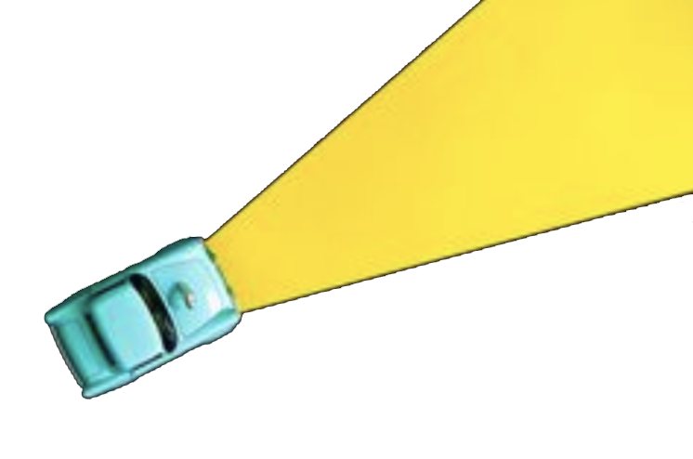
Beam search
Use evaluation function f(n), but maximum size of the nodes list is k, a fixed constant
Only keep k best nodes as candidates for expansion, discard rest
k is the beam width
More space efficient than greedy search, but may discard nodes on a solution path
As k increases, approaches best first search
Not complete
Not admissible (optimal)

Slide 14
Algorithm A
Use as an evaluation function
    f(n) = g(n) + h(n)
g(n) = minimal-cost path from the start state to state n
g(n) term adds “breadth-first” component to evaluation function
Ranks nodes on search frontier by estimated cost of solution from start node via given node to goal
Not complete if h(n) can = ∞
Not admissible (optimal)
S
0
5
8
1
1
8
A
5
B
C
9
7
3
5
4
1
E
D
G
8
9
g(d)=4
h(d)=9
C is chosen next to expand

Slide 15
Algorithm A
1 Put the start node S on the nodes list, called OPEN
2 If OPEN is empty, exit with failure
3 Select node in OPEN with minimal f(n) and place on CLOSED
4 If n is a goal node, collect path back to start and stop
5 Expand n, generating all its successors and attach to them pointers back to n. For each successor n' of n
  1 If n’ not already on OPEN or CLOSED
    put n' on OPEN
    compute h(n'), g(n')=g(n)+ c(n,n'), f(n')=g(n')+h(n')
  2 If n’ already on OPEN or CLOSED and if g(n') is lower for new version of n', then:
    Redirect pointers backward from n’ on path with lower g(n’)
    Put n' on OPEN

Slide 16
Algorithm A*
Pronounced “a star”
Algorithm A with constraint that h(n) <= h*(n)
h*(n) = true cost of minimal cost path from n to a goal
h is admissible when h(n) <= h*(n) holds
Using an admissible heuristic guarantees that 1st solution found will be an optimal one
A* is complete whenever branching factor is finite and every action has fixed, positive cost
A* is admissible
Hart, P. E.; Nilsson, N. J.; Raphael, B. (1968). "A Formal Basis for the Heuristic Determination of Minimum Cost Paths". IEEE Transactions on Systems Science and Cybernetics SSC4 4 (2): 100–107.

Slide 17
Observations on A
Perfect heuristic: If h(n) = h*(n) for all n, then only nodes on an optimal solution path are expanded; no extra work is performed
Null heuristic: If h(n) = 0 for all n, then it is an admissible heuristic and A* acts like uniform-cost search
Better heuristic: If h1(n) < h2(n) <= h*(n) for all non-goal nodes, then h2 is a better heuristic than h1
  If A1* uses h1, and A2* uses h2, then every node expanded by A2* is also expanded by A1*
  i.e., A1 expands at least as many nodes as A2*
  We say that A2* is better informed than A1*
The closer h to h*, the fewer extra nodes expanded

Slide 18
Example search space
0
S
8
1
8
5
1
A
5
B
4
8
C
3
8
3
9
7
4
5
4
D
∞
8
E
∞
9
G
0

Slide 19
Example search space
start state
parent pointer
(current)
0
S
8
arc cost
1
8
5
1
A
5
B
4
8
C
3
8
3
9
7
4
h value
5
g value (current)
4
D
∞
8
E
∞
9
G
0
goal state

Slide 20
Example
0
S
8
1
5
8
1
A
8
5
B
4
8
C
3
3
    n g(n) h(n) f(n) h*(n)
    S 0 8 8 9
    A 1 8 9 9
    B 5 4 9 4
    C 8 3 11 5
    D 4 inf inf inf
    E 8 inf inf inf
    G 9 0 9 0
h*(n) is (hypothetical) perfect heuristic (an oracle)
Since h(n) <= h*(n) for all n, h is admissible (optimal)
Optimal path = S B G with cost 9
7
9
4
5
4
D
∞
8
E
∞
9
G
0

Slide 21
Greedy search
0
S
8
1
5
8
1
A
8
5
B
4
8
C
3
3
9
7
4
5
4
D
8
E
∞
9
G
f(n) = h(n)
node expanded nodes list
{ S(8) }
S { C(3) B(4) A(8) }
C { G(0) B(4) A(8) }
G { B(4) A(8) }
Solution path found is S C G, 3 nodes expanded.
See how fast the search is!! But it is NOT optimal.
∞
0

Slide 22
A* search
0
S
8
1
5
8
1
A
8
5
B
4
8
C
3
3
9
7
4
5
f(n) = g(n) + h(n)
node exp. nodes list
{ S(8) }
S { A(9) B(9) C(11) }
A { B(9) G(10) C(11) D(inf) E(inf) }
B { G(9) G(10) C(11) D(inf) E(inf) }
G { C(11) D(inf) E(inf) }
Solution path found is S B G, 4 nodes expanded..
Still pretty fast. And optimal, too.
4
D
∞
8
E
∞
9
G
0

Slide 23
Proof of the optimality of A*
Assume that A* has selected G2, a goal state with a suboptimal solution, i.e., g(G2) > f*
Proof by contradiction shows it’s impossible
  Choose a node n on an optimal path to G
  Because h(n) is admissible, f* >= f(n)
  If we choose G2 instead of n for expansion, then
  f(n) >= f(G2)
  This implies f* >= f(G2)
  G2 is a goal state: h(G2) = 0, f(G2) = g(G2).
  Therefore f* >= g(G2)
  Contradiction

Slide 24
Dealing with hard problems
For large problems, A* may require too much space
Variations conserve memory: IDA* and SMA*
IDA*, iterative deepening A*, uses successive iteration with growing limits on f, e.g.
  A* but don’t consider a node n where f(n) >10
  A* but don’t consider a node n where f(n) >20
  A* but don’t consider a node n where f(n) >30, ...
SMA* -- Simplified Memory-Bounded A*
  Uses queue of restricted size to limit memory use

Slide 25
How to find good heuristics
If h1(n) < h2(n) <= h*(n) for all n, h2 is better than (dominates) h1
Relaxing problem: remove constraints for easier problem; use its solution cost as heuristic function
Max of two admissible heuristics is a Combining heuristics: admissible heuristic, and it’s better!
Use statistical estimates to compute h; may lose admissibility
Identify good features, then use machine learning to find heuristic function; also may lose admissibility

Slide 26
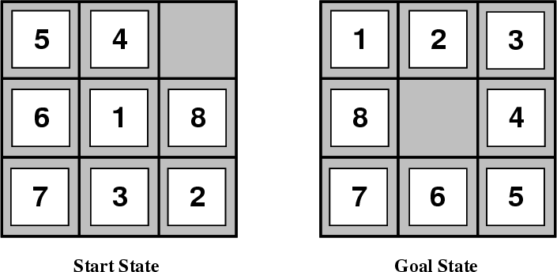
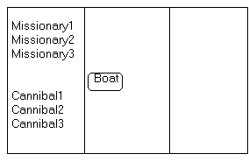
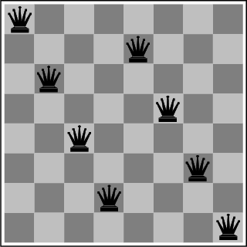
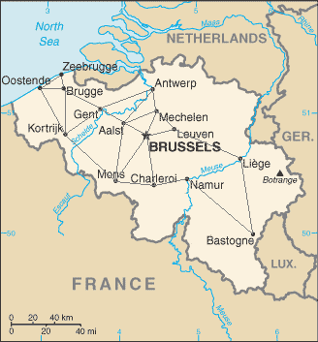
In-class Exercise: Creating Heuristics
Missionaries and Cannibals
Remove 5
Sticks
8-Puzzle
Water Jug Problem
Route Planning
N-Queens
5
2

Slide 27
Summary: Informed search
Best-first search is general search where minimum-cost nodes (w.r.t. some measure) are expanded first
Greedy search uses minimal estimated cost h(n) to goal state as measure; reduces search time, but is neither complete nor optimal
A* search combines uniform-cost search & greedy search: f(n) = g(n) + h(n). Handles state repetitions & h(n) never overestimates
  A* is complete & optimal, but space complexity high
  Time complexity depends on quality of heuristic function
  IDA* and SMA* reduce the memory requirements of A*

