Slide 1
CMSC 471
Introduction to
Artificial Intelligence section 1
Course Overview
Spring 2019

Slide 2
Today’s class
Course overview
Introduction
  Brief history of AI
  What is AI? (and why is it so interesting?)
  What’s the state of AI now?

Slide 3
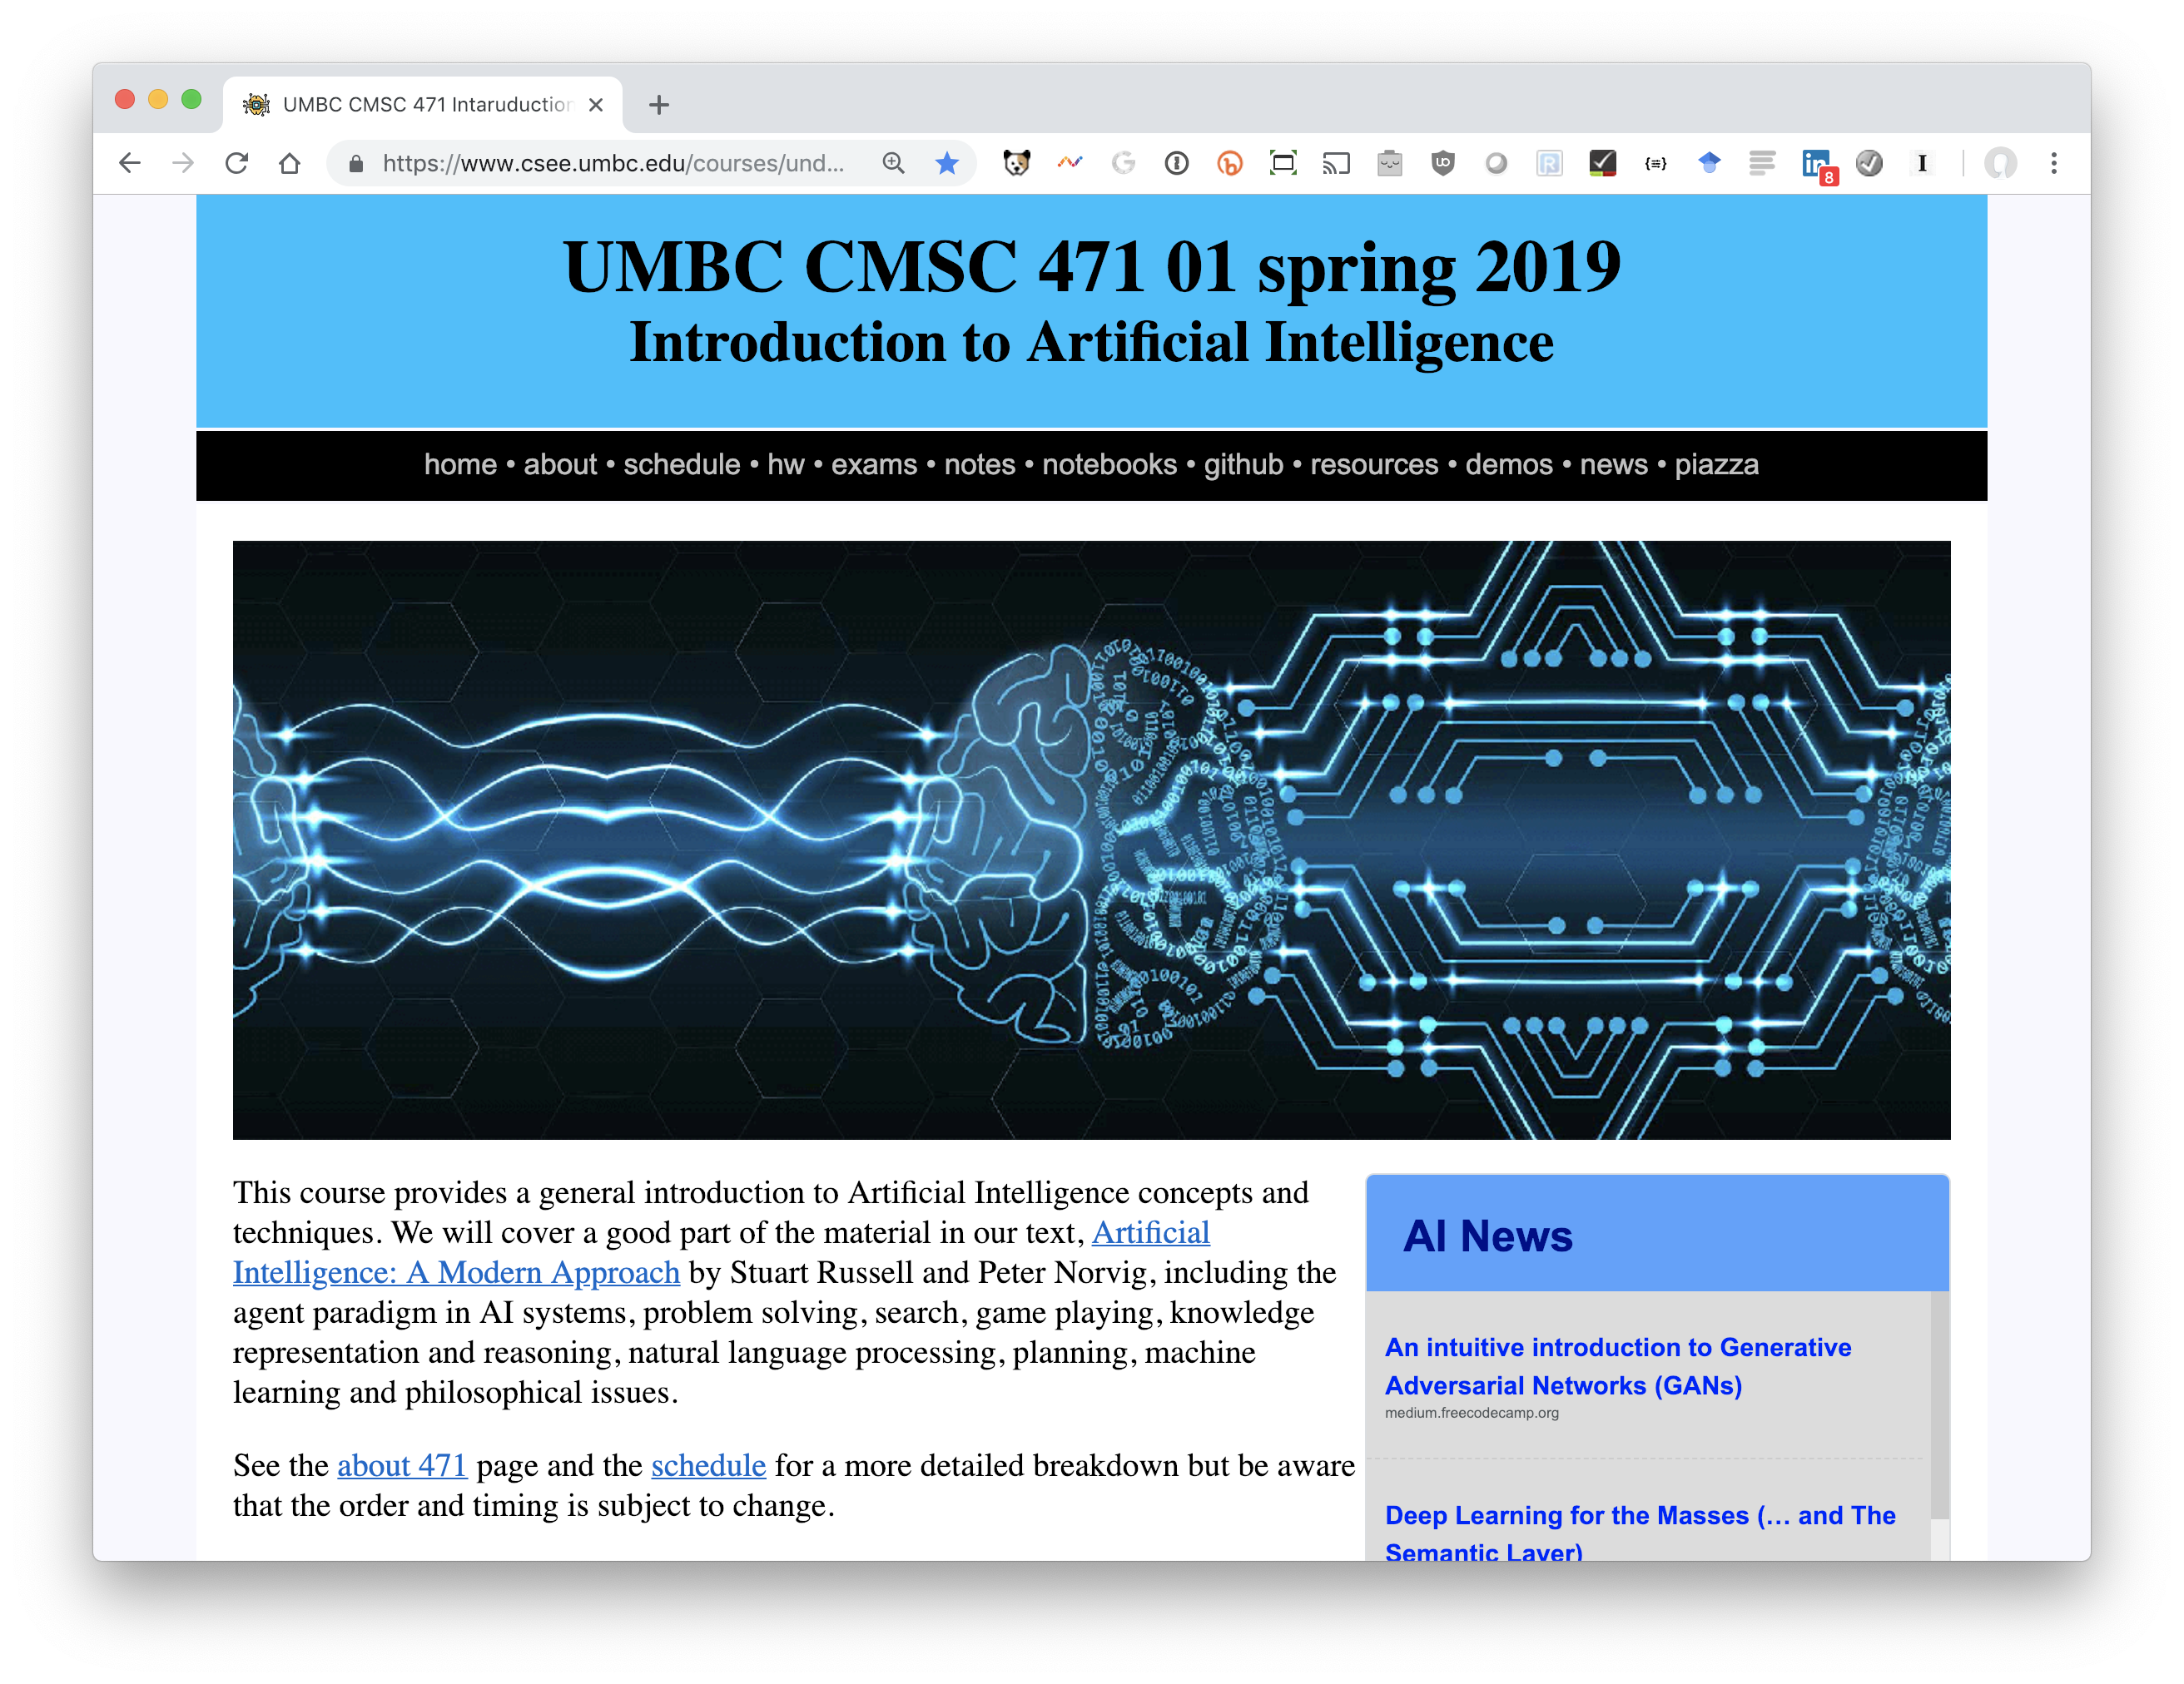
http://bit.ly/471s19

Slide 4
Homework and grading policies
Six to eight short homework assignments (mix of written and programming)
  One-time extensions of up to a week may be granted if requested in advance
  Last-minute requests for extensions probably will not be granted
Do the reading before each class!

Slide 5
Programming
Programming assignments in Python
  We’ll use Python in the notes and examples
We’ll use GitHub to share code, Jupyter notebooks and for HW submission
Some assignments may require using other systems
  E.g., C5 decision tree learning system, Weka Machine learning environments

Slide 6
Exams
Midterm exam
  In class in mid October
  About 15% of grade
Final exam
  At regularly scheduled time
  About 25% of grade
  Comprehensive, but with an emphasis on the last half of material (e.g., 30/70 split)

Slide 7
Instructor availability
Professor Finin, finin@umbc.edu
  Office hours: by arrangement
  Drop in whenever my door is open
  Direct general questions to Piazza first
  We will try to respond to discussion list postings within 24 hours
TA: TBD

