Slide 1
What’s better than a tree?

Slide 2
Random Forest
Can often improve performance of a decision tree classifier using a set of decision trees (a forest)
Each tree trained on a random subset of training data
Classify a data instance using all trees
Combine answers to make classification
E.g., vote for most common class

Slide 3
Bagging
Idea can be used on any classifier!
Bagging = Bootstrap aggregating
An ensemble meta-algorithm that can improve stability & accuracy of algorithms for statistical classification and regression
Helps avoid overfitting

Slide 4
Choosing subsets of training data
Classic bagging: select random set of training instances with replacement
Pasting: select random subset of training instances
Random Subspaces: use all training instances, but with a random subset of features
Random Patches: random subset of instances and random subset of features
What’s best? YMMV: depends on problem, training data, algorithm

Slide 7
Created a train and test collection
Train has ~95% of data, test 5%
Trained models for J48 and random forest using train dataset
Tested on test data set
Results were that random forest was (at best) about the same as J48

Slide 8
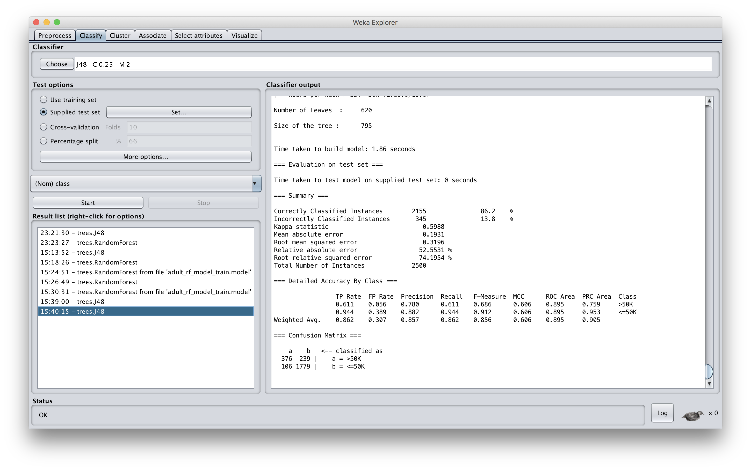

Slide 9
