Slide 1
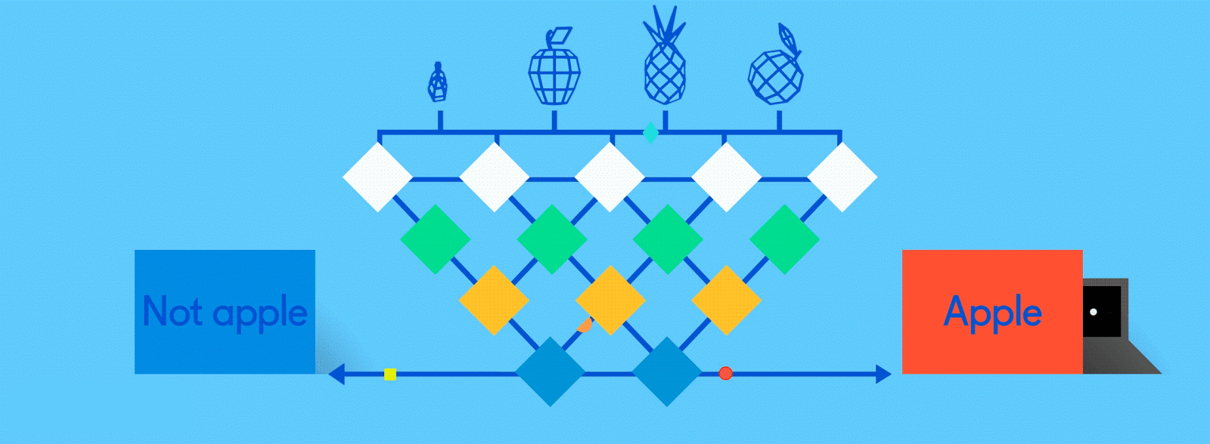
Neural Networks for Machine Learning

Slide 2
Biological neural activity
Neuron has body, axon and many dendrites
  In one of the two states: firing and rest
  Neuron fires if total incoming stimulus > threshold
Synapse: thin gap between axon of one neuron and dendrite of another
  Signal exchange

Slide 3
Artificial neural network
Notes:
Set of nodes
Node have inputs and outputs
Nodes performs computation via its activation function
Weighted connections between nodes
Connectivity gives structure/architecture of net
What can be computed by a NN determined by the connections and their weights
Simplified version of networks of neurons in animal nerve systems

Slide 4
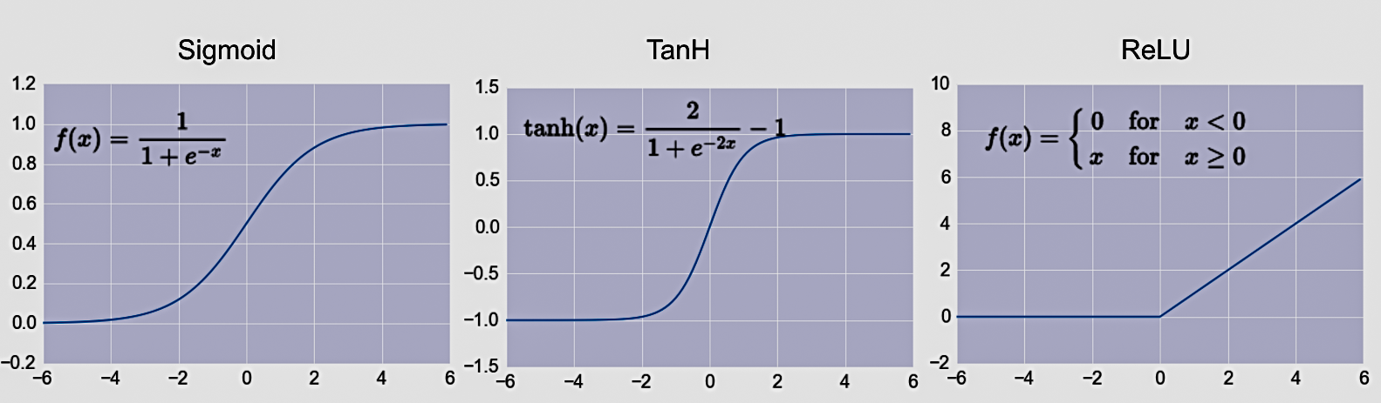
Common Activation Functions
Choice of activation function depends on problem and available computational power

Slide 5
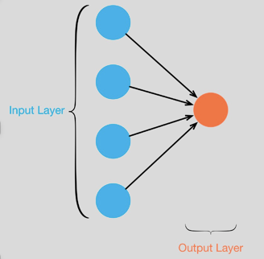
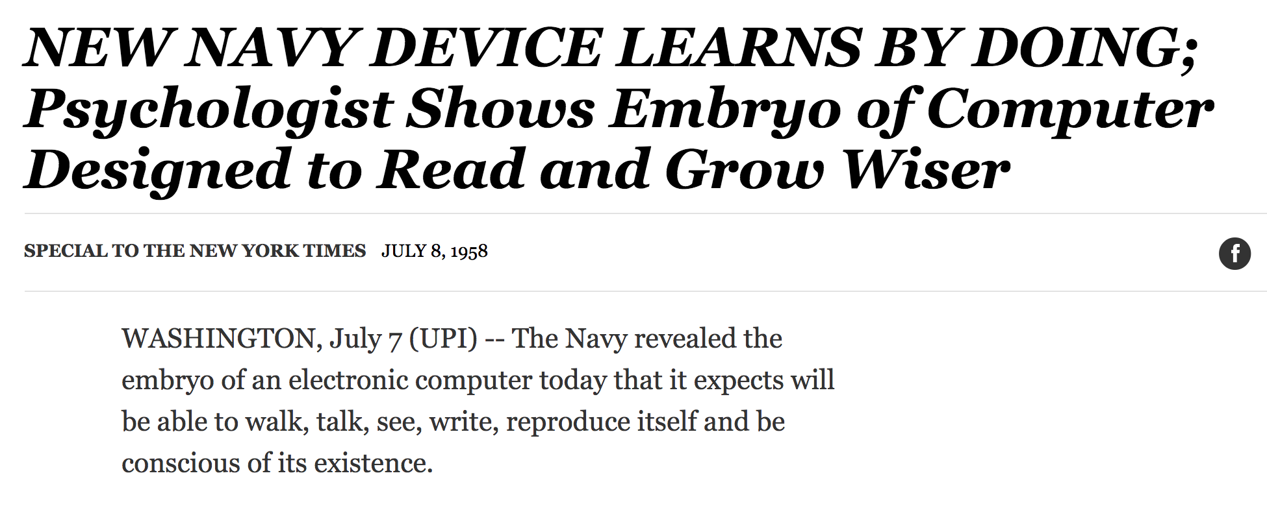
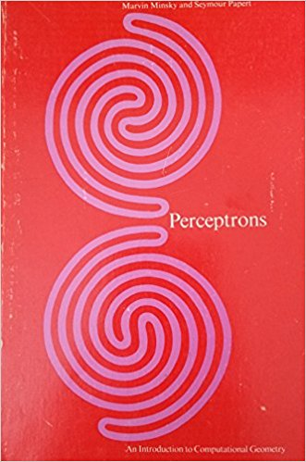
Single Layer Perceptron
Full 1958 NYT article above here
Rosenblatt showed how it can learn to compute functions by learning weights on inputs from examples
Not all functions ☹️, cf. Perceptrons

Slide 6
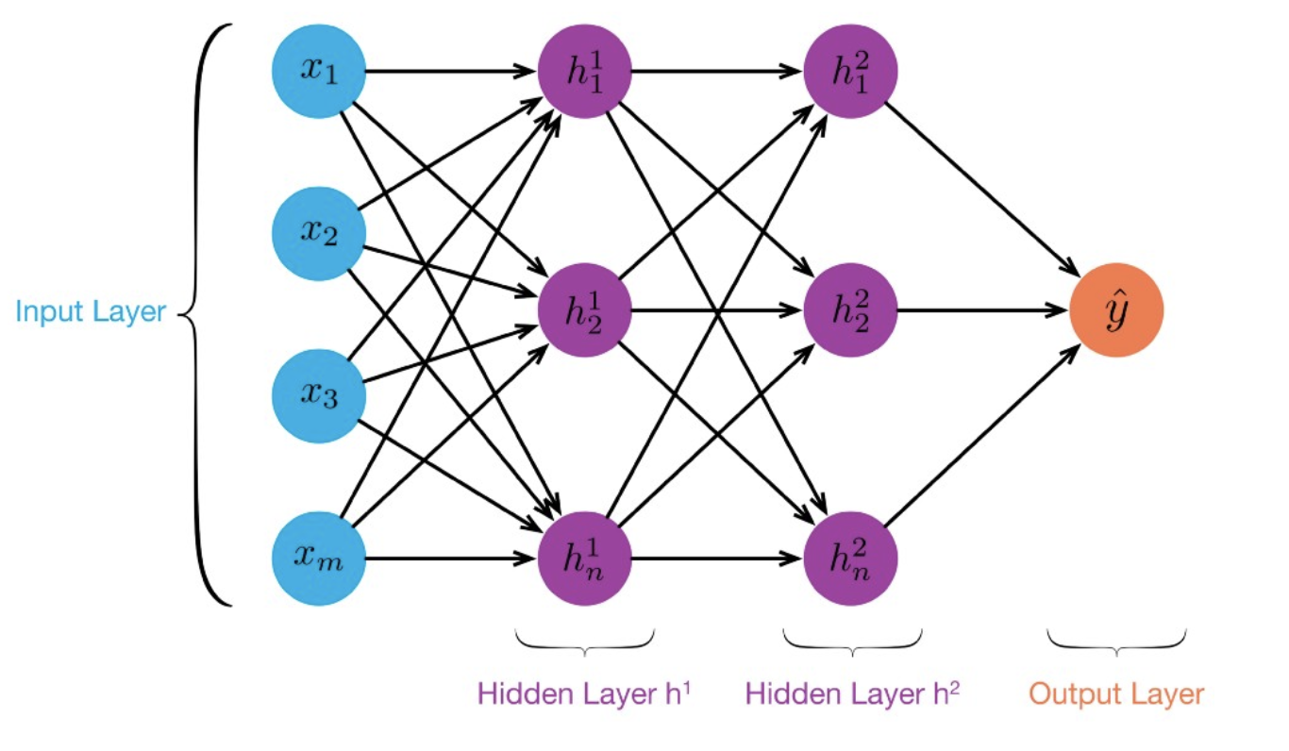
Multilayer perceptrons
Can compute non linear functions
Perceptron training rule: adjust weights slightly to reduce error between perceptron output y and target value t; repeat

Slide 7
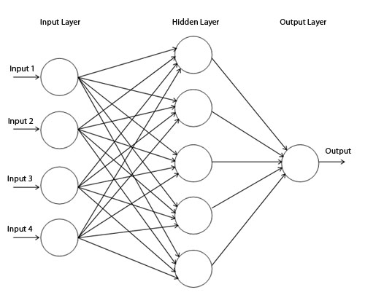
Backpropagation Algorithm
Forward direction
Calculate network and error
Rumelhart, David E.; Hinton, Geoffrey E.; Williams, Ronald J. (8 October 1986). Learning representations by back-propagating errors. Nature. 323 (6088): 533–536.

Slide 8
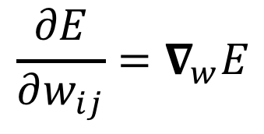
Backpropagation Algorithm
Backward direction
Backpropagate: from output to input, recursively compute and adjust weights
$$\frac{∂E}{∂w_{ij}}=∇_{w}E$$

Slide 9
Neural Network Architectures
Current focus on large networks with different “architectures” suited for different kinds of tasks
Feedforward Neural Network
CNN: Convolutional Neural Network
RNN: Recurrent Neural Network
LSTM: Long Short Term Memory
GAN: Generative Adversarial Network

Slide 10
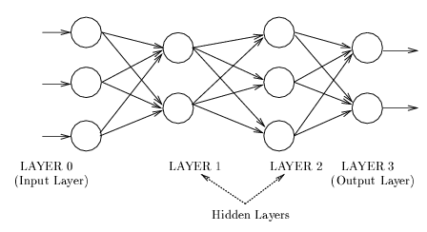
Feedforward net
Connections allowed from a node in layer i only to nodes in layer i+1
Simple, widely used architecture.
downstream nodes tend to successively abstract features from preceding layers
http://playground.tensorflow.org/

Slide 11
CNN: Convolutional Neural Network
Good for image processing: classification, object recognition, automobile lane tracking, etc.
Classic demo: learn to recognize hand-written digits from MNIST data with 70K examples

Slide 12
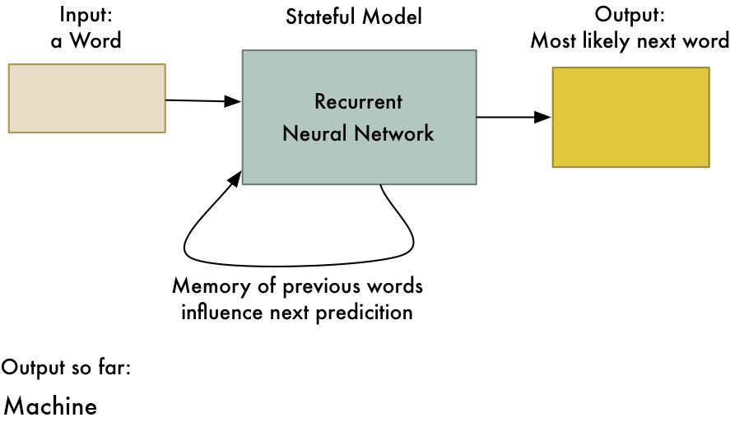
RNN: Recurrent Neural Networks
Good for learning over sequences of data, e.g., natural language understanding tasks
LSTM (Long Short Term Memory) a popular architecture
gif from Adam Geitgey

Slide 13

http://playground.tensorflow.org/

Slide 14
Deep Learning Frameworks
Popular open source deep learning frame-works use Python at top-level; C++ in backend
  TensorFlow (via Google)
  PyTorch (via Facebook)
Keras: popular API works with both and provides good support at architecture level
Demo: MNIST CNN
Demo: RNN sentiment

Slide 15
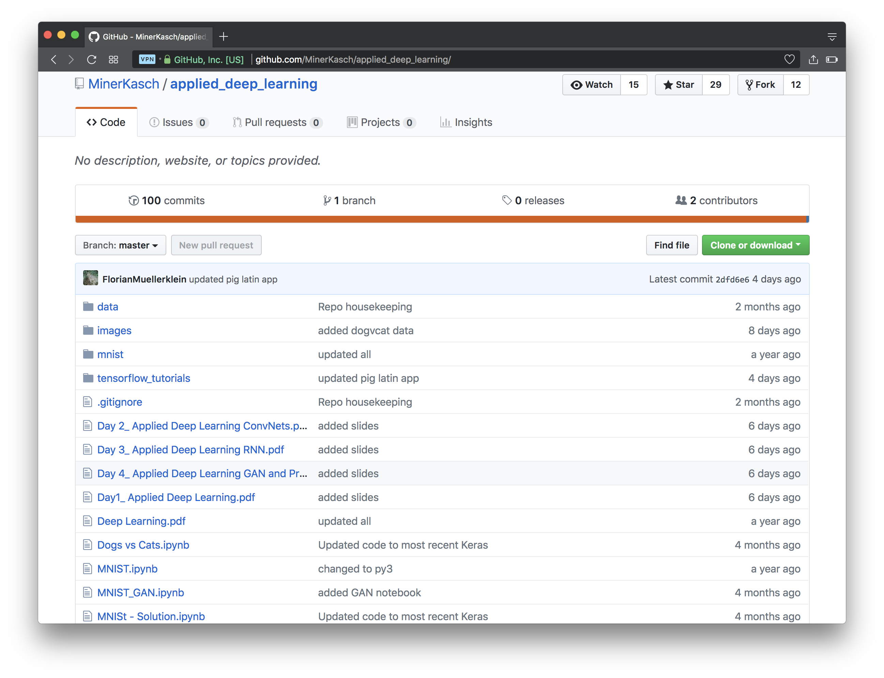
https://github.com/MinerKasch/applied_deep_learning

Slide 16
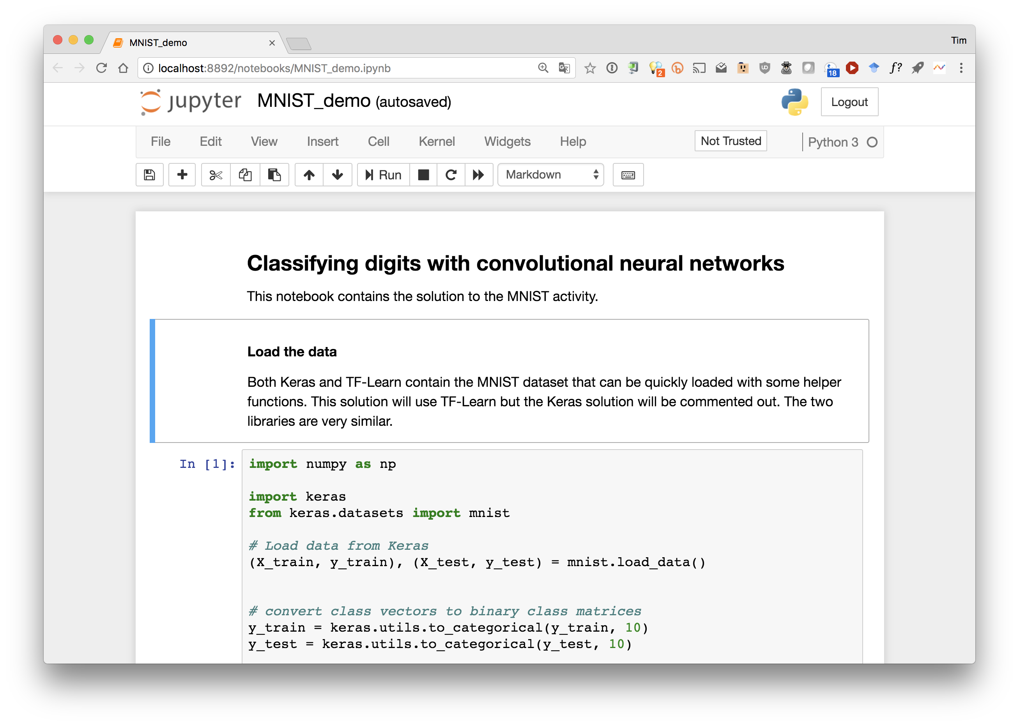

Slide 17
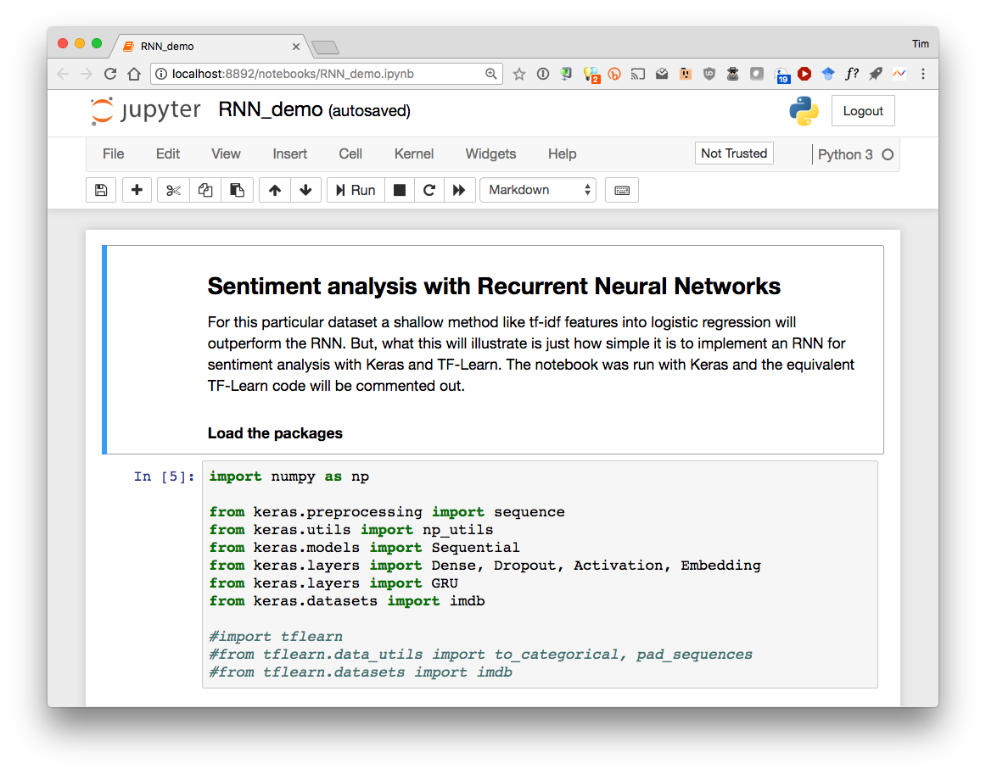

Slide 18
Conclusions
This was a very quick introduction to neural networks and deep learning
Find data and notebooks on github here
Learn more by
  taking UMBC’s machine learning class
  Self study online: try Miner/Kasch tutorial by Forian Muellerklein on applied deep learning
  Working through examples
and then trying your own project idea

Slide 19
History of NN
Pitts & McCulloch (1943)
  First mathematical model of biological neurons
  All Boolean operations can be implemented by these neuron-like nodes
  Competitor to Von Neumann model for general purpose computing device
  Origin of automata theory
Hebb (1949)
  Hebbian rule of learning: increase connection strength between neurons i and j whenever both are activated
  Or increase connection strength between nodes i and j whenever both are simultaneously ON or OFF

Slide 20
History: Early booming (50s – early 60s)
Rosenblatt (1958)
  Perceptron: network of threshold nodes
  for pattern classification; Perceptron
  learning rule
  Perceptron convergence theorem: everything
  that can be represented by a perceptron can be learned
Widrow and Hoff (1960, 19062)
  Learning rule based on gradient descent (differentiable unit)
Minsky’s attempt to build a general purpose machine with Pitts/McCullock units
x₁ x₂ x_{n}

Slide 21
History: setback in mid 60s – late 70s)
Serious problems with perceptron model (Minsky’s book 1969)
  Single layer perceptrons cannot represent (learn) simple functions such as XOR
  Multi-layer of non-linear units may have greater power but there is no learning rule for such nets
  Scaling problem: connection weights may grow infinitely
  First two problems overcame by latter effort in 80s, but scaling problem persists
Death of Rosenblatt (1964)
Striving of Von Neumann machine and AI

Slide 22
History of NN: Renewed enthusiasm
New techniques
  Backpropagation learning for multi-layer feed forward nets (with non-linear, differentiable node functions)
  Thermodynamic models (Hopfield net, Boltzmann machine …)
  Unsupervised learning
Impressive application (character recognition, speech recognition, text-to-speech transformation, process control, associative memory, etc.)
Traditional approaches face difficult challenges
Caution:
  Don’t underestimate difficulties and limitations
  Poses more problems than solutions

Slide 23
Not with a perceptron ☹
Training examples are not linearly separable for one case: sum=1 iff x1 xor x2

Slide 24
Works well on some problems
Learning curves
Are majority of inputs 1?
Restaurant example: WillWait?

