Slide 1
Unsupervised Learning: Clustering
Some material adapted from slides by Andrew Moore, CMU

Slide 2
Unsupervised Learning
Supervised learning used labeled data pairs (x, y) to learn a function f : X→Y.
But, what if we don’t have labels?
No labels = unsupervised learning
Only some points are labeled = semi-supervised learning
  Getting labels is expensive, so we only get a few
Clustering is the unsupervised grouping of data points. It can be used for knowledge discovery

Slide 3
Clustering algorithms
Many clustering algorithms
Clustering typically done using a distance measure defined between instances
Distance defined by instance feature space
Agglomerative approach works bottom up:
  Treat each instance as a cluster
  Merge two closest clusters
  Repeat until a stop condition is met
Top-down approach starts cluster with all instances
  Find a cluster to split into two or more smaller clusters
  Repeat until stop condition met

Slide 4
Clustering Data

Slide 5
K-Means Clustering
Randomly choose k cluster center locations, aka centroids
Loop until convergence
  assign a point to cluster of the closest centroid
  re-estimate cluster centroids based on its data assigned
Convergence: no point is assigned to a different cluster
k = 5

Slide 6
K-Means Clustering
K-Means ( k , data )
Randomly choose k cluster center locations (centroids)
Loop until convergence
  Assign each point to the cluster of the closest centroid.
  Re-estimate the cluster centroids based on the data assigned to each
Convergence: no point is assigned to a different cluster

Slide 7
K-Means Clustering
K-Means ( k , data )
Randomly choose k cluster center locations (centroids)
Loop until convergence
  Assign each point to the cluster of the closest centroid
  Re-estimate the cluster centroids based on the data assigned to each
Convergence: no point is assigned to a different cluster

Slide 8
K-Means Clustering
K-Means ( k , data )
Randomly choose k cluster center locations (centroids)
Loop until convergence
  Assign each point to the cluster of the closest centroid
  Re-estimate the cluster centroids based on the data assigned to each
Convergence: no point is assigned to a different cluster

Slide 9
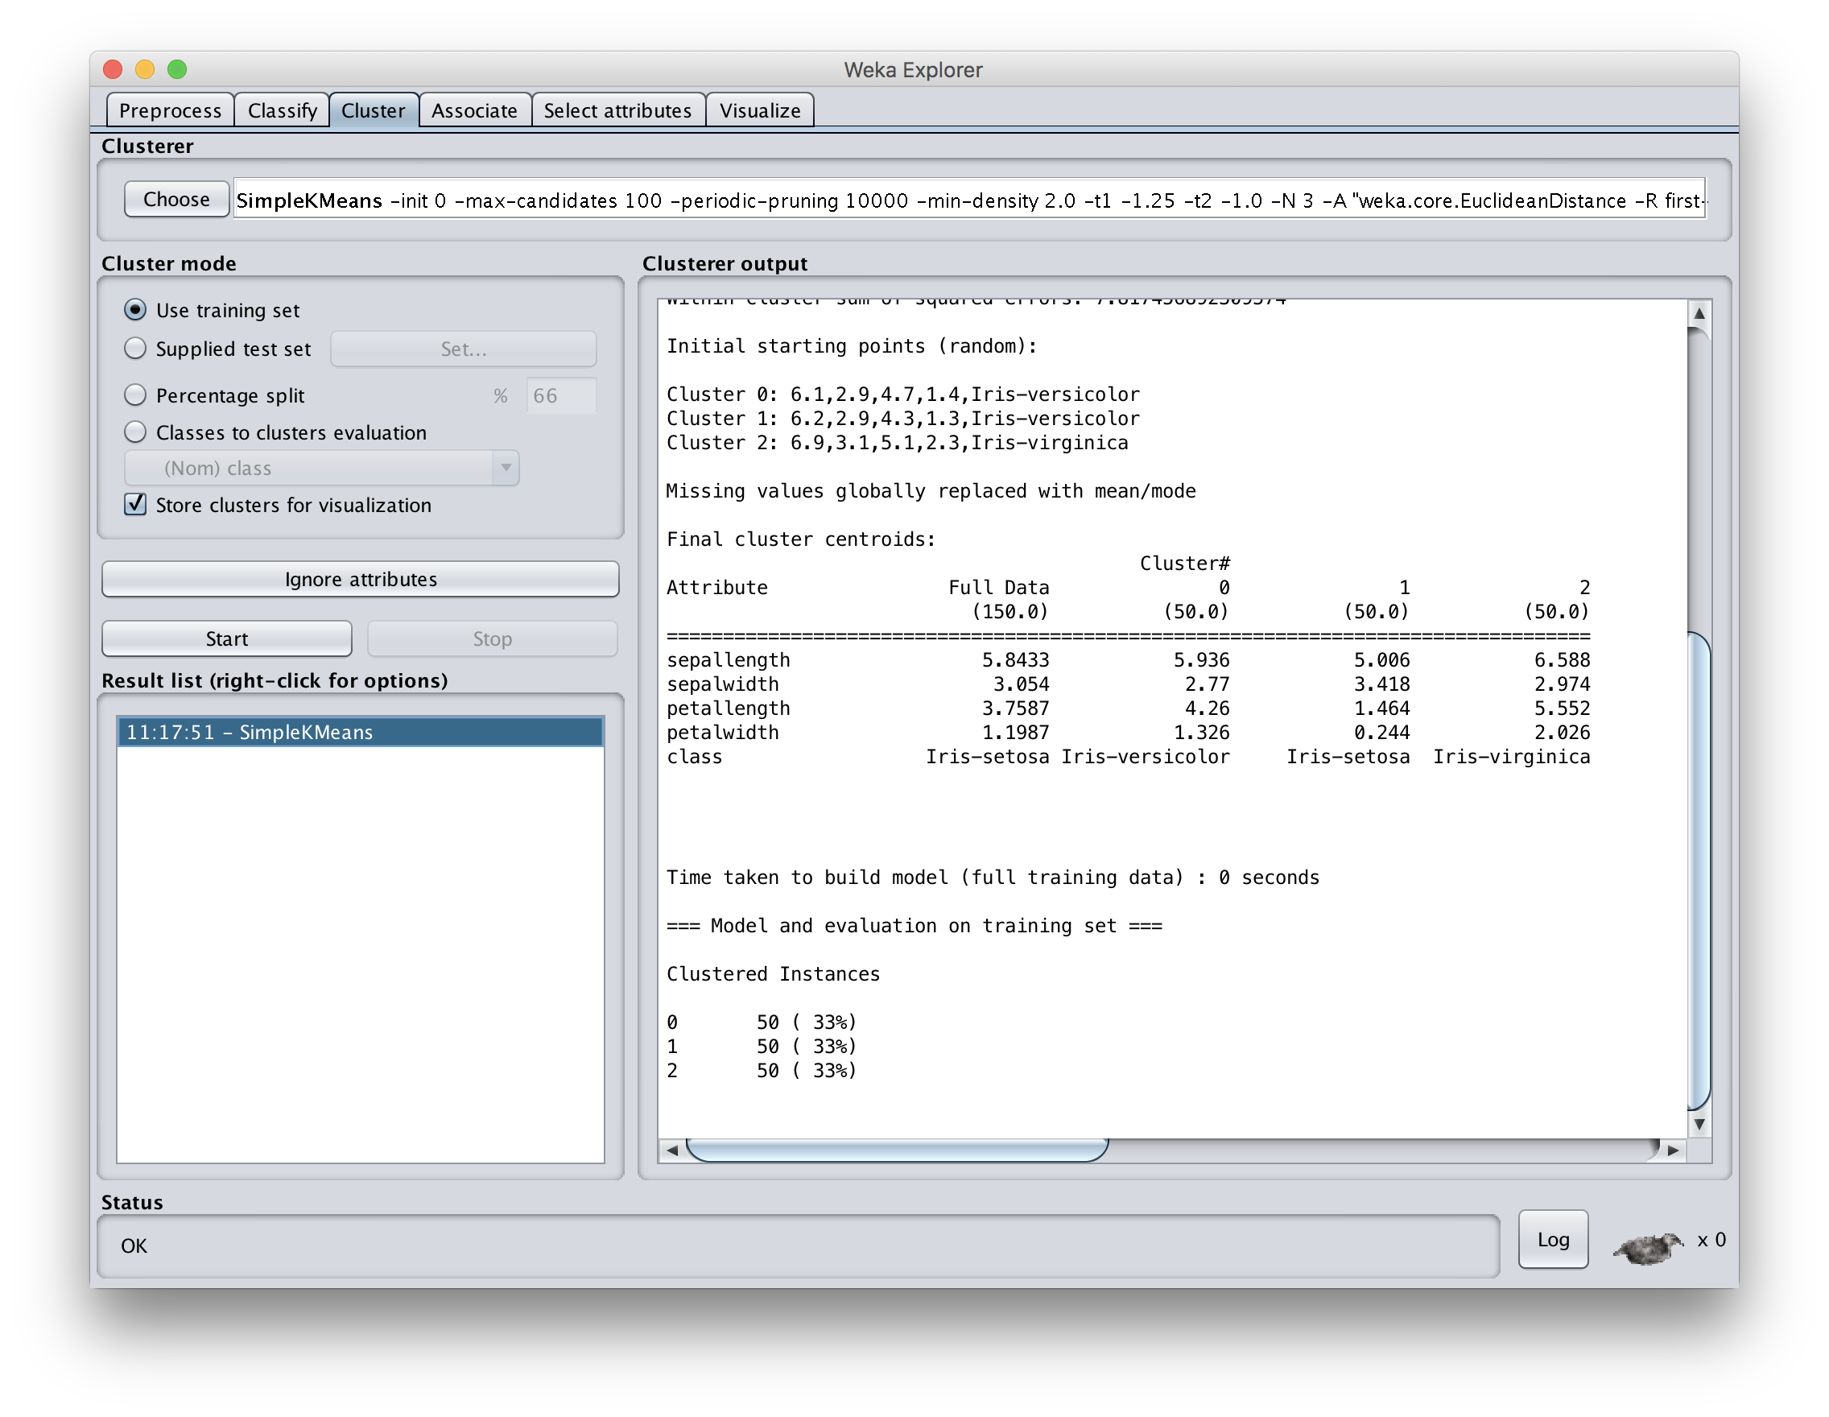
Notes:
We get perfect results, but we forgot to remove the ground truth nominal attribute! Select “Classes to cluster evaluation” to identify that class.

Slide 10
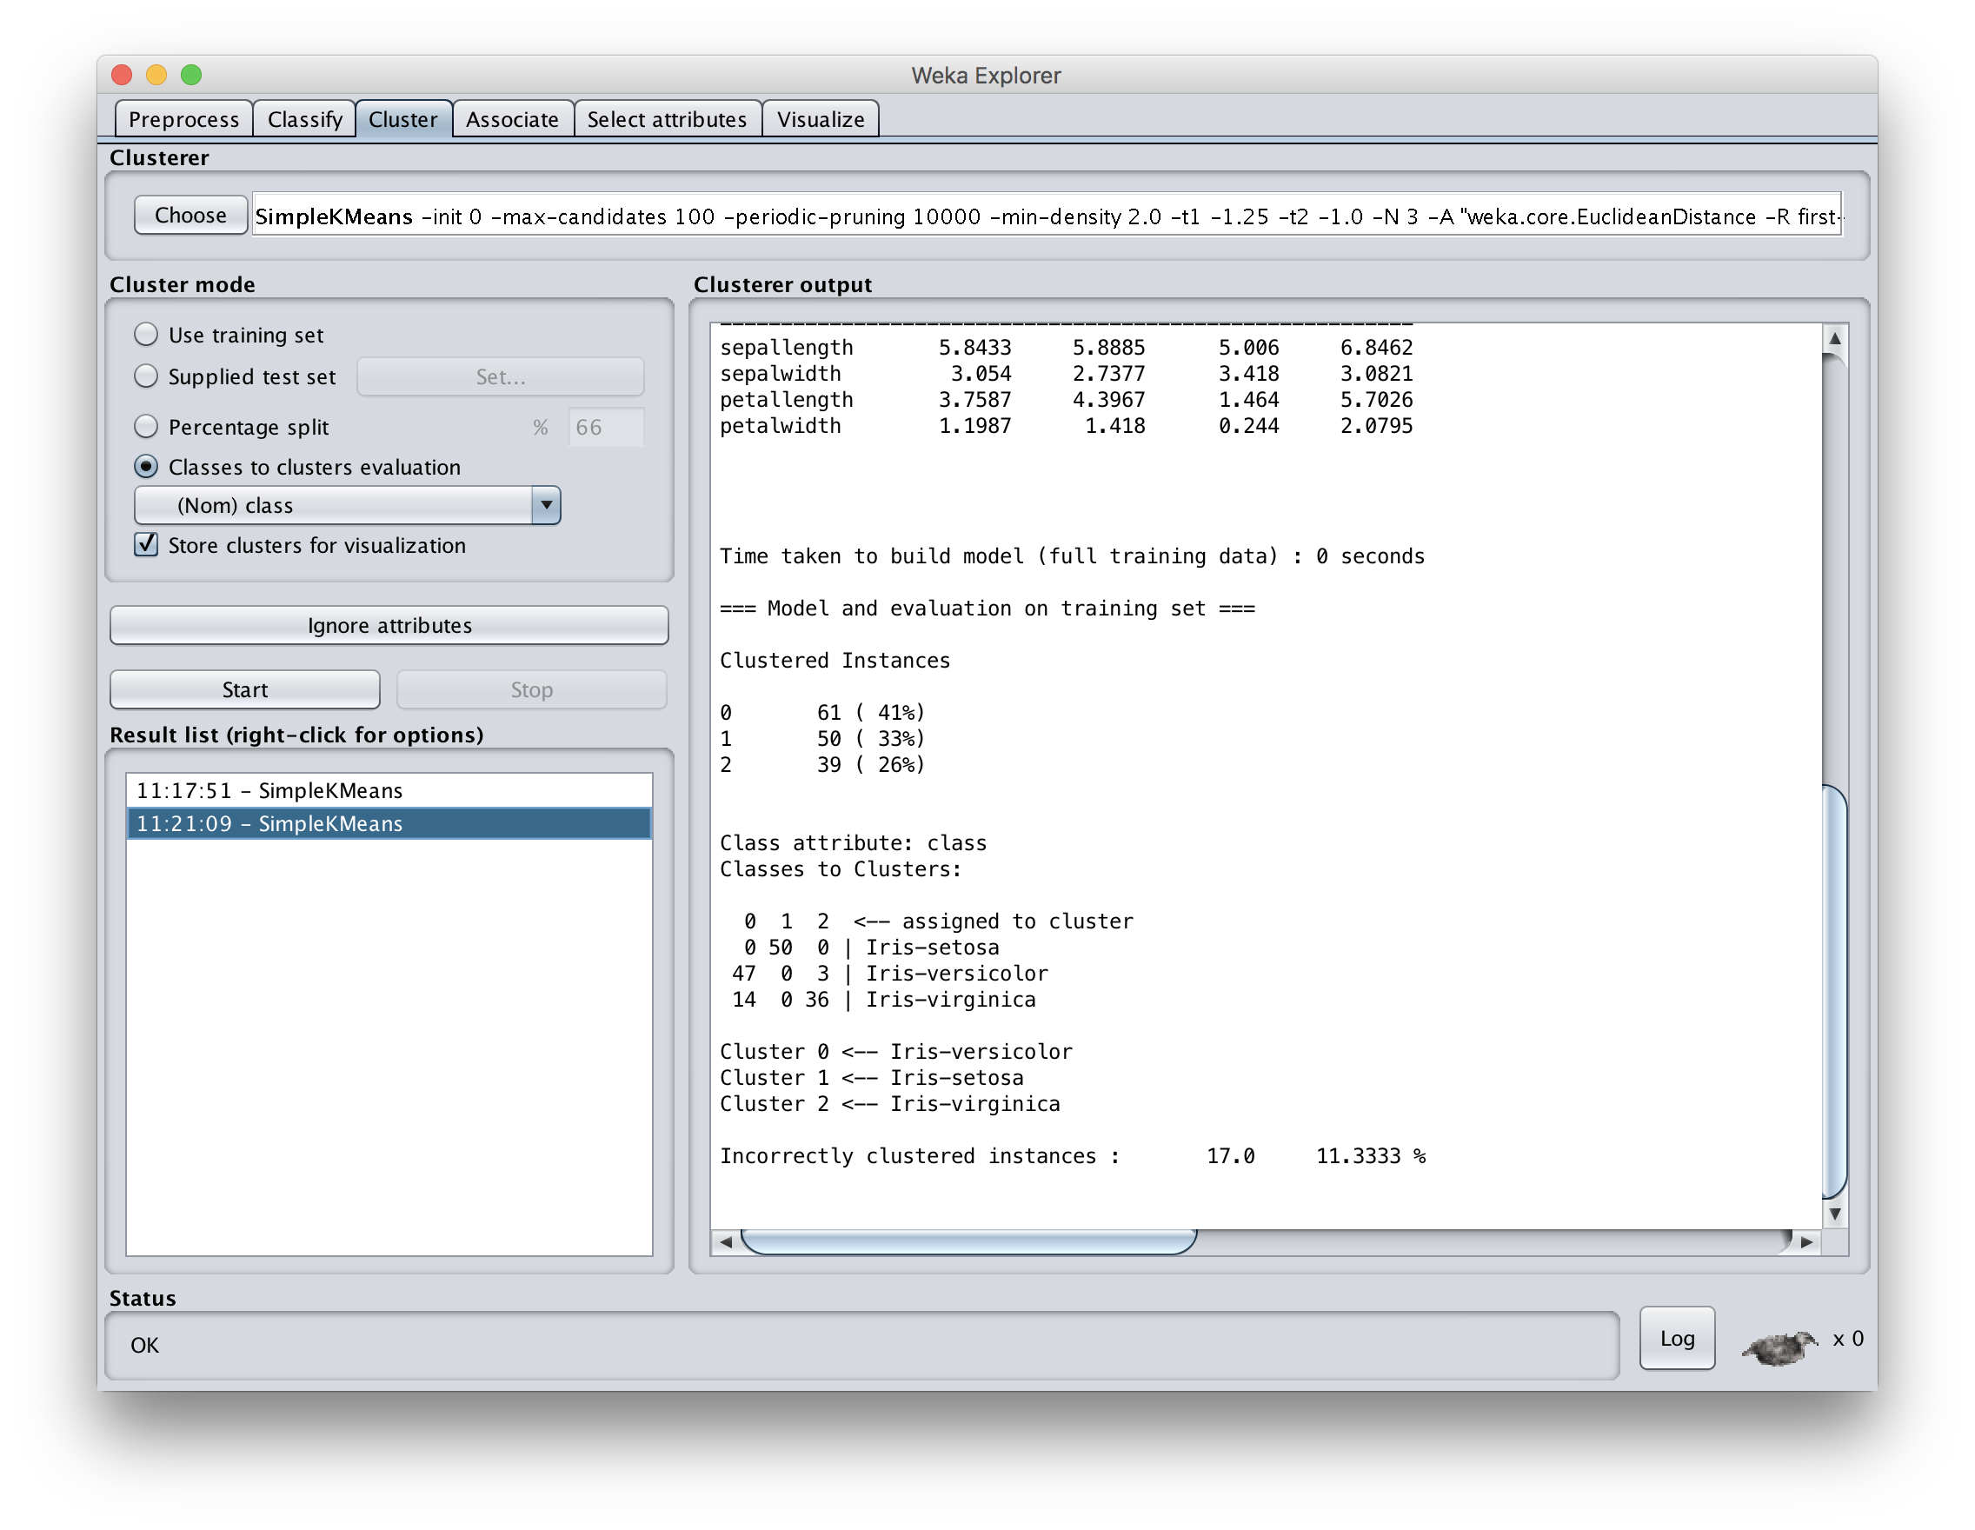

Slide 11
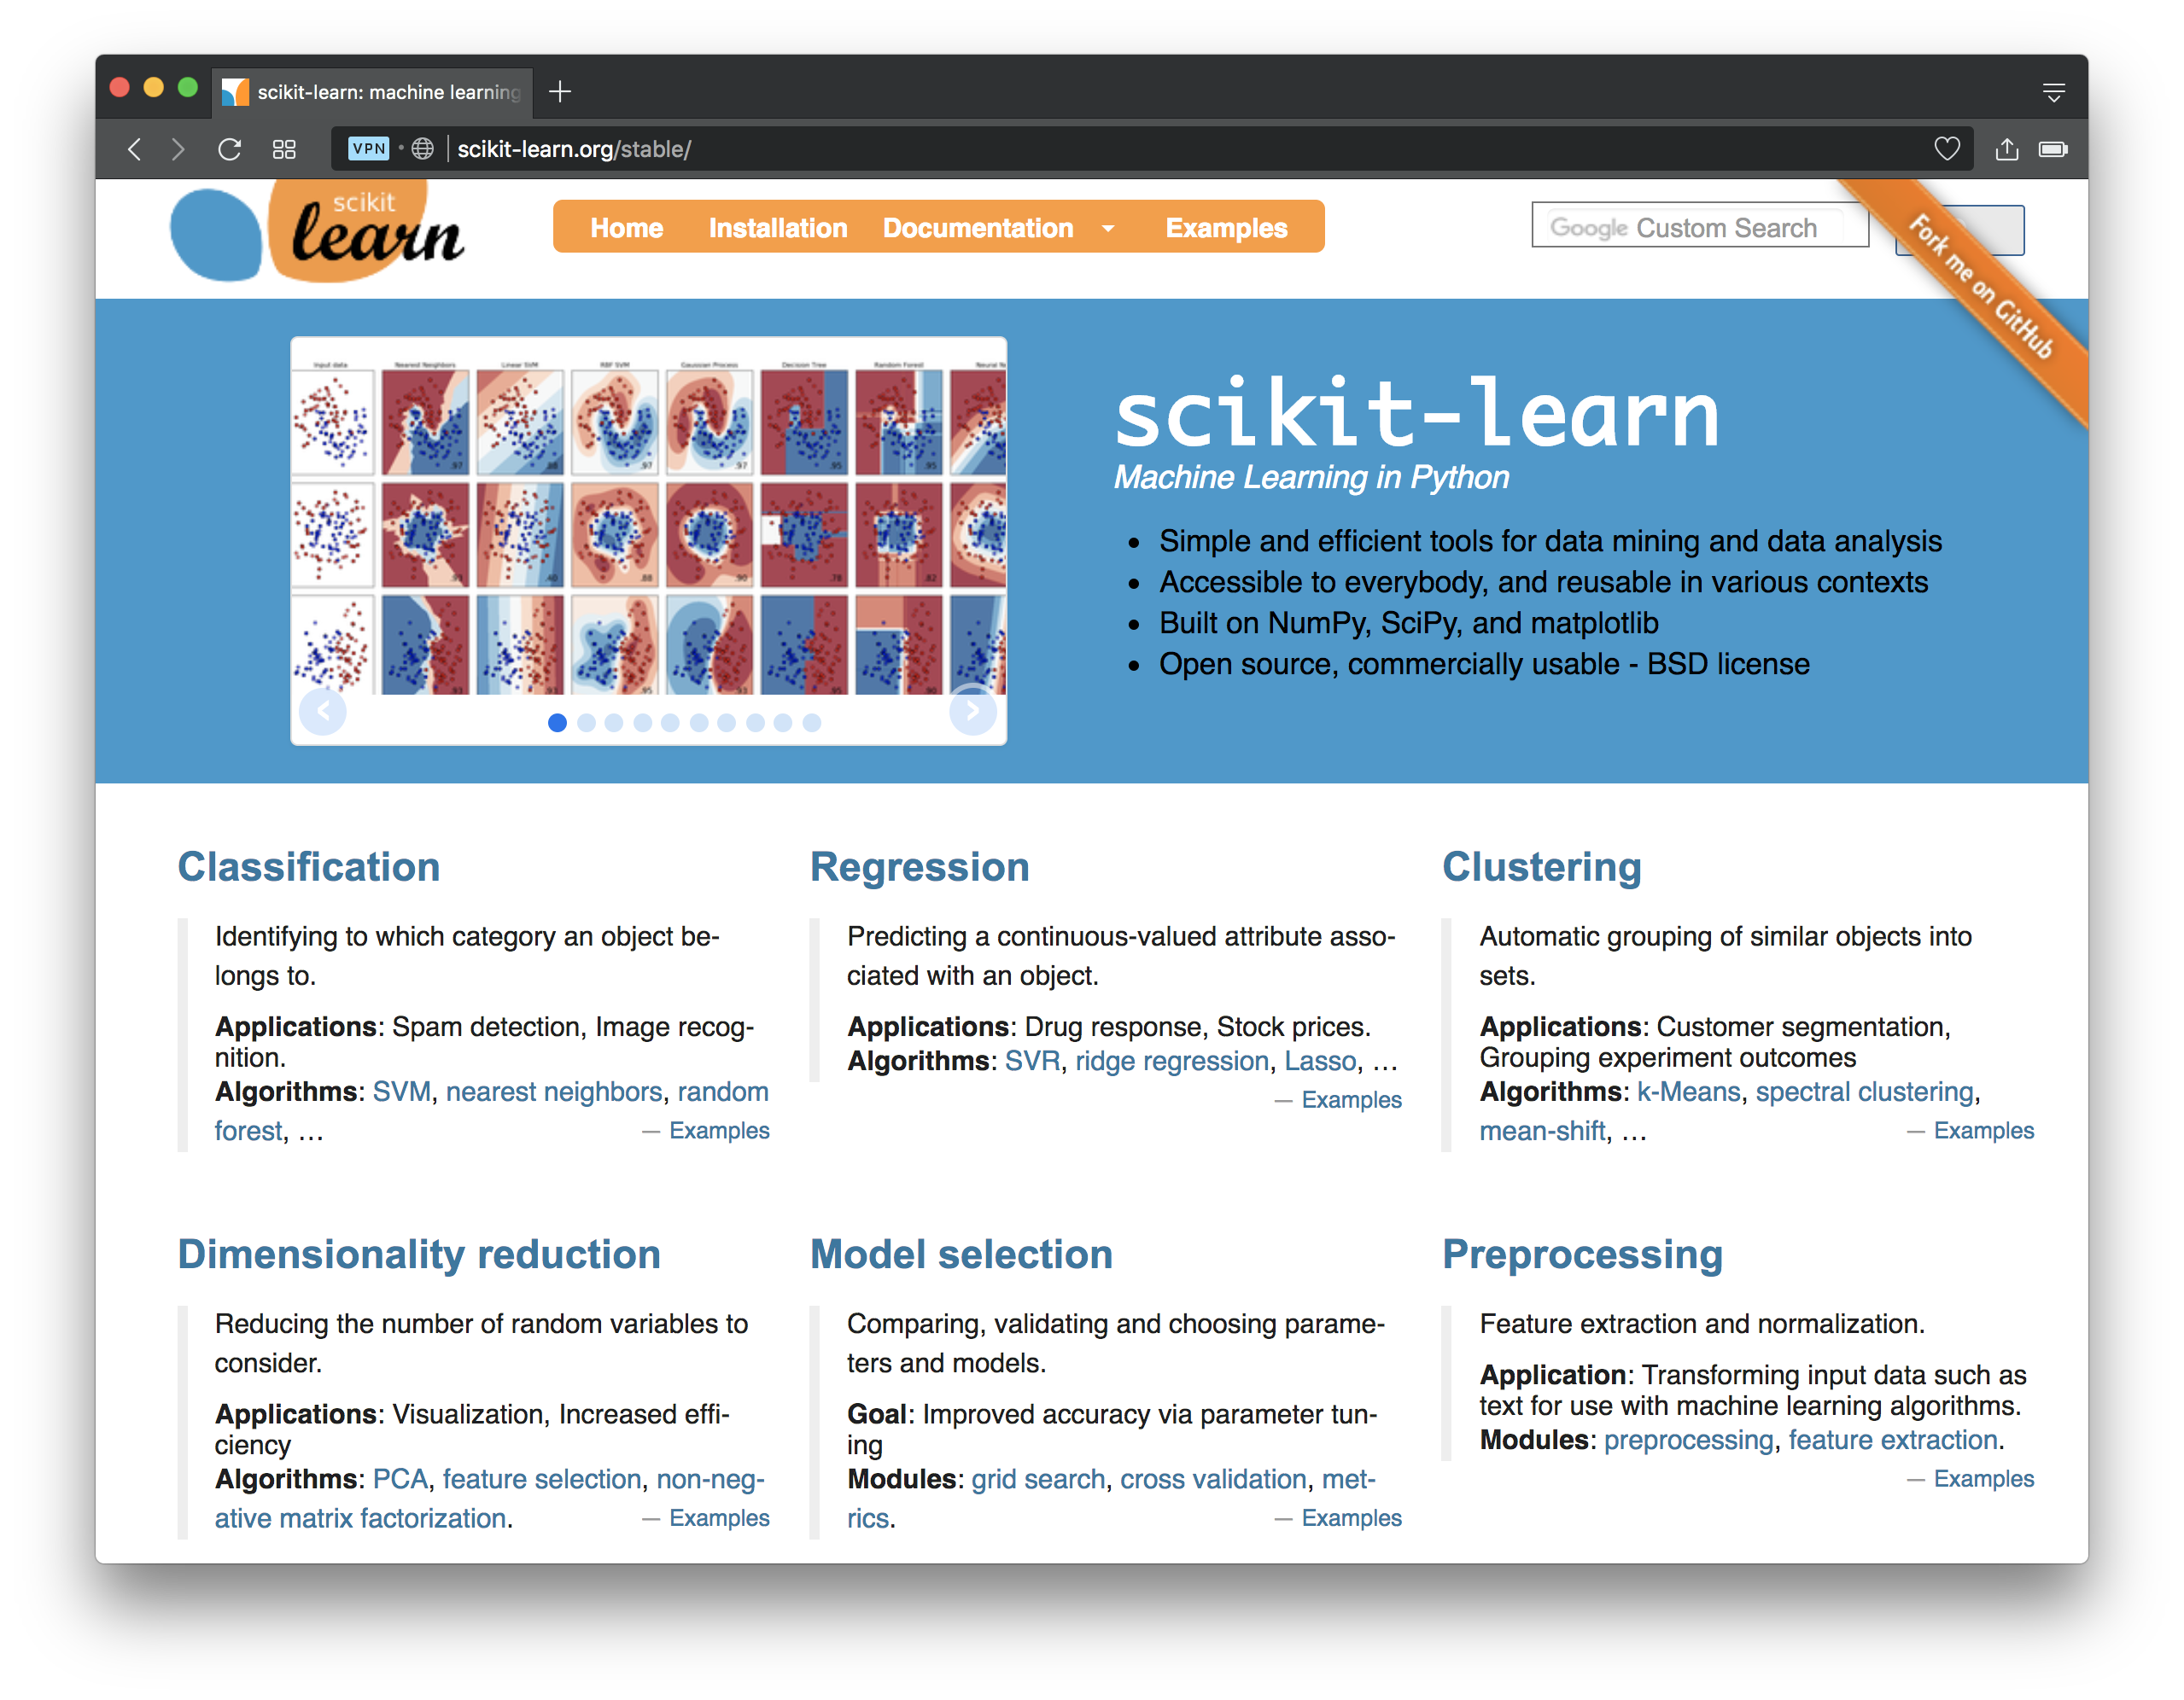

Slide 12
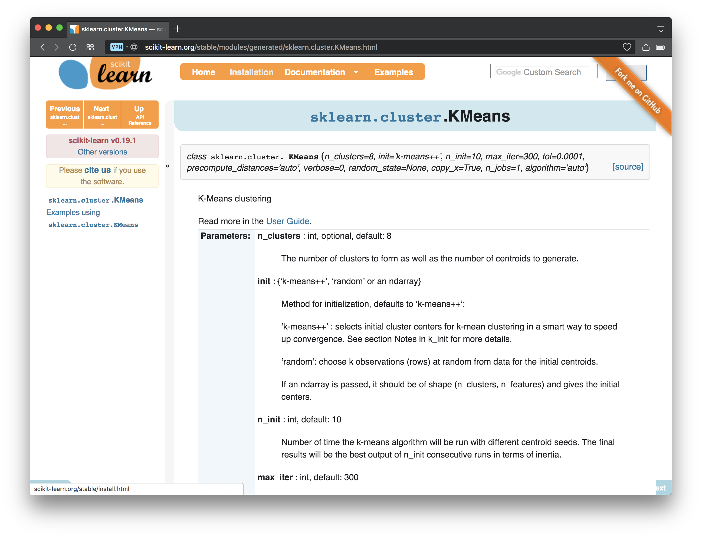

Slide 13
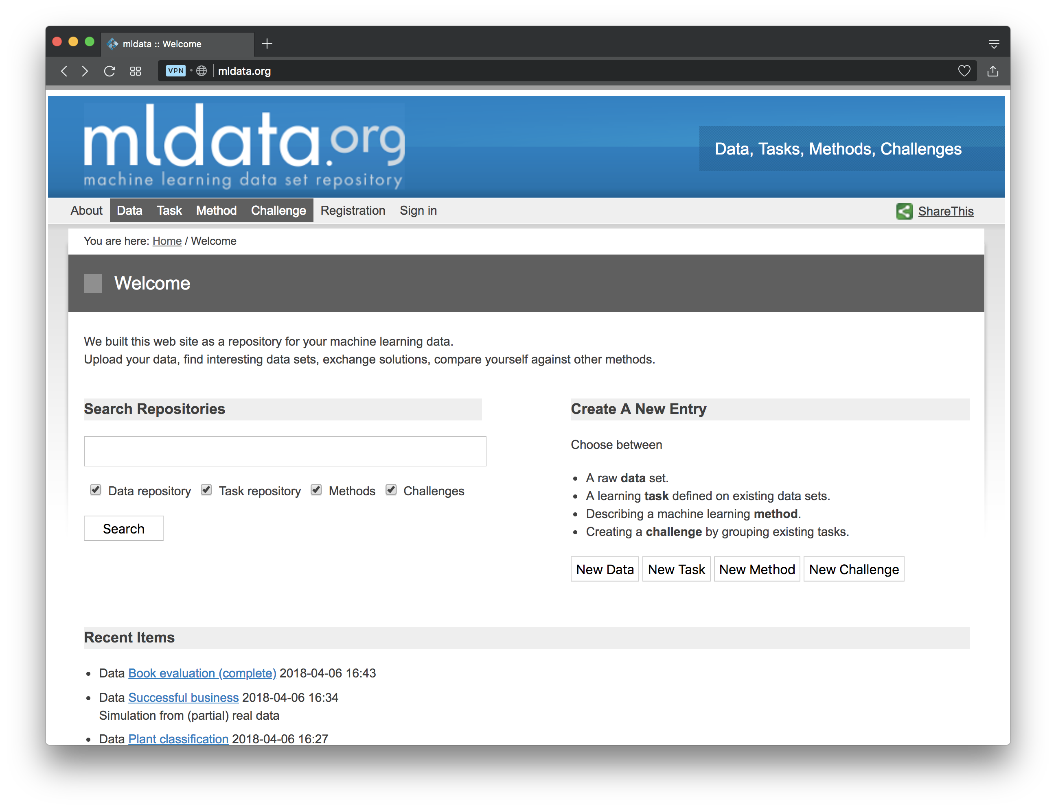
sklearn has a few test datasets, including IRIS
Can load data directly from mldata.org & from CSV files
mldata.org has ~900 datasets for machine learning

Slide 14
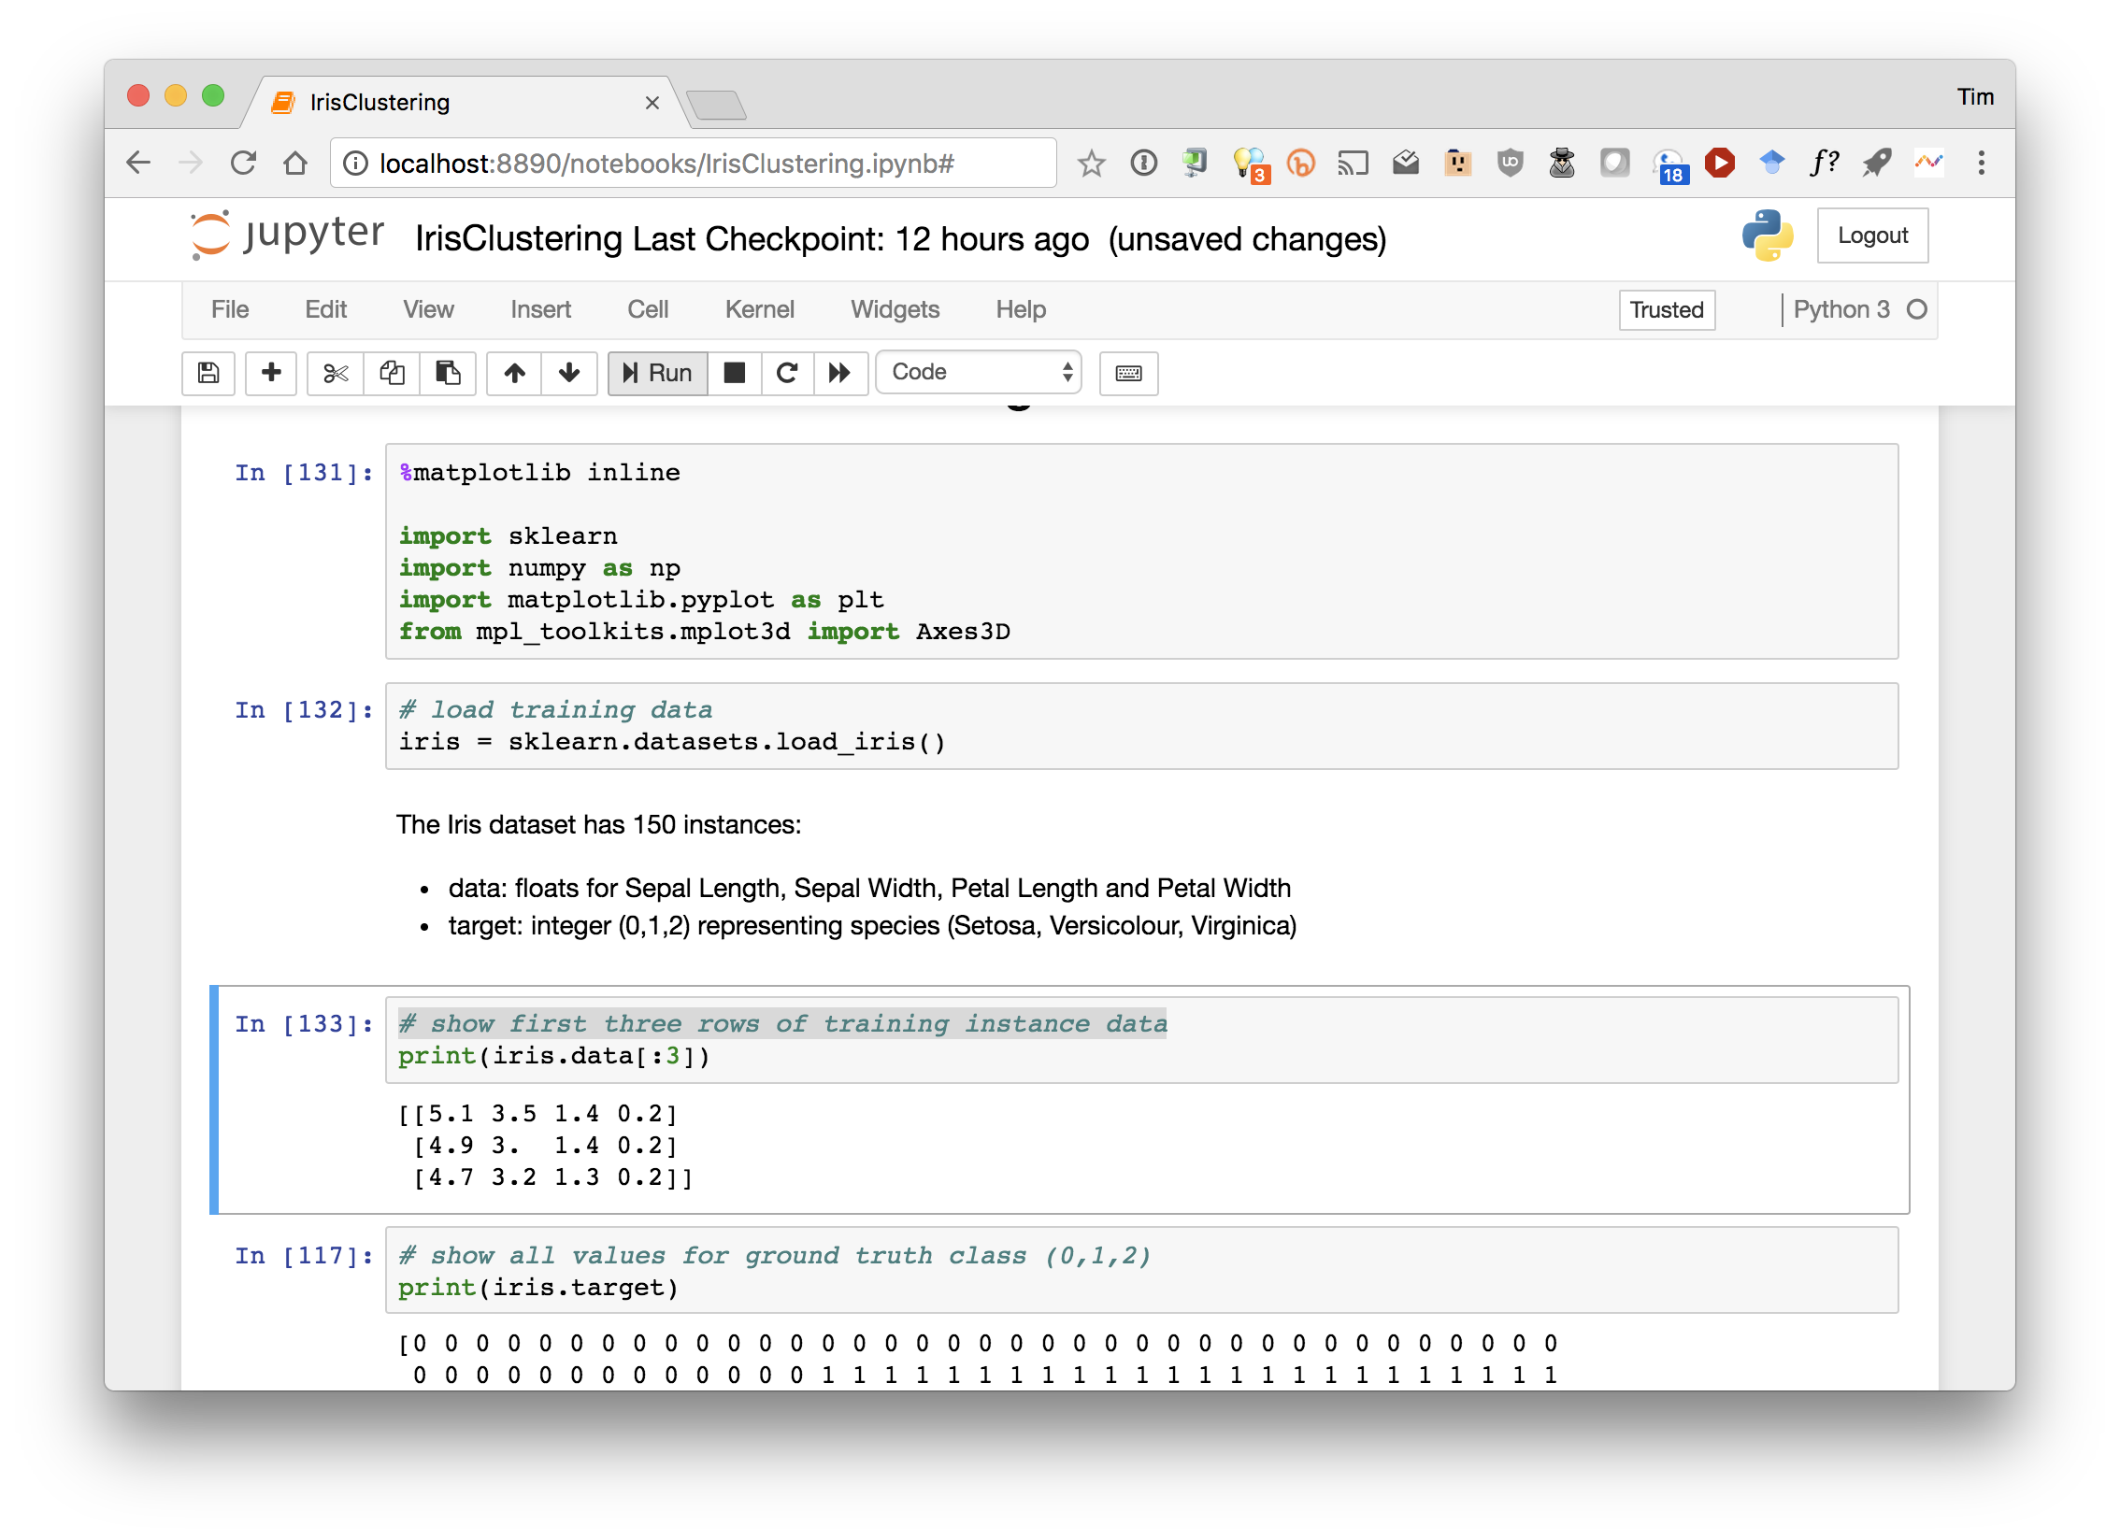

Slide 15
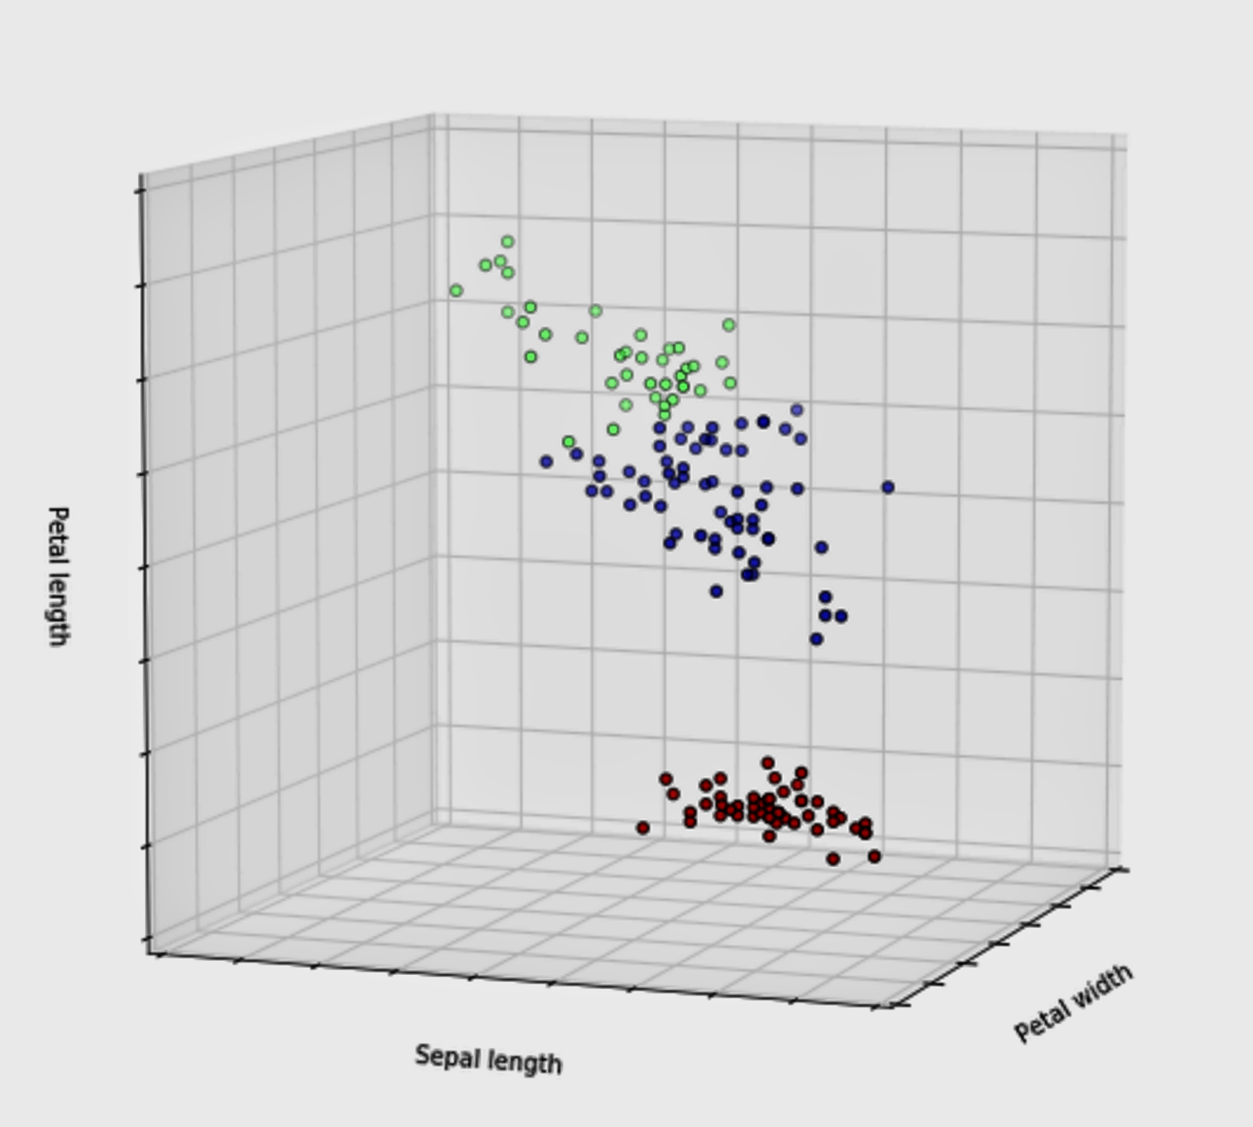

Slide 16
Problems with K-Means
Only works for numeric data (typically reals)
Very sensitive to the initial points
  Do many runs of k-Means, each with different initial centroids
  Seed centroids using better method than random (e.g., Farthest-first sampling)
Must manually choose k
  Learn optimal k for clustering
  Note: requires a performance measure

Slide 17
Problems with K-Means
How do you tell it which clustering you want?
Constrained clustering technique
Same-cluster constraint
(must-link)
Different-cluster constraint
(cannot-link)

Slide 18
Hierarchical clustering
Agglomerative
  bottom up approach: elements start as individual clusters & clusters are merged as one moves up the hierarchy
Divisive
  top down approach: elements start as a single cluster & clusters are split as one moves down the hierarchy

Slide 19
Hierarchical Clustering
Recursive partitioning/merging of a data set
1−clustering
5
2−clustering
1
3−clustering
4
2
4−clustering
3
5−clustering
1 2 3 4 5

Slide 20
Dendogram
  Tree structure representing all data partitionings
  Constructed as clustering proceeds
Nine items

Slide 21
Dendogram
  Tree structure representing all data partitionings
  Constructed as clustering proceeds
  Get a K-clustering by looking at connected components at any given level
  Frequently binary dendo-grams, but n-ary ones easy to obtain with minor algorithm changes
Four clusters

Slide 22
Hierarchical clustering advantages
Need not specify number of clusters
Good for data visualization
  See how data points interact at many levels
  Can view data at multiple granularity levels
  Understand how all points interact
Specifies all of the K clusterings/partitions

Slide 23
Divisive hierarchical clustering
Top-down
Finding best partitioning of data generally exponential in time
Common approach:
  Let C be a set of clusters
  Initialize C to be a one-clustering of data
  While there exists a cluster c in C
    remove c from C
    partition c into 2 clusters (c₁ and c₂ ) using a flat clustering algorithm (e.g., k-means
    Add to c₁ and c₂ C
Bisecting k-means

Slide 24
Divisive clustering

Slide 25
Divisive clustering
start with one cluster

Slide 26
Divisive clustering
split using flat clustering, e.g., Kmeans

Slide 27
Divisive clustering

Slide 28
Divisive clustering
split using flat clustering, e.g., Kmeans

Slide 29
Divisive clustering
split using flat clustering
split using flat clustering, e.g., Kmeans

Slide 30
Divisive clustering
Stop when clusters reach some constraint

Slide 31
Hierarchical Agglomerative Clustering
Let C be a set of clusters
Initialize C to all points/docs as separate clusters
While C contains more than one cluster
  find c₁ and c₂ in C that are closest together
  remove c₁ and c₂ from C
  merge c₁ and c₂ and add resulting cluster to C
Merging history forms a binary tree or hierarchy
Q: How to measure distance between clusters?

Slide 32
Distance between clusters
Single-link: Similarity of the most similar (single-link)

Slide 33
Distance between clusters
Complete-link: Similarity of the “furthest” points, the least similar

Slide 34
Distance between clusters
Centroid: Clusters whose centroids (centers of gravity) are the most similar

Slide 35
Distance between clusters
Average-link: Average similarity between all pairs of elements

Slide 36
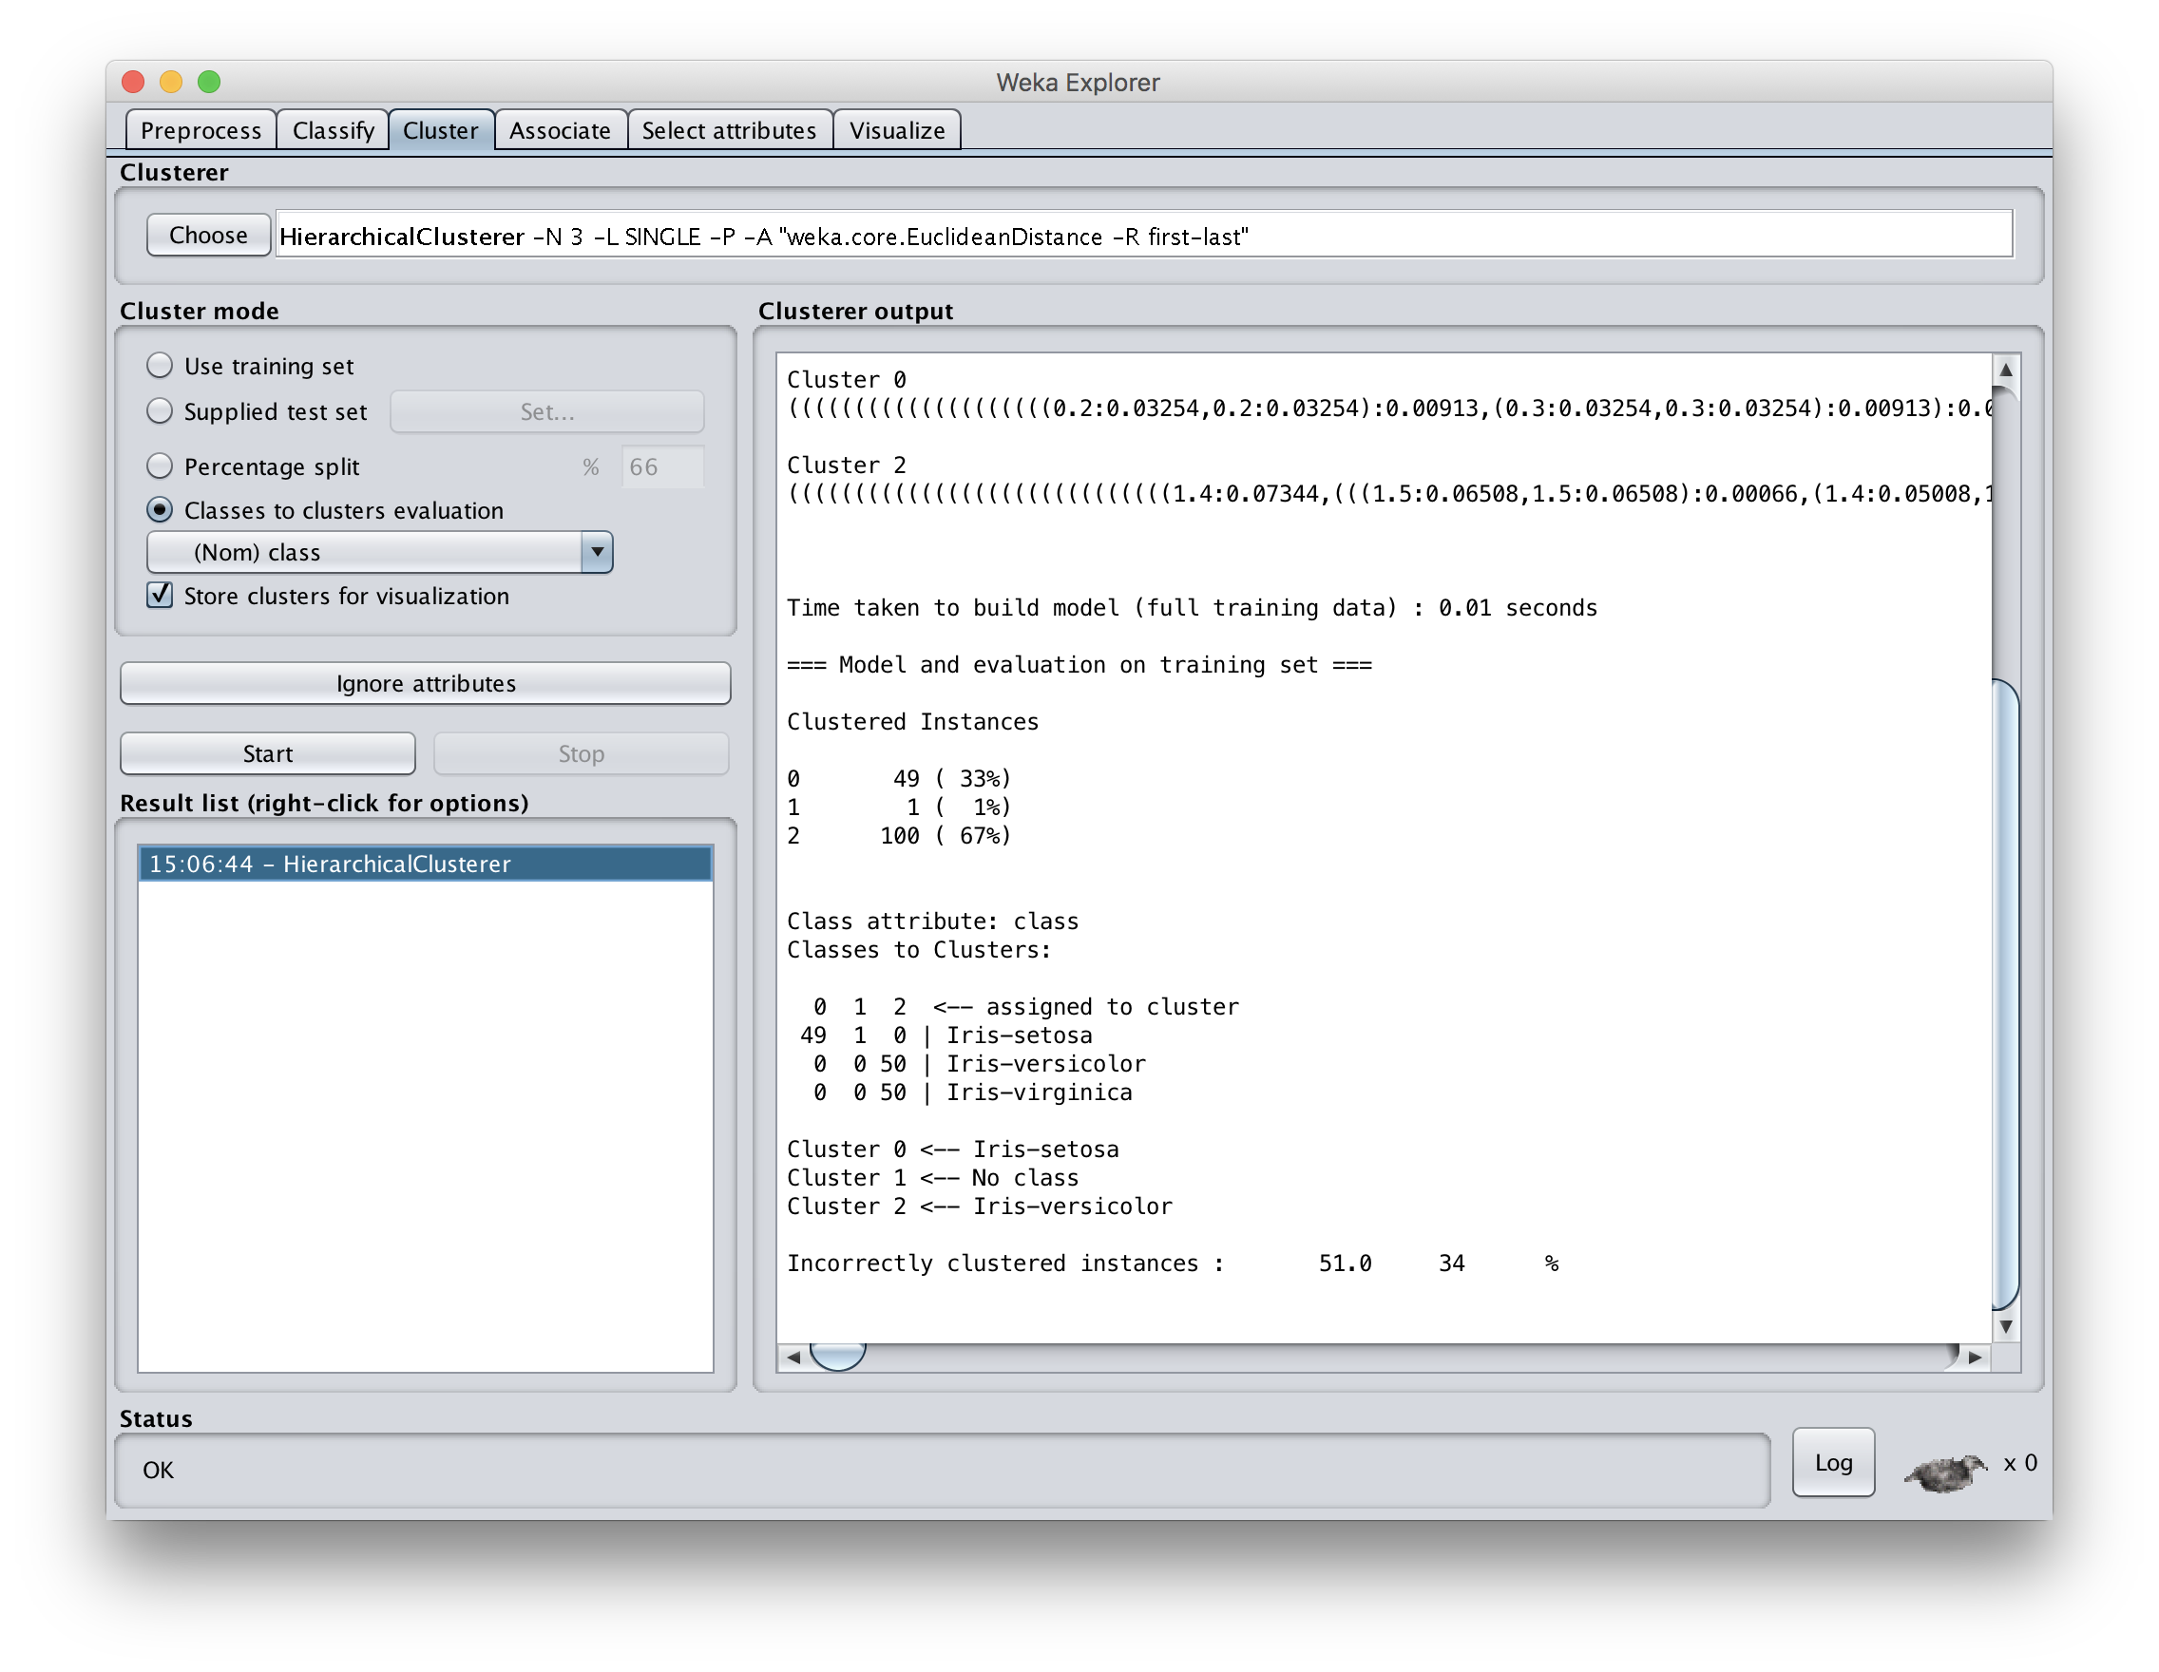
Using default LINK cluster distance measure gives bad results

Slide 37
Knowing when to stop
A general issue for hierarchical clustering is knowing when to stop merging/splitting a cluster
We may have a problem specific desired range of clusters (e.g., 3-6)
There are some general metrics for assessing the quality of a cluster
There are also domain specific heuristics for cluster quality

Slide 38
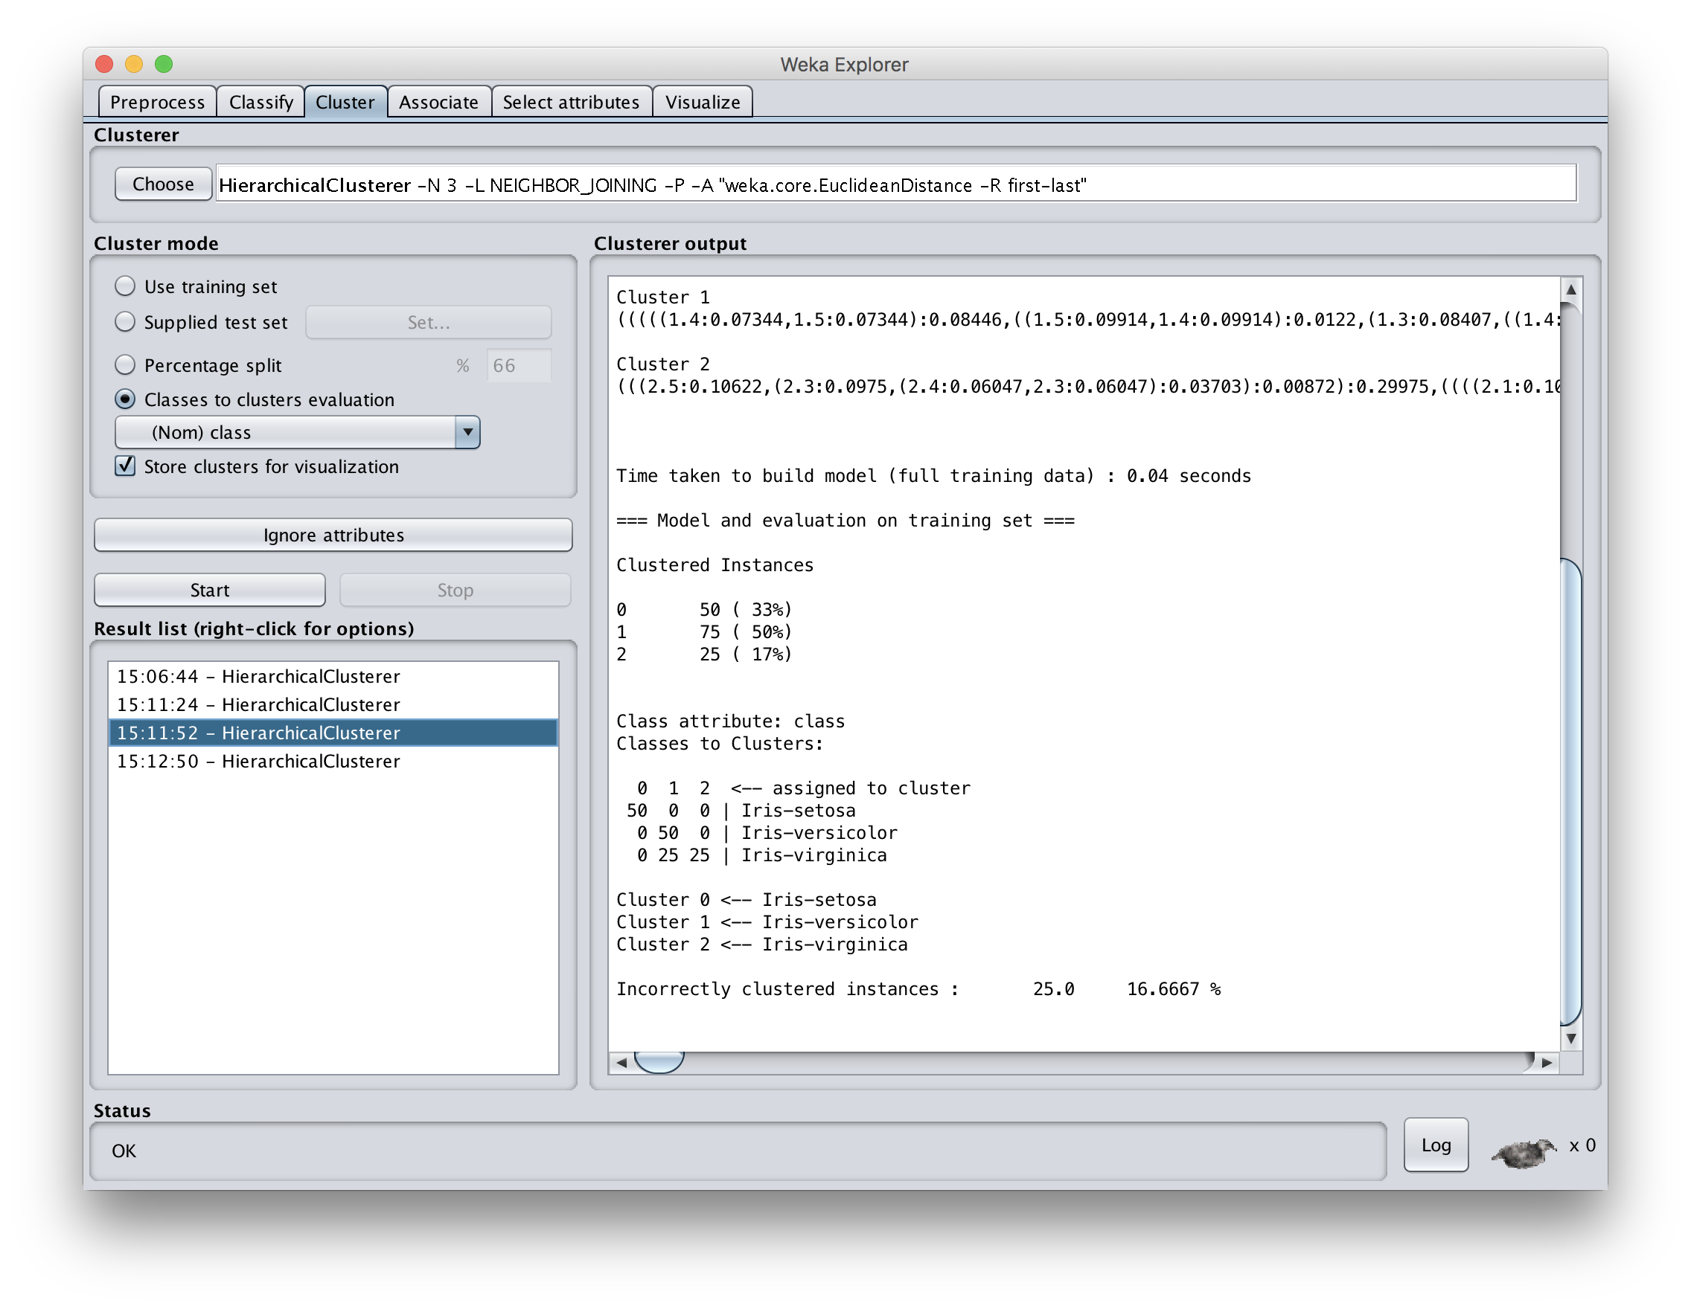
Using WARD cluster distance measure improves results

