Slide 1
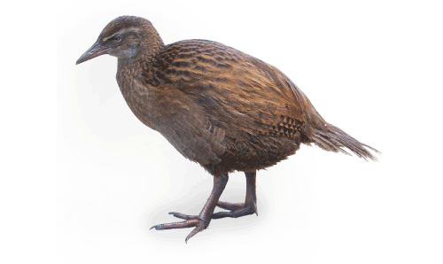
Machine Learning: Decision Trees in
AIMA and WEKA

Slide 2
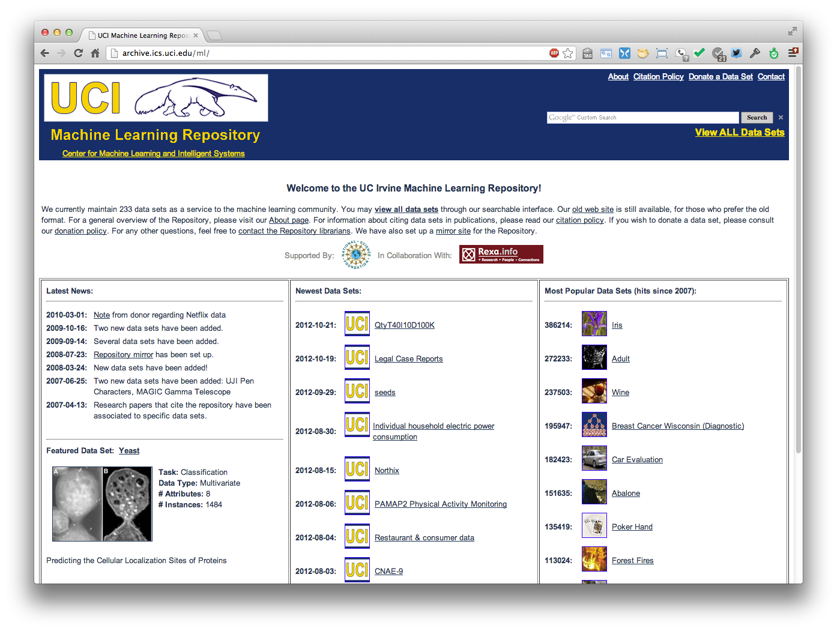
http://archive.ics.uci.edu/ml
Est. 1987!
370 data sets
Notes:
The UCI Machine Learning Repository maintains 370 (as of 2017-05-01) data sets as a service to the machine learning community.
The archive was created as an ftp archive in 1987 by David Aha and fellow graduate students at UC Irvine.

Slide 3
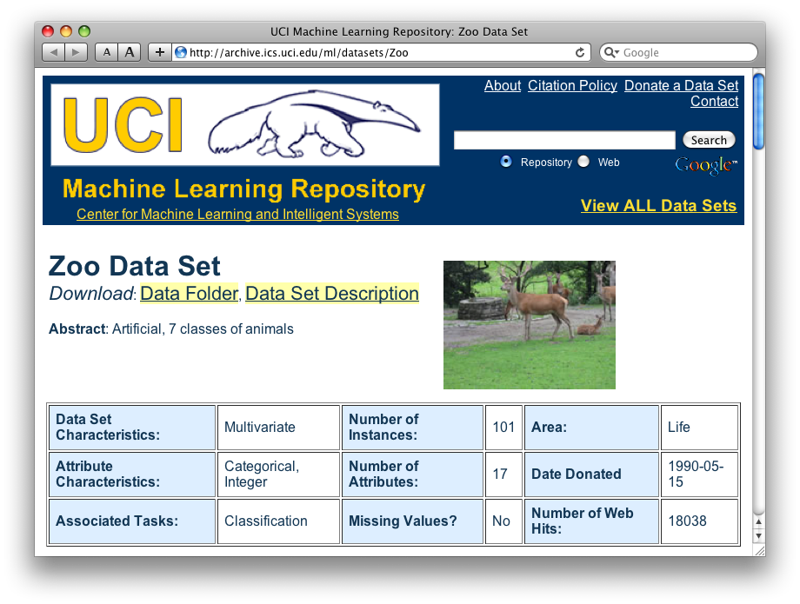
http://archive.ics.uci.edu/ml/datasets/Zoo

Slide 4
Zoo training data
animal name: string
hair: Boolean
feathers: Boolean
eggs: Boolean
milk: Boolean
airborne: Boolean
aquatic: Boolean
predator: Boolean
toothed: Boolean
backbone: Boolean
breathes: Boolean
venomous: Boolean
fins: Boolean
legs: {0,2,4,5,6,8}
tail: Boolean
domestic: Boolean
catsize: Boolean
type: {mammal, fish, bird, shellfish, insect, reptile, amphibian}
category
label
101 Instances
aardvark,1,0,0,1,0,0,1,1,1,1,0,0,4,0,0,1,mammal
antelope,1,0,0,1,0,0,0,1,1,1,0,0,4,1,0,1,mammal
bass,0,0,1,0,0,1,1,1,1,0,0,1,0,1,0,0,fish
bear,1,0,0,1,0,0,1,1,1,1,0,0,4,0,0,1,mammal
boar,1,0,0,1,0,0,1,1,1,1,0,0,4,1,0,1,mammal
buffalo,1,0,0,1,0,0,0,1,1,1,0,0,4,1,0,1,mammal
calf,1,0,0,1,0,0,0,1,1,1,0,0,4,1,1,1,mammal
carp,0,0,1,0,0,1,0,1,1,0,0,1,0,1,1,0,fish
catfish,0,0,1,0,0,1,1,1,1,0,0,1,0,1,0,0,fish
cavy,1,0,0,1,0,0,0,1,1,1,0,0,4,0,1,0,mammal
cheetah,1,0,0,1,0,0,1,1,1,1,0,0,4,1,0,1,mammal
chicken,0,1,1,0,1,0,0,0,1,1,0,0,2,1,1,0,bird
chub,0,0,1,0,0,1,1,1,1,0,0,1,0,1,0,0,fish
clam,0,0,1,0,0,0,1,0,0,0,0,0,0,0,0,0,shellfish
crab,0,0,1,0,0,1,1,0,0,0,0,0,4,0,0,0,shellfish
…

Slide 5
Zoo example
aima-python> python
>>> from learning import *
>>> zoo
<DataSet(zoo): 101 examples, 18 attributes>
>>> dt = DecisionTreeLearner()
>>> dt.train(zoo)
>>> dt.predict(['shark',0,0,1,0,0,1,1,1,1,0,0,1,0,1,0,0]) #eggs=1
'fish'
>>> dt.predict(['shark',0,0,0,0,0,1,1,1,1,0,0,1,0,1,0,0]) #eggs=0
'mammal’
Notes:
Sharks bear their young alive

Slide 6
Zoo example
>> dt.dt
DecisionTree(13, 'legs', {0: DecisionTree(12, 'fins', {0: DecisionTree(8, 'toothed', {0: 'shellfish', 1: 'reptile'}), 1: DecisionTree(3, 'eggs', {0: 'mammal', 1: 'fish'})}), 2: DecisionTree(1, 'hair', {0: 'bird', 1: 'mammal'}), 4: DecisionTree(1, 'hair', {0: DecisionTree(6, 'aquatic', {0: 'reptile', 1: DecisionTree(8, 'toothed', {0: 'shellfish', 1: 'amphibian'})}), 1: 'mammal'}), 5: 'shellfish', 6: DecisionTree(6, 'aquatic', {0: 'insect', 1: 'shellfish'}), 8: 'shellfish'})

Slide 7
Zoo example
>>> dt.dt.display()
Test legs
legs = 0 ==> Test fins
fins = 0 ==> Test toothed
toothed = 0 ==> RESULT = shellfish
toothed = 1 ==> RESULT = reptile
fins = 1 ==> Test eggs
eggs = 0 ==> RESULT = mammal
eggs = 1 ==> RESULT = fish
legs = 2 ==> Test hair
hair = 0 ==> RESULT = bird
hair = 1 ==> RESULT = mammal
legs = 4 ==> Test hair
hair = 0 ==> Test aquatic
aquatic = 0 ==> RESULT = reptile
aquatic = 1 ==> Test toothed
toothed = 0 ==> RESULT = shellfish
toothed = 1 ==> RESULT = amphibian
hair = 1 ==> RESULT = mammal
legs = 5 ==> RESULT = shellfish
legs = 6 ==> Test aquatic
aquatic = 0 ==> RESULT = insect
aquatic = 1 ==> RESULT = shellfish
legs = 8 ==> RESULT = shellfish

Slide 8
8
legs
shellfish
0
2
4
5
6
fins
hair
shellfish
aquadic
0
0
insect
1
0
1
eggs
tooth
shellfish
aquadic
0
1
0
1
hair
1
mammal
shellfish
1
0
tooth
0
fish
reptile
mammal
1
0
bird
shellfish
reptile
reptile

Slide 9
Zoo example
>>> dt.dt.display()
Test legs
legs = 0 ==> Test fins
fins = 0 ==> Test toothed
toothed = 0 ==> RESULT = shellfish
toothed = 1 ==> RESULT = reptile
fins = 1 ==> Test milk
milk = 0 ==> RESULT = fish
milk = 1 ==> RESULT = mammal
legs = 2 ==> Test hair
hair = 0 ==> RESULT = bird
hair = 1 ==> RESULT = mammal
legs = 4 ==> Test hair
hair = 0 ==> Test aquatic
aquatic = 0 ==> RESULT = reptile
aquatic = 1 ==> Test toothed
toothed = 0 ==> RESULT = shellfish
toothed = 1 ==> RESULT = amphibian
hair = 1 ==> RESULT = mammal
legs = 5 ==> RESULT = shellfish
legs = 6 ==> Test aquatic
aquatic = 0 ==> RESULT = insect
aquatic = 1 ==> RESULT = shellfish
legs = 8 ==> RESULT = shellfish
After adding the shark example to the training data & retraining

Slide 10

Weka
Open-source Java machine learning tool
http://www.cs.waikato.ac.nz/ml/weka/
Implements many classifiers & ML algorithms
Uses common data representation format; easy to try different ML algorithms and compare results
  Comprehensive set of data pre-processing tools and evaluation methods
Three modes of operation: GUI, command line, Java API

Slide 11
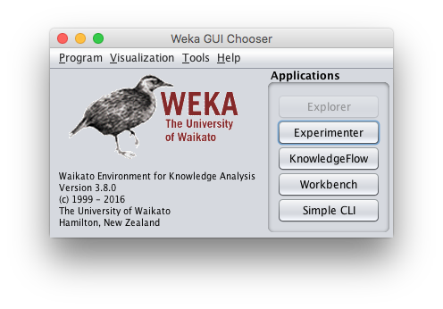
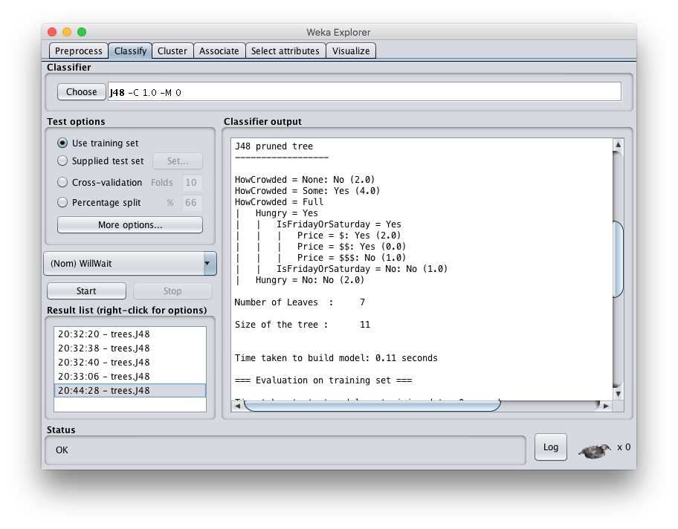

Slide 12
Common .arff* data format
@relation heart-disease-simplified
@attribute age numeric
@attribute sex { female, male }
@attribute chest_pain_type { typ_angina, asympt, non_anginal, atyp_angina}
@attribute cholesterol numeric
@attribute exercise_induced_angina {no, yes}
@attribute class {present, not_present}
@data
63,male,typ_angina,233,no,not_present
67,male,asympt,286,yes,present
67,male,asympt,229,yes,present
38,female,non_anginal,?,no,not_present
...
Numeric attribute
Nominal attribute
Training data
*ARFF = Attribute-Relation File Format

Slide 13
Weka demo

Slide 14
Install Weka
Download and install Weka
cd to your weka directory
Invoke the GUI interface or call components from the command line
  You will probably want to set environment variables (e.g., CLASSPATH) or aliases (e.g., weka)

Slide 15
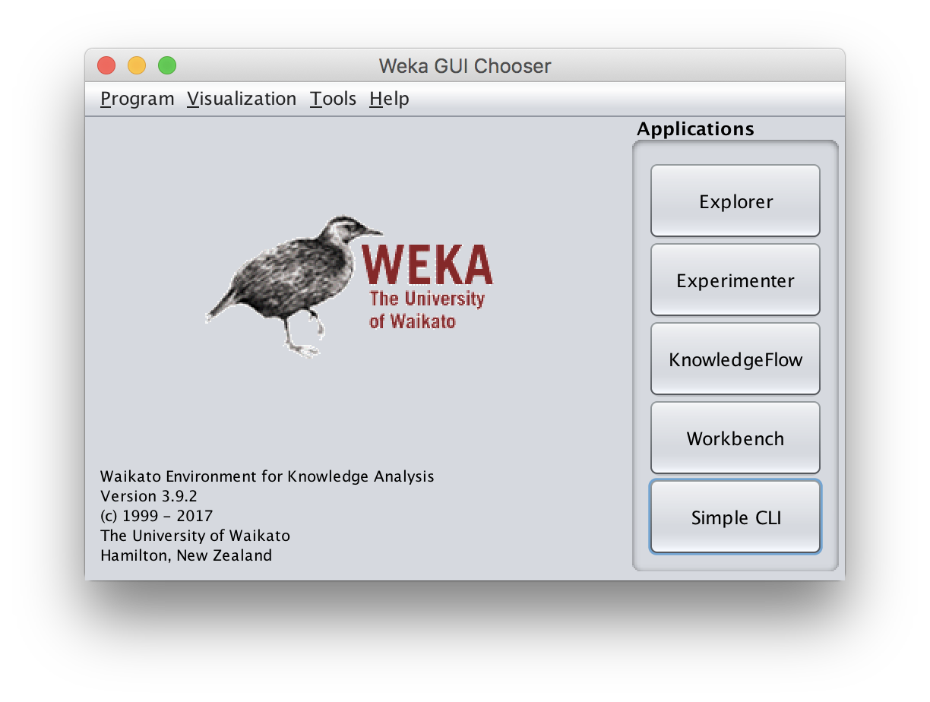
Open Weka app
cd /Applications/weka
java -jar weka.jar
Available apps opti-mized for different tasks
Start with Explorer

Slide 16
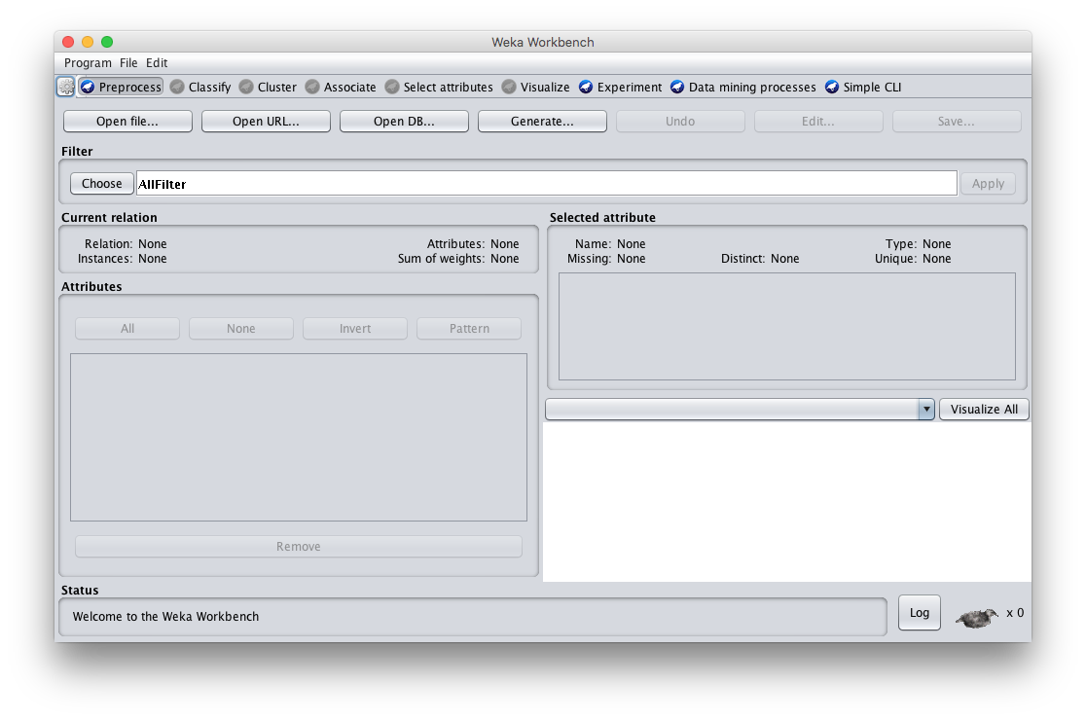
Explorer Interface

Slide 17
Starts with Data Preprocessing; open file to load data

Slide 18
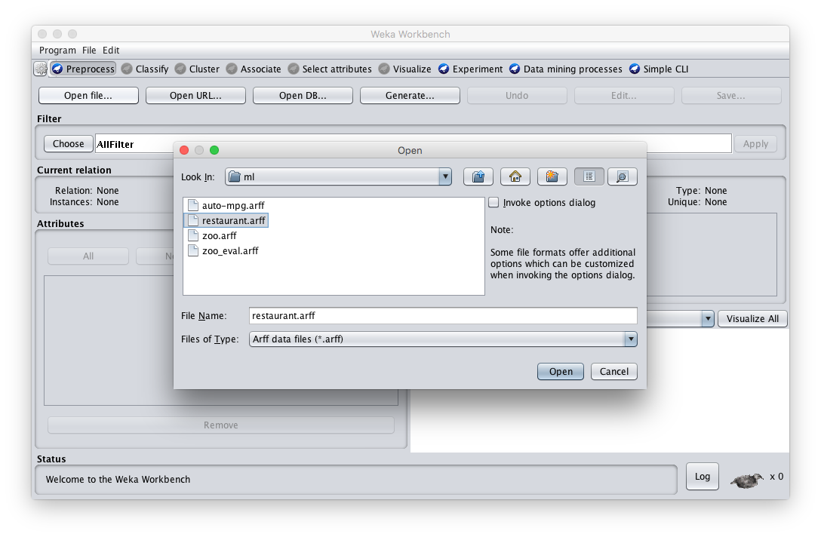
Load restaurant.arff training data

Slide 19
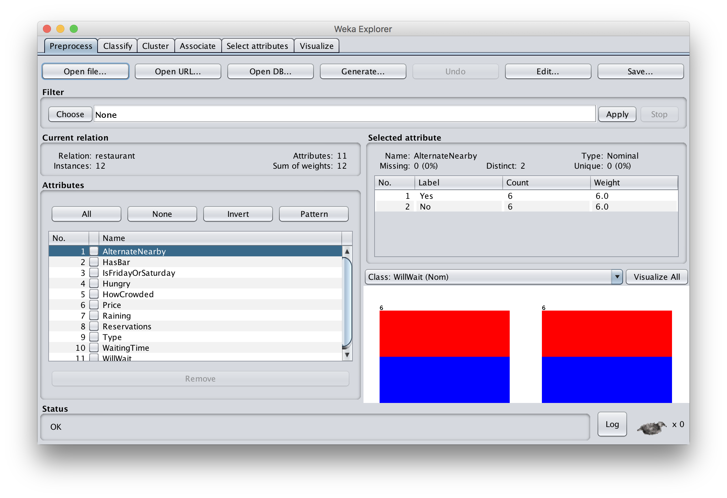
We can inspect/remove features

Slide 20
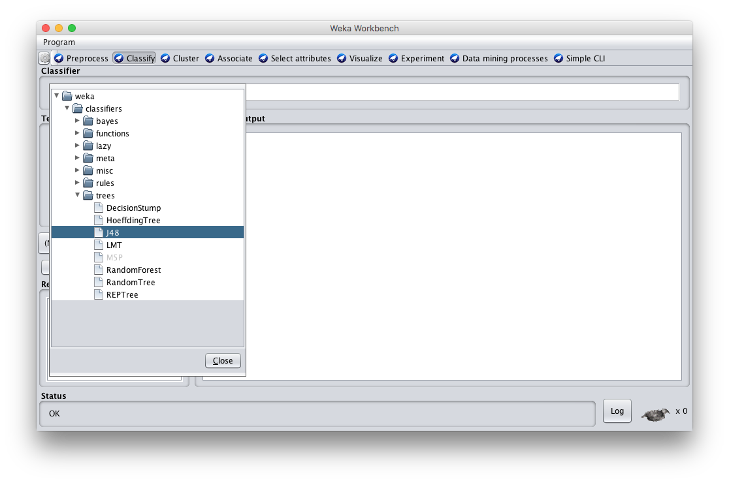
Select classify then J48

Slide 21
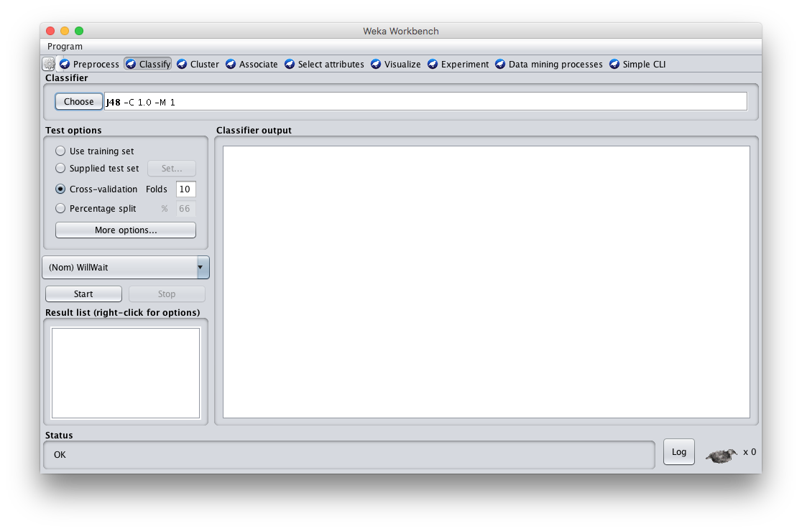
Adjust parameters & training options; click start to train

Slide 22
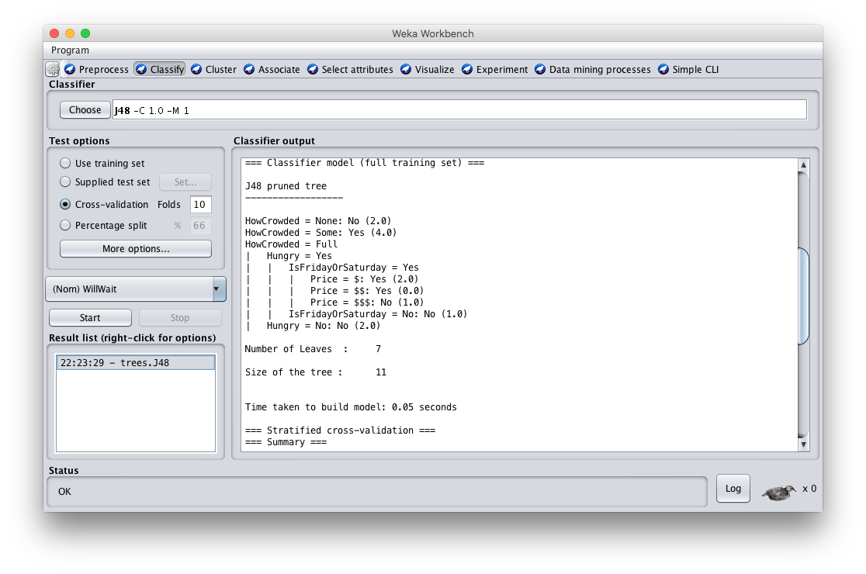
See the training results

Slide 23
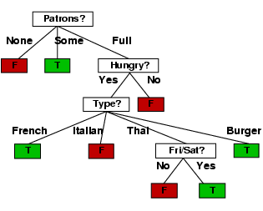
Compare results
HowCrowded = None: No (2.0)
HowCrowded = Some: Yes (4.0)
HowCrowded = Full
| Hungry = Yes
| | IsFridayOrSaturday = Yes
| | | Price = $: Yes (2.0)
| | | Price = $$: Yes (0.0)
| | | Price = $$$: No (1.0)
| | IsFridayOrSaturday = No: No (1.0)
| Hungry = No: No (2.0)
J48 pruned tree: nodes:11; leaves:7, max depth:4
ID3 tree: nodes:12; leaves:8, max depth:4

Slide 24

Weka vs. svm_light vs. …
Weka: good for experimenting with different ML algorithms
Other tools are more efficient &scalable
Scikit-learn: popular suite of open-source machine-learning tools in Python
  Built on NumPy, SciPy, and matplotlib for efficiency
  Use anaconda or do pip install scikit-learn
For SVMs, many use svm_light
Deep learning: some support

