Slide 1
Machine Learning overview Chapter 18, 21

Slide 2
What is learning?
Learning denotes changes in a system that ... enable a system to do the same task more efficiently the next time – Herbert Simon
Learning is constructing or modifying representations of what is being experienced – Ryszard Michalski
Learning is making useful changes in our minds – Marvin Minsky

Slide 3
Why study learning?
Understand and improve efficiency of human learning
Use to improve methods for teaching and tutoring people (e.g., better computer-aided instruction)
Discover new things or structure previously unknown
Examples: data mining, scientific discovery
Fill in skeletal or incomplete specifications in a domain
Large, complex systems can’t be completely built by hand & require dynamic updating to incorporate new information
Learning new characteristics expands the domain or expertise and lessens the “brittleness” of the system
Build agents that can adapt to users, other agents, and their environment

Slide 4
AI & Learning Today
Neural network learning was popular in 50s and 60s
Marvin Minsky did neural networks for his dissertation
Replaced in 60s & 70s with paradigm based on manually encoding and using symbolic knowledge
cf Perceptrons, Minsky & Papet book showing limitations of the perceptron model of neural networks
In the 90s, more data and the Web drove interest in new statistical machine learning (ML) techniques and new data mining applications
Today, ML techniques & big data play an important role almost all successful intelligent systems

Slide 5
Machine Leaning Successes
Games: chess, go, poker, …
Sentiment analysis
Spam detection
Machine translation, spoken language understanding, named entity detection
Autonomous vehicles
Motion recognition (Microsoft X-Box)
Understanding digital images
Recommender systems (Netflix, Amazon)
Credit card fraud detection

Slide 6
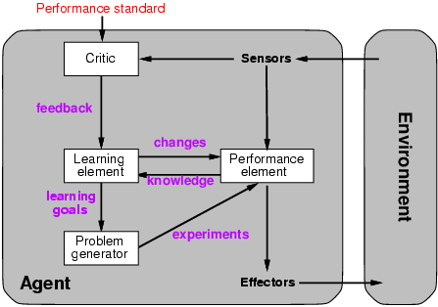
A general model of learning agents

Slide 7
Many paradigms for machine learning
Rote learning: 1-1 mapping from inputs to stored representa-tion, learning by memorization, association-based storage & retrieval
Induction: Use specific examples to reach general conclusions
Clustering: Unsupervised discovery of natural groups in data
Analogy: Find correspondence between different representa-tions
Discovery: Unsupervised, specific goal not given
Genetic algorithms: Evolutionary search techniques, based on an analogy to survival of the fittest
Reinforcement – Feedback (positive or negative reward) given at the end of a sequence of steps

Slide 8
What we will and won’t cover
We’ll look at a few popular machine learning problems and algorithms
Take CMSC 478/678 Machine Leaning for more
Use online resources & experiment on your own
We’ll focus on when/how to use techniques and only touch on how/why they work
We’ll cover basic methodology and evaluation
We’ll use Weka platform for examples & demos
Great for exploration and learning

Slide 9
Types of learning problems
Supervised: learn from training examples
Regression
Classification: Decision Trees, SVM
Unsupervised: learn w/o training examples
Clustering
Dimensionality reduction
Reinforcement learning: improve performance using feedback from actions taken
Lots more we won’t cover
Hidden Marrkov models, Learning to rank, Semi-supervised learning, Active learning …

Slide 11
Supervised learning
Given training examples of inputs & corres-ponding outputs, produce “correct” outputs for new inputs
Two imnportant scenarios:
Classification: outputs typically labels (goodRisk, badRisk); learn a decision boundary that separates classes
Regression: aka “curve fitting” or “function approximation.” Learn a continuous input-output mapping from (possibly noisy) examples

Slide 12
Unsupervised Learning
Given only unlabeled data as input, learn some sort of structure, e.g.:
Clustering: group Facebook friends based on similarity of posts and friends
Embeddings: Find sets of words whose meanings are related (e.g., doctor, hospital)
Topic modelling: Induce N topics and words most common in documents about each

Slide 13
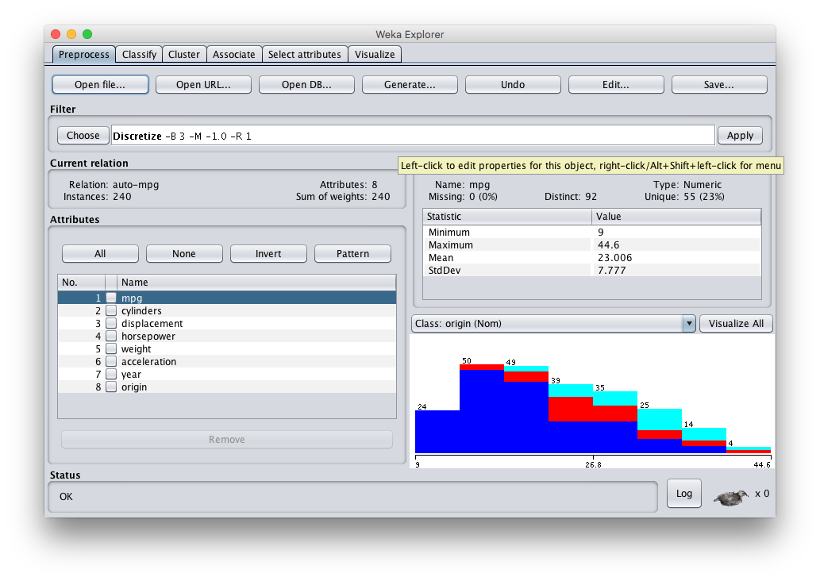
Weka: Waikato Environment for Knowledge Analysis
Open source Java software for ML and datamining
http://cs.waikato.ac.nz/ml/weka/

