Slide 1
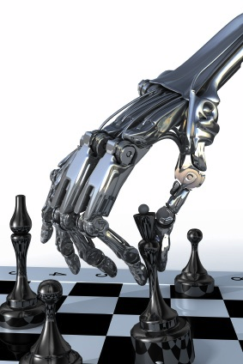
More on Games
Chapter 6
Some material adopted from notes by Charles R. Dyer, University of Wisconsin-Madison

Slide 2
Overview
Stochastic games
Other issues
General game playing

Slide 3
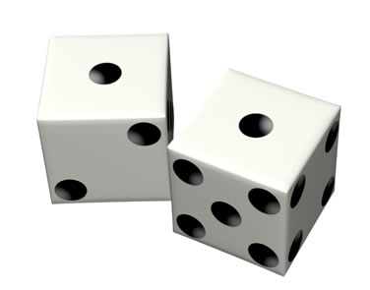
Stochastic Games
In real life, unpredictable external events can put us into unforeseen situations
Many games introduce unpredictability through a random element, such as the throwing of dice
These offer simple scenarios for problem solving with adversaries and uncertainty

Slide 4
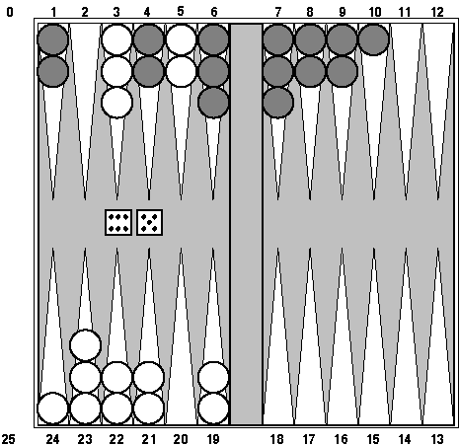
Example: Backgammon
Backgammon is a two-player game with uncertainty
Players roll dice to determine what moves can be made
White has just rolled 5 and 6 and has four legal moves:
5-10, 5-11
5-11, 19-24
5-10, 10-16
5-11, 11-16
Good for exploring decision making in adversarial prob-lems involving skill and luck

Slide 5
Why can’t we use MiniMax?
Before a player chooses her move, she rolls dice and then knows exactly what they are
And the immediate outcome of each move is also known
But she does not know what moves her opponent will have available in the future
Need to adapt MiniMax to handle this

Slide 6
MiniMax trees with Chance Nodes

Slide 7
Understanding the notation
Max’s move 1
Max’s move 2
Min flips coin
Outcome probability
Min knows two possible moves
Apply static evaluator here
Board state includes chance outcome determining what moves are available

Slide 8
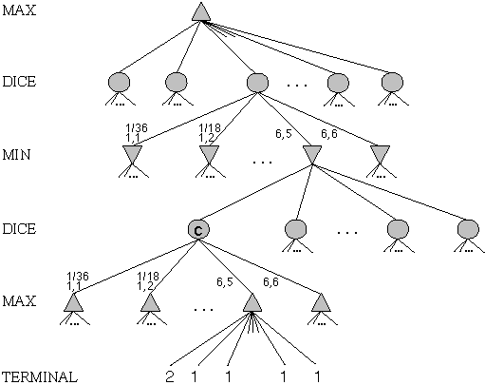
Game trees with chance nodes
Chance nodes (circles) represent random events
For a random event with N outcomes, chance node has N children, each with a probability
2 dice: 21 distinct outcomes
Use minimax to compute values for MAX and MIN nodes
Use expected values for chance nodes
Chance nodes over max node:
expectimax(C) = ∑_{i}(P(d_{i})*maxval(i))
Chance nodes over min node: expectimin(C) = ∑_{i}(P(d_{i})*minval(i))
Min
Rolls
Max
Rolls

Slide 9
Impact on Lookahead
Dice rolls increase branching factor
There are 21 possible rolls with two dice
Backgammon: ~20 legal moves for given roll
~6K with 1-1 roll (get to roll again!)
At depth 4: 20 * (21 * 20)**3 ≈ 1.2B boards
As depth increases, probability of reaching a given node shrinks
lookahead’s value diminished and alpha-beta pruning is much less effective
TDGammon used depth-2 search + good static evaluator to achieve world-champion level
Notes:
1 1
1 2
1 3
1 4
1 5
1 6
2 2
2 3
2 4
2 5
2 6
3 3
3 4
3 5
3 6
4 4
4 5
4 6
5 5
5 6
6 6
Possible outcomes rolling two dice if they are not considered distinguishable
1 1
1 2
1 3
1 4
1 5
1 6
2 2
2 3
2 4
2 5
2 6
3 3
3 4
3 5
3 6
4 4
4 5
4 6
5 5
5 6
6

Slide 10
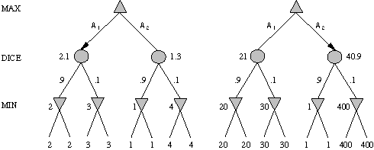
Meaning of the evaluation function
A1 is best move
A2 is best move
2 outcomes with probabilities {.9, .1}
With probabilities and expected values we must be careful about the meaning of values returned by static evaluator
relative-order preserving change of static evaluation values doesn’t change minimax decision, but could here
Linear transformations are OK

Slide 11
Games of imperfect information
E.g. card games where opponent's initial hand unknown
Can calculate probability for each possible deal
Like having one big dice roll at beginning of game
Possible approach: minimax over each action in each deal; choose action with highest expected value over all deals
Special case: if action optimal for all deals, it's optimal
GIB bridge program, approximates this idea by
Generating 100 deals consistent with bidding
Picking action that wins most tricks on average

Slide 12
High-Performance Game Programs
Many game programs based on alpha-beta + iterative deepening + extended/singular search + transposition tables + huge databases + …
For instance, Chinook searched all checkers configurations with ≤ 8 pieces to create endgame database of 444 billion board configurations
Methods are general, but implementations improved by many specifically tuned-up enhancements (e.g., the evaluation functions)

Slide 13
Other Issues
Multi-player games, no alliances
E.g., many card games like Hearts
Multi-player games with alliances
E.g., Risk
More on this when we discuss game theory
Good model for a social animal like humans, where we are always balancing cooperation and competition

Slide 14
AI and Games II
AI also of interest to the video game industry
Many games include ‘agents’ controlled by the game program that could be
Adversaries, in first person shooter games
Collaborators, in a virtual reality game
Some game environments used as AI challenges
2009 Mario AI Competition
Unreal Tournament bots

Slide 15
General Game Playing
General Game Playing is an idea developed by Professor Michael Genesereth of Stanford
See his site for more information
Goal: don’t develop specialized systems to play specific games (e.g., Checkers) well
Goal: design AI programs to be able to play more than one game successfully
Work from a description of a novel game

Slide 16
General Game Playing
Stanford’s GGP is a Web-based system
Complete, logical specification of many different games in terms of:
relational descriptions of states
legal moves and their effects
goal relations and their payoffs
Management of matches between automated players and of competitions involving many players and games

Slide 17
GGP
Input: logical description of a game in a custom game description language
Game bots must
Learn how to play legally from description
Play well using general problem solving strategies
Improve using general machine learning techniques
Regular completions 2005-2016, $10K prize
Java General Game Playing Base Package

Slide 18
GGP Peg Jumping Game
; http://games.stanford.edu/gamemaster/games-debug/peg.kif
(init (hole a c3 peg))
(init (hole a c4 peg))
…
(init (hole d c4 empty))
…
(<= (next (pegs ?x)) (does jumper (jump ?sr ?sc ?dr ?dc)) (true (pegs ?y)) (succ ?x ?y)) (<= (next (hole ?sr ?sc empty)) (does jumper (jump ?sr ?sc ?dr ?dc)))
…
(<= (legal jumper (jump ?sr ?sc ?dr ?dc)) (true (hole ?sr ?sc peg)) (true (hole ?dr ?dc empty)) (middle ?sr ?sc ?or ?oc ?dr ?dc) (true (hole ?or ?oc peg)))
…
(<= (goal jumper 100) (true (hole a c3 empty)) (true (hole a c4 empty))
(true (hole a c5 empty))
…
(succ s1 s2)
(succ s2 s3)
…

Slide 19
Tic-Tac-Toe in GDL
(role xplayer)
(role oplayer)
;; Initial State
(init (cell 1 1 b))
(init (cell 1 2 b))
...
(init (control xplayer))
;; Dynamic Components
(<= (next (cell ?m ?n x))
(does xplayer (mark ?m ?n))
(true (cell ?m ?n b)))
(<= (next (cell ?m ?n o))
(does oplayer (mark ?m ?n))
(true (cell ?m ?n b)))
…
...
(<= (next (control xplayer))
(true (control oplayer)))
(<= (legal ?w (mark ?x ?y))
(true (cell ?x ?y b))
(true (control ?w)))
(<= (legal xplayer noop)
(true (control oplayer)))
(<= (legal oplayer noop)
(true (control xplayer)))
...
(<= (goal xplayer 100) (line x))
...
(<= (goal oplayer 0) (line x))
...
See ggp-base repository: http://bit.ly/RB49q5

Slide 20
A example of General Intelligence
Artificial General Intelligence describes research that aims to create machines capable of general intelligent action
Harkens back to early visions of AI, like McCarthy’s Advise Taker
See Programs with Common Sense (1959)
A response to frustration with narrow specialists, often seen as “hacks”
See On Chomsky and the Two Cultures of Statistical Learning

Slide 21
Why study games?
Interesting, hard problems that require minimal “initial structure”
Clear criteria for success
A way to study problems involving {hostile, adversarial, competing} agents and the uncertainty of interacting with the natural world
People have used them to asses their intelligence
Fun, good, easy to understand, PR potential
Games often define very large search spaces
chess 35¹⁰⁰ nodes in search tree, 10⁴⁰ legal states

Slide 22
Perspective on Games: Con and Pro
“Chess is the Drosophila of artificial intelligence. However, computer chess has developed much as genetics might have if the geneticists had concentrated their efforts starting in 1910 on breeding racing Drosophila. We would have some science, but mainly we would have very fast fruit flies.” John McCarthy, Stanford
“Saying Deep Blue doesn’t really think about chess is like saying an airplane doesn't really fly because it doesn't flap its wings.”
Drew McDermott, Yale

