Slide 1
Intelligent Agents
Chapter 2

Slide 2
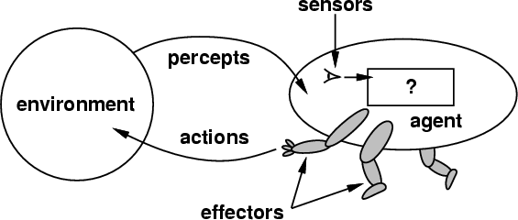
How do you design an intelligent agent?
Intelligent agents perceive environment via sensors and act rationally on them with their effectors
Discrete agents receive percepts one at a time, and map them to a sequence of discrete actions
General properties
Reactive to the environment
Pro-active or goal-directed
Interacts with other agents through communication or via the environment
Autonomous

Slide 3
sensors/percepts and effectors/actions ?
Humans have
Sensors: Eyes (vision), ears (hearing), skin (touch), tongue (gustation), nose (olfaction), neuromuscular system (proprioception)
Percepts:
At the lowest level: electrical signals from these sensors
After preprocessing: objects in the visual field (location, textures, colors, …), auditory streams (pitch, loudness, direction), …
Effectors: limbs, digits, eyes, tongue, …
Actions: lift a finger, turn left, walk, run, carry an object, …
The Point: percepts and actions need to be carefully defined, possibly at different levels of abstraction

Slide 4
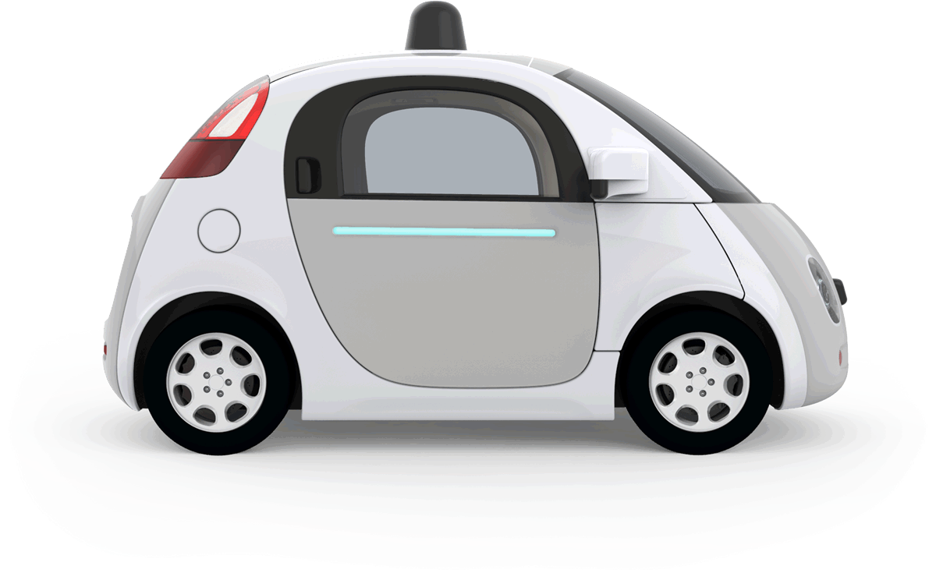
Example: autonomous taxi
Percepts: Video, sonar, speedometer, odometer, engine sensors, keyboard input, microphone, GPS, …
Actions: Steer, accelerate, brake, horn, speak, …
Goals: Maintain safety, reach destination, maximize profits (fuel, tire wear), obey laws, provide passenger comfort, …
Environment: U.S. urban streets, freeways, traffic, pedestrians, weather, customers, …
Different aspects of driving may require different types of agent programs!

Slide 5
Rationality
Ideal rational agents should, for each percept sequence, act to maximize expected performance measure based on
(1) the percept sequence, and
(2) its built-in and acquired knowledge
Rationality includes information gathering -- If you don’t know something, find out!
Rationality → Need a performance measure to say how well a task has been achieved
Types of performance measures: false alarm (false positive) and false dismissal (false negative) rates, speed, resources required, effect on environment, etc.

Slide 6
Autonomy
A system is autonomous to extent that its behavior is determined by its experience
A system isn’t autonomous if guided by its designer according to a priori decisions
An autonomous agent can always say “no”
To survive, agents must have:
Enough built-in knowledge to survive
The ability to learn

Slide 7
Some agent types
(0) Table-driven agents
Use percept sequence/action table to find the next action. Implemented by a (large) lookup table
(1) Simple reflex agents
Based on condition-action rules, implemented with an appropriate production system; stateless devices with no memory of past world states
(2) Agents with memory
have internal state used to keep track of past states of the world
(3) Agents with goals
Agents with a state and goal information describing desirable situations. Agents of this kind take future events into consideration.
(4) Utility-based agents
base decisions on classic axiomatic utility theory in order to act rationally
simple
complex

Slide 8
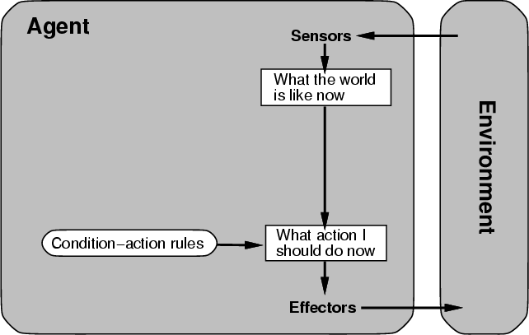
(0/1) Table-driven/reflex agent architecture
Use percept sequence/action table to find the next action. Implemented by a (large) lookup table

Slide 9
(0) Table-driven agents
Table lookup of percept-action pairs mapping from every possible perceived state to optimal action for it
Problems:
Too big to generate and to store (Chess has about 10¹²⁰ states, for example)
No knowledge of non-perceptual parts of the current state
Not adaptive to changes in the environment; entire table must be updated if changes occur
Looping: Can’t make actions conditional on previous actions/states

Slide 10
(1) Simple reflex agents
Rule-based reasoning maps percepts to optimal action; each rule handles collection of perceived states (aka reactive agents)
Problems
Still usually too big to generate and to store
Still no knowledge of non-perceptual parts of state
Still not adaptive to changes in environment; collection of rules must be updated if changes occur
Still can’t condition actions on previous state
Difficult to engineer if the number of rules is large due to conflicts

Slide 11
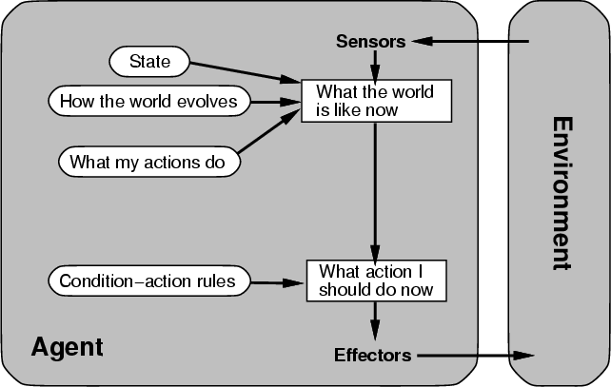
(2) Architecture for an agent with memory
internal state used to keep track of past states of the world

Slide 12
(2) Agents with memory
Encode internal state of world to remember past as contained in earlier percepts
Note: sensors don’t usually give entire world state at each input, so environment perception is captured over time.
State used to encode different "world states" that generate the same immediate percept
Requires representing change in the world
We might represent just latest state, but then can’t reason about hypothetical courses of action

Slide 13
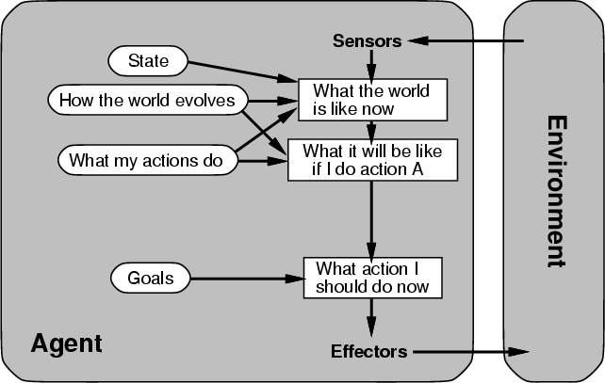
(3) Architecture for goal-based agent
state and goal information describe desirable situations allowing agent to take future events into consideration

Slide 14
(3) Goal-based agents
Deliberative instead of reactive
Choose actions to achieve a goal
Goal is a description of a desirable situation
Keeping track of current state often not enough: must add goals to decide which situations are good
Achieving goal may require long action sequence
Model action consequences: “what happens if I do...?”
Use planning algorithms to produce action sequences

Slide 15
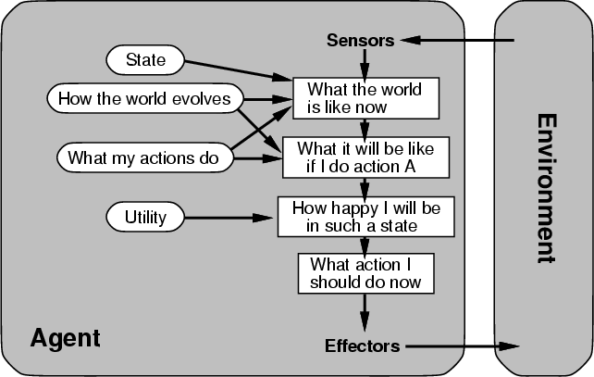
(4) a complete utility-based agent
base decisions on utility theory in order to act rationally

Slide 16
(4) Utility-based agents
For multiple possible alternatives, how to decide which is best?
Goals give a crude distinction between happy and unhappy states, but often need a performance measure for degree
Utility function U: State→Reals gives measure of success/happiness for given state
Allows decisions comparing choices between conflicting goals and likelihood of success and importance of goal (if achievement uncertain)

Slide 17
Properties of Environments
Fully/Partially observable
If agent’s sensors give complete state of environment needed to choose action, environment is fully observable
Such environments are convenient, freeing agents from keeping track of the environment’s changes
Deterministic/Stochastic
Environment is deterministic if next state is completely determined by current state and agent’s action
Stochastic (i.e., non-deterministic) environments have multiple, unpredictable outcomes
In fully observable, deterministic environments agents need not deal with uncertainty

Slide 18
Properties of Environments
Episodic/Sequential
In episodic environments subsequent episodes don’t depend on actions in previous episodes
In sequential environments agent engages in a series of connected episodes
Episodic environments don’t require agent to plan ahead
Static/Dynamic
Static environments doesn’t change as agent is thinking
The passage of time as agent deliberates is irrelevant
The agent needn’t observe world during deliberation

Slide 19
Properties of Environments III
Discrete/Continuous
If number of distinct percepts and actions is limited, environment is discrete, otherwise it’s continuous
Single agent/Multiagent
In environments with other agents, agent must consider strategic, game-theoretic aspects of environment (for either cooperative or competitive agents)
Most engineering environments don’t have multiagent properties, whereas most social and economic systems get their complexity from interactions of (more or less) rational agents

Slide 20
Characteristics of environments
 | Fully observable? | Deterministic? | Episodic? | Static? | Discrete? | Single agent?
Solitaire
Backgammon
Taxi driving
Internet shopping
Medical diagnosis
A Yes in a cell means that aspect is simpler; a No more complex

Slide 21
Characteristics of environments
 | Fully observable | Deterministic | Episodic | Static | Discrete? | Single agent?
Solitaire | No | Yes | Yes | Yes | Yes | Yes
Backgammon
Taxi driving
Internet shopping
Medical diagnosis
A Yes in a cell means that aspect is simpler; a No more complex

Slide 22
Characteristics of environments
 | Fully observable? | Deterministic? | Episodic? | Static? | Discrete? | Single agent?
Solitaire | No | Yes | Yes | Yes | Yes | Yes
Backgammon | Yes | No | No | Yes | Yes | No
Taxi driving
Internet shopping
Medical diagnosis
A Yes in a cell means that aspect is simpler; a No more complex

Slide 23
Characteristics of environments
 | Fully observable? | Deterministic? | Episodic? | Static? | Discrete? | Single agent?
Solitaire | No | Yes | Yes | Yes | Yes | Yes
Backgammon | Yes | No | No | Yes | Yes | No
Taxi driving | No | No | No | No | No | No
Internet shopping
Medical diagnosis
A Yes in a cell means that aspect is simpler; a No more complex

Slide 24
Characteristics of environments
 | Fully observable? | Deterministic? | Episodic? | Static? | Discrete? | Single agent?
Solitaire | No | Yes | Yes | Yes | Yes | Yes
Backgammon | Yes | No | No | Yes | Yes | No
Taxi driving | No | No | No | No | No | No
Internet shopping | No | No | No | No | Yes | No
Medical diagnosis
A Yes in a cell means that aspect is simpler; a No more complex

Slide 25
Characteristics of environments
→ Lots of real-world domains fall into the hardest case!
 | Fully observable? | Deterministic? | Episodic? | Static? | Discrete? | Single agent?
Solitaire | No | Yes | Yes | Yes | Yes | Yes
Backgammon | Yes | No | No | Yes | Yes | No
Taxi driving | No | No | No | No | No | No
Internet shopping | No | No | No | No | Yes | No
Medical diagnosis | No | No | No | No | No | Yes
A Yes in a cell means that aspect is simpler; a No more complex

Slide 26
Summary
Agents perceive and act in an environment, have an architecture and are implemented by an agent program
Ideal agents chooses actions to maximize their expected performance, given percept sequence so far
Autonomous agents use own experience rather than built-in knowledge of environ-ment by designer

Slide 27
Summary
Agent programs map percepts to actions and update their internal state
Reflex agents respond immediately to percepts
Goal-based agents act to achieve their goal(s)
Utility-based agents maximize their utility function
Representing knowledge is important for good agent design
Most challenging environments are partially observable, stochastic, sequential, dynamic, and continuous and contain multiple agents

Slide 28
Summary
Not all AI problems a good fit for or require an agent agent model, e.g., playing solitaire
Nor are many AI tasks you might be asked to solve:
Classify movie reviews as negative, neutral or positive
Locate faces of people in an image
An efficient theorem prover
Learn preferred thermostat settings for each hour of each day of a week

