Slide 1
CMSC 471 Introduction to Artificial Intelligence section 1 Course Overview
Spring 2018

Slide 2
Today’s class
Course overview
Introduction
Brief history of AI
What is AI? (and why is it so interesting?)
What’s the state of AI now?

Slide 3
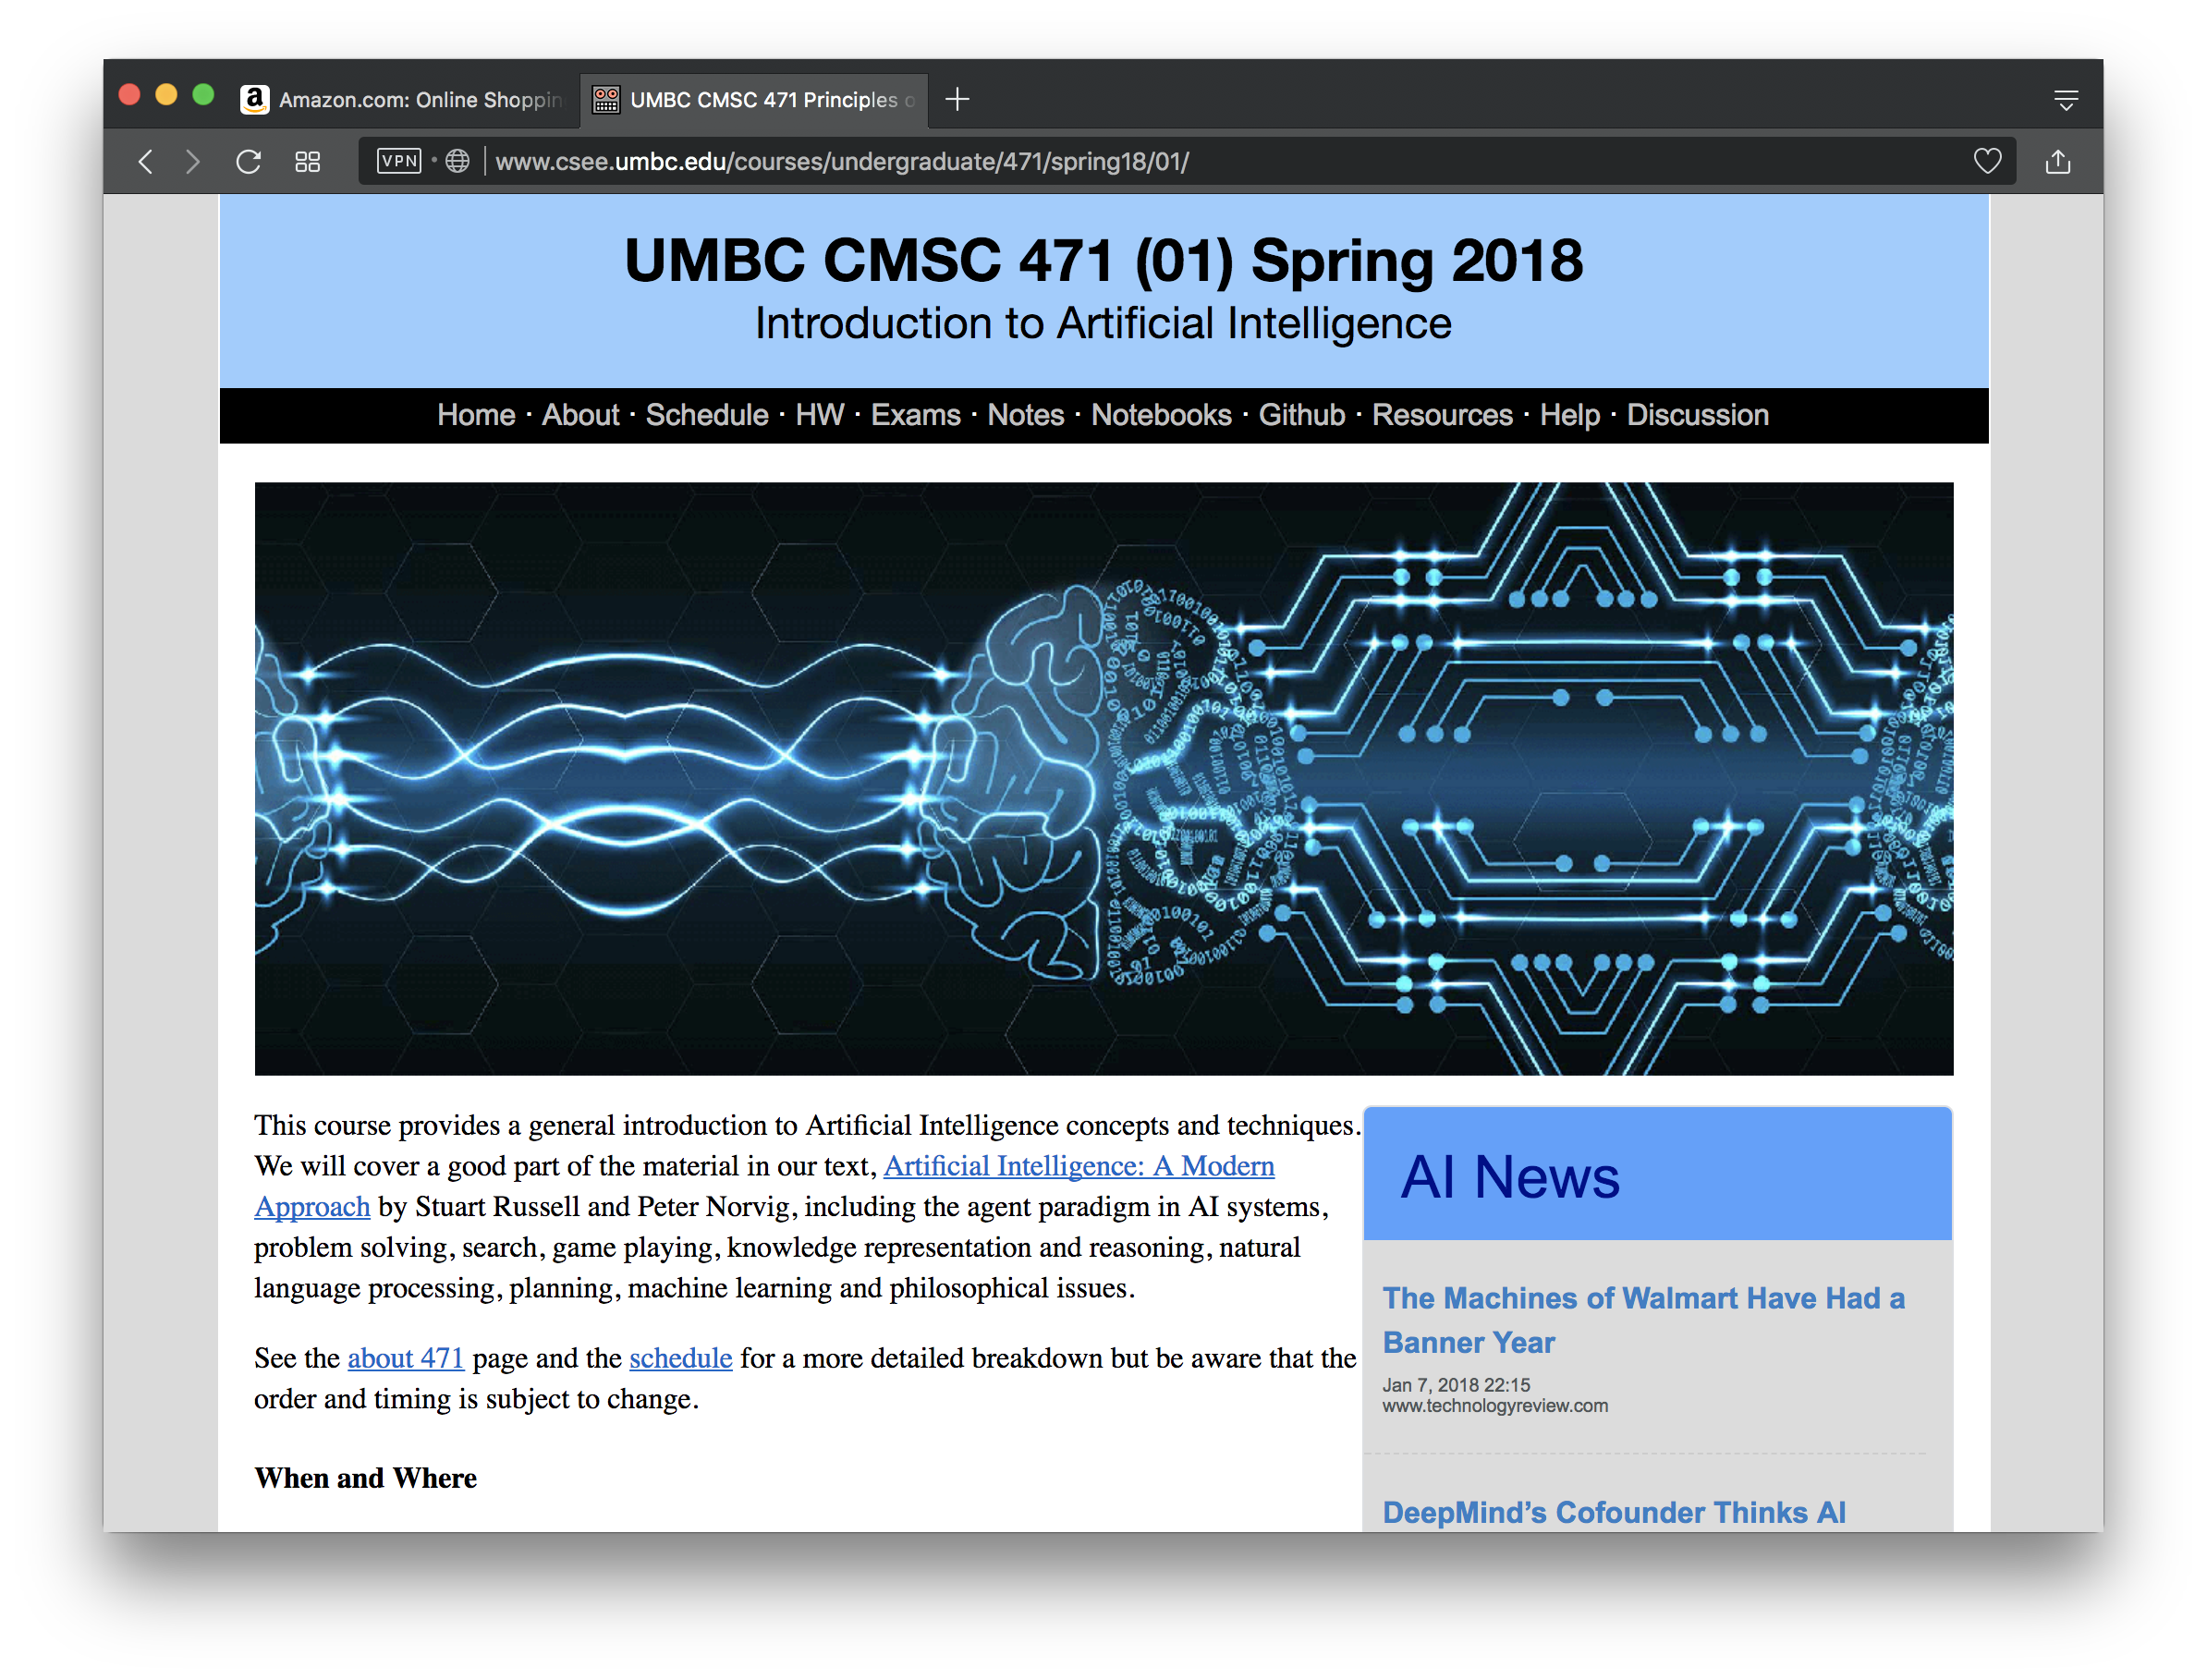
http://bit.ly/471s18

Slide 4
Homework and grading policies
Six to eight quizzes based on readings
Six to eight homework assignments (mix of written and programming)
One-time extensions of up to a week may be granted if requested in advance
Last-minute requests for extensions probably will not be granted
Do the reading before each class!

Slide 5
Programming
Programming assignments in Python
We’ll use Python in the notes and examples
This is a good chance for you to learn Python
We’ll use GitHub to share code, Jupyter notebooks and for HW submission
Some assignments may require using other systems
E.g., C5 decision tree learning system, Weka Machine learning environments

Slide 6
Exams
Midterm exam
In class in mid October
About 15% of grade
Final exam
At regularly scheduled time
About 25% of grade
Comprehensive, but with an emphasis on the last half of material (e.g., 30/70 split)

Slide 7
Instructor availability
Professor Finin, finin@umbc.edu
Office hours: by arrangement
Drop in whenever my door is open
Direct general questions to Piazza first
We will try to respond to discussion list postings within 24 hours
TA: Muhammad Mahbubur Rahman
mrahman1@umbc.edu,
ITE 331
office hours tbd

