Slide 1
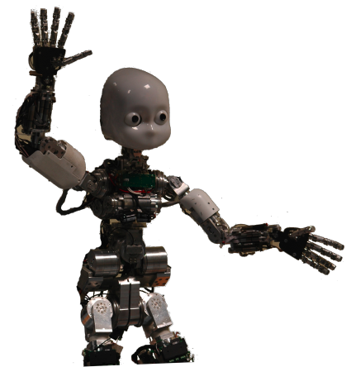
Machine Learning: Methodology
Chapter 18.1-18.3

Slide 2
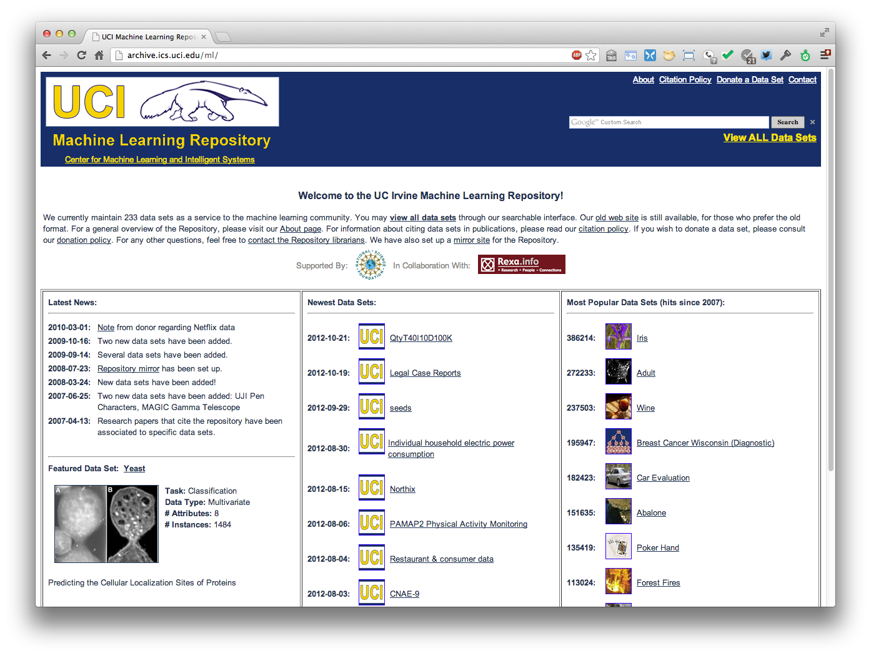
http://archive.ics.uci.edu/ml
233 data sets

Slide 3
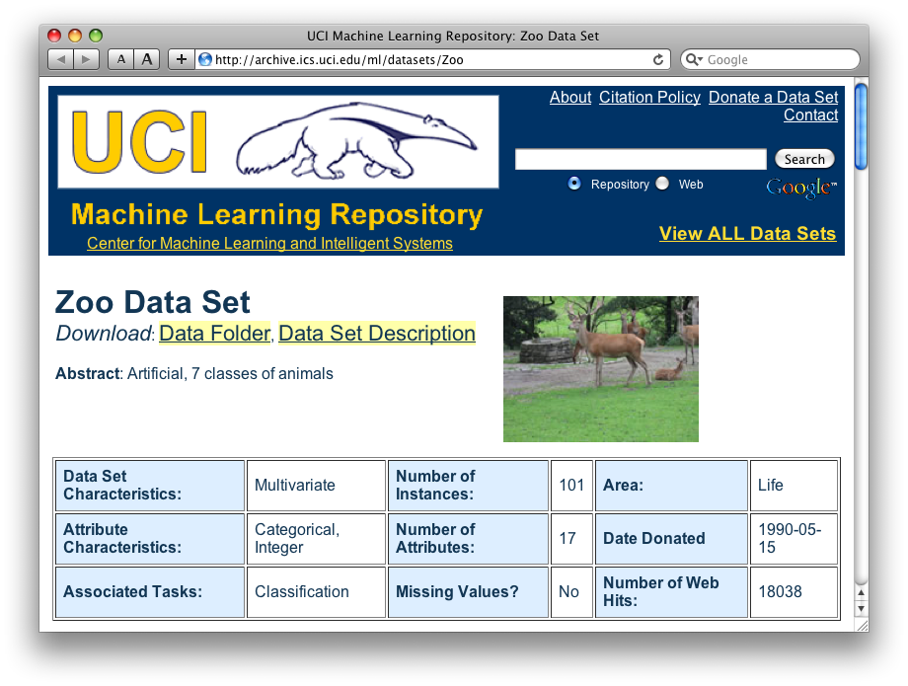
http://archive.ics.uci.edu/ml/datasets/Zoo

Slide 4
Zoo data
animal name: string
hair: Boolean
feathers: Boolean
eggs: Boolean
milk: Boolean
airborne: Boolean
aquatic: Boolean
predator: Boolean
toothed: Boolean
backbone: Boolean
breathes: Boolean
venomous: Boolean
fins: Boolean
legs: {0,2,4,5,6,8}
tail: Boolean
domestic: Boolean
catsize: Boolean
type: {mammal, fish, bird, shellfish, insect, reptile, amphibian}
101 examples
aardvark,1,0,0,1,0,0,1,1,1,1,0,0,4,0,0,1,mammal
antelope,1,0,0,1,0,0,0,1,1,1,0,0,4,1,0,1,mammal
bass,0,0,1,0,0,1,1,1,1,0,0,1,0,1,0,0,fish
bear,1,0,0,1,0,0,1,1,1,1,0,0,4,0,0,1,mammal
boar,1,0,0,1,0,0,1,1,1,1,0,0,4,1,0,1,mammal
buffalo,1,0,0,1,0,0,0,1,1,1,0,0,4,1,0,1,mammal
calf,1,0,0,1,0,0,0,1,1,1,0,0,4,1,1,1,mammal
carp,0,0,1,0,0,1,0,1,1,0,0,1,0,1,1,0,fish
catfish,0,0,1,0,0,1,1,1,1,0,0,1,0,1,0,0,fish
cavy,1,0,0,1,0,0,0,1,1,1,0,0,4,0,1,0,mammal
cheetah,1,0,0,1,0,0,1,1,1,1,0,0,4,1,0,1,mammal
chicken,0,1,1,0,1,0,0,0,1,1,0,0,2,1,1,0,bird
chub,0,0,1,0,0,1,1,1,1,0,0,1,0,1,0,0,fish
clam,0,0,1,0,0,0,1,0,0,0,0,0,0,0,0,0,shellfish
crab,0,0,1,0,0,1,1,0,0,0,0,0,4,0,0,0,shellfish
…

Slide 5
Zoo example
aima-python> python
>>> from learning import *
>>> zoo
<DataSet(zoo): 101 examples, 18 attributes>
>>> dt = DecisionTreeLearner()
>>> dt.train(zoo)
>>> dt.predict(['shark',0,0,1,0,0,1,1,1,1,0,0,1,0,1,0,0])
'fish'
>>> dt.predict(['shark',0,0,0,0,0,1,1,1,1,0,0,1,0,1,0,0])
'mammal’

Slide 6
Evaluation methodology (1)
Standard methodology:
  1. Collect large set of examples with correct classifications
  2. Randomly divide collection into two disjoint sets: training and test
  3. Apply learning algorithm to training set giving hypothesis H
  4. Measure performance of H w.r.t. test set

Slide 7
Evaluation methodology (2)
Important: keep the training and test sets disjoint!
Study efficiency & robustness of algorithm: repeat steps 2-4 for different training sets & training set sizes
On modifying algorithm, restart with step 1 to avoid evolving algorithm to work well on just this collection

Slide 8
Evaluation methodology (3)
Common variation on methodology:
  1. Collect large set of examples with correct classifications
  2. Randomly divide collection into two disjoint sets: development and test, and further divide development into devtrain and devtest
  3. Apply learning algorithm to devtrain set giving hypothesis H
  4. Measure performance of H w.r.t. devtest set
  5. Modify approach, repeat 3-4 as needed
  6. Final test on test data

Slide 9
Zoo evaluation
train_and_test(learner, data, start, end) uses data[start:end] for test and the rest for train
  >>> dtl = DecisionTreeLearner
  >>> train_and_test(dtl(), zoo, 0, 10)
  1.0
  >>> train_and_test(dtl(), zoo, 90, 100)
  0.80000000000000004
  >>> train_and_test(dtl(), zoo, 90, 101)
  0.81818181818181823
  >>> train_and_test(dtl(), zoo, 80, 90)
  0.90000000000000002

Slide 10
K-fold Cross Validation
Problem: getting ground truth data expensive
Problem: Need different test data each time we test
Problem: experiments needed to find right feature space & parameters for ML algorithm
Goal: minimize training+test data needed
Idea: split training data into K subsets, use K-1 for training, and one for development testing
Common K values are 5 and 10

Slide 11
Zoo evaluation
cross_validation(learner, data, K, N) does N iterations, each time randomly selecting 1/K data points for test, rest for train
  >>> cross_validation(dtl(), zoo, 10, 20)
  0.95500000000000007
leave1out(learner, data) does len(data) trials, each using one element for test, rest for train
  >>> leave1out(dtl(), zoo)
  0.97029702970297027

Slide 12
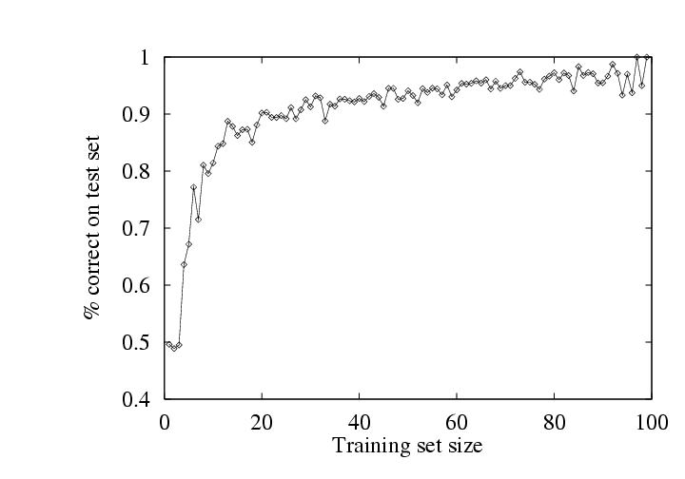
Learning curve
Learning curve = % correct on test set as a function of training set size

Slide 13
Zoo
>>> learningcurve(DecisionTreeLearner(), zoo)
[(2, 1.0), (4, 1.0), (6, 0.98333333333333339), (8, 0.97499999999999998), (10, 0.94000000000000006), (12, 0.90833333333333321), (14, 0.98571428571428577), (16, 0.9375), (18, 0.94999999999999996), (20, 0.94499999999999995), … (86, 0.78255813953488373), (88, 0.73636363636363644), (90, 0.70777777777777795)]

Slide 14
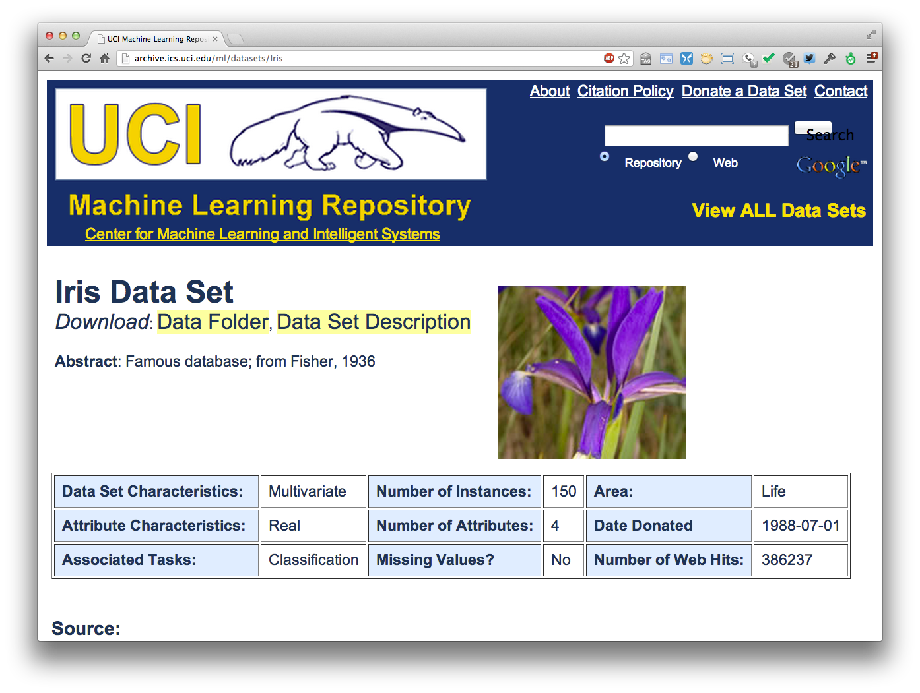
http://archive.ics.uci.edu/ml/datasets/Iris

Slide 15
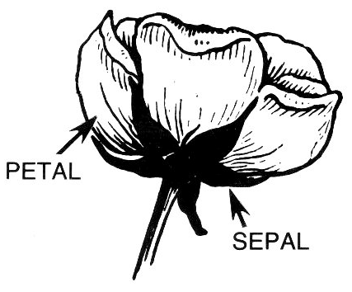
Iris Data
Three classes: Iris Setosa, Iris
Versicolour, Iris Virginica
Four features: sepal length and width, petal length and width
150 data elements (50 of each)
aima-python> more data/iris.csv
5.1,3.5,1.4,0.2,setosa
4.9,3.0,1.4,0.2,setosa
4.7,3.2,1.3,0.2,setosa
4.6,3.1,1.5,0.2,setosa
5.0,3.6,1.4,0.2,setosa
http://code.google.com/p/aima-data/source/browse/trunk/iris.csv

Slide 16
Comparing ML Approaches
The effectiveness of ML algorithms varies de-pending on the problem, data and features used
You may have intuitions, but run experiments
Average accuracy (% correct) is a standard metric
>>> compare([DecisionTreeLearner, NaiveBayesLearner, NearestNeighborLearner], datasets=[iris, zoo], k=10, trials=5)
iris zoo
DecisionTree 0.86 0.94
NaiveBayes 0.92 0.92
NearestNeighbor 0.85 0.96

Slide 17
Confusion Matrix (1)
A confusion matrix can be a better way to show results
For binary classifiers it’s simple and is related to type I and type II errors (i.e., false positives and false negatives)
There may be different costs
for each kind of error
So we need to understand
their frequencies
predicted
a/c | C | ~C
C | True positive | False negative
~C | False positive | True negative
actual

Slide 18
Confusion Matrix (2)
For multi-way classifiers, a confusion matrix is even more useful
It lets you focus in on where the errors are
predicted
 | Cat | Dog | rabbit
Cat | 5 | 3 | 0
Dog | 2 | 3 | 1
Rabbit | 0 | 2 | 11
actual

Slide 19
Accuracy, Error Rate, Sensitivity, Specificity
A\P | C | ¬C
C | TP | FN | P
¬C | FP | TN | N
 | P’ | N’ | All
Class Imbalance Problem:
  One class may be rare, e.g. fraud, HIV-positive, ebola
  Significant majority of the negative class and minority of the positive class
  Sensitivity: True Positive recognition rate
    Sensitivity = TP/P
  Specificity: True Negative recognition rate
    Specificity = TN/N
Classifier Accuracy, or recognition rate: percentage of test set tuples that are correctly classified
  Accuracy = (TP + TN)/All
Error rate: 1 – accuracy, or
  Error rate = (FP + FN)/All
19

Slide 20
On Sensitivity and Specificity
sensitivity measures avoiding of false negatives
specificity measures avoiding false positives
TSA security scenario:
  metal scanners set for low specificity (e.g.trigger on keys) to reduce risk of missing dangerous objects
  result is high sensitivity overall

Slide 21
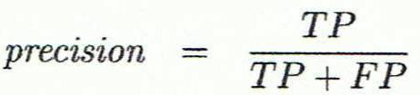
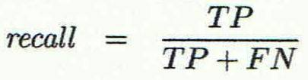
Precision and Recall
Information retrieval uses precision and recall to characterize retrieval effectiveness
  Precision: exactness – what % of tuples that the classifier labeled as positive are actually positive
  Recall: completeness – what % of positive tuples did the classifier label as positive?

Slide 22
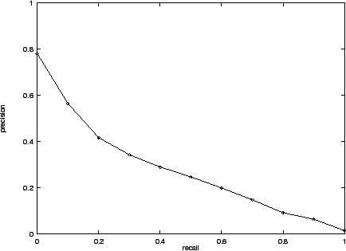
Precision and Recall
In general, increasing one causes the other to decrease
Studying the precision recall curve is informative

Slide 23
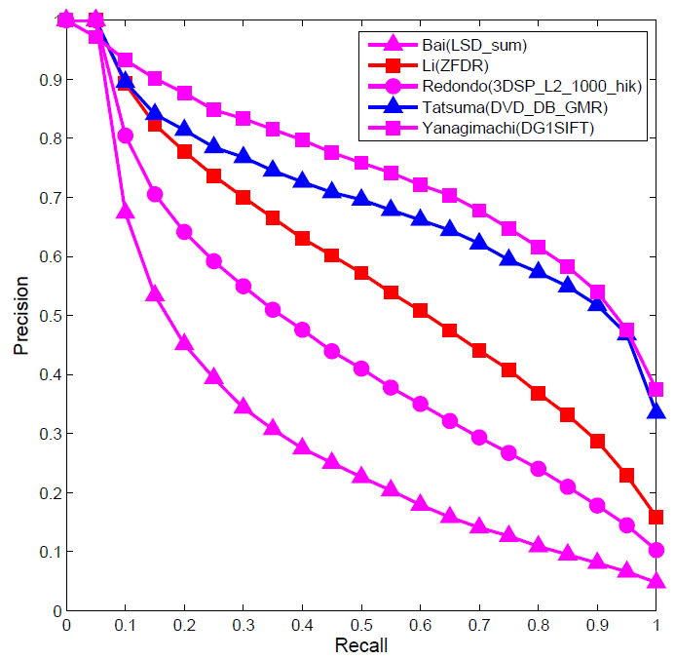
Precision and Recall
If one system’s curve is always above the other, it’s better

Slide 24
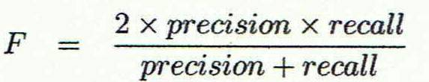
F measure
The F1 measure combines both into a useful single metric
Actual\Predicted class | cancer = yes | cancer = no | Total | Recognition(%)
cancer = yes | 90 | 210 | 300 | 30.00 (sensitivity
cancer = no | 140 | 9560 | 9700 | 98.56 (specificity)
Total | 230 | 9770 | 10000 | 96.40 (accuracy)

Slide 25
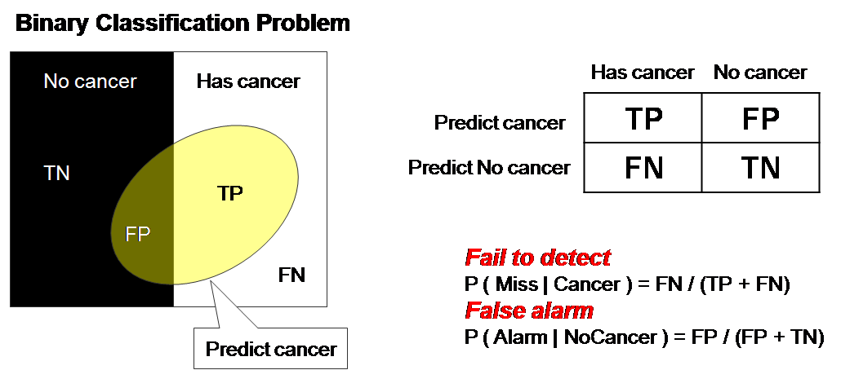
ROC Curve (1)
ROC = Receiver operating characteristic
Notes:
The ROC curve was first developed by electrical engineers and radar engineers during World War II for detecting enemy objects in battlefields and was soon introduced to psychology to account for perceptual detection of stimuli.

Slide 26
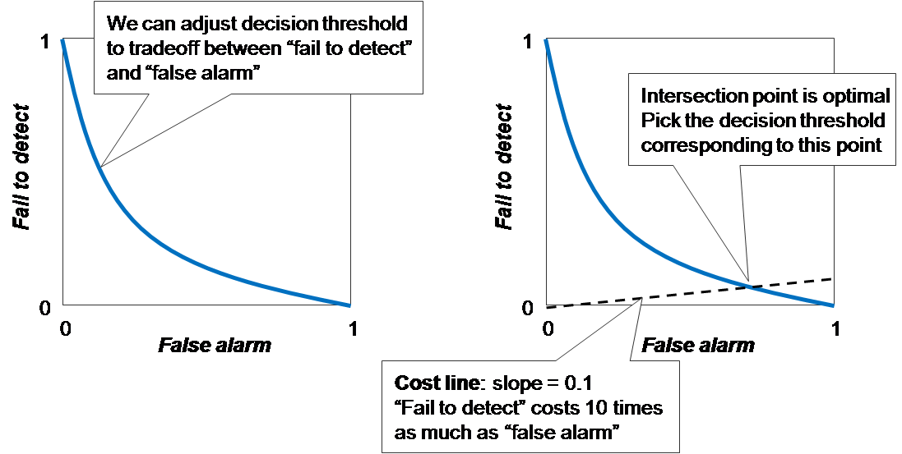
ROC Curve (2)
There is always a tradeoff between the false negative rate and the false positive rate

Slide 27
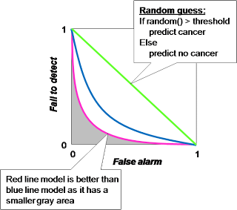
ROC Curve (3)
"Random guess" is worst prediction model and used as a baseline. The decision threshold of random guess is number in 0..1 in order to determine between positive and negative prediction.

Slide 28
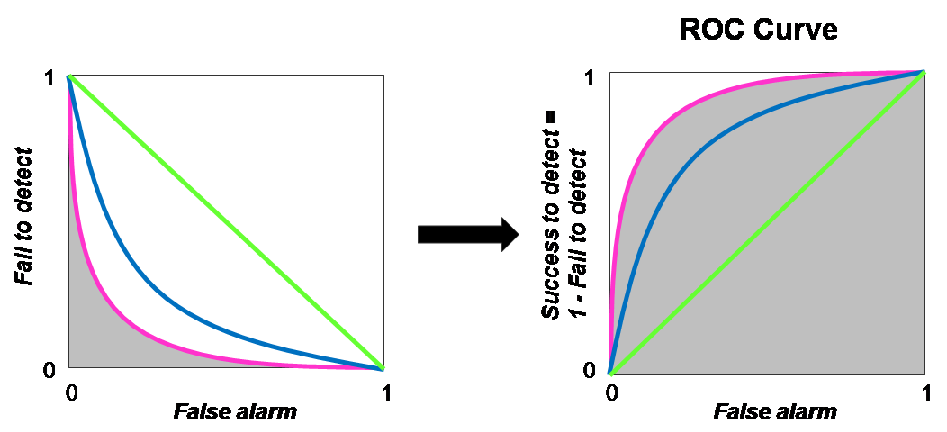
ROC Curve (4)
ROC Curve transforms the y-axis from "fail to detect" to 1 - "fail to detect”, i.e., "success to detect”

Slide 29
Precision at N
Ranking tasks return a set of results ordered from best to worst
  E.g., documents about “barack obama”
  Types for “Barack Obama”
Learning to rank systems can do this using a variety of algorithms (including SVM)
Precision at N is the fraction of top N answers that are correct

