Slide 1
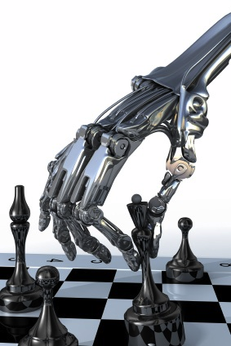
More on Games
Chapter 6
Some material adopted from notes by Charles R. Dyer, University of Wisconsin-Madison

Slide 2
Overview
Stochastic games
Other issues
General game playing

Slide 3
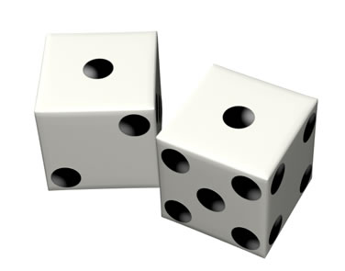
Stochastic Games
In real life, unpredictable external events can put us into unforeseen situations
Many games introduce unpredictability through a random element, such as the throwing of dice
These offer simple scenarios for problem solving with adversaries and uncertainty

Slide 4
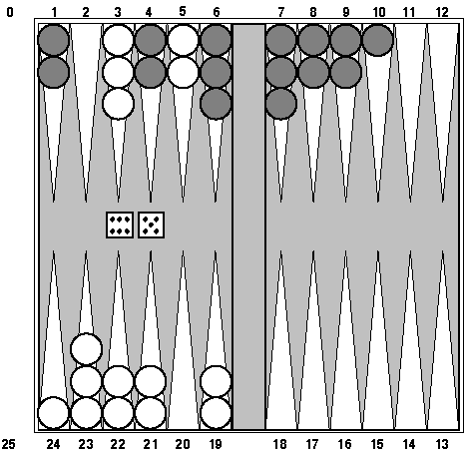
Example: Backgammon
Backgammon is a two-player game with uncertainty.
Players roll dice to determine what moves to make.
White has just rolled 5 and 6 and has four legal moves:
  5-10, 5-11
  5-11, 19-24
  5-10, 10-16
  5-11, 11-16
Such games are good for exploring decision making in adversarial problems involving skill and luck

Slide 5
Why can’t we use MiniMax?
Before a player chooses her move, she rolls dice and then knows exactly what they are
And the immediate outcome of each move is also known
But she does not know what moves her opponent will have available to choose from
We need to adapt MiniMax to handle this

Slide 6
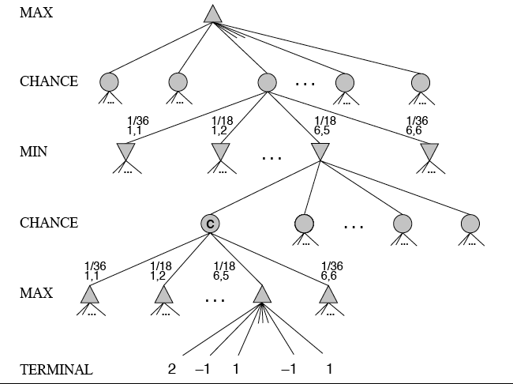
MiniMax trees with Chance Nodes

Slide 7
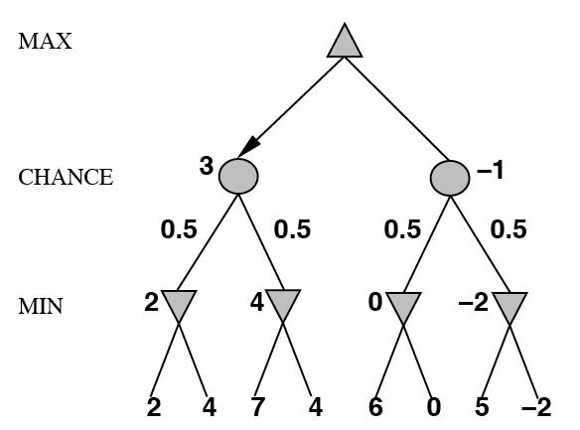
Understanding the notation
Max’s move 1
Max’s move 2
Min flips coin
Min knows possible moves
Board state includes chance outcome
determining what moves are available

Slide 8
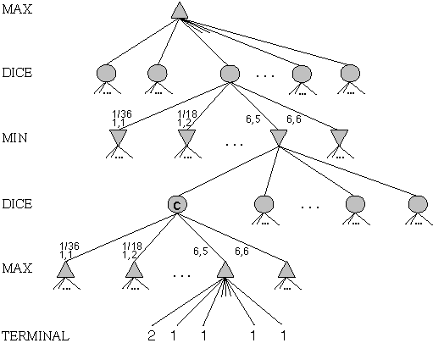
Game trees with chance nodes
Chance nodes (circles) represent random events
For a random event with N outcomes, chance node has N children; probability is associated with each
2 dice: 21 distinct outcomes
Use minimax to compute values
for MAX and MIN nodes
Use expected values for
chance nodes
Chance nodes over max node:
expectimax(C) = ∑_{i}(P(d_{i})*maxval(i))
Chance nodes over min node:
expectimin(C) = ∑_{i}(P(d_{i})*minval(i))
Min
Rolls
Max
Rolls

Slide 9
Impact on Lookahead
Dice rolls increase branching factor
  21 possible rolls with two dice
Backgammon: ~20 legal moves for given roll
  ~6K with 1-1 roll (get to roll again!)
At depth 4: 20 * (21 * 20)**3 ≈ 1.2B boards
As depth increases, probability of reaching a given node shrinks
  value of lookahead diminished and alpha-beta pruning is much less effective
TDGammon used depth-2 search + good static evaluator to achieve world-champion level

Slide 10
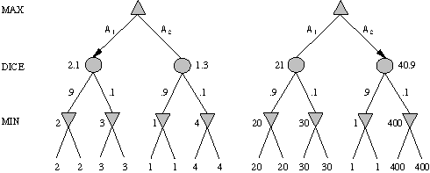
Meaning of the evaluation function
A1 is best move
A2 is best move
2 outcomes with probabilities {.9, .1}
With probabilities and expected values we must be careful about the meaning of values returned by static evaluator
relative-order preserving change of static evaluation values doesn’t change minimax decision, but could here
Linear transformations are OK

Slide 11
Games of imperfect information
Example: card games, opponent's initial cards unknown
  Can calculate a probability for each possible deal
  Like having one big dice roll at beginning of game
Possible approach: minimax over of each action in each deal; choose action with highest expected value over all deals
Special case: if action is optimal for all deals, it's optimal
GIB bridge program, approximates this idea by
  1) generating 100 deals consistent with bidding information
  2) picking the action that wins most tricks on average

Slide 12
High-Performance Game Programs
Many game programs are based on alpha-beta + iterative deepening + extended/singular search + transposition tables + huge databases + ...
For instance, Chinook searched all checkers configurations with 8 pieces or less and created endgame database of 444 billion board configurations
Methods are general, but implementation is improved by many specifically tuned-up enhancements (e.g., the evaluation functions)

Slide 13
Other Issues
Multi-player games
  E.g., many card games like Hearts
Multiplayer games with alliances
  E.g., Risk
  More on this when we discuss game theory
  Good model for a social animal like humans, where we are always balancing cooperation and competition

Slide 14
AI and Games II
AI also of interest to the video game industry
Many games include ‘agents’ controlled by the game program that could be
  Adversaries, in first person shooter games
  Collaborators, in a virtual reality game
Some game environments used as AI challenges
  2009 Mario AI Competition
  Unreal Tournament bots

Slide 15
Perspective on Games: Con and Pro
“Chess is the Drosophila of artificial intelligence. However, computer chess has developed much as genetics might have if the geneticists had concentrated their efforts starting in 1910 on breeding racing Drosophila. We would have some science, but mainly we would have very fast fruit flies.” John McCarthy, Stanford
“Saying Deep Blue doesn’t really think about chess is like saying an airplane doesn't really fly because it doesn't flap its wings.”
Drew McDermott, Yale

Slide 16

General Game Playing
General Game Playing is an idea
developed by Professor Michael
Genesereth of Stanford
See his site for more information
Goal: don’t develop specialized systems to play specific games (e.g., Checkers) very well
Goal: design AI programs to be able to play more than one game successfully
Work from a description of a novel game

Slide 17
General Game Playing
Stanford’s GGP is a Web-based system
Complete, logical specification of many different games in terms of:
    relational descriptions of states
    legal moves and their effects
    goal relations and their payoffs
Management of matches between automated players and of competitions involving many players and games

Slide 18
GGP
Input: logical description of a game in a custom game description language
  Game bots must
    Learn how to play legally from description
    Play well using general problem solving strategies
    Improve using general machine learning techniques
Yearly completions since 2005, $10K prize
Java General Game Playing Base Package

Slide 19
GGP Peg Jumping Game
; http://games.stanford.edu/gamemaster/games-debug/peg.kif
(init (hole a c3 peg))
(init (hole a c4 peg))
…
(init (hole d c4 empty))
…
(<= (next (pegs ?x)) (does jumper (jump ?sr ?sc ?dr ?dc)) (true (pegs ?y))
(succ ?x ?y)) (<= (next (hole ?sr ?sc empty)) (does jumper (jump ?sr ?sc ?dr ?dc)))
…
(<= (legal jumper (jump ?sr ?sc ?dr ?dc)) (true (hole ?sr ?sc peg))
(true (hole ?dr ?dc empty)) (middle ?sr ?sc ?or ?oc ?dr ?dc) (true (hole ?or ?oc peg)))
…
(<= (goal jumper 100) (true (hole a c3 empty)) (true (hole a c4 empty))
(true (hole a c5 empty))
…
(succ s1 s2)
(succ s2 s3)
…

Slide 20
Tic-Tac-Toe in GDL
(role xplayer)
(role oplayer)
;; Initial State
(init (cell 1 1 b))
(init (cell 1 2 b))
...
(init (control xplayer))
;; Dynamic Components
(<= (next (cell ?m ?n x))
(does xplayer (mark ?m ?n))
(true (cell ?m ?n b)))
(<= (next (cell ?m ?n o))
(does oplayer (mark ?m ?n))
(true (cell ?m ?n b)))
…
...
(<= (next (control xplayer))
(true (control oplayer)))
(<= (legal ?w (mark ?x ?y))
(true (cell ?x ?y b))
(true (control ?w)))
(<= (legal xplayer noop)
(true (control oplayer)))
(<= (legal oplayer noop)
(true (control xplayer)))
...
(<= (goal xplayer 100) (line x))
...
(<= (goal oplayer 0) (line x))
...
See ggp-base repository: http://bit.ly/RB49q5

Slide 21
A example of General Intelligence
Artificial General Intelligence describes research that aims to create machines capable of general intelligent action
Harkens back to early visions of AI, like McCarthy’s Advise Taker
  See Programs with Common Sense (1959)
A response to frustration with narrow specialists, often seen as “hacks”
  See On Chomsky and the Two Cultures
  of Statistical Learning

