Slide 1
CMSC 471
Principles of
Artificial Intelligence
Course Overview
Spring 2016

Slide 2
Today’s class
Course overview
Introduction
  Brief history of AI
  What is AI? (and why is it so interesting?)
  What’s the state of AI now?

Slide 3
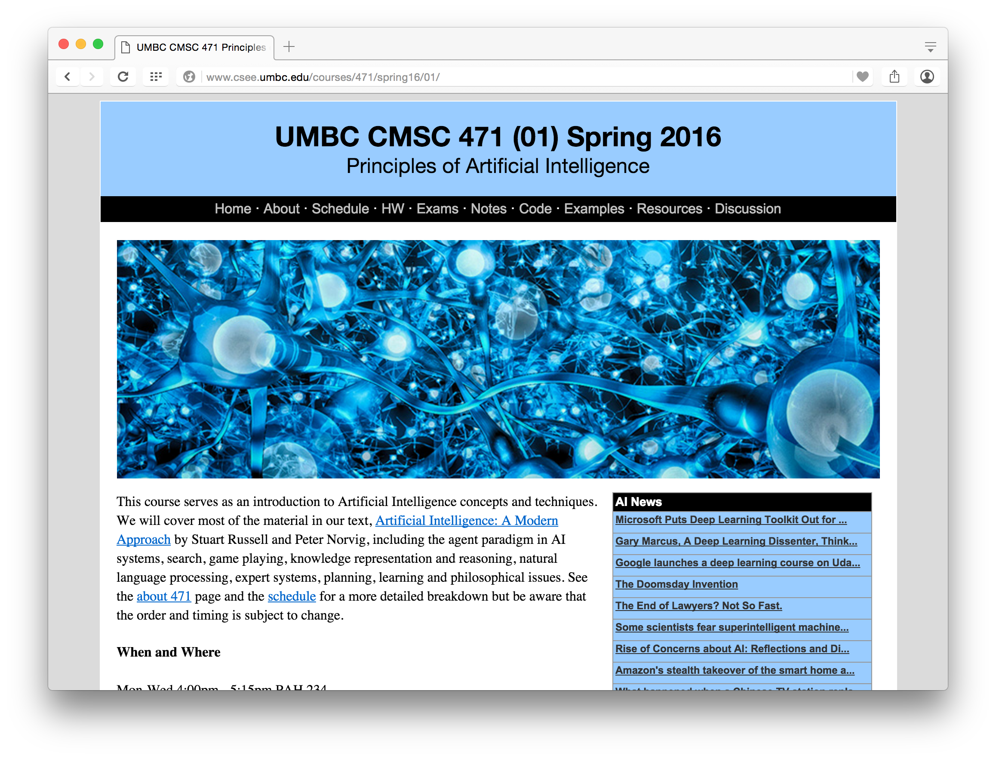
http://bit.ly/471s16

Slide 4
Homework and grading policies
Six to eight homework assignments (mix of written and programming)
One-time extensions of up to a week may be granted if requested in advance
Last-minute requests for extensions probably will not be granted
NOTE ON READING: Please do the reading before each class!

Slide 5
Programming
Programming assignments in Python
  We’ll use Python in the notes and examples
  This is a good chance for you to learn Python
Why not Lisp or Prolog?
Some assignments may require using other systems
  E.g., C5 decision tree learning system, Weka Machine learning environment, Prolog, Jess production rule system, etc.

Slide 6
Exams
Midterm exam
  In class in mid October
  About 15% of grade
Final exam
  At regularly scheduled time
  About 25% of grade
  Comprehensive, but with an emphasis on the last half of material (e.g., 30/70 split)

Slide 7
Instructor availability
Professor Finin
  Office hours: by arrangement
  Drop in whenever my door is open
  Direct general questions (i.e., those other students may also be wondering about and that Google can’t answer) to Piazza first
  We will try to respond to postings on the discussion list or private email messages within 24 hours
TA is Neha Tilak, office hours tbd

