Slide 1
Neural
Networks

Slide 2
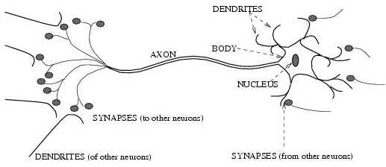
Biological neural activity
  Each neuron has a body, an axon, and many dendrites
    Can be in one of the two states: firing and rest.
    Neuron fires if total incoming stimulus exceeds a threshold
  Synapse: thin gap between axon of one neuron and dendrite of another.
    Signal exchange
    Synaptic strength/efficiency

Slide 3
Artificial neural network
Set of nodes (units, neurons, processing elements)
  Each node has input and output
  Each node performs a simple computation by its node function
Weighted connections between nodes
  Connectivity gives the structure/architecture of the net
  What can be computed by a NN is primarily determined by the connections and their weights
Simplified version of networks of neurons in animal nerve systems

Slide 4
History of NN
Pitts & McCulloch (1943)
  First mathematical model of biological neurons
  All Boolean operations can be implemented by these neuron-like nodes
  Competitor to Von Neumann model for general purpose computing device
  Origin of automata theory
Hebb (1949)
  Hebbian rule of learning: increase the connection strength between neurons i and j whenever both i and j are activated.
  Or increase the connection strength between nodes i and j whenever both nodes are simultaneously ON or OFF.

Slide 5
History: Early booming (50s – early 60s)
  Rosenblatt (1958)
    Perceptron: network of threshold
    nodes for pattern classification
    Perceptron learning rule
    Percenptron convergence theorem:
    everything that can be represented by a perceptron can be learned
  Widrow and Hoff (1960, 19062)
    Learning rule based on gradient descent (with differentiable unit)
  Minsky’s attempt to build a general purpose machine with Pitts/McCullock units
x₁ x₂ x_{n}

Slide 6
History: setback in mid 60s – late 70s)
  Serious problems with perceptron model (Minsky’s book 1969)
    Single layer perceonptrons cannot represent (learn) simple functions such as XOR
    Multi-layer of non-linear units may have greater power but there is no learning rule for such nets
    Scaling problem: connection weights may grow infinitely
    The first two problems overcame by latter effort in 80’s, but the scaling problem persists
  Death of Rosenblatt (1964)
  Striving of Von Neumann machine and AI

Slide 7
History of NN: Renewed enthusiasm
  New techniques
    Backpropagation learning for multi-layer feed forward nets (with non-linear, differentiable node functions)
    Thermodynamic models (Hopfield net, Boltzmann machine, etc.)
    Unsupervised learning
  Impressive application (character recognition, speech recognition, text-to-speech transformation, process control, associative memory, etc.)
  Traditional approaches face difficult challenges
  Caution:
    Don’t underestimate difficulties and limitations
    Poses more problems than solutions

Slide 8
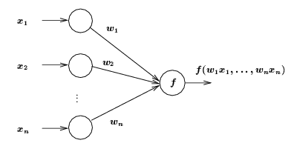
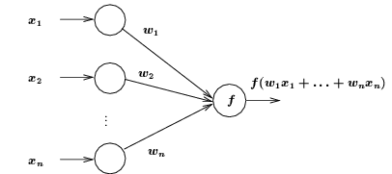
ANN Neuron Models
Each node has one or more inputs from other nodes, and one output to other nodes
Input/output values can be
  Binary {0, 1}
  Bipolar {-1, 1}
  Continuous (bounded or not)
All inputs to a node come in at same time and remain activated until output is produced
Weights associated with links
Node function
General neuron model
Weighted input summation

Slide 9
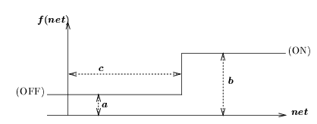
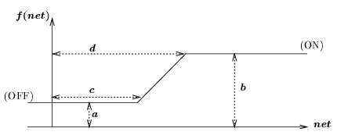
Node Function
Step function
Ramp function

Slide 10
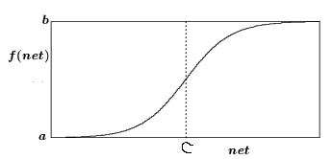



Node Function
Sigmoid function
  S-shaped
  Continuous and everywhere differentiable
  Rotationally symmetric about some point (net = c)
  Asymptotically approaches saturation points
  Examples:
Sigmoid function
When y = 0 and z = 0:
a = 0, b = 1, c = 0.
When y = 0 and z = -0.5
a = -0.5, b = 0.5, c = 0.
Larger x gives steeper curve

Slide 11
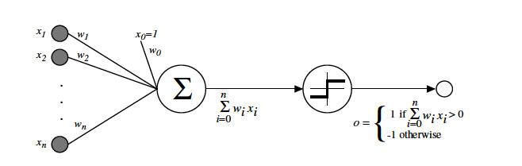
Perceptron
A single layer neural network

Slide 12
Simple architectures

Slide 13
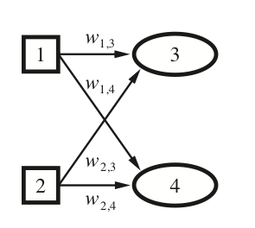
Can we make a two bit adder?
Inputs are bits x1 and x2
Outputs: carry bit (y1),
sum bit (y2)
Two NNs, really
x1
y1
x2
y2
X1 | X2 | Y1 (carry) | Y2 (sum)
0 | 0 | 0 | 0
0 | 1 | 0 | 1
1 | 0 | 0 | 0
1 | 1 | 1 | 0

Slide 14
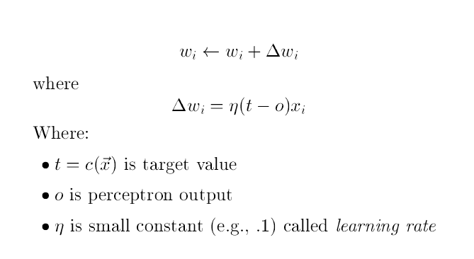
Perceptron training rule
Adjust weights slightly to reduce error between perceptron output o and target value t; repeat

Slide 15
Not with a perceptron ☹
Training examples are not linearly separable for one case: sum=1 iff x1 xor x2

Slide 16
Works well on some problems
Learning curves
Are majority of inputs 1?
Restaurant example: WillWait?

Slide 17
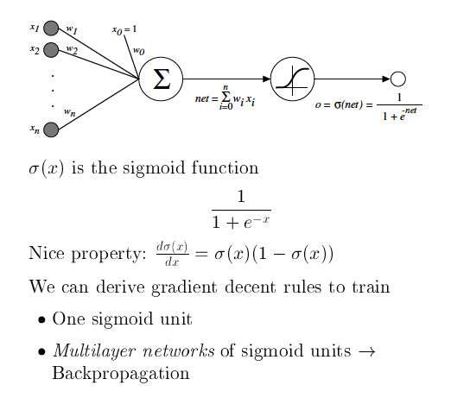
Sigmoid Unit

Slide 18
Multilayer Networks
Input
Hidden
Output

Slide 19
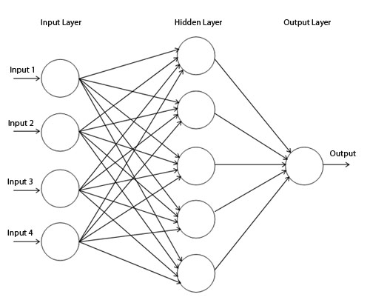
Backpropagation Algorithm
Forward direction
Calculate network and error

Slide 20

Backpropagation Algorithm
Backward direction
Backpropagate: from output to input, recursively compute and adjust weights
$$\frac{∂E}{∂w_{ij}}=∇_{w}E$$

Slide 21
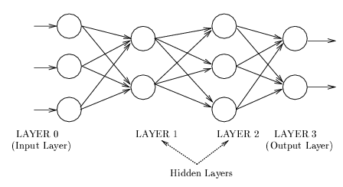
Network Architecture: Feedforward net
  A connection is allowed from a node in layer i only to nodes in layer i + 1.
  Most widely used architecture.
Conceptually, nodes at higher levels successively abstract features from preceding layers

Slide 22
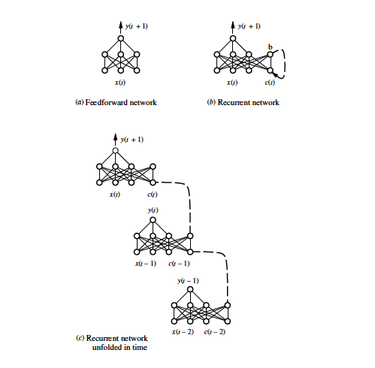
Recurrent neural networks
Good for learning sequences of data
e.g., text
Lots of variations today: convoluted NNs, LSTMs, …

Slide 23
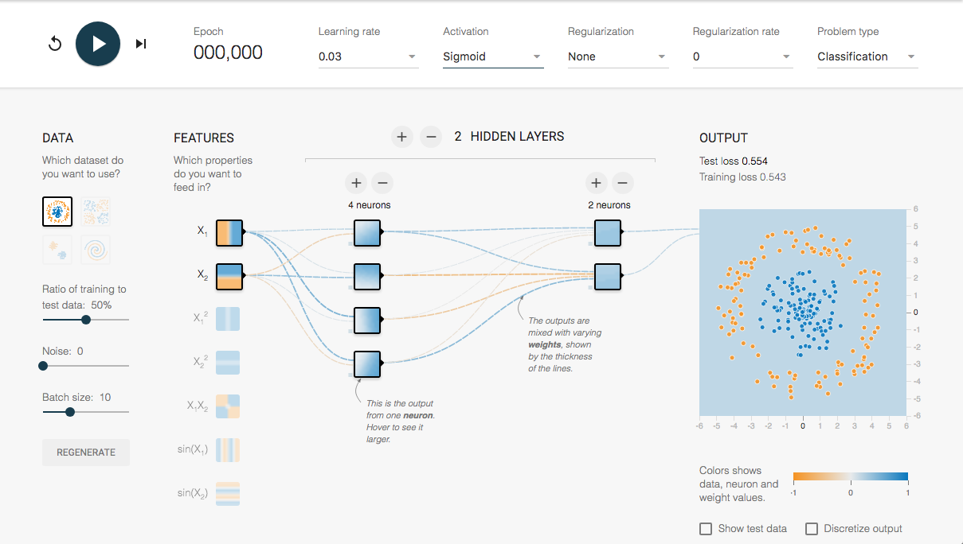
Neural network playground
http://playground.tensorflow.org/

