Slide 1
Machine Learning: Decision Trees
Chapter 18.1-18.3
Some material adopted from notes by Chuck Dyer

Slide 2
Decision Trees (DTs)
A supervised learning method used for classification and regression
Given a set of training tuples, learn model to predict one value from the others
Learned value typically a class (e.g. goodRisk)
Resulting model is simple to understand, interpret, visualize and apply

Slide 3
Learning a Concept
The red groups are negative examples, blue positive
Attributes
Size: large, small
Color: red, green, blue
Shape: square, circle

Slide 4
Training data
Size | Color | Shape | class
Large | Green | Square | Negative
Large | Green | Circle | Negative
Small | Green | Square | Positive
Small | Green | Circle | positive
Large | Red | Square | Positive
Large | Red | Circle | Positive
Small | Red | Square | Positive
Small | Red | Circle | Positive
Large | Blue | Square | Negative
Small | Blue | Square | Positive
Large | Blue | Circle | Positive
Small | Blue | Circle | Positive

Slide 5
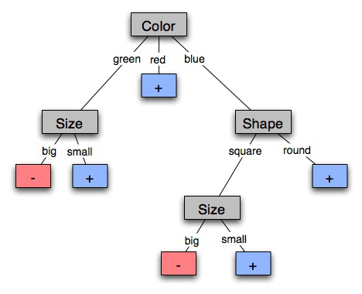
A decision tree-induced partition
The red groups are negative examples, blue positive
Negative things are big, green shapes and big, blue squares

Slide 6
Learning decision trees
Goal: Build a decision tree to classify examples as positive or negative instances of a concept using supervised learning from a training set
A decision tree is a tree where
each non-leaf node has an attribute (feature)
each leaf node has a classification (+ or -)
each arc has a possible value of its attribute
Generalization: allow for >2 classes
e.g., for stocks, classify into {sell, hold, buy}
Color
green
red
blue
Size
+
Shape
big
small
square
round
-
+
Size
+
big
small
-
+

Slide 7
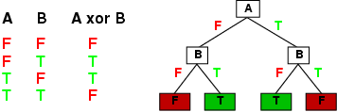
Expressiveness of Decision Trees
Can express any function of the input attributes, e.g. for Boolean functions, truth table row → path to leaf:
There’s a consistent decision tree for any training set with one path to leaf for each example (assuming deterministic), but it probably won't generalize to new examples
We prefer more compact decision trees

Slide 8
Inductive learning and bias
Suppose that we want to learn a function f(x) = y and we’re given sample (x,y) pairs, as in figure (a)
There are several hypotheses we could make about this function, e.g.: (b), (c) and (d)
A preference for one over the others reveals the bias of our learning technique, e.g.:
prefer piece-wise functions
prefer a smooth function
prefer a simple function and treat outliers as noise

Slide 9
Preference bias: Occam’s Razor
William of Ockham (1285-1347)
“non sunt multiplicanda entia praeter necessitatem”
entities are not to be multiplied beyond necessity
Simplest consistent explanation is the best
Smaller decision trees correctly classifying training examples preferred over larger ones
Finding the smallest decision tree is NP-hard, so we use algorithms that find reasonably small ones

Slide 10
Hypothesis spaces
How many distinct decision trees with n Boolean attributes?
= number of Boolean functions
= number of distinct truth tables with 2^{n} rows = 2^{2n}
e.g., with 6 Boolean attributes, 18,446,744,073,709,551,616 trees
How many conjunctive hypotheses (e.g., Hungry ∧ ¬Rain)?
Each attribute can be in (positive), in (negative), or out
3^{n} distinct conjunctive hypotheses
e.g., with 6 Boolean attributes, 729 trees
A more expressive hypothesis space
increases chance that target function can be expressed
increases number of hypotheses consistent with training set
⇒ may get worse predictions in practice

Slide 11
R&N’s restaurant domain
Develop decision tree for decision patron makes when deciding whether or not to wait for a table
Two classes: wait, leave
Ten attributes: Alternative available? Bar in restaurant? Is it Friday? Are we hungry? How full is the restaurant? How expensive? Is it raining? Do we have reservation? What type of restaurant is it? Estimated waiting time?
Training set of 12 examples
~ 7000 possible cases

Slide 12
Attribute-based representations
Examples described by attribute values (Boolean, discrete, continuous), e.g., situations where I will/won't wait for a table
Classification of examples is positive (T) or negative (F)
Serves as a training set

Slide 13
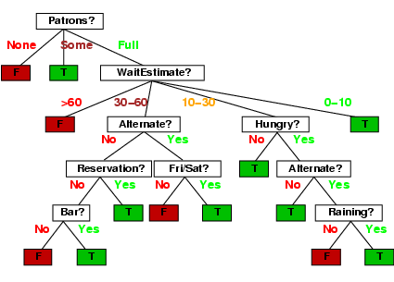
A decision tree from introspection

Slide 14
Issues
It’s like 20 questions
We can generate many decision trees depending on what attributes we ask about and in what order
How do we decide?
What makes one decision tree better than another: number of nodes? number of leaves? maximum depth?

Slide 15
ID3 / C4.5 / J48 Algorithm
Greedy algorithm for decision tree construction developed by Ross Quinlan circa 1987
Top-down construction of tree by recursively selecting best attribute to use at current node
Once attribute selected for current node, generate child nodes, one for each possible value of attribute
Partition examples using values of attribute, & assign these subsets of examples to appropriate child node
Repeat for each child node until all examples associated with node are all positive or negative

Slide 16
Choosing the best attribute
Key problem: choose attribute to split a given set of examples
Possibilities for choosing attribute:
Random: Select one at random
Least-Values: one with smallest # of possible values
Most-Values: one with largest # of possible values
Max-Gain: one with largest expected information gain – i.e., results in smallest expected size of subtrees rooted at its children
The ID3 algorithm uses the max-gain method of selecting the best attribute

Slide 17
Restaurant example
Random: Patrons or Wait-time; Least-values: Patrons; Most-values: Type; Max-gain: ???
French
Y
N
Y
N
Type variable
Italian
Thai
N
Y
N
Y
N
Y
N
Y
Burger
Empty
Some
Full
Patrons variable

Slide 18
Choosing an attribute
stay
leave
Idea: good attribute splits examples into subsets that are (ideally) all positive or all negative
Which is better: Patrons? or Type?

Slide 19
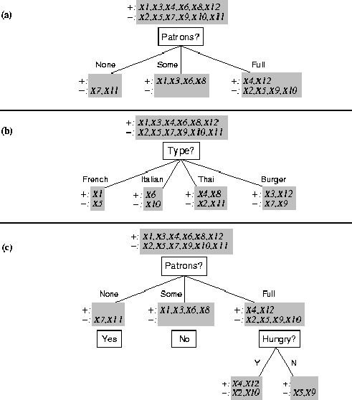
Splitting examples by testing attributes

Slide 20
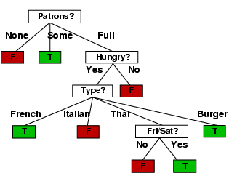
ID3-induced decision tree

Slide 21
Compare the two Decision Trees

Slide 22
Information theory 101
Sprang fully formed from Claude Shannon’s seminal work: Mathematical Theory of Communication in 1948
Intuitions
Common words (a, the, dog) shorter than less common ones (parlimentarian, foreshadowing)
morse code: common letters have shorter encodings
Information inherent in data/message (inform- ation entropy) measured in minimum number of bits needed to store/send using a good encoding

Slide 23
Information theory 101
Information entropy ... tells how much information there is in an event. The more uncertain or random the event is, the more information it contains.
Receiving a message is an event
How much information is in these messages
The sun rose today!
It’s sunny today in Honolulu!
The coin toss is heads!
It’s sunny today in Seattle!
Life discovered on Mars!
None
A lot

Slide 24
Information theory 101
For n equally probable possible messages or data values, each has probability 1/n
Information of a message is -log(p) = log(n)
e.g., with 16 messages, then log(16) = 4 and we need 4 bits to identify/send each message
If probability distribution P (p₁,p₂ … p_{n}) for n messages, its information (aka H or entropy) is:
I(P) = -(p₁*log(p₁) + p₂*log(p₂) + .. + p_{n}*log(p_{n}))

Slide 25
Entropy of a distribution
I(P) = -(p₁*log(p₁) + p₂*log(p₂) + .. + p_{n}*log(p_{n}))
Examples:
If P is (0.5, 0.5) then I(P) = 0.5*1 + 0.5*1 = 1
If P is (0.67, 0.33) then I(P) = -(2/3*log(2/3) + 1/3*log(1/3)) = 0.92
If P is (1, 0) then I(P) = 1*1 + 0*log(0) = 0
More uniform probability distribution, greater its information: more information is conveyed by a message telling you which event actually occurred
Entropy is the average number of bits/message needed to represent a stream of messages

Slide 26
Example: Huffman code
In 1952 MIT student David Huffman devised (for a homework assignment!) a coding scheme that’s optimal when all data probabilities are powers of 1/2
A Huffman code can be built in the following manner:
Rank symbols in order of probability of occurrence
Successively combine two symbols of lowest probability to form a new composite symbol; eventually we will build a binary tree where each node is probability of all nodes beneath it
Trace path to each leaf, noticing direction at each node

Slide 27
Huffman code example
M P
A .125
B .125
C .25
D .5
1
0
1
.5
.5
D
0
1
.25
If we use this code to many messages (A,B,C or D) with this probability distribution, then, over time, the average bits/message should approach 1.75
.25
C
0
1
.125
.125
A
B

Slide 28
Information for classification
If set T of records is divided into disjoint exhaustive classes (C₁,C₂,..,C_{k}) by value of class attribute, then information needed to identify class of an element of T is:
Info(T) = I(P)
where P is the probability distribution of partition (C₁,C₂,..,C_{k}):
P = (|C₁|/|T|, |C₂|/|T|, ..., |C_{k}|/|T|)
C1
C2
C3
C1
C2
C3
High information
Lower information

Slide 29
Information for classification II
If we further divide T wrt attribute X into sets {T₁,T₂, ..,T_{n}}, the information needed to identify class of an element of T becomes the weighted average of the information needed to identify the class of an element of T_{i}, i.e. the weighted average of Info(T_{i}):
Info(X,T) = Σ|T_{i}|/|T| * Info(T_{i})
C1
C2
C3
C1
C2
C3
High information
Low information

Slide 30
Information gain
Gain(X,T) = Info(T) - Info(X,T) is difference of
info needed to identify element of T and
info needed to identify element of T after value of attribute X known
This is gain in information due to attribute X
Used to rank attributes and build DT where each node uses attribute with greatest gain of those not yet considered in path from root
Intent: create small DTs to minimize questions

Slide 31
Computing Information Gain
French
Y
N
Should we ask about restaurant type or how many patrons there are?
I(T) = ?
I (Pat, T) = ?
I (Type, T) = ?
Italian
Y
N
Thai
N
Y
N
Y
Burger
N
Y
N
Y
Empty
Some
Full
Gain (Patrons, T) = ?
Gain (Type, T) = ?
I(P) = -(p₁*log(p₁) + p₂*log(p₂) + .. + p_{n}*log(p_{n}))

Slide 32
Computing information gain
I(T) = - (.5 log .5 + .5 log .5) = .5 + .5 = 1
I (Pat, T) = 2/12 (0) + 4/12 (0) + 6/12 (- (4/6 log 4/6 + 2/6 log 2/6)) = 1/2 (2/3*.6 + 1/3*1.6) = .47
I (Type, T) = 2/12 (1) + 2/12 (1) + 4/12 (1) + 4/12 (1) = 1
French
Y
N
Italian
Y
N
Thai
N
Y
N
Y
Burger
N
Y
N
Y
Empty
Some
Full
Gain (Patrons, T) = 1 - .47 = .53
Gain (Type, T) = 1 – 1 = 0
I(P) = -(p₁*log(p₁) + p₂*log(p₂) + .. + p_{n}*log(p_{n}))

Slide 33
The ID3 algorithm builds a decision tree, given a set of non-categorical attributes C1, C2, .., Cn, the class attribute C, and a training set T of records
function ID3(R:input attributes, C:class attribute, S:training set) returns decision tree;
If S is empty, return single node with value Failure;
If every example in S has same value for C, return single node with that value;
If R is empty, then return a single node with most frequent of the values of C found in examples S; # causes errors -- improperly classified record
Let D be attribute with largest Gain(D,S) among R;
Let {dj| j=1,2, .., m} be values of attribute D;
Let {Sj| j=1,2, .., m} be subsets of S consisting of records with value dj for attribute D;
Return tree with root labeled D and arcs labeled d1..dm going to the trees ID3(R-{D},C,S1). . . ID3(R-{D},C,Sm);

Slide 34
How well does it work?
Case studies show that decision trees often at least as accurate as human experts
Study for diagnosing breast cancer had humans correctly classifying the examples 65% of the time; DT classified 72% correct
British Petroleum designed DT for gas-oil separation for offshore oil platforms that replaced an earlier rule-based expert system
Cessna designed an airplane flight controller using 90,000 examples and 20 attributes per example

Slide 35
Extensions of ID3
Using gain ratios
Real-valued data
Noisy data and overfitting
Generation of rules
Setting parameters
Cross-validation for experimental validation of performance
C4.5 is an extension of ID3 that accounts for unavailable values, continuous attribute value ranges, pruning of decision trees, rule derivation, and so on

Slide 36
Using gain ratios
Information gain criterion favors attributes that have a large number of values
An attribute D with a distinct value for each record has Info(D,T) 0, thus Gain(D,T) is maximal
To compensate, use GainRatio instead of Gain:
GainRatio(D,T) = Gain(D,T) / SplitInfo(D,T)
SplitInfo(D,T) is information due to split of T on basis of value of categorical attribute D
SplitInfo(D,T) = I(|T1|/|T|, |T2|/|T|, .., |Tm|/|T|)
where {T1, … Tm} is partition of T induced by value of D

Slide 37
Computing gain ratio
French
Y
N
I(T) = 1
I (Pat, T) = .47
I (Type, T) = 1
Italian
Y
N
Thai
N
Y
N
Y
Gain (Pat, T) =.53
Gain (Type, T) = 0
Burger
N
Y
N
Y
Empty
Some
Full
SplitInfo (Pat, T) = - (1/6 log 1/6 + 1/3 log 1/3 + 1/2 log 1/2) = 1/6*2.6 + 1/3*1.6 + 1/2*1 = 1.47
SplitInfo (Type, T) = 1/6 log 1/6 + 1/6 log 1/6 + 1/3 log 1/3 + 1/3 log 1/3 = 1/6*2.6 + 1/6*2.6 + 1/3*1.6 + 1/3*1.6 = 1.93
GainRatio (Pat, T) = Gain (Pat, T) / SplitInfo(Pat, T) = .53 / 1.47 = .36
GainRatio (Type, T) = Gain (Type, T) / SplitInfo (Type, T) = 0 / 1.93 = 0

Slide 38
Real-valued data
Select thresholds defining intervals so each becomes a discrete value of attribute
Use heuristics, e.g. always divide into quartiles
Use domain knowledge, e.g. divide age into infant (0-2), toddler (3-5), school-aged (5-8)
Or treat this as another learning problem
Try different ways to discretize continuous variable; see which yield better results w.r.t. some metric
E.g., try midpoint between every pair of values

Slide 39
Noisy data
Many kinds of noise can occur in training data
Two examples have same attribute/value pairs, but different classifications
Some attribute values wrong due to errors in the data acquisition or preprocessing phase
The classification is wrong (e.g., + instead of -) because of some error
Some attributes irrelevant to decision-making, e.g., color of a die is irrelevant to its outcome

Slide 40
Overfitting
Overfitting occurs when a statistical model describes random error or noise instead of underlying relationship
If hypothesis space has many dimensions (large number of attributes) we may find meaningless regularity in the data that is irrelevant to the true, important, distinguishing features
If we have too little training data, even a reasonable hypothesis space can overfit

Slide 41
Overfitting
Fix by by removing irrelevant features
E.g., remove ‘year observed’, ‘month observed’, ‘day observed’, ‘observer name’ from feature vector
Fix by getting more training data
Fix by pruning lower nodes in the decision tree
E.g., if gain of best attribute at a node is below a threshold, stop and make this node a leaf rather than generating children nodes

Slide 42
Pruning decision trees
Pruning a decision tree is done by replacing a whole subtree by a leaf node
Replacement takes place if the expected error rate in the subtree is greater than in the single leaf, e.g.,
Training: 1 training red success and 2 training blue failures
Test: 3 red failures and one blue success
Consider replacing this subtree by a single Failure node.
After replacement, only 2 errors instead of 5
Training
Test
Pruned
Color
Color
FAILURE
red
blue
red
blue
2 success
4 failure
1 success
0 failure
0 success
2 failures
1 success
3 failure
1 success
1 failure

Slide 43
Converting decision trees to rules
It’s easy to derive rules from a decision tree: write a rule for each path from the root to a leaf
In that rule the left-hand side is built from the label of the nodes and the labels of the arcs
The resulting rules set can be simplified:
Let LHS be the left hand side of a rule
LHS’ obtained from LHS by eliminating some conditions
Replace LHS by LHS' in this rule if the subsets of the training set satisfying LHS and LHS' are equal
A rule may be eliminated by using meta-conditions such as “if no other rule applies”

Slide 44
Summary: decision tree learning
Widely used learning methods in practice for problems with relatively few features
Strengths
Fast and simple to implement
Can convert result to a set of easily interpretable rules
Empirically valid in many commercial products
Handles noisy data
Easy for people to understand
Weaknesses
Univariate splits/partitioning using only one attribute at a time so limits types of possible trees
Large decision trees may be hard to understand
Requires fixed-length feature vectors
Non-incremental (i.e., batch method)

