Slide 1

Machine Learning overview
Chapter 18, 21

Slide 2
What is learning?
“Learning denotes changes in a system that ... enable a system to do the same task more efficiently the next time” – Herbert Simon
“Learning is constructing or modifying representations of what is being experienced”
– Ryszard Michalski
“Learning is making useful changes in our minds” – Marvin Minsky

Slide 3
Why study learning?
Understand and improve efficiency of human learning
  Use to improve methods for teaching and tutoring people (e.g., better computer-aided instruction)
Discover new things or structure previously unknown
  Examples: data mining, scientific discovery
Fill in skeletal or incomplete specifications in a domain
  Large, complex systems can’t be completely built by hand & require dynamic updating to incorporate new information
  Learning new characteristics expands the domain or expertise and lessens the “brittleness” of the system
Build agents that can adapt to users, other agents, and their environment

Slide 4
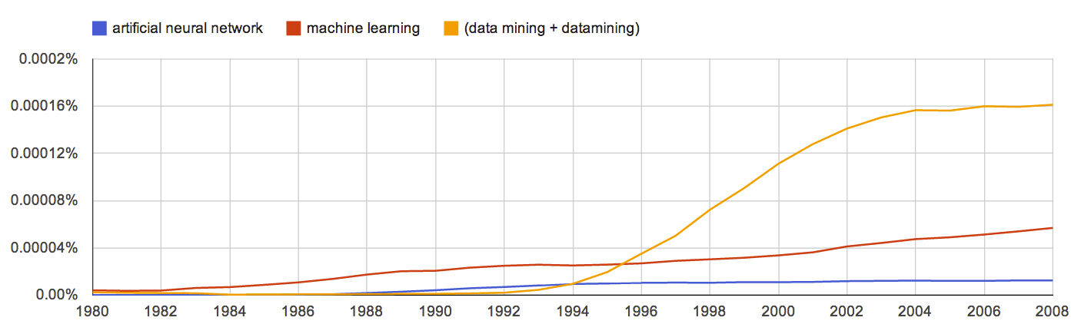
AI & Learning Today
Neural network learning was popular in the 60s
In the 70s and 80s it was replaced with a paradigm based on manually encoding and using knowledge
In the 90s, more data and the Web drove interest in new statistical machine learning (ML) techniques and new data mining applications
Today, ML techniques and big data are behind almost all successful intelligent systems
http://bit.ly/U2ZAC8

Slide 5
Machine Leaning Successes
Sentiment analysis
Spam detection
Machine translation
Spoken language understanding
Named entity detection
Self driving cars
Motion recognition (Microsoft X-Box)
Identifying paces in digital images
Recommender systems (Netflix, Amazon)
Credit card fraud detection

Slide 6
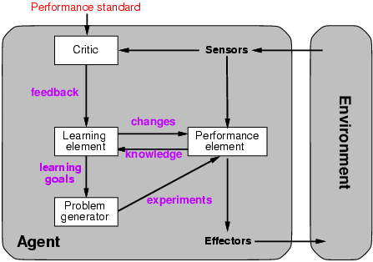
A general model of learning agents

Slide 7
Major paradigms of machine learning
Rote learning: 1-1 mapping from inputs to stored representa-tion, learning by memorization, association-based storage & retrieval
Induction: Use specific examples to reach general conclusions
Clustering: Unsupervised discovery of natural groups in data
Analogy: Find correspondence between different representa-tions
Discovery: Unsupervised, specific goal not given
Genetic algorithms: Evolutionary search techniques, based on an analogy to survival of the fittest
Reinforcement – Feedback (positive or negative reward) given at the end of a sequence of steps

Slide 8
What we will and won’t cover
We’ll look at a few popular machine learning problems and algorithms
  Take CMSC 478/678 Machine Leaning for more
  Use online resources & experiment on your own
We’ll focus on when/how to use techniques and only touch on how/why they work
We’ll cover basic methodology and evaluation
We’ll use Weka platform for examples & demos
  Great for exploration and learning

Slide 9
Types of learning problems
Supervised: learn from training examples
  Regression
  Classification: Decision Trees, SVM
Unsupervised: learn w/o training examples
  Clustering
  Dimensionality reduction
Lots more we won’t cover
  Hidden Marrkov models
  Learning to rank
  Semi-supervised learning
  Reinforcement learning
  Active learning

Slide 10
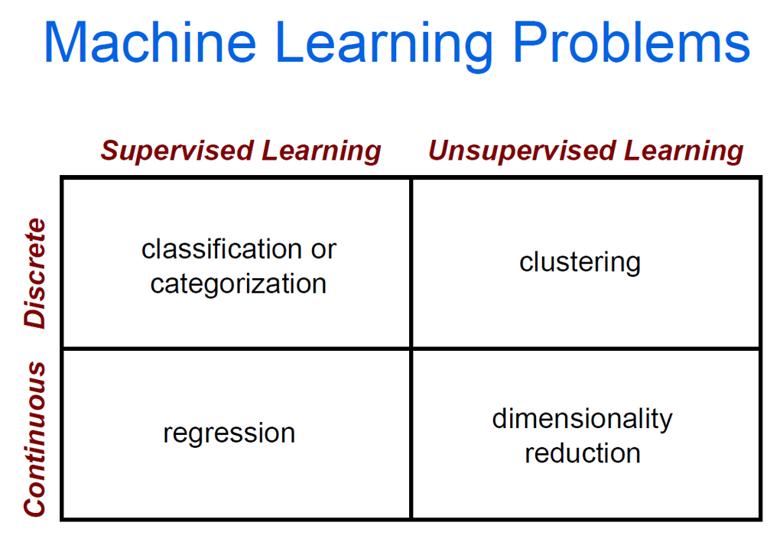

Slide 11
Supervised learning
Given training examples of inputs & corres-ponding outputs, produce “correct” outputs for new inputs
Two main scenarios:
  Classification: outputs typically labels (goodRisk, badRisk); learn a decision boundary that separates classes
  Regression: aka “curve fitting” or “function approximation.” Learn a continuous input-output mapping from (possibly noisy) examples

Slide 12
Unsupervised Learning
Given only unlabeled data as input, learn some sort of structure, e.g.:
Cluster your Facebook friends based on similarity of posts and friends
Find sets of words whose meanings are related (e.g., doctor, hospital)
Induce N topics and the words that are common in documents that are about that dopic

Slide 13
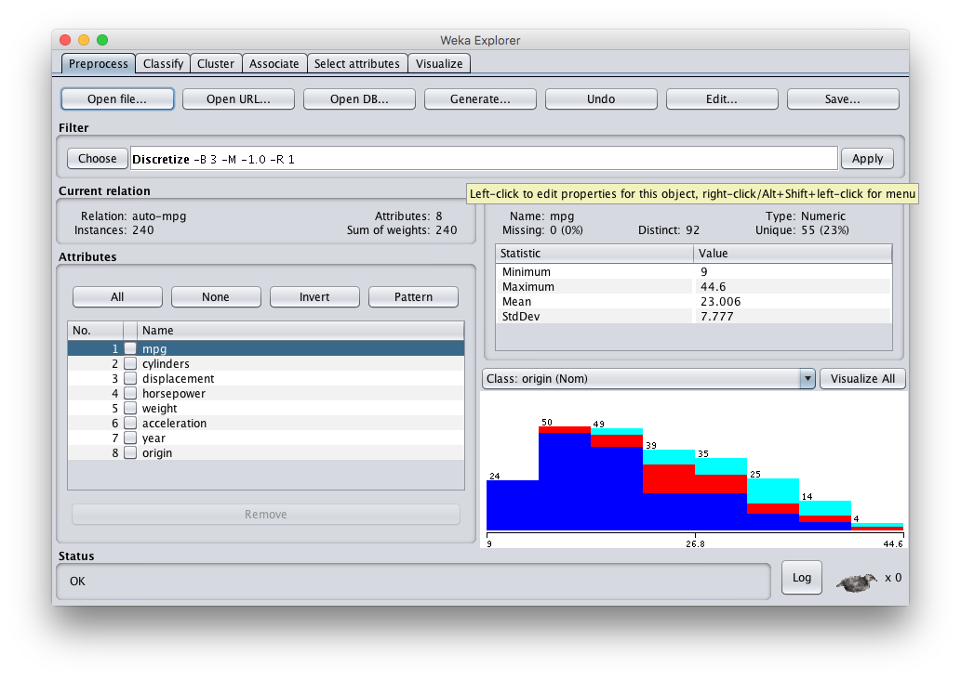

Weka: Waikato Environment for Knowledge Analysis
Open source Java software for ML and datamining
http://cs.waikato.ac.nz/ml/weka/

