Slide 1
Knowledge-Based Agents
Chapter 7.1-7.3
Some material adopted from notes by Andreas Geyer-Schulz and Chuck Dyer

Slide 2

Big Idea
Drawing reasonable conclusions from
a set of data (observations, beliefs, etc.) seems key to intelligence
Logic is a powerful and well developed approach to this and highly regarded by people
Logic is also a strong formal system that computers to use (cf. John McCarthy)
We can solve some AI problems by represent-ing them in logic and applying standard proof techniques to generate solutions

Slide 3
Inference in People
People can do logical inference, but are not very good at it
Reasoning with negation and disjunction seems to be particularly difficult
But, people seem to employ many kinds of reasoning strategies, most of which are neither complete nor sound

Slide 4
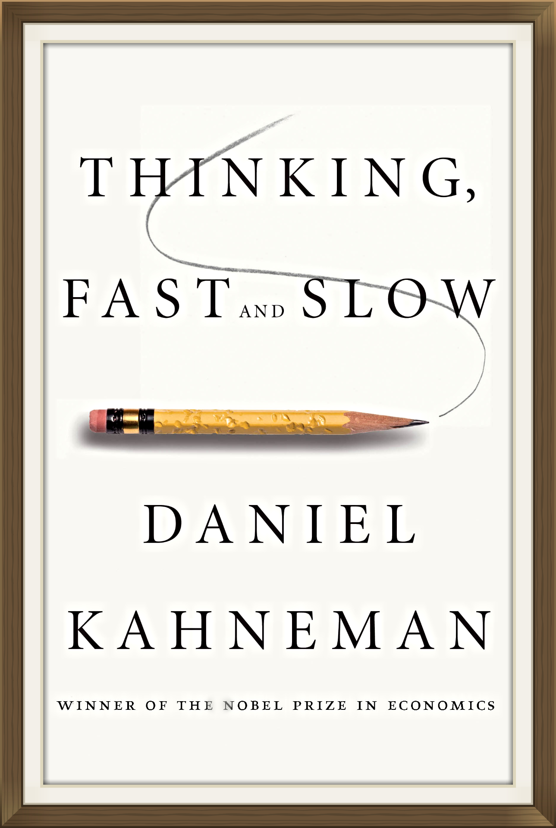
Thinking Fast and Slow
A popular 2011 book by a Nobel prize winning author
His model is that we have 2 differ-ent types of reasoning facilities
System 1 operates automatically and quickly, with little or no effort and no sense of voluntary control
System 2 allocates attention to the effortful mental activities that demand it, including complex computations

Slide 5
Question #1
Here is a simple puzzle.
Do not try to solve it but listen to your intuition:
A bat and ball cost $1.10.
The bat costs one dollar more than the ball.
How much does the ball cost?

Slide 6
The ball costs $0.05.

Slide 7
Question #2
Try to determine, as quickly as you can, if the argument is logically valid. Does the conclusion follow the premises?
All roses are flowers.
Some flowers fade quickly.
Therefore some roses fade quickly.

Slide 8
It is possible that there are no roses
among the flowers that fade quickly.

Slide 9
Question #3
If it takes 5 machines 5 minutes to make 5 widgets,
how long would it take 100 machines to make 100 widgets?
100 minutes or 5 minutes?

Slide 10
5 minutes

Slide 11
Wason Selection Task
I have a pack of cards; each has a letter written on one side and a number on the other
I claim the following rule is true:
  If a card has a vowel on one side, then it has an even number on the other
For these cards, which should you turn over in order to decide whether the rule is true or false?
E
4
T
7
Wikipedia
Notes:
Turn over e and 7

Slide 12
Wason Selection Task
Wason (1966) showed that people are bad at this task
To disprove rule P=>Q, find a situation in which P is true but Q is false, i.e., show P^~Q
To disprove vowel => even, find a card with a vowel and an odd number
Thus, turn over the cards showing vowels and turn over cards showing odd numbers
E
4
T
7

Slide 13

Wason Selection Task
This version is easier for people, as shown by Griggs & Cox, 1982
You are the bouncer in a bar; which of these people do you card given the rule: You must be 21 or older to drink beer.
beer
coke
22
20
Perhaps easier because it’s more familiar or because people have special strategies to reason about certain situations, such as cheating in a social situation

Slide 14

Negation in Natural Language
We often model the meaning of natural language sentences as a logic statements
This maps these into equivalent statements
  All elephants are gray
  No elephant are not gray
Double negation is common in informal language: that won’t do you no good
But what does this mean: we cannot underestimate the importance of logic
Notes:
There is no regard for logic that is too low
We consider logic to be of zero importance

Slide 15
Logic as a Methodology
Even if people don’t use formal logical reason-ing for solving a problem, logic might be a good approach for AI for a number of reasons
  Airplanes don’t need to flap their wings
  Logic may be a good implementation strategy
  Solution in a formal system can offer other benefits, e.g., letting us prove properties of the approach
See neats vs. scruffies

Slide 16
Knowledge-based agents
Knowledge-based agents have a knowledge base (KB) and an inference system
A KB is a set of representations of facts believed true
Each individual representation is called a sentence
Sentences are expressed in a knowledge represen-tation language
The agent operates as follows:
  1. It TELLs the KB what it perceives
  2. It ASKs the KB what action it should perform
  3. It performs the chosen action

Slide 17
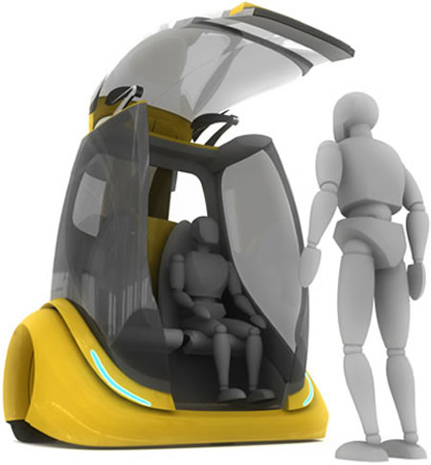
Architecture of a KB agent
Knowledge Level
  The most abstract level: describe agent by saying
  what it knows
  Ex: A taxi agent might know that the Golden Gate Bridge connects San Francisco with the Marin County
Logical Level
  The level at which the knowledge is encoded into sentences
  Ex: links(GoldenGateBridge, SanFrancisco, MarinCounty)
Implementation Level
  Physical representation of the sentences in the logical level
  Ex: as a tuple serialized as (links goldengatebridge sanfrancisco marincounty)

Slide 18
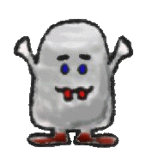
Wumpus World environment
Based on Hunt the Wumpus computer game
Agent explores a cave of rooms connected by passageways
Lurking in a room is the Wumpus, a beast that eats any agent that enters its room
Some rooms have bottomless pits that trap any agent that wanders into the room
Somewhere is a heap of gold in a room
Goal is to collect gold and exit w/o being eaten by Wumpus

Slide 19
Jargon file on “Hunt the Wumpus”
WUMPUS /wuhm'p*s/ n. The central monster (and, in many versions, the name) of a famous family of very early computer games called “Hunt The Wumpus,” dating back at least to 1972 (several years before ADVENT) on the Dartmouth Time-Sharing System. The wumpus lived somewhere in a cave with the topology of a dodecahedron's edge/vertex graph (later versions supported other topologies, including an icosahedron and Mobius strip). The player started somewhere at random in the cave with five “crooked arrows”; these could be shot through up to three connected rooms, and would kill the wumpus on a hit (later versions introduced the wounded wumpus, which got very angry). Unfortunately for players, the movement necessary to map the maze was made hazardous not merely by the wumpus (which would eat you if you stepped on him) but also by bottomless pits and colonies of super bats that would pick you up and drop you at a random location (later versions added “anaerobic termites” that ate arrows, bat migrations, and earthquakes that randomly changed pit locations).
This game appears to have been the first to use a non-random graph-structured map (as opposed to a rectangular grid like the even older Star Trek games). In this respect, as in the dungeon-like setting and its terse, amusing messages, it prefigured ADVENT and Zork and was directly ancestral to both. (Zork acknowledged this heritage by including a super-bat colony.) Today, a port is distributed with SunOS and as freeware for the Mac. A C emulation of the original Basic game is in circulation as freeware on the net.

Slide 20
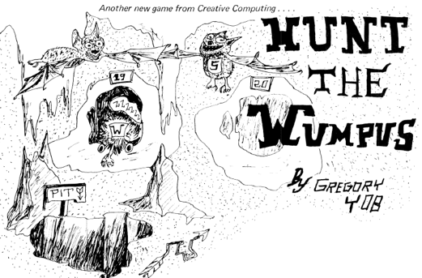
Wumpus History
See Hunt_the_Wumpus for
details
Early (c. 1972) text-based game
written in BASIC written by Gregory Yob, a student at UMASS, Dartmouth
Defined a genre of games including adventure, zork, and nethack
Eventually commercialized (c. 1980) for early personal computers
The Hunt the Wumpus basic code is available in a 1976 article in Creative Computing by Yob!

Slide 21
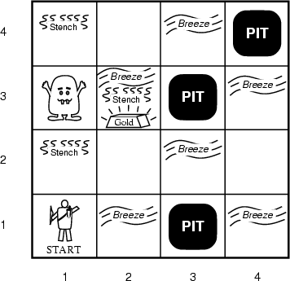
AIMA’s Wumpus World
The agent always starts in the field [1,1]
Agent’s task is to find the gold, return to the field [1,1] and climb out of the cave

Slide 22
Agent in a Wumpus world: Percepts
The agent perceives
  stench in square containing Wumpus and in adjacent squares (not diagonally)
  breeze in squares adjacent to a pit
  glitter in the square where the gold is
  bump, if it walks into a wall
  Woeful scream everywhere in cave, if Wumpus is killed
Percepts given as five-tuple, e.g., if stench and breeze, but no glitter, bump or scream:
  [Stench, Breeze, None, None, None]
Agent cannot perceive its own location (e.g., in (2,2)

Slide 23
Wumpus World Actions
go forward
turn right 90 degrees
turn left 90 degrees
grab: Pick up object in same square as agent
shoot: Fire arrow in straight line in direction agent is facing. It continues until it hits and kills Wumpus or hits outer wall. Agent has only one arrow, so only first shoot action has effect
climb is used to leave cave, only effective in start square
die: This action automatically and irretrievably happens if agent enters square with pit or live Wumpus

Slide 24
Wumpus World Goal
Agent’s goal is to find the gold and bring it back to the start square as quickly as possible, without getting killed
  1,000 point reward for climbing out of cave with gold
  1 point deducted for every action taken
  10,000 point penalty for getting killed

Slide 25
Wumpus world characterization
Fully Observable?
Deterministic?
Episodic?
Static?
Discrete?
Single-agent?

Slide 26
Wumpus world characterization
Fully Observable No – only local perception
Deterministic Yes, outcomes exactly specified
Episodic No – sequential at the level of actions
Static Yes – Wumpus and Pits do not move
Discrete Yes
Single-agent? Yes, Wumpus is essentially a natural feature

Slide 27
AIMA’s Wumpus World
The agent always starts in the field [1,1]
Agent’s task is to find the gold, return to the field [1,1] and climb out of the cave

Slide 28
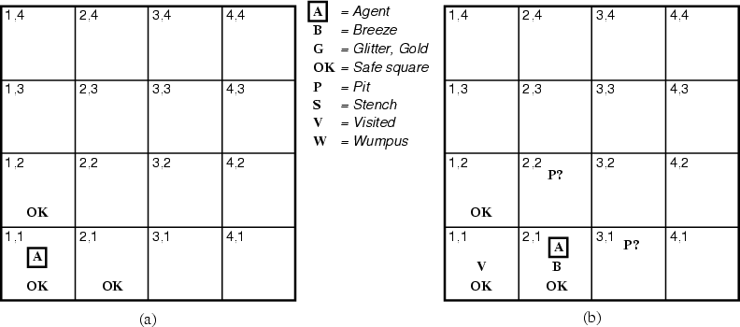
The Hunter’s first step
¬W
¬W
Since agent is alive and perceives neither breeze nor stench at [1,1], it knows that [1,1] and its neighbors are OK
Moving to [2,1] is a safe move that reveals a breeze but no stench, implying that Wumpus is not adjacent but that one or more pits are

Slide 29
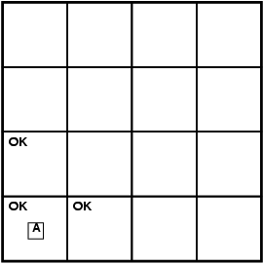
Exploring a wumpus world
A agent
B breeze
G glitter
OK safe cell
P pit
S stench
W wumpus

Slide 30
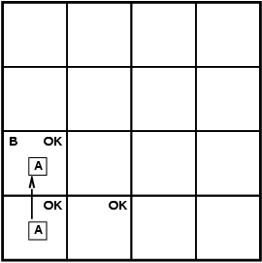
Exploring a wumpus world
A agent
B breeze
G glitter
OK safe cell
P pit
S stench
W wumpus

Slide 31
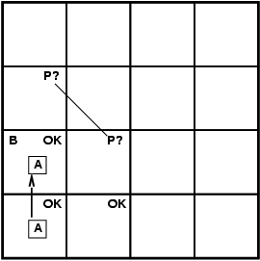
Exploring a wumpus world
A agent
B breeze
G glitter
OK safe cell
P pit
S stench
W wumpus

Slide 32
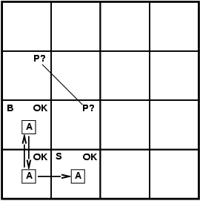
Exploring a wumpus world
A agent
B breeze
G glitter
OK safe cell
P pit
S stench
W wumpus

Slide 33
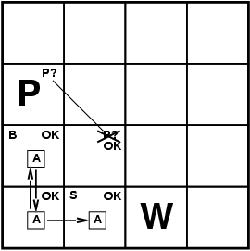
Exploring a wumpus world
A agent
B breeze
G glitter
OK safe cell
P pit
S stench
W wumpus

Slide 34

Exploring a wumpus world
A agent
B breeze
G glitter
OK safe cell
P pit
S stench
W wumpus

Slide 35
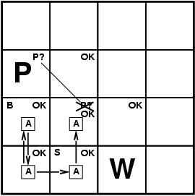
Exploring a wumpus world
A agent
B breeze
G glitter
OK safe cell
P pit
S stench
W wumpus

Slide 36
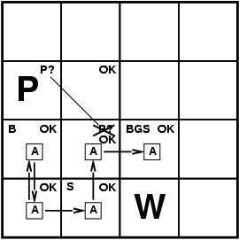
Exploring a wumpus world
A agent
B breeze
G glitter
OK safe cell
P pit
S stench
W wumpus

Slide 37
Exploring a wumpus world
A agent
B breeze
G glitter
OK safe cell
P pit
S stench
W wumpus
P?
P?

Slide 38
Wumpus World games online
AIMA code
  Python
  Lisp
http://scv.bu.edu/cgi-bin/wcl – Web-based version you can play
http://codenautics.com/wumpus/ - Mac version

Slide 39
Logic in general
Logics are formal languages for representing information such that conclusions can be drawn
Syntax defines the sentences in the language
Semantics define the "meaning" of sentences
  i.e., define truth of a sentence in a world
E.g., the language of arithmetic
  x+2 ≥ y is a sentence; x2+y > {} is not a sentence
  x+2 ≥ y is true iff the number x+2 is no less than the number y
  x+2 ≥ y is true in a world where x = 7, y = 1
  x+2 ≥ y is false in a world where x = 0, y = 6
  x+1> x is true for all numbers x

Slide 40
Entailment
Entailment means that one thing follows from another:
KB ╞ α
Knowledge base KB entails sentence α iff α is true in all possible worlds where KB is true
  E.g., the KB containing “UMBC won” and “JHU won” entails “Either UMBC won or JHU won”
  E.g., x+y = 4 entails 4 = x+y
  Entailment is a relationship between sentences (i.e., syntax) that is based on semantics

Slide 41
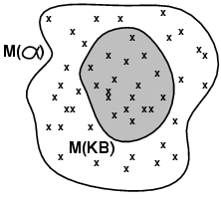
Models
Logicians typically think in terms of models: formally structured worlds w.r.t which truth can be evaluated
m is a model of sentence α if α is true in m
M(α) is the set of all models of α
Then KB ╞ α iff M(KB) ⊆ M(α)
  KB = UMBC and JHU won
  α = UMBC won
  Then KB ╞ α

Slide 42
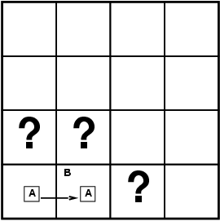
Entailment in the wumpus world
Situation after detecting nothing in [1,1], moving right, breeze in [2,1]
Possible models for KB assuming only pits and restricting cells to {(1,3)(2,1)(2,2)}
Two observations: ~B11, B12
Three propositional variables variables: P13, P21, P22
⇒ 8 possible models
B11: breeze in (1,1)
P13: pit in (1,3)

Slide 43
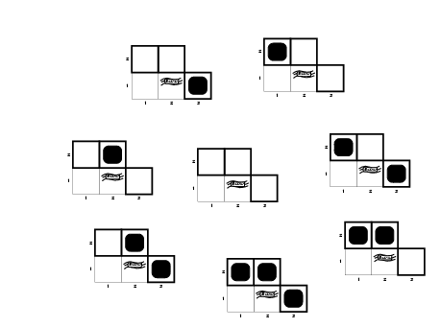
Wumpus models
P13 | P21 | P22
F | F | F
F | F | T
F | T | F
F | T | T
T | F | F
T | F | T
T | T | F
T | T | T
Each row is a possible world

Slide 44
Wumpus World Rules (1)
If a cell has a pit, then a breeze is observable in every adjacent cell
In propositional calculus we can not have rules with variables (e.g., forall X…)
  P11 => B21
  P11 => B12
  P21 => B11
  P21 => B22 …
these also follow
~B21 => ~P11
~B12 => ~P11
~B11 => ~P21
~B22 => ~P21
…
If a pit in (1,1) then a breeze in (2,1), …

Slide 45
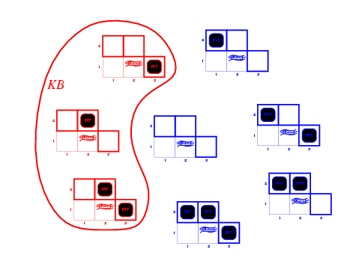
Wumpus models
Only three of the possible models are consistent with what we know
KB = wumpus-world rules + observations

Slide 46
Wumpus World Rules (2)
Cell safe if it has neither a pit or wumpus
  OK11 => ~P11 ∧ ~W11
  OK12 => ~P12 ∧ ~W12 …
From which we can derive
P11 ∨ W11 => ~OK11
P11 => ~OK11
W11 => ~OK11 …
OK11: (1,1) is safe
W11: Wumpus in (1,1)

Slide 47
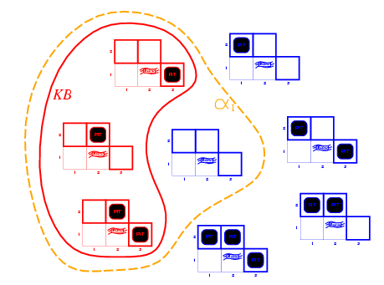
Wumpus models
KB = wumpus-world rules + observations
α₁ = “[1,2] is safe”
Since all models include α₁
KB ╞ α₁, proved by model checking

Slide 48
Wumpus models
KB = wumpus-world rules + observations

Slide 49
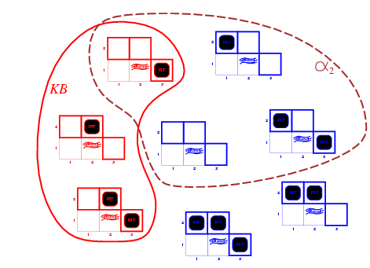
Is (2,2) Safe?
KB = wumpus-world rules + observations
α₂ = "[2,2] is safe"
Since some models don’t include α_{2,} KB ╞ α₂
We cannot prove OK22; it might be true or false.

Slide 50
Inference, Soundness, Completeness
KB ├_{i} α = sentence α can be derived from KB by procedure i
Soundness: i is sound if whenever KB ├_{i} α, it is also true that KB╞ α
Completeness: i is complete if whenever KB╞ α, it is also true that KB ├_{i} α
Preview: first-order logic is expressive enough to say almost anything of interest and has a sound and complete inference procedure

Slide 51
Representation, reasoning, and logic
Object of knowledge representation (KR): express knowledge in a computer-tractable form, so that agents can perform well
A KR language is defined by:
  Syntax: defines all possible sequences of symbols that constitute sentences of the language
    Ex: Sentences in a book, bit patterns in computer memory
  Semantics: determines facts in the world to which the sentences refer
    Each sentence makes a claim about the world.
    An agent is said to believe a sentence about the world.

Slide 52
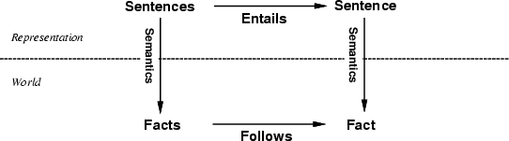
The connection between sentences and facts
Semantics maps sentences in logic to facts in the world.
The property of one fact following from another is mirrored
by the property of one sentence being entailed by another.

Slide 53
Soundness and completeness
A sound inference method derives only entailed sentences
Analogous to the property of completeness in search, a complete inference method can derive any sentence that is entailed

Slide 54
Logic as a KR language
Multi-valued
Logic
Modal
Temporal
Non-monotonic
Logic
Higher Order
Probabilistic
Logic
First Order
Propositional Logic
Fuzzy
Logic

Slide 55
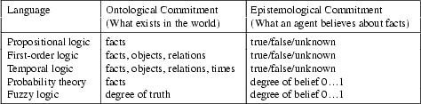
Ontology and epistemology
Ontology is the study of what there is—an inventory of what exists. An ontological commitment is a commitment to an existence claim.
Epistemology is a major branch of philosophy that concerns the forms, nature, and preconditions of knowledge.

Slide 56
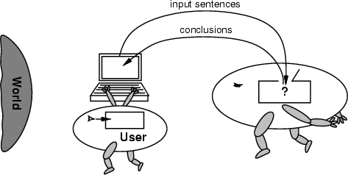
No independent access to the world
Reasoning agents often gets knowledge about facts of the world as a sequence of logical sentences and must draw conclusions only from them w/o independent access to world
Thus, it is very important that the agents’ reasoning is sound!

Slide 57
Summary
Intelligent agents need knowledge about world for good decisions
Agent’s knowledge stored in a knowledge base (KB) as sentences in a knowledge representation (KR) language
A knowledge-based agent needs a KB and an inference mechanism. It operates by storing sentences in its KB, inferring new sentences and using them to deduce which actions to take
A representation language is defined by its syntax and semantics, which specify structure of sentences and how they relate to facts of the world
The interpretation of a sentence is fact to which it refers. If the fact is part of the actual world, then the sentence is true

