Slide 1
Networking and Distributed Systems
CMSC 421 – Section 02
May 5 and 7, 2020
Many slides adapted from OSC 10e (Silberschatz, Galvin, and Gagne 2018)

Slide 2
Outline
Networked and Distributed Systems
OSI Model
Communication Structure
Network-oriented Systems
Berkeley Sockets
Distributed System Model
Byzantine Fault Tolerance
Peer-to-peer Systems
Distributed Filesystems

Slide 3
Networked and Distributed Systems
A distributed system is a collection of loosely coupled nodes interconnected by a communications network
Nodes variously called processors, computers, machines, hosts
  Site is location of the machine, node refers to specific system
  Generally a server has a resource a client node at a different site wants to use

Slide 4
Networked and Distributed Systems
Nodes may exist in a client-server, peer-to-peer, or hybrid configuration.
  In client-server configuration, server has a resource that a client would like to use
  In peer-to-peer configuration, each node shares equal responsibilities and can act as both clients and servers
  A hybrid configuration combines characteristics of both of the above
Communication over a network occurs through message passing
  All higher-level functions of a standalone system can be expanded to encompass a distributed system

Slide 5
Why?
Resource sharing
  Sharing files or printing at remote sites
  Processing information in a distributed database
  Using remote specialized hardware devices such as graphical processing units (GPUs) and other compute devices (FPGAs, ASICs)
Computation speedup
  Distribute portions of computations among various sites to run concurrently
  Load balancing: moving jobs to more lightly-loaded sites
Reliability
  Detect and recover from site failure, function transfer, reintegrate failed site

Slide 6
Network Structure
Local-Area Network (LAN) – designed to cover small geographical area, usually limited to within one building or site
  Consists of multiple computers (workstations, laptops, mobile devices), peripherals (printers, storage arrays), switches, and routers providing access to other networks
  Ethernet and/or Wireless (WiFi) most common way to construct LANs
    Ethernet defined by standard IEEE 802.3 with speeds typically varying from 10Mbps (original 802.3 specification – 1983) to 400Gbps (802.3cn – 2019).
      Typically transmitted over copper wire, but also sometimes over optical cable
    WiFi defined by standard IEEE 802.11 with speeds typically varying from 1Mbps (original 802.11 specification –1997) to about 20Gbps (802.11ay – 2020).
    Both standards constantly evolving

Slide 7
Network Structure
Wide-Area Network (WAN) – links geographically separated sites
  Point-to-point connections via links
    Telephone lines, leased (dedicated data) lines, optical cable, microwave links, radio waves, and satellite channels
  Implemented via routers to direct (route) traffic from one network to another
  The Internet enables hosts world wide to communicate
  Speeds vary
    Many backbone providers have speeds at 40-100Gbps
    Local Internet Service Providers (ISPs) are usually significantly slower
    WAN links constantly being upgraded
  WANs and LANs interconnect, similar to cell phone network
    Cell phones use radio waves to cell towers
    Towers connect to other towers and to the POTS

Slide 8
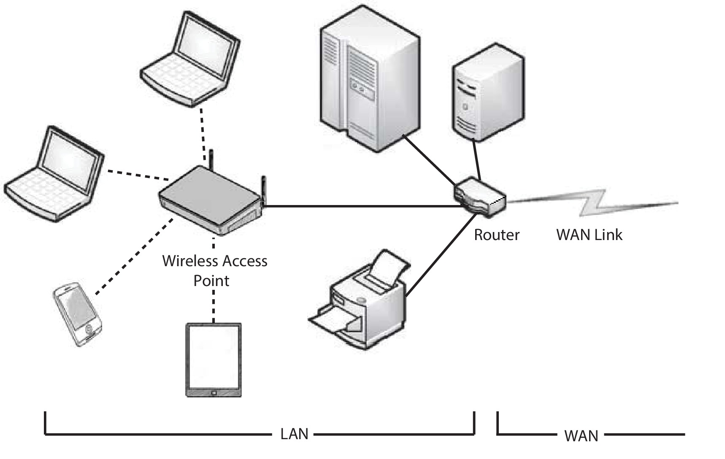
Local Area Network (LAN)

Slide 9
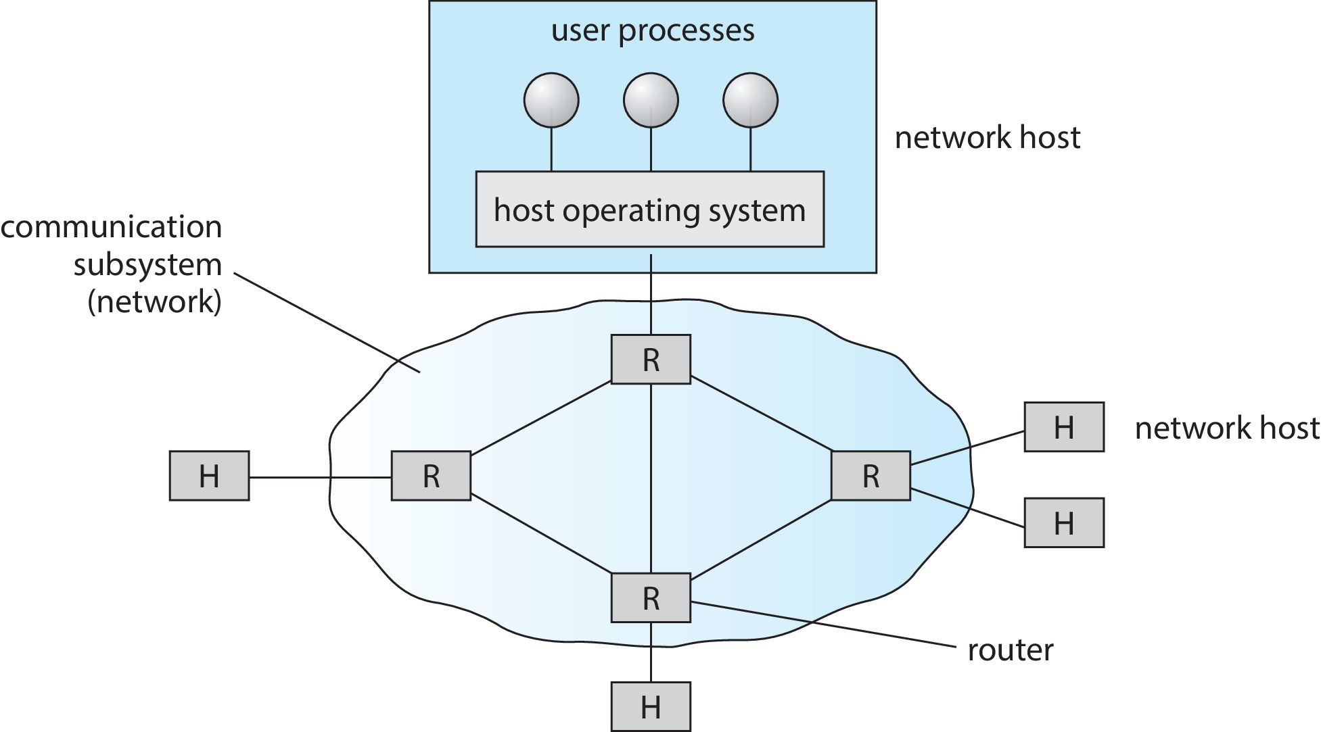
Wide Area Network (WAN)

Slide 10
Name Resolution
Each computer system in a network is usually identified by a unique name
Each potential server on a system is identified by a unique port number
Identification of services on a remote system can be done by <hostname, port> pairs
The Domain Name System (DNS) specifies the naming structure of hosts, as well as providing for name to address resolution over the Internet
  Originally specified in Internet Engineering Task Force RFC 882 and 883 (November 1983)

Slide 11
OSI Model
Networked communication is specified in a layered model known as the Open Systems Interconnect (OSI) Model
  Specifies a seven layer model, where each higher level builds off the services provided by the layers beneath it
This is a theoretical model and often in practice it is not quite so clearly defined
Developed in the late 1970s to formalize earlier work done in network protocols
Most widely deployed stack is the TCP/IP model
  TCP/IP has less layers than the OSI Model, but some portions of each layer in TCP/IP would be in multiple layers of the OSI Model

Slide 12
Layers of the OSI Model
Layer 1: Physical Layer
  Defines mechanical and electrical details of the physical connection layer between hosts
  Specifies the conversion of bits into electrical signals, radio signals, etc.
  Defines network topology and how remote networks are connected
Layer 2: Data-link Layer
  Defines communication between two directly connected hosts in terms of frames of data
  Defines error correction measures for the physical layer
  Defines framing mechanisms for identifying communication boundaries
  802.3, 802.11, Point-to-Point Protocol

Slide 13
Layers of the OSI Model
Layer 3: Network Layer
  Provides connections and routing for packets over the Data-link Layer
  Does not necessarily guarantee reliable communication of packets between nodes or sites (but may optionally do so)
  IPv4, IPv6, IGMP, IPX, AppleTalk
Layer 4: Transport Layer
  Responsible for message transfer between clients
  Partitions messages into packets for Layer 3
  Responsible for ordering and reliable delivery if needed
  TCP, UDP, UDPLite

Slide 14
Layers of the OSI Model
Layer 5: Session Layer
  Implements sessions and defines process-to-process communication protocols
  NetBIOS, PPTP, RTP, Named Pipes, SPDY
Layer 6: Presentation Layer
  Implements protocols for resolving difference between formats used on communicating nodes
  Deals with character set conversions, etc
Layer 7: Application Layer
  Interactions with users and definitions of standard protocols used by applications
  FTP, HTTP, NFS, DHCP, DNS, etc.

Slide 15
Layers of the OSI Model

Slide 16
TCP/IP
Every host has a name and an associated IP address
  Hierarchical and segmented
Sending system checks routing tables and locates a router to send packet
Router uses segmented network part of IP address to determine where to transfer packet
  This may repeat among multiple routers
  May also fragment packets into smaller chunks if needed by communication medium
Destination system receives the packet
  Packet may be complete message, or it may need to be reassembled into larger message spanning multiple packets

Slide 17
TCP/IP
Within a network, how does a packet move from sender (host or router) to receiver?
  Every Ethernet/WiFi device has a medium access control (MAC) address
  Two devices on same LAN communicate via MAC address
  If a system needs to send data to another system, it needs to discover the IP to MAC address mapping
    Uses address resolution protocol (ARP)
  A broadcast or multicast packet uses a special network address to signal that all hosts should receive and process the packet
    Not forwarded by routers to different networks

Slide 18
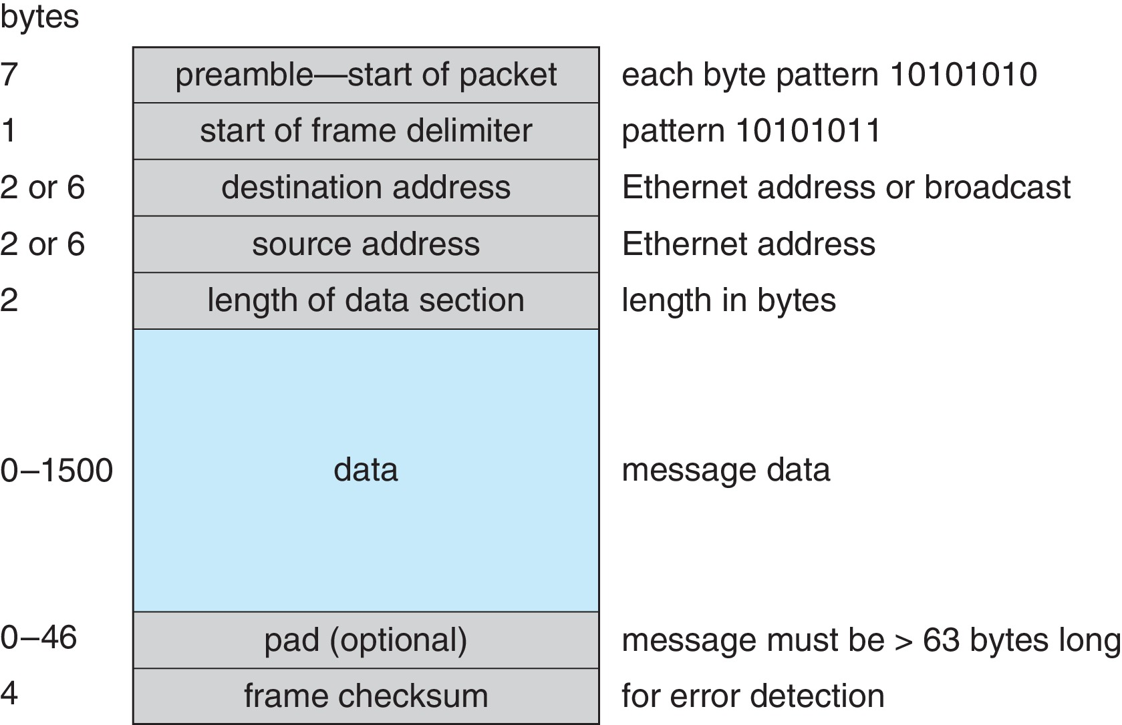
Ethernet (802.3) Frame

Slide 19
Transport Layer Protocols
Once a host with a specific IP address receives a packet, it must somehow pass it to the correct waiting process
Transport protocols TCP and UDP identify receiving and sending processes through the use of a 16-bit port number
  Allows host with single IP address to have multiple server/client processes sending/receiving packets
  Well-known port numbers are used for many services
    FTP – port 21
    Secure Shell – port 22
    SMTP – port 25
    HTTP – port 80
Transport protocol can be simple or can add reliability to network packet stream

Slide 20
User Datagram Protocol
UDP is unreliable – bare-bones extension to IP with addition of port number
  Since there are no guarantees of delivery in the lower network (IP) layer, packets may become lost
  Packets may also be received out-out-order
UDP is also connectionless – no connection setup at the beginning of the transmission to set up state
  Also no connection tear-down at the end of transmission
UDP packets are also called datagrams
UDPLite makes UDP even more barebones by removing checksums that are unnecessary over a reliable physical medium

Slide 21
Transmission Control Protocol
TCP is both reliable and connection-oriented
In addition to port number, TCP provides abstraction to allow in-order, uninterrupted byte-stream across an unreliable network
  Whenever host sends packet, the receiver must send an acknowledgement packet (ACK). If ACK not received before a timer expires, sender will resend.
  Sequence numbers in TCP header allow receiver to put packets in order and notice missing packets
  Connections are initiated with series of control packets called a three-way handshake
    Connections also closed with series of control packets

Slide 22
Transmission Control Protocol
Receiver can send a cumulative ACK to acknowledge series of packets
  Server can also send multiple packets before waiting for ACKs
  Takes advantage of network throughput
Flow of packets regulated through flow control and congestion control
  Flow control – prevents sender from overrunning capacity of receiver
  Congestion control – approximates congestion of the network to slow down or speed up packet sending rate

Slide 23
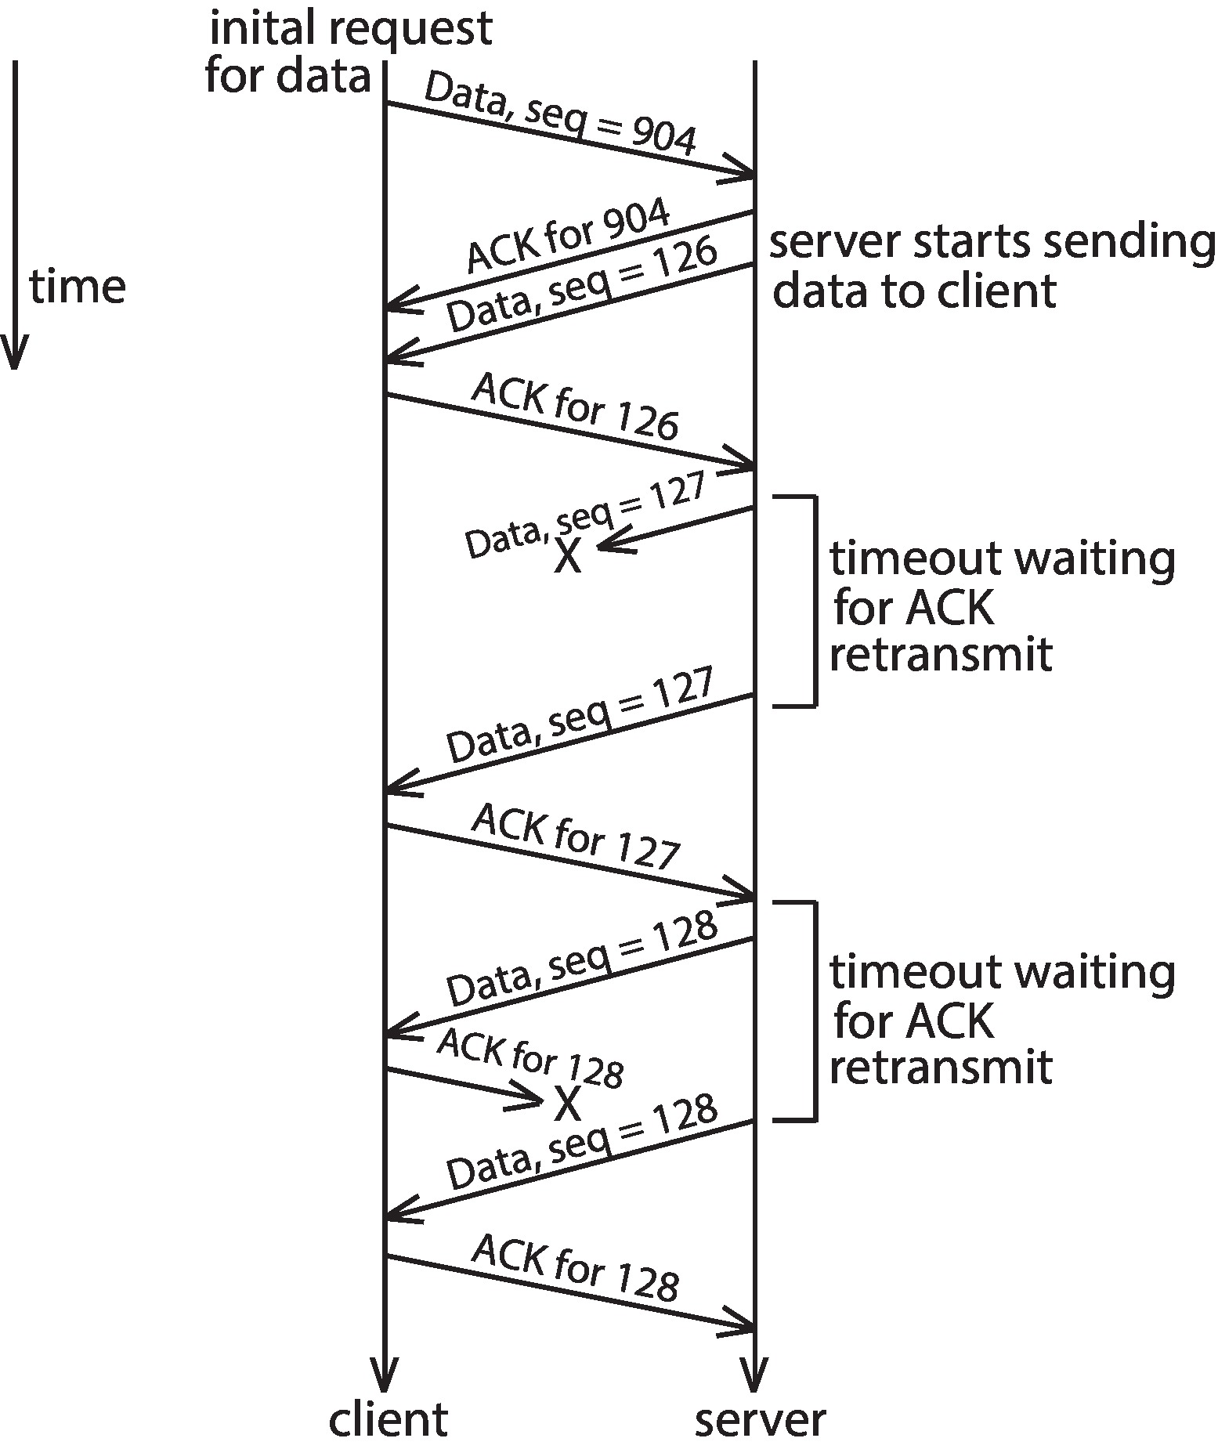
TCP Connection Sequence

Slide 24
Berkeley Sockets
Communications API to link multiple systems using (usually) the TCP/IP protocol stack
Originated in the 4.2BSD Unix System in 1983
  BSD: Berkeley Software Distribution
    A Unix-derived OS that was developed at the University of California – Berkeley
    Still maintained today through systems such as FreeBSD, NetBSD, OpenBSD, etc.
    One of the primary “free” competitors to Linux in the server-space
Specifies a series of system calls used for network communication and a mapping onto the VFS
  socket(), bind(), listen(), accept(), connect(), recv(), send(), recvfrom(), sendto()
Defines a message-passing like mechanism for remote communication
Widely implemented on most OSes today

Slide 25
Network-oriented Systems
Two main types
Network Operating Systems
  Users are aware of multiplicity of machines
Distributed Operating Systems
  Users not aware of multiplicity of machines

Slide 26
Network Operating Systems
Users are aware of multiplicity of machines
Access to resources of various machines is done explicitly by:
  Remote logging into the appropriate remote machine (SSH)
    ssh kristen.cs.yale.edu
  Transferring data from remote machines to local machines, via the File Transfer Protocol (FTP) mechanism
  Upload, download, access, or share files through cloud storage
Users must change paradigms – establish a session, give network-based commands, use a web browser
  More difficult for users

Slide 27
Distributed Operating Systems
Users not aware of multiplicity of machines
  Access to remote resources similar to access to local resources
Data Migration – transfer data by transferring entire file, or transferring only those portions of the file necessary for the immediate task
Computation Migration – transfer the computation, rather than the data, across the system
  Via remote procedure calls (RPCs)
  Via messaging system

Slide 28
Distributed Operating Systems
Process Migration – execute an entire process, or parts of it, at different sites
  Load balancing – distribute processes across network to even the workload
  Computation speedup – subprocesses can run concurrently on different sites
  Hardware preference – process execution may require specialized processor
  Software preference – required software may be available at only a particular site
  Data access – run process remotely, rather than transfer all data locally

Slide 29
Robustness in Distributed Systems
Hardware failures can include failure of a link, failure of a site, and loss of a message.
A fault-tolerant system can tolerate a certain level of failure
  Degree of fault tolerance depends on design of system and the specific fault
  The more fault tolerance, the better!
Involves failure detection, re-configuration, and recovery

Slide 30
Failure Detection
Detecting hardware failure is difficult
To detect a link failure, a heartbeat protocol can be used
Assume Site A and Site B have established a link
  At fixed intervals, each site will exchange an I-am-up message indicating that they are up and running
If Site A does not receive a message within the fixed interval, it assumes either (a) the other site is not up or (b) the message was lost
Site A can now send an Are-you-up? message to Site B
If Site A does not receive a reply, it can repeat the message or try an alternate route to Site B

Slide 31
Failure Detection
If Site A does not ultimately receive a reply from Site B, it concludes some type of failure has occurred
However, Site A cannot determine exactly why the failure has occurred
Some possibilities:
- Site B is down
- The direct link between A and B is down
- The alternate link from A to B is down
- The message has been lost

Slide 32
Re-configuration and Recovery
When Site A determines a failure has occurred, it must reconfigure the system:
  If the link from A to B has failed, this must be broadcast to every site in the system
  If a site has failed, every other site must also be notified indicating that the services offered by the failed site are no longer available
When the link or the site becomes available again, this information must again be broadcast to all other sites

Slide 33
Byzantine Faults and Failures
So far we have assumed that failures are caused by lost nodes or broken network connections
Sometimes nodes might fail in more interesting ways
  Consider both benign and malicious failures
  Especially in systems that require consensus
For instance, consider a node that responds differently to certain nodes than to others
  Such a fault is known as a Byzantine Fault
A Byzantine Failure is one where a system that requires consensus is broken due to a Byzantine Fault

Slide 34
The Byzantine Generals Problem
“We imagine that several divisions of the Byzantine army are camped outside an enemy city, each division commanded by its own general. The generals can communicate with one another only by messenger. After observing the enemy, they must decide upon a common plan of action. However, some of the generals may be traitors, trying to prevent the loyal generals from reaching agreement. The generals must have an algorithm to guarantee that
A. All loyal generals decide upon the same plan of action…
B. A small number of traitors cannot cause the loyal generals to adopt a bad plan. “[1]
[1] Lamport, L.; Shostak, R.; Pease, M. (1982). "The Byzantine Generals Problem". ACM Transactions on Programming Languages and Systems. 4 (3): 387–389. https://www.microsoft.com/en-us/research/uploads/prod/2016/12/The-Byzantine-Generals-Problem.pdf

Slide 35
The Byzantine Generals Problem
A proper solution to the Byzantine Generals problem requires at least 3m + 1 “generals” to be present, where m is the number of traitorous generals.
  That is to say that in order for a system to be resistant to a one node Byzantine Fault, there must be at least 4 nodes within the system
  This assumes that messages are not changed in transit, but that individual nodes may (for whatever reason) lie about the information received when communicating with other nodes
Signature schemes may be used to lower the bound on the number of functioning nodes

Slide 36
Byzantine Fault Tolerance and
Peer-to-Peer Systems
Byzantine Fault Tolerance is needed in many distributed systems in order to prevent these types of faults from corrupting the state of the system
Cryptocurrencies such as Dogecoin, Bitcoin, Litecoin, and Ethereum are examples of BFT systems that are in common use today
  As are any other systems that use “Blockchain” technology
Peer-to-peer systems often employ various complex BFT schemes to ensure correctness

Slide 37
Peer-to-peer Systems
A peer-to-peer systems is a distributed system where a client-server model is not present
  That is to say all nodes can act both as a client of the network and as one offering services to the network
Consider systems like cryptocurrencies and BitTorrent

Slide 38
Distributed Filesystems
A Distributed Filesystem (DFS) is a system that stores data for access on a distributed system
  Clients, servers, and storage devices may be dispersed amongst some or all of the nodes in the distributed system – file data is not centralized!
Distributed filesystems have problems of load-balancing and data distribution that are not present in on-disk filesystems that are limited to a single node
These systems must tackle the problems of keeping data close to where it is needed, while ensuring that consistency is preserved on all nodes in the distributed system
As many systems may be attempting to access files in the DFS at the same time, especially in a large cluster, efficiency is of paramount concern!

Slide 39
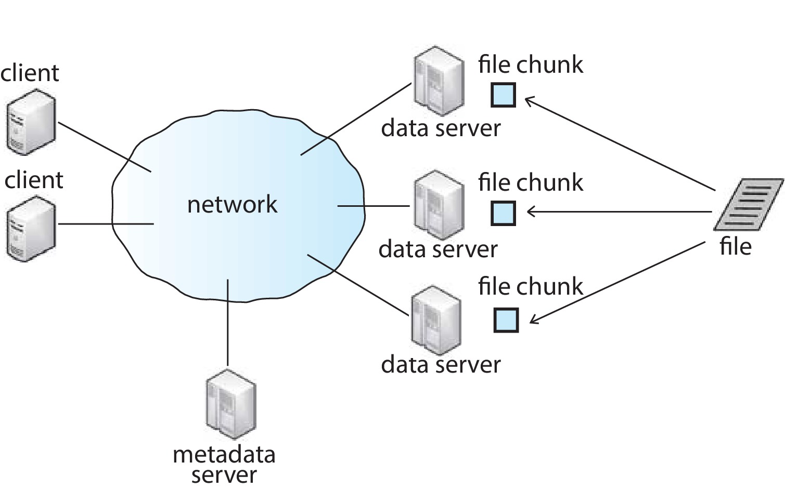
Cluster-based DFS

Slide 40
Cluster Based DFS
Built to be more fault-tolerant and scalable than a client-server filesystem setup
Examples include the Google File System (GFS) and Hadoop Distributed File System (HDFS)
  Clients connected to master metadata server and several data servers that hold “chunks” (portions) of files
  Metadata server keeps mapping of which data servers hold chunks of which files
    As well as hierarchical mapping of directories and files
  File chunks replicated n times

