Slide 1
Chapter 8: Main Memory

Slide 2
Chapter 8: Memory Management
Background
Swapping
Contiguous Memory Allocation
Segmentation
Paging
Structure of the Page Table
Example: The Intel 32 and 64-bit Architectures
Example: ARM Architecture

Slide 3
Objectives
To provide a detailed description of various ways of organizing memory hardware
To discuss various memory-management techniques, including paging and segmentation
To provide a detailed description of the Intel Pentium, which supports both pure segmentation and segmentation with paging

Slide 4
Background
Program must be brought (from disk) into memory and placed within a process for it to be run
Main memory and registers are only storage CPU can access directly
Memory unit only sees a stream of addresses + read requests, or address + data and write requests
Register access in one CPU clock (or less)
Main memory can take many cycles, causing a stall
Cache sits between main memory and CPU registers
Protection of memory required to ensure correct operation

Slide 5
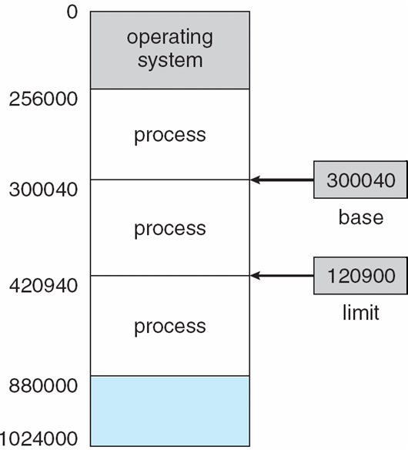
Base and Limit Registers
A pair of base and limit registers define the logical address space
CPU must check every memory access generated in user mode to be sure it is between base and limit for that user

Slide 6
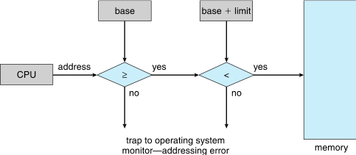
Hardware Address Protection

Slide 7
Address Binding
Programs on disk, ready to be brought into memory to execute form an input queue
  Without support, must be loaded into address 0000
Inconvenient to have first user process physical address always at 0000
  How can it not be?
Further, addresses represented in different ways at different stages of a program’s life
  Source code addresses usually symbolic
  Compiled code addresses bind to relocatable addresses
    i.e. “14 bytes from beginning of this module”
  Linker or loader will bind relocatable addresses to absolute addresses
    i.e. 74014
  Each binding maps one address space to another

Slide 8
Binding of Instructions and Data to Memory
Address binding of instructions and data to memory addresses can happen at three different stages
  Compile time: If memory location known a priori, absolute code can be generated; must recompile code if starting location changes
  Load time: Must generate relocatable code if memory location is not known at compile time
  Execution time: Binding delayed until run time if the process can be moved during its execution from one memory segment to another
    Need hardware support for address maps (e.g., base and limit registers)

Slide 9
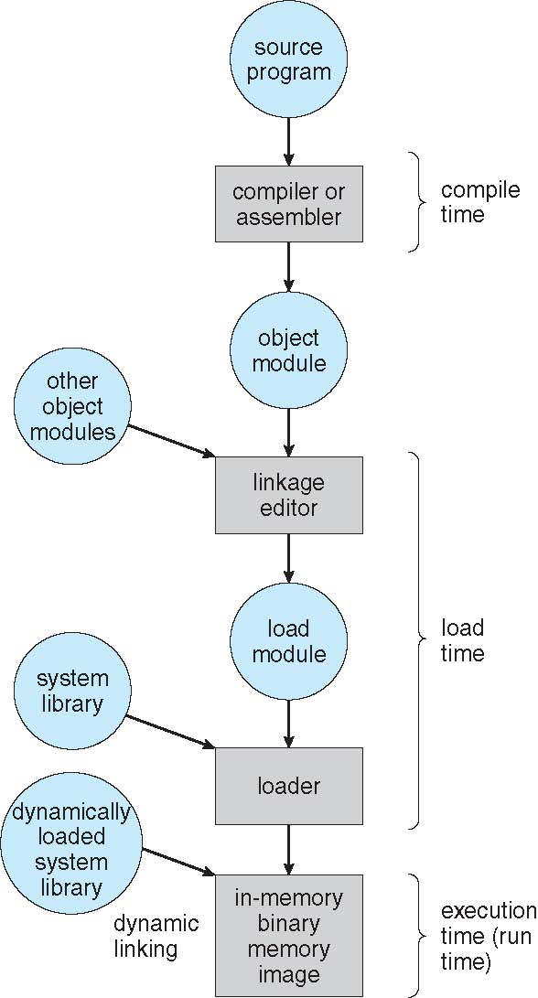
Multistep Processing of a User Program

Slide 10
Logical vs. Physical Address Space
The concept of a logical address space that is bound to a separate physical address space is central to proper memory management
  Logical address – generated by the CPU; also referred to as virtual address
  Physical address – address seen by the memory unit
Logical and physical addresses are the same in compile-time and load-time address-binding schemes; logical (virtual) and physical addresses differ in execution-time address-binding scheme
Logical address space is the set of all logical addresses generated by a program
Physical address space is the set of all physical addresses generated by a program

Slide 11
Memory-Management Unit (MMU)
Hardware device that at run time maps virtual to physical address
Many methods possible, covered in the rest of this chapter
To start, consider simple scheme where the value in the relocation register is added to every address generated by a user process at the time it is sent to memory
  Base register now called relocation register
  MS-DOS on Intel 80x86 used 4 relocation registers
The user program deals with logical addresses; it never sees the real physical addresses
  Execution-time binding occurs when reference is made to location in memory
  Logical address bound to physical addresses

Slide 12
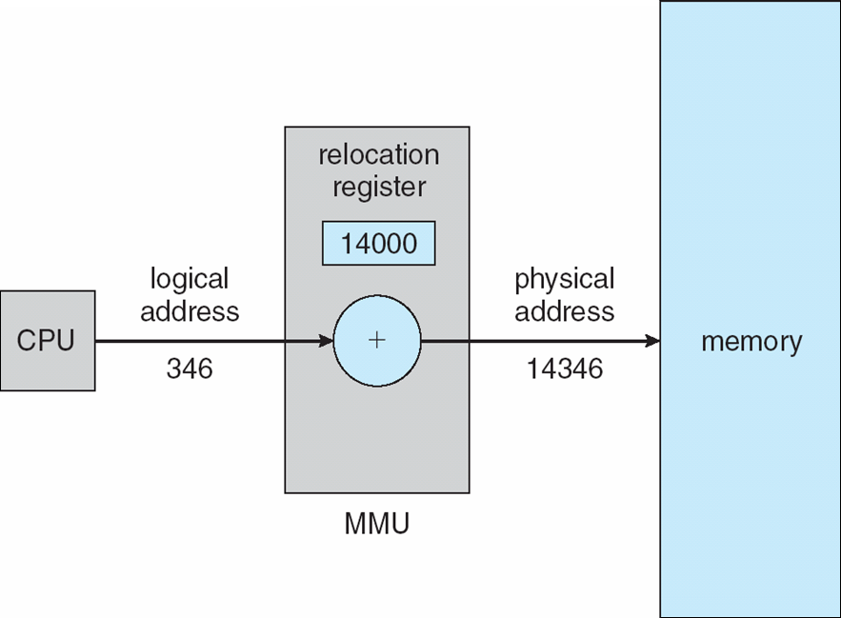
Dynamic relocation using a relocation register
Routine is not loaded until it is called
Better memory-space utilization; unused routine is never loaded
All routines kept on disk in relocatable load format
Useful when large amounts of code are needed to handle infrequently occurring cases
No special support from the operating system is required
  Implemented through program design
  OS can help by providing libraries to implement dynamic loading

Slide 13
Dynamic Linking
Static linking – system libraries and program code combined by the loader into the binary program image
Dynamic linking –linking postponed until execution time
Small piece of code, stub, used to locate the appropriate memory-resident library routine
Stub replaces itself with the address of the routine, and executes the routine
Operating system checks if routine is in processes’ memory address
  If not in address space, add to address space
Dynamic linking is particularly useful for libraries
System also known as shared libraries
Consider applicability to patching system libraries
  Versioning may be needed

Slide 14
Swapping
A process can be swapped temporarily out of memory to a backing store, and then brought back into memory for continued execution
  Total physical memory space of processes can exceed physical memory
Backing store – fast disk large enough to accommodate copies of all memory images for all users; must provide direct access to these memory images
Roll out, roll in – swapping variant used for priority-based scheduling algorithms; lower-priority process is swapped out so higher-priority process can be loaded and executed
Major part of swap time is transfer time; total transfer time is directly proportional to the amount of memory swapped
System maintains a ready queue of ready-to-run processes which have memory images on disk

Slide 15
Swapping (Cont.)
Does the swapped out process need to swap back in to same physical addresses?
Depends on address binding method
  Plus consider pending I/O to / from process memory space
Modified versions of swapping are found on many systems (i.e., UNIX, Linux, and Windows)
  Swapping normally disabled
  Started if more than threshold amount of memory allocated
  Disabled again once memory demand reduced below threshold

Slide 16
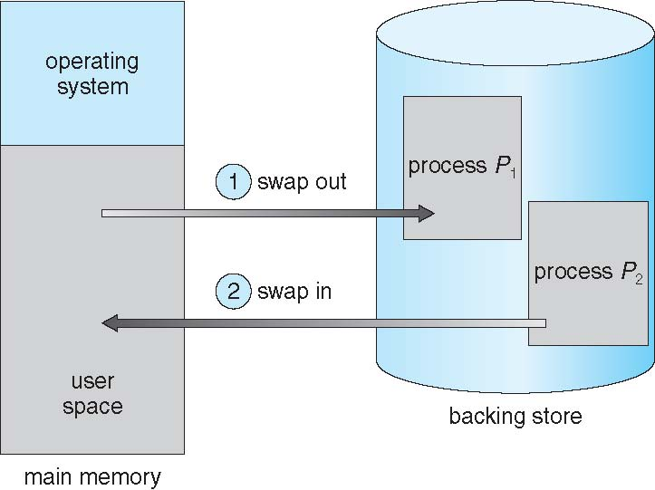
Schematic View of Swapping

Slide 17
Context Switch Time including Swapping
If next processes to be put on CPU is not in memory, need to swap out a process and swap in target process
Context switch time can then be very high
100MB process swapping to hard disk with transfer rate of 50MB/sec
  Swap out time of 2000 ms
  Plus swap in of same sized process
  Total context switch swapping component time of 4000ms (4 seconds)
Can reduce if reduce size of memory swapped – by knowing how much memory really being used
  System calls to inform OS of memory use via request_memory() and release_memory()

Slide 18
Context Switch Time and Swapping (Cont.)
Other constraints as well on swapping
  Pending I/O – can’t swap out as I/O would occur to wrong process
  Or always transfer I/O to kernel space, then to I/O device
    Known as double buffering, adds overhead
Standard swapping not used in modern operating systems
  But modified version common
    Swap only when free memory extremely low

Slide 19
Swapping on Mobile Systems
Not typically supported
  Flash memory based
    Small amount of space
    Limited number of write cycles
    Poor throughput between flash memory and CPU on mobile platform
Instead use other methods to free memory if low
  iOS asks apps to voluntarily relinquish allocated memory
    Read-only data thrown out and reloaded from flash if needed
    Failure to free can result in termination
  Android terminates apps if low free memory, but first writes application state to flash for fast restart
  Both OSes support paging as discussed below

Slide 20
Contiguous Allocation
Main memory must support both OS and user processes
Limited resource, must allocate efficiently
Contiguous allocation is one early method
Main memory usually into two partitions:
  Resident operating system, usually held in low memory with interrupt vector
  User processes then held in high memory
  Each process contained in single contiguous section of memory

Slide 21
Contiguous Allocation (Cont.)
Relocation registers used to protect user processes from each other, and from changing operating-system code and data
  Base register contains value of smallest physical address
  Limit register contains range of logical addresses – each logical address must be less than the limit register
  MMU maps logical address dynamically
  Can then allow actions such as kernel code being transient and kernel changing size

Slide 22
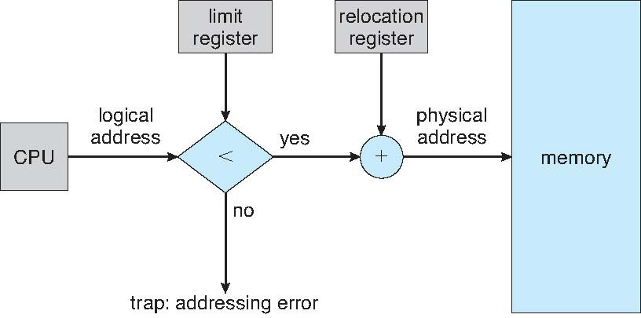
Hardware Support for Relocation and Limit Registers

Slide 23
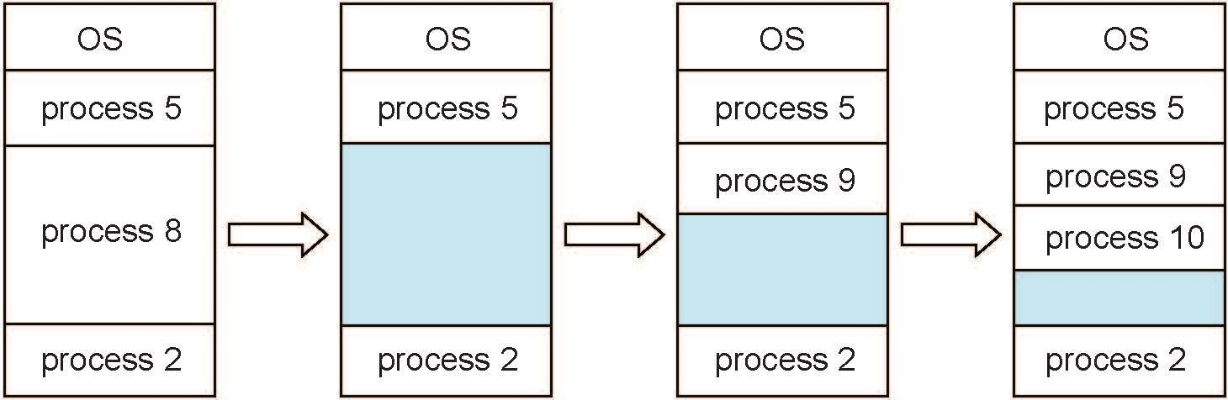
Multiple-partition allocation
Multiple-partition allocation
  Degree of multiprogramming limited by number of partitions
  Variable-partition sizes for efficiency (sized to a given process’ needs)
  Hole – block of available memory; holes of various size are scattered throughout memory
  When a process arrives, it is allocated memory from a hole large enough to accommodate it
  Process exiting frees its partition, adjacent free partitions combined
  Operating system maintains information about:
  a) allocated partitions b) free partitions (hole)

Slide 24
Dynamic Storage-Allocation Problem
How to satisfy a request of size n from a list of free holes?
First-fit: Allocate the first hole that is big enough
Best-fit: Allocate the smallest hole that is big enough; must search entire list, unless ordered by size
  Produces the smallest leftover hole
Worst-fit: Allocate the largest hole; must also search entire list
  Produces the largest leftover hole
First-fit and best-fit better than worst-fit in terms of speed and storage utilization

Slide 25
Fragmentation
External Fragmentation – total memory space exists to satisfy a request, but it is not contiguous
Internal Fragmentation – allocated memory may be slightly larger than requested memory; this size difference is memory internal to a partition, but not being used
First fit analysis reveals that given N blocks allocated, 0.5 N blocks lost to fragmentation
  1/3 may be unusable -> 50-percent rule

Slide 26
Fragmentation (Cont.)
Reduce external fragmentation by compaction
  Shuffle memory contents to place all free memory together in one large block
  Compaction is possible only if relocation is dynamic, and is done at execution time
  I/O problem
    Latch job in memory while it is involved in I/O
    Do I/O only into OS buffers
Now consider that backing store has same fragmentation problems

Slide 27
Segmentation
Memory-management scheme that supports user view of memory
A program is a collection of segments
  A segment is a logical unit such as:
main program
procedure
function
method
object
local variables, global variables
common block
stack
symbol table
arrays

Slide 28
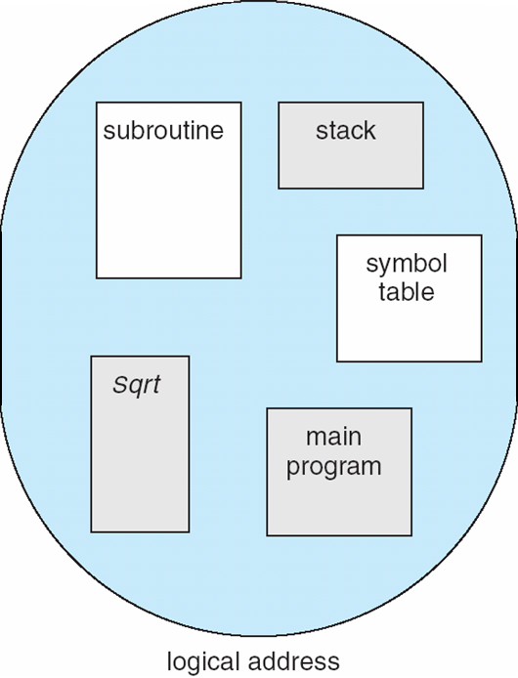
User’s View of a Program

Slide 29
Logical View of Segmentation
1
4
1
2
3
2
4
3
user space
physical memory space

Slide 30
Segmentation Architecture
Logical address consists of a two tuple:
<segment-number, offset>,
Segment table – maps two-dimensional physical addresses; each table entry has:
  base – contains the starting physical address where the segments reside in memory
  limit – specifies the length of the segment
Segment-table base register (STBR) points to the segment table’s location in memory
Segment-table length register (STLR) indicates number of segments used by a program;
segment number s is legal if s < STLR

Slide 31
Segmentation Architecture (Cont.)
Protection
  With each entry in segment table associate:
    validation bit = 0 ⇒ illegal segment
    read/write/execute privileges
Protection bits associated with segments; code sharing occurs at segment level
Since segments vary in length, memory allocation is a dynamic storage-allocation problem
A segmentation example is shown in the following diagram

Slide 32
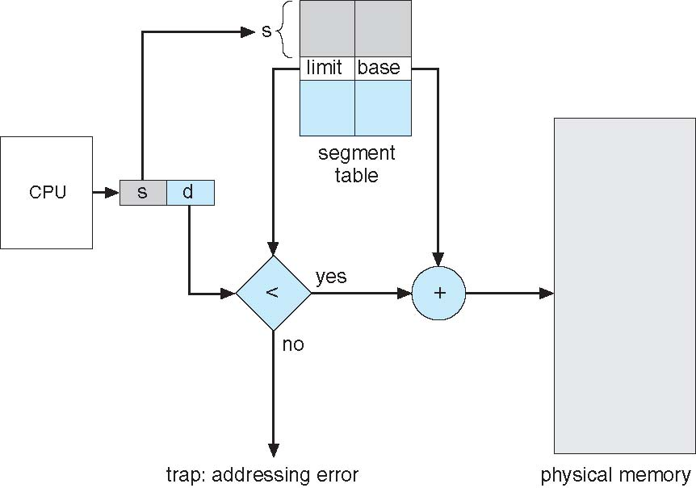
Segmentation Hardware

Slide 33
Paging
Physical address space of a process can be noncontiguous; process is allocated physical memory whenever the latter is available
  Avoids external fragmentation
  Avoids problem of varying sized memory chunks
Divide physical memory into fixed-sized blocks called frames
  Size is power of 2, between 512 bytes and 16 Mbytes
Divide logical memory into blocks of same size called pages
Keep track of all free frames
To run a program of size N pages, need to find N free frames and load program
Set up a page table to translate logical to physical addresses
Backing store likewise split into pages
Still have Internal fragmentation

Slide 34
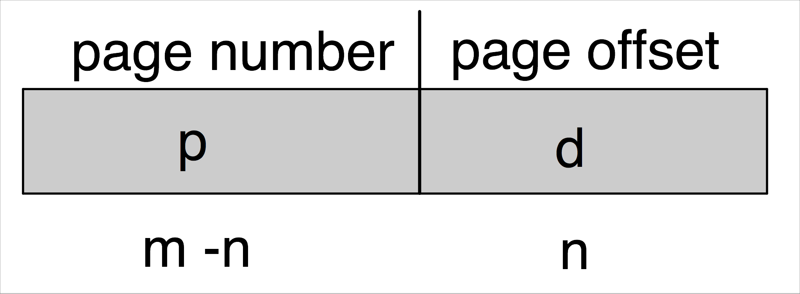
Address Translation Scheme
Address generated by CPU is divided into:
  Page number (p) – used as an index into a page table which contains base address of each page in physical memory
  Page offset (d) – combined with base address to define the physical memory address that is sent to the memory unit
  For given logical address space 2^{m} and page size 2^{n}

Slide 35
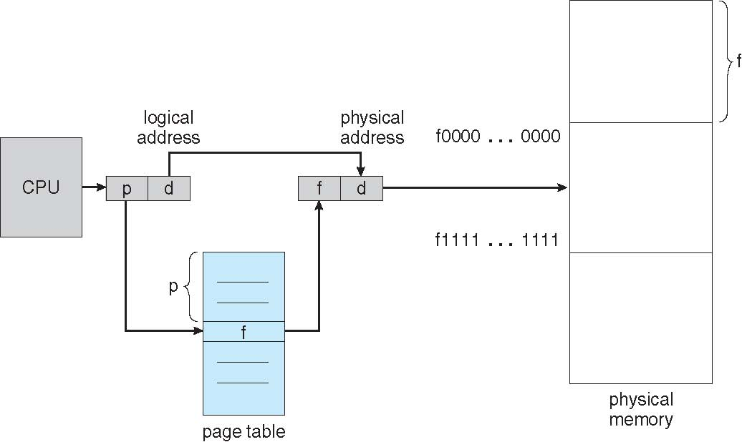
Paging Hardware

Slide 36
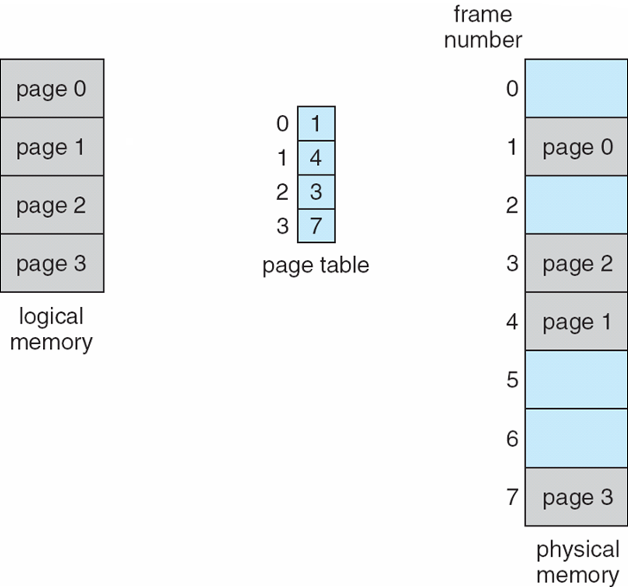
Paging Model of Logical and Physical Memory

Slide 37
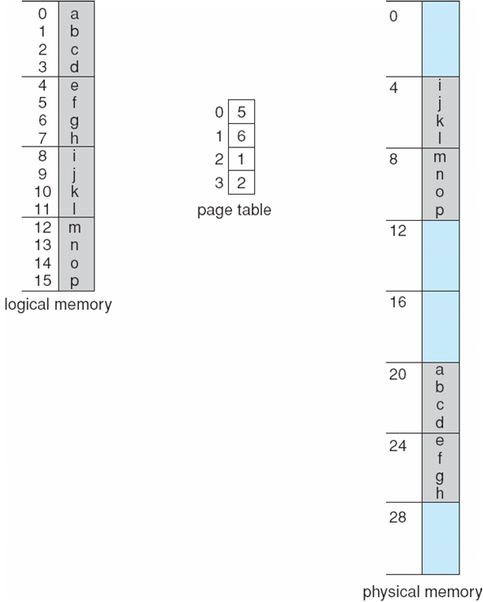
Paging Example
n=2 and m=4 32-byte memory and 4-byte pages

Slide 38
Paging (Cont.)
Calculating internal fragmentation
  Page size = 2,048 bytes
  Process size = 72,766 bytes
  35 pages + 1,086 bytes
  Internal fragmentation of 2,048 - 1,086 = 962 bytes
  Worst case fragmentation = 1 frame – 1 byte
  On average fragmentation = 1 / 2 frame size
  So small frame sizes desirable?
  But each page table entry takes memory to track
  Page sizes growing over time
    Solaris supports two page sizes – 8 KB and 4 MB
Process view and physical memory now very different
By implementation process can only access its own memory

Slide 39
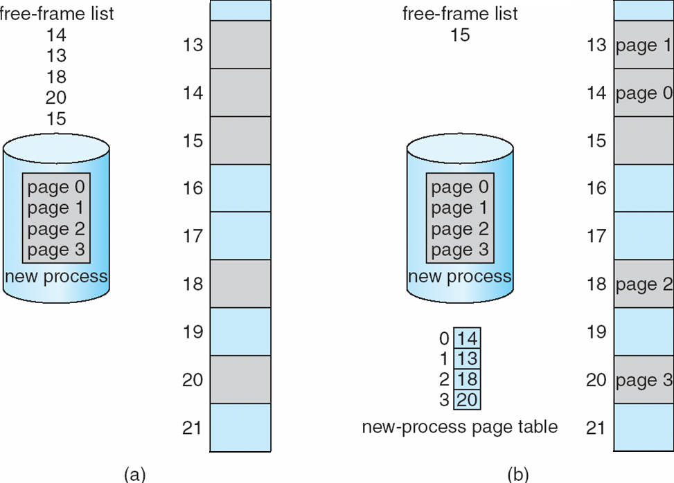
Free Frames
Before allocation
After allocation

Slide 40
Implementation of Page Table
Page table is kept in main memory
Page-table base register (PTBR) points to the page table
Page-table length register (PTLR) indicates size of the page table
In this scheme every data/instruction access requires two memory accesses
  One for the page table and one for the data / instruction
The two memory access problem can be solved by the use of a special fast-lookup hardware cache called associative memory or translation look-aside buffers (TLBs)

Slide 41
Implementation of Page Table (Cont.)
Some TLBs store address-space identifiers (ASIDs) in each TLB entry – uniquely identifies each process to provide address-space protection for that process
  Otherwise need to flush at every context switch
TLBs typically small (64 to 1,024 entries)
On a TLB miss, value is loaded into the TLB for faster access next time
  Replacement policies must be considered
  Some entries can be wired down for permanent fast access

Slide 42
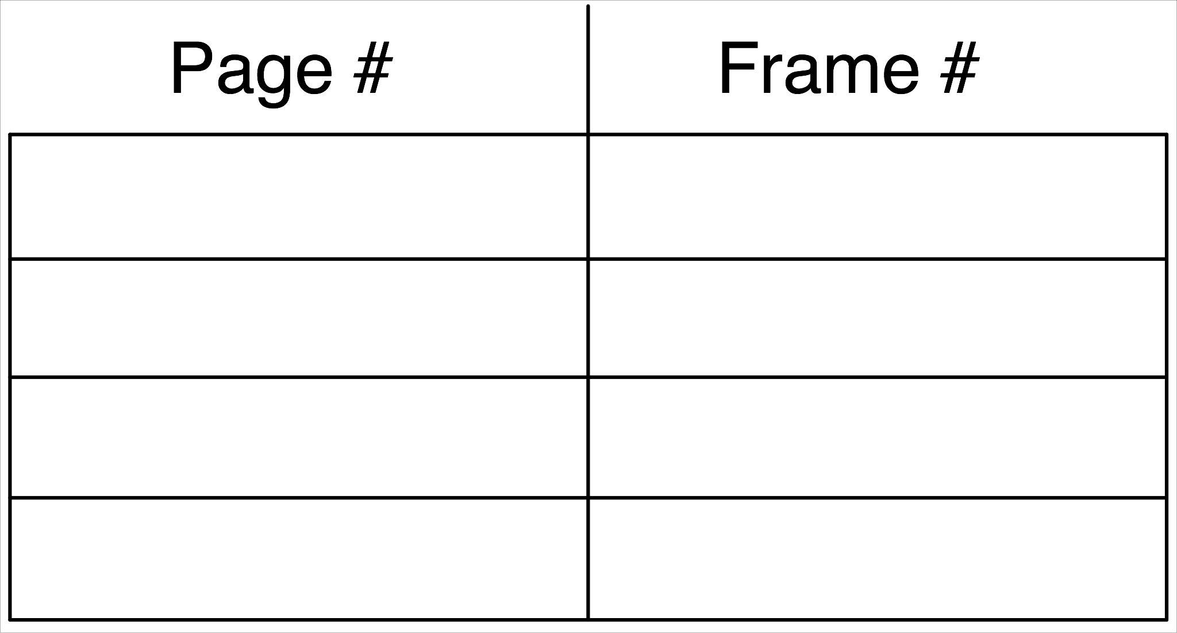
Associative Memory
Associative memory – parallel search
Address translation (p, d)
  If p is in associative register, get frame # out
  Otherwise get frame # from page table in memory

Slide 43
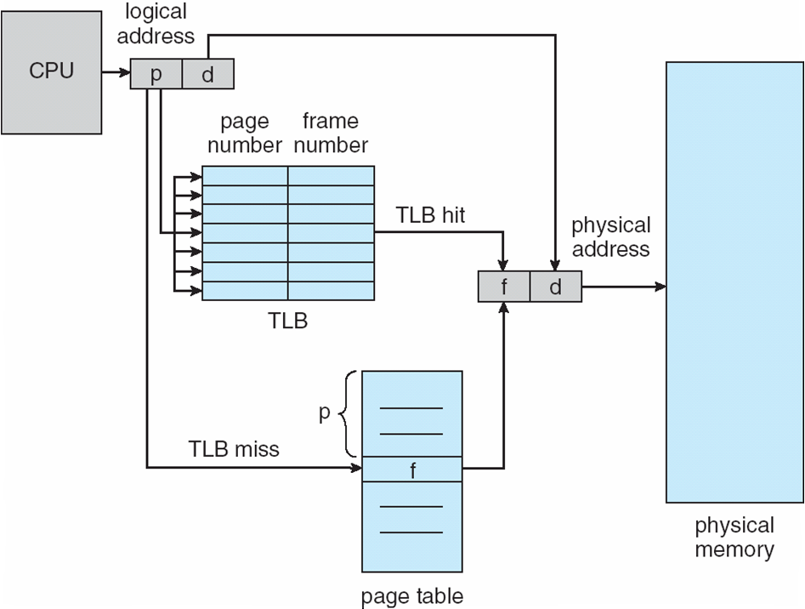
Paging Hardware With TLB

Slide 44
Effective Access Time
Associative Lookup = ε time unit
  Can be < 10% of memory access time
Hit ratio = α
  Hit ratio – percentage of times that a page number is found in the associative registers; ratio related to number of associative registers
Consider α = 80% (0.80), ε = 20ns for TLB search, M = 100ns for memory access
Effective Access Time (EAT)
EAT = ((1 + ε/Μ) α + (2 + ε/Μ)(1 – α)) * M
= (2 + ε/M – α) M
(Alternatively) = (α x (M + ε)) + ((1 − α) x (2M + ε))
Consider α = 80%, ε = 20ns for TLB search, 100ns for memory access
  EAT = 0.80 x 120 + 0.20 x 220 = 140ns
Consider more realistic hit ratio -> α = 99%, ε = 20ns for TLB search, 100ns for memory access
  EAT = 0.99 x 120 + 0.01 x 220 = 121ns

Slide 45
Memory Protection
Memory protection implemented by associating protection bit with each frame to indicate if read-only or read-write access is allowed
  Can also add more bits to indicate page execute-only, and so on
Valid-invalid bit attached to each entry in the page table:
  “valid” indicates that the associated page is in the process’ logical address space, and is thus a legal page
  “invalid” indicates that the page is not in the process’ logical address space
  Or use page-table length register (PTLR)
Any violations result in a trap to the kernel

Slide 46
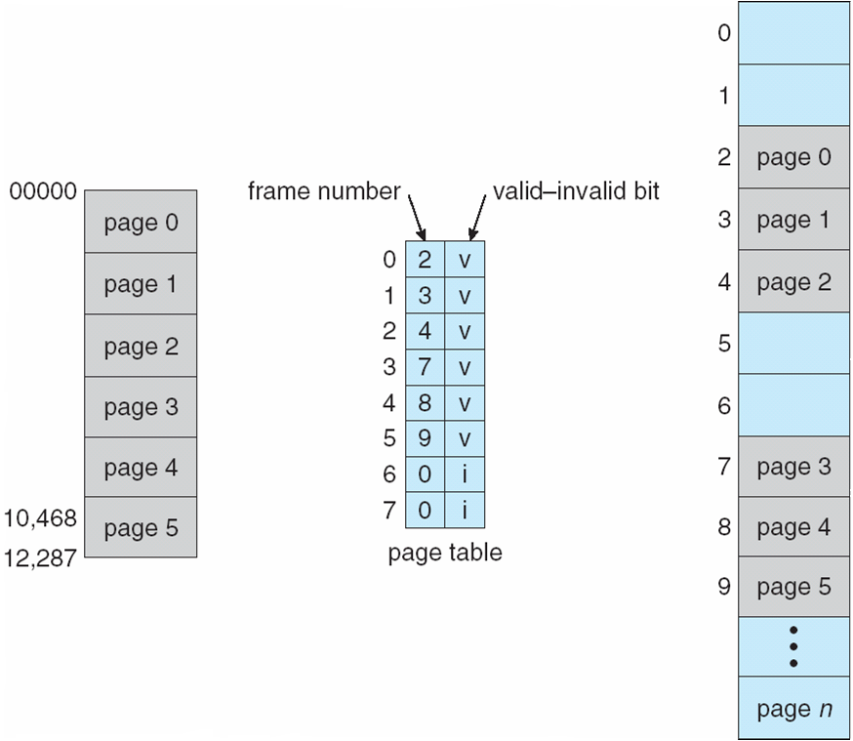
Valid (v) or Invalid (i) Bit In A Page Table

Slide 47
Shared Pages
Shared code
  One copy of read-only (reentrant) code shared among processes (i.e., text editors, compilers, window systems)
  Similar to multiple threads sharing the same process space
  Also useful for interprocess communication if sharing of read-write pages is allowed
Private code and data
  Each process keeps a separate copy of the code and data
  The pages for the private code and data can appear anywhere in the logical address space

Slide 48
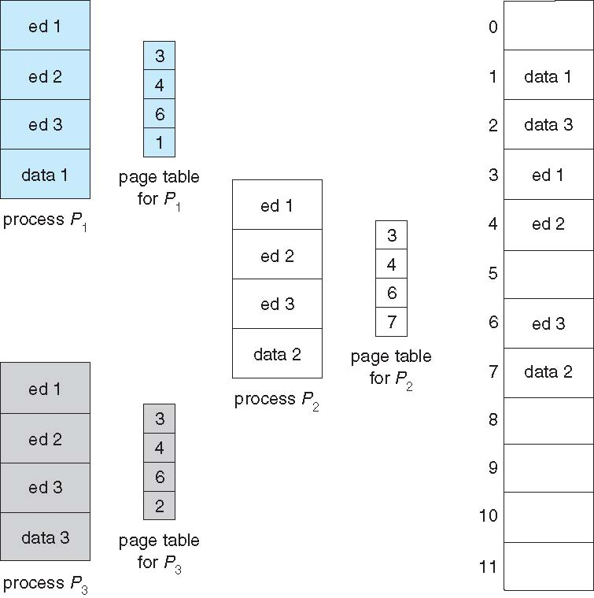
Shared Pages Example

Slide 49
Structure of the Page Table
Memory structures for paging can get huge using straight-forward methods
  Consider a 32-bit logical address space as on modern computers
  Page size of 4 KB (2¹²)
  Page table would have 1 million entries (2³² / 2¹²)
  If each entry is 4 bytes -> 4 MB of physical address space / memory for page table alone
    That amount of memory used to cost a lot
    Don’t want to allocate that contiguously in main memory
Hierarchical Paging
Hashed Page Tables
Inverted Page Tables

Slide 50
Hierarchical Page Tables
Break up the logical address space into multiple page tables
A simple technique is a two-level page table
We then page the page table

Slide 51
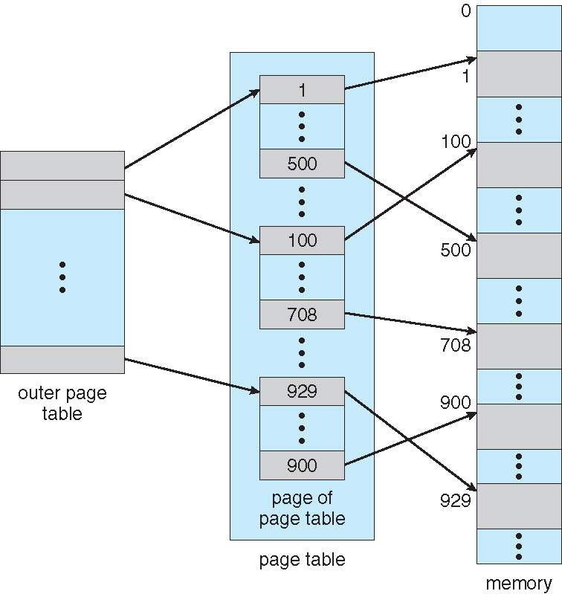
Two-Level Page-Table Scheme

Slide 52
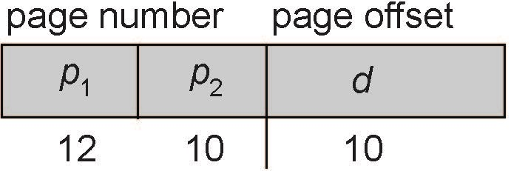
Two-Level Paging Example
A logical address (on 32-bit machine with 1K page size) is divided into:
  a page number consisting of 22 bits
  a page offset consisting of 10 bits
Since the page table is paged, the page number is further divided into:
  a 12-bit page number
  a 10-bit page offset
Thus, a logical address is as follows:
where p₁ is an index into the outer page table, and p₂ is the displacement within the page of the inner page table
Known as forward-mapped page table

Slide 53
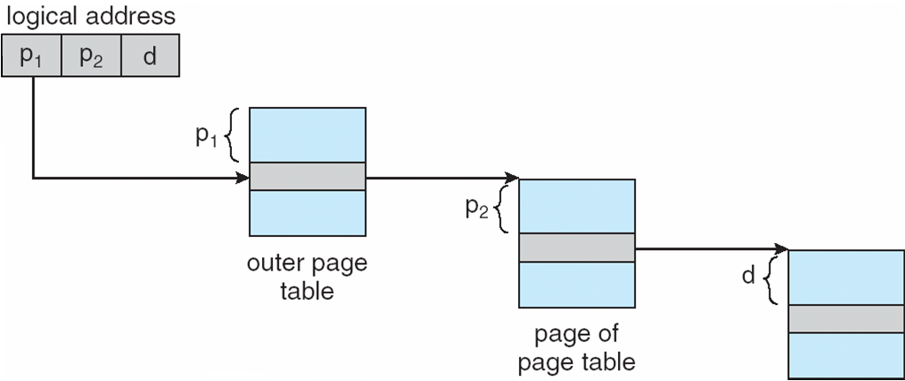
Address-Translation Scheme

Slide 54
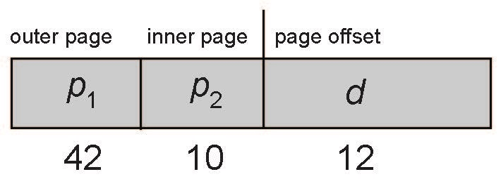
64-bit Logical Address Space
Even two-level paging scheme not sufficient
If page size is 4 KB (2¹²)
  Then page table has 2⁵² entries
  If two level scheme, inner page tables could be 2¹⁰ 4-byte entries
  Address would look like
  Outer page table has 2⁴² entries or 2⁴⁴ bytes
  One solution is to add a 2nd outer page table
  But in the following example the 2nd outer page table is still 2³⁴ bytes in size
    And possibly 4 memory access to get to one physical memory location

Slide 55
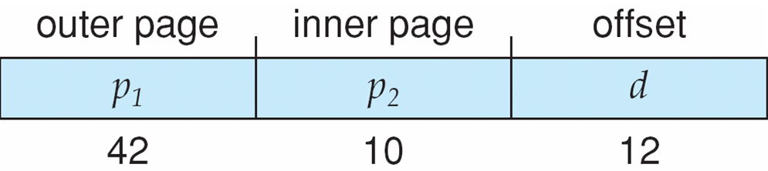
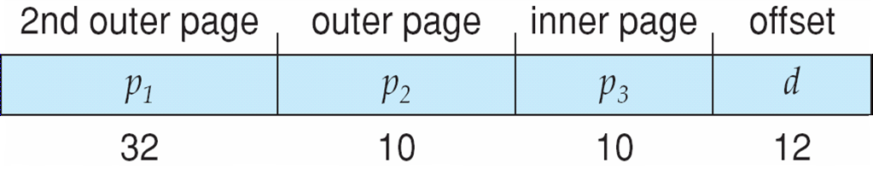
Three-level Paging Scheme

Slide 56
Hashed Page Tables
Common in address spaces > 32 bits
The virtual page number is hashed into a page table
  This page table contains a chain of elements hashing to the same location
Each element contains (1) the virtual page number (2) the value of the mapped page frame (3) a pointer to the next element
Virtual page numbers are compared in this chain searching for a match
  If a match is found, the corresponding physical frame is extracted
Variation for 64-bit addresses is clustered page tables
  Similar to hashed but each entry refers to several pages (such as 16) rather than 1
  Especially useful for sparse address spaces (where memory references are non-contiguous and scattered)

Slide 57
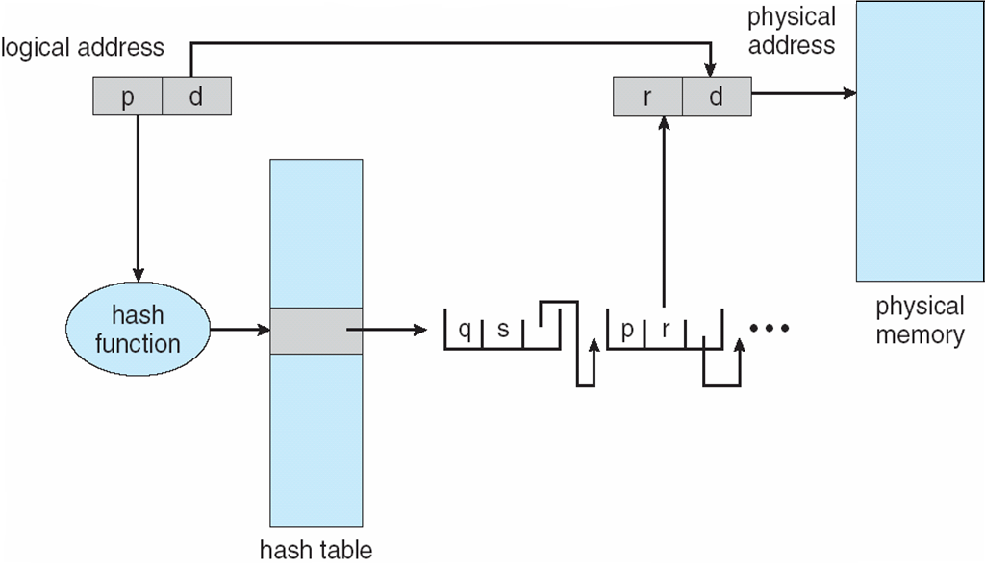
Hashed Page Table

Slide 58
Inverted Page Table
Rather than each process having a page table and keeping track of all possible logical pages, track all physical pages
One entry for each real page of memory
Entry consists of the virtual address of the page stored in that real memory location, with information about the process that owns that page
Decreases memory needed to store each page table, but increases time needed to search the table when a page reference occurs
Use hash table to limit the search to one — or at most a few — page-table entries
  TLB can accelerate access
But how to implement shared memory?
  One mapping of a virtual address to the shared physical address

Slide 59
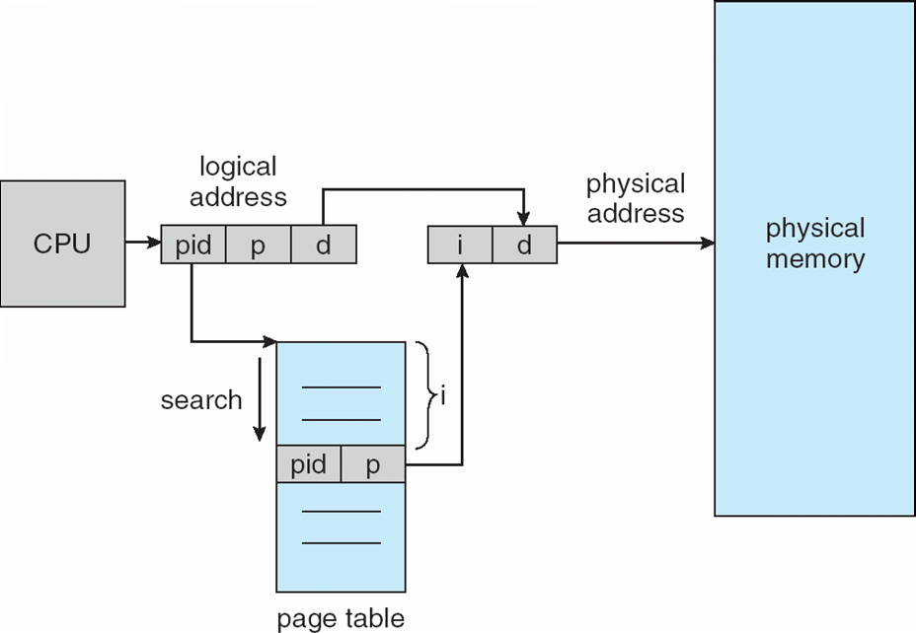
Inverted Page Table Architecture

Slide 60
Oracle SPARC Solaris
Consider modern, 64-bit operating system example with tightly integrated HW
  Goals are efficiency, low overhead
Based on hashing, but more complex
Two hash tables
  One kernel and one for all user processes
  Each maps memory addresses from virtual to physical memory
  Each entry represents a contiguous area of mapped virtual memory,
    More efficient than having a separate hash-table entry for each page
  Each entry has base address and span (indicating the number of pages the entry represents)

Slide 61
Oracle SPARC Solaris (Cont.)
TLB holds translation table entries (TTEs) for fast hardware lookups
  A cache of TTEs reside in a translation storage buffer (TSB)
    Includes an entry per recently accessed page
Virtual address reference causes TLB search
  If miss, hardware walks the in-memory TSB looking for the TTE corresponding to the address
    If match found, the CPU copies the TSB entry into the TLB and translation completes
    If no match found, kernel interrupted to search the hash table
      The kernel then creates a TTE from the appropriate hash table and stores it in the TSB, Interrupt handler returns control to the MMU, which completes the address translation.

Slide 62
Example: The Intel 32 and 64-bit Architectures
Dominant industry chips
Pentium CPUs are 32-bit and called IA-32 architecture
Current Intel CPUs are 64-bit and called IA-64 architecture
Many variations in the chips, cover the main ideas here

Slide 63
Example: The Intel IA-32 Architecture
Supports both segmentation and segmentation with paging
  Each segment can be 4 GB
  Up to 16 K segments per process
  Divided into two partitions
    First partition of up to 8 K segments are private to process (kept in local descriptor table (LDT))
    Second partition of up to 8K segments shared among all processes (kept in global descriptor table (GDT))

Slide 64

Example: The Intel IA-32 Architecture (Cont.)
CPU generates logical address
  Selector given to segmentation unit
    Which produces linear addresses
  Linear address given to paging unit
    Which generates physical address in main memory
    Paging units form equivalent of MMU
    Pages sizes can be 4 KB or 4 MB

Slide 65
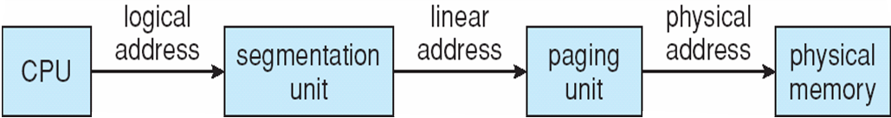
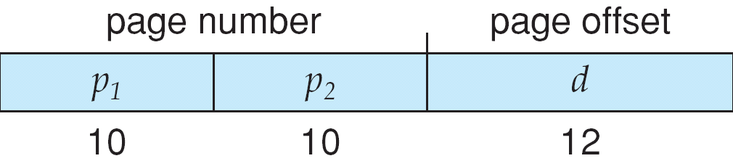
Logical to Physical Address Translation in IA-32

Slide 66
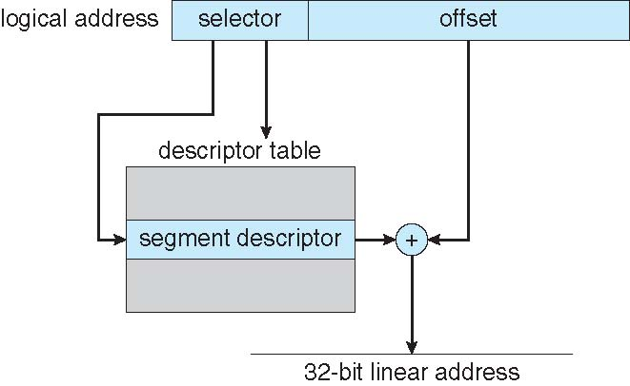
Intel IA-32 Segmentation

Slide 67
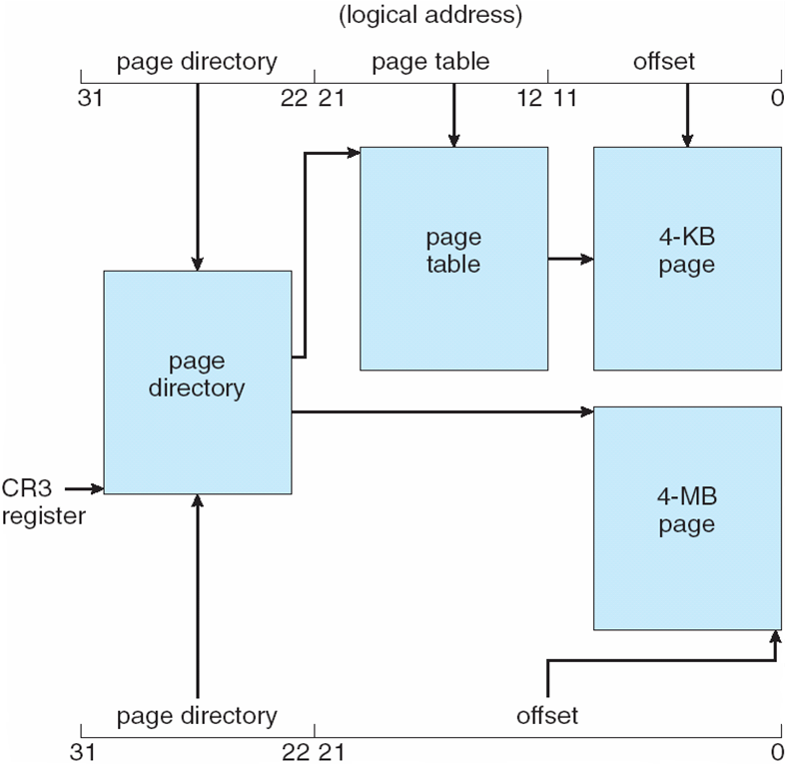
Intel IA-32 Paging Architecture

Slide 68
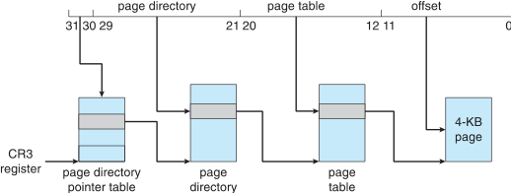
Intel IA-32 Page Address Extensions
32-bit address limits led Intel to create page address extension (PAE), allowing 32-bit apps access to more than 4GB of memory space
  Paging went to a 3-level scheme
  Top two bits refer to a page directory pointer table
  Page-directory and page-table entries moved to 64-bits in size
  Net effect is increasing address space to 36 bits – 64GB of physical memory

Slide 69
Intel x86-64
Current generation Intel x86 architecture
64 bits is ginormous (> 16 exabytes)
In practice only implement 48 bit addressing
  Page sizes of 4 KB, 2 MB, 1 GB
  Four levels of paging hierarchy
Can also use PAE so virtual addresses are 48 bits and physical addresses are 52 bits

Slide 70
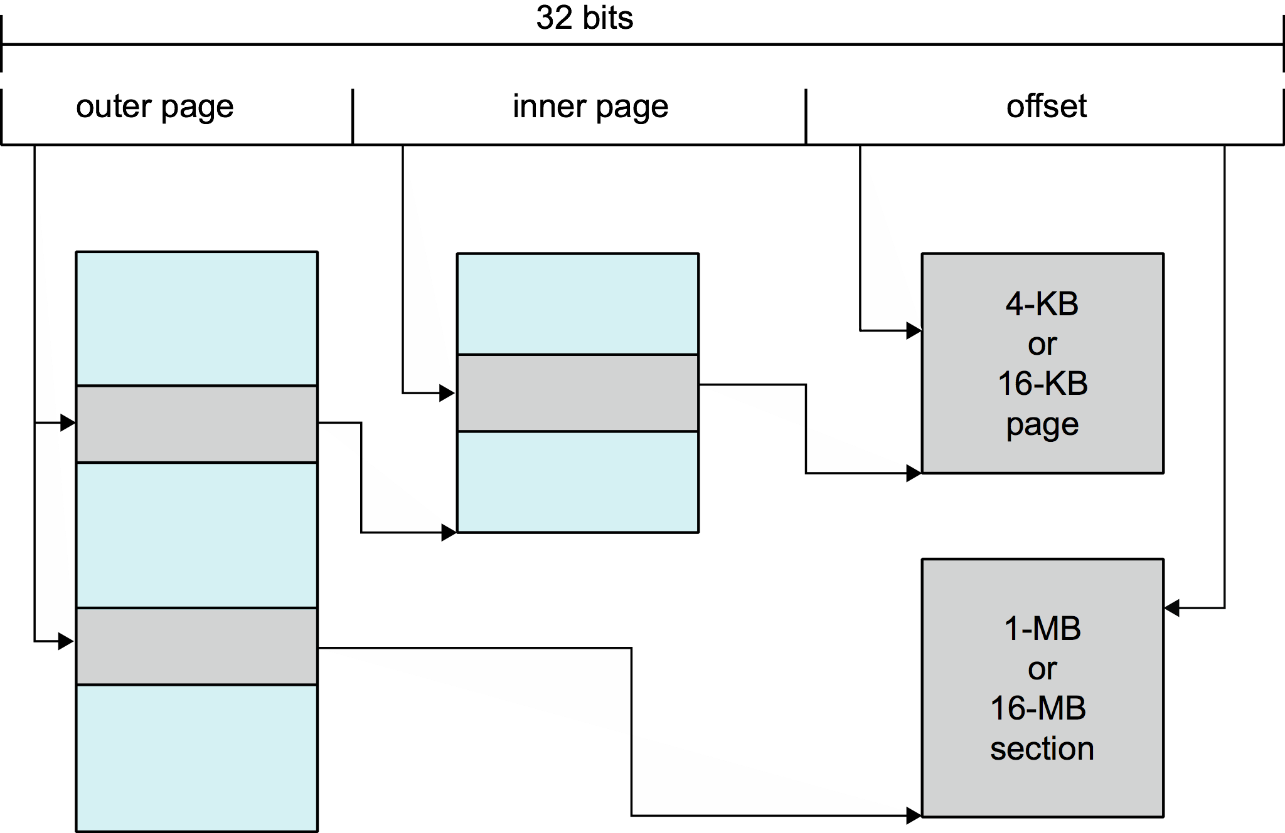
Example: ARM Architecture
Dominant mobile platform chip (Apple iOS and Google Android devices for example)
Modern, energy efficient, 32-bit CPU
4 KB and 16 KB pages
1 MB and 16 MB pages (termed sections)
One-level paging for sections, two-level for smaller pages
Two levels of TLBs
  Outer level has two micro TLBs (one data, one instruction)
  Inner is single main TLB
  First inner is checked, on miss outers are checked, and on miss page table walk performed by CPU

Slide 71
End of Chapter 8

