Slide 1
NLP* from Strings to Things
* natural language processing

Slide 2

The Web is our greatest knowledge source
Notes:
The Web is the greatest source of general knowledge available today.

Slide 3
But it has limitations
Notes:
The Web is the greatest source of general knowledge available today.

Slide 4

It was designed for people, not machines

Slide 5
It was designed for people, not machines
Its content is mostly text, spoken language, images and videos
These are easy for people to understand
But hard for machines
Machines need access to this knowledge too

Slide 6
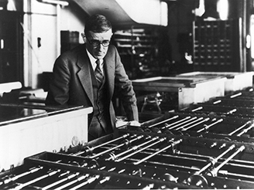
Access is primarily via information retrieval
Vannevar Bush envisioned a hypertext/IR system in 1945

Slide 7
Access is primarily via information retrieval
Key-word queries→ranked document list
We still need to read the documents or watch the videos
We often want an answer to a question
And so do our machines and apps
Vannevar Bush envisioned a hypertext/IR system in 1945

Slide 8
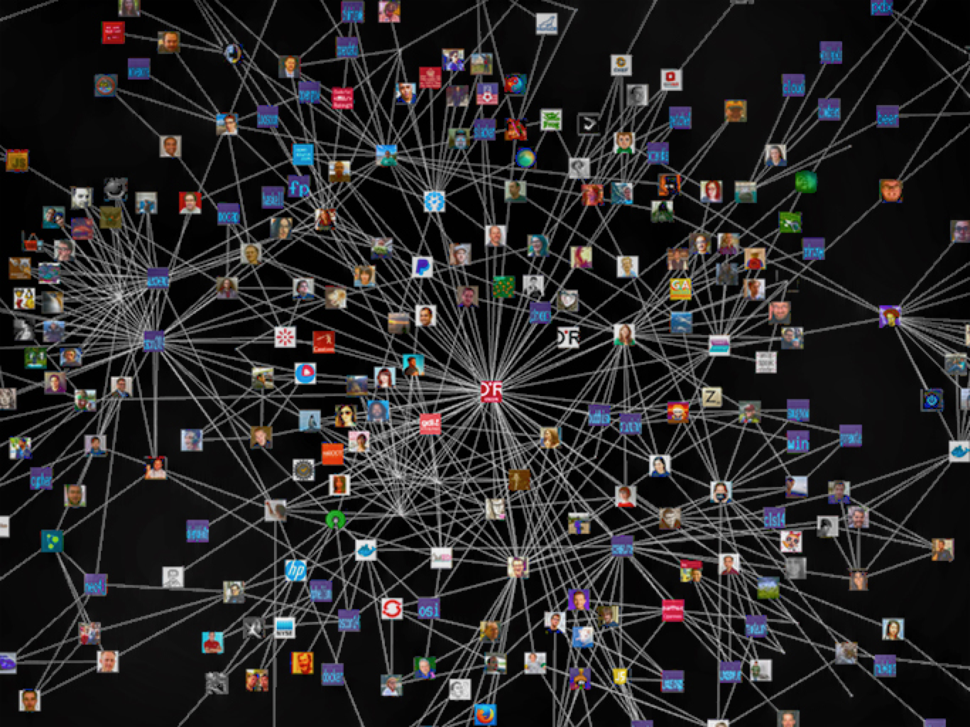
We need to add knowledge graphs
Notes:
I’m using knowledge graph here as being synonymous with knowledge base

Slide 9
We need to add knowledge graphs
High quality semi-structured information about entities, events and relations
Represented & accessed via standard APIs
Easily integrated, fused and reasoned with
Notes:
Knowledge graphs are essential to the new cognitive services being developed and supported by companies like IBM, Google, Facebook, Amazon and Apple

Slide 10

State of the Art?
Google is a good example, but Microsoft, IBM, Apple and Facebook all have similar capabilities
2010 Google acquired MediaWeb and its Freebase KB
2014: Freebase: 1.2B facts about 43M entities
2015+: Google knowledge graph, updated by text IE
DBpedia open source RDF KB is another
800M facts about 4.6M subjects from English Wikipedia, data also available in 21 other languages
Helps integrate 90B facts from 1000 RDF datasets in the linked data cloud

Slide 11
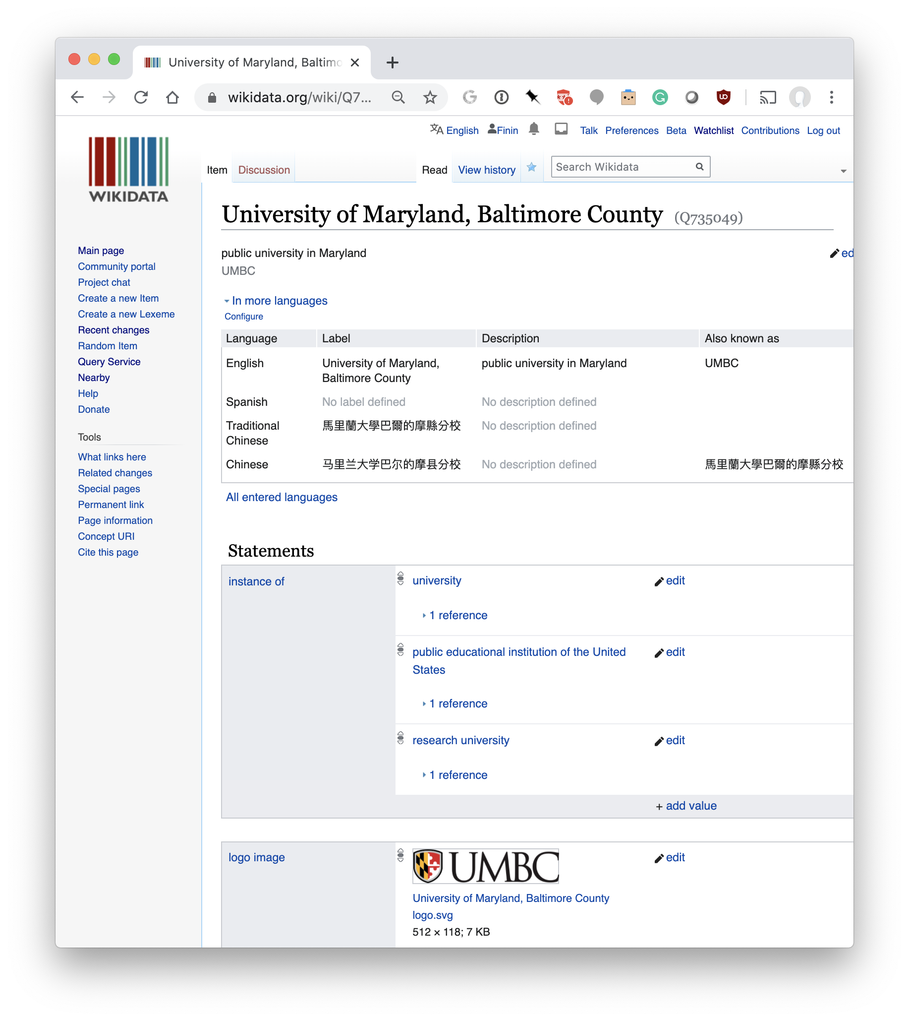
Wikidata Knowledge Graph
Large knowledge graph with 1B statements about ~72M items
Fine-grained ontology: ~2M types; ~5K properties
Multilingual, strings tagged with language id
Links to entity’s Wikimedia pages
Entities have a canonical name and aliases in multiple languages and multiple claims
UMBC=Q64780099, with type University, 569 statements
Editable by humans and bots
Can query with SPARQL query language
Q64780099

Slide 12
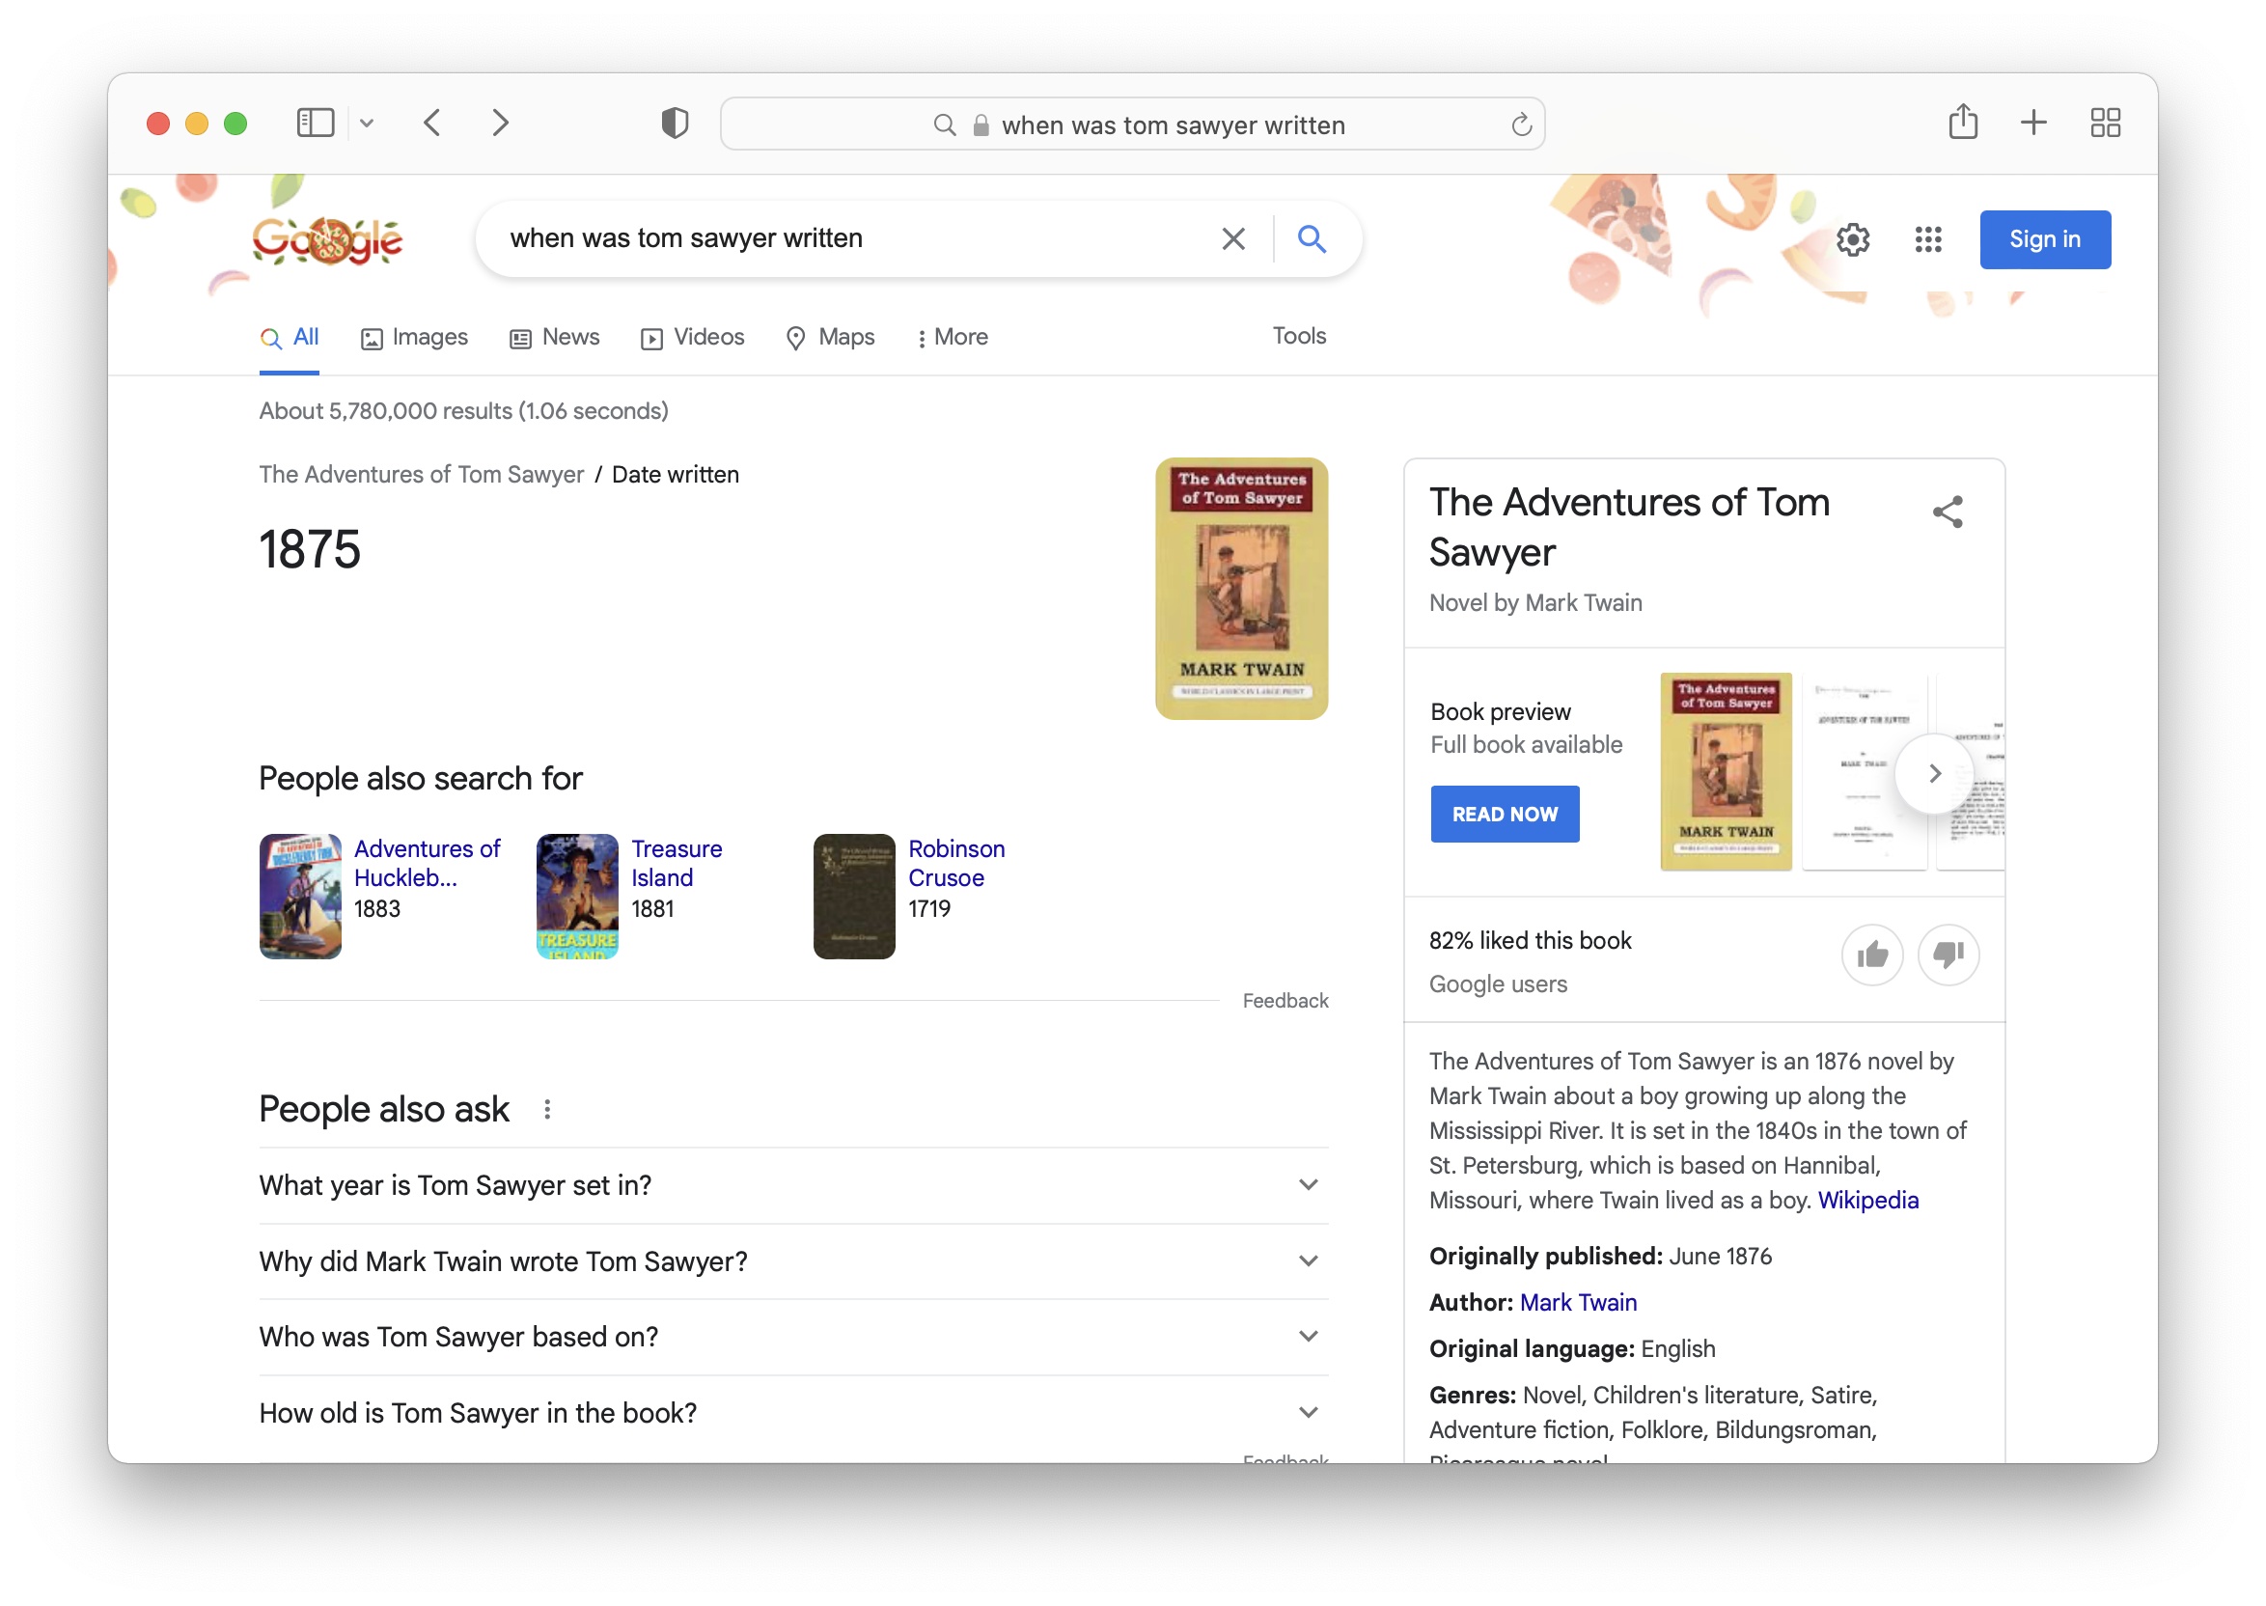
Ask: When was Tom Sawyer written?
Google Knowledge Graph data
answer

Slide 13
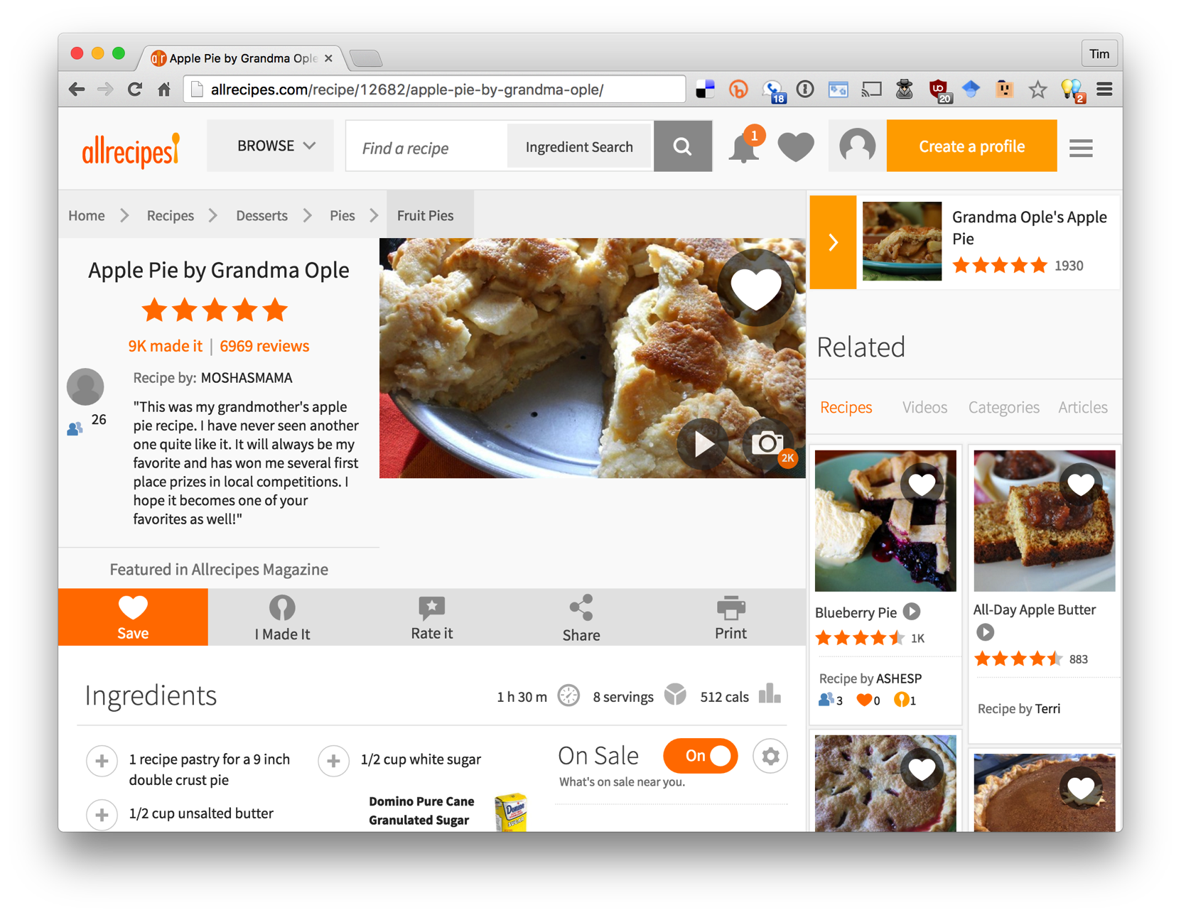
Notes:
As a separate, but related example of using data on the web, many sites not embed semantic data on web pages. The data is represented in an RDF-compatible graph format using terms defined in common ontologies found at schema.org.

Slide 14
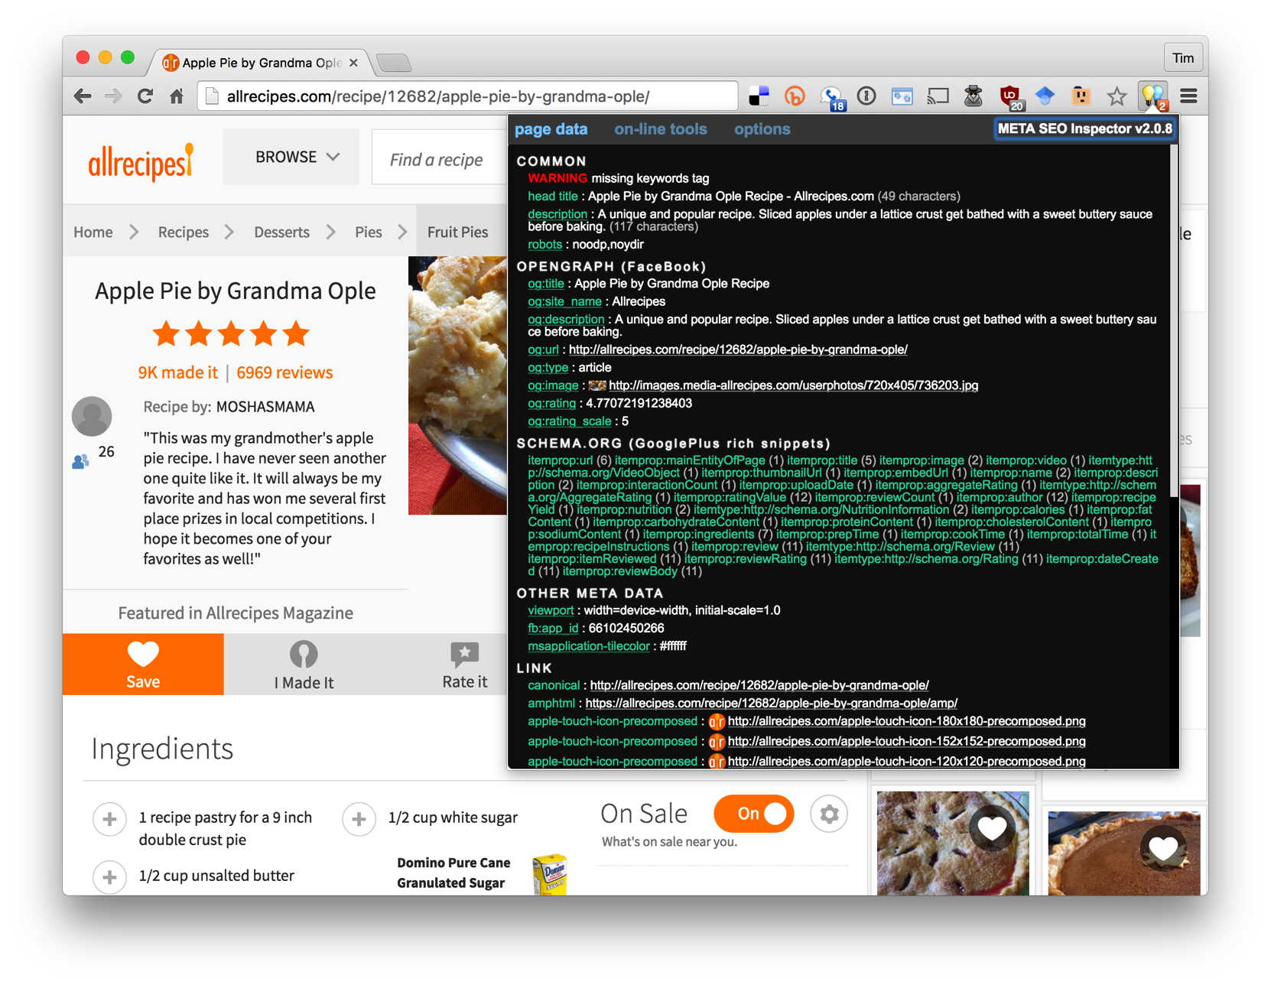
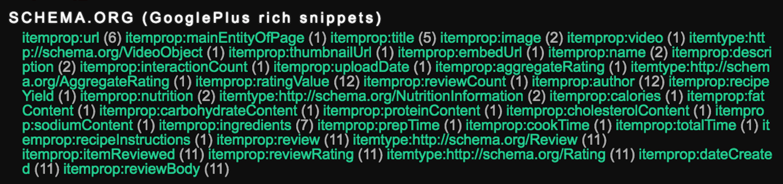
Almost all commercial recipe sites embed semantic data about their recipes in an RDF-compatible form using terms from the schema.org ontology.
Search engines read and use this data to better under-stand the semantics of the page content

Slide 15
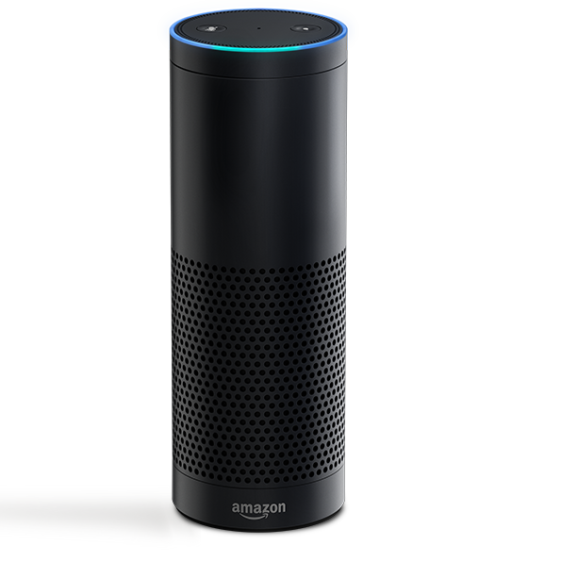
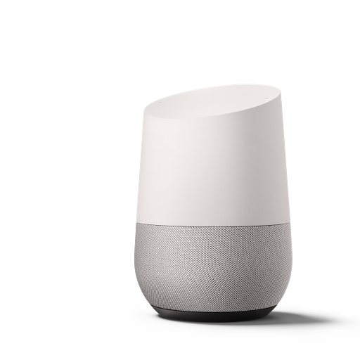

Conversational Bots
Voice-driven conversational systems like Amazon Echo and Google Home use knowledge graphs to help understand our requests

Slide 16
Where does the knowledge come from?
Initial knowledge graphs like DBpedia and Freebase started with data from Wikipedia and encoded it in custom ontologies
Current focus is on extracting information from text of source documents, e.g., journal articles, Newswire, social media, etc.

Slide 17

NIST Text Analysis Conference
Annual evaluation workshops since 2008 on natural language processing & related applications with large test collections and common evaluation procedures
Knowledge Base Population (KBP) tracks focus on building KBs from information extracted from text
Cold Start KBP: construct a KB from text
Entity discovery & linking: cluster and link entity mentions
Slot filling
Slot filler validation
Sentiment
Events: discover and cluster events in text
http://nist.gov/tac

Slide 18
2016 TAC Cold Start KBP
Read 90K documents: newswire articles & social media posts in English, Chinese and Spanish
Find entity mentions, types and relations
Cluster entities within and across documents and link to a reference KB when appropriate
Remove errors (Obama born in Illinois), draw sound inferences (Malia and Sasha sisters)
Create knowledge graph with provenance data for entities, mentions and relations

Slide 19
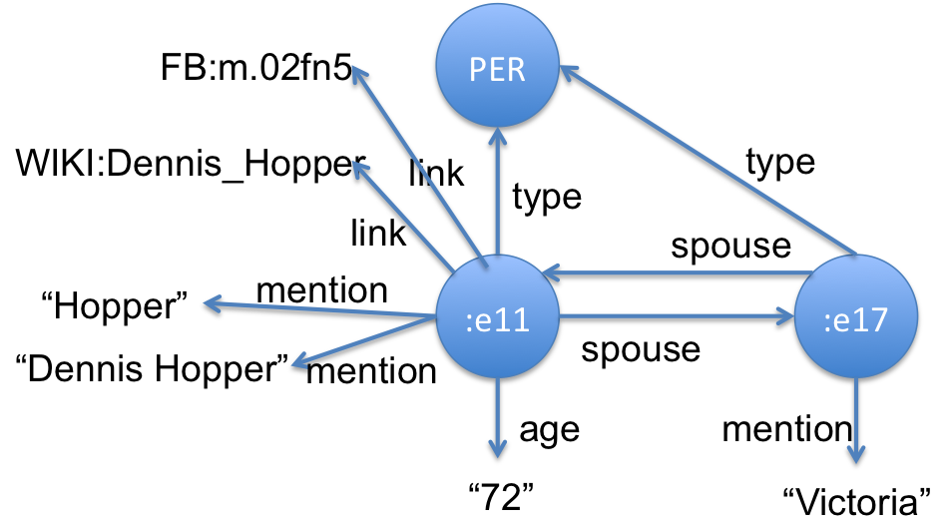
2016 TAC Cold Start KBP
Read 90K documents: newswire articles & social media posts in English, Chinese and Spanish
Find entity mentions, types and relations
Cluster entities within and across documents and link to a reference KB when appropriate
Remove errors (Obama born in Illinois), draw sound inferences (Malia and Sasha sisters)
Create knowledge graph with provenance data for entities, mentions and relations
<DOC id="APW_ENG_20100325.0021" type="story" >
<HEADLINE>
Divorce attorney says Dennis Hopper is dying
</HEADLINE>
<DATELINE>
LOS ANGELES 2010-03-25 00:15:51 UTC
</DATELINE>
<TEXT
<P>
Dennis Hopper's divorce attorney says in a court filing that the actor is dying and can't undergo chemotherapy as he battles prostate cancer.
</P>
<P>
Attorney Joseph Mannis described the "Easy Rider" star's grave condition in a declaration filed Wednesday in Los Angeles Superior Court.
</P>
<P>
Mannis and attorneys for Hopper's wife Victoria are fighting over when and whether to take the actor's deposition.
</P> …
…
:e00211 type PER
:e00211 link FB:m.02fn5
:e00211 link WIKI:Dennis_Hopper
:e00211 mention "Dennis Hopper" APW_021:185-197
:e00211 mention "Hopper" APW_021:507-512
:e00211 mention "Hopper" APW_021:618-623
:e00211 mention "丹尼斯·霍珀” CMN_011:930-936
:e00211 per:spouse :e00217 APW_021:521-528
:e00217 per:spouse :e00211 APW_021:521-528
:e00211 per:age "72" APW_021:521-528
…

Slide 20

Information extraction from text
Identify relationships
Link concepts to entities
ebqids:hasMeans
http://dbpedia.org/resource/Buffer_overflow
ebqids:affectsProduct
CVE-2012-0150
Buffer overflow in msvcrt.dll in Microsoft Windows Vista SP2, Windows Server 2008 SP2, R2, and R2 SP1, and Windows 7 Gold and SP1 allows remote attackers to execute arbitrary code via a crafted media file, aka ”Msvcrt.dll Buffer Overflow Vulnerability.”
http://dbpedia.org/resource/Arbitrary_code_execution
http://dbpedia.org/resource/Windows_7
Information extraction techniques identify entities, relations and concepts in security related text
Map to terms in our ontology and DBpedia knowledge graph
Also map them to terms in the Wikidata knowledge graph
http://ebiq.org/p/540

Slide 21
NLP Tools
There is a rich and growing collection of open-source NLP tools
Comprehensive pipelines:
Stanford CorNLP tools
Spacy
NLTK
Word embeddings
Word2vec, BERT, Semsim

Slide 22
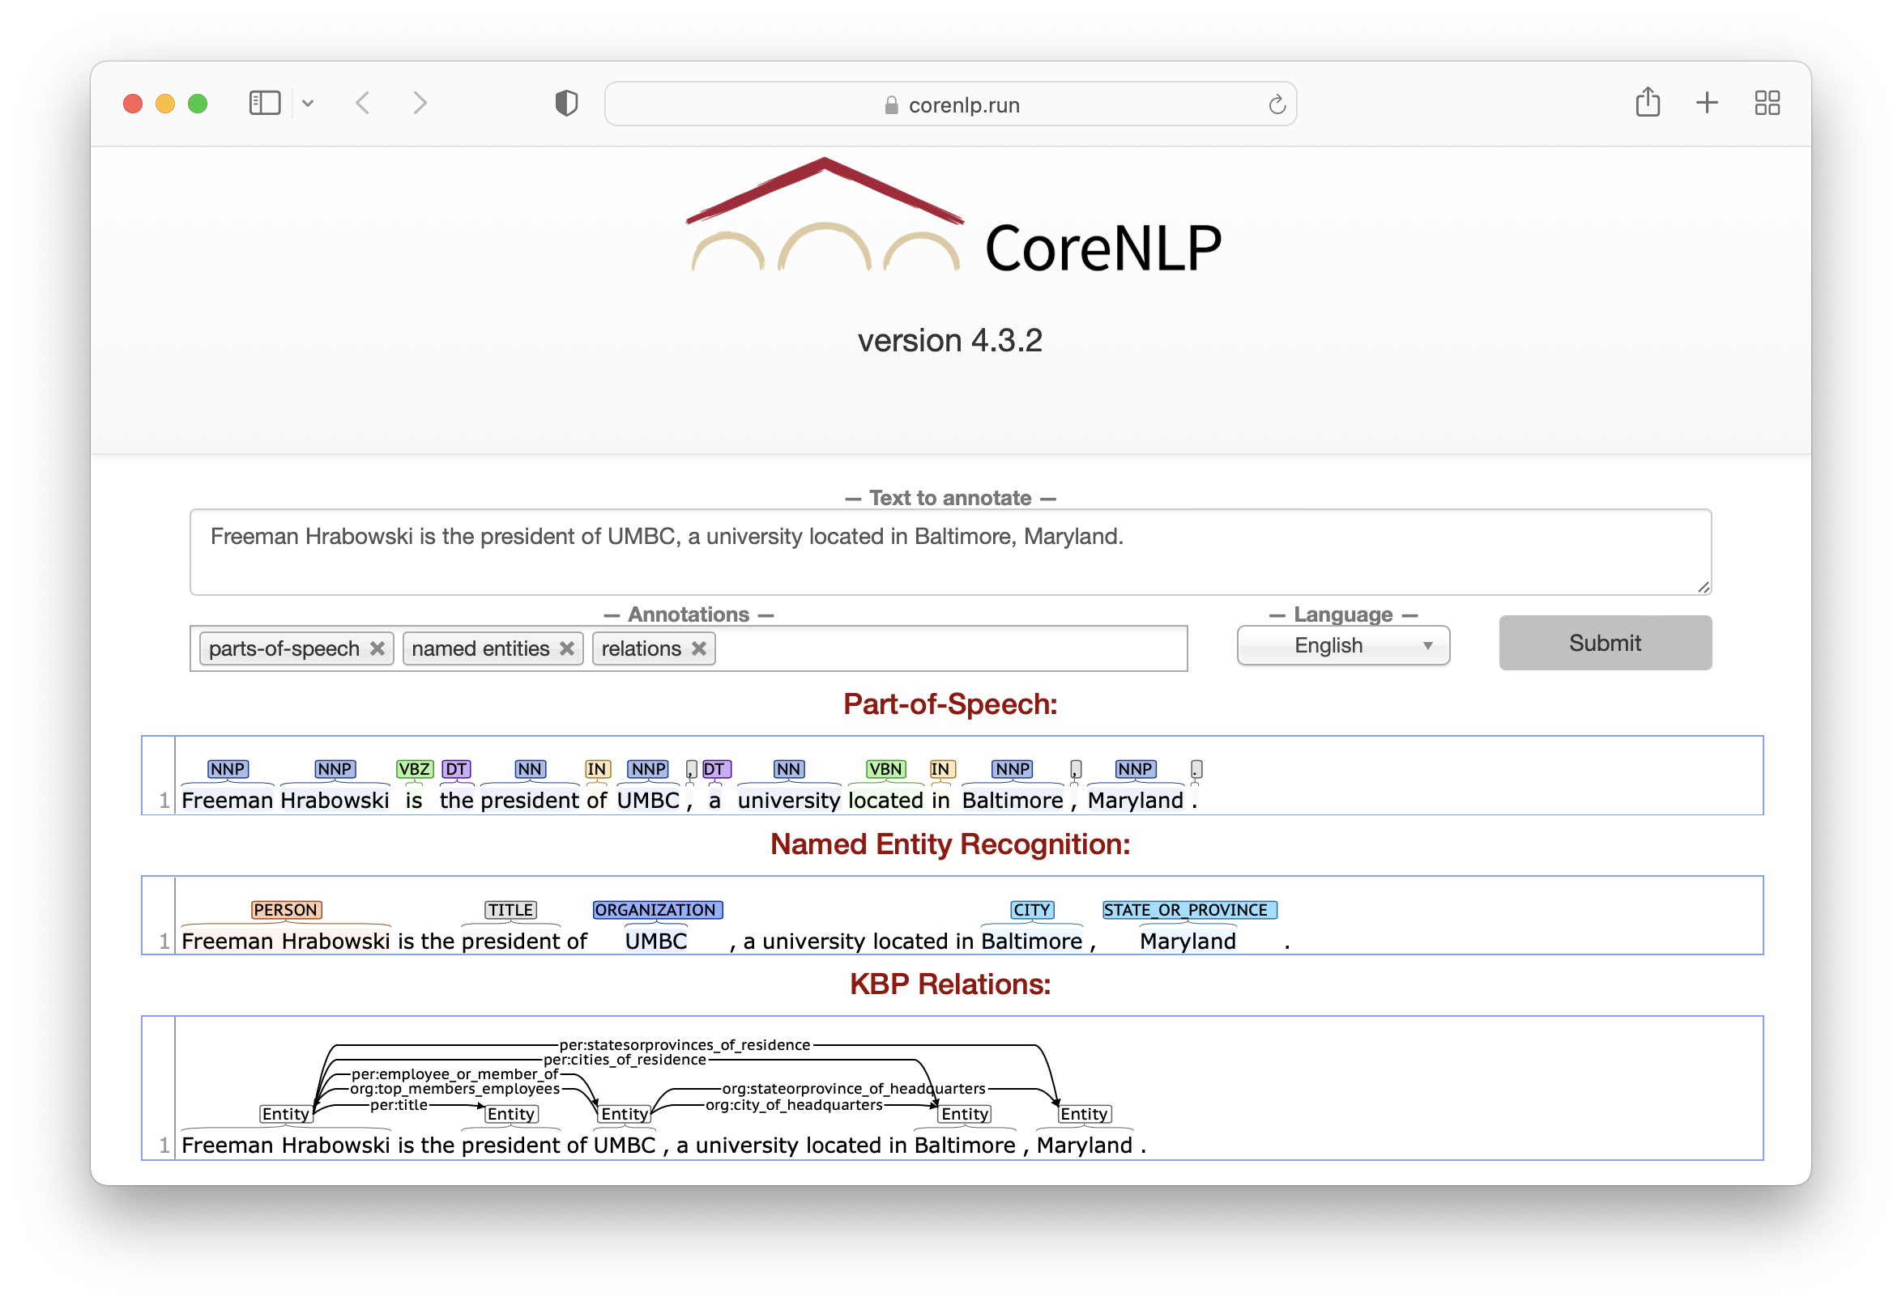
Stanford CoreNLP Tools
Click for demo

Slide 23
JSON/XML => KG triples
{ "text": "John Smith lives in Baltimore, Maryland. He is married to Mary Jones. She works at Loyola University where she is a professor. The university is in Baltimore.\n\n\n\n”,
"docid": "text1.txt",
"corefs": {
"9": [
{"endIndex": 6,
"animacy": "INANIMATE",
"text": "Baltimore",
"isRepresentativeMention": true,
"number": "SINGULAR",
"startIndex": 5,
"sentNum": 1,
"gender": "NEUTRAL",
"position": [1, 2q],
"headIndex": 5,
"type": "PROPER",
"id": 1
},
{ ....
##### :e_text1_1 LOCATION "Baltimore" #####
:e_text1_1 type LOCATION
:e_text1_1 canonical_mention "Baltimore" text1:20-29
:e_text1_1 mention "Baltimore" text1:20-29
:e_text1_1 mention "Baltimore" text1:151-160
##### :e_text1_2 ORGANIZATION "Loyola University" #####
:e_text1_2 type ORGANIZATION
:e_text1_2 canonical_mention "Loyola University" text1:85-102
:e_text1_2 mention "Loyola University" text1:85-102
:e_text1_2 mention "The university" text1:130-144
##### :e_text1_3 PERSON "John Smith" #####
:e_text1_3 type PERSON
:e_text1_3 canonical_mention "John Smith" text1:0-10
:e_text1_3 mention "John Smith" text1:0-10
:e_text1_3 mention "He" text1:42-44
:e_text1_3 mention "She" text1:72-75
:e_text1_3 mention "she" text1:109-112
:e_text1_3 openie:lives_in :e_text1_1 text1:0-3
:e_text1_3 per:spouse :e_text1_5 text1:42-43
:e_text1_3 openie:is_married_to :e_text1_5 text1:42-43
:e_text1_3 per:employee_of :e_text1_2 text1:72-74

Slide 24
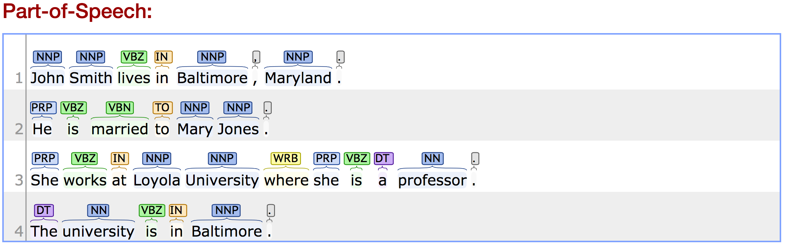
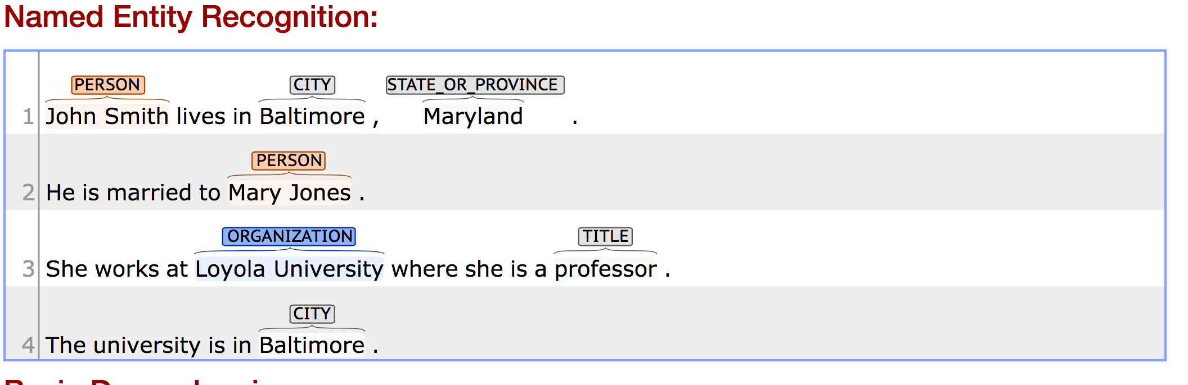

Slide 25
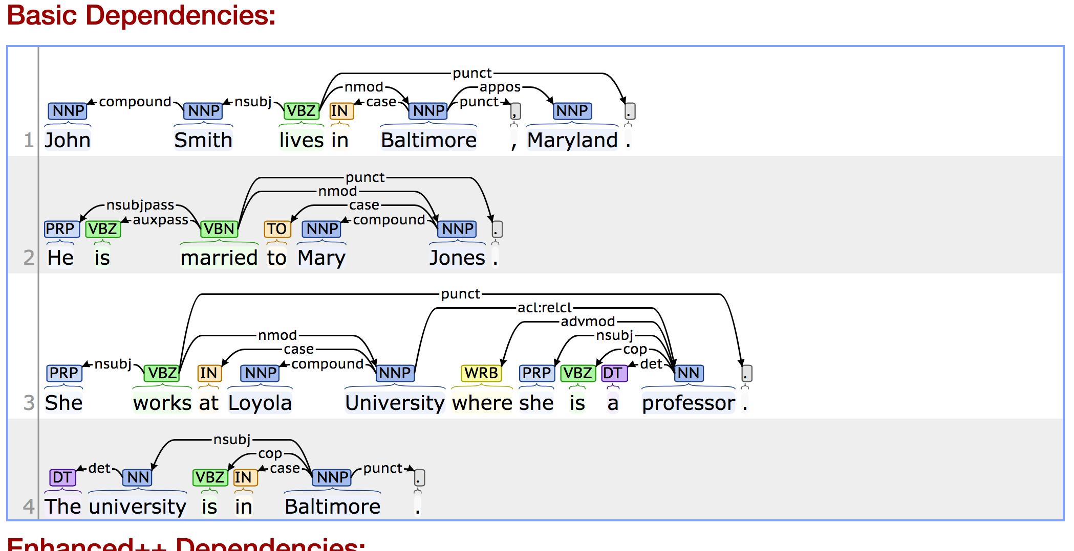

Slide 26
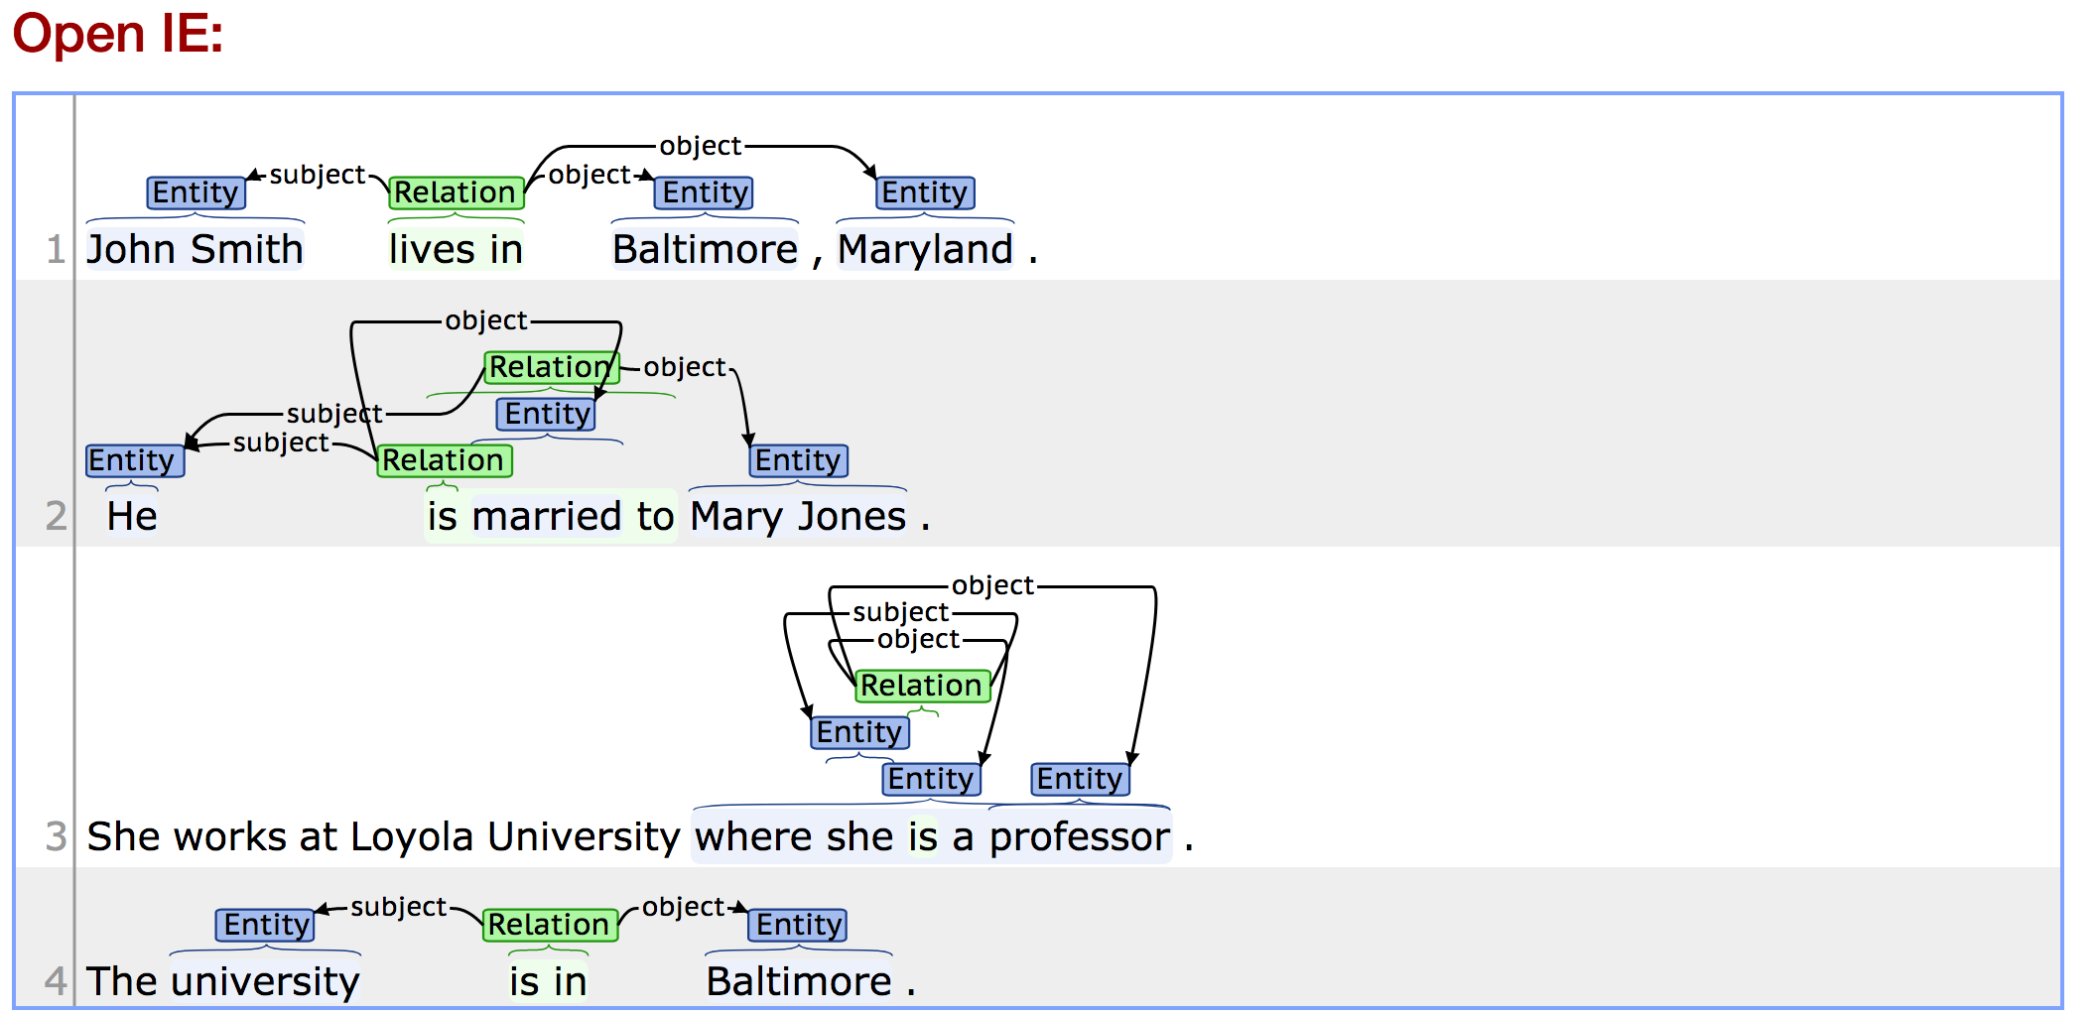

Slide 27
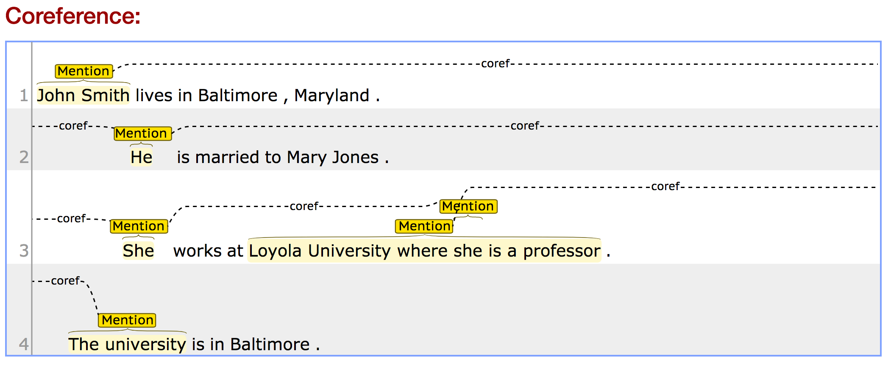

Slide 28
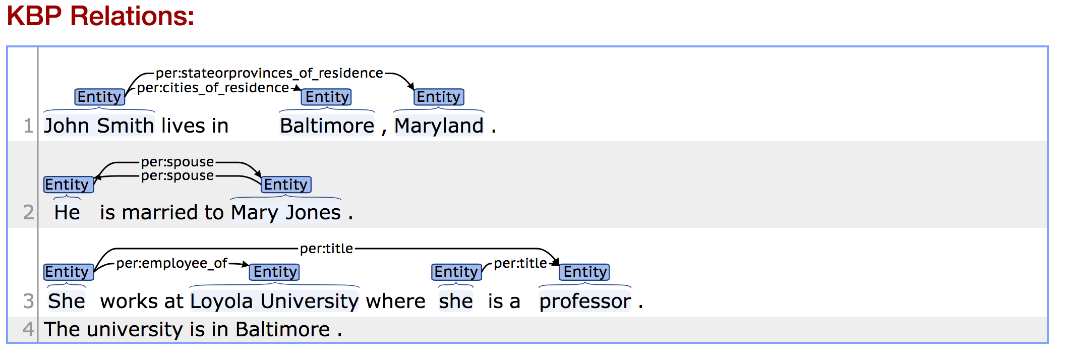

Slide 29
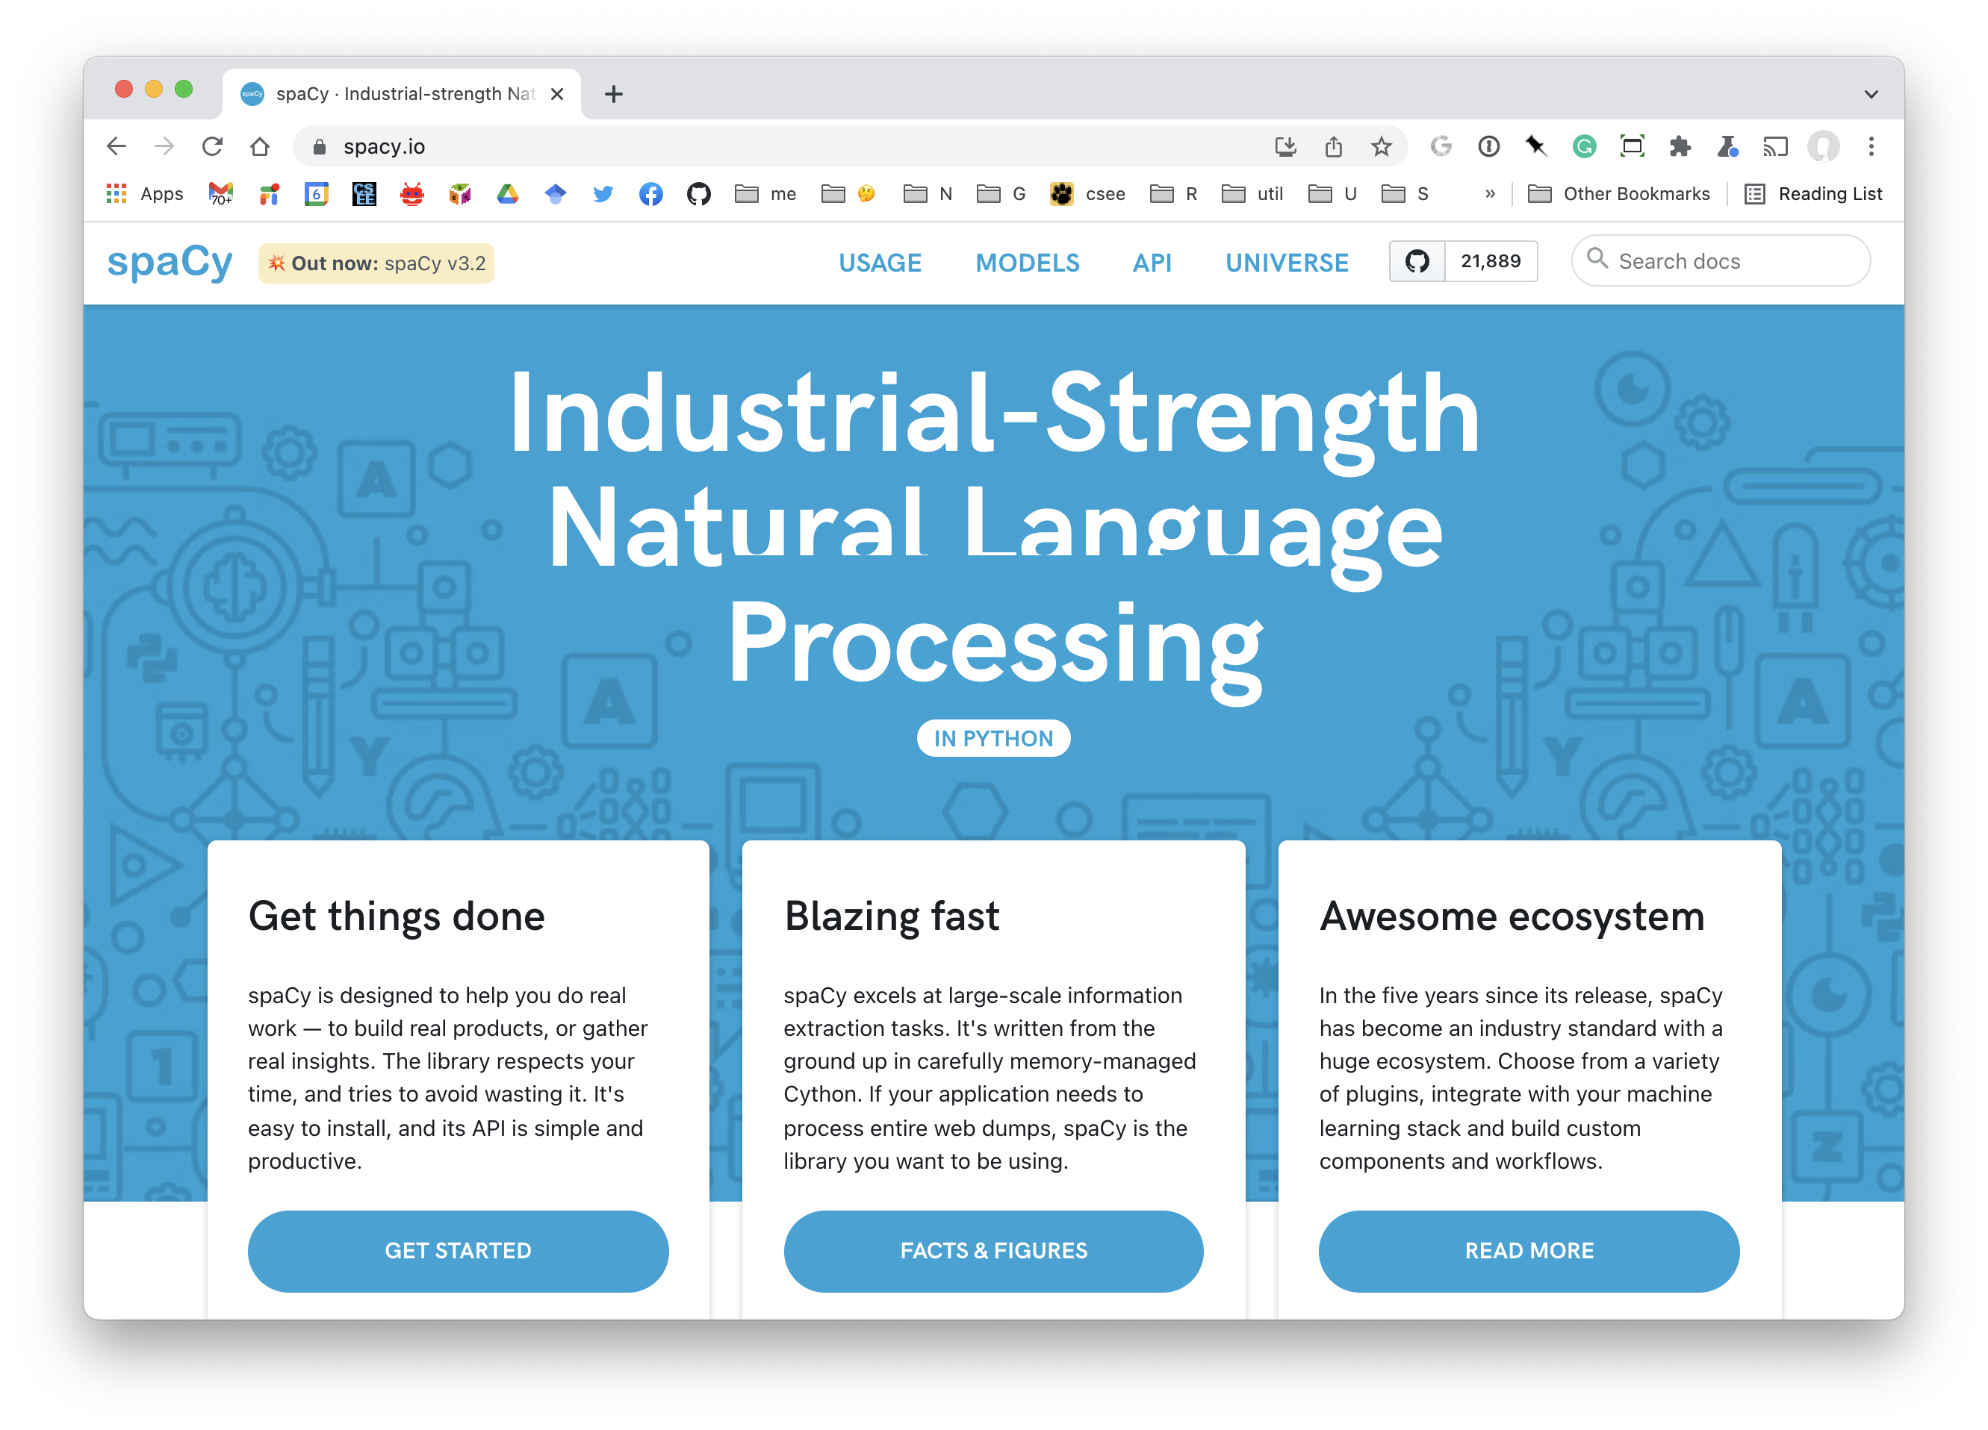

Slide 30
Learning word meaning?
How can we learn what a word means?
The linguist John Rupert Firth famously write in 1957
“You shall know a word by the company it keeps”
A way to recognize that two words have similar meanings is to note that they occur in similar contexts
E.g., physician & doctor, nurse & doctor, love & hate

Slide 31
Word Embeddings
Latent Semantic Analysis (LSA) learns a vector (e.g., 300 reals 0..1) for each unique word in a corpus to represent its meaning
LSA also used for document topic modelling
An example of dimentionality reduction
50k most common words
300 semantic topics
Frequency of co-occurrence of words in a 5-word window in a huge corpus
Each row is a vector of 300 reals for degree a word has of that topic
50k most common words
50k most common words

Slide 32


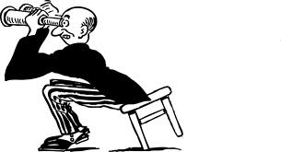
Sentence similarity
How similar are the two sentences semantically on a scale of 0-5?
3.824
The mouse ate some cheese
Pearson’s Correlation
It’s a 4!
Cheddar was eaten by a rat
Close enough!
We used this approach in 2013 to win in a sentence similarity task

Slide 33
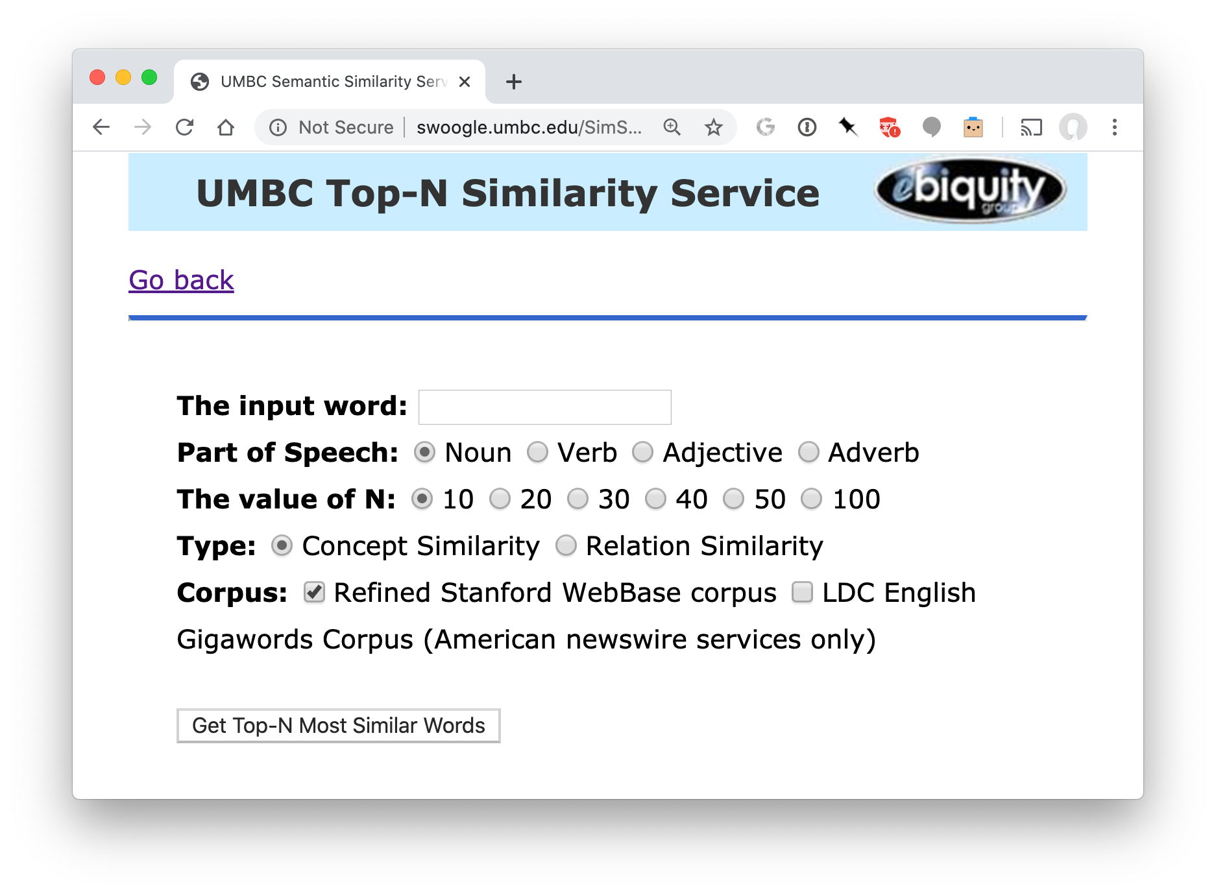
UMBC semantic similarity service

Slide 34
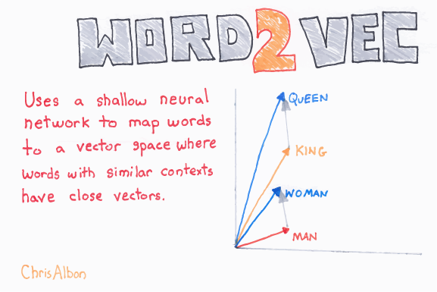
word2vec

Slide 35
Word2Vec
Developed by Google also in 2013 using a neural network approach
Two models: CBOW and skip grams
Trained on a much larger corpus from the Web
Models can be downloaded and are still used today
E.g., the spaCy NLP system includes word2vec to measure similarity

Slide 36
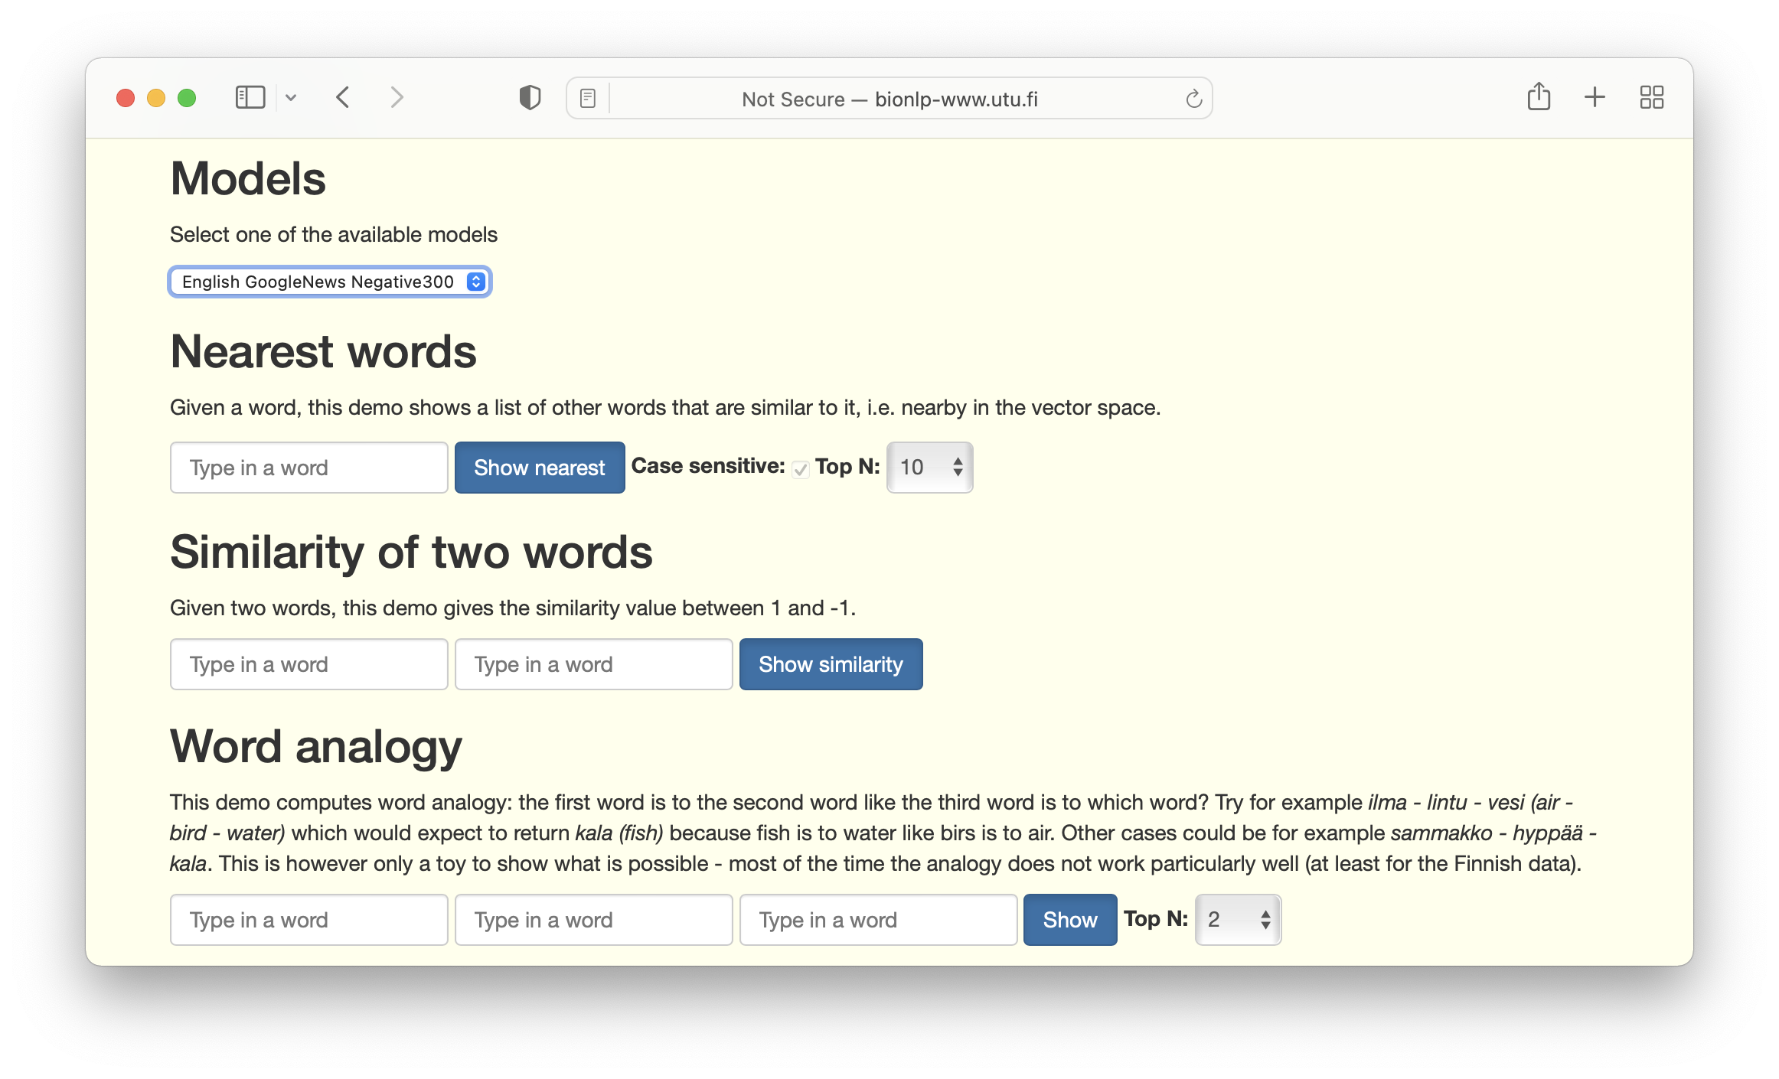
Word2vec demo
Click for demo

Slide 37
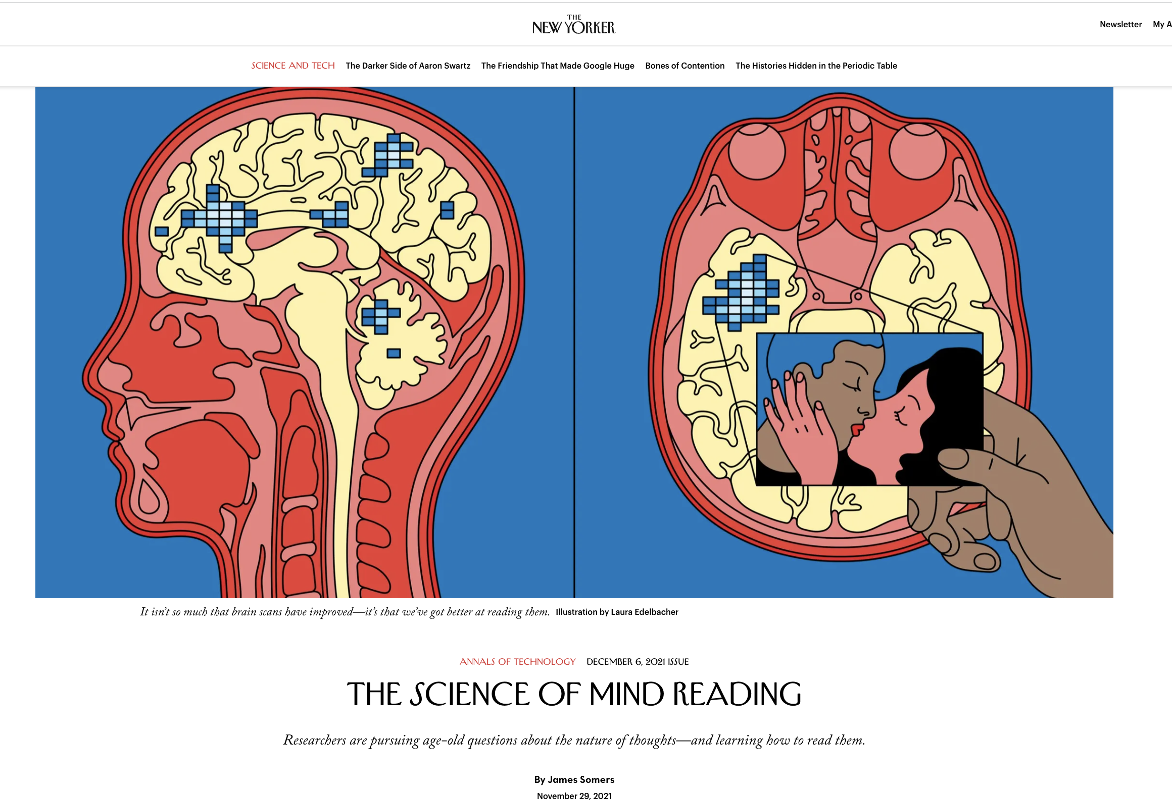
Scientists using fMRI to measure brain activity find locations associated with smilar concepts – brain embeddings!
Click to read

Slide 38

Conclusion
KGs help in extracting information from text
The information extracted can update the KGs
The KGs provide support for new tasks, such as question answering, speech interfaces and produce data useful in applications, like IDSs
There use will grow and evolve in the future
New machine learning frameworks will result in better accuracy

