Slide 1

Weka

Slide 2

Weka
A Java-based machine vlearning tool
http://www.cs.waikato.ac.nz/ml/weka/
Implements numerous classifiers and other ML algorithms
Uses a common data representation format, making comparisons easy
  Comprehensive set of data pre-processing tools and evaluation methods
3 modes of operation: GUI, Command Line, Java API

Slide 3
.arff data format
@relation heart-disease-simplified
@attribute age numeric
@attribute sex { female, male}
@attribute chest_pain_type { typ_angina, asympt, non_anginal, atyp_angina}
@attribute cholesterol numeric
@attribute exercise_induced_angina { no, yes}
@attribute class { present, not_present}
@data
63,male,typ_angina,233,no,not_present
67,male,asympt,286,yes,present
67,male,asympt,229,yes,present
38,female,non_anginal,?,no,not_present
...
numeric attribute
nominal attribute

Slide 4
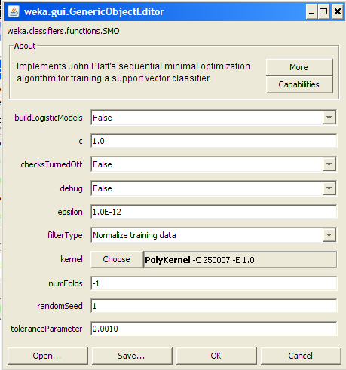
Using SVM in Weka
SMO is the implementation of SVM used in Weka
Note that all nominal attributes are converted into sets of binary attributes
You can choose either the RBF kernel or the polynomial kernel
In either case, you have the linear versus non-linear options

Slide 5
Weka demo

Slide 6

Weka vs. svm_light vs. …
Weka is good for experimenting with different ML algorithms
Other, more specific tools are much more efficient and scalable
For SVMs, for example, many use svm_light
http://svmlight.joachims.org/
Works well for 10K+ features, 100K+ training vectors
Uses a sparse vector representation
  Good for many features (e.g., text)

