Slide 1
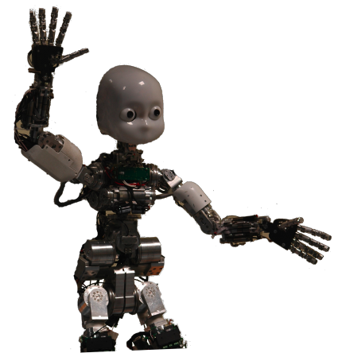
Machine Learning: Decision Trees
Chapter 18.1-18.3
Some material adopted from notes by Chuck Dyer

Slide 2
What is learning?
“Learning denotes changes in a system that ... enable a system to do the same task more efficiently the next time” – Herbert Simon
“Learning is constructing or modifying representations of what is being experienced”
– Ryszard Michalski
“Learning is making useful changes in our minds” – Marvin Minsky

Slide 3
Why study learning?
Understand and improve efficiency of human learning
  Use to improve methods for teaching and tutoring people (e.g., better computer-aided instruction)
Discover new things or structure previously unknown
  Examples: data mining, scientific discovery
Fill in skeletal or incomplete specifications in a domain
  Large, complex systems can’t be completely built by hand & require dynamic updating to incorporate new information
  Learning new characteristics expands the domain or expertise and lessens the “brittleness” of the system
Build agents that can adapt to users, other agents, and their environment

Slide 4
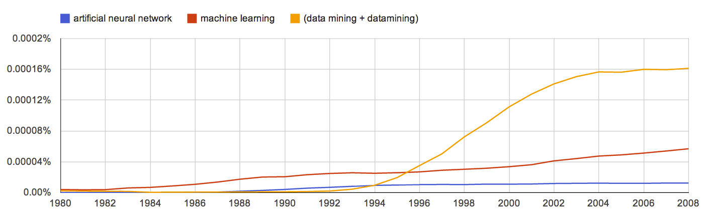
AI & Learning Today
Neural network learning was popular in the 60s
In the 70s and 80s it was replaced with a paradigm based on manually encoding and using knowledge
In the 90s, more data and the Web drove interest in new statistical machine learning (ML) techniques and new data mining applications
Today, ML techniques and big data are behind almost all successful intelligent systems
http://bit.ly/U2ZAC8

Slide 5
Machine Leaning Successes
Sentiment analysis
Spam detection
Machine translation
Spoken language understanding
Named entity detection
Self driving cars
Motion recognition (Microsoft X-Box)
Identifying paces in digital images
Recommender systems (Netflix, Amazon)
Credit card fraud detection

Slide 6
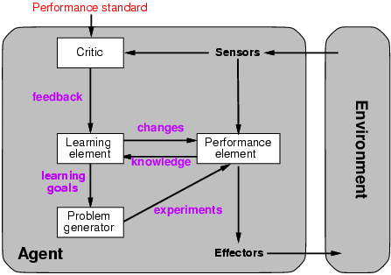
A general model of learning agents

Slide 7
Major paradigms of machine learning
Rote learning – One-to-one mapping from inputs to stored representation. “Learning by memorization.” Association-based storage and retrieval.
Induction – Use specific examples to reach general conclusions
Clustering – Unsupervised identification of natural groups in data
Analogy – Determine correspondence between two different representations
Discovery – Unsupervised, specific goal not given
Genetic algorithms – “Evolutionary” search techniques, based on an analogy to “survival of the fittest”
Reinforcement – Feedback (positive or negative reward) given at the end of a sequence of steps

Slide 8
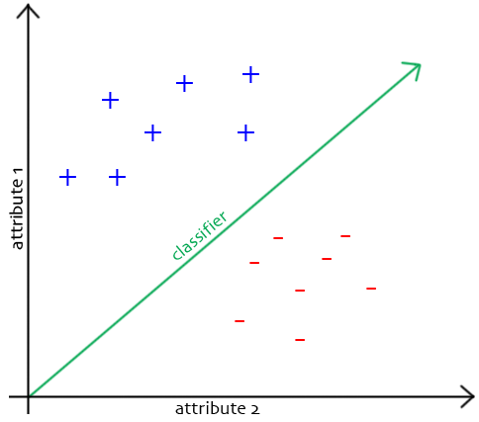
The Classification Problem
Extrapolate from set of examples to make accurate predictions about future ones
Supervised versus unsupervised learning
  Learn unknown function f(X)=Y, where X is an input example and Y is desired output
  Supervised learning implies we’re given a training set of (X, Y) pairs by a “teacher”
  Unsupervised learning means we are only given the Xs and some (ultimate) feedback function on our performance.
Concept learning or classification (aka “induction”)
  Given a set of examples of some concept/class/category, determine if a given example is an instance of the concept or not
  If it is an instance, we call it a positive example
  If it is not, it is called a negative example
  Or we can make a probabilistic prediction (e.g., using a Bayes net)

Slide 9
Supervised Concept Learning
Given a training set of positive and negative examples of a concept
Construct a description that will accurately classify whether future examples are positive or negative
That is, learn some good estimate of function f given a training set {(x₁, y₁), (x₂, y₂), ..., (x_{n}, y_{n})}, where each y_{i} is either + (positive) or - (negative), or a probability distribution over +/-

Slide 10
Inductive Learning Framework
Raw input data from sensors are typically preprocessed to obtain a feature vector, X, that adequately describes all of the relevant features for classifying examples
Each x is a list of (attribute, value) pairs. For example,
  X = [Person:Sue, EyeColor:Brown, Age:Young, Sex:Female]
The number of attributes (a.k.a. features) is fixed (positive, finite)
Each attribute has a fixed, finite number of possible values (or could be continuous)
Each example can be interpreted as a point in an
n-dimensional feature space, where n is the number of attributes

Slide 11
Measuring Model Quality
How good is a model?
  Predictive accuracy
  False positives / false negatives for a given cutoff threshold
    Loss function (accounts for cost of different types of errors)
  Area under the (ROC) curve
  Minimizing loss can lead to problems with overfitting
Training error
  Train on all data; measure error on all data
  Subject to overfitting (of course we’ll make good predictions on the data on which we trained!)
Regularization
  Attempt to avoid overfitting
  Explicitly minimize the complexity of the function while minimizing loss. Tradeoff is modeled with a regularization parameter

Slide 12
Cross-Validation
Holdout cross-validation:
  Divide data into training set and test set
  Train on training set; measure error on test set
  Better than training error, since we are measuring generalization to new data
  To get a good estimate, we need a reasonably large test set
  But this gives less data to train on, reducing our model quality!

Slide 13
Cross-Validation, cont.
k-fold cross-validation:
  Divide data into k folds
  Train on k-1 folds, use the kth fold to measure error
  Repeat k times; use average error to measure generalization accuracy
  Statistically valid and gives good accuracy estimates
Leave-one-out cross-validation (LOOCV)
  k-fold cross validation where k=N (test data = 1 instance!)
  Quite accurate, but also quite expensive, since it requires building N models

Slide 14
Inductive learning as search
Instance space I defines the language for the training and test instances
  Typically, but not always, each instance i∈I is a feature vector
  Features are sometimes called attributes or variables
  I: V₁ x V₂ x … x V_{k}, i = (v₁, v₂, …, v_{k})
Class variable C gives an instance’s class (to be predicted)
Model space M defines the possible classifiers
  M: I → C, M = {m1, … mn} (possibly infinite)
  Model space is sometimes, but not always, defined in terms of the same features as the instance space
Training data can be used to direct the search for a good (consistent, complete, simple) hypothesis in the model space

Slide 15
Model spaces
Decision trees
  Partition the instance space into axis-parallel regions, labeled with class value
Version spaces
  Search for necessary (lower-bound) and sufficient (upper-bound) partial instance descriptions for an instance to be in the class
Nearest-neighbor classifiers
  Partition the instance space into regions defined by the centroid instances (or cluster of k instances)
Associative rules (feature values → class)
First-order logical rules
Bayesian networks (probabilistic dependencies of class on attributes)
Neural networks

Slide 16
Model spaces
I
I
-
-
-
-
+
+
+
+
I
Nearest
neighbor
-
Decision
tree
-
+
+
Version space

Slide 17
Learning decision trees
Goal: Build a decision tree to classify examples as positive or negative instances of a concept using supervised learning from a training set
A decision tree is a tree where
  each non-leaf node has associated
  with it an attribute (feature)
  each leaf node has associated
  with it a classification (+ or -)
  each arc has associated with it one
  of the possible values of the attribute
  at the node from which the arc is directed
Generalization: allow for >2 classes
  e.g., for stocks, classify into {sell, hold, buy}
Color
green
red
blue
Size
+
Shape
big
small
square
round
-
+
Size
+
big
small
-
+

Slide 18
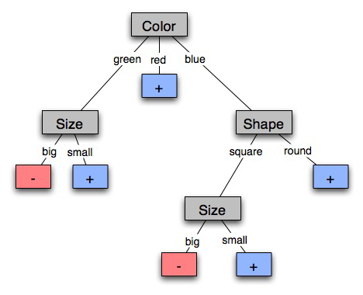
Decision tree-induced partition – example
I

Slide 19
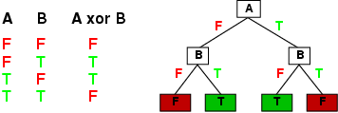
Expressiveness
Decision trees can express any function of the input attributes
E.g., for Boolean functions, truth table row → path to leaf:
Trivially, there’s a consistent decision tree for any training set with one path to leaf for each example (unless f nondeterministic in x), but it probably won't generalize to new examples
We prefer to find more compact decision trees

Slide 20
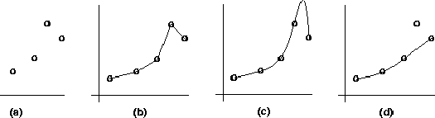
Inductive learning and bias
Suppose that we want to learn a function f(x) = y and we are given some sample (x,y) pairs, as in figure (a)
There are several hypotheses we could make about this function, e.g.: (b), (c) and (d)
A preference for one over the others reveals the bias of our learning technique, e.g.:
  prefer piece-wise functions
  prefer a smooth function
  prefer a simple function and treat outliers as noise

Slide 21
Preference bias: Ockham’s Razor
AKA Occam’s Razor, Law of Economy, or Law of Parsimony
Principle stated by William of Ockham (1285-1347)
  “non sunt multiplicanda entia praeter necessitatem”
  entities are not to be multiplied beyond necessity
The simplest consistent explanation is the best
Therefore, the smallest decision tree that correctly classifies all of the training examples is best
Finding the provably smallest decision tree is NP-hard, so instead of constructing the absolute smallest tree consistent with the training examples, construct one that is pretty small

Slide 22
Hypothesis spaces
How many distinct decision trees with n Boolean attributes?
  = number of Boolean functions
  = number of distinct truth tables with 2^{n} rows = 2^{2n}
  e.g., with 6 Boolean attributes, 18,446,744,073,709,551,616 trees
How many conjunctive hypotheses (e.g., Hungry ∧ ¬Rain)?
  Each attribute can be in (positive), in (negative), or out
    3^{n} distinct conjunctive hypotheses
  e.g., with 6 Boolean attributes, 729 trees
A more expressive hypothesis space
  increases chance that target function can be expressed
  increases number of hypotheses consistent with training set
  ⇒ may get worse predictions in practice

Slide 23
R&N’s restaurant domain
Develop a decision tree to model decision a patron makes when deciding whether or not to wait for a table at a restaurant
Two classes: wait, leave
Ten attributes: Alternative available? Bar in restaurant? Is it Friday? Are we hungry? How full is the restaurant? How expensive? Is it raining? Do we have a reservation? What type of restaurant is it? What’s the purported waiting time?
Training set of 12 examples
~ 7000 possible cases

Slide 24
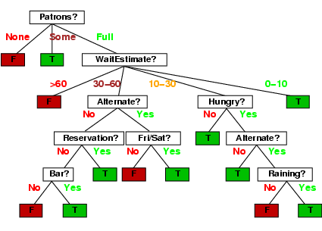
A decision tree from introspection

Slide 25
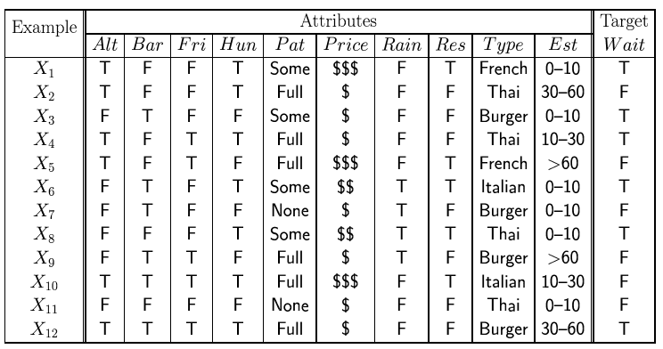
Attribute-based representations
Examples described by attribute values (Boolean, discrete, continuous), e.g., situations where I will/won't wait for a table
Classification of examples is positive (T) or negative (F)
Serves as a training set

Slide 26
ID3/C4.5 Algorithm
A greedy algorithm for decision tree construction developed by Ross Quinlan circa 1987
Top-down construction of decision tree by recursively selecting “best attribute” to use at the current node in tree
  Once attribute is selected for current node, generate child nodes, one for each possible value of selected attribute
  Partition examples using the possible values of this attribute, and assign these subsets of the examples to the appropriate child node
  Repeat for each child node until all examples associated with a node are either all positive or all negative

Slide 27
Choosing the best attribute
Key problem: choosing which attribute to split a given set of examples
Some possibilities are:
  Random: Select any attribute at random
  Least-Values: Choose the attribute with the smallest number of possible values
  Most-Values: Choose the attribute with the largest number of possible values
  Max-Gain: Choose the attribute that has the largest expected information gain–i.e., attribute that results in smallest expected size of subtrees rooted at its children
The ID3 algorithm uses the Max-Gain method of selecting the best attribute

Slide 28
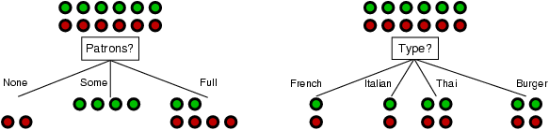
Choosing an attribute
Idea: a good attribute splits the examples into subsets that are (ideally) “all positive” or “all negative”
Which is better: Patrons? or Type?

Slide 29
Restaurant example
Random: Patrons or Wait-time; Least-values: Patrons; Most-values: Type; Max-gain: ???
French
Y
N
Y
N
Type variable
Italian
Thai
N
Y
N
Y
N
Y
N
Y
Burger
Empty
Some
Full
Patrons variable

Slide 30
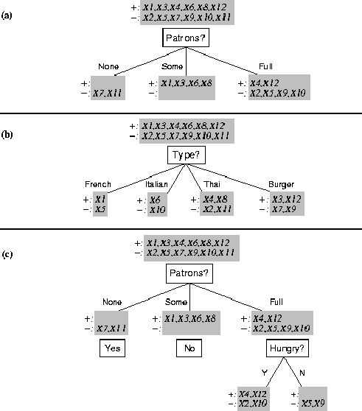
Splitting examples by testing attributes

Slide 31
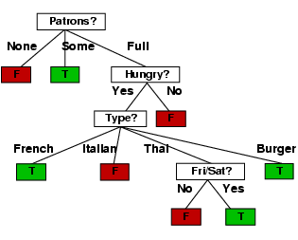
ID3-induced decision tree

Slide 32
Compare the two Decision Trees

Slide 33
Information theory 101
Information theory sprang almost fully formed from the seminal work of Claude E. Shannon at Bell Labs
  A Mathematical Theory of Communication, Bell System Technical Journal, 1948.
Intuitions
  Common words (a, the, dog) shorter than less common ones (parlimentarian, foreshadowing)
  Morse code: common (probable) letters have shorter encodings
Information is measured in minimum number of bits needed to store or send some information
Wikipedia: The measure of data, known as information
entropy, is usually expressed by the average number of bits needed for storage or communication.

Slide 34
Information theory 101
Information is measured in bits
Information conveyed by message depends on its probability
For n equally probable possible messages, each has prob. 1/n
Information conveyed by message is -log(p) = log(n)
  e.g., with 16 messages, then log(16) = 4 and we need 4 bits to identify/send each message
Given probability distribution for n messages P = (p₁,p₂…p_{n}), the information conveyed by distribution (aka entropy of P) is:
  I(P) = -(p₁*log(p₁) + p₂*log(p₂) + .. + p_{n}*log(p_{n}))
probability of msg 2
info in msg 2

Slide 35
Information theory II
Information conveyed by distribution (aka entropy of P):
  I(P) = -(p₁*log(p₁) + p₂*log(p₂) + .. + p_{n}*log(p_{n}))
Examples:
  If P is (0.5, 0.5) then I(P) = .5*1 + 0.5*1 = 1
  If P is (0.67, 0.33) then I(P) = -(2/3*log(2/3) + 1/3*log(1/3)) = 0.92
  If P is (1, 0) then I(P) = 1*1 + 0*log(0) = 0
The more uniform the probability distribution, the greater its information: more information is conveyed by a message telling you which event actually occurred
Entropy is the average number of bits/message needed to represent a stream of messages

Slide 36
Example: Huffman code
In 1952 MIT student David Huffman devised, in the course of doing a homework assignment, an elegant coding scheme which is optimal in the case where all symbols’ probabilities are integral powers of 1/2.
A Huffman code can be built in the following manner:
  Rank all symbols in order of probability of occurrence
  Successively combine the two symbols of the lowest probability to form a new composite symbol; eventually we will build a binary tree where each node is the probability of all nodes beneath it
  Trace a path to each leaf, noticing direction at each node

Slide 37
Huffman code example
M P
A .125
B .125
C .25
D .5
1
0
1
.5
.5
D
0
1
.25
If we use this code to many messages (A,B,C or D) with this probability distribution, then, over time, the average bits/message should approach 1.75
.25
C
0
1
.125
.125
A
B

Slide 38
Information for classification
If a set T of records is partitioned into disjoint exhaustive classes (C₁,C₂,..,C_{k}) on the basis of the value of the class attribute, then information needed to identify class of an element of T is:
Info(T) = I(P)
where P is the probability distribution of partition (C₁,C₂,..,C_{k}):
  P = (|C₁|/|T|, |C₂|/|T|, ..., |C_{k}|/|T|)
C₁
C₂
C₃
C₁
C₃
C₂
Low information
High information

Slide 39
Information for classification II
If we partition T w.r.t attribute X into sets {T₁,T₂, ..,T_{n}} then the information needed to identify the class of an element of T becomes the weighted average of the information needed to identify the class of an element of T_{i}, i.e. the weighted average of Info(T_{i}):
  Info(X,T) = Σ|T_{i}|/|T| * Info(T_{i})
C₁
C₃
C₁
C₃
C₂
C₂
High information
Low information

Slide 40
Information gain
Consider the quantity Gain(X,T) defined as
Gain(X,T) = Info(T) - Info(X,T)
This represents the difference between
  info needed to identify element of T and
  info needed to identify element of T after value of attribute X known
This is the gain in information due to attribute X
Use to rank attributes and build DT where each node uses attribute with greatest gain of those not yet considered (in path from root)
The intent of this ordering is to:
  Create small DTs so records can be identified with few questions
  Match a hoped-for minimality of the process represented by the records being considered (Occam’s Razor)

Slide 41
Computing Information Gain
I(T) = ?
I (Pat, T) = ?
I (Type, T) = ?
French
Y
N
Italian
Y
N
Thai
N
Y
N
Y
Burger
N
Y
N
Y
Empty
Some
Full
Gain (Pat, T) = ?
Gain (Type, T) = ?

Slide 42
Computing information gain
I(T) =
- (.5 log .5 + .5 log .5)
= .5 + .5 = 1
I (Pat, T) =
2/12 (0) + 4/12 (0) +
6/12 (- (4/6 log 4/6 +
2/6 log 2/6))
= 1/2 (2/3*.6 +
1/3*1.6)
= .47
I (Type, T) =
2/12 (1) + 2/12 (1) +
4/12 (1) + 4/12 (1) = 1
French
Y
N
Italian
Y
N
Thai
N
Y
N
Y
Burger
N
Y
N
Y
Empty
Some
Full
Gain (Pat, T) = 1 - .47 = .53
Gain (Type, T) = 1 – 1 = 0

Slide 43
The ID3 algorithm builds a decision tree, given a set of non-categorical attributes C1, C2, .., Cn, the class attribute C, and a training set T of records
function ID3(R:input attributes, C:class attribute, S:training set) returns decision tree;
If S is empty, return single node with value Failure;
If every example in S has same value for C, return
single node with that value;
If R is empty, then return a single node with most
frequent of the values of C found in examples S;
# causes errors -- improperly classified record
Let D be attribute with largest Gain(D,S) among R;
Let {dj| j=1,2, .., m} be values of attribute D;
Let {Sj| j=1,2, .., m} be subsets of S consisting of
records with value dj for attribute D;
Return tree with root labeled D and arcs labeled
d1..dm going to the trees ID3(R-{D},C,S1). . .
ID3(R-{D},C,Sm);

Slide 44
How well does it work?
Many case studies have shown that decision trees are at least as accurate as human experts.
  A study for diagnosing breast cancer had humans correctly classifying the examples 65% of the time; the decision tree classified 72% correct
  British Petroleum designed a decision tree for gas-oil separation for offshore oil platforms that replaced an earlier rule-based expert system
  Cessna designed an airplane flight controller using 90,000 examples and 20 attributes per example

Slide 45
Extensions of ID3
Using gain ratios
Real-valued data
Noisy data and overfitting
Generation of rules
Setting parameters
Cross-validation for experimental validation of performance
C4.5 is an extension of ID3 that accounts for unavailable values, continuous attribute value ranges, pruning of decision trees, rule derivation, and so on

Slide 46
Using gain ratios
The information gain criterion favors attributes that have a large number of values
  If we have an attribute D that has a distinct value for each record, then Info(D,T) is 0, thus Gain(D,T) is maximal
To compensate for this Quinlan suggests using the following ratio instead of Gain:
  GainRatio(D,T) = Gain(D,T) / SplitInfo(D,T)
SplitInfo(D,T) is the information due to the split of T on the basis of value of categorical attribute D
  SplitInfo(D,T) = I(|T1|/|T|, |T2|/|T|, .., |Tm|/|T|)
where {T1, T2, .. Tm} is the partition of T induced by value of D

Slide 47
Computing gain ratio
French
Y
N
I(T) = 1
I (Pat, T) = .47
I (Type, T) = 1
Italian
Y
N
Thai
N
Y
N
Y
Gain (Pat, T) =.53
Gain (Type, T) = 0
Burger
N
Y
N
Y
Empty
Some
Full
SplitInfo (Pat, T) = - (1/6 log 1/6 + 1/3 log 1/3 + 1/2 log 1/2) = 1/6*2.6 + 1/3*1.6 + 1/2*1
= 1.47
SplitInfo (Type, T) = 1/6 log 1/6 + 1/6 log 1/6 + 1/3 log 1/3 + 1/3 log 1/3
= 1/6*2.6 + 1/6*2.6 + 1/3*1.6 + 1/3*1.6 = 1.93
GainRatio (Pat, T) = Gain (Pat, T) / SplitInfo(Pat, T) = .53 / 1.47 = .36
GainRatio (Type, T) = Gain (Type, T) / SplitInfo (Type, T) = 0 / 1.93 = 0

Slide 48
Real-valued data
Select a set of thresholds defining intervals
Each interval becomes a discrete value of the attribute
Use some simple heuristics…
  always divide into quartiles
Use domain knowledge…
  divide age into infant (0-2), toddler (3 - 5), school-aged (5-8)
Or treat this as another learning problem
  Try a range of ways to discretize the continuous variable and see which yield “better results” w.r.t. some metric
  E.g., try midpoint between every pair of values

Slide 49
Noisy data
Many kinds of “noise” can occur in the examples:
Two examples have same attribute/value pairs, but different classifications
Some values of attributes are incorrect because of errors in the data acquisition process or the preprocessing phase
The classification is wrong (e.g., + instead of -) because of some error
Some attributes are irrelevant to the decision-making process, e.g., color of a die is irrelevant to its outcome

Slide 50
Overfitting
Irrelevant attributes, can result in overfitting the training example data
If hypothesis space has many dimensions (large number of attributes), we may find meaningless regularity in the data that is irrelevant to the true, important, distinguishing features
If we have too little training data, even a reasonable hypothesis space will ‘overfit’

Slide 51
Overfitting
Fix by by removing irrelevant features
  E.g., remove ‘year observed’, ‘month observed’, ‘day observed’, ‘observer name’ from feature vector
Fix by getting more training data
Fix by pruning lower nodes in the decision tree
  E.g., if gain of the best attribute at a node is below a threshold, stop and make this node a leaf rather than generating children nodes

Slide 52
Pruning decision trees
Pruning of the decision tree is done by replacing a whole subtree by a leaf node
The replacement takes place if a decision rule establishes that the expected error rate in the subtree is greater than in the single leaf. E.g.,
  Training: one training red success and two training blue failures
  Test: three red failures and one blue success
  Consider replacing this subtree by a single Failure node.
After replacement we will have only two errors instead of five:
Training
Test
Pruned
Color
Color
FAILURE
red
blue
red
blue
2 success
4 failure
1 success
0 failure
0 success
2 failures
1 success
3 failure
1 success
1 failure

Slide 53
Converting decision trees to rules
It is easy to derive rules from a decision tree: write a rule for each path from the root to a leaf
In that rule the left-hand side is built from the label of the nodes and the labels of the arcs
The resulting rules set can be simplified:
  Let LHS be the left hand side of a rule
  LHS’ obtained from LHS by eliminating some conditions
  Replace LHS by LHS' in this rule if the subsets of the training set satisfying LHS and LHS' are equal
  A rule may be eliminated by using meta-conditions such as “if no other rule applies”

Slide 54

http://archive.ics.uci.edu/ml
233 data sets

Slide 55
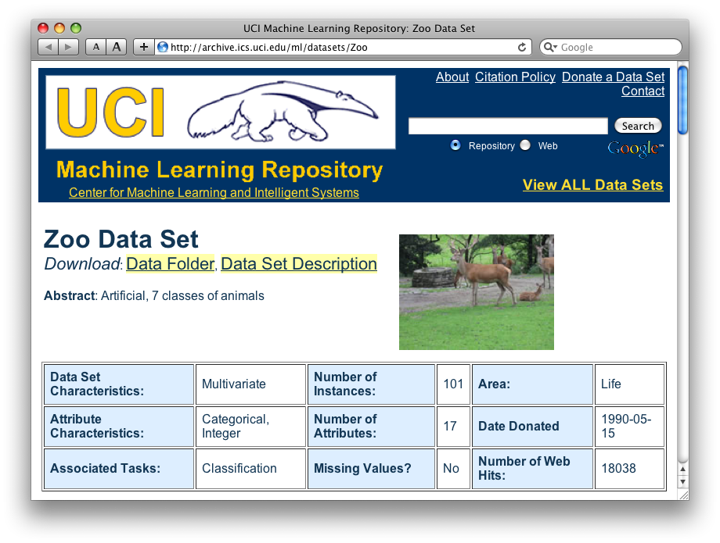
http://archive.ics.uci.edu/ml/datasets/Zoo

Slide 56
Zoo data
animal name: string
hair: Boolean
feathers: Boolean
eggs: Boolean
milk: Boolean
airborne: Boolean
aquatic: Boolean
predator: Boolean
toothed: Boolean
backbone: Boolean
breathes: Boolean
venomous: Boolean
fins: Boolean
legs: {0,2,4,5,6,8}
tail: Boolean
domestic: Boolean
catsize: Boolean
type: {mammal, fish, bird, shellfish, insect, reptile, amphibian}
101 examples
aardvark,1,0,0,1,0,0,1,1,1,1,0,0,4,0,0,1,mammal
antelope,1,0,0,1,0,0,0,1,1,1,0,0,4,1,0,1,mammal
bass,0,0,1,0,0,1,1,1,1,0,0,1,0,1,0,0,fish
bear,1,0,0,1,0,0,1,1,1,1,0,0,4,0,0,1,mammal
boar,1,0,0,1,0,0,1,1,1,1,0,0,4,1,0,1,mammal
buffalo,1,0,0,1,0,0,0,1,1,1,0,0,4,1,0,1,mammal
calf,1,0,0,1,0,0,0,1,1,1,0,0,4,1,1,1,mammal
carp,0,0,1,0,0,1,0,1,1,0,0,1,0,1,1,0,fish
catfish,0,0,1,0,0,1,1,1,1,0,0,1,0,1,0,0,fish
cavy,1,0,0,1,0,0,0,1,1,1,0,0,4,0,1,0,mammal
cheetah,1,0,0,1,0,0,1,1,1,1,0,0,4,1,0,1,mammal
chicken,0,1,1,0,1,0,0,0,1,1,0,0,2,1,1,0,bird
chub,0,0,1,0,0,1,1,1,1,0,0,1,0,1,0,0,fish
clam,0,0,1,0,0,0,1,0,0,0,0,0,0,0,0,0,shellfish
crab,0,0,1,0,0,1,1,0,0,0,0,0,4,0,0,0,shellfish
…

Slide 57
Zoo example
aima-python> python
>>> from learning import *
>>> zoo
<DataSet(zoo): 101 examples, 18 attributes>
>>> dt = DecisionTreeLearner()
>>> dt.train(zoo)
>>> dt.predict(['shark',0,0,1,0,0,1,1,1,1,0,0,1,0,1,0,0])
'fish'
>>> dt.predict(['shark',0,0,0,0,0,1,1,1,1,0,0,1,0,1,0,0])
'mammal’

Slide 58
Zoo example
>> dt.dt
DecisionTree(13, 'legs', {0: DecisionTree(12, 'fins', {0: DecisionTree(8, 'toothed', {0: 'shellfish', 1: 'reptile'}), 1: DecisionTree(3, 'eggs', {0: 'mammal', 1: 'fish'})}), 2: DecisionTree(1, 'hair', {0: 'bird', 1: 'mammal'}), 4: DecisionTree(1, 'hair', {0: DecisionTree(6, 'aquatic', {0: 'reptile', 1: DecisionTree(8, 'toothed', {0: 'shellfish', 1: 'amphibian'})}), 1: 'mammal'}), 5: 'shellfish', 6: DecisionTree(6, 'aquatic', {0: 'insect', 1: 'shellfish'}), 8: 'shellfish'})

Slide 59
Zoo example
>>> dt.dt.display()
Test legs
legs = 0 ==> Test fins
fins = 0 ==> Test toothed
toothed = 0 ==> RESULT = shellfish
toothed = 1 ==> RESULT = reptile
fins = 1 ==> Test eggs
eggs = 0 ==> RESULT = mammal
eggs = 1 ==> RESULT = fish
legs = 2 ==> Test hair
hair = 0 ==> RESULT = bird
hair = 1 ==> RESULT = mammal
legs = 4 ==> Test hair
hair = 0 ==> Test aquatic
aquatic = 0 ==> RESULT = reptile
aquatic = 1 ==> Test toothed
toothed = 0 ==> RESULT = shellfish
toothed = 1 ==> RESULT = amphibian
hair = 1 ==> RESULT = mammal
legs = 5 ==> RESULT = shellfish
legs = 6 ==> Test aquatic
aquatic = 0 ==> RESULT = insect
aquatic = 1 ==> RESULT = shellfish
legs = 8 ==> RESULT = shellfish

Slide 60
Zoo example
>>> dt.dt.display()
Test legs
legs = 0 ==> Test fins
fins = 0 ==> Test toothed
toothed = 0 ==> RESULT = shellfish
toothed = 1 ==> RESULT = reptile
fins = 1 ==> Test milk
milk = 0 ==> RESULT = fish
milk = 1 ==> RESULT = mammal
legs = 2 ==> Test hair
hair = 0 ==> RESULT = bird
hair = 1 ==> RESULT = mammal
legs = 4 ==> Test hair
hair = 0 ==> Test aquatic
aquatic = 0 ==> RESULT = reptile
aquatic = 1 ==> Test toothed
toothed = 0 ==> RESULT = shellfish
toothed = 1 ==> RESULT = amphibian
hair = 1 ==> RESULT = mammal
legs = 5 ==> RESULT = shellfish
legs = 6 ==> Test aquatic
aquatic = 0 ==> RESULT = insect
aquatic = 1 ==> RESULT = shellfish
legs = 8 ==> RESULT = shellfish
Add the shark example to the training set and retrain

Slide 61
Summary: Decision tree learning
Widely used learning methods in practice
Can out-perform human experts in many problems
Strengths include
  Fast and simple to implement
  Can convert result to a set of easily interpretable rules
  Empirically valid in many commercial products
  Handles noisy data
Weaknesses include
  Univariate splits/partitioning using only one attribute at a time so limits types of possible trees
  Large decision trees may be hard to understand
  Requires fixed-length feature vectors
  Non-incremental (i.e., batch method)

