Slide 1
RDFa:
Embedding RDF Knowledge in HTML
Some content from a presentation by Ivan Herman of the W3c, Introduction
to RDFa, given at the 2011 Semantic Technologies Conference.

Slide 2
What is RDFa?
Simple idea: RDFa is a serialization of RDF embedded in XHTML, HTML or XML
  Provides a set of attributes (the a in RDFa) to use with existing tags to carry the RDF metadata
2004: work on developing standards began
2008: RDFa 1.0 a recommendation
  Worked only in XHTML, which did not catch on
2012: RDFa 1.1 a recommendation
  Works in HTML4, HTML5 and XHTML
See http://rdfa.info/

Slide 3
Principles of RDFa
RDF content specified in XML attributes rather than elements
The XML/HTML tree structure is used as context, when appropriate
Some new attributes are introduced and some existing ones (@href, @rel) reused
When possible, HTML text content is used for literal values
➔Same file used by browser & RDF extractor

Slide 4
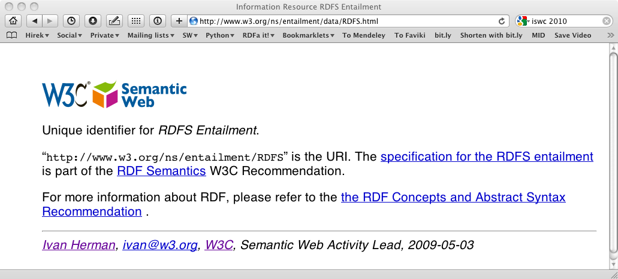
A Web page viewed by a person
http://www.w3.org/ns/entailment/data/RDFS.html

Slide 5
The source
<p about="http://www.w3.org/ns/entailment/RDFS"
property="http://purl.org/dc/terms/description">
Unique identifier for <em>RDFS Entailment</em>.</p>

Slide 6
Source and generated RDF…
<p about="http://www.w3.org/ns/entailment/RDFS"
property="http://purl.org/dc/terms/description">
Unique identifier for <em>RDFS Entailment</em>.</p>
<http://www.w3.org/ns/entailment/RDFS>
… .

Slide 7
Source and generated RDF…
<p about="http://www.w3.org/ns/entailment/RDFS"
property="http://purl.org/dc/terms/description">
Unique identifier for <em>RDFS Entailment</em>.</p>
<http://www.w3.org/ns/entailment/RDFS>
<http://purl.org/dc/terms/description>
… .

Slide 8
Source and generated RDF…
<p about="http://www.w3.org/ns/entailment/RDFS"
property="http://purl.org/dc/terms/description">
Unique identifier for <em>RDFS Entailment</em>.</p>
<http://www.w3.org/ns/entailment/RDFS>
<http://purl.org/dc/terms/description>
"Unique identifier for RDFS Entailment." .

Slide 9
The Web page viewed by a person

Slide 10
The source
<a about="http://www.w3.org/ns/entailment/RDFS"
rel="http://www.w3.org/2000/01/rdf-schema#seeAlso"
href="http://www.w3.org/TR/2004/REC-rdf-mt-20040210/">
RDF Semantics.
</a>

Slide 11
Source and generated RDF…
<a about="http://www.w3.org/ns/entailment/RDFS"
rel="http://www.w3.org/2000/01/rdf-schema#seeAlso"
href="http://www.w3.org/TR/2004/REC-rdf-mt-20040210/">
RDF Semantics.
</a>
<http://www.w3.org/ns/entailment/RDFS>
….

Slide 12
Source and generated RDF…
<a about="http://www.w3.org/ns/entailment/RDFS"
rel="http://www.w3.org/2000/01/rdf-schema#seeAlso"
href="http://www.w3.org/TR/2004/REC-rdf-mt-20040210/">
RDF Semantics.
</a>
<http://www.w3.org/ns/entailment/RDFS>
<http://www.w3.org/2000/01/rdf-schema#seeAlso>
… .

Slide 13
Source and generated RDF…
<a about="http://www.w3.org/ns/entailment/RDFS"
rel="http://www.w3.org/2000/01/rdf-schema#seeAlso"
href="http://www.w3.org/TR/2004/REC-rdf-mt-20040210/">
RDF Semantics.
</a>
<http://www.w3.org/ns/entailment/RDFS>
<http://www.w3.org/2000/01/rdf-schema#seeAlso>
<http://www.w3.org/TR/2004/REC-rdf-mt-20040210/> .

Slide 14
We have Ntriples in HTML
Maybe we can do better, instead of this
<http://www.w3.org/ns/entailment/RDFS>
<http://purl.org/dc/terms/description>
"Unique identifier for RDFS Entailment." .
<http://www.w3.org/ns/entailment/RDFS>
<http://www.w3.org/2000/01/rdf-schema#seeAlso>
<http://www.w3.org/TR/2004/REC-rdf-mt-20040210/> .
Allow URI prefixes and shared subject, like this
@prefix rdfs: <http://www.w3.org/2000/01/rdf-schema#> .
@prefix dcterms: <http://purl.org/dc/terms/> .
<http://www.w3.org/ns/entailment/RDFS>
rdfs:seeAlso <http://www.w3.org/TR/2004/REC-rdf-mt-20040210/> ;
dcterms:description "Unique identifier for RDFS Entailment." .

Slide 15
Turtlizing RDFa
Turtle supports several simplifying ideas
Use compact URIs when possible
  A CURIE or compact URI, typically a URI with a prefix defined elsewhere, e.g., foaf:mbox
Making use of the natural structure for
  shared subjects
  shared predicates
  creating blank nodes
  …

Slide 16
CURIE definition and usage
<html>
…
<p about="http://www.w3.org/ns/entailment/RDFS"
property="http://purl.org/dc/terms/description">
Unique identifier for <em>RDFS Entailment</em>.</p>
…
</html>
can be replaced by:
<html prefix="dcterms: http://purl.org/dc/terms/">
…
<p about="http://www.w3.org/ns/entailment/RDFS"
property="dcterms:description">
Unique identifier for <em>RDFS Entailment</em>.</p>
…
</html>

Slide 17
Details on @prefix in RDFa
Can be anywhere in the tree and is valid for the whole sub-tree
  i.e., the html element is not the only place to have it
The same @prefix attribute can hold several definitions:
  prefix="dcterm: http://purl.org… foaf: http://…”
CURIEs and “real” URIs can usually be mixed
CURIEs cannot be used on @href

Slide 18
Sharing subjects
The basic principle: @about is inherited by children nodes, so there’s no reason to repeat it
<html prefix="dcterms: http://purl.org/dc/terms/
rdfs: http://www.w3.org/2000/01/rdf-schema#">
…
<body about="http://www.w3.org/ns/entailment/RDFS">
…
<p property="dcterms:description">
Unique identifier for <em>RDFS Entailment</em>.</p>
<p>…<a rel="rdfs:seeAlso"
href="http://www.w3.org/TR/2004/REC-rdf-mt-20040210">
RDFS Semantics</a>…</p>

Slide 19
… yielding
@prefix rdfs: <http://www.w3.org/2000/01/rdf-schema#> .
@prefix dcterms: <http://purl.org/dc/terms/> .
<http://www.w3.org/ns/entailment/RDFS>
rdfs:seeAlso <http://www.w3.org/TR/2004/REC-rdf-mt-20040210/> ;
dcterms:description "Unique identifier for RDFS Entailment." .

Slide 20
On reusing literals
Reusing literals is a plus, but you don’t always want to do it
The basic rule says: the (RDF) Literal is the enclosed text from the HTML content
This is fine in 80% of the cases, but…
…it may not be natural in many cases!

Slide 21
Example: dates
<body about=".." prefix="dcterms: http://… xsd: http://…"
<address>
<p property="dcterms:date" datatype="xsd:date">2010-07-05</p>
</address>
</body>
This leads to:
@prefix dcterms: <http://…> .
@prefix xsd: <http://…> .
<..> dcterms:date "2010-07-05"^^xsd:date .
2010-07-05 is the official ISO format (for xsd:date) but “July 5, 2010” is preferred by people

Slide 22
Usage of @content
<body about=".." prefix="dcterms: http://… xsd: http://…"
<address>
<p property="dcterms:date" datatype="xsd:date"
content="2010-07-05">July 5, 2010</p>
</address>
</body>
Also leads to:
@prefix dcterms: <http://…> .
@prefix xsd: <http://…> .
<..> dcterms:date "2010-07-05"^^xsd:date .

Slide 23
On subjects and objects
Here is our rule so far
  @about sets the subject
  @href sets the object
But that is not always good enough
  We may not want to introduce an active link (i.e., "a" element) on the web page
  what about other links in HTML?

Slide 24
We may not always want links…
The RDFa @resource attribute is equivalent to @href
Sets the object, just like @href but is ignored by browsers, e.g.,:
<span about="http://www.ivan-herman.net/foaf#me">
<span rel="rdfs:seeAlso"
resource="http://www.w3.org/People/Ivan/">Activity Lead</span>
</span>

Slide 25
More features
RDFa1.1 has more features that make it easier to represent knowledge compactly in HTML
These take advantage of the HTML tree context
See the hidden slides if you are interested

Slide 26
Chaining
Here is what we would like to have in RDFa
<http://www.w3.org/ns/entailment/RDFS>
dcterms:creator <http://www.ivan-herman.net/foaf#me> .
<http://www.ivan-herman.net/foaf#me>
foaf:mailbox <mailto:ivan@w3.org> ;
foaf:workplaceHomepage <http://www.w3.org> .

Slide 27
Chaining
A straightforward way:
<body about="http://www.w3.org/ns/entailment/RDFS">
…
<address>
<span rel="dcterms:creator"
resource="http://www.ivan-herman.net/foaf#me"/>
<span about="http://www.ivan-herman.net/foaf#me">
<a rel="foaf:mailbox"
href="mailto:ivan@w3.org">ivan@w3.org</a>,
<a rel="foaf:workplaceHomepage"
href="http://www.w3.org">W3C</a>
</span>
</address>

Slide 28
Chaining
A straightforward way:
<body about="http://www.w3.org/ns/entailment/RDFS">
…
<address>
<span rel="dcterms:creator"
resource="http://www.ivan-herman.net/foaf#me"/>
<span about="http://www.ivan-herman.net/foaf#me">
<a rel="foaf:mailbox"
href="mailto:ivan@w3.org">ivan@w3.org</a>,
<a rel="foaf:workplaceHomepage"
href="http://www.w3.org">W3C</a>
</span>
</address>

Slide 29
Chaining: when objects become subjects
An alternative:
<body about="http://www.w3.org/ns/entailment/RDFS">
…
<address>
<span rel="dcterms:creator"
resource="http://www.ivan-herman.net/foaf#me">
<a rel="foaf:mailbox"
href="mailto:ivan@w3.org">ivan@w3.org</a>,
<a rel="foaf:workplaceHomepage"
href="http://www.w3.org">W3C</a>
</span>
</address>

Slide 30
Chaining means
@resource (or @href) becomes a subject for the sub-tree
This feature is a bit like in RDF/XML

Slide 31
Some extra features
Blank nodes can be created using “_:XX”
Shorthand for RDF types
Helping single-vocabulary cases
Profiles

Slide 32
Typing
Typing can of course be done using @rel="rdf:type"
But that is a widely used combination, so there is a separate @typeof attribute for that

Slide 33
Typing example
<span about="http://www.ivan-herman.net/foaf#me"
typeof="foaf:Person">
<span property="foaf:name">Ivan Herman</span>
</span>,
yields
<http://www.ivan-herman.net/foaf#me> a foaf:Person ;
foaf:name "Ivan Herman" .

Slide 34
Single-vocabulary case
In many cases the content is dominated by one vocabulary, e.g., dcterms, foaf, etc.
CURIEs and URIs use is intuitive for RDF people but not for average HTML authors!
Solution:
  define a vocabulary URI for a sub-tree
  for that sub-tree, simple terms in @rel, @property, etc., are automatically expanded into a full URI using the vocabulary

Slide 35
@vocab and terms: this…
<div prefix="foaf: http://xmlns.com/foaf/0.1/">
…
<address about="http://www.ivan-herman.net/foaf#me"
typeof="foaf:Person”>
<span property="foaf:name">Ivan Herman</span>,
<a rel="foaf:mailbox"
href="mailto:ivan@w3.org">ivan@w3.org</a>,
<a rel="foaf:workplaceHomepage"
href="http://www.w3.org">W3C</a>
</address>

Slide 36
…becomes
<div vocab="http://xmlns.com/foaf/0.1/">
…
<address about="http://www.ivan-herman.net/foaf#me"
typeof="Person">
<span property="name">Ivan Herman</span>,
<a rel="mailbox"
href="mailto:ivan@w3.org">ivan@w3.org</a>,
<a rel="workplaceHomepage"
href="http://www.w3.org">W3C</a>
</address>

Slide 37
…becomes
<div vocab="http://xmlns.com/foaf/0.1/">
…
<address about="http://www.ivan-herman.net/foaf#me"
typeof="Person">
<span property="name">Ivan Herman</span>,
<a rel="mailbox"
href="mailto:ivan@w3.org">ivan@w3.org</a>,
<a rel="workplaceHomepage"
href="http://www.w3.org">W3C</a>
</address>

Slide 38
…becomes
<div vocab="http://xmlns.com/foaf/0.1/">
…
<address about="http://www.ivan-herman.net/foaf#me"
typeof="Person">
<span property="name">Ivan Herman</span>,
<a rel="mailbox"
href="mailto:ivan@w3.org">ivan@w3.org</a>,
<a rel="workplaceHomepage"
href="http://www.w3.org">W3C</a>
</address>

Slide 39
Profile files
Prefix and term declarations can be collect-ed in a separate file and referred to via a @profile attribute pointing to the file
Say, file “http://ex.org/prof” defines
  prefix mappings:
    "foaf" → "http://xmlns.com/foaf/0.1/"
    "rdfs" → http://www.w3.org/2000/01/rdf-schema#
  term mapping:
    "desc" → http://purl.org/dc/terms/description

Slide 40
Profile usage example: this…
<html prefix="dcterms: http://purl.org/dc/terms/
rdfs: http://www.w3.org/2000/01/rdf-schema#">
…
<body about="http://www.w3.org/ns/entailment/RDFS">
…
<p property="dcterms:description">
Unique identifier for <em>RDFS Entailment</em>.</p>
<p>…<a rel="rdfs:seeAlso"
href="http://www.w3.org/TR/2004/REC-rdf-mt-20040210">
RDFS Semantics</a>…</p>
…
<address about="http://www.ivan-herman.net/foaf#me">
<span property="foaf:name">Ivan Herman</span>,
…

Slide 41
…becomes
<html profile="http://ex.org/prof">
…
<body about="http://www.w3.org/ns/entailment/RDFS">
…
<p property="desc">
Unique identifier for <em>RDFS Entailment</em>.</p>
<p>…<a rel="rdfs:seeAlso"
href="http://www.w3.org/TR/2004/REC-rdf-mt-20040210">
RDFS Semantics</a>…</p>
…
<address about="http://www.ivan-herman.net/foaf#me">
<span property="foaf:name">Ivan Herman</span>,
…

Slide 42
…becomes
<html profile="http://ex.org/prof">
…
<body about="http://www.w3.org/ns/entailment/RDFS">
…
<p property="desc">
Unique identifier for <em>RDFS Entailment</em>.</p>
<p>…<a rel="rdfs:seeAlso"
href="http://www.w3.org/TR/2004/REC-rdf-mt-20040210">
RDFS Semantics</a>…</p>
…
<address about="http://www.ivan-herman.net/foaf#me">
<span property="foaf:name">Ivan Herman</span>,
…

Slide 43
Default profiles
Even usage of profiles might be “too much” for many HTML authors
  authors will forget to add the @profile declaration
RDFa defines default profiles:
  RDFa clients include these profiles automatically

Slide 44
Default profiles
Default for RDFa in general
  http://www.w3.org/profile/rdfa-1.1
  includes some widely used prefixes (rdf, rdfs, vcard, og, foaf, dc, or dcterms are typical candidates)
  the profile is to be updated regularly by adding new prefixes
Default for (X)HTML
  http://www.w3.org/profile/html-rdfa-1.1
  includes the HTML4 @rel values (next, up, license, …)
  the profile is to be updated regularly by adding @rel values as they evolve in the HTML world

Slide 45
So this…
<html profile="http://ex.org/prof">
…
<body about="http://www.w3.org/ns/entailment/RDFS">
…
<p property="dcterms:description">
Unique identifier for <em>RDFS Entailment</em>.</p>
<p>…<a rel="rdfs:seeAlso"
href="http://www.w3.org/TR/2004/REC-rdf-mt-20040210">
RDFS Semantics</a>…</p>

Slide 46
…becomes:
<html>
…
<body about="http://www.w3.org/ns/entailment/RDFS">
…
<p property="dcterms:description">
Unique identifier for <em>RDFS Entailment</em>.</p>
<p>…<a rel="rdfs:seeAlso"
href="http://www.w3.org/TR/2004/REC-rdf-mt-20040210">
RDFS Semantics</a>…</p>

Slide 47
Authoring RDFa
Some authoring tools already have RDFa facilities:
  e.g., it is possible to add the right DTD to Dreamweaver, Amaya has it at its core, etc.
There are plugins to, e.g., WordPress, to generate RDFa markup
CMS systems (like Drupal 7) may have RDFa built in their publication system
  users generate RDFa whether they know about it or not…

Slide 48
Consuming RDFa
Various search engines are consuming RDFa
  Google, Yahoo, …
    they may specify which vocabularies they “understand”
    this is still an evolving area
There are libraries, distillers, etc., to extract RDFa information
  may be part of RDF development environments like Redland, RDFLib
  see, for further references, http://rdfa.info/wiki/Consume
Facebook’s “social graph” is based on RDFa

Slide 49
Publishing RDFa
RDFa+HTML file can just be on a server
  the client extracts the RDF content
Content negotiations can be set up on the server side
  the client gets the format he/she asks for
  the RDF content can either be generated on the fly or stored on the server statically

Slide 50
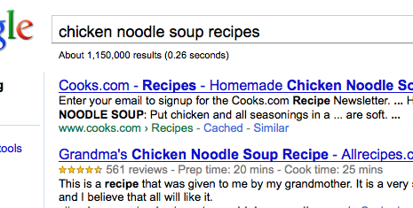
Google’s rich snippets
Embedded metadata (microdata or RDFa) is used to improve search result page
  at the moment only a few vocabularies are recognized, but that will evolve over the years

Slide 51
Effects of, e.g., Google of Facebook
A number of popular sites publish RDFa as part of their normal pages:
  Tesco, BestBuy, Slideshare, The London Gazette, Newsweek, MSNBC, O’Reilly Catalog, the White House…
  Creative Commons snippets are in RDFa (e.g., on Flickr)

Slide 52
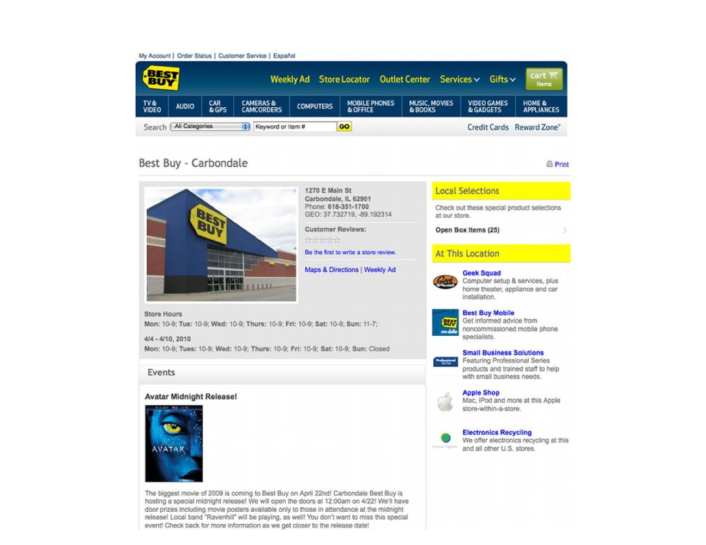
BestBuy xxample of RDFa use
Courtesy of Jay Myers, BestBuy, SemTech2010 Presentation

Slide 53
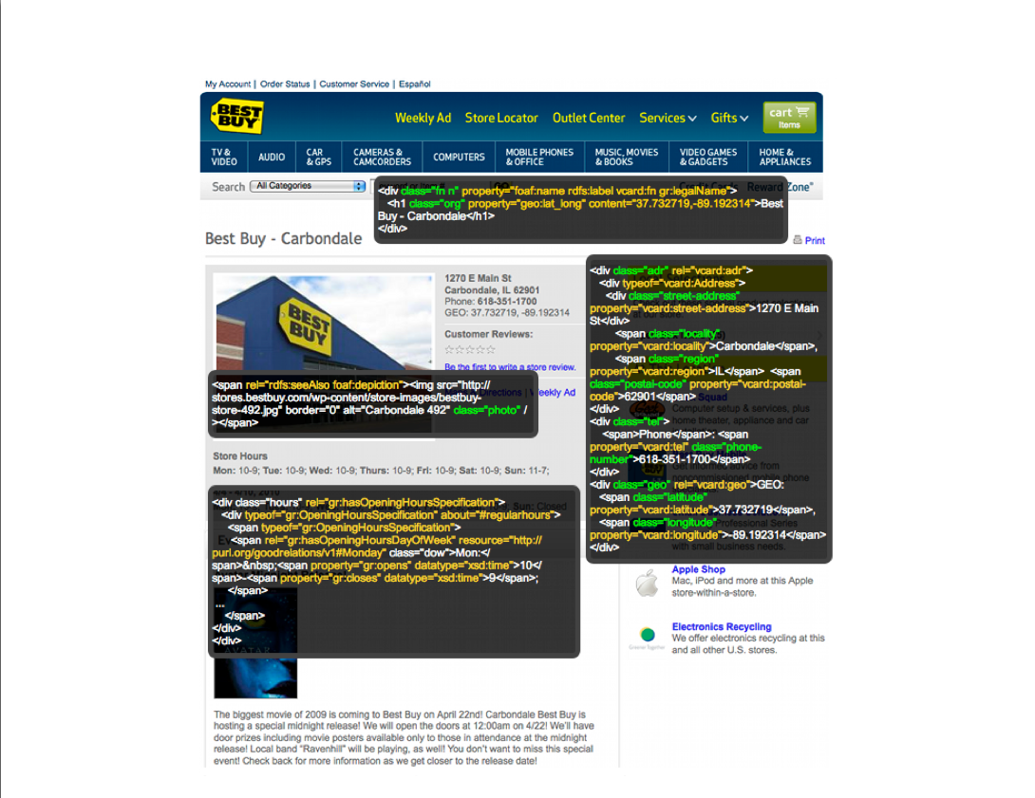
BestBuy example of RDFa Use
Courtesy of Jay Myers, BestBuy, SemTech2010 Presentation

Slide 54
Effects on BestBuy
Reported in a BestBuy blog:
  GoodRelations+RDFa improved Google rank tremendously
  30% increase in traffic on BestBuy store pages
  Yahoo observers a 15% increase in click-through rate
Today, BestBuy uses RDFa for much more than just snippets
  E.g., to locate shops that have certain products on stock…

Slide 55
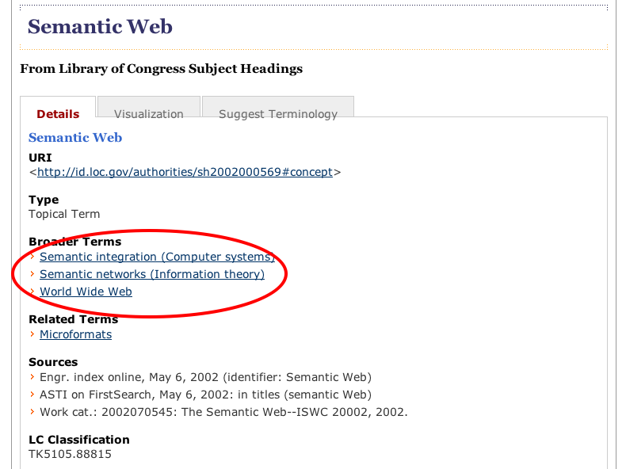
Library of Congress RDFa use

Slide 56
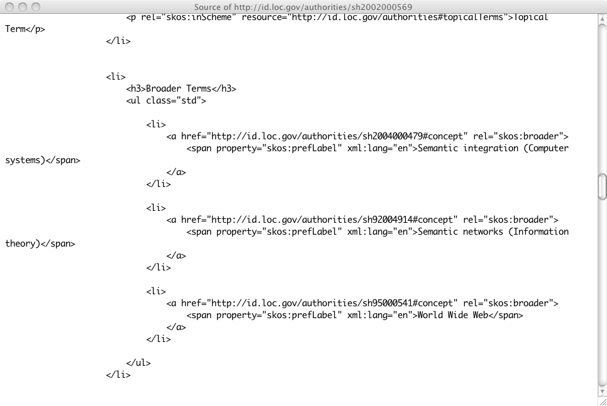
Library of Congress RDFa use

Slide 57
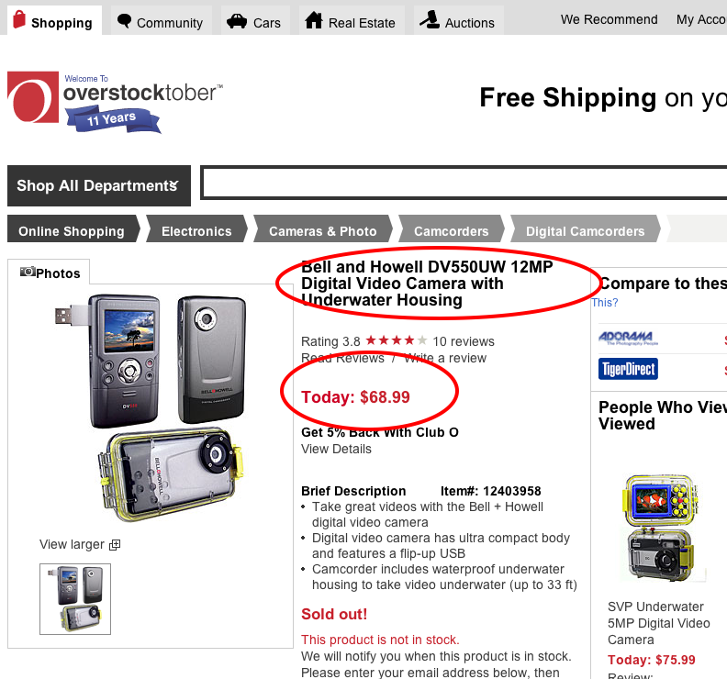
Overstock.com example

Slide 58
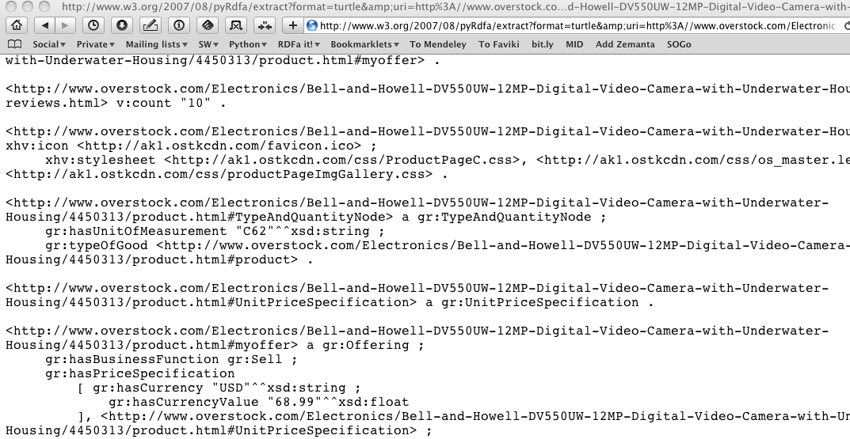
Overstock.com example

Slide 59
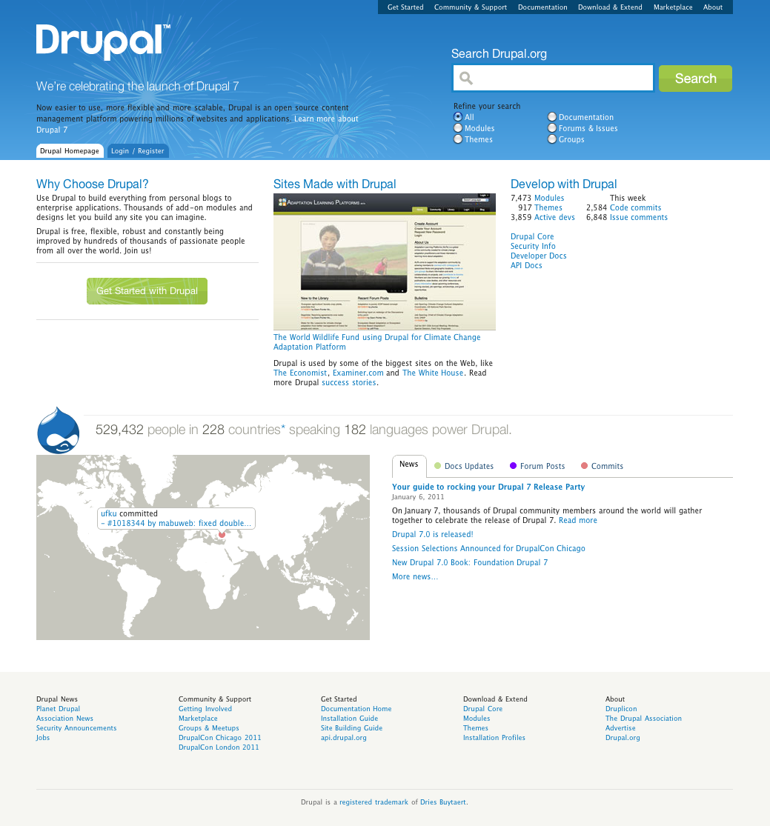
Drupal content management system
RDF support in Drupal v. 7
Major CMS system
Has RDF at his core, pages contain RDFa
In one step millions of pages of additional RDF data!

Slide 60
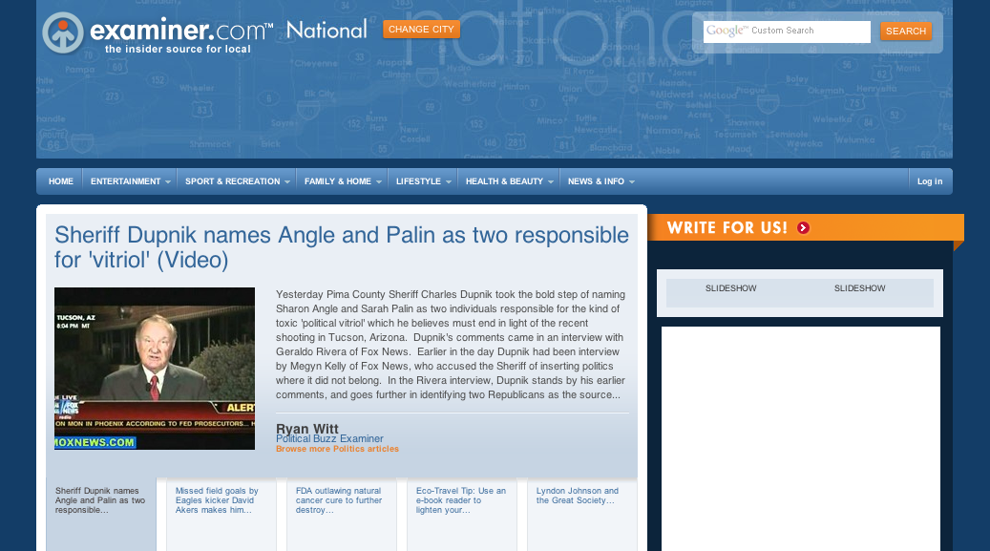
The Examiner.com

Slide 61
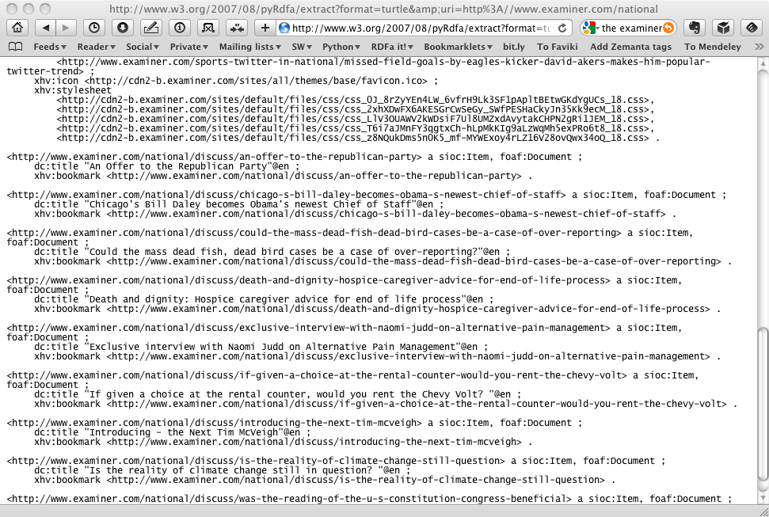
The Examiner.com

Slide 62
Extracting the data
rdfa> python getdata.py "http://www.w3.org/ns/entailment/data/RDFS.html"
@prefix dc: <http://purl.org/dc/terms/> .
@prefix ent: <http://www.w3.org/ns/entailment/> .
…
ent:RDFS a ent:Entailment ;
dc:creator <http://www.ivan-herman.net/foaf#me> ;
dc:date "2010-05-03"^^xsd:date ;
dc:description "Unique identifier for RDFS Entailment" ;
rdfs:comment "The specification for the RDFS entailment is … Semantics W3C Recommendation." ;
rdfs:isDefinedBy <http://www.w3.org/TR/2004/REC-rdf-mt-20040210/#rdfs_entailment> ;
rdfs:seeAlso <http://www.w3.org/TR/2004/REC-rdf-mt-20040210/> .
<http://www.w3.org/ns/entailment/data/RDFS.html> dc:title "Information Resource RDFS Entailment" ;
xhv:stylesheet <http://www.w3.org/StyleSheets/TR/base> .
<http://www.ivan-herman.net/foaf#me> a foaf:Person ;
rdfs:seeAlso <http://www.ivan-herman.net/foaf> ;
foaf:mbox <mailto:ivan@w3.org> ;
foaf:name "Ivan Herman" ;
foaf:title "Semantic Web Activity Lead" ;
foaf:workplaceHomepage <http://www.w3.org> .

Slide 63
getdata.py is very simple
import rdflib, sys
nargs = len(sys.argv)
if not (1 < nargs < 4):
print 'usage: python getdata.py url [ rdfa | rdfa1.1 | microdata | html ]'
print ' eg: python getdata.py "http://www.w3.org/ns/entailment/data/RDFS.html"'
sys.exit(0)
url = sys.argv[1]
format = sys.argv[2] if nargs == 3 else 'rdfa1.1'
g = rdflib.Graph()
g.parse(url, format=format)
print g.serialize(format='n3')

Slide 64
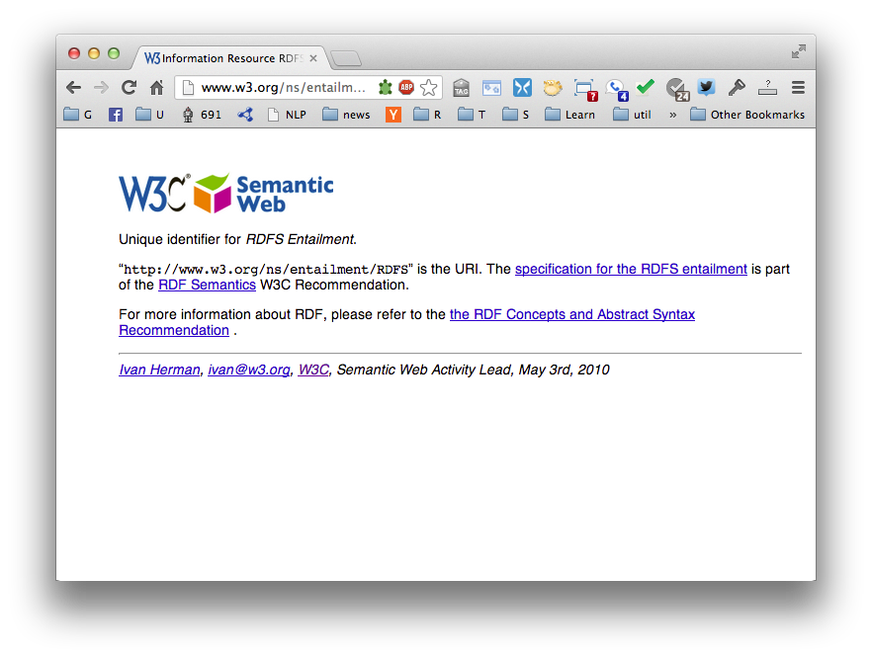
Greenturtle Chrome plugin
https://code.google.com/p/green-turtle/

Slide 65
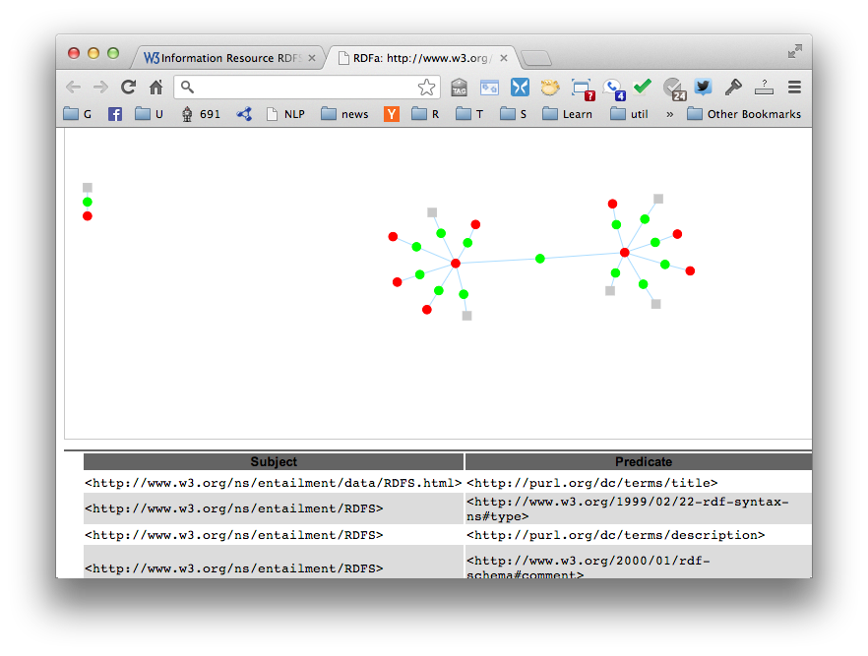
Greenturtle Chrome plugin

Slide 66
Conclusions
Web developers want content providers to add structured data to HTML pages
Content providers are incentivsed to do so because their content will be better understood, ranked higher, more useful, etc.
RDFa is the most powerful and flexible of the knowledge mark up standards understood by search engines
RDFa is also an alternative serialization of full RDF

