Slide 1
An overview of
Semantic Web Languages and Technologies

Slide 2
Semantic Web Technologies
W3C “recommendations”
  RDF, RDFS, RDFa, OWL, SPARQL, …
  Under development: recommendations for rules, provenance, database export, etc.
Common tools and systems -- commercial, free and open sourced
  Ontology editors, triple stores, reasoners, etc.
Common ontologies and data sets
  Foaf, Dbpedia, SKOS, etc.
Infrastructure systems
  Search, ontology metadata, linking services

Slide 3
Common KR languages
Knowledge representation (KR) has always been an important part of AI and other disciplines
Many approaches have been developed, implemented and evolved since the 1960s
Most were one-offs, used only by the developers
Starting in the 1990s, there was an interest in developing a common KR language to support knowledge reuse and distributed KB systems
The Semantic Web languages are the current generation of this idea

Slide 4
Semantic web languages today
Today there are, IOHO, two semantic web languages
  RDF – Resource Description Framework
  http://www.w3.org/RDF/
  DAML+OIL – Darpa Agent Markup Language http://www.daml.org/ (deprecated)
  OWL – Ontology Web Language
  http://www.w3.org/2001/sw/
Topic maps (http://topicmaps.org/) are another species, not based on RDF
Microformats, Common Logic, etc. offer other possibilities

Slide 5
Two Semantic Web Notions
The semantic web
  Idea of a web of machine understandable information
  Agnostic about the technology used to support it
  May involve more AI (e.g., NLP)
  Human end users in the center
The Semantic Web
  The current vision of a semantic web as defined by the W3C community: a web of data
  Using W3C supported standards, i.e., RDF, OWL, SPARQL, XML, RIF, etc.
  By machines for machines with human oriented applications on top

Slide 6
RDF is the first SW language
Graph
XML Encoding
RDF
Data Model
<rdf:RDF ……..>
<….>
<….>
</rdf:RDF>
Good For
Human
Viewing
Good for
Machine
Processing
Triples
stmt(docInst, rdf_type, Document)
stmt(personInst, rdf_type, Person)
stmt(inroomInst, rdf_type, InRoom)
stmt(personInst, holding, docInst)
stmt(inroomInst, person, personInst)
RDF is a simple language for building graph based representations
Good For
Reasoning

Slide 7
The RDF Data Model
An RDF document is an unordered collection of statements, each with a subject, predicate and object (aka triples)
A triple can be thought of as a labelled arc in a graph
Statements describe properties of web resources
A resource is any object that can be pointed to by a URI:
  a document, a picture, a paragraph on the Web, …
  E.g., http://umbc.edu/~finin/cv.html
  a book in the library, a real person (?)
  isbn://5031-4444-3333
Properties themselves are also resources (URIs)

Slide 8
URIs are a foundation
URI = Uniform Resource Identifier
  "The generic set of all names/addresses that are short strings that refer to resources"
  URLs (Uniform Resource Locators) are a subset of URIs, used for resources that can be accessed on the web
URIs look like “normal” URLs, often with fragment identifiers to point to a document part:
  http://foo.com/bar/mumble.html#pitch

Slide 9
URIs are a foundation
URIs are unambiguous, unlike natural language terms -- the web provides a global namespace
A URI denotes something, e.g., a concept, entity or relation
We usually assume references to the same URI are to the same thing

Slide 10
What does a URI mean?
Sometimes URIs denote a web resource
  http://umbc.edu/~finin/finin.jpg denotes a file
  We can use RDF to make assertions about the resource, e.g., it’s an image and depicts a person with name Tim Finin, …
Sometimes concepts in the external world
  E.g., http://umbc.edu/ denotes a particular University located in Baltimore
  This is done by social convention
Cool URIs don’t change
  http://www.w3.org/Provider/Style/URI

Slide 11
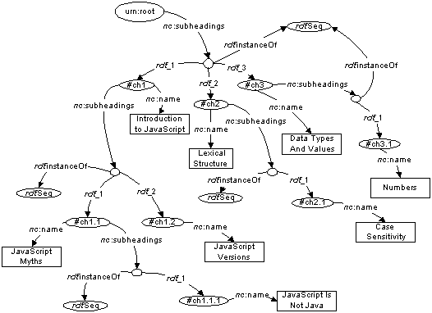
The RDF Graph
An RDF document is an unordered collection of triples
The subject of one triple can be the object of another
So the result is a
directed, labelled
graph
A triple’s object can
also be a literal, e.g.,
a string.

Slide 12
Simple RDF Example
http://umbc.edu/
~finin/talks/idm02/
dc:Title
“Intelligent Information Systems
on the Web”
dc:Creator
bib:Aff
http://umbc.edu/
bib:email
bib:name
“Tim Finin”
“finin@umbc.edu”

Slide 13
Serialization
A graph is an abstract model, we’ll need to serialize it as text for many reasons, e.g., display, editing, exchange
There are several standard RDF serializations, the three most important are: XML, turtle and ntriples
Most Semantic Web tools can read or write in any of these serializations

Slide 14
XML encoding for RDF
<rdf:RDF xmlns:rdf="http://www.w3.org/1999/02/22-rdf-syntax-ns#"
xmlns:dc="http://purl.org/dc/elements/1.1/"
xmlns:bib=http://daml.umbc.edu/ontologies/bib/>
<rdf:Description rdf:about="http://umbc.edu/~finin/talks/idm02/">
<dc:title>Intelligent Information Systems on the Web</dc:title>
<dc:creator>
<rdf:Description>
<bib:Name>Tim Finin</bib:Name>
<bib:Email>finin@umbc.edu</bib:Email>
<bib:Aff rdf:resource="http://umbc.edu/" />
</rdf:Description>
</dc:creator>
</rdf:Description>
</rdf:RDF>

Slide 15
Note the prefix declarations
<rdf:RDF xmlns:rdf="http://www.w3.org/1999/02/22-rdf-syntax-ns#"
xmlns:dc="http://purl.org/dc/elements/1.1/"
xmlns:bib=http://daml.umbc.edu/ontologies/bib/>
<rdf:Description rdf:about="http://umbc.edu/~finin/talks/idm02/">
<dc:title>Intelligent Information Systems on the Web</dc:title>
<dc:creator>
<rdf:Description>
<bib:Name>Tim Finin</bib:Name>
<bib:Email>finin@umbc.edu</bib:Email>
<bib:Aff rdf:resource="http://umbc.edu/" />
</rdf:Description>
</dc:creator>
</rdf:Description>
</rdf:RDF>

Slide 16
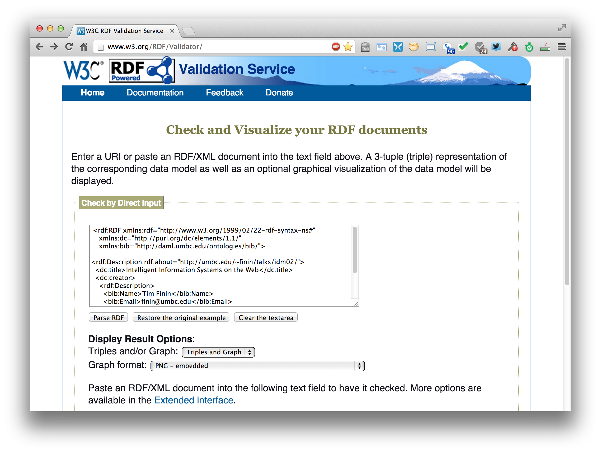
An RDF validation service
http://www.w3.org/RDF/Validator/

Slide 17
Easy to convert between serializations
Most software tools can read and write different serilizations
rdf2rdf is a simple utility that’s handy

Slide 18
N-triple representation
RDF can be encoded as a set of triples.
  <subject> <predicate> <object> .
  <http://umbc.edu/~finin/talks/idm02/> <http://purl.org/dc/elements/1.1/title> "Intelligent Information Systems on the Web" .
  <http://umbc.edu/~finin/talks/idm02/> <http://purl.org/dc/elements/1.1/creator> _:node17i6ht38ux1 .
  _:node17i6ht38ux1 <http://daml.umbc.edu/ontologies/bib/Name> "Tim Finin" .
  _:node17i6ht38ux1 <http://daml.umbc.edu/ontologies/bib/Email> "finin@umbc.edu" .
  _:node17i6ht38ux1 <http://daml.umbc.edu/ontologies/bib/Aff> <http://umbc.edu/> .

Slide 19
N3/Turtle notation for RDF
N3 is a compact notation for RDF that is easier for people to read, write and edit
It’s just “syntactic sugar”
Aka Notation 3, developed by TBL himself
But, XML is largely unreadable and even harder to write
Turtle is a W3C standard that covers most of N3

Slide 20
N3 Example
@prefix rdf: http://www.w3.org/1999/02/22-rdf-syntax-ns# .
@prefix dc: http://purl.org/dc/elements/1.1/ .
@prefix bib: http://daml.umbc.edu/ontologies/bib/ .
<http://umbc.edu/~finin/talks/idm02/>
dc:title "Intelligent Information Systems on the Web" ;
dc:creator
[ bib:Name "Tim Finin";
bib:Email "finin@umbc.edu"
bib:Aff: "http://umbc.edu/" ] .

Slide 21
Triple Notes
RDF triples have one of two forms:
  <URI> <URI> <URI>
  <URI> <URI> <quoted string>
Triples are also easily mapped into logic
  <subject> <predicate> <object> becoming:
    <predicate>(<subject>,<object>)
    With type(<S>,<O>) becoming <O>(<S>)
  Example:
    subclass(man,person)
    sex(man,male)
    domain(sex,animal)
    man(adam)
    age(adam,100)
Triples are easily stored and managed in DBMS
  Flat nature of a triple a good match for relational DBs
; Note: we’re not
; showing the actual
; URIs for clarity

Slide 22

A usecase: FOAF
FOAF (Friend of a Friend) is a simple ontology to describe people and their social networks.
  See the foaf project page: http://www.foaf-project.org/
In 2008 we crawled the web and discovered over 1,000,000 valid RDF FOAF files.
  Most of these are from the http://liveJournal.com/ blogging system which encodes basic user info in foaf
  See http://apple.cs.umbc.edu/semdis/wob/foaf/
<foaf:Person>
  <foaf:name>Tim Finin</foaf:name>
  <foaf:mbox_sha1sum>2410…37262c252e</foaf:mbox_sha1sum>
  <foaf:homepage rdf:resource="http://umbc.edu/~finin/" />
  <foaf:img rdf:resource="http://umbc.edu/~finin/images/passport.gif" />
</foaf:Person>

Slide 23
FOAF Vocabulary
Basics
Agent
Person
name
nick
title
homepage
mbox
mbox_sha1sum
img
depiction (depicts)
surname
family_name
givenname
firstName
Personal Info
weblog
knows
interest
currentProject
pastProject
plan
based_near
workplaceHomepage
workInfoHomepage
schoolHomepage
topic_interest
publications
geekcode
myersBriggs
dnaChecksum
Documents & Images
Document
Image
PersonalProfileDocument
topic (page)
primaryTopic
tipjar
sha1
made (maker)
thumbnail
logo
Online Accts
OnlineAccount
OnlineChatAccount
OnlineEcommerceAccount
OnlineGamingAccount
holdsAccount
accountServiceHomepage
accountName
icqChatID
msnChatID
aimChatID
jabberID
yahooChatID
Projects & Groups
Project Organization
Group member
membershipClass fundedBy
theme

Slide 24
FOAF: why RDF? Extensibility!
FOAF vocabulary provides 50+ basic terms for making simple claims about people
FOAF files can use other RDF terms too: RSS, MusicBrainz, Dublin Core, Wordnet, Creative Commons, blood types, starsigns, …
RDF guarantees freedom of independent extension
  OWL provides fancier data-merging facilities
Result: Freedom to say what you like, using any RDF markup you want, and have RDF crawlers merge your FOAF documents with other’s and know when you’re talking about the same entities.
After Dan Brickley, danbri@w3.org

Slide 25
No free lunch!
Consequence:
We must plan for lies, mischief, mistakes, stale data, slander
Dataset is out of control, distributed, dynamic
Importance of knowing who-said-what
  Anyone can describe anyone
  We must record data provenance
  Modeling and reasoning about trust is critical
Legal, privacy and etiquette issues emerge
Welcome to the real world
After Dan Brickley, danbri@w3.org

Slide 26
More RDF Vocabulary
RDF has terms for describing lists, bags, sequences, etc.
RDF also can describe triples through reification
Enabling statements about statements
  :john bdi:believes _:s.
  _:s rdf:type rdf:Statement.
  _:s rdf:subject <http://ex.com/catalog/widgetX>.
  _:s rdf:predicate cat:salePrice .
  _:s rdf:object "19.95" .

Slide 27
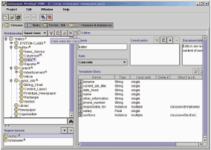
RDF Schema (RDFS)
RDF Schema adds taxonomies for
classes & properties
  subClass and subProperty
and some metadata.
  domain and range
  constraints on properties
Several widely used
KB tools can import
and export in RDFS
Stanford Protégé KB editor
Java, open sourced
extensible, lots of plug-ins
provides reasoning & server capabilities

Slide 28
RDFS Vocabulary
RDFS introduces the following terms and gives each a meaning w.r.t. the rdf data model
Terms for classes
  rdfs:Class
  rdfs:subClassOf
Terms for properties
  rdfs:domain
  rdfs:range
  rdfs:subPropertyOf
Special classes
  rdfs:Resource
  rdfs:Literal
  rdfs:Datatype
Terms for collections
  rdfs:member
  rdfs:Container
  rdfs:ContainerMem-bershipProperty
Special properties
  rdfs:comment
  rdfs:seeAlso
  rdfs:isDefinedBy
  rdfs:label

Slide 29
RDF and RDF Schema
<rdfs:Property rdf:ID=“name”>
<rdfs:domain rdf:resource=“Person”>
</rdfs:Property>
<rdfs:Class rdf:ID=“Chair”>
<rdfs:subclassOf rdf:resource=
“http://schema.org/gen#Person”>
</rdfs:Class>
rdfs:Class
rdfs:Property
rdf:type
rdf:type
rdf:type
g:Person
rdfs:domain
<rdf:RDF
xmlns:g=“http://schema.org/gen”
xmlns:u=“http://schema.org/univ”>
<u:Chair rdf:ID=“john”>
<g:name>John Smith</g:name>
</u:Chair>
</rdf:RDF>
rdfs:subclassOf
u:Chair
g:name
rdf:type
g:name
John Smith

Slide 30
RDFS supports simple inferences
New and
Improved!
100% Better
than XML!!
An RDF ontology plus some RDF statements may imply additional RDF statements.
This is not true of XML.
Note that this is part of the data model and not of the accessing or processing code.
@prefix rdfs: <http://www.....>.
@prefix : <genesis.n3>.
:parent rdfs:domain :Person;
  rdfs:range :Person.
  :mother rdfs:subProperty parent;
  rdfs:domain Woman;
  rdfs:range Person
  :eve :mother :cain.
:parent a rdf:Property.
:Person a rdf:Class.
:Woman rdfs:subClassOf Person.
:mother a rdf:Property.
:eve a :Person;
a :Woman;
:parent :cain.
:cain a :Person.

Slide 31
N3 example
Here’s how you declare a namespace.
<> Is an alias for the URI of this document.
This defines the “empty prefix” as refering to “this document”
@prefix rdf: <http://www.w3.org/1999/02/22-rdf-syntax-ns#>.
@prefix rdfs: <http://www.w3.org/2000/01/rdf-schema#>.
@prefix : <#> .
<> rdfs:comment “This is an N3 example”.
:Person a rdfs:Class.
:Woman a rdfs:Class; rdfs:subClassOf :Person.
:eve a :Woman; :age “100”.
:sister a rdf:Property; rdfs:domain :Person;
rdfs:range :Woman.
:eve :sister [a :Woman; :age 98].
:eve :believe {:eve :age “100”}.
[is :spouse of [is :sister of :eve]] :age 99.
:eve.:sister.:spouse :age 99.
“person is a class”. The “a” syntax is sugar for rdf:type property.
“Woman is a class and a subclass of person”. Note the ; syntax.
“eve is a woman whose age is 100.”
“sister is a property from person to woman”
“eve has a sister who is a 98 year old woman”. The brackets introduce an anonymous resource.
“eve believes that her age is 100”. The braces introduce a reified triple.
“the spouse of the sister of eve is 99”.
“the spouse of the sister of eve is 99”.

Slide 32
Is RDF(S) better than XML?
Q: For a specific application, should I use XML or RDF?
A: It depends…
XML's model is
  a tree, i.e., a strong hierarchy
  applications may rely on hierarchy position
  relatively simple syntax and structure
  not easy to combine trees
RDF's model is
  a loose collections of relations
  applications may do database-like search
  not easy to recover hierarchy
  easy to combine relations in one big collection
  great for the integration of heterogeneous information

Slide 33
From where will the markup come?
A few authors will add it manually.
More will use annotation tools.
  SMORE: Semantic Markup, Ontology and RDF Editor
Intelligent processors (e.g., NLP) can understand documents and add markup (hard)
  Machine learning powered information extraction tools show promise
Lots of web content comes from databases & we can generate SW markup along with the HTML
  See http://ebiquity.umbc.edu/

Slide 34
From where will the markup come?
In many tools, part of the metadata information is present, but thrown away at output
  e.g., a business chart can be generated by a tool…
  …it “knows” the structure, the classification, etc. of the chart
  …but, usually, this information is lost
  …storing it in metadata is easy!
So “semantic web aware” tools can produce lots of metadata
  E.g., Adobe’s use of its XMP platform

Slide 35
Problems with RDFS
RDFS too weak to describe resources in detail, e.g.
  No localised range and domain constraints
    Can’t say that the range of hasChild is person when applied to persons and dog when applied to dogs
  No existence/cardinality constraints
    Can’t say that all instances of person have a mother that is also a person, or that persons have exactly 2 parents
  No transitive, inverse or symmetrical properties
    Can’t say isPartOf is a transitive property, hasPart is the inverse of isPartOf or touches is symmetrical
We need RDF terms providing these and other features.

Slide 36
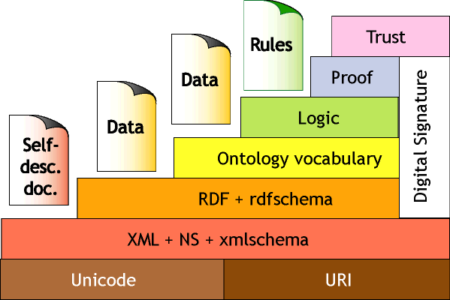
DAML+OIL = RDF + KR
DAML = Darpa Agent Markup Language
  DARPA program with 17 projects & an integrator developing language spec, tools, applications for SW.
OIL = Ontology Inference Layer
  An EU effort aimed at developing a layered approach to representing knowledge on the web.
Process
  Joint Committee: US DAML and EU Semantic Web Technologies participants
  DAML+OIL specs released in 2001
  See http://www.daml.org/
  Includes model theoretic and axiomatic
  semantics
DAML+OIL

Slide 37
W3C’s Web Ontology Language (OWL)
DAML+OIL begat OWL.
OWL released as W3C recommendation 2/10/04
See the W3C OWL pages for overview, guide, specification, test cases, etc.
Three layers of OWL are defined of decreasing levels of complexity and expressiveness
  OWL Full is the whole thing
  OWL DL (Description Logic) introduces
  restrictions
  OWL Lite is an entry level language
  intended to be easy to understand
  and implement
Owl 2 became a W3C recommendation in 2009
OWL

Slide 38
OWL ↔ RDF
An OWL ontology is a set of RDF statements
  OWL defines semantics for certain statements
  Does NOT restrict what can be said -- documents can include arbitrary RDF
  But no OWL semantics for non-OWL statements
Adds capabilities common to description logics, e.g., cardinality constraints, defined classes, equivalence, disjoint classes, etc.
Support for ontologies as objects (e.g., importing, versioning, …
But not (yet) variables, quantification, & rules
A complete OWL reasoning is significantly more complex than a complete RDFS reasoner.

Slide 39
Owl is based on Description Logic
DL is a family of KR languages that might be described as “Logic meets Objects”
DL is characterized by a set of constructors that allow one to build complex concepts and roles from atomic ones
  Concepts correspond to classes; interpreted as sets of objects
  Roles correspond to relations; interpreted as binary relations on objects
Axioms assert facts about concepts, roles & individuals
Distinguished by:
  Formal semantics for a decidable fragment of FOL
  Sound and complete procedures for key problems
  Many implemented systems, some highly optimized

Slide 40
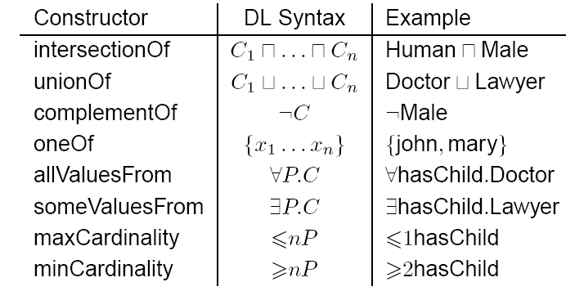
OWL Class Constructors
borrowed from Ian Horrocks

Slide 41
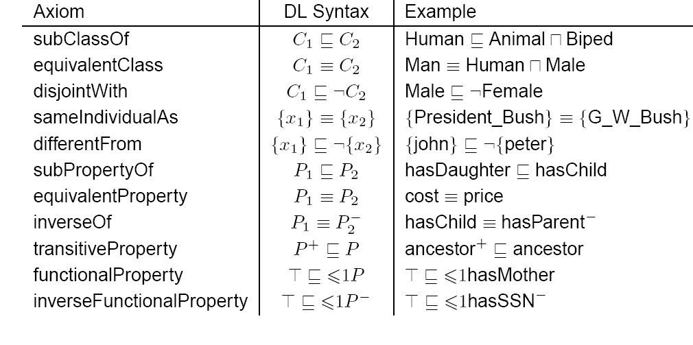
OWL Axioms
borrowed from Ian Horrocks

Slide 42
OWL Language
Three species of OWL
  OWL Full is union of OWL syntax and RDF
  OWL DL restricted to FOL fragment (≅ DAML+OIL)
  OWL Lite is “simpler” subset of OWL DL
Semantic layering
  OWL DL ≅ OWL full within DL fragment
OWL DL based on SHIQ Description Logic
OWL DL Benefits from many years of DL research
  Well defined semantics
  Formal properties well understood (complexity, decidability)
  Known reasoning algorithms
  Implemented systems (highly optimised)

Slide 43
OWL Lite Features
RDF Schema Features
  Class, rdfs:subClassOf , Individual
  rdf:Property, rdfs:subPropertyOf
  rdfs:domain , rdfs:range
Equality and Inequality
  sameClassAs , samePropertyAs , sameIndividualAs
  differentIndividualFrom
Restricted Cardinality
  minCardinality, maxCardinality (restricted to 0 or 1)
  cardinality (restricted to 0 or 1)
Property Characteristics
  inverseOf , TransitiveProperty , SymmetricProperty
  FunctionalProperty(unique) , InverseFunctionalProperty
  allValuesFrom, someValuesFrom (universal and existential local range restrictions)
Datatypes
  Following the decisions of RDF Core.
Header Information
  imports , Dublin Core Metadata , versionInfo

Slide 44
OWL Features
Class Axioms
  oneOf (enumerated classes)
  disjointWith
  sameClassAs applied to class expressions
  rdfs:subClassOf applied to class expressions
Boolean Combinations of Class Expressions
  unionOf
  intersectionOf
  complementOf
Arbitrary Cardinality
  minCardinality
  maxCardinality
  cardinality
Filler Information
  hasValue Descriptions can include specific value information

Slide 45
OWL Ontologies
The owl:Ontology class describes an ontology
An ontology file should be one instance of owl:Ontology
Ontology properties include
  owl:imports, owl:versionInfo, owl:priorVersion
  owl:backwardCompatibleWith, owl:incompatibleWith
  rdfs:label, rdfs:comment can also be used
Deprecation control classes:
  owl:DeprecatedClass, owl:DeprecatedProperty types

Slide 46
OWL in One Slide
OWL is built on top of XML and RDF
<rdf:RDF xmlns:rdf ="http://w3.org/22-rdf-syntax-ns#"
xmlns:rdfs=http://w3.org/rdf-schema#> xmlns:owl="http://www.w3.org/2002/07/owl#”>
<owl:Ontology rdf:about="">
<owl:imports rdf:resource="http://owl.org/owl+oil"/>
</owl:Ontology>
<owl:Class rdf:ID="Person">
<rdfs:subClassOf rdf:resource="#Animal"/>
<rdfs:subClassOf>
<owl:Restriction>
<owl:onProperty rdf:resource="#hasParent"/>
<owl:allValuesFrom rdf:resource="#Person"/>
</owl:Restriction>
</rdfs:subClassOf>
<rdfs:subClassOf>
<owl:Restriction owl:cardinality="1">
<owl:onProperty rdf:resource="#hasFather"/>
</owl:Restriction>
</rdfs:subClassOf>
</owl:Class>
<Person rdf:about=“http://umbc.edu/~finin/">
<rdfs:comment>Finin is a person.</rdfs:comment>
</Person>
It allows the definition, sharing, composition and use of ontologies
OWL is ~= a frame based knowledge representation language
It can be used to add metadata about anything which has a URI.
URIs are a W3C standard generalizing URLs
everything has a URI

Slide 47
RDFa
RDFa is a W3C recommendation for embed-ding SW markup in HTML as tag attributed
= RDF in

Slide 48
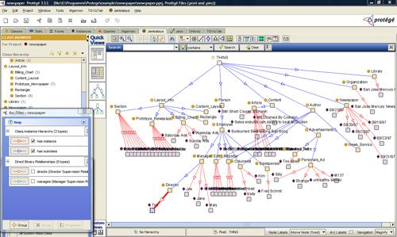
Ontology Editor
There are a number of editors available for creating and editing ontologies and data
We recommend using Protégé, a java-based free system developed at Stanford
  Good support for reasoning
  Lots of plugins

Slide 49
Triple Stores
A triple store is a database for RDF triples
It usually has a native API and often accepts SPARQL queries
It might do reasoning, either in an eager manner (as triples are loaded) or on demand (to answer queries), etc
Some stores focus on scalability and others on flexibility and features
We’ll look at several, including Sesame, Apache Jena and stardog

Slide 50
Frameworks and Libraries
There are frameworks, libraries and packages for most programming languages
RDFLib is a popular library for Python that we will study
Jena is a very comprehensive Java framework originally developed by HP and now Apache
Redlands is set of libraries for using RDF in C
Others are available for Ruby, C#, Perl, PHP, Lisp, etc.

