Slide 1
CMSC 491/691
A Web of Data
Administrivia
Spring 2013

Slide 2
Administrivia
Course objectives
Resources
Structure
Homework assignments
Project
491 vs. 691

Slide 3
Course Objectives
Understand SW concepts, motivation and goals
Be able to create and use SW ontologies
Understand the different kinds of SW reasoning
Familiarity with SW languages and standards
Create, consume & manipulate SW data
Ability to use SW software tools and systems
Know alternatives: XML, JSON, Microdata
Ability to define and implement a SW project

Slide 4
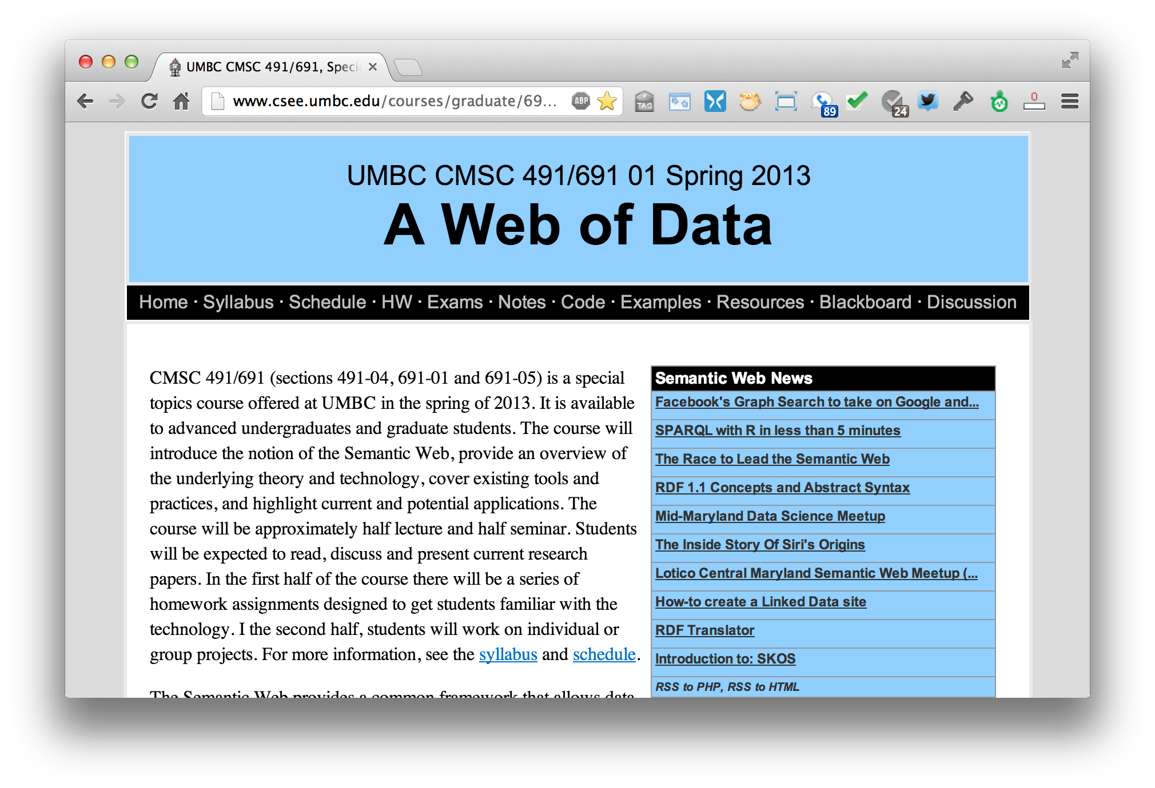
Web resources: http://bit.ly/691S13

Slide 5
Grading
Grades will be based on participation, homework, exam, and project
Participation includes in class & on Piazza
6-8 short homework assignments
  Will experiment with peer assessment
  Submission details TBD
In class exam near middle of term
Projects can be individual or small groups and will have a proposal and final report

Slide 6
Instructor availability
Instructor: Professor Finin
Official office hours: by arrangement
Drop in whenever my door is open
Direct general questions (i.e., those that other students may also be wondering about and that Google can’t answer) to Piazza first
We will try to respond to postings on the discussion list or private email messages within 24 hours
TA: Yang Kang, kangyan1@umbc.edu, officehours: Mon/Wed 3:00 – 4:00

Slide 7
Programming, etc.
The homework assignments will require using various systems and tools
Some will require programming, which can be done in a language of your choice (e.g., Java, Python)
Our examples will be demonstrated in Unix (Linux or MAC OS X), but most can be made to work on Windows
Having a web server on your own computer may be useful

