Slide 1

Making the Semantic Web Easier to Use
Tim Finin
University of Maryland, Baltimore County
Joint work with Lushan Han, Varish Mulwad, Anupam Joshi
Presented at the Workshop on Data Engineering Meets the Semantic Web
of the IEEE International Conference on Data Engineering, 1 April 2012
http://ebiq.org/r/339

Slide 2
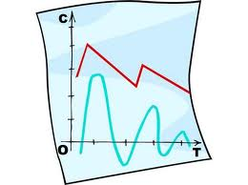
Overview
Linked Open Data 101
Two ongoing UMBC dissertations
  Varish Mulwad, Generating linked data from tables
  Lushan Han, Querying linked data with a quasi-NL interface

Slide 3
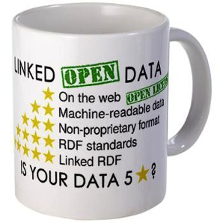
Linked Open Data (LOD)
Linked data is just RDF data, typically
just the instances (ABOX), not schema (TBOX)
RDF data is a graph of triples
  URI URI string
  dbr:Barack_Obama dbo:spouse “Michelle Obama”
  URI URI URI
  dbr:Barack_Obama dbo:spouse dbpedia:Michelle_Obama
Best linked data practice prefers the 2nd pattern, using nodes rather than strings for “entities”
Liked open data is just linked data freely accessible on the Web along with any required ontologies

Slide 4
Semantic Web
Use Semantic Web Technology to publish shared data & knowledge
Semantic web technologies allow machines to share data and knowledge using common web language and protocols.
~ 1997
Semantic Web beginning

Slide 5
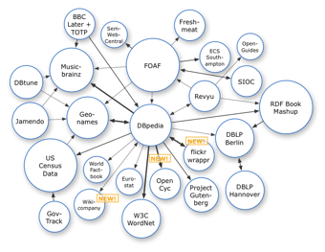
Semantic Web => Linked Open Data
Use Semantic Web Technology to publish shared data & knowledge
2007
Data is inter-
linked to support inte-
gration and fusion of knowledge
LOD beginning

Slide 6
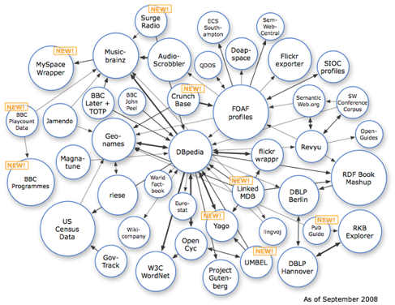
Semantic Web => Linked Open Data
Use Semantic Web Technology to publish shared data & knowledge
2008
Data is inter-
linked to support inte-
gration and fusion of knowledge
LOD growing

Slide 7
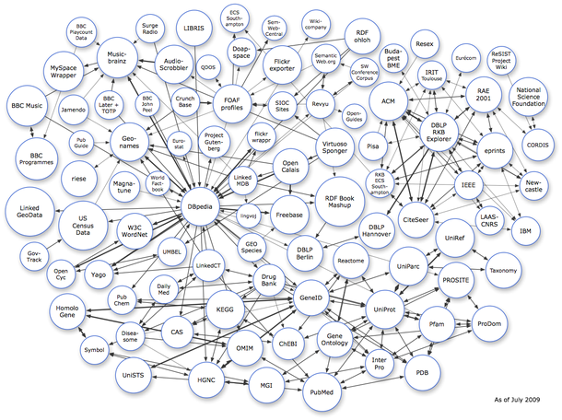
Semantic Web => Linked Open Data
Use Semantic Web Technology to publish shared data & knowledge
2009
Data is inter-
linked to support inte-
gration and fusion of knowledge
… and growing

Slide 8
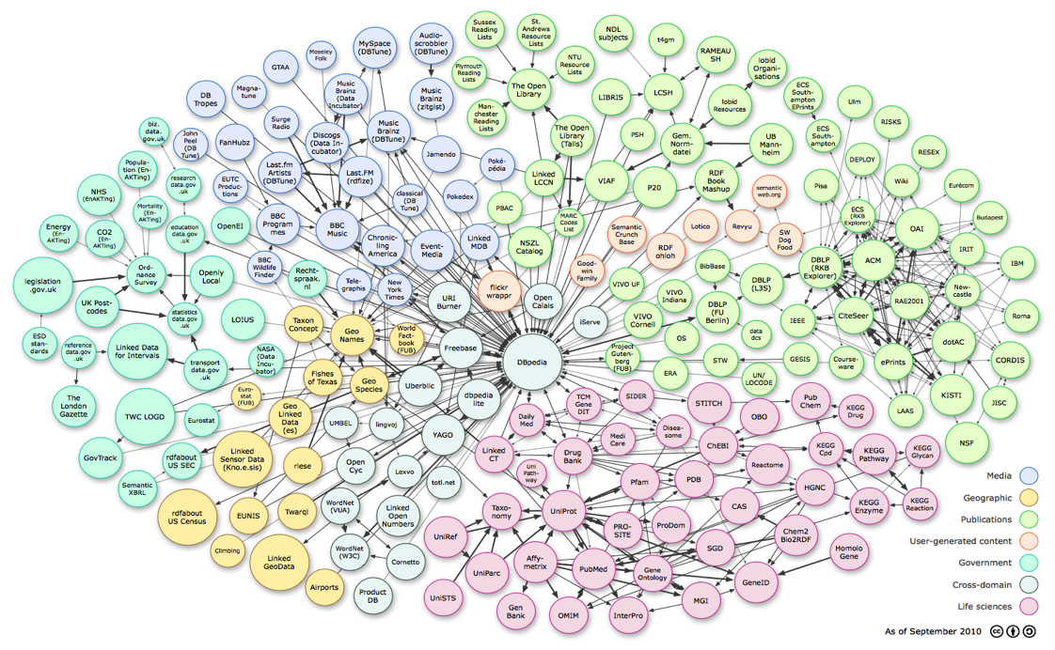
Linked Open Data
Use Semantic Web Technology to publish shared data & knowledge
LOD is the new Cyc: a common source of background
knowledge
Data is inter-
linked to support inte-
gration and fusion of knowledge
2010
…growing faster

Slide 9
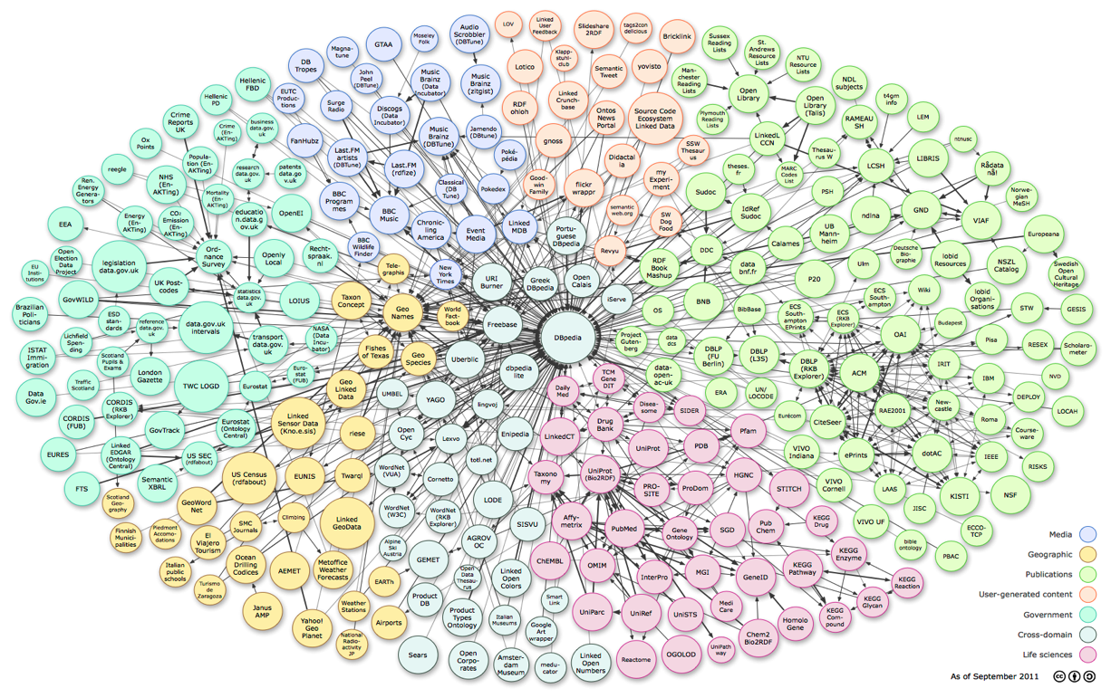
Linked Open Data
Use Semantic Web Technology to publish shared data & knowledge
LOD is the new Cyc: a common source of background
knowledge
Data is inter-
linked to support inte-
gration and fusion of knowledge
2011: 31B facts in 295 datasets interlinked by 504M assertions on ckan.net

Slide 10

Exploiting LOD not (yet) Easy
Publishing or using LOD data has
inherent difficulties for the potential user
  It’s difficult to explore LOD data and to query it for answers
  It’s challenging to publish data using appropri-ate LOD vocabularies & link it to existing data
Problem: O(10⁴) schema terms, O(10¹¹) instances
I’ll describe two ongoing research projects that are addressing these problems

Slide 11
Generating Linked Data by Inferring the
Semantics of Tables
Research with Varish Mulwad
http://ebiq.org/j/96

Slide 12
Goal: Table => LOD*
dbprop:team
http://dbpedia.org/class/yago/NationalBasketballAssociationTeams
Name | Team | Position | Height
Michael Jordan | Chicago | Shooting guard | 1.98
Allen Iverson | Philadelphia | Point guard | 1.83
Yao Ming | Houston | Center | 2.29
Tim Duncan | San Antonio | Power forward | 2.11
http://dbpedia.org/resource/Allen_Iverson
Player height in meters
* DBpedia

Slide 13
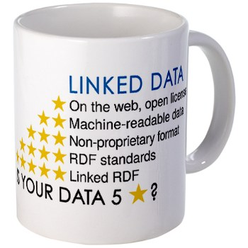
Goal: Table => LOD*
Name | Team | Position | Height
Michael Jordan | Chicago | Shooting guard | 1.98
Allen Iverson | Philadelphia | Point guard | 1.83
Yao Ming | Houston | Center | 2.29
Tim Duncan | San Antonio | Power forward | 2.11
@prefix dbpedia: <http://dbpedia.org/resource/> .
@prefix dbo: <http://dbpedia.org/ontology/> .
@prefix yago: <http://dbpedia.org/class/yago/> .
"Name"@en is rdfs:label of dbo:BasketballPlayer .
"Team"@en is rdfs:label of yago:NationalBasketballAssociationTeams .
"Michael Jordan"@en is rdfs:label of dbpedia:Michael Jordan .
dbpedia:Michael Jordan a dbo:BasketballPlayer .
"Chicago Bulls"@en is rdfs:label of dbpedia:Chicago Bulls .
dbpedia:Chicago Bulls a yago:NationalBasketballAssociationTeams .
RDF Linked Data
All this in a completely automated way
* DBpedia

Slide 14

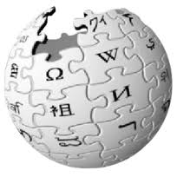


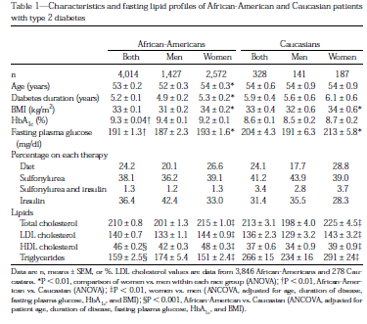


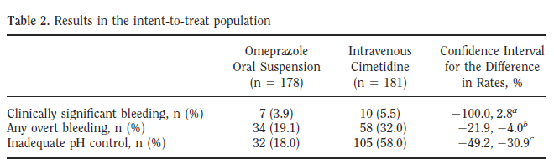
Tables are everywhere !! … yet …
The web – 154 million high quality relational tables
Notes:
Why do we want to interpret tables

Slide 15
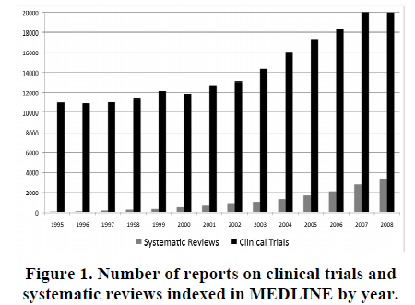
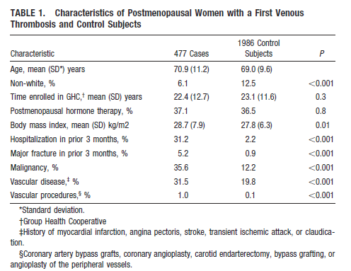
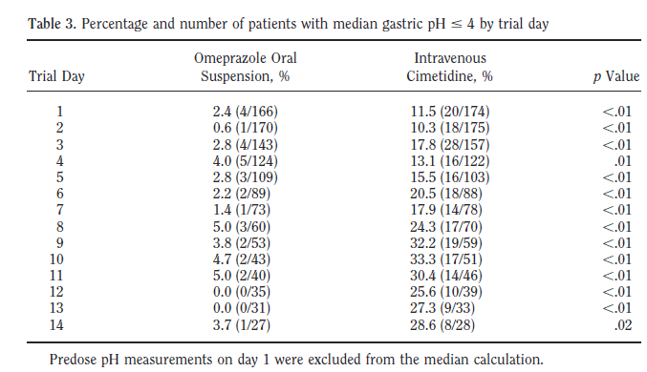
Evidence–based medicine
Evidence-based medicine judges the efficacy of treatments or tests by meta-analyses of clinical trials. Key information is often found in tables in articles
# of Clinical trials published in 2008
# of meta analysis published in 2008
However, the rate at which meta-analyses are published remains very low … hampers effective health care treatment …
Figure: Evidence-Based Medicine - the Essential Role of Systematic Reviews, and the Need for Automated Text Mining Tools, IHI 2010

Slide 16




~ 400,000 datasets
~ < 1 % in RDF

Slide 17
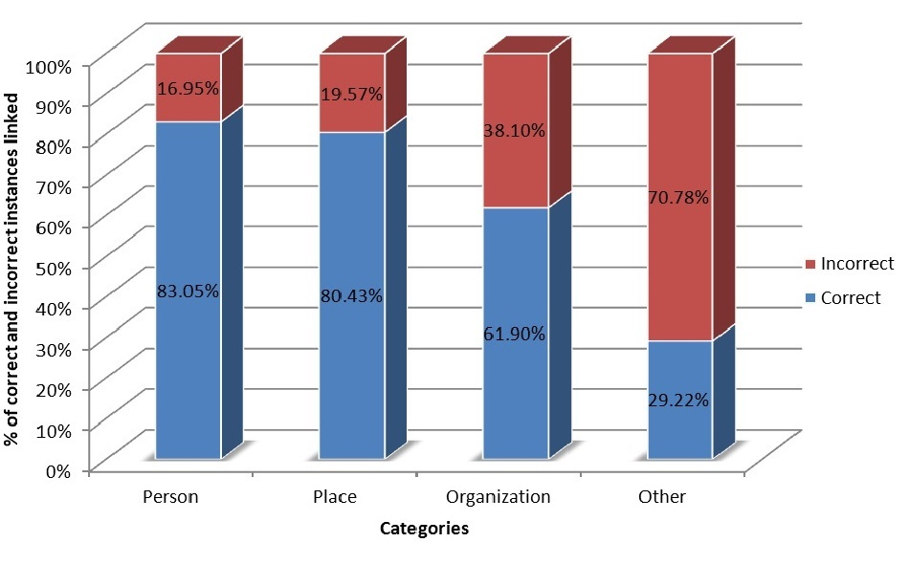


2010 Preliminary System
T2LD Framework
Predict Class for Columns
Linking the table cells
Identify and Discover relations
Class prediction for column: 77%
Entity Linking for table cells: 66%
Examples of class label prediction results:
Column – Nationality
Prediction – MilitaryConflict
Column – Birth Place
Prediction – PopulatedPlace

Slide 18

Sources of Errors
The sequential approach let errors perco-late from one phase to the next
The system was biased toward predicting overly general classes over more appropriate specific ones
Heuristics largely drive the system
Although we consider multiple sources of evidence, we did not joint assignment

Slide 19
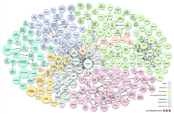

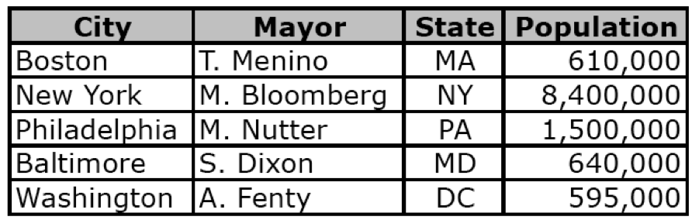
A Domain Independent Framework
Pre-processing modules
Sampling
Acronym detection
Query and generate initial mappings
Joint Inference/Assignment
2
1
Generate Linked RDF
Verify (optional)
Store in a knowledge base & publish as LOD

Slide 20


Query Mechanism
Team
Michael Jordan | Chicago Bulls | Shooting Guard | 1.98
{dbo:Place,dbo:City,yago:WomenArtist,yago:LivingPeople,yago:NationalBasketballAssociationTeams…}
Chicago Bulls, Chicago, Judy Chicago …
………
possible types
possible entities

Slide 21
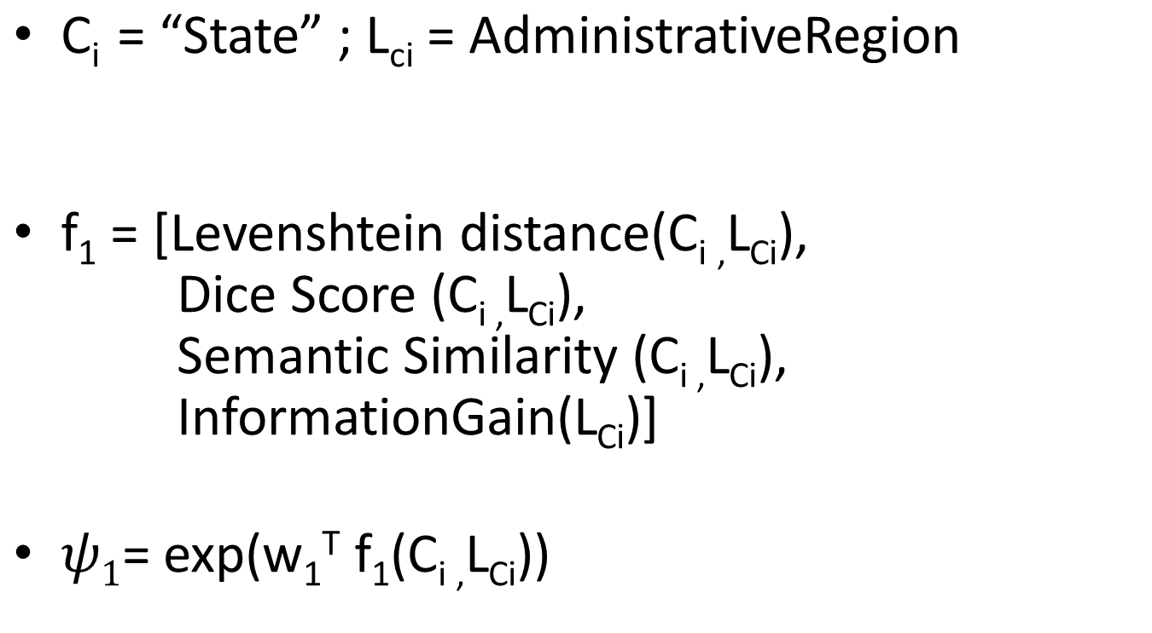
Ranking the candidates
String in column header
Class from an ontology
String similarity metrics

Slide 22
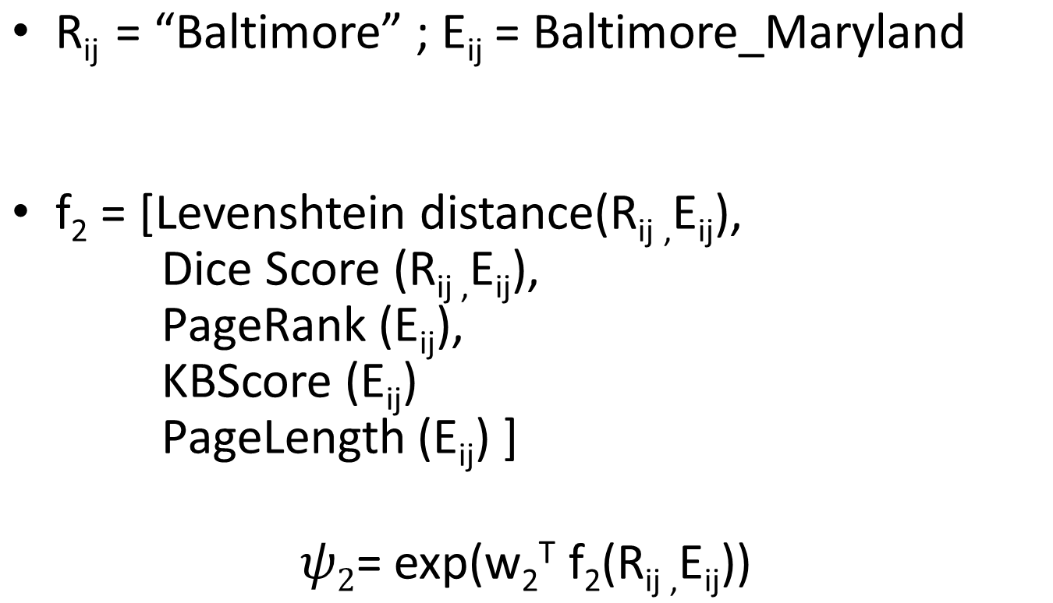
Ranking the candidates
String in table cell
Entity from the knowledge base (KB)
String similarity metrics
Popularity metrics

Slide 23

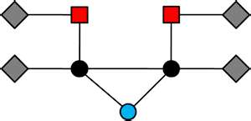
Joint Inference over evidence in a table
Probabilistic Graphical Models

Slide 24
A graphical model for tables
Joint inference over evidence in a table
Class
C1
C2
C3
Team
Chicago
Philadelphia
Houston
San Antonio
R11
R21
R31
R12
R22
R32
R13
R23
R33
Instance

Slide 25






Parameterized graphical model
Captures interaction between row values
$$ψ4$$
$$ψ4$$
$$ψ4$$
R11
R12
R13
R21
R22
R23
R31
R32
R33
$$ψ3$$
$$ψ3$$
$$ψ3$$
Row value
C1
C2
Factor Node
C3
Function that captures the affinity between the column headers and row values
Variable Node: Column header
$$ψ5$$
Captures interaction between column headers

Slide 26
Challenge: Interpreting Literals
Many columns have literals, e.g., numbers
Population
690,000
345,000
510,020
120,000
Age
75
65
50
25
Age in years?
Percent?
Population?
Profit in $K ?
Predict properties based on cell values
Cyc had hand coded rules: humans don’t live past 120
We extract value distributions from LOD resources
  Differ for subclasses: age of people vs. political leaders vs. athletes
  Represent as measurements: value + units
Metric: possibility/probability of values given distribution

Slide 27

Other Challenges
Using table captions and other text is associated documents to provide context
Size of some data.gov tables (> 400K rows!) makes using full graphical model impractical
  Sample table and run model on the subset
Achieving acceptable accuracy may require human input
  100% accuracy unattainable automatically
  How best to let humans offer advice and/or correct interpretations?

Slide 28

PMI as an association measure
We use pointwise mutual information (pmi) to measure the association between two RDF resources (nodes)
pmi is used for word association by comparing how often two words occur together in text to their expected co-occurrence if independent

Slide 29
PMI for RDF instances
For text, the co-occurrence context is usually a window of some number of words (e.g, 50)
For RDF instances, we count three graph patterns as instances of the co-occurrence of N1 and N2
N1
N1
N1
N2
N2
N2
Other graph patterns can be added, but we’ve not evaluated their utility or cost to compute.

Slide 30
PMI for RDF types
We also want to measure the association strength between RDF types, e.g., a dbo:Actor associated with a dbo:Film vs. a dbo:Place
We can also measure the association of an RDF property and types, e.g. dbo:author used with a dbo:Film vs. a dbo:Book
Such simple statistics can be efficiently computed for large RDF collections in parallel
prefix dbo: <http://dbpedia.org/ontology/>

Slide 31
GoRelations:
Intuitive Query System for Linked Data
Research with Lushan Han
http://ebiq.org/j/93

Slide 32
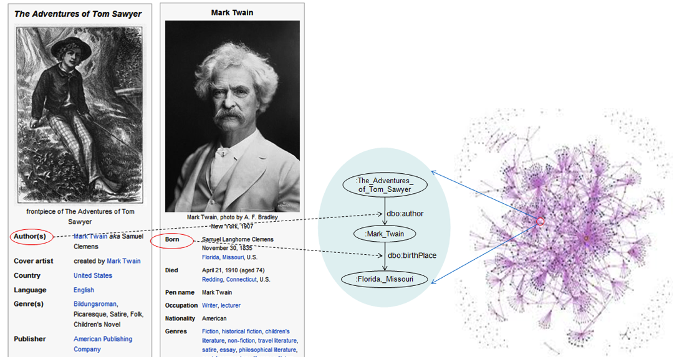
Dbpedia is the Stereotypical LOD
DBpedia is an important example of Linked Open Data
  Extracts structured data from Infoboxes in Wikipedia
  Stores in RDF using custom ontologies Yago terms
The major integration point for the entire LOD cloud
Explorable as HTML, but harder to query in SPARQL
DBpedia

Slide 33
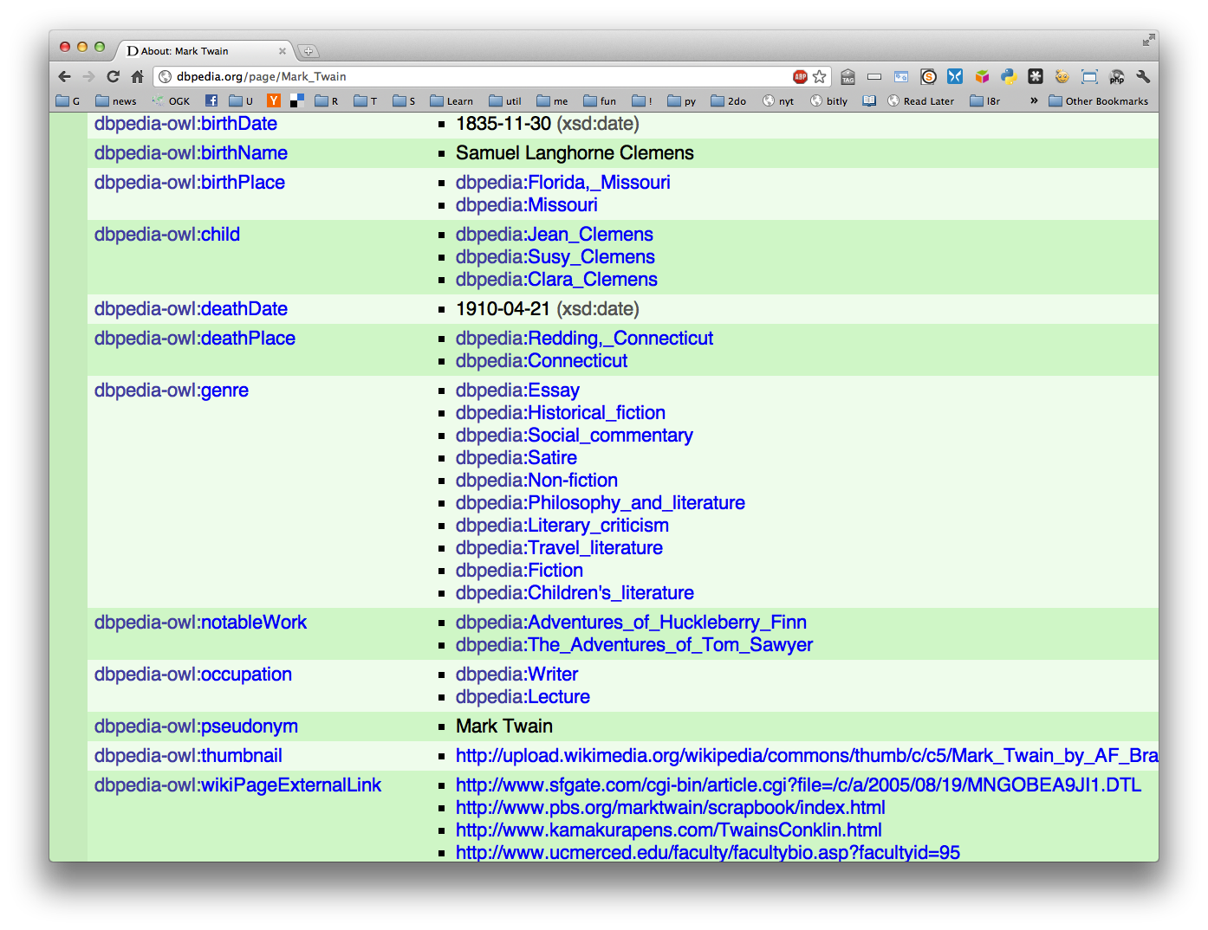
Browsing DBpedia’s Mark Twain

Slide 34
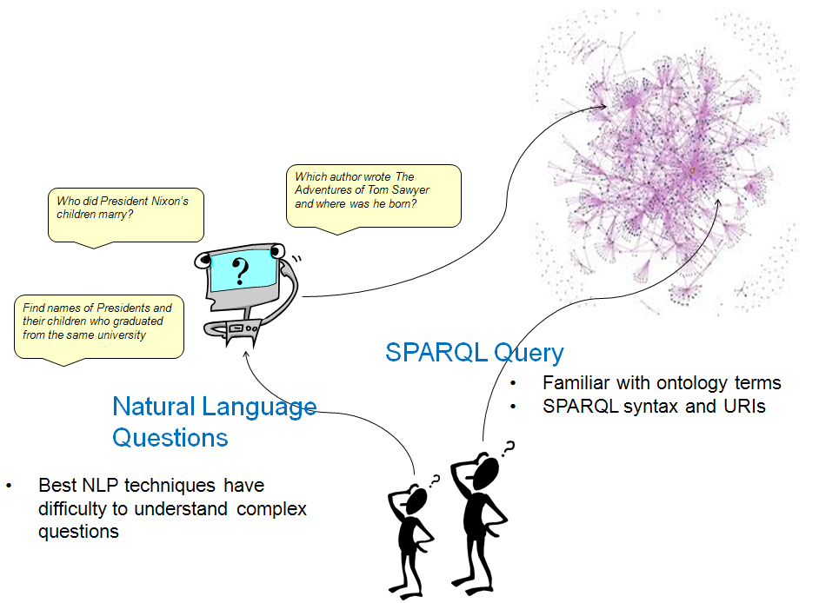


Querying LOD is Much Harder
Querying DBpedia requires a lot of a user
  Understand the RDF model
  Master SPARQL, a formal query language
  Understand ontology terms: 320 classes & 1600 properties !
  Know instance URIs (>1M entities !)
  Term heterogeneity (Place vs. PopulatedPlace)
Querying large LOD
sets overwhelming
Natural language
query systems still
a research goal

Slide 35

Goal
Allow a user with a basic understanding of RDF to query DBpedia and ultimately distrib-uted LOD collections
  To explore what data is in the system
  To get answers to question
  To create SPARQL queries for reuse or adaptation
Desiderata
  Easy to learn and to use
  Good accuracy (e.g., precision and recall)
  Fast

Slide 36

Key Idea
Structured keyword queries
Reduce problem complexity by:
  User enters a simple graph, and
  Annotates the nodes and arcs with words and phrases

Slide 37

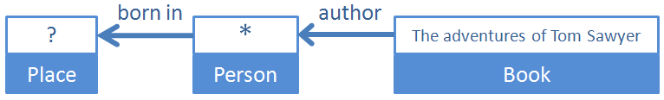
Structured Keyword Queries
Nodes denote entities and links binary relations
Entities described by two unrestricted terms: name or value and type or concept
Result entities marked with ? and those not with *
A compromise between a natural language Q&A system and SPARQL
  Users provide compositional structure of the question
  Free to use their own terms in annotating the structure

Slide 38
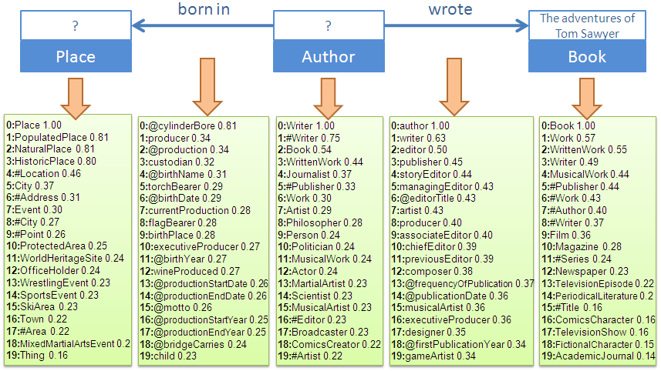
Translation – Step One finding semantically similar ontology terms
For each concept or relation in the graph, generate the k most semantically similar candidate ontology classes or properties
Similarity metric is distributional similarity, LSA, and WordNet.

Slide 39
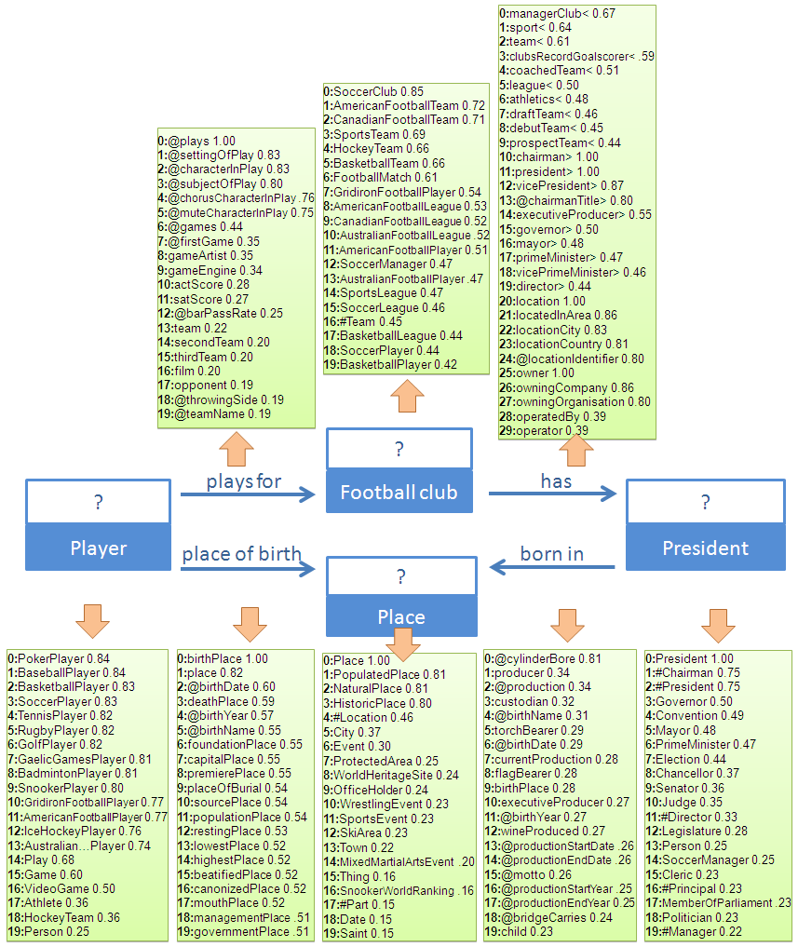
Another
Example
Football players who were born in the same place as their team’s president

Slide 40
Translation – Step Two disambiguation algorithm
To assemble the best interpretation we rely on statistics of the data
Primary measure is pointwise mutual informa-tion (PMI) between RDF terms in the LOD collection
  This measures the degree to which two RDF terms
  occur together in the knowledge base
In a reasonable interpretation, ontology terms associate in the way that their corresponding user terms connect in the structured keyword query

Slide 41

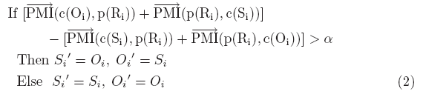
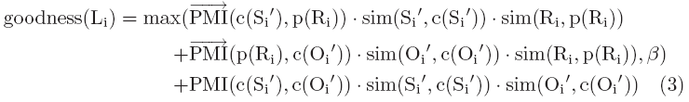
Translation – Step Two disambiguation algorithm
Three aspects are combined to derive an overall goodness measure for each candidate interpretation
Joint disam-
biguation
Resolving
direction
Link reason-
ableness

Slide 42
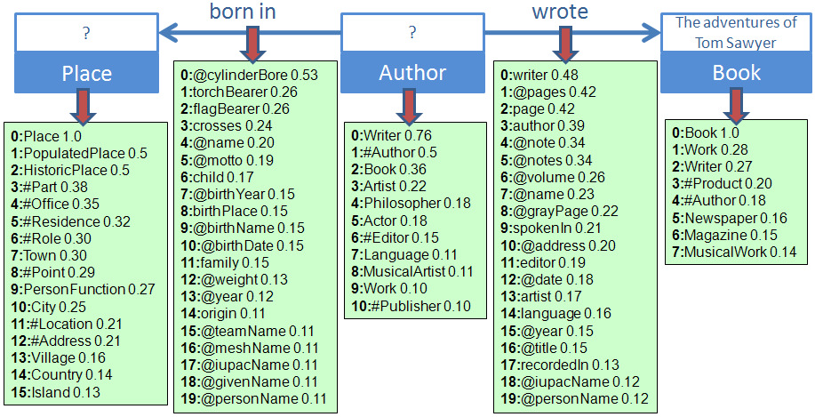
Example of Translation result
Concepts: Place => Place, Author => Writer, Book => Book
Properties: born in => birthPlace, wrote => author (inverse direction)

Slide 43

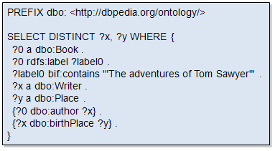
SPARQL Generation
The translation of a semantic graph query to SPARQL is straightforward given the mappings
Concepts
Place => Place
Author => Writer
Book => Book
Relations
born in => birthPlace
wrote => author

Slide 44

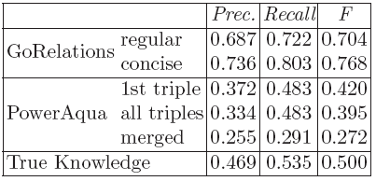
Evaluation
33 test questions from 2011 Workshop on Question Answering over Linked Data answerable using DBpedia
Three human subjects unfamiliar with DBpedia translated the test questions into semantic graph queries
Compared with two top natural language QA systems: PowerAqua and True Knowledge

Slide 45
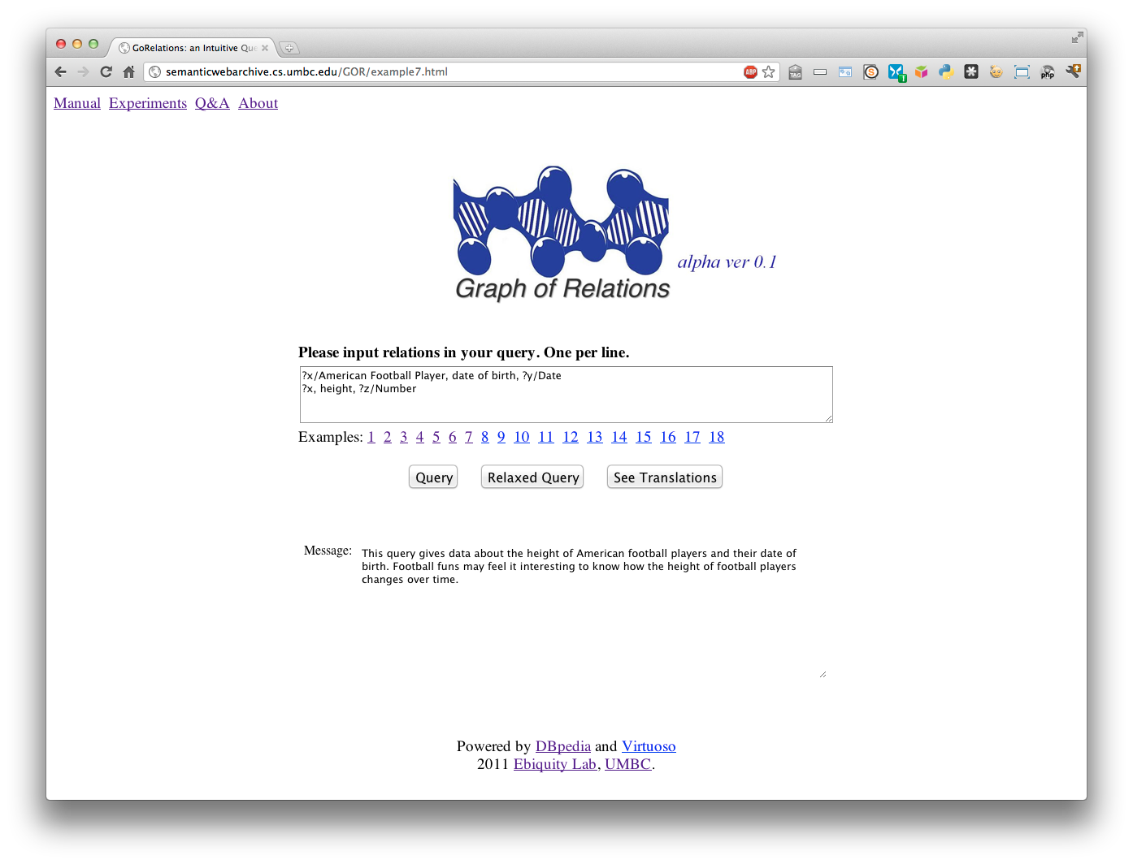
http://ebiq.org/GOR

Slide 46
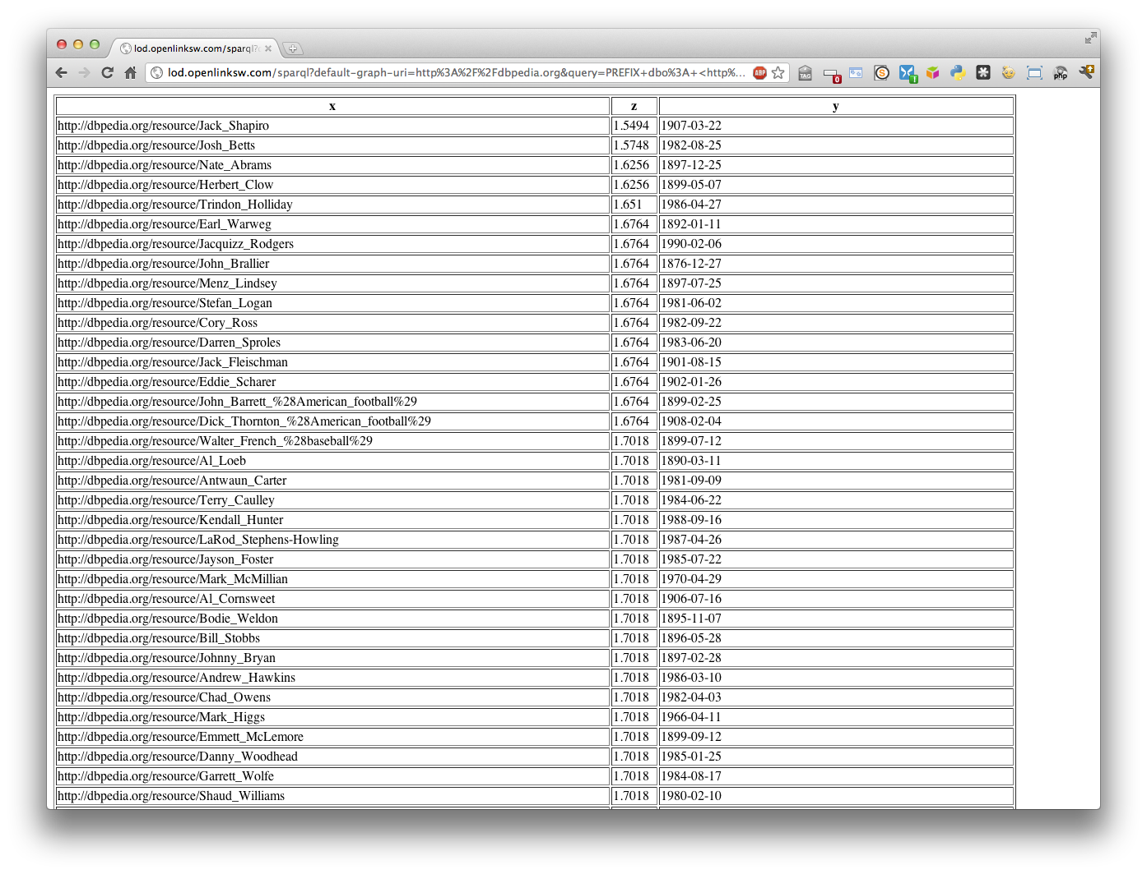
http://ebiq.org/GOR

Slide 47
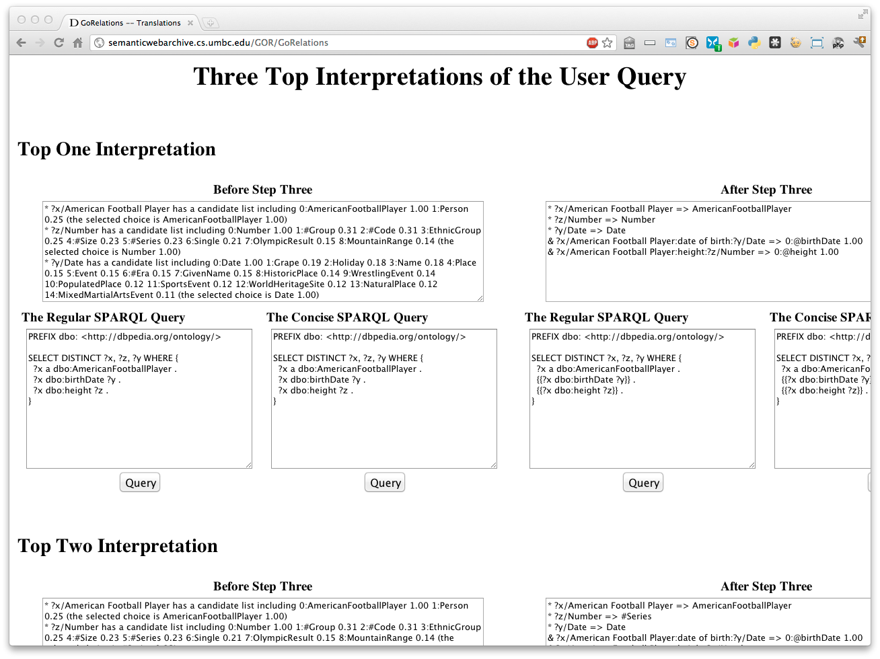
http://ebiq.org/GOR

Slide 48
Current challenges
Baseline system works well for DBpedia
Current challenges we are addressing are
  Adding direct entity matching
  Relaxing the need for type information
  Testing on other LOD collections and extending to a set of distributed LOD collections
  Developing a better Web interface
  Allowing user feedback and advice
See http://ebiq.org/93 for more information & try our alpha version at http://ebiq.org/GOR

Slide 49
Final Conclusions
Linked Data is an emerging paradigm for sharing structured and semi-structured data
  Backed by machine-understandable semantics
  Based on successful Web languages and protocols
Generating and exploring Linked Data resources can be challenging
  Schemas are large, too many URIs
New tools for mapping tables to Linked Data and translating structured natural language queries help reduce the barriers

Slide 50
http://ebiq.org/

