Slide 1
Semantic Web Languages and Technologies

Slide 2
Semantic Web Technologies
W3C “recommendations”
RDF, RDFS, RDFa, OWL, SPARQL, …
Under development: recommendations for rules, provenance, database export, etc.
Common tools and systems -- commercial, free and open sourced
Ontology editors, triple stores, reasoners
Common ontologies and data sets
Foaf, Dbpedia
Infrastructure systems
Search, ontology metadata, linking services

Slide 3
Semantic web languages today
Today there are, IOHO, two semantic web languages
RDF – Resource Description Framework http://www.w3.org/RDF/
DAML+OIL – Darpa Agent Markup Language http://www.daml.org/ (deprecated)
OWL – Ontology Web Language http://www.w3.org/2001/sw/
Topic maps (http://topicmaps.org/) are another species, not based on RDF
Microformats, Common Logic, etc. offer other possibilities

Slide 4
Two Semantic Web Notions
The semantic web
The idea of a web of machine understandable information
Agnostic about the technology used to support it
May involve more AI (e.g., NLP)
Human end users in the center
The Semantic Web
The current vision of a semantic web as defined by the W3C community: a web of data
Using W3C supported standards (i.e., RDF, OWL, SPARQL, XML, RIF, etc.
By machines for machines with human oriented applications on top.

Slide 5
RDF is the first SW language
Graph
XML Encoding
RDF
Data Model
<rdf:RDF ……..>
<….>
<….>
</rdf:RDF>
Good For
Human Viewing
Good for
Machine Processing
Triples
stmt(docInst, rdf_type, Document)
stmt(personInst, rdf_type, Person)
stmt(inroomInst, rdf_type, InRoom)
stmt(personInst, holding, docInst)
stmt(inroomInst, person, personInst)
RDF is a simple language for building graph based representations
Good For
Reasoning

Slide 6
The RDF Data Model
An RDF document is an unordered collection of statements, each with a subject, predicate and object (aka triples)
A triple can be thought of as a labelled arc in a graph
Statements describe properties of web resources
A resource is any object that can be pointed to by a URI:
a document, a picture, a paragraph on the Web, …
E.g., http://umbc.edu/~finin/cv.html
a book in the library, a real person (?)
isbn://5031-4444-3333
…
Properties themselves are also resources (URIs)

Slide 7
URIs are a foundation
URI = Uniform Resource Identifier
"The generic set of all names/addresses that are short strings that refer to resources"
URLs (Uniform Resource Locators) are a subset of URIs, used for resources that can be accessed on the web
URIs look like “normal” URLs, often with fragment identifiers to point to a document part:
http://foo.com/bar/mumble.html#pitch
URIs are unambiguous, unlike natural language terms
the web provides a global namespace
We assume references to the same URI are to the same thing

Slide 8
What does a URI mean?
Sometimes URIs denote a web resource
http://umbc.edu/~finin/finin.jpg denotes a file
We can use RDF to make assertions about the resource, e.g., it’s an image and depicts a person with name Tim Finin, …
Sometimes concepts in the external world
E.g., http://umbc.edu/ denotes a particular University located in Baltimore
This is done by social convention
Cool URIs don’t change
http://www.w3.org/Provider/Style/URI

Slide 9
The RDF Graph
An RDF document is an unordered collection of triples
The subject of one triple can be the object of another
So the result is a directed, labelled graph
A triple’s object can also be a literal, e.g., a string.

Slide 10
Simple RDF Example
http://umbc.edu/ ~finin/talks/idm02/
dc:Title
“Intelligent Information Systems on the Web and in the Aether”
dc:Creator
bib:Aff
http://umbc.edu/
bib:email
bib:name
“Tim Finin”
“finin@umbc.edu”

Slide 11
XML encoding for RDF
<rdf:RDF xmlns:rdf="http://www.w3.org/1999/02/22-rdf-syntax-ns#"
xmlns:dc="http://purl.org/dc/elements/1.1/"
xmlns:bib="http://daml.umbc.edu/ontologies/bib/">
<description about="http://umbc.edu/~finin/talks/idm02/">
<dc:title>Intelligent Information Systems on the Web and in the Aether</dc:Title>
<dc:creator>
<description>
<bib:Name>Tim Finin</bib:Name>
<bib:Email>finin@umbc.edu</bib:Email>
<bib:Aff resource="http://umbc.edu/" />
</description>
</dc:Creator>
</description>
</rdf:RDF>

Slide 12
N triple representation
RDF can be encoded as a set of triples.
<subject> <predicate> <object> .
<http://umbc.edu/~finin/talks/idm02/> <http://purl.org/dc/elements/1.1/Title> "Intelligent Information Systems on the Web and in the Aether" .
_:j10949 <http://daml.umbc.edu/ontologies/bib/Name> "Tim Finin" .
_:j10949 <http://daml.umbc.edu/ontologies/bib/Email> "finin@umbc.edu" .
_:j10949 <http://daml.umbc.edu/ontologies/bib/Aff> <http://umbc.edu/> .
_:j10949 <http://www.w3.org/1999/02/22-rdf-syntax-ns#type><Description> .
<http://umbc.edu/~finin/talks/idm02/> <http://purl.org/dc/elements/1.1/Creator> _:j10949 .
<http://umbc.edu/~finin/talks/idm02/> <http://www.w3.org/1999/02/22-rdf-syntax-ns#type> <Description> .
Note the gensym for the anonymous node _:j10949

Slide 13
Triple Notes
RDF triples have one of two forms:
<URI> <URI> <URI>
<URI> <URI> <quoted string>
Triples are also easily mapped into logic
<subject> <predicate> <object> becoming:
<predicate>(<subject>,<object>)
With type(<S>,<O>) becoming <O>(<S>)
Example:
subclass(man,person)
sex(man,male)
domain(sex,animal)
man(adam)
age(adam,100)
Triples are easily stored and managed in DBMS
Flat nature of a triple a good match for relational DBs
; Note: we’re not ; showing the actual ; URIs for clarity

Slide 14
N3 notation for RDF
N3 is a compact notation for RDF that is easier for people to read, write and edit.
Aka Notation 3, developed by TBL himself.
Translators exist between N3 and the XML encoding, such as the web form on
http://www.w3.org/DesignIssues/Notation3.html
So, it’s just “syntactic sugar”
But, XML is largely unreadable and even harder to write

Slide 15
N3 Example
@prefix rdf: http://www.w3.org/1999/02/22-rdf-syntax-ns# .
@prefix dc: http://purl.org/dc/elements/1.1/ .
@prefix bib: http://daml.umbc.edu/ontologies/bib/ .
<http://umbc.edu/~finin/talks/idm02/>
dc:title "Intelligent Information Systems on the Web and in the Aether" ;
dc:creator
[ bib:Name "Tim Finin";
bib:Email "finin@umbc.edu"
bib:Aff: "http://umbc.edu/" ] .

Slide 16
A usecase: FOAF
FOAF (Friend of a Friend) is a simple ontology to describe people and their social networks.
See the foaf project page: http://www.foaf-project.org/
We recently crawled the web and discovered over 1,000,000 valid RDF FOAF files.
Most of these are from the http://liveJournal.com/ blogging system which encodes basic user info in foaf
See http://apple.cs.umbc.edu/semdis/wob/foaf/
<foaf:Person>
<foaf:name>Tim Finin</foaf:name>
<foaf:mbox_sha1sum>2410…37262c252e</foaf:mbox_sha1sum>
<foaf:homepage rdf:resource="http://umbc.edu/~finin/" />
<foaf:img rdf:resource="http://umbc.edu/~finin/images/passport.gif" />
</foaf:Person>

Slide 17
FOAF Vocabulary
Basics
Agent
Person
name
nick
title
homepage
mbox
mbox_sha1sum
img
depiction (depicts)
surname
family_name
givenname
firstName
Personal Info
weblog
knows
interest
currentProject
pastProject
plan
based_near
workplaceHomepage
workInfoHomepage
schoolHomepage
topic_interest
publications
geekcode
myersBriggs
dnaChecksum
Documents & Images
Document
Image
PersonalProfileDocument
topic (page)
primaryTopic
tipjar
sha1
made (maker)
thumbnail
logo
Online Accts
OnlineAccount
OnlineChatAccount
OnlineEcommerceAccount
OnlineGamingAccount
holdsAccount
accountServiceHomepage
accountName
icqChatID
msnChatID
aimChatID
jabberID
yahooChatID
Projects & Groups
Project Organization
Group member
membershipClass fundedBy
theme

Slide 18
FOAF: why RDF? Extensibility!
FOAF vocabulary provides 50+ basic terms for making simple claims about people
FOAF files can use other RDF terms too: RSS, MusicBrainz, Dublin Core, Wordnet, Creative Commons, blood types, starsigns, …
RDF guarantees freedom of independent extension
OWL provides fancier data-merging facilities
Result: Freedom to say what you like, using any RDF markup you want, and have RDF crawlers merge your FOAF documents with other’s and know when you’re talking about the same entities.
After Dan Brickley, danbri@w3.org

Slide 19
No free lunch!
Consequence:
We must plan for lies, mischief, mistakes, stale data, slander
Dataset is out of control, distributed, dynamic
Importance of knowing who-said-what
Anyone can describe anyone
We must record data provenance
Modeling and reasoning about trust is critical
Legal, privacy and etiquette issues emerge
Welcome to the real world
After Dan Brickley, danbri@w3.org

Slide 20
More RDF Vocabulary
RDF has terms for describing lists, bags, sequences, etc.
RDF also can describe triples through reification
Enabling statements about statements
:john bdi:believes _:s.
_:s rdf:type rdf:Statement.
_:s rdf:subject <http://yd.example.com/catalog/widgetX>.
_:s rdf:predicate cat:salePrice .
_:s rdf:object "19.95" .

Slide 21
RDF is being used!
RDF has a solid specification
RDF is being used in a number of web standards
CC/PP (Composite Capabilities/Preference Profiles)
P3P (Platform for Privacy Preferences Project)
RSS (RDF Site Summary)
RDF Calendar (~ iCalendar in RDF)
And in other systems
Netscape’s Mozilla web browser, open directory (http://dmoz.org/)
Adobe products via XMP (eXtensible Metadata Platform)
Web communities: LiveJournal, Ecademy, and Cocolog
In Microsoft’s VISTA: Connected Services Framework uses an RDF database and SPARQL

Slide 22
RDF Schema (RDFS)
RDF Schema adds taxonomies for classes & properties
subClass and subProperty
and some metadata.
domain and range constraints on properties
Several widely used KB tools can import and export in RDFS
Stanford Protégé KB editor
Java, open sourced
extensible, lots of plug-ins
provides reasoning & server capabilities

Slide 23
RDFS Vocabulary
RDFS introduces the following terms and gives each a meaning w.r.t. the rdf data model
Terms for collections
rdfs:member
rdfs:Container
rdfs:ContainerMembershipProperty
Special properties
rdfs:comment
rdfs:seeAlso
rdfs:isDefinedBy
rdfs:label
Terms for classes
rdfs:Class
rdfs:subClassOf
Terms for properties
rdfs:domain
rdfs:range
rdfs:subPropertyOf
Special classes
rdfs:Resource
rdfs:Literal
rdfs:Datatype

Slide 24
RDF and RDF Schema
<rdfs:Property rdf:ID=“name”>
<rdfs:domain rdf:resource=“Person”>
</rdfs:Property>
<rdfs:Class rdf:ID=“Chair”>
<rdfs:subclassOf rdf:resource=
“http://schema.org/gen#Person”>
</rdfs:Class>
rdfs:Class
rdfs:Property
rdf:type
rdf:type
rdf:type
g:Person
rdfs:domain
<rdf:RDF xmlns:g=“http://schema.org/gen” xmlns:u=“http://schema.org/univ”>
<u:Chair rdf:ID=“john”>
<g:name>John Smith</g:name> </u:Chair>
</rdf:RDF>
rdfs:subclassOf
u:Chair
g:name
rdf:type
g:name
John Smith

Slide 25
RDFS supports simple inferences
New and Improved!
100% Better than XML!!
An RDF ontology plus some RDF statements may imply additional RDF statements.
This is not true of XML.
Note that this is part of the data model and not of the accessing or processing code.
@prefix rdfs: <http://www.....>.
@prefix : <genesis.n3>.
parent rdfs:domain person;
rdfs:range person.
mother rdfs:subProperty parent;
rdfs:domain woman;
rdfs:range person.
eve mother cain.
parent a property.
person a class.
woman subClass person.
mother a property.
eve a person;
a woman;
parent cain.
cain a person.

Slide 26
N3 example
Here’s how you declare a namespace.
<> Is an alias for the URI of this document.
This defines the “empty prefix” as refering to “this document”
@prefix rdf: <http://www.w3.org/1999/02/22-rdf-syntax-ns#>.
@prefix rdfs: <http://www.w3.org/2000/01/rdf-schema#>.
@prefix : <#> .
<> rdfs:comment “This is an N3 example”.
:Person a rdfs:Class.
:Woman a rdfs:Class; rdfs:subClassOf :Person.
:eve a :Woman; :age “100”.
:sister a rdf:Property; rdfs:domain :Person; rdfs:range :Woman.
:eve :sister [a :Woman; :age 98].
:eve :believe {:eve :age “100”}.
[is :spouse of [is :sister of :eve]] :age 99.
:eve.:sister.:spouse :age 99.
“person is a class”. The “a” syntax is sugar for rdf:type property.
“Woman is a class and a subclass of person”. Note the ; syntax.
“eve is a woman whose age is 100.”
“sister is a property from person to woman”
“eve has a sister who is a 98 year old woman”. The brackets introduce an anonymous resource.
“eve believes that her age is 100”. The braces introduce a reified triple.
“the spouse of the sister of eve is 99”.
“the spouse of the sister of eve is 99”.

Slide 27
Is RDF(S) better than XML?
Q: For a specific application, should I use XML or RDF?
A: It depends…
XML's model is
a tree, i.e., a strong hierarchy
applications may rely on hierarchy position
relatively simple syntax and structure
not easy to combine trees
RDF's model is
a loose collections of relations
applications may do “database”-like search
not easy to recover hierarchy
easy to combine relations in one big collection
great for the integration of heterogeneous information

Slide 28
From where will the markup come?
A few authors will add it manually.
More will use annotation tools.
SMORE: Semantic Markup, Ontology and RDF Editor
Intelligent processors (e.g., NLP) can understand documents and add markup (hard)
Machine learning powered information extraction tools show promise
Lots of web content comes from databases & we can generate SW markup along with the HTML
See http://ebiquity.umbc.edu/

Slide 29
From where will the markup come?
In many tools, part of the metadata information is present, but thrown away at output
e.g., a business chart can be generated by a tool…
…it “knows” the structure, the classification, etc. of the chart
…but, usually, this information is lost
…storing it in metadata is easy!
So “semantic web aware” tools can produce lots of metadata
E.g., Adobe’s use of its XMP platform

Slide 30
Problems with RDFS
RDFS too weak to describe resources in sufficient detail, e.g.:
No localised range and domain constraints
Can’t say that the range of hasChild is person when applied to persons and elephant when applied to elephants
No existence/cardinality constraints
Can’t say that all instances of person have a mother that is also a person, or that persons have exactly 2 parents
No transitive, inverse or symmetrical properties
Can’t say that isPartOf is a transitive property, that hasPart is the inverse of isPartOf or that touches is symmetrical
We need RDF terms providing these and other features.

Slide 31
DAML+OIL = RDF + KR
DAML = Darpa Agent Markup Language
DARPA program with 17 projects & an integrator developing language spec, tools, applications for SW.
OIL = Ontology Inference Layer
An EU effort aimed at developing a layered approach to representing knowledge on the web.
Process
Joint Committee: US DAML and EU Semantic Web Technologies participants
DAML+OIL specs released in 2001
See http://www.daml.org/
Includes model theoretic and axiomatic semantics
DAML+OIL

Slide 32
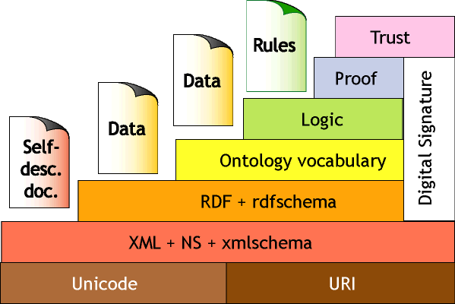
W3C’s Web Ontology Language (OWL)
DAML+OIL begat OWL.
OWL released as W3C recommendation 2/10/04
See http://www.w3.org/2001/sw/WebOnt/ for OWL overview, guide, specification, test cases, etc.
Three layers of OWL are defined of decreasing levels of complexity and expressiveness
OWL Full is the whole thing
OWL DL (Description Logic) introduces restrictions
OWL Lite is an entry level language intended to be easy to understand and implement
OWL

Slide 33
OWL ↔ RDF
An OWL ontology is a set of RDF statements
OWL defines semantics for certain statements
Does NOT restrict what can be said -- documents can include arbitrary RDF
But no OWL semantics for non-OWL statements
Adds capabilities common to description logics:
cardinality constraints, defined classes (=> classification), equivalence, local restrictions, disjoint classes, etc.
More support for ontologies
Ontology imports ontology, versioning, …
But not (yet) variables, quantification, & rules
A complete OWL reasoning is significantly more complex than a complete RDFS reasoner.

Slide 34
Owl is based on Description Logic
DL is a family of KR languages that might be described as “Logic meets Objects”
A DL is characterized by a set of constructors that allow one to build complex concepts and roles from atomic ones
Concepts correspond to classes; interpreted as sets of objects
Roles correspond to relations; interpreted as binary relations on objects
Axioms assert facts about concepts, roles and individuals
Distinguished by:
Formal semantics for a decidable fragment of FOL
Sound and complete decision procedures for key problems
Many implemented systems, some highly optimized

Slide 35
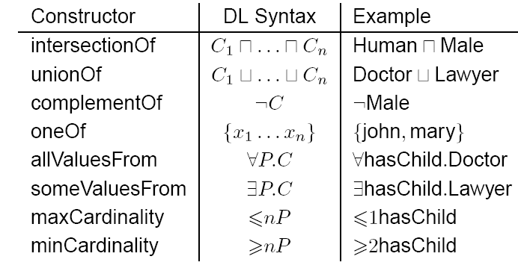
OWL Class Constructors
borrowed from Ian Horrocks

Slide 36
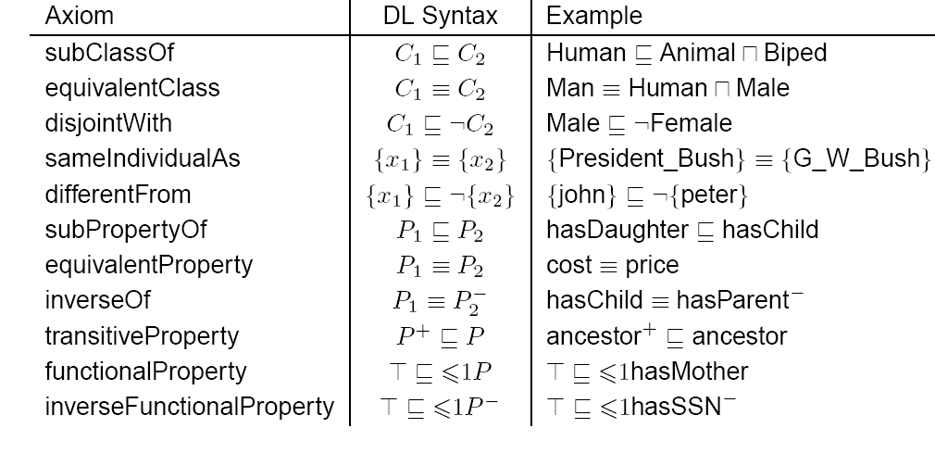
OWL Axioms
borrowed from Ian Horrocks

Slide 37
OWL Language
Three species of OWL
OWL Full is union of OWL syntax and RDF
OWL DL restricted to FOL fragment (≅ DAML+OIL)
OWL Lite is “simpler” subset of OWL DL
Semantic layering
OWL DL ≅ OWL full within DL fragment
OWL DL based on SHIQ Description Logic
OWL DL Benefits from many years of DL research
Well defined semantics
Formal properties well understood (complexity, decidability)
Known reasoning algorithms
Implemented systems (highly optimised)

Slide 38
OWL Lite Features
RDF Schema Features
Class, rdfs:subClassOf , Individual
rdf:Property, rdfs:subPropertyOf
rdfs:domain , rdfs:range
Equality and Inequality
sameClassAs , samePropertyAs , sameIndividualAs
differentIndividualFrom
Restricted Cardinality
minCardinality, maxCardinality (restricted to 0 or 1)
cardinality (restricted to 0 or 1)
Property Characteristics
inverseOf , TransitiveProperty , SymmetricProperty
FunctionalProperty(unique) , InverseFunctionalProperty
allValuesFrom, someValuesFrom (universal and existential local range restrictions)
Datatypes
Following the decisions of RDF Core.
Header Information
imports , Dublin Core Metadata , versionInfo

Slide 39
OWL Features
Class Axioms
oneOf (enumerated classes)
disjointWith
sameClassAs applied to class expressions
rdfs:subClassOf applied to class expressions
Boolean Combinations of Class Expressions
unionOf
intersectionOf
complementOf
Arbitrary Cardinality
minCardinality
maxCardinality
cardinality
Filler Information
hasValue Descriptions can include specific value information

Slide 40
OWL Ontologies
The owl:Ontology class describes an ontology
An ontology file should be one instance of owl:Ontology
Ontology properties include
owl:imports, owl:versionInfo, owl:priorVersion
owl:backwardCompatibleWith, owl:incompatibleWith
rdfs:label, rdfs:comment can also be used
Deprecation control classes:
owl:DeprecatedClass, owl:DeprecatedProperty types

Slide 41
OWL in One Slide
OWL is built on top of XML and RDF
<rdf:RDF xmlns:rdf ="http://w3.org/22-rdf-syntax-ns#"
xmlns:rdfs=http://w3.org/rdf-schema#> xmlns:owl="http://www.w3.org/2002/07/owl#”>
<owl:Ontology rdf:about="">
<owl:imports rdf:resource="http://owl.org/owl+oil"/>
</owl:Ontology>
<owl:Class rdf:ID="Person">
<rdfs:subClassOf rdf:resource="#Animal"/>
<rdfs:subClassOf>
<owl:Restriction>
<owl:onProperty rdf:resource="#hasParent"/>
<owl:allValuesFrom rdf:resource="#Person"/>
</owl:Restriction>
</rdfs:subClassOf>
<rdfs:subClassOf>
<owl:Restriction owl:cardinality="1">
<owl:onProperty rdf:resource="#hasFather"/>
</owl:Restriction>
</rdfs:subClassOf>
</owl:Class>
<Person rdf:about=“http://umbc.edu/~finin/">
<rdfs:comment>Finin is a person.</rdfs:comment>
</Person>
It allows the definition, sharing, composition and use of ontologies
OWL is ~= a frame based knowledge representation language
It can be used to add metadata about anything which has a URI.
URIs are a W3C standard generalizing URLs
everything has a URI

Slide 42
RDFa
RDFa is a W3C recommendation for embed-ding SW markup in HTML as tag attributed
= RDF in

Slide 43
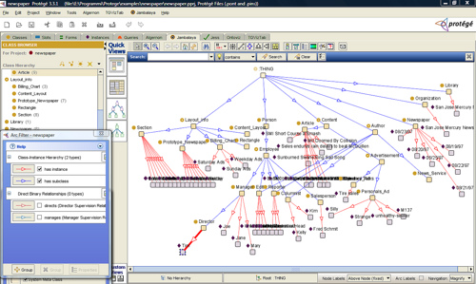
Ontology Editor
There are a number of editors available for creating and editing ontologies and data
We recommend using Protégé, a java-based free system developed at Stanford
Good support for reasoning
Lots of plugins

Slide 44
Triple Store
A triple store is a database for RDF triples
It usually has a native API and often accepts SPARQL queries
It might do reasoning, either in an eager manner (as triples are loaded) or on demand (to answer queries), etc
Some stores focus on scalability and others on flexibility and features
We’ll experiment with stardog

Slide 45
Frameworks and Libraries
There are frameworks, libraries and packages for most programming languages
RDFLib is a popular library for Python that we will study
Jena is a very comprehensive Java framework originally developed by HP and now Apache

