Slide 1
SPARQL
An RDF Query Language

Slide 2
SPARQL
SPARQL is a recursive acronym for
  SPARQL Protocol And Rdf Query Language
SPARQL is the SQL for RDF
Example query suitable for DBpedia
# find countries and their languages
  PREFIX dbo: <http://dbpedia.org/ontology/>
  SELECT * WHERE {
  ?country a dbo:Country;
  dbo:officialLanguage ?lang .
  }
  LIMIT 10

Slide 3
SPARQL History
Several RDF query languages were developed prior to SPARQL
W3C RDF Data Access Working Group (DAWG) worked out SPARQL 2005-2008
Became a W3C recommendation in Jan 2008
SPARQL 1.1 (2013) is the current standard
Support for many prog. languages available
W3 SPARQL 1.2 Community Group established in 2019 to explore extensions

Slide 4
Typical Architecture
SPARQL endpoint receives queries and requests via HTTP from programs or GUIs, accesses associated RDF triple store and returns result, e.g., data
Program
Rdf
module
SPARQL
protocol
Web Browser GUI
SPARQL
endpoint
RDF Triple
Store

Slide 5
Some SPARQL endpoints
There are many public endpoints, e.g.
Dbpedia: https://dbpedia.ort/sparql/
Wikidata: https://query.wikidata.org/sparql
DBLP: https://dblp.l3s.de/d2r/sparql
See W3C’s list of currently alive SPARQL endpoints
It’s not hard to set up your own, e.g.
UMBC cybersecurity knowledge graph: http://eb4.cs.umbc.edu:9090/ckg/query/

Slide 6
Endpoint GUIs
Some endpoints offer their own SPARQL GUI you can use to enter ad hoc queries
They may use the same URL as the REST interface and rely on the protocol to know when it’s a person and when a query
  Dbpedia: http://dbpedia.org/sparql/
  Wikidata: https://query.wikidata.org/
  DBLP: https://dblp.l3s.de/d2r/snorql/

Slide 7
General SPARQL GUIs
You can also access or run a general SPARQL GUI that can talk to any SPARQL endpoint
A nice example is YASGUI, which has a public resource: https://yqagui.org/ and is available to download
Another open-source GUI is Twinkle

Slide 8
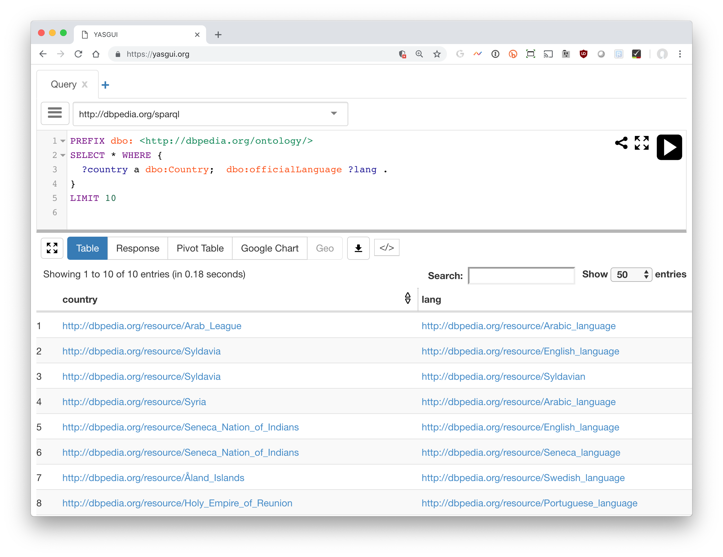
YASGUI: Yet Another SPARQL GUI
https://yasgui.org

Slide 9
SPARQL query structure
Prefix declarations for abbreviating URIs
Dataset definition: what RDF graph(s) are being queried
Result clause: what information to return from the query
Query pattern: what to query for in dataset
Query modifiers, slicing, ordering, rearranging query results
# prefix declarations
PREFIX ex: <http://example.com/rdf/> …
# optional named graph source
FROM ...
# result clause (select,ask,update…)
SELECT ...
# query pattern
WHERE { ... }
# query modifiers
ORDER BY ...
GROUP BY ….
LIMIT 100

Slide 10
Basic SPARQL Query Forms
SELECT
  Returns all, or a subset of, the variables bound in a query pattern match
ASK
  Returns boolean indicating whether a query pattern matches or not
DESCRIBE
  Returns an RDF graph describing resources found
CONSTRUCT
  Returns an RDF graph constructed by substituting variable bindings in a set of triple templates

Slide 11
SPARQL protocol parameters
To use this query, we need to know]
  What endpoint (URL) to send it to
  How we want the results encoded (JSON, XML, …)
  … other parameters …
These are set in GUI or your program
  Except for the endpoint, all have defaults
Can even query with the unix curl command:
  curl http://dbpedia.org/sparql/ --data-urlencode query='PREFIX yago: <http://dbpedia.org/class/yago/> SELECT * WHERE {?city rdf:type yago:WikicatCitiesInMaryland.}'

Slide 12
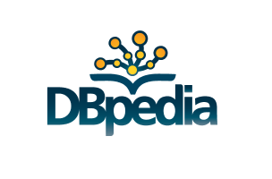
Exploring SPARQL with DBpedia
DBpedia is a knowledge graph extracted from
different Wikipedia sites
Started in 2007, it continued to develop and offer services based on it
Explore it in your browser in a human-readable form
Query it using a public SPARQL endpoint to collect data
Use services like Dbpedia Spotlight to get entities and concepts from text
Download its data as JSON objects for your own use

Slide 13
Let’s find data about cities in MD
We need to understand how DBpedia models data about cites
We can view the ontology with its ~700 classes and ~2,800 properties
And/or examine familiar entities, like Baltimore by
  Doing a web search on dbpedia Baltimore
  Clicking on links in the resulting page

Slide 14
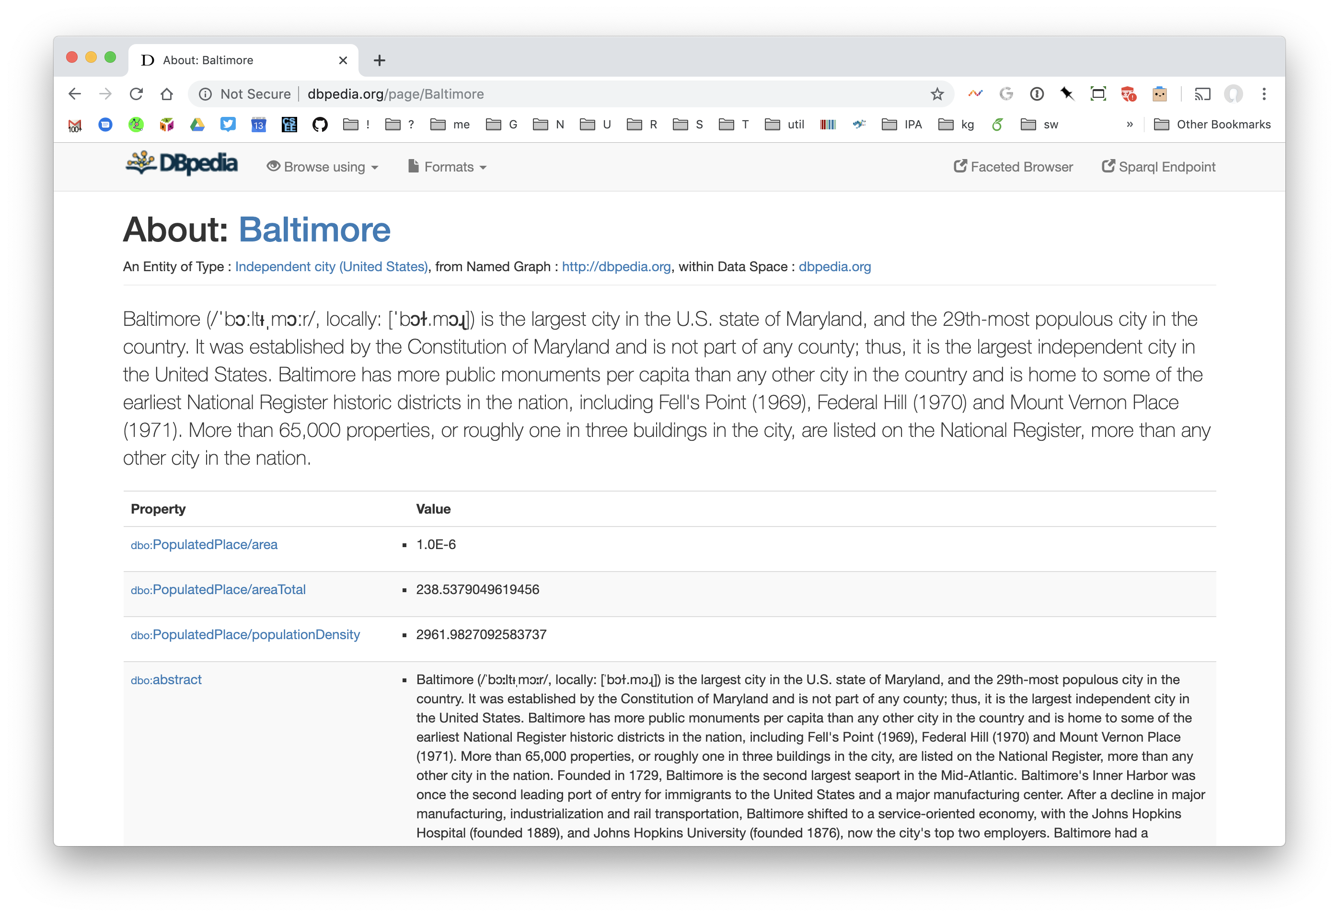
Baltimore in Dbpedia (1)
final URL part is Wikipedia name
Property value pairs for this subject
DBO: is used as the prefix for the DBpedia ontology

Slide 15
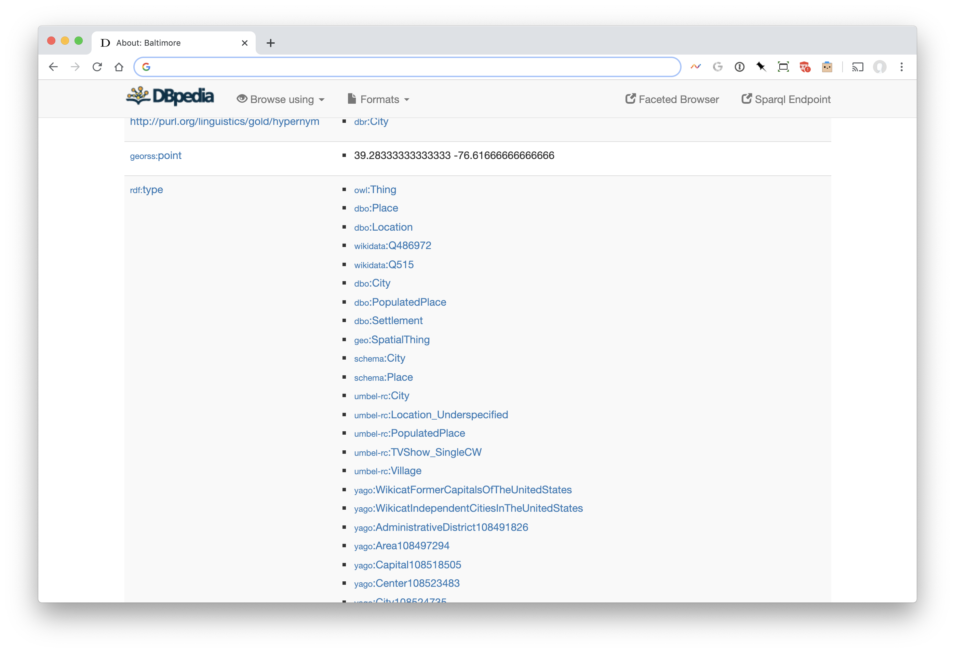
Baltimore in Dbpedia (2)
Scroll down to find the rdf:type
Property to see Baltimore’s
types

Slide 16
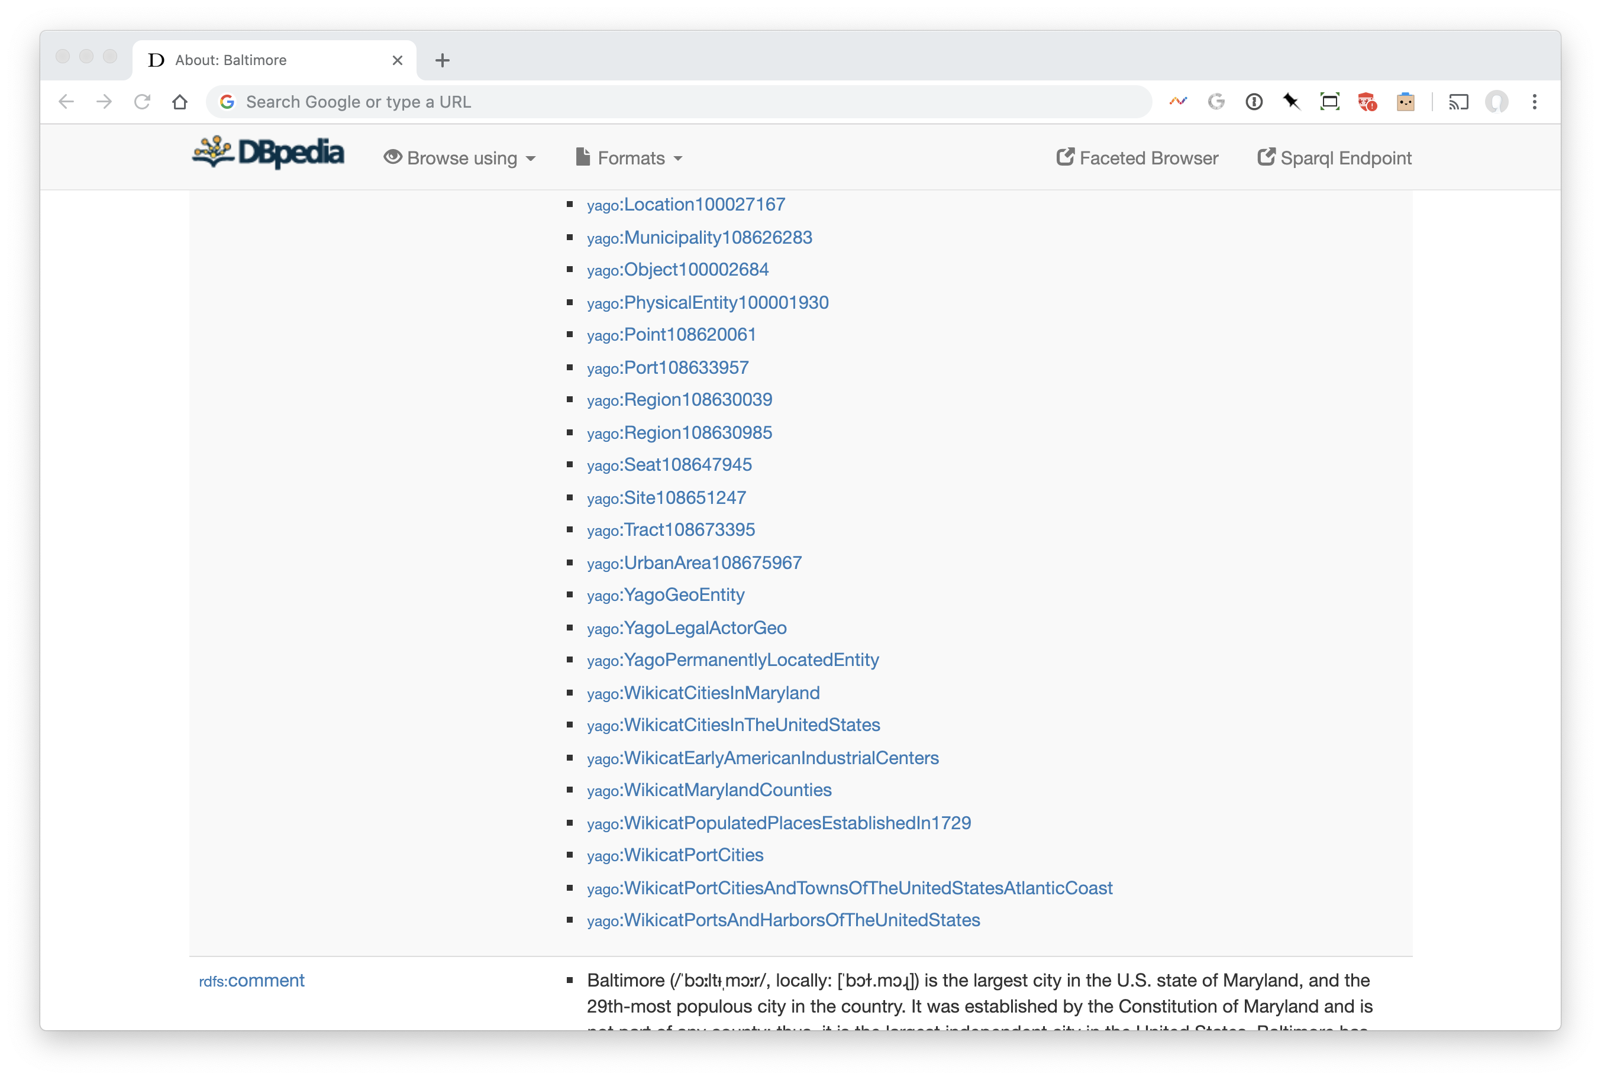
Baltimore in Dbpedia (3)
This looks like the type we want!
Note: yago provides an ontology derived from Wikipedia with > 10M entities.
For example, it induces types from Wikipedia category pages.

Slide 17
A Query: Maryland Cities
# find URIs for cities in Maryland
PREFIX yago: <http://dbpedia.org/class/yago/>
SELECT * WHERE {
?city a yago:WikicatCitiesInMaryland
}

Slide 18
Maryland Cities and population
# get cities in MD and their populations
PREFIX yago: <http://dbpedia.org/class/yago/>t
PREFIX dbo: <http://dbpedia.org/ontology/>
SELECT * WHERE {
?city a yago:WikicatCitiesInMaryland;
dbo:populationTotal ?population .
}

Slide 19
Maryland cities, population, names
# this returns names in multiple languages ☹
PREFIX yago: <http://dbpedia.org/class/yago/>
PREFIX dbo: <http://dbpedia.org/ontology/>
PREFIX rdfs: <http://www.w3.org/2000/01/rdf-schema#>
SELECT ?city ?name ?population WHERE {
?city a yago:WikicatCitiesInMaryland;
dbo:populationTotal ?population ;
rdfs:label ?name .
}

Slide 20
Just the @en names, w/o lang tag
# FILTER gives conditions that must be true
# LANG(x) returns string’s language tag or ””
# STR(x) returns a string’s value, i.e. w/o language tag
PREFIX yago: <http://dbpedia.org/class/yago/>
PREFIX dbo: <http://dbpedia.org/ontology/>
PREFIX rdfs: <http://www.w3.org/2000/01/rdf-schema#>
select (str(?name) as ?name) ?population where {
?city a yago:WikicatCitiesInMaryland;
dbo:populationTotal ?population;
rdfs:label ?name .
FILTER (LANG(?name) = "en")
}

Slide 21
Order results by population (descending)
# sort results by population
PREFIX yago: http://dbpedia.org/class/yago/
PREFIX dbo: <http://dbpedia.org/ontology/>
select str(?name) ?population where {
?city a yago:WikicatCitiesInMaryland;
dbo:populationTotal ?population;
rdfs:label ?name .
FILTER (LANG(?name) = "en")
}
ORDER BY DESC(?population)

Slide 22
Wait, where’s Catonsville? ☹
MD’s government focused on counties
Catonsville not considered a city – it has no government
We need another category of place
  Census designated place? Populated Place?
Populated places include counties & regions; let’s use census designated place
But some ‘real’ cities in Maryland are not listed as census designated places and some are

Slide 23
UNION operator is OR
PREFIX yago: <http://dbpedia.org/class/yago/>
PREFIX dbo: http://dbpedia.org/ontology/
PREFIX dbr: <http://dbpedia.org/resource/>
SELECT str(?name) ?population where {
{?city dbo:type dbr:Census-designated_place;
dbo:isPartOf dbr:Maryland .}
UNION
{?city a yago:WikicatCitiesInMaryland . }
?city dbo:populationTotal ?population; rdfs:label ?name .
FILTER (LANG(?name) = "en")
}
ORDER BY DESC(?population)

Slide 24
Now we have duplicate entries ☹
This happens because:
  Some “cities” are just in WikicatCitiesInMaryland
  Some are just in Census-designated_places
  Some are in both
SPARQL’s procedure finds all ways to satisfy a query, and for each one, records the variable bindings
We add DISTINCT to get SPARQL to remove duplicate bindings from the results

Slide 25
DISTINCT produces unique results
PREFIX yago: <http://dbpedia.org/class/yago/>
PREFIX dbo: http://dbpedia.org/ontology/
PREFIX dbr: <http://dbpedia.org/resource/>
SELECT DISTINCT str(?name) ?population where {
{?city dbo:type dbr:Census-designated_place;
dbo:isPartOf dbr:Maryland .}
UNION
{?city a yago:WikicatCitiesInMaryland . }
?city dbo:populationTotal ?population;
rdfs:label ?name .
FILTER (LANG(?name) = "en")
}
ORDER BY DESC(?population)

Slide 26
Some cities are missing ☹
Experimentation with query showed there are 427 entities in MD that are either census designated places or cities
Only get 411 because nine have no population and one has neither a population nor a label
  Typical of a large and somewhat noisy knowledge graph created from crowdsourced data
SPARQL’s OPIONAL directive to the rescue
Notes:
Was 439 -> 423??

Slide 27
OPTIONAL handles missing data
PREFIX yago: <http://dbpedia.org/class/yago/>
PREFIX dbo: <http://dbpedia.org/ontology/>
PREFIX dbr: <http://dbpedia.org/resource/>
select DISTINCT str(?name) ?population where {
{?city dbo:type dbr:Census-designated_place;
dbo:isPartOf dbr:Maryland .}
UNION
{?city a yago:WikicatCitiesInMaryland . }
OPTIONAL {?city dbo:populationTotal ?population.}
OPTIONAL {?city rdfs:label ?name . FILTER (LANG(?name) = "en") }
}
ORDER BY DESC(?population)

Slide 28
Handling queries with many results
Endpoints typically have limits on a query’s runtime or the number of results it can return
You can use the LIMIT and OFFSET query modifiers to manage large queries
Suppose we want to find all types that DBpedia uses
  SELECT distinct ?type WHERE {?x a ?type.}
DBpedia’s public endpoint limits queries to 10K results

Slide 29
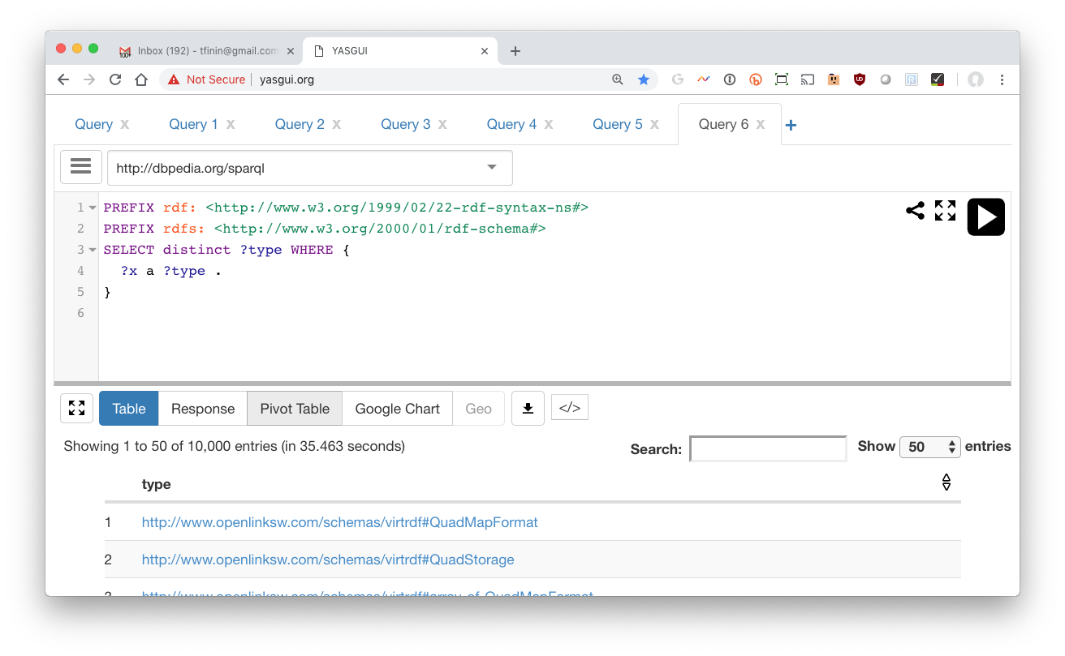
Get the first 10K

Slide 30
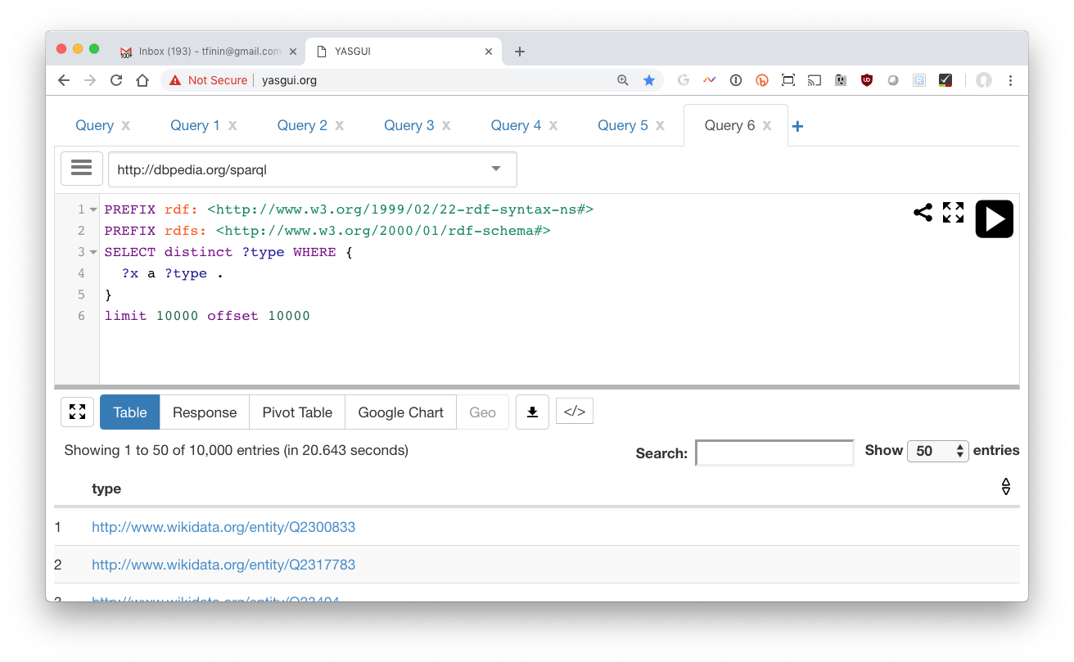
Get the second 10K with OFFSET

Slide 31
A simple program gets them all
from SPARQLWrapper import SPARQLWrapper, JSON
default_endpoint = "http://dbpedia.org/sparql"
type_query = """SELECT DISTINCT ?class WHERE {{?x a ?class}} LIMIT {LIM} OFFSET {OFF}"""
def getall(query, endpoint=default_endpoint):
limit = 10000
offset = total = 0
found = limit
tuples = []
sparql = SPARQLWrapper(endpoint)
sparql.setReturnFormat('json')
while found == limit: # keep going until we don't get limit results
q = query.format(LIM=limit, OFF=offset)
sparql.setQuery(q)
results = sparql.query().convert()
found = 0
for result in results["results"]["bindings"]:
found += 1
tuples.append(tuple([str(v['value']) for v in result.values()]))
print('Found', found, 'results')
total = total + found
offset = offset + limit
return tuples

Slide 32
ASK query
An ASK query returns True if it can be satisfied and False if not
Was Barack Obama born in the US?
  PREFIX dbo: <http://dbpedia.org/ontology/>
  PREFIX dbr: <http://dbpedia.org/resource/>
  ask WHERE {
  {dbr:Barack_Obama dbo:birthPlace dbr:United_States}
  UNION
  {dbr:Barack_Obama dbo:birthPlace ?x .
  ?x dbo:isPartOf*/dbo:country dbr:United_States }
  }

Slide 33
DESCRIBE Query
“Describe ?x” means “tell me everything you know about ?x
Example: Describe Alan Turing …
  DESCRIBE <http://dbpedia.org/resource/Alan_Turing>
  -- or –
  PREFIX dbr: <http://dbpedia.org/resource/>
  DESCRIBE dbr:Alan_Turing
Returns a collection of ~1500 triples in which dbr:Alan_Turing is either the subject or object

Slide 34
Describes’s results?
The DAWG did not reach a consensus on what describe should return
Possibilities include
  All triples where the variable bindings are mentioned
  All triples where the bindings are the subject
  Something else
What is useful might depend on the application or the amount of data involved
So it was left to the implementation

Slide 35
On construct
Having a result form that produces an RDF graph is a good idea
It enables on to construct systems by using the output of one SPARQL query as the data over which another query works
This kind of capability was a powerful one for relational databases

Slide 36
Construct query (2)
SPARQL 1.1 allows using alternative properties separated by vertical bar
Actors and directors or producers
they’ve worked for
  PREFIX dbo: <http://dbpedia.org/ontology/>
  PREFIX ex: <http://example.org/>
  Construct {?actor ex:workedFor ?directorOrProducer}
  WHERE {
  ?film a dbo:Film;
  dbo:director|dbo:producer ?directorOrProducer;
  dbo:starring ?actor}
Returns a graph with ~31,000 triples

Slide 37
Example: finding missing inverses
DBpedia is missing many inverse relations, including more than 10k missing spouse relations
This creates a graph of all the missing ones, which can be added back to the KG via UPDATE ADD
  PREFIX dbo: <http://dbpedia.org/ontology/>
  CONSTRUCT { ?p2 dbo:spouse ?p1. }
  WHERE {?p1 dbo:spouse ?p2.
  FILTER NOT EXISTS {?p2 dbo:spouse ?p1}}
Not the NOT EXISTS operator that succeeds iff its graph pattern is not satisfiable

Slide 38
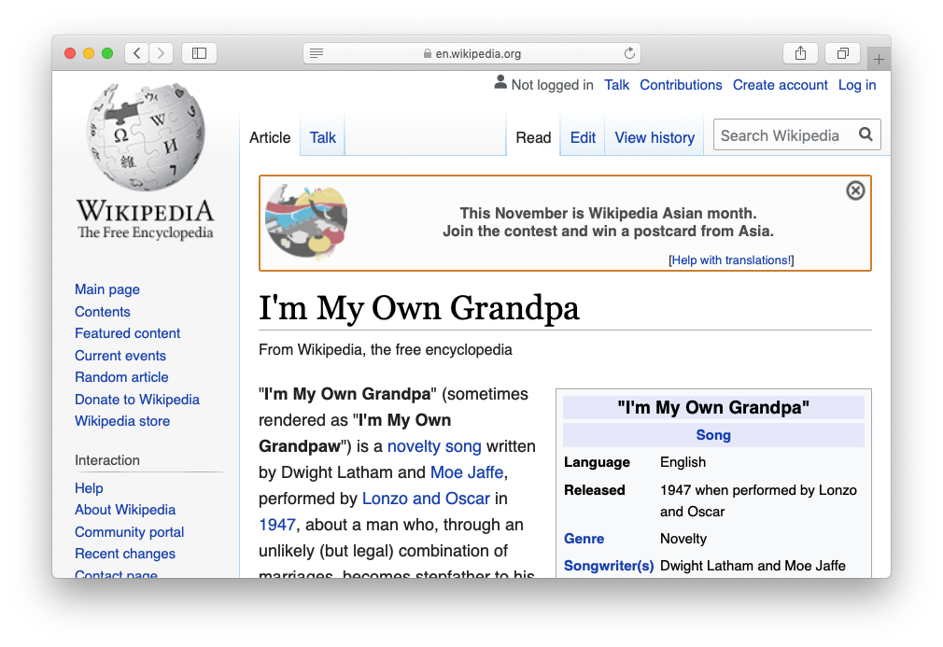
I’m my own grandpa
HEAR IT

Slide 39
I’m my own grandparent
# find people who are their own grandparent
PREFIX dbo: <http://dbpedia.org/ontology/>
SELECT distinct ?P
WHERE {?P dbo:child/dbo:child ?P}
99 results
TRY IT

Slide 40
I’m my own ancestor
# find people who are their own ancestor
PREFIX dbo: <http://dbpedia.org/ontology/>
SELECT distinct ?P
WHERE {?P dbo:child/dbo:child* ?P}
109 results
TRY IT

Slide 41
RDF Named graphs
Having multiple RDF graphs in a single document/repository and naming them with URIs
Provides useful additional functionality built on top of the RDF Recommendations
SPARQL queries can involve several graphs, a background one and multiple named ones, e.g.:
  SELECT ?who ?g ?mbox
  FROM <http://example.org/dft.ttl>
  FROM NAMED <http://example.org/alice>
  FROM NAMED <http://example.org/bob>
  WHERE
  { ?g dc:publisher ?who .
  GRAPH ?g { ?x foaf:mbox ?mbox }
  }

Slide 42
UPDATE QUERIES
Simple insert
INSERT DATA { :book1 :title "A new book" ; :creator "A.N.Other" . }
Simple delete
DELETE DATA { :book1 dc:title "A new book" . }
Combine the two for a modification, optionally guided by the results of a graph pattern
  PREFIX foaf: <http://xmlns.com/foaf/0.1/>
  DELETE { ?person foaf:givenName 'Bill’ }
  INSERT { ?person foaf:givenName 'William’ }
  WHERE { ?person foaf:givenName 'Bill' }

Slide 43
Aggregation Operators
SPARQL 1.1 added many aggregation operators, like count, min, max,sum, avg, sample, group_concat…
Generally used in the results specification, because that’s where the final values are known
  PREFIX dbo: <http://dbpedia.org/ontology/>
  SELECT (COUNT(?film) AS ?numberOfFilms)
  WHERE {?film a dbo:Film .}
This finds 129,980 films

Slide 44
COUNT aggregation operator (1)
  # How many instances of dbo:film in Dbpedia?
  PREFIX dbo: <http://dbpedia.org/ontology/>
  SELECT (COUNT(?film) AS ?numberOfFilms)
  WHERE {?film a dbo:Film .}
Returns "129980"^{^^xsd:integer}
TRY IT

Slide 45
COUNT aggregation operator (2)
  How may films has each director in DBpedia made?
  We need to know how to identify a director
  We can use the strategy of looking at a known director, e.g., Billy Wilder and seeing if there’s an appropriate type
  Another option is to collect objects in a relation dbo:director relation to a film

Slide 46
COUNT aggregation operator (3)
  # How many films has each director made
  PREFIX dbo: <http://dbpedia.org/ontology/>
  SELECT ?dir (COUNT (DISTINCT ?film) as ?num)
  WHERE {?film a dbo:Film;
  dbo:director ?dir. }
  GROUP BY ?dir
  ORDER BY DESC(?num)
TRY IT

Slide 47
COUNT aggregation operator (4)
# How many films has each director made, with example
PREFIX dbo: <http://dbpedia.org/ontology/>
SELECT ?director
(COUNT (DISTINCT ?film) as ?num)
(SAMPLE (?film) as ?example)
WHERE {?film a dbo:Film;
dbo:director ?director. }
GROUP BY ?director
ORDER BY DESC(?num)
TRY IT

Slide 48
COUNT aggregation operator (5)
# How many films has each director made, with example
PREFIX dbo: <http://dbpedia.org/ontology/>
SELECT ?director
(COUNT (DISTINCT ?film) as ?num)
(SAMPLE (?film) as ?example)
WHERE {?film a dbo:Film;
dbo:director ?director. }
GROUP BY ?director
ORDER BY DESC(?num)
LIMIT 10000 OFFSET 10000
# Get More!
TRY IT

Slide 49
Group by
GROUP BY breaks the query's result set into groups before applying the aggregate functions
Find BO’s properties and group them by property and find the number in each group
  PREFIX dbr: <http://dbpedia.org/resource/>
  PREFIX dbo: <http://dbpedia.org/ontology/>
  SELECT ?p (COUNT(?p) as ?number)
  WHERE { dbr:Barack_Obama ?p ?o }
  GROUP BY ?p ORDER BY DESC(count(?p))

Slide 50
Inference via SPARQL
This query adds inverse spouse relations that don’t already exist:
  PREFIX dbo: <http://dbpedia.org/ontology/>
  INSERT { ?p2 dbo:spouse ?p1. }
  WHERE {?p1 dbo:spouse ?p2.
  FILTER NOT EXISTS {?p2 dbo:spouse ?p1}}
SPIN and SHACL are systems to represent simple constraint & inference rules that are done by SPARQL
A big feature is that the rules are represented in the graph

Slide 51
SPARQL 1.1 Additions
SPARQ 1.1 added many more
features …
  Subqueries
  Negation: MINUS
  Federated queries that access multiple endpoints
Data you want to extract from an RDF graph can probably be returned by one query
  Might be a complicated one, though …
Search web for SPARQL tricks or this book

