Slide 1
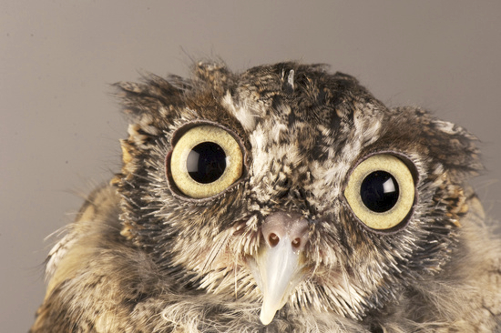
Chapter 4
OWL
Based on slides from Grigoris Antoniou and Frank van Harmelen

Slide 2
TL;DR: What is OWL
OWL uses the syntax of RDF but defines new classes and properties, making it more expressive as knowledge representation language

Slide 3
Outline
A bit of history
Basic Ideas of OWL
The OWL Language
Examples
The OWL Namespace
OWL 2

Slide 4

A Brief History of OWL
Builds on RDF to “represent rich and complex knowledge about things, groups of things, and relations between things”
Draws on decades of experience with systems for representing and reasoning with knowledge
Based on a 2001 DAML+OIL specification
OWL became a W3C recommendation in 2004, extended as OWL2 in 2009
Well defined RDF/XML serializations
Formal semantics based on first order logic
Good tools, both opensource and commercial

Slide 5
The OWL Family Tree
Logic Programming
1970s
SHOE
1996
DAML
RDF/RDF(S)
DAML-ONT
1974
~2000
Frames
Joint EU/US Committee
2004
~2000
DAML+OIL
OWL
1980
Klone
OIL
~2002
W3C
1980s
OntoKnowledge+Others
Description
Logic

Slide 6
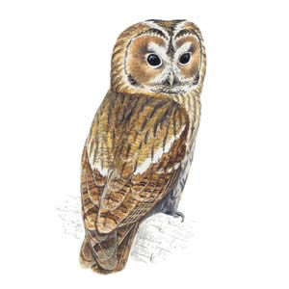
Outline
A bit of history
Basic Ideas of OWL
The OWL Language
Examples
The OWL Namespace
OWL 2

Slide 7
Ontology and Data
Philosophy: Ontologies are models of what exists in the world (kinds of things, relations, events, properties, etc.)
  Information systems: a schema for info. or data
  KR languages: model of classes & relations/properties & associated axioms, e.g., subPropertyOf is transitive
Data is information about individual instances expressed with terms in the ontology
  Some instances might be considered part of the ontology (e.g., God, George Washington, Baltimore)

Slide 8
Requirements for Ontology Languages
Ontology languages let users write explicit, formal conceptualizations of domain models
Requirements:
  well-defined syntax
  efficient reasoning support
  formal semantics
  sufficient expressive power
  convenience of expression

Slide 9
Expressive Power vs. Efficient Reasoning
Always a tradeoff between expressive power and efficient reasoning support
The richer the language, the more inefficient the reasoning support becomes (in general)
Reasoning can be undecidable or semi-decidable and even if decidable can be exponentially hard
We need a compromise between:
  Language supported by reasonably efficient reasoners
  Language that can express large classes of ontologies and knowledge

Slide 10
Kinds of Reasoning about Knowledge
Class membership
  If x is an instance of a class C, and C is a subclass of D, then we can infer that x is an instance of D
Equivalence of classes
  If class A is equivalent to class B, and class B is equivalent to class C, then A is equivalent to C, too
Consistency
  X is an instance of classes A and B, but A and B are disjoint
  This is an indication of an error in the ontology or data
Classification
  Certain property-value pairs are a sufficient condition for membership in a class A; if an individual x satisfies such conditions, we conclude that x must be an instance of A

Slide 11
Uses for Reasoning
Reasoning support is important for
  Deriving new relations and properties
  Automatically classifying instances in classes
  Checking consistency of ontology and knowledge
  checking for unintended relationships between classes
Checks like these are valuable for
  designing large ontologies, where multiple authors are involved
  integrating and sharing ontologies from various sources

Slide 12
Reasoning Support for OWL
Semantics is a prerequisite for reasoning support
Formal semantics and reasoning support usually provided by
  mapping an ontology language to known logical formalism
  using automated reasoners that already exist for those formalisms
OWL is (partially) mapped to a description logic
  DLs are a subset of logic for which efficient reasoning support is possible

Slide 13
RDFS’s Expressive Power Limitations
Local scope of properties
  rdfs:range defines range of a property (e.g., eats) for all instances of a class
  In RDF Schema we can’t declare range restrictions that apply to only some
  E.g., animals eat living_things but cows only eat plants
  :eat rdfs:domain :animal; range :living_thing
    :eat rdfs:domain :cow; range :plant

Slide 14
RDFS’s Expressive Power Limitations
Disjointness of classes
  Sometimes we wish to say that classes are disjoint (e.g. male and female)
Boolean combinations of classes
  We may want to define new classes by combining other classes using union, intersection, and complement
  E.g., person equals union of male and female classes
  E.g., weekdays equals set {:Monday, … :Sunday}

Slide 15
RDFS’s Expressive Power Limitations
Cardinality restrictions
  E.g., a person has exactly two parents, a course is taught by at least one lecturer
Special characteristics of properties
  Transitive property (like hasAncestor)
  Unique property (like hasMother)
  A property is the inverse of another property (like eats and eatenBy

Slide 16
Combining OWL with RDF Schema
Ideally, OWL would extend RDF Schema
  Consistent with the layered architecture of the Semantic Web
But simply extending RDF Schema works against obtaining expressive power and efficient reasoning
  Combining RDF Schema with logic leads to uncontrollable computational properties
OWL uses RDF and most of RDFS

Slide 17
Three Species of OWL 1
W3C’sWeb Ontology Working Group defined OWL as three different sublanguages:
  OWL Full
  OWL DL (DL for Description Logic)
  OWL Lite
Each sublanguage geared toward fulfilling different aspects of requirements

Slide 18
OWL Full
It uses all the OWL languages primitives
It allows the combination of these primitives in arbitrary ways with RDF and RDF Schema
OWL Full is fully upward-compatible with RDF, both syntactically and semantically
OWL Full is so powerful that its reasoning is undecidable

Slide 19
Soundness and completeness
A sound reasoner only makes conclusions that logically follow from the input, i.e., all of its conclusions are correct
  We typically require our reasoners to be sound
A complete reasoner can make all conclusions that logically follow from the input
  We cannot guarantee complete reasoners for full FOL and many subsets
  So, we can’t do it for OWL Full

Slide 20
OWL DL
OWL DL (Description Logic) is a sublanguage of OWL Full that restricts application of the constructors from OWL and RDF
  Application of OWL’s constructors to each other is disallowed
  It corresponds to a well studied description logic
OWL DL permits efficient reasoning support
But we lose full compatibility with RDF
  Not every RDF document is a legal OWL DL document
  Every legal OWL DL document is a legal RDF document

Slide 21
OWL Lite
An even further restriction limits OWL DL to a subset of the language constructors
  E.g., OWL Lite excludes enumerated classes, disjointness statements, and arbitrary cardinality
The advantage of this is a language that is easier to
  grasp, for users
  implement, for tool builders
The disadvantage is restricted expressivity

Slide 22
OWL Compatibility with RDF Schema
All varieties of OWL use RDF for their syntax
Instances are declared as in RDF, using RDF descriptions
OWL constructors are specializations of their RDF counterparts
OWL classes and properties have additional constraints
rdfs:Resource
rdfs:Class
rdf:Property
owl:Class
owl:DatatypeProperty
owl:ObjectProperty

Slide 23
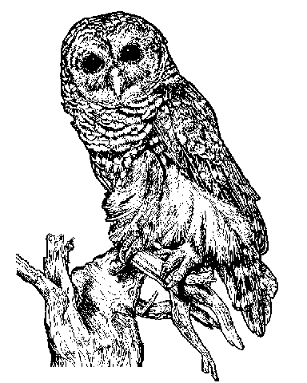
Outline
A bit of history
Basic Ideas of OWL
The OWL Language
Examples
The OWL Namespace
Future Extensions

Slide 24
OWL Syntactic Varieties
OWL builds on RDF and uses RDF’s serializations
Other syntactic forms for OWL have also been defined:
  Alternative, more readable serializations
  These are often used in ontology editing tools, like Protege

Slide 25
OWL XML/RDF Syntax: Header in Turtle
@prefix owl: <http://www.w3.org/2002/07/owl#> .
@prefix rdf: <http://www.w3.org/1999/02/22-rdf-syntax-ns#> .
@prefix rdfs: <http://www.w3.org/2000/01/rdf-schema#> .
@prefix xsd: <http://www.w3.org/2001/ XLMSchema#> .
OWL documents are RDF documents
and start with a typical declaration of namespaces
W3C owl recommendation has the namespace
http://www.w3.org/2002/07/owl#"

Slide 26
owl:Ontology
<> a owl:Ontology ;
rdfs:comment "Example OWL ontology" ;
owl:priorVersion <http://example.org/uni-ns-old> ;
owl:imports <http://example.org/persons> ;
rdfs:label "University Ontology" .
owl:imports, a transitive property, indicates that the document commits to all of the terms as defined in its target
owl:priorVersion points to an earlier version of this document

Slide 27
OWL Classes
:AssociateProfessor a owl:Class ;
owl:disjointWith (:Professor :AssistantProfessor) .
Classes are defined using owl:Class
  owl:Class is a subclass of rdfs:Class
Owl:Class is disjoint with datatypes (aka literals)
Disjointness is defined using owl:disjointWith
  Two disjoint classes are can share no instances

Slide 28
Another Example
:Man rdfs:subClassOf foaf:Person .
:Woman rdfs:subClassOf foaf:Person .
:Man owl:disjointWith :Woman .
Questions:
Is :Man an rdfs:Class or a owl:Class?
Why don’t we need to assert that :Man is some kind of class?
Do we need to assert the disjointness both ways?
What happens of we assert :pat a :Man; a :Woman?
Notes:
Ravi Chandan, Darshan 3000604290 CG40779

Slide 29
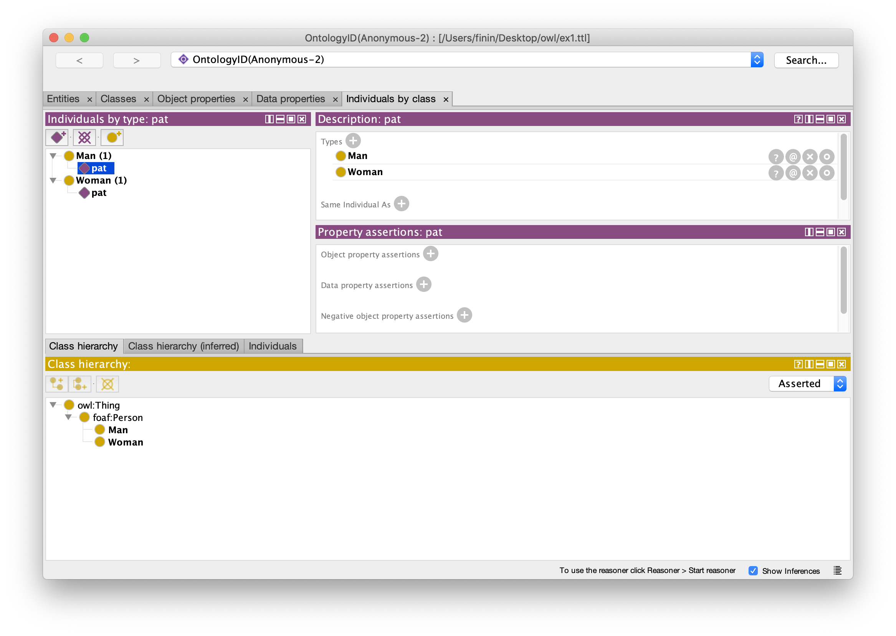
Protégé

Slide 30
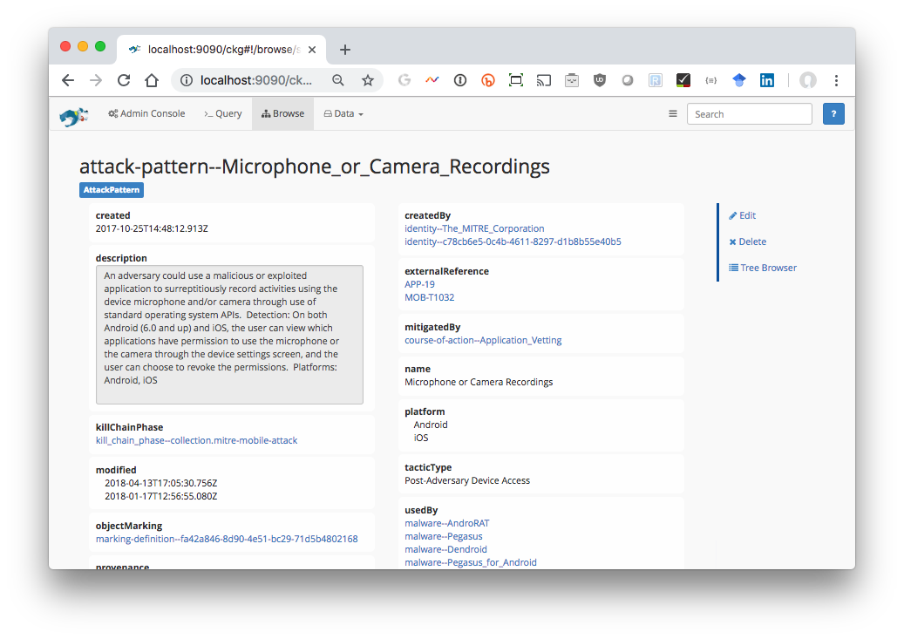
StarDog

Slide 31
OWL Classes
:Faculty a owl:Class;
owl:equivalentClass :AcademicStaffMember .
owl:equivalentClass asserts two classes are equivalent
  Each must have the same members
owl:Thing is the most general class, which contains everything
  i.e., every owl class is rdfs:subClassOf owl:Thing
owl:Nothing is the empty class
  i.e., owl:NoThing is rdfs:subClassOf every owl class

Slide 32
OWL Properties
OWL has two kinds of properties
Object properties relate objects to other objects
  owl:ObjectProperty, e.g. isTaughtBy, supervises
Data type properties relate objects to datatype values
  owl:DatatypeProperty, e.g. phone, title, age, …
These were made separate to make it easier to implement sound and complete reasoners

Slide 33
Datatype Properties
OWL uses XML Schema data types, exploiting the layered architecture of the Semantic Web
:age a owl:DatatypeProperty;
rdfs:domain foaf:Person;
rdfs:range xsd:nonNegativeInteger .

Slide 34
OWL Object Properties
Typically user-defined data types
:isTaughtBy a owl:ObjectProperty;
rdfs:domain :Course;
rdfs:range :AcademicStaffMember;
rdfs:subPropertyOf :involves .

Slide 35
Inverse Properties
:teaches a owl:ObjectProperty;
rdfs:range :Course;
rdfs:domain :AcademicStaffMember;
owl:inverseOf :isTaughtBy .
Or just
:teaches owl:inverseOf :isTaughtBy .
A partial list of axioms:
  owl:inverseOf rdfs:domain owl:ObjectProperty;
  rdfs:range owl:ObjectProperty;
  a owl:SymmetricProperty.
  {?P owl:inverseOf ?Q. ?S ?P ?O} => {?O ?Q ?S}.
  {?P owl:inverseOf ?Q. ?P rdfs:domain ?C} => {?Q rdfs:range ?C}.
  {?A owl:inverseOf ?C. ?B owl:inverseOf ?C} => {?A rdfs:subPropertyOf ?B}.

Slide 36
Equivalent Properties
:lecturesIn owl:equivalentProperty :teaches .
Two properties have the same extension
  Intention vs. extension
  Extension of a property is all of the subject-object pairs it holds between
Axioms
  { ?A rdfs:subPropertyOf ?B.
  ?B rdfs:subPropertyOf ?A.}
  <=> {?A owl:equivalentProperty ?B.}.

Slide 37
Property Restrictions
Declare that class C satisfies certain conditions
  All instances of C satisfy the conditions
Equivalent to: C is subclass of a class C', where C' collects all objects that satisfy the conditions (C' can remain anonymous)
Example:
  People whose sex is male and have at least one child whose sex is female and whose age is six
  Things with exactly two arms and two legs

Slide 38
Property Restrictions
owl:Restriction element describes such a class
Element has an owl:onProperty element and one or more restriction declarations
One type defines cardinality restrictions
  A Parent must have at least one child
  :Parent rdfs:subClassOf
  [a owl:Restriction;
owl:onProperty :hasChild;
owl:minCardinalityQ "1"] .

Slide 39
Property Restrictions
This statement defines Parent as any Person who has at least one child
  :Parent owl:equivalentClass
  owl:intersectionOf (:Person
[a owl:Restriction;
owl:onProperty :hasChild;
owl:minCardinalityQ "1”])
Note the Turtle syntax
  :C1 owl:intersectionOf (:C2 :C3 :C4) .

Slide 40
Property Restrictions
Other restriction types defines constraints on the kinds of values the property may take
  owl:allValuesFrom specifies universal quantification
  owl:hasValue specifies a specific value
  owl:someValuesFrom specifies existential quantification

Slide 41
owl:allValuesFrom
Describe a class where all of the values of a property match some requirement
E.g., Math courses taught by professors:
[a :mathCourse,
[a owl:Restriction;
owl:onProperty :isTaughtBy;
owl:allValuesFrom :Professor] ].

Slide 42
Offspring of people are people
:Person a owl:Class,
rdfs:subClassOf
[ a owl:Restriction;
owl:onProperty bio:offspring;
owl:allValuesFrom :Person] .

Slide 43
Offspring of people are people
:Person a owl:Class,
rdfs:subClassOf
[ a owl:Restriction;
owl:onProperty bio:offspring;
owl:allValuesFrom :Person] .
“The class of things, all of whose offspring are people”
:Person
things, all of whose offspring are people

Slide 44
Offspring of people are people
:Person a owl:Class;
rdfs:subClassOf
[ a owl:Restriction;
owl:allValuesFrom :Person;
owl:onProperty bio:offspring ] .
:john a :Person; bio:offspring :mary

Slide 45
What follows?
:Person rdfs:subClassOf
[owl:allValuesFrom :Person;
owl:onProperty bio:offspring] .
???
:bio:offspring rdfs:domain :animal;
rdfs:range :animal.
???
:alice a foaf:Person;
bio:offspring :bob.
???
:carol a foaf:Person.
:don bio:offspring :carol.
???
“people give birth to people”
Notes:
???1 = nothing
???2 = :Person rdfs:subClassOf :bio:animal
???3 = :alice a :animal. :bob a :animal, :person
???4: :don a :animal

Slide 46
What follows?
:Person rdfs:subClassOf
[owl:allValuesFrom :Person;
owl:onProperty bio:sprungFrom] .
bio:sprungFrom rdfs:domain :animal;
rdfs:range :animal;
owl:inverse bio:offspring.
:carol a foaf:Person.
:don bio:offspring :carol.
???
“people are born of people”
Notes:
:don a foaf:Person

Slide 47
owl:hasValue
Describe a class with a particular value for a property
E.g., Math courses taught by Professor Longhair
# Math courses taught by :longhair
[ rdfs:subclassOf :mathCourse;
[ a owl:restriction;
owl:onProperty :isTaughtBy;
owl:hasValue :longhair] .
Questions:
Does this say all math courses are taught by :longhair?
Does it say that there are some courses taught by :longhair?
Can all classes, however defined, be paraphrased by a noun phrase in English?

Slide 48
A typical example
:Male owl:equivalentClass
owl:intersectionOf
(:Person,
[a owl:Restriction;
owl:onProperty :sex;
owl:hasValue "male"] ).

Slide 49
A typical example
:Man owl:equivalentClass
owl:intersectionOf
(:Person,
[a owl:Restriction;
owl:onProperty :sex;
owl:hasValue "male"] ).
:Person
:Man
:sex == “male”
Classes are sets in OWL

Slide 50
What follows?
:ed a :Man .
???
:frank a foaf:Person; :sex "male".
???
:pat a foaf:Person; :sex "male"; :sex "female" .
???
Notes:
???1: :ed a :Person; :sex “male”
???2: :frank a :Person
???3: :pat a :Person

Slide 51
owl:someValuesFrom
Describe class requiring it to have at least one value for a property matching a description
E.g., Academic staff members who teach an undergraduate course
[ a :academicStaffMember;
a [owl:onProperty :teaches;
owl:someValuesFrom :undergraduateCourse] ]
Notes:
Where did the “a owl:Restriction” go?

Slide 52
Cardinality Restrictions
We can specify minimum and maximum number using owl:minCardinality & owl:maxCardinality
  Courses with fewer than 10 students
  Courses with between 10 and 100 students
  Courses with more than 100 students
Can specify a precise number by using the same minimum and maximum number
  Courses with exactly seven students
For convenience, OWL offers also owl:cardinality
  E.g., exactly N

Slide 53
Cardinality Restrictions
E.g. courses taught be at least two people
[a owl:Restriction;
owl:onProperty :isTaughtBy;
owl:minCardinality “2”^^xsd;nonNegativeInteger] .

Slide 54
What does this say?
:Parent owl:equivalentClass
[a owl:Restriction;
owl:onProperty :hasChild;
owl:minCardinality “1”^^xsd:integer] .
Questions:
Must parents be humans?
Must their children be humans?

Slide 55
Definition of a parent
The parent class is equivalent to the class of things that have at least one child
  All(x): Parent(x) ⬄ Exisits(y) hasChild(x, y)
If hasChild is defined as having Person as it’s domain, then Parents are also people.

Slide 56
Special Properties
owl:TransitiveProperty (transitive property)
  E.g. “has better grade than”, “is ancestor of”
owl:SymmetricProperty (symmetry)
  E.g. “has same grade as”, “is sibling of”
owl:FunctionalProperty defines a property that has at most one value for each object
  E.g. “age”, “height”, “directSupervisor”
owl:InverseFunctionalProperty defines a property for which two different subjects cannot have the same value
  e.g., “ssn”, “mobile phone number”

Slide 57
Boolean Combinations
We can combine classes using Boolean operations (union, intersection, complement)
Negation is introduced by the complementOf, e.g., courses not taught be staffMembers
[ a :course,
owl:Restriction;
owl:onProperty :taughtBy;
owl:allValuesFrom [a owl:Class;
owl:complementOf :staffMember]
] .

Slide 58
Boolean Combinations
The new class is not a subclass of the union, but rather equal to the union
  We have stated an equivalence of classes
E.g., university people is the union of staffMembers and Students
:peopleAtUni
owl:equivalentClass
owl:unionOf (:staffMember :student) .

Slide 59
Boolean Combinations
E.g., CS faculty is the intersection of faculty and things that belongTo the CS Department.
:facultyInCS owl:equivalentClass
owl:intersectionOf
(:faculty
[ a owl:Restriction;
owl:onProperty :belongsTo;
owl:hasValue :CSDepartment ]
) .

Slide 60
Nesting of Boolean Operators
E.g., administrative staff are staff members who are not faculty or technical staff members
:adminStaff owl:equivalentClass
owl:intersectionOf
(:staffMember
[a owl:Class;
owl:complementOf [a owl:Class;
owl:equivalentClass
owl:unionOf (:faculty :techSupportStaff)]])
SM
F
TS

Slide 61
Enumerations with owl:oneOf
E.g., a thing that is either Monday, Tuesday, …
[a owl:Class;
owl:oneOf (:Monday
:Tuesday
:Wednesday
:Thursday
:Friday
:Saturday
:Sunday) ]

Slide 62
Declaring Instances
Instances of OWL classes are declared as in RDF
:john
a :academicStaffMember;
uni:age 39^^xsd:integer .

Slide 63
No Unique-Names Assumption
OWL does not adopt the unique-names assumption of database systems
  That two instances have a different name or ID does not imply that they are different individuals
Suppose we state that each course is taught by at most one staff member, and that a given course is taught by #949318 and is taught by #949352
  An OWL reasoner does not flag an error
  Instead it infers that the two resources are equal

Slide 64
Distinct Objects
To ensure that different individuals are recognized as such, we must explicitly assert their inequality:
  :john owl:differentFrom :mary .

Slide 65
Distinct Objects
OWL provides a shorthand notation to assert the pairwise inequality of all individuals in a given list
[a owl:allDifferent;
owl:distinctMembers (:alice :bob :carol :don) ].

Slide 66

Data Types in OWL
XML Schema provides a mechanism to construct user-defined data types
  E.g., the data type of adultAge includes all
  integers greater than 18
Such derived data types can’t be used in OWL
  The OWL reference document lists all the XML Schema data types that can be used
  These include the most frequently used types such as string, integer, Boolean, time, and date.

Slide 67
Inferring Distinctness
An ontology may provide many ways to infer that individ- uals as distinct from what’s known about them, e.g. they
Belong to sets known to be disjoint (e.g., :Man, :Woman)
  :pat1 a :man. :pat2 a :woman. :Man owl:disjointWith :Woman.
Have inverse functional properties with different values
  :pat1 :ssn “249148660” . :pat2 :ssn “482962271” .
  :ssn a owl:InverseFunctionalProperty .
Have different values for a functional property
  :pat1 :ssn “249148660” . :pat2 :ssn “482962271” .
  :ssn a owl:FunctionalProperty .
Are connected with an irreflexive relation
  :pat1 :hasChild :pat2. :hasChild a owl:IrreflexiveProperty .

Slide 68
Combination of Features in OWL Profiles
Different OWL profiles have different sets of restrictions regarding the application of features
In OWL Full, all the language constructors may be used in any combination as long as the result is legal RDF
OWL DL removes or restricts some features to ensure that complete reasoning is tractable or to make reasoning implementations easier

Slide 69
Restriction of Features in OWL DL
Vocabulary partitioning
  Any resource is allowed to be only a class, a data type, a data type property, an object property, an individual, a data value, or part of the built-in vocabulary, and not more than one of these
Explicit typing
  The partitioning of all resources must be stated explicitly (e.g., a class must be declared if used in conjunction with rdfs:subClassOf)

Slide 70
Restriction of Features in OWL DL
Property Separation
  The set of object properties and data type properties are disjoint
  Therefore the following can never be specified for data type properties:
    owl:inverseOf
    owl:FunctionalProperty
    owl:InverseFunctionalProperty
    owl:SymmetricProperty

Slide 71
Restriction of Features in OWL DL
No transitive cardinality restrictions
  No cardinality restrictions may be placed on transitive properties
  e.g., people with more than 5 descendants
Restricted anonymous classes
  Anonymous classes are only allowed to occur as:
  the domain and range of either owl:equivalentClass or owl:disjointWith
  the range (but not the domain) of rdfs:subClassOf

Slide 72
Restriction of Features in OWL Lite
Restrictions of OWL DL and more
owl:oneOf, owl:disjointWith, owl:unionOf, owl:complementOf, owl:hasValue not allowed
Cardinality statements (minimal, maximal, exact cardinality) can only be made on values 0 or 1
owl:equivalentClass statements can no longer be made between anonymous classes but only between class identifiers

Slide 73
African Wildlife Ontology
An small example using OWL for an ontology of African animals and plants
Used in 2nd edition of the Semantic Web Primer
Used by Maria Keet for her course and book An Introduction to Ontology Engineering
See her recent article, The African Wildlife Ontology tutorial ontologies: requirements, design, and content
See

Slide 74
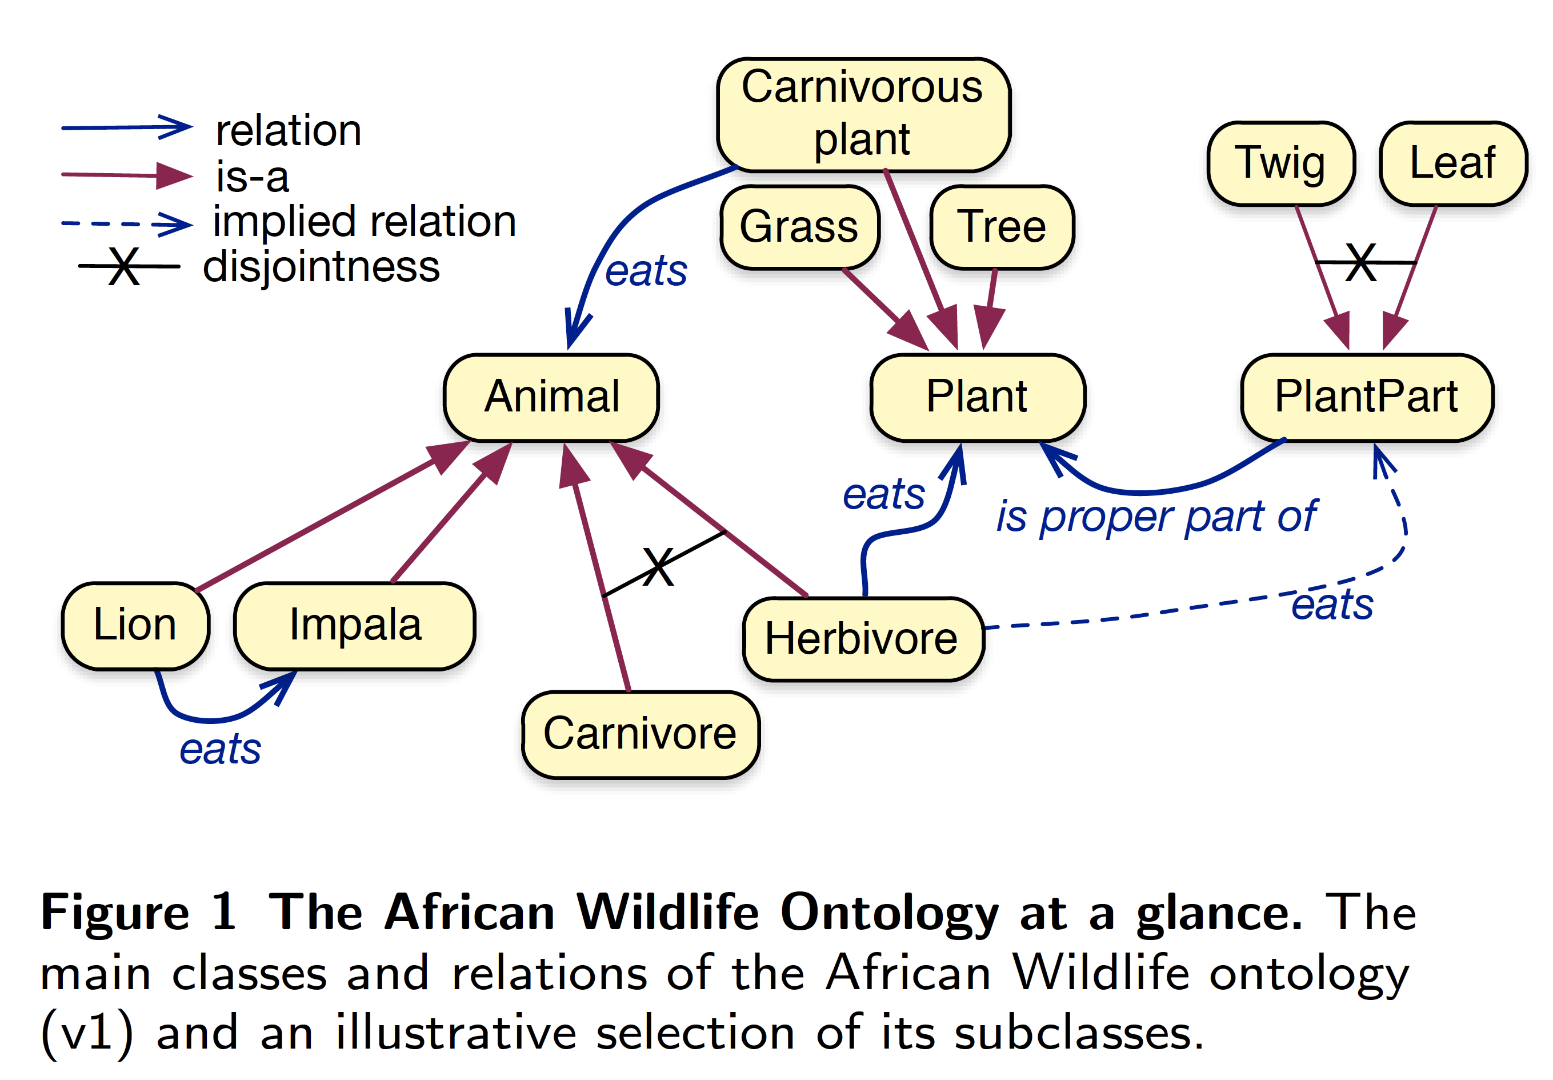
African Wildlife Ontology

Slide 75
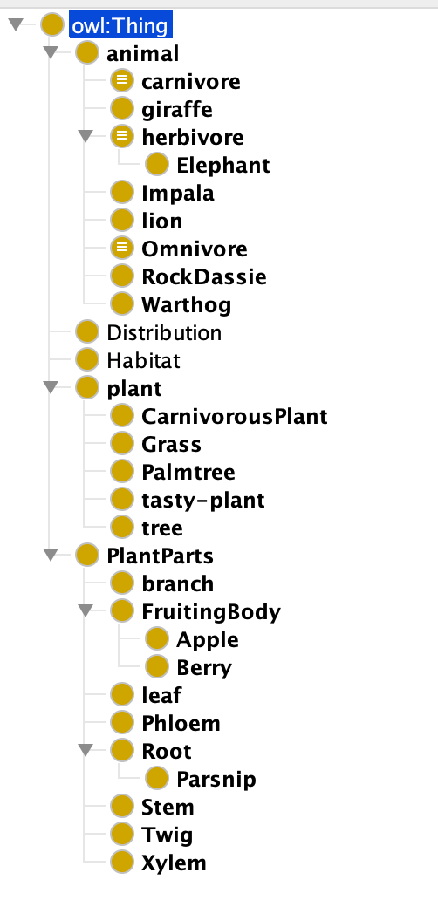
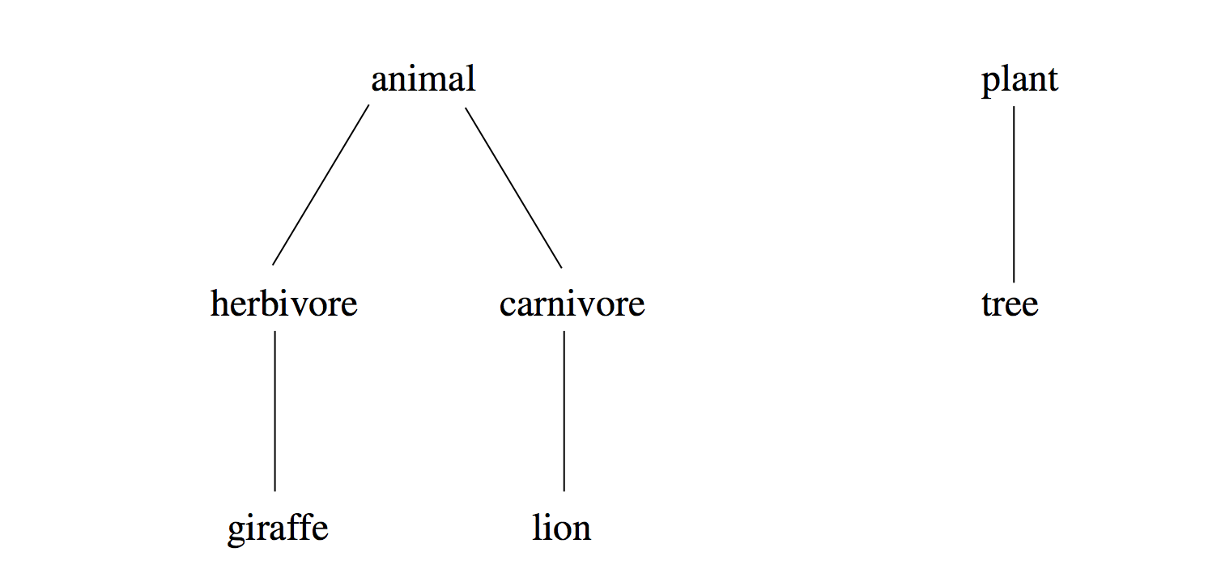
African Wildlife Ontology: Classes
See awo1.ttl

Slide 76
African Wildlife Ontology: Classes
:animal owl:disjointWith :plant .
:herbivore rsds:subClassOf :animal;
owl:disjointWith :carnivore .
:giraffe rdfs:subClassOf :herbivore .
:carnivore rdfs:subClassOf :animal .
:lion rdfs:subClassOf :carnivore .

Slide 77
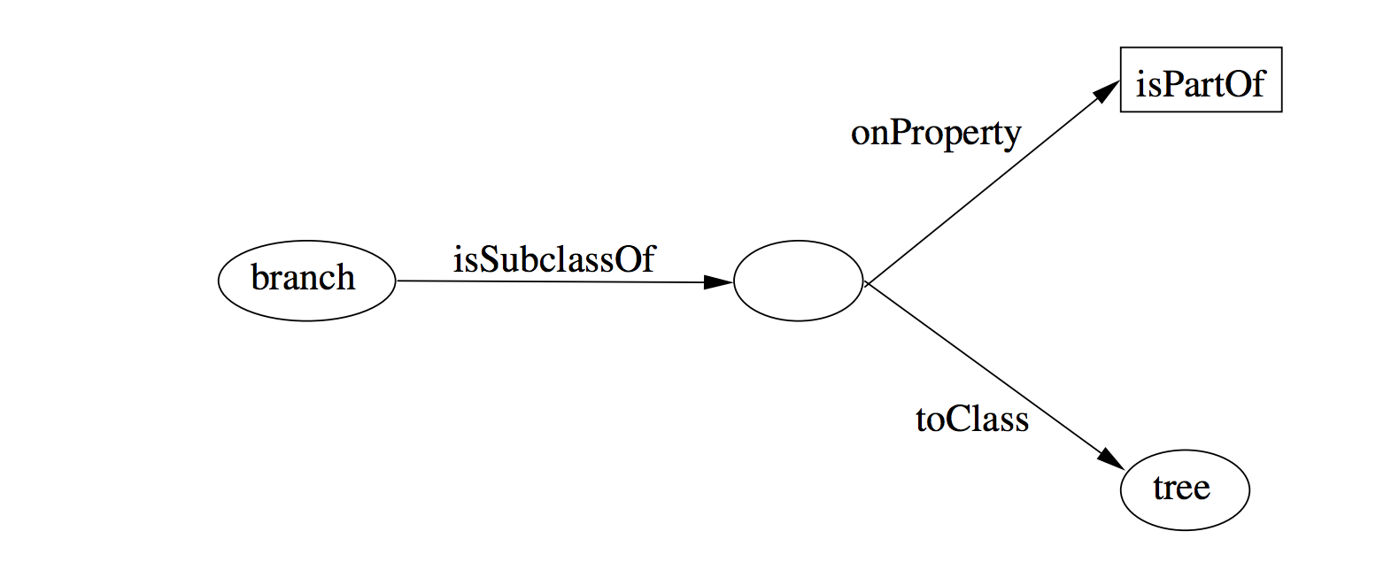
Branches are parts of trees

Slide 78
African Wildlife: Properties
# e.g, hand part of arm, arm part of body
:isPartOf a owl:TransitiveProperty .
# only animals eat things
:eats :domain :animal.
# the inverse of :eats in :eatenBy
:eats owl:inverseOf :eatenBy.
Notes:
<owl:TransitiveProperty rdf:ID="is-part-of"/>
<owl:ObjectProperty rdf:ID="eats">
<rdfs:domain rdf:resource="#animal"/>
</owl:ObjectProperty>
<owl:ObjectProperty rdf:ID="eaten-by">
<owl:inverseOf rdf:resource="#eats"/>
</owl:ObjectProperty>

Slide 79
An African Wildlife: Branches
# plants and animals are disjoint
:plant owl:disjointWith :animal
# trees are plants
:tree rdfs:subClassOf :plant
# branches are only parts of trees
:branch rdfs:subClassOf
[a owl:Restriction;
owl:allValuesFrom :tree
owl:onProperty :isPartOf]
Notes:
<owl:Class rdf:ID="branch">
<rdfs:comment>Branches are parts of trees. </rdfs:comment>
<rdfs:subClassOf>
<owl:Restriction>
<owl:onProperty rdf:resource="#is-part-of"/>
<owl:allValuesFrom rdf:resource="#tree"/>
</owl:Restriction>
</rdfs:subClassOf>
</owl:Class>

Slide 80
African Wildlife: Leaves
# leaves are only parts of branches
:leaf rdfs:subClassOf
[a owl:Restriction;
owl:allValuesFrom :branch
owl:onProperty :isPartOf]
Notes:
<owl:Class rdf:ID="leaf">
<rdfs:comment>Leaves are parts of branches. </rdfs:comment>
<rdfs:subClassOf>
<owl:Restriction>
<owl:onProperty rdf:resource="#is-part-of"/>
<owl:allValuesFrom rdf:resource="#branch"/>
</owl:Restriction>
</rdfs:subClassOf>
</owl:Class>

Slide 81
African Wildlife: Carnivores
# carnivores are exactly those animals
# that eat animals
:Carnivore owl:intersectionOf
(:Animal,
[a owl:Restriction;
owl:someValuesFrom :Animal
owl:onProperty :eats]
) .
Can carnivores eat plants?
Notes:
<owl:Class rdf:ID="carnivore">
<rdfs:comment>Carnivores are exactly those animals that eat also animals.</rdfs:comment>
<owl:intersectionOf rdf:parsetype="Collection">
<owl:Class rdf:about="#animal"/>
<owl:Restriction>
<owl:onProperty rdf:resource="#eats"/>
<owl:someValuesFrom rdf:resource="#animal"/>
</owl:Restriction>
</owl:intersectionOf>
</owl:Class>

Slide 82
African Wildlife: Herbivores
How can we define Herbivores?

Slide 83
African Wildlife: Herbivores
Here is a start
:herbivore a owl:Class;
rdfs:comment "Herbivores are exactly those animals that eat only plants or parts of plants” .

Slide 84
African Wildlife: Herbivores
:Herbivore owl:equivalentClass
[a owl:Class;
owl:intersectionOf
(:Animal
[a owl:Restriction
owl:onProperty :eats;
owl:allValuesFrom
[a owl:Class;
owl:equivalentClass
owl:unionOf
(:Plant
[a owl:Restriction;
owl:onProperty :isPartOf;
owl:allValuesFrom :Plant])]])]

Slide 85
African Wildlife: Giraffes
# giraffes are herbivores, and eat only leaves
Giraffe rdfs:subClassOf
:Herbavore,
[owl:Restriction
owl:onProperty :eats;
owl:allValues:From :Leaf] .
Notes:
<owl:Class rdf:ID="giraffe">
<rdfs:comment>Giraffes are herbivores, and they
eat only leaves.</rdfs:comment>
<rdfs:subClassOf rdf:type="#herbivore"/>
<rdfs:subClassOf>
<owl:Restriction>
<owl:onProperty rdf:resource="#eats"/>
<owl:allValuesFrom rdf:resource="#leaf"/>
</owl:Restriction>
</rdfs:subClassOf>
</owl:Class>

Slide 86
African Wildlife: Lions
# Lions are animals that eat only herbivores
:lion rdfs:subClassOf
:Carnivore,
[a Restriction
owl:onProperty :eats;
owl:allValuesFrom :Herbavore] .
Notes:
<owl:Class rdf:ID="lion">
<rdfs:comment>Lions are animals that eat
only herbivores.</rdfs:comment>
<rdfs:subClassOf rdf:type="#carnivore"/>
<rdfs:subClassOf>
<owl:Restriction>
<owl:onProperty rdf:resource="#eats"/>
<owl:allValuesFrom rdf:resource="#herbivore"/>
</owl:Restriction>
</rdfs:subClassOf>
</owl:Class>

Slide 87
African Wildlife: Tasty Plants
#tasty plants are eaten both by herbivores & carnivores
???????????????

Slide 88
African Wildlife: Tasty Plants
#tasty plants are eaten both by herbivores & carnivores
:TastyPlant
rdfs:subClassOf
:Plant,
[a Restriction
owl:onProperty :eatenBy;
owl:someValuesFrom :Herbavore],
[a Restriction
owl:onProperty :eatenBy;
owl:someValuesFrom :Carnivore .]

Slide 89

Outline
A bit of history
Basic Ideas of OWL
The OWL Language
Examples
The OWL Namespace
OWL 2

Slide 90
Extensions of OWL
Modules and Imports
Defaults
Closed World Assumption
Unique Names Assumption
Procedural Attachments
Rules for Property Chaining

Slide 91
Modules and Imports
The importing facility of OWL is very trivial:
  It only allows importing of an entire ontology, not parts of it
Modules in programming languages based on information hiding: state functionality, hide implementation details
  Open question how to define appropriate module mechanism for Web ontology languages

Slide 92
Defaults
Many practical knowledge representation systems allow inherited values to be overridden by more specific classes in the hierarchy
  treat inherited values as defaults
No consensus has been reached on the right formalization for the nonmonotonic behaviour of default values

Slide 93
Closed World Assumption
OWL currently adopts the open-world assumption:
  A statement cannot be assumed true on the basis of a failure to prove it
  On the huge and only partially knowable WWW, this is a correct assumption
Closed-world assumption: a statement is true when its negation cannot be proved
  tied to the notion of defaults, leads to nonmonotonic behaviour

Slide 94
Unique Names Assumption
Typical database applications assume that individuals with different names are indeed different individuals
OWL follows the usual logical paradigm where this is not the case
  Plausible on the WWW
One may want to indicate portions of the ontology for which the assumption does or does not hold

Slide 95
Procedural Attachments
A common concept in knowledge representation is to define the meaning of a term by attaching a piece of code to be executed for computing the meaning of the term
  Not through explicit definitions in the language
Although widely used, this concept does not lend itself very well to integration in a system with a formal semantics, and it has not been included in OWL

Slide 96
Rules for Property Chaining
OWL does not allow the composition of properties for reasons of decidability
In many applications this is a useful operation
One may want to define properties as general rules (Horn or otherwise) over other properties
Integration of rule-based knowledge representation and DL-style knowledge representation is an area of research

Slide 97
OWL 2 adds
Qualified cardinality
  A hand has five digits, one of which is a thumb and four of which are fingers
Stronger datatype/range support
Additional property characteristics
  E.g., reflexivity
Role chains
  E.g., hasParent.hasSibling.hasChild
A better defined model for punning within DL
  Allows a term to name both a concept and an individual
More powerful annotations

Slide 98
Conclusions
OWL is the proposed standard for Web ontologies
OWL builds upon RDF and RDF Schema:
  (XML-based) RDF syntax is used
  Instances are defined using RDF descriptions
  Most RDFS modelling primitives are used
Formal semantics and reasoning support is provided through the mapping of OWL on logics
  Predicate logic and description logics have been used for this purpose
While OWL is sufficiently rich to be used in practice, extensions are in the making
  They will provide further logical features, including rules

