Slide 1
Introduction to
Knowledge Graphs and the
Semantic Web

Slide 2
Questions
What are Graph Databases?
What are Knowledge Graphs
What is the Semantic Web?
How are they all related?
How are they being used today?
What can we expect in the future?

Slide 3

Web is our greatest knowledge source
Notes:
The Web is the greatest source of general knowledge available today.

Slide 4
But it has limitations
Notes:
The Web is the greatest source of general knowledge available today.

Slide 5

Designed for people, not machines

Slide 6
Designed for people, not machines
Content is mostly text, spoken language, images and videos
Easy for people to understand
But hard for machines
Machines need access to this knowledge too

Slide 7
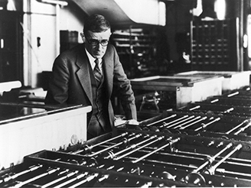
Access via information retrieval
Vannevar Bush envisioned a hypertext/IR system in 1945

Slide 8
Access is primarily via information retrieval
Key-word queries→ranked document list
We still need to read the documents or watch the videos
We often want an answer to a question: where is the Census Big Data Day event
And so do our machines and apps
Vannevar Bush envisioned a hypertext/IR system in 1945

Slide 9
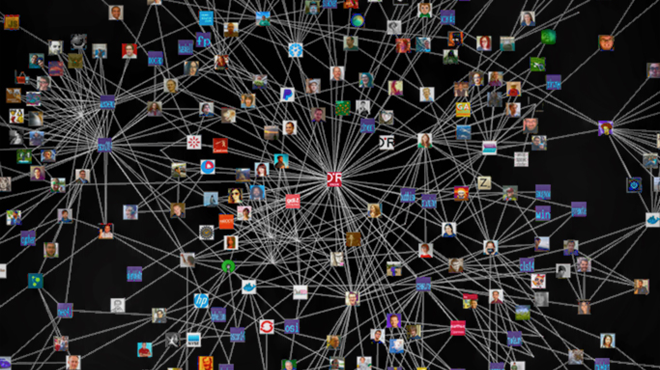
We need to add knowledge graphs

Slide 10
We need to add knowledge graphs
High quality semi-structured information about entities and relations
Represented and accessed via Web standards
Easily integrated, fused and reasoned with

Slide 11
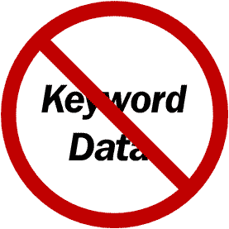
State of the Art?
Google is a good example, but Microsoft, IBM, Apple and Facebook all have similar capabilities
2010 Google acquired MediaWeb and its Freebase KB
2014: Freebase: 1.2B facts about 43M entities
2015+: Google knowledge graph, updated by text IE
DBpedia open source RDF KB is another
800M facts about 4.6M subjects from English Wikipedia, data available in 21 other languages
Helps integrate 90B facts from 1000 RDF datasets in the linked data cloud

Slide 12
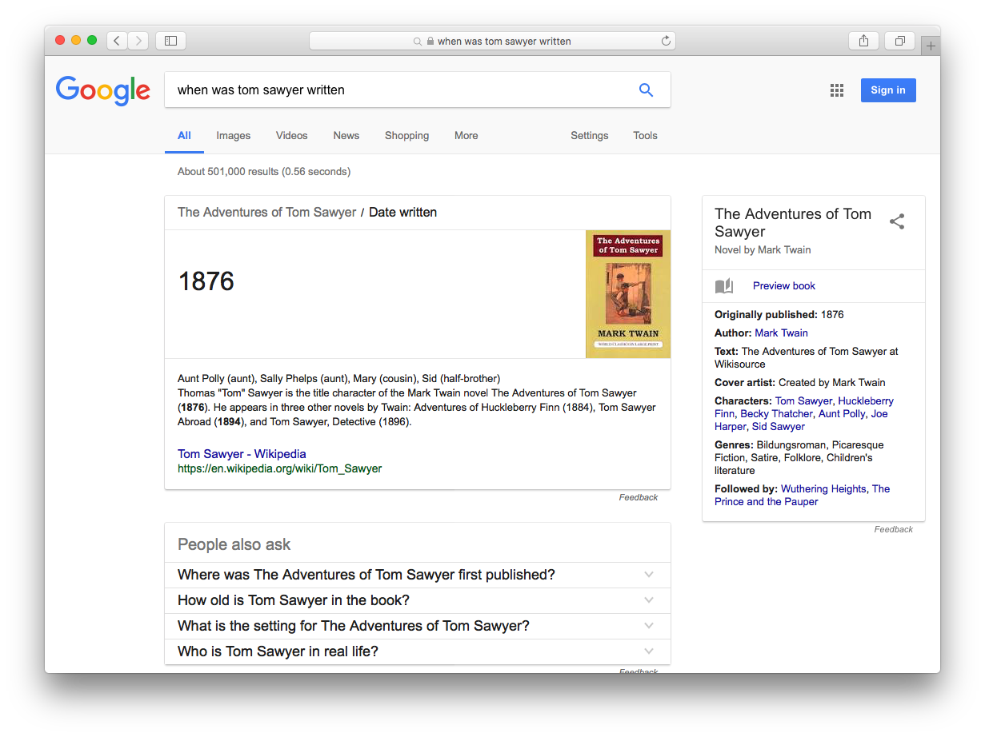
Ask: When was Tom Sawyer written?

Slide 13
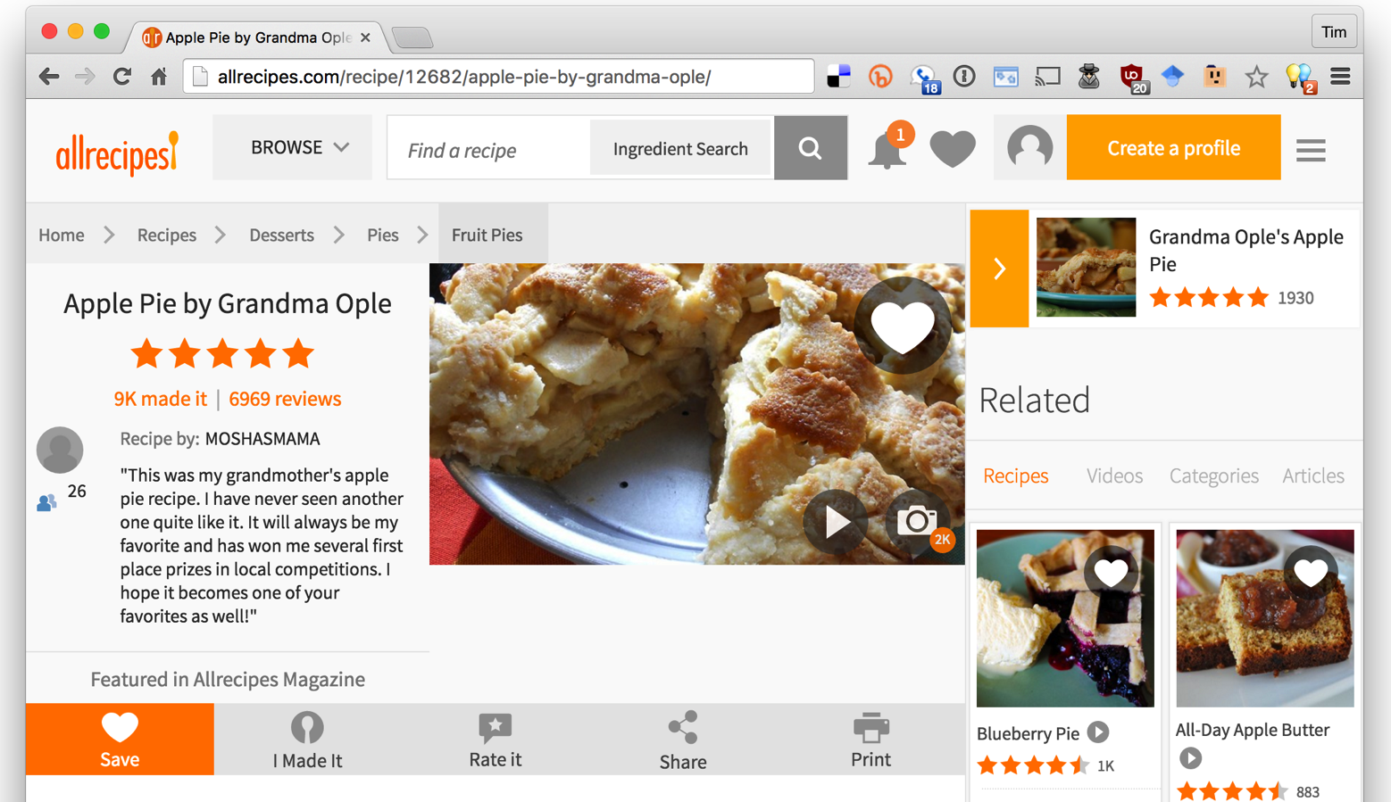
Many commercial recipe sites on Web
Notes:
As a separate, but related example of using data on the web, many sites not embed semantic data on web pages. The data is represented in an RDF-compatible graph format using terms defined in common ontologies found at schema.org.

Slide 14
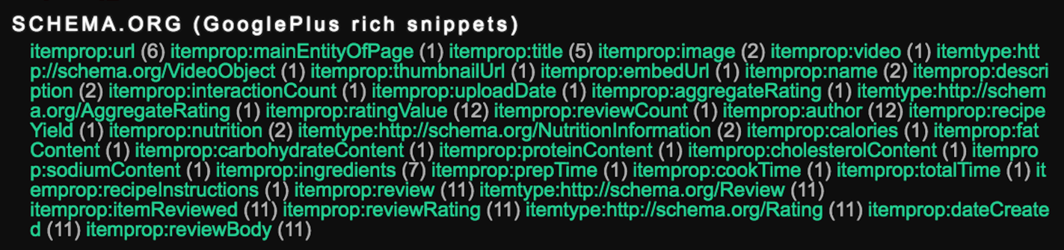
Most recipe sites embed semantic data about their recipes in an RDF-compatible form using terms from the schema.org ontology
Search engines read and use this data to better under-stand the semantics of the page content

Slide 15
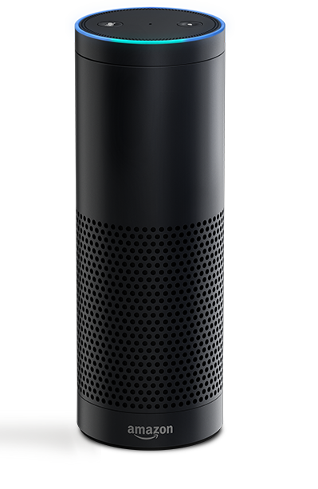
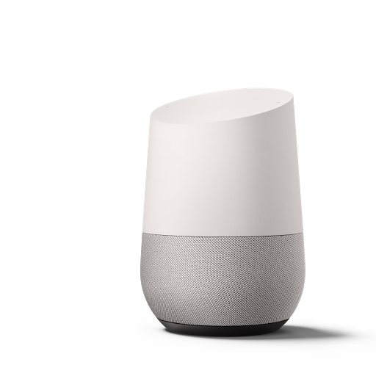

Conversational Bots
Voice-driven conversational systems like Siri, Amazon Echo and Google Home use knowledge graphs to help understand
our requests

Slide 16
Where does the knowledge come from?
Knowledge graphs like DBpedia & Freebase started with Wikipedia data encoded in custom ontologies (aka schemas)
Semantic Web technologies are an open source way to encode the knowledge
They are and will continue to evolve, see Wikidata
Current: extract data from text documents, e.g., articles, newswire, social media, etc.

Slide 17
Who invented the Web?

Slide 18
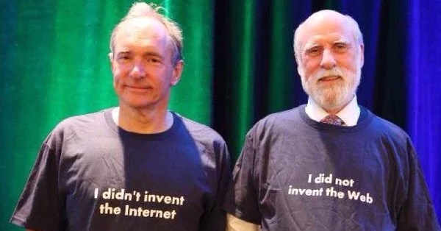
Who invented the Web?

Slide 19

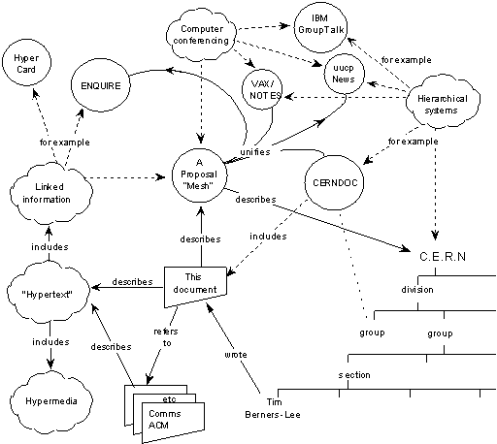
Semantic Web Origin
Tim Berners-Lee’s original 1989 pro-posal described a web of relationships among named objects unifying many information management tasks
Capsule history
Guha’s MCF (~94)
XML+MCF=>RDF (~96)
RDF+OO=>RDFS (~99)
RDFS+KR=>DAML+OIL (00)
W3C’s SW activity (01)
W3C’s OWL (03)
…
http://www.w3.org/History/1989/proposal.html

Slide 20
W3C’s Semantic Web Goals
Focus on machine consumption:
  "The Semantic Web is an extension of the current web in which information is given well-defined meaning, better enabling computers and people to work in cooperation."
  -- Berners-Lee, Hendler and Lassila, The Semantic Web, Scientific American, 2001

Slide 21
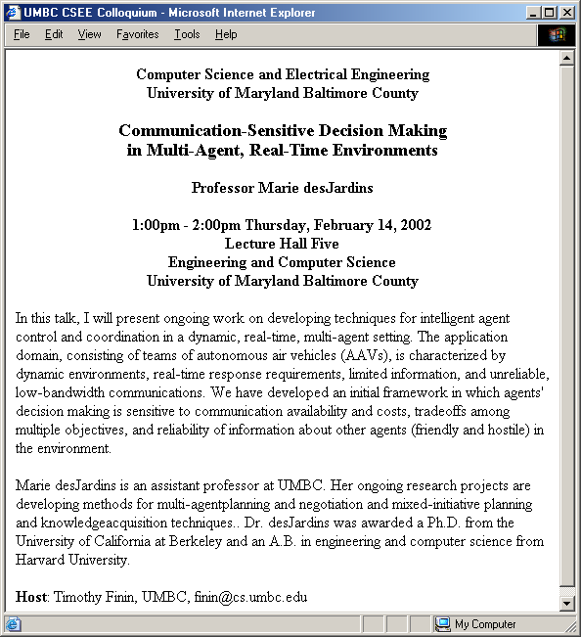
Why is this hard?
after Frank van Harmelen
and Jim Hendler

Slide 22
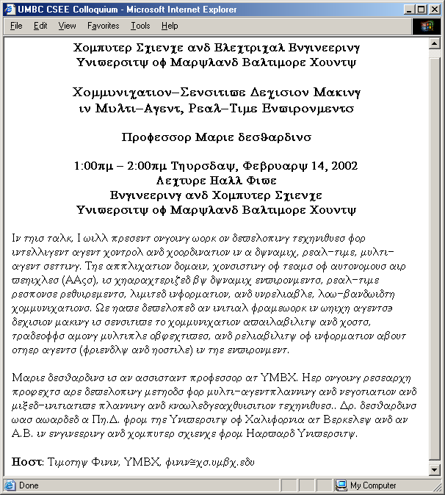
What this looks like to a machine…
after Frank van Harmelen
and Jim Hendler

Slide 23
OK, so HTML is not helpful
Maybe we can tell the machine what the different parts of the text represent?
title
speaker
time
location
abstract
biosketch
host

Slide 24
XML to the rescue?
XML fans propose creating a XML tag set to use for each application.
For talks, we can choose <title>, <speaker>, etc.
<title>
</title>
<speaker>
</speaker>
<time>
</time>
<location>
</location>
<abstract>
</abstract>
<biosketch>
</biosketch>
<host>
</host>
after Frank van Harmelen and Jim Hendler

Slide 25
XML ≠ machine accessible meaning
But, to your machine, the tags still look like this….
The tag names carry no meaning.
XML DTDs and
Schemas have little or no semantics.
<τιτλε>
</τιτλε>
<σπεακερ>
</σπεακερ>
<τιμε>
</τιμε>
<λοχατιον>
</λοχατιον>
<αβστραχτ>
</αβστραχτ>
<βιοσκετχη>
</βιοσκετχη>
<ηοστ>
</ηοστ>
after Frank van Harmelen and Jim Hendler

Slide 26
XML Schema helps
<?xml version="1.0" encoding="utf-8"?>
<xs:schema xmlns:xs="http://www.w3.org/2001/XMLSchema">
<xs:element name="book">
<xs:complexType>
<xs:sequence>
<xs:element name="title" type="xs:string"/>
<xs:element name="author" type="xs:string"/>
<xs:element name="character" minOccurs="0" maxOccurs="unbounded">
<xs:complexType>
<xs:sequence>
<xs:element name="name" type="xs:string"/>
<xs:element name="friend-of" type="xs:string" minOccurs="0"
maxOccurs="unbounded"/>
<xs:element name="since" type="xs:date"/>
<xs:element name="qualification" type="xs:string"/>
</xs:sequence>
</xs:complexType>
</xs:element>
</xs:sequence>
<xs:attribute name="isbn" type="xs:string"/>
</xs:complexType>
</xs:element>
</xs:schema>
XML Schemas provide a simple mechanism to define shared vocabularies.
XML Schema file
<τιτλε>
</τιτλε>
<τιτλε>
</τιτλε>
<σπεακερ>
</σπεακερ>
<σπεακερ>
</σπεακερ>
<τιμε>
</τιμε>
<τιμε>
</τιμε>
<λοχατιον>
<λοχατιον>
</λοχατιον>
</λοχατιον>
<αβστραχτ>
<αβστραχτ>
</αβστραχτ>
</αβστραχτ>
<βιοσκετχη>
<βιοσκετχη>
</βιοσκετχη>
</βιοσκετχη>
<ηοστ>
</ηοστ>
<ηοστ>
</ηοστ>
after Frank van Harmelen and Jim Hendler

Slide 27
But there are many schemas
<?xml version="1.0" encoding="utf-8"?>
<xs:schema xmlns:xs="http://www.w3.org/2001/XMLSchema">
<xs:element name="book">
<xs:complexType>
<xs:sequence>
<xs:element name="title" type="xs:string"/>
<xs:element name="author" type="xs:string"/>
<xs:element name="character" minOccurs="0" maxOccurs="unbounded">
<xs:complexType>
<xs:sequence>
<xs:element name="name" type="xs:string"/>
<xs:element name="friend-of" type="xs:string" minOccurs="0"
maxOccurs="unbounded"/>
<xs:element name="since" type="xs:date"/>
<xs:element name="qualification" type="xs:string"/>
</xs:sequence>
</xs:complexType>
</xs:element>
</xs:sequence>
<xs:attribute name="isbn" type="xs:string"/>
</xs:complexType>
</xs:element>
</xs:schema>
<?xml version="1.0" encoding="utf-8"?>
<xs:schema xmlns:xs="http://www.w3.org/2001/XMLSchema">
<xs:element name="book">
<xs:complexType>
<xs:sequence>
<xs:element name="title" type="xs:string"/>
<xs:element name="author" type="xs:string"/>
<xs:element name="character" minOccurs="0" maxOccurs="unbounded">
<xs:complexType>
<xs:sequence>
<xs:element name="name" type="xs:string"/>
<xs:element name="friend-of" type="xs:string" minOccurs="0"
maxOccurs="unbounded"/>
<xs:element name="since" type="xs:date"/>
<xs:element name="qualification" type="xs:string"/>
</xs:sequence>
</xs:complexType>
</xs:element>
</xs:sequence>
<xs:attribute name="isbn" type="xs:string"/>
</xs:complexType>
</xs:element>
</xs:schema>
XML Schema file 1
XML Schema file 42
<τιτλε>
</τιτλε>
<title>
</title>
<σπεακερ>
</σπεακερ>
<speaker>
</speaker>
<τιμε>
</τιμε>
<time>
</time>
<λοχατιον>
<location>
</λοχατιον>
</location>
<αβστραχτ>
<abstract>
</αβστραχτ>
</abstract>
<βιοσκετχη>
<biosketch>
</βιοσκετχη>
</biosketch>
<ηοστ>
</ηοστ>
<host>
</host>
after Frank van Harmelen and Jim Hendler

Slide 28
There’s no way to relate schema
<?xml version="1.0" encoding="utf-8"?>
<xs:schema xmlns:xs="http://www.w3.org/2001/XMLSchema">
<xs:element name="book">
<xs:complexType>
<xs:sequence>
<xs:element name="title" type="xs:string"/>
<xs:element name="author" type="xs:string"/>
<xs:element name="character" minOccurs="0" maxOccurs="unbounded">
<xs:complexType>
<xs:sequence>
<xs:element name="name" type="xs:string"/>
<xs:element name="friend-of" type="xs:string" minOccurs="0"
maxOccurs="unbounded"/>
<xs:element name="since" type="xs:date"/>
<xs:element name="qualification" type="xs:string"/>
</xs:sequence>
</xs:complexType>
</xs:element>
</xs:sequence>
<xs:attribute name="isbn" type="xs:string"/>
</xs:complexType>
</xs:element>
</xs:schema>
<?xml version="1.0" encoding="utf-8"?>
<xs:schema xmlns:xs="http://www.w3.org/2001/XMLSchema">
<xs:element name="book">
<xs:complexType>
<xs:sequence>
<xs:element name="title" type="xs:string"/>
<xs:element name="author" type="xs:string"/>
<xs:element name="character" minOccurs="0" maxOccurs="unbounded">
<xs:complexType>
<xs:sequence>
<xs:element name="name" type="xs:string"/>
<xs:element name="friend-of" type="xs:string" minOccurs="0"
maxOccurs="unbounded"/>
<xs:element name="since" type="xs:date"/>
<xs:element name="qualification" type="xs:string"/>
</xs:sequence>
</xs:complexType>
</xs:element>
</xs:sequence>
<xs:attribute name="isbn" type="xs:string"/>
</xs:complexType>
</xs:element>
</xs:schema>
XML Schema file 1
XML Schema file 42
<τιτλε>
</τιτλε>
<title>
</title>
<σπεακερ>
</σπεακερ>
<speaker>
</speaker>
<τιμε>
</τιμε>
<time>
</time>
<λοχατιον>
<location>
</λοχατιον>
</location>
<αβστραχτ>
<abstract>
</αβστραχτ>
</abstract>
<βιοσκετχη>
<biosketch>
</βιοσκετχη>
</biosketch>
<ηοστ>
</ηοστ>
<host>
</host>
Either manually or automatically.
XML Schema is weak on semantics.

Slide 29
An Ontology level is needed
XML
Ontology
256
<?xml version="1.0" encoding="utf-8"?>
<xs:schema xmlns:xs="http://www.w3.org/2001/XMLSchema">
<xs:element name="book">
<xs:complexType>
<xs:sequence>
<xs:element name="title" type="xs:string"/>
<xs:element name="author" type="xs:string"/>
<xs:element name="character" minOccurs="0" maxOccurs="unbounded">
<xs:complexType>
<xs:sequence>
<xs:element name="name" type="xs:string"/>
<xs:element name="friend-of" type="xs:string" minOccurs="0"
maxOccurs="unbounded"/>
<xs:element name="since" type="xs:date"/>
<xs:element name="qualification" type="xs:string"/>
</xs:sequence>
</xs:complexType>
</xs:element>
</xs:sequence>
<xs:attribute name="isbn" type="xs:string"/>
</xs:complexType>
</xs:element>
</xs:schema>
Ontologies add
  Structure
  Constraints
  mappings
imports
imports
XML Ontology 1
XML Ontology 42
<?xml version="1.0" encoding="utf-8"?>
<xs:schema xmlns:xs="http://www.w3.org/2001/XMLSchema">
<xs:element name="book">
<xs:complexType>
<xs:sequence>
<xs:element name="title" type="xs:string"/>
<xs:element name="author" type="xs:string"/>
<xs:element name="character" minOccurs="0" maxOccurs="unbounded">
<xs:complexType>
<xs:sequence>
<xs:element name="name" type="xs:string"/>
<xs:element name="friend-of" type="xs:string" minOccurs="0"
maxOccurs="unbounded"/>
<xs:element name="since" type="xs:date"/>
<xs:element name="qualification" type="xs:string"/>
</xs:sequence>
</xs:complexType>
</xs:element>
</xs:sequence>
<xs:attribute name="isbn" type="xs:string"/>
</xs:complexType>
</xs:element>
</xs:schema>
<?xml version="1.0" encoding="utf-8"?>
<xs:schema xmlns:xs="http://www.w3.org/2001/XMLSchema">
<xs:element name="book">
<xs:complexType>
<xs:sequence>
<xs:element name="title" type="xs:string"/>
<xs:element name="author" type="xs:string"/>
<xs:element name="character" minOccurs="0" maxOccurs="unbounded">
<xs:complexType>
<xs:sequence>
<xs:element name="name" type="xs:string"/>
<xs:element name="friend-of" type="xs:string" minOccurs="0"
maxOccurs="unbounded"/>
<xs:element name="since" type="xs:date"/>
<xs:element name="qualification" type="xs:string"/>
</xs:sequence>
</xs:complexType>
</xs:element>
</xs:sequence>
<xs:attribute name="isbn" type="xs:string"/>
</xs:complexType>
</xs:element>
</xs:schema>
=
<>
We need a way to define ontologies in XML
So we can relate them
So machines can understand (to some degree) their meaning

Slide 30
Semantic Web
Use Semantic Web Technology to publish shared data & knowledge
Semantic web technologies allow machines to share data and knowledge using common web language and protocols.
~ 1997
Semantic Web beginning

Slide 31
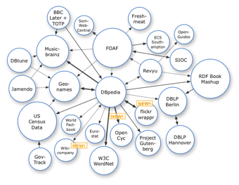
Semantic Web => Linked Open Data
Use Semantic Web Technology to publish shared data & knowledge
2007
Data is inter-
linked to support inte-
gration and fusion of knowledge
LOD beginning

Slide 32
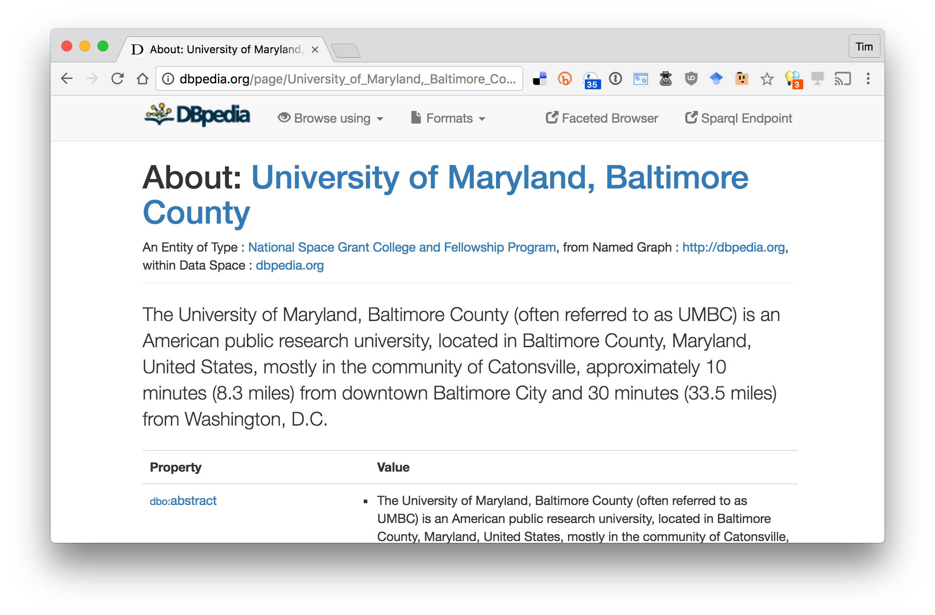
The node in the center is DBpedia
http://dbpedia.org/page/University_of_Maryland,_Baltimore_County

Slide 33
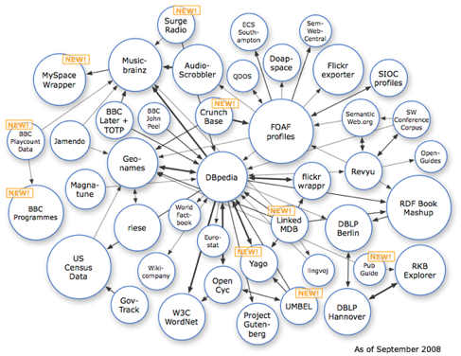
Semantic Web => Linked Open Data
Use Semantic Web Technology to publish shared data & knowledge
2008
Data is inter-
linked to support inte-
gration and fusion of knowledge
LOD growing

Slide 34
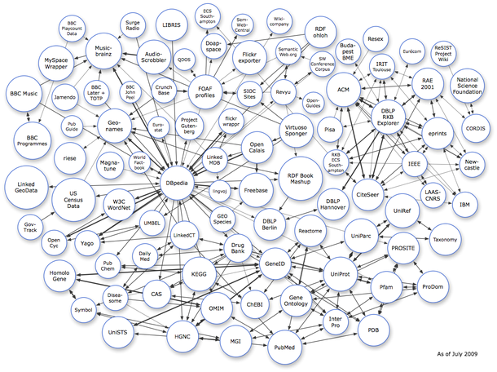
Semantic Web => Linked Open Data
Use Semantic Web Technology to publish shared data & knowledge
2009
Data is inter-
linked to support inte-
gration and fusion of knowledge
… and growing

Slide 35
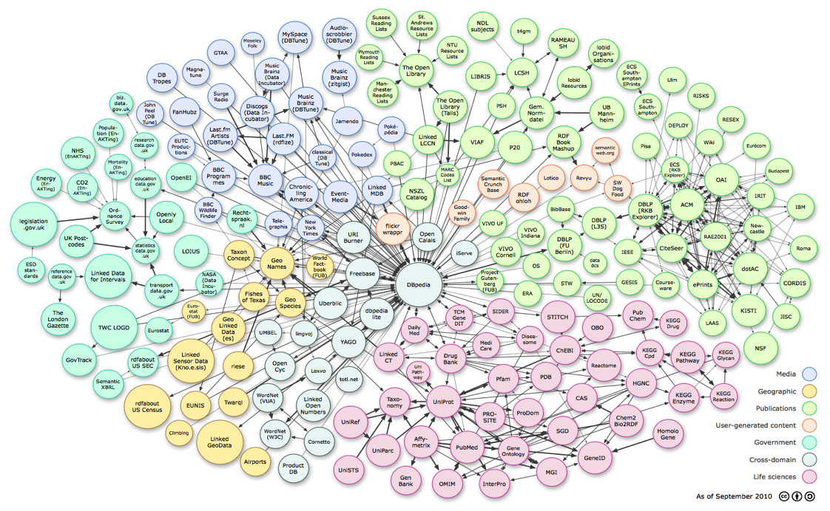
Linked Open Data
Use Semantic Web Technology to publish shared data & knowledge
LOD is the new Cyc: a common source of background
knowledge
Data is inter-
linked to support inte-
gration and fusion of knowledge
2010
…growing faster

Slide 36
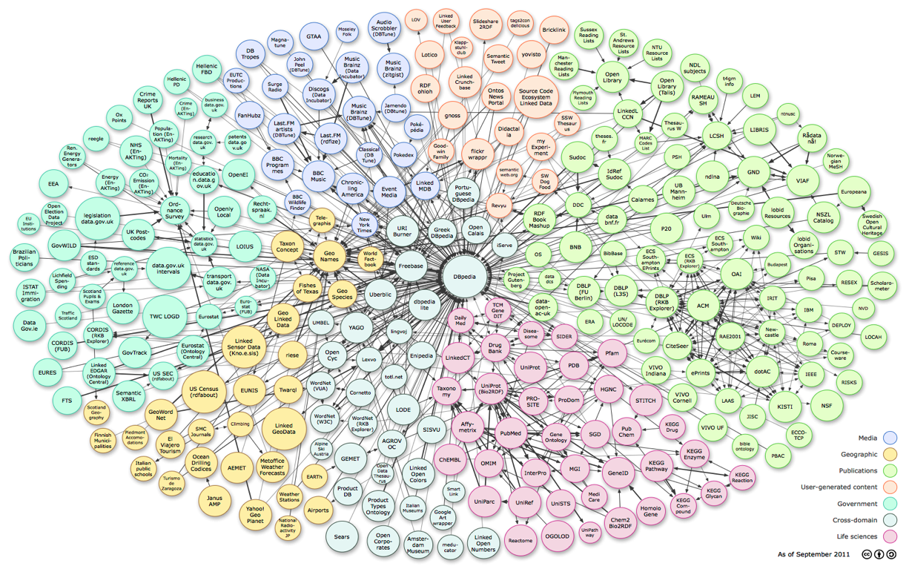
Linked Open Data
Use Semantic Web Technology to publish shared data & knowledge
LOD is the new Cyc: a common source of background
knowledge
Data is inter-
linked to support inte-
gration and fusion of knowledge
2011: 31B facts in 295 datasets interlinked by 504M assertions on ckan.net

Slide 37
Semantic Web: 1, 2, 3
Languages typically divided into three parts:
Syntax: legal forms that make up the sentences in a language
Semantics: mapping of sentences to meaning (perhaps truth theoretic)
Pragmatics: everything else (how to do things with language, knowledge of world, etc.)

Slide 38
1: Syntax
URIs denote classes, properties, objects, relations
  http://live.dbpedia.org/resource/Alan_Turing
  http://schema.org/Person
  http://www.w3.org/1999/02/22-rdf-syntax-ns#type
Use strings for literals
Use triples to make statements
  dbpedia:Alan_Turing rdfs:type schema:Person .
  “Alan Turing is a Person”
*URI = Uniform Resource Identifier

Slide 39
2: Semantics
Semantics maps URIs to the things they denote in “the world”
Some of this in in your mind or in how you write your program
Meaning of some URIs allow inference
  parent relation is inverse of the child relation
  schema:parent owl:inverse schema:child

Slide 40
3: Pragmatics
Semantics is more than just about truth (statements that assert things)
Must account for commands, requests, questions, context, etc.
  Some handled by Web protocols (GET, POST)
  Some by special protocols (e.g., SPARLQ queries)
  Some by having reference KBs of the world (e.g., DBpedia) to help identify common entities

Slide 41
Where are we
The W3C version of the open semantic web has been growing steadily
Languages and standards are being used in
  BBC uses RDF to make up much of its content online
  Google and Facebook detect AND MAKE USE OF (some) RDF embedded in html pages
  Google, Yahoo, Microsoft and Yandex formed Schema.org to develop useful vocabularies
  Data.gov has many datasets in RDF

Slide 42
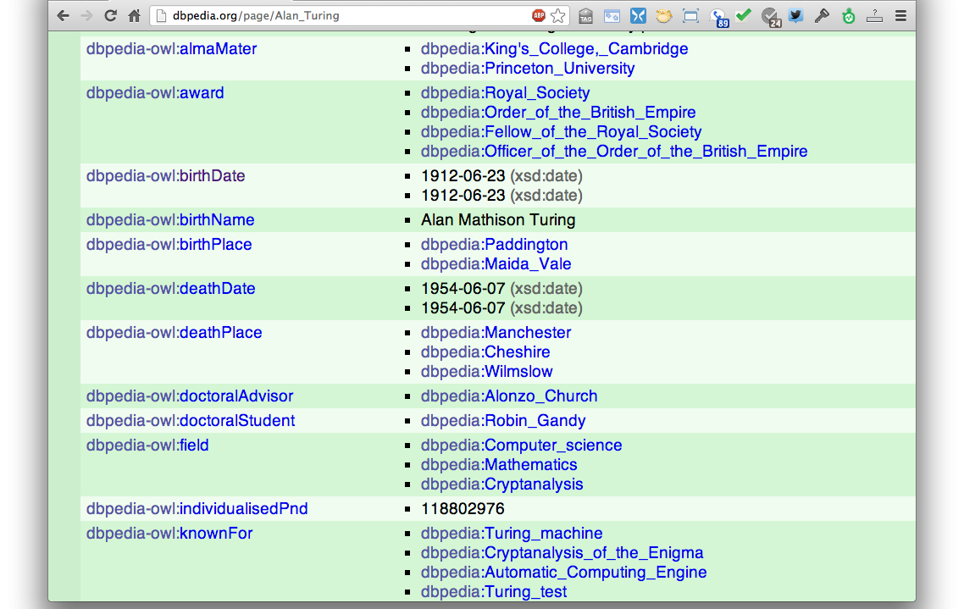
DBpedia
Wikipedia data in RDF
dbpedia:Alan_Turing dbpedia-owl:doctoralAdvisor dbpedia:Alonzo_Church .

Slide 43
Wikidata
Wikidata aims to create an rdf-compatible KG that can be read/edited by humans & machines
  Wikimedia project started in April 2012
Wikidata clients use the repository, e.g., to populate Web pages or Wikipedia infoboxes
Based on ideas from Semantic MediaWiki and Freebase

Slide 44
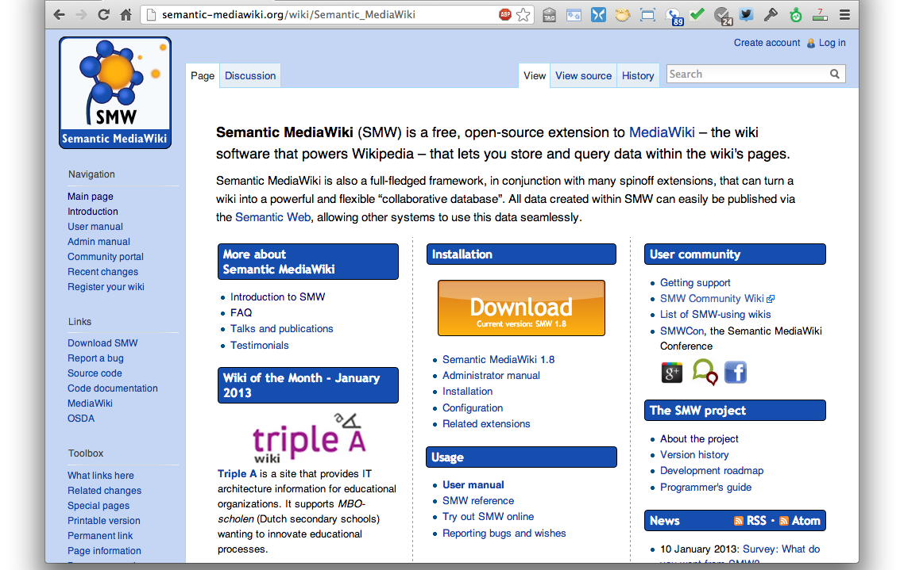
Semantic Media Wiki
Open source since 2005
Store infobox info in a KB

Slide 45
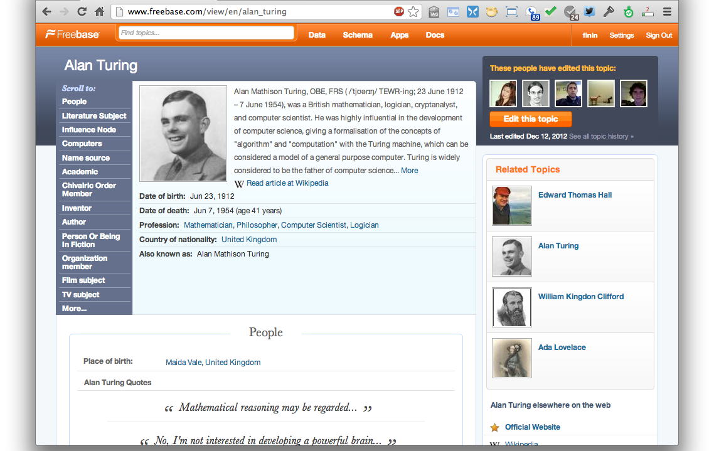
Freebase
Acquired by Google in 2010
“An entity graph of people, places and things, built by a community that loves open data”

Slide 46
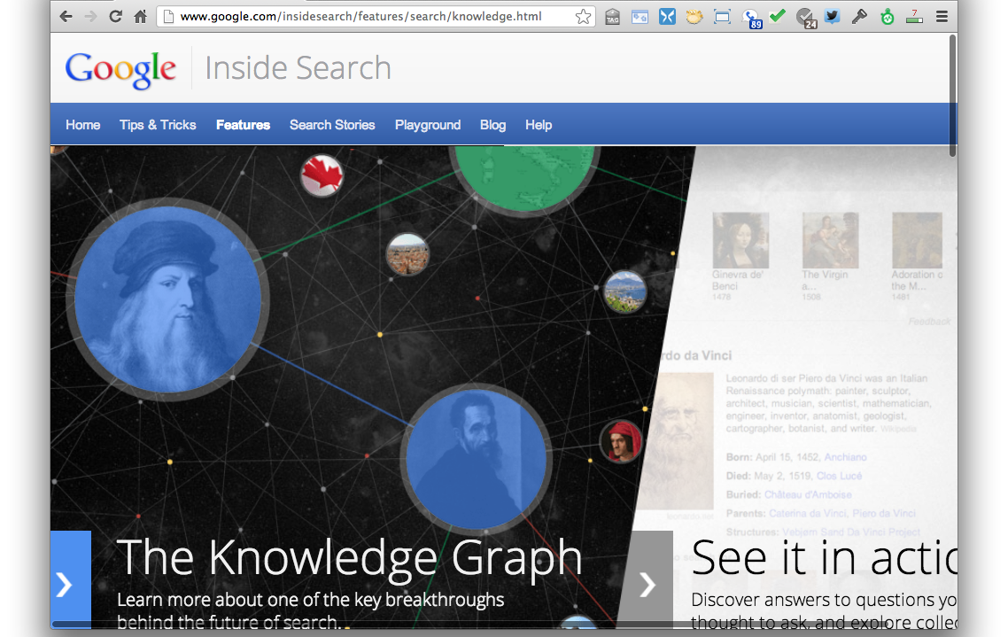
Google Knowledge Graph
Google’s slogan for the knowledge graph: “things, not strings”

Slide 47
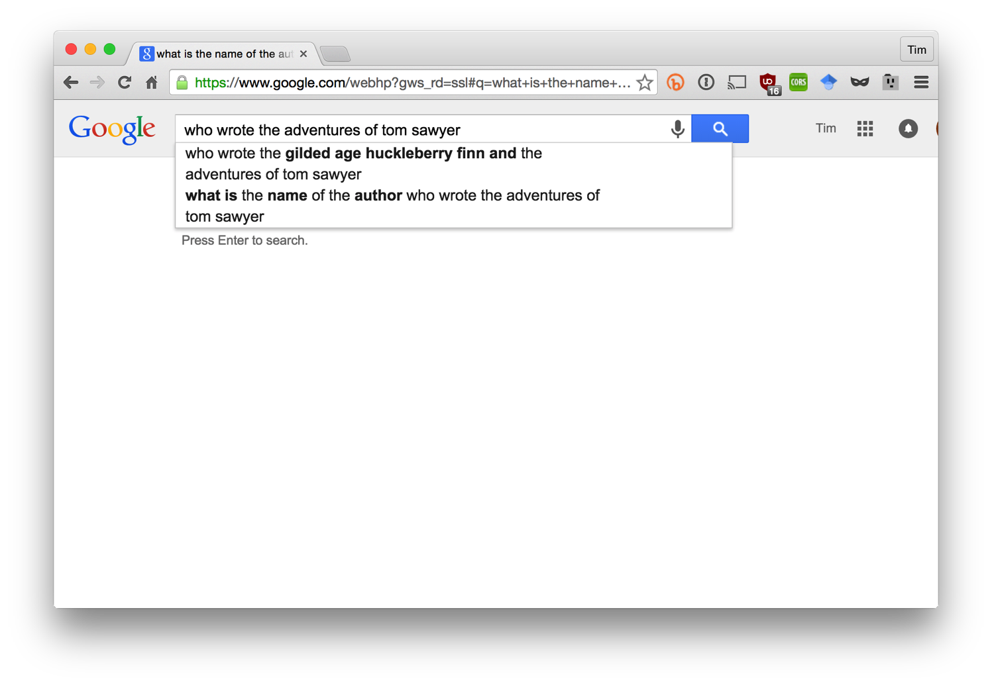
Who wrote Tom Sawyer?

Slide 48
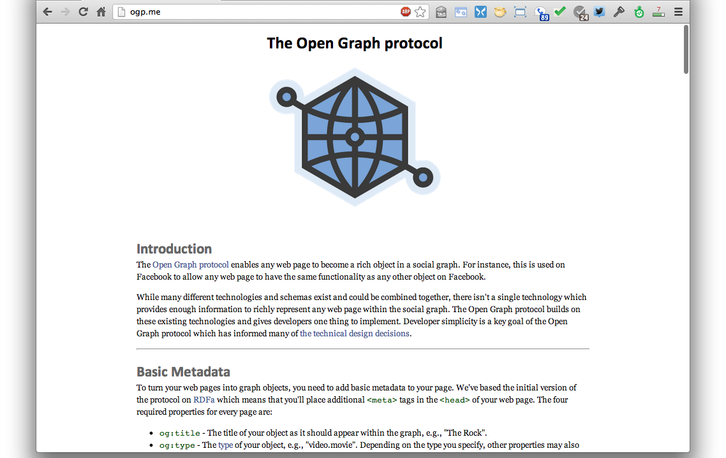
Facebook Open Graph
Annotate your web pages in RDFa
=> object in the FB graph

Slide 49
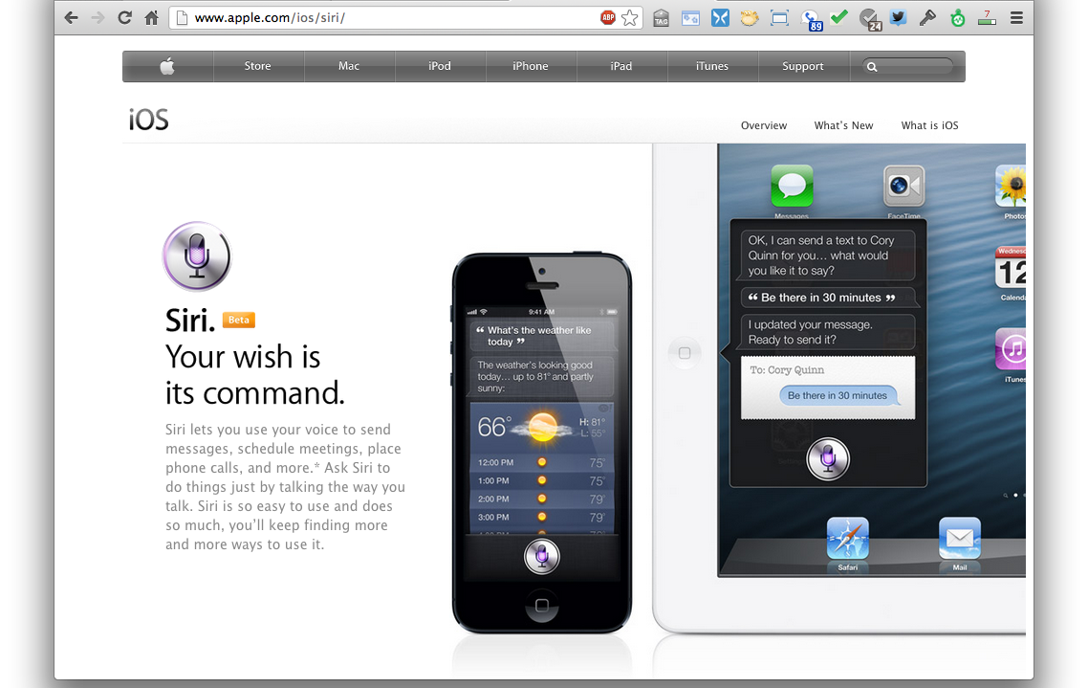
Apple’s SIRI
speech => text => entities => task
SIRI engineers from AI/SW community
SIRI needs lots of semantic data about entities in the world

Slide 50
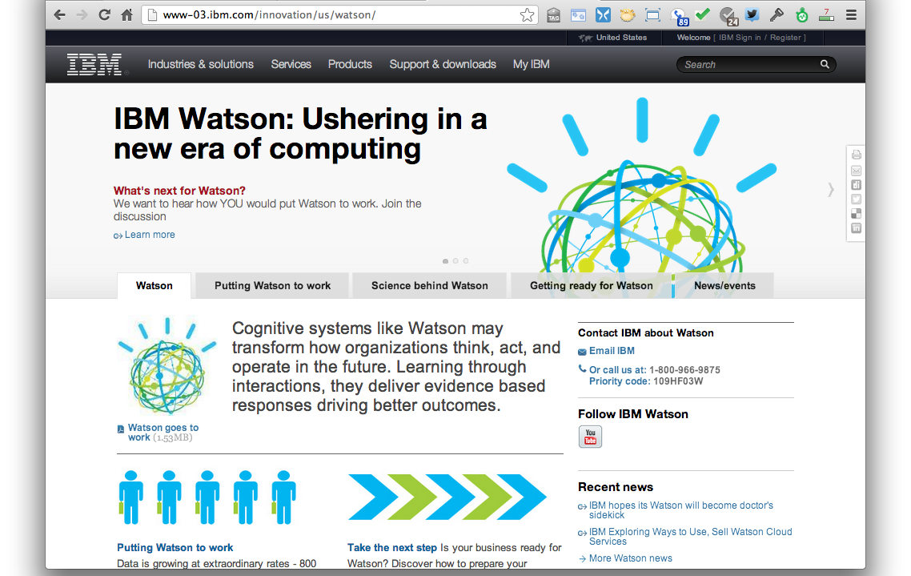
IBM’s Watson
IBM used Semantic Web technology and data in Watson, see http://bit.ly/X44alE

Slide 51
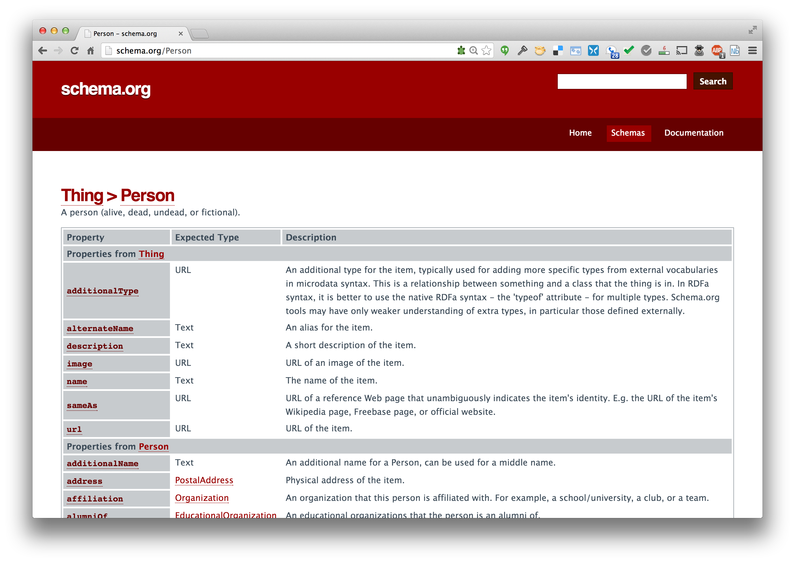
Schema.org
Embed in HTML using RDFa to make machine understand-able statements
A collection of useful ontologies

Slide 52
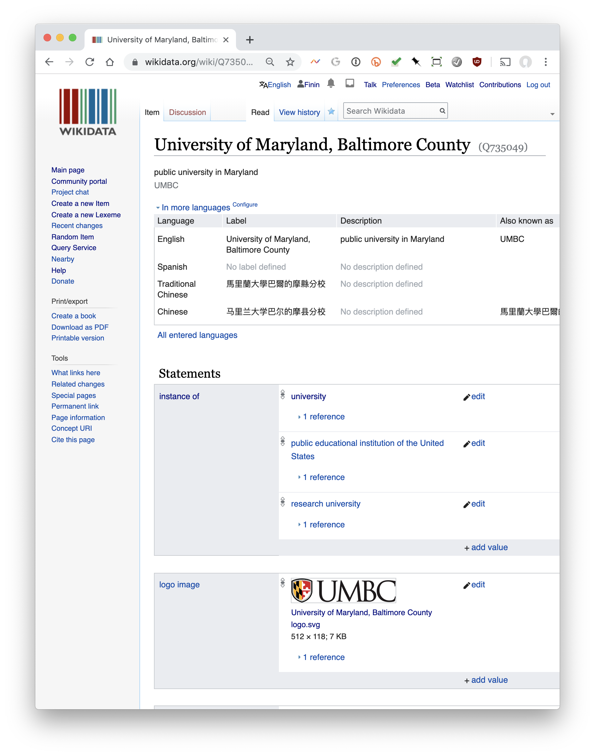
Wikidata
Knowledge graph with ~700M statements about ~57M items
Fine-grained ontology has ~2M types and ~5K properties
Strings tagged with language id
Entities have a canonical name, aliases and description in multiple languages
UMBC= Q735049, a university with English name University of Maryland, Baltimore County and alias UMBC

Slide 53
Summary
Web has made us smarter by sharing information and knowledge as text, audio and images
Machines should also be able to use the Web to publish & retrieve information & knowledge
Human forms of knowledge are hard for machines to understand and generate
The Semantic Web is a collection of languages, ontologies, software tools, services and KBs that are designed to support machines

