Slide 1
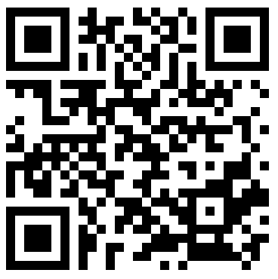
Wikidata 101:
An introduction for the citation-oriented
Andrew Lih | Wikipedia/Wikidata trainer
WikiCite 2018
November 28, 2018
#Wikicite
Licensed via CC-BY-SA 4.0
Slides:
http://bit.ly/wikicite2018wikidataintro
One page guide:
http://bit.ly/wikidata-onepage
andrew@ANDREWLIH.com @fuzheado

Slide 2
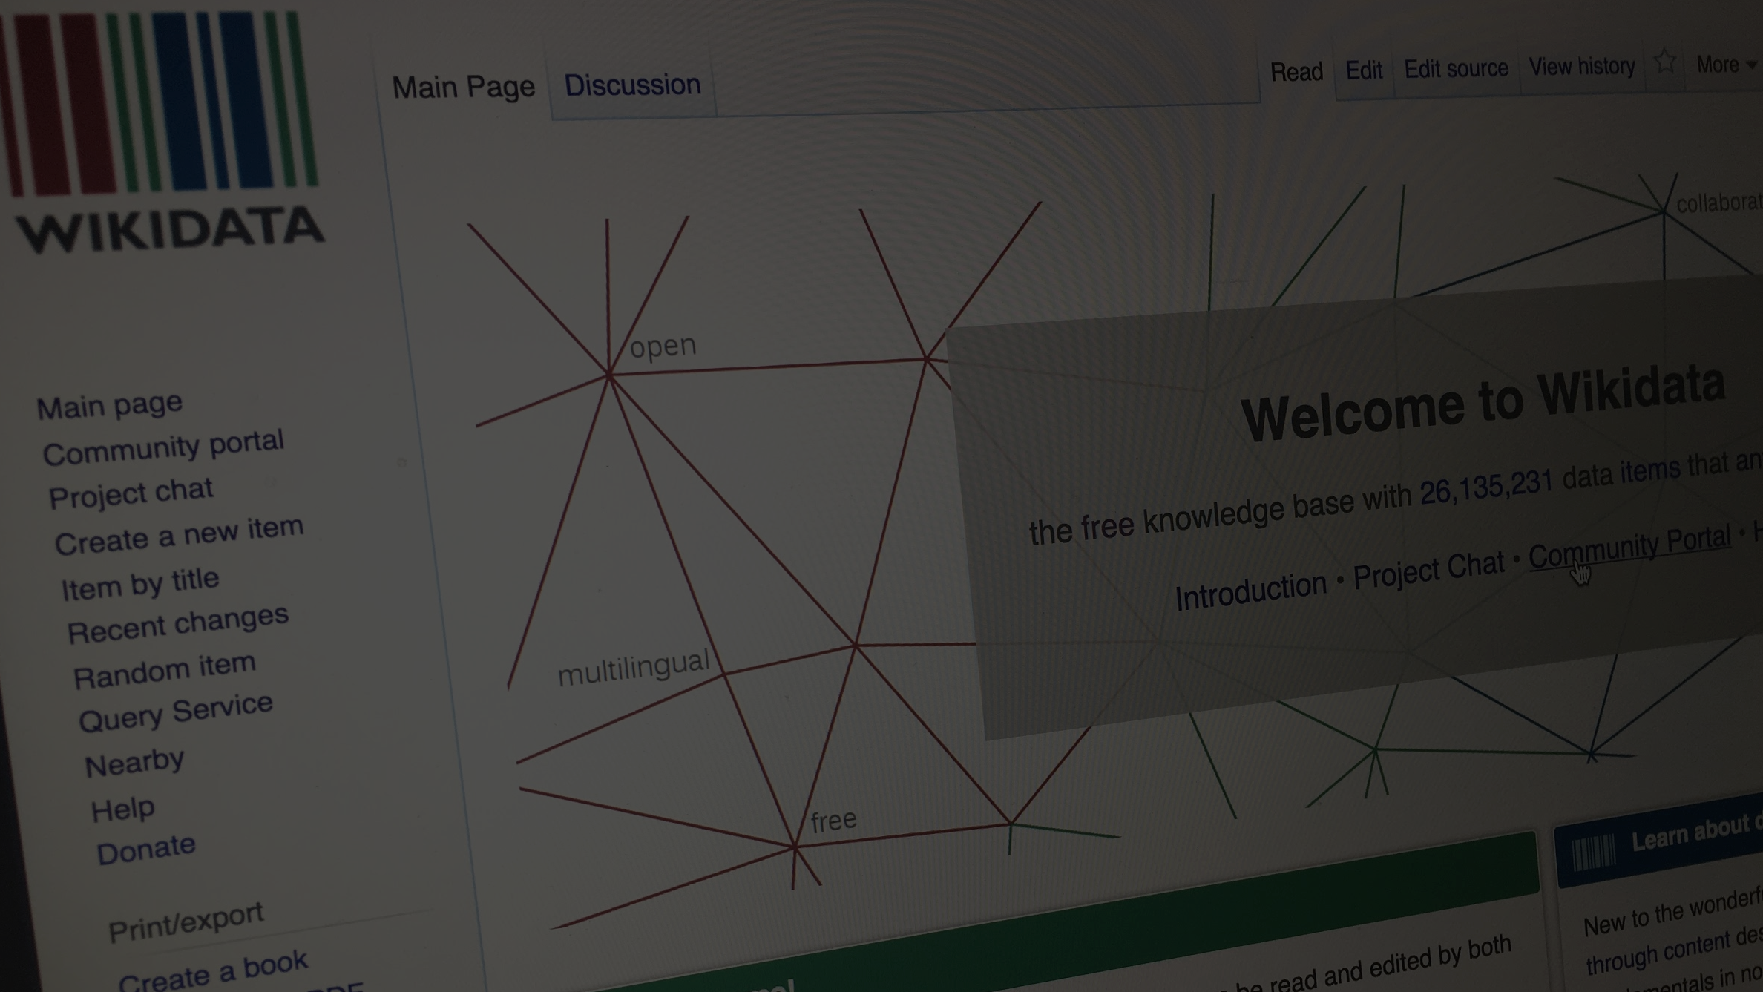
Wikidata: The evolution of the wiki movement towards the ultimate, free, linked open database

Slide 3
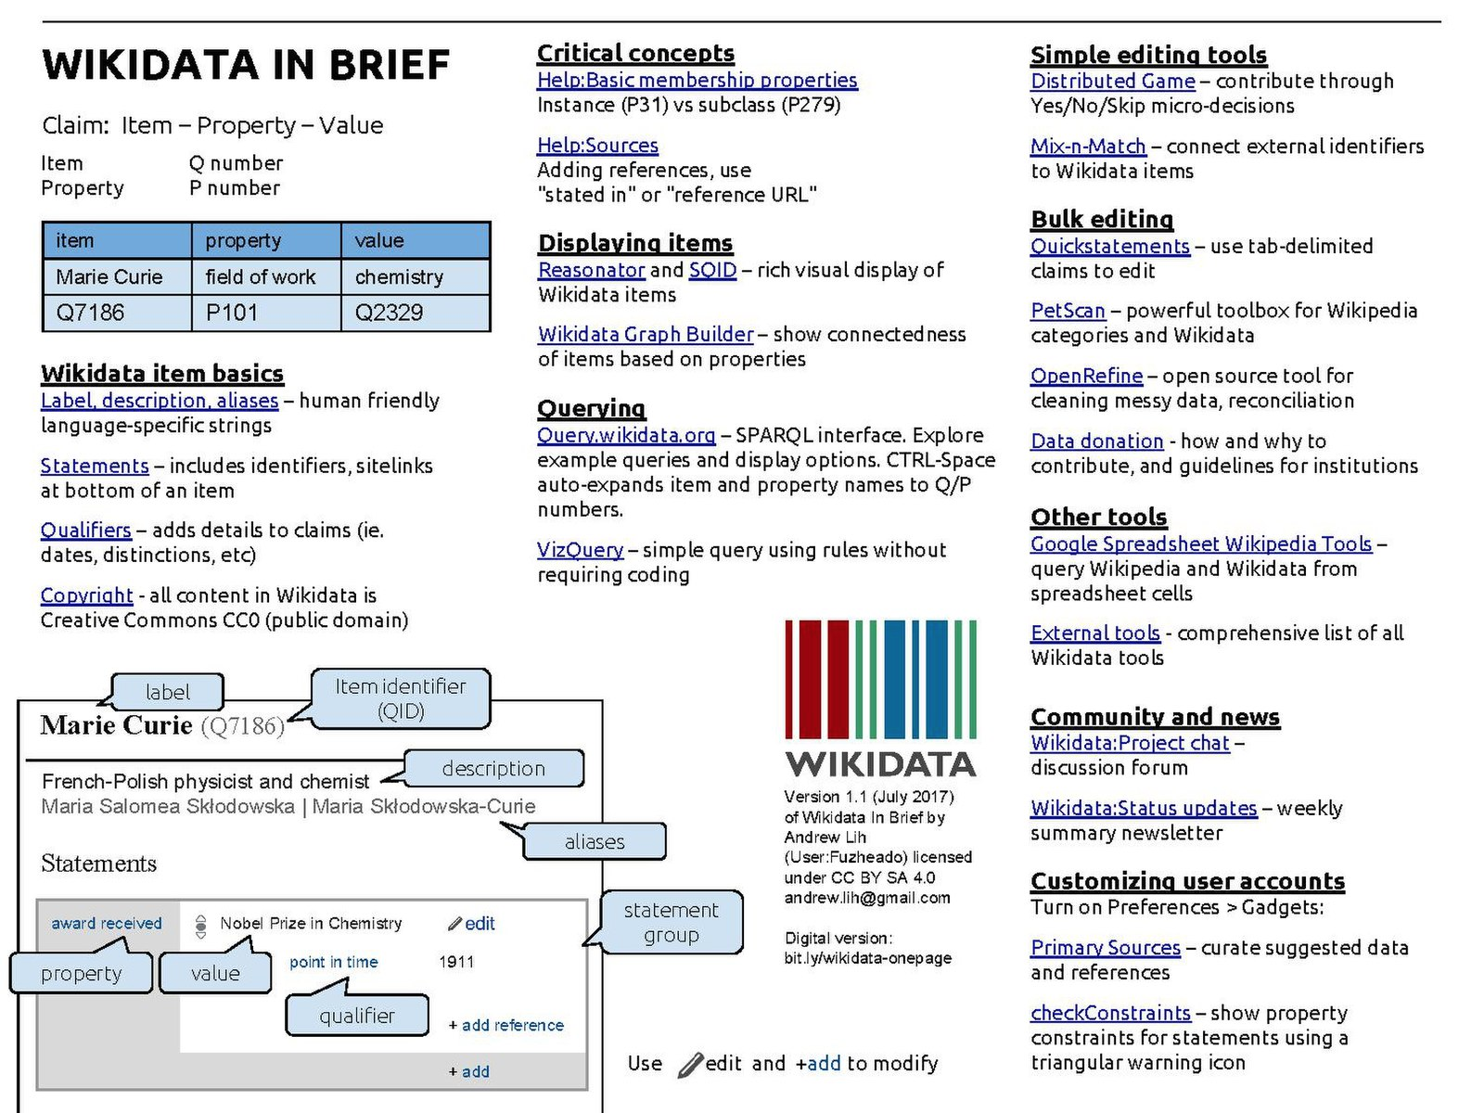
Wikidata In one page
http://bit.ly/wikidata-onepage

Slide 4
2017: A Wikidata turning point
Wikidata used by
Google Knowledge Graph
Digital assistants: Siri, Alexa
Infoboxes on Wikipedia
Structured data on Commons
Wikicite, WikidataCon conferences
A hub for the future of Wikimedia, academic, bibliographic content

Slide 5
Wikipedia
today
More than 5.7 million English articles
Top 10 most visited site
High reputation and cultural partnerships

Slide 6
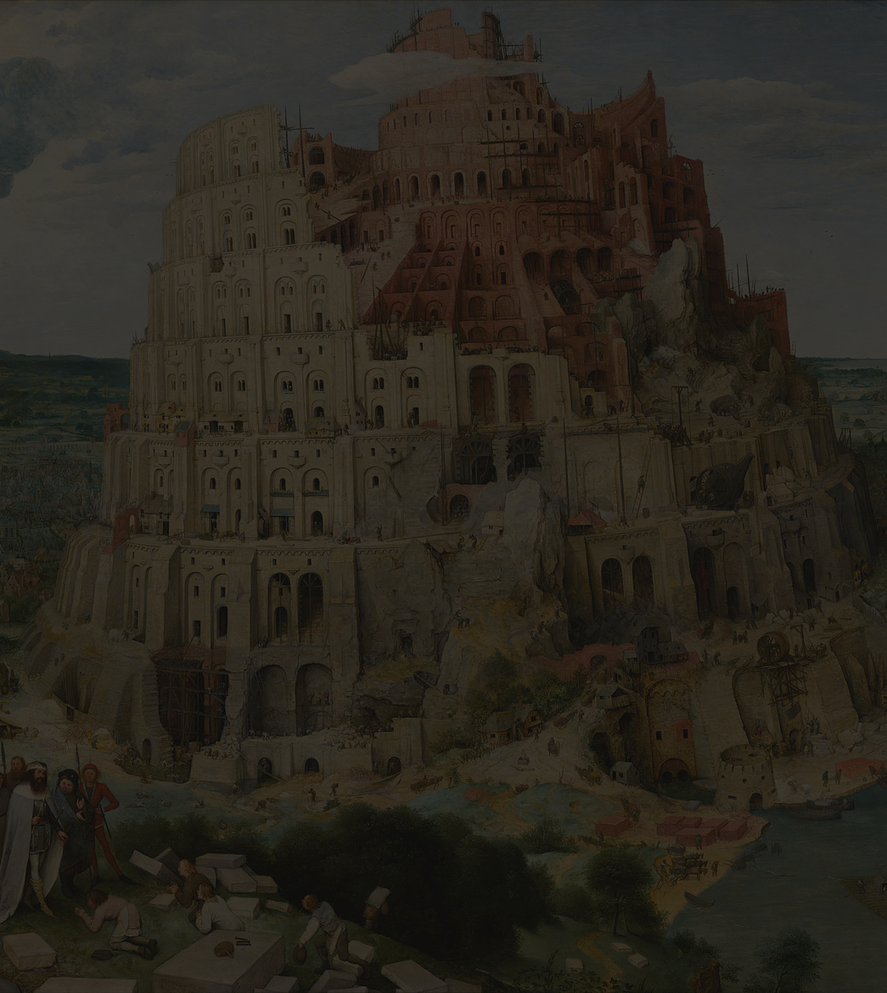
Wikipedia
challenges
Knowledge scattered among 30 million articles in 200+ languages
Inconsistency, gaps and replication
How to consolidate knowable facts?

Slide 7
Lesson: Consolidating images and multimedia
2001: Images scattered across Wikipedia editions
2004: Wikimedia Commons centralized and consolidated multimedia
commons.wikimedia.org

Slide 8
Wikidata
as the future
Convert encyclopedic lexical content into "structured" statements
Turn human readable into machine understandable
Link to stable external data of LAM institutions
"Semantic web" realized

Slide 9
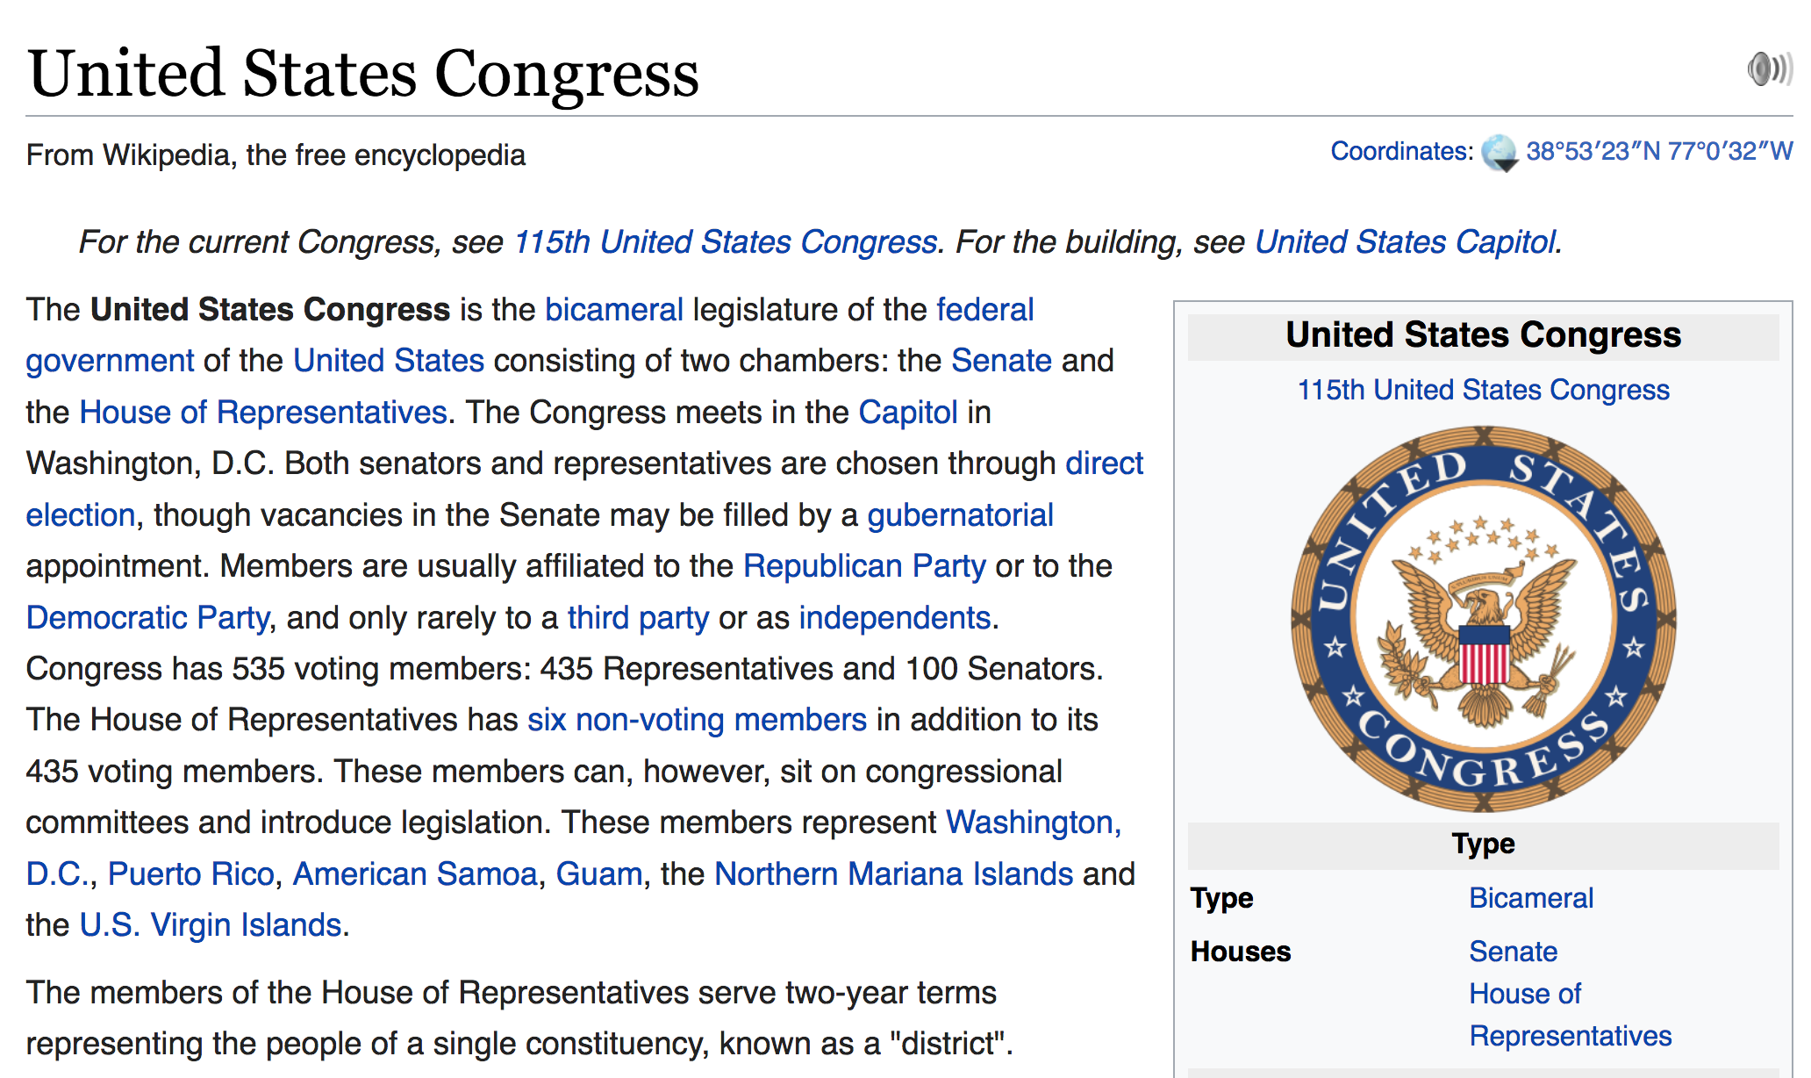
Facts and figures from articles, infoboxes are only in human-readable prose
Notes:
In a typical Wikipedia article you'll see facts and figures in prose. There are infoboxes on the right side.

Slide 10
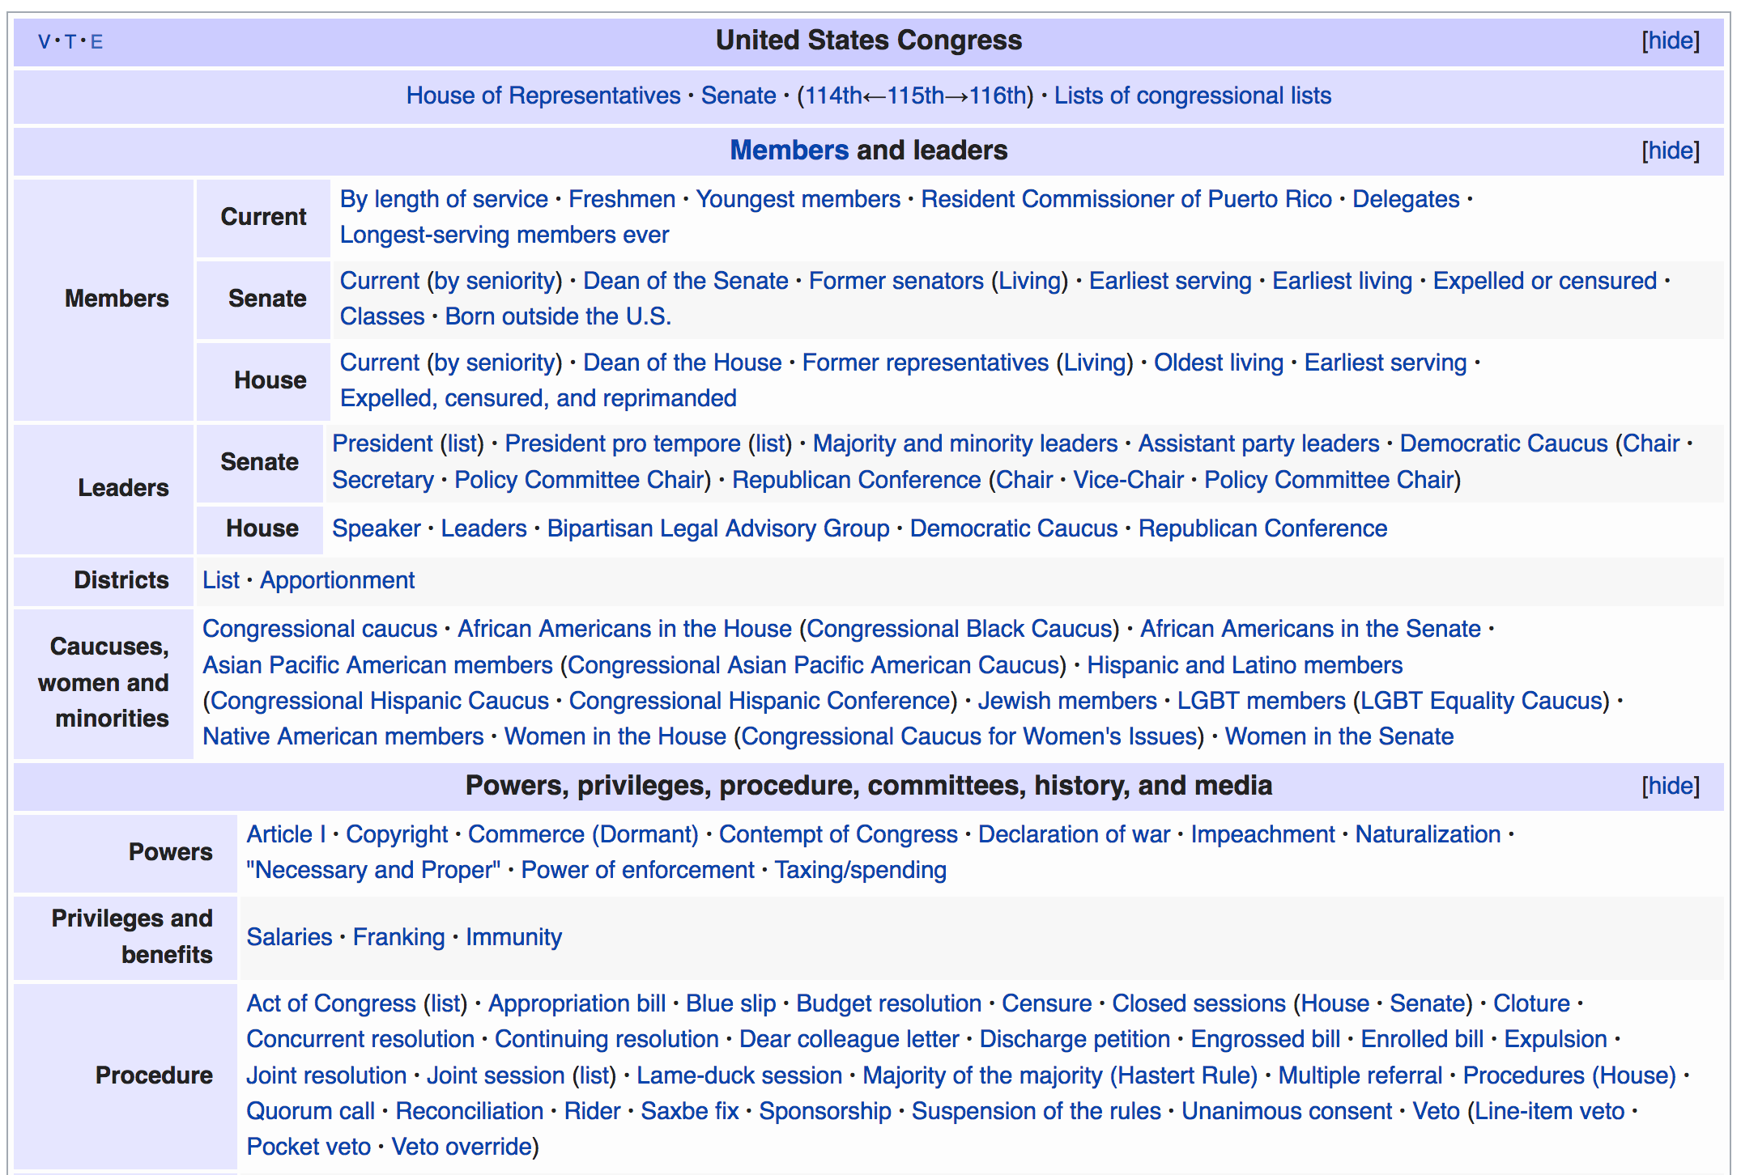
Navigation boxes at bottom of Wikipedia articles done by hand
Notes:
In a typical Wikipedia article you'll see facts and figures in prose. There are infoboxes on the right side.

Slide 11
Wikidata
capabilities
Launched in 2012
Provides power of searching, sorting and querying
Sum Interconnected mesh of all human knowledge

Slide 12
Fundamentals: Statements
Factual claims are stored as statements in Wikidata
subject - predicate - object
or
item - property - value
or
thing - relationship - thing

Slide 13
Moving to structured data
Lexical
United States Congress
instance of
bicameral legislature
Semantic
United States Congress
in country
United States
Notes:
In a typical Wikipedia article you'll see facts and figures in prose. There are infoboxes on the right side.

Slide 14
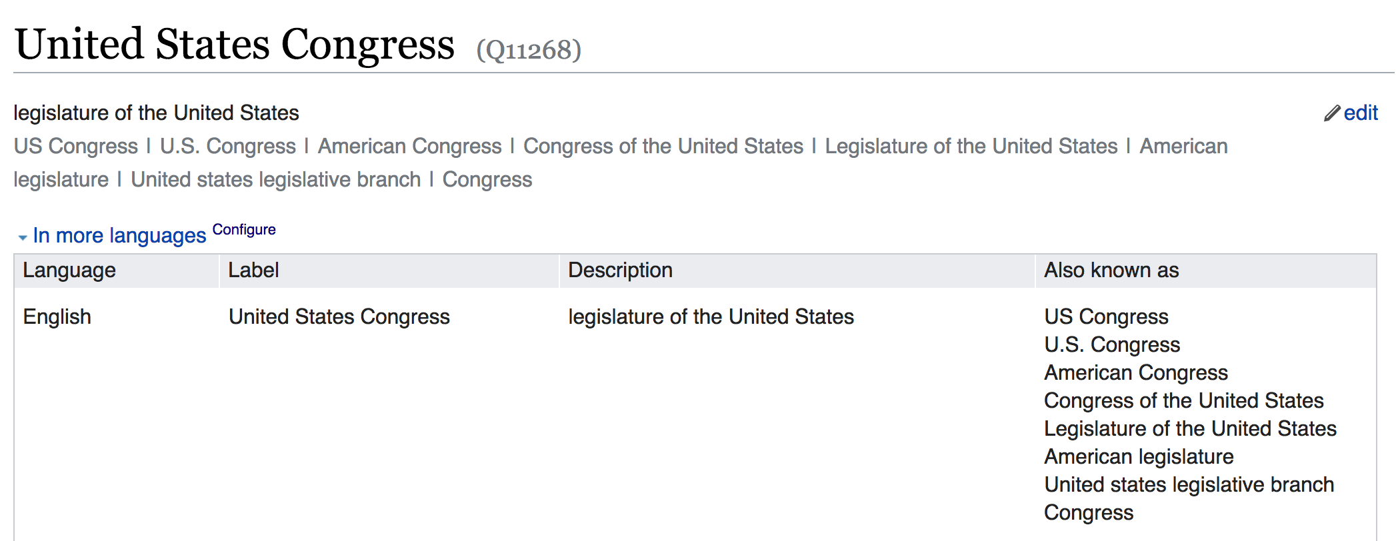
Wikidata item for United States Congress (Q11268)
Notes:
In a typical Wikipedia article you'll see facts and figures in prose. There are infoboxes on the right side.

Slide 15
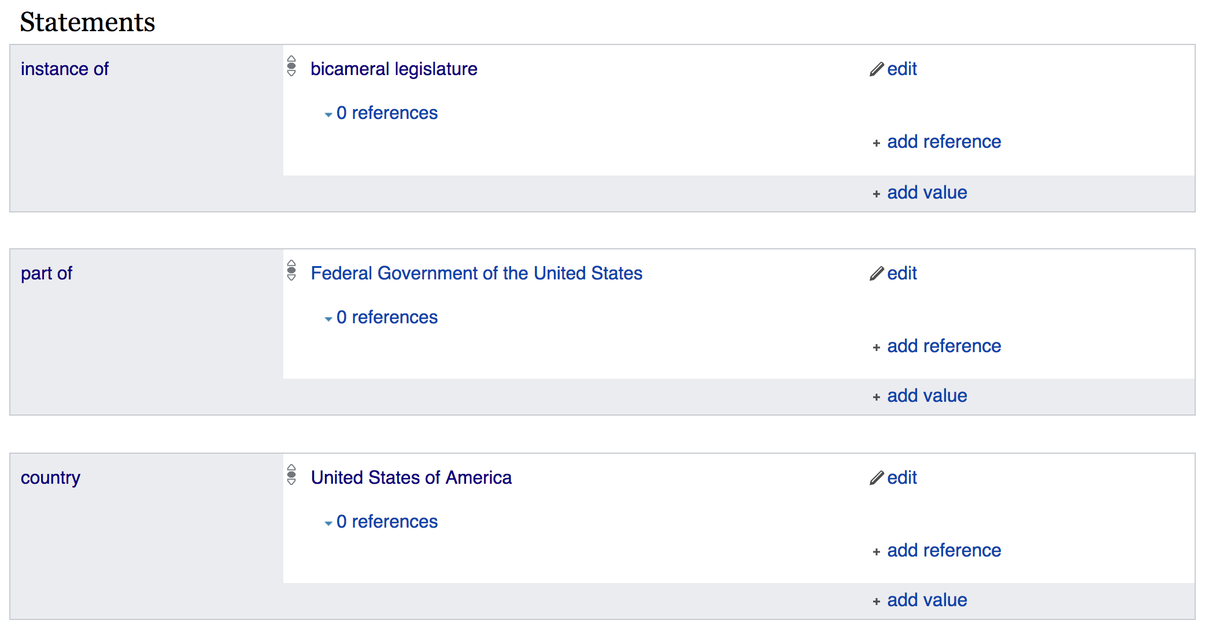
Wikidata item for United States Congress (Q11268)
Notes:
In a typical Wikipedia article you'll see facts and figures in prose. There are infoboxes on the right side.

Slide 16
Wikidata Basics
"Triple" item - property - value
Q numbers - item
Anyone can make a Q item
Corresponds to Wikipedia article / concept
Examples
Q1 - the Universe
Q2 - Earth
Q5 - human
Q146 - cat
Q729 - animal
Q571 - book
Q7075 - library
Q309331 - The Ohio State University
P numbers - property
Controlled vocabulary for consistency
Proposal, discussion and approval process
Examples
P31 - instance of
P279 - subclass of
P214 - VIAF ID
P569 - date of birth
P625 - coordinate location
See: Wikidata:List_of_properties

Slide 17
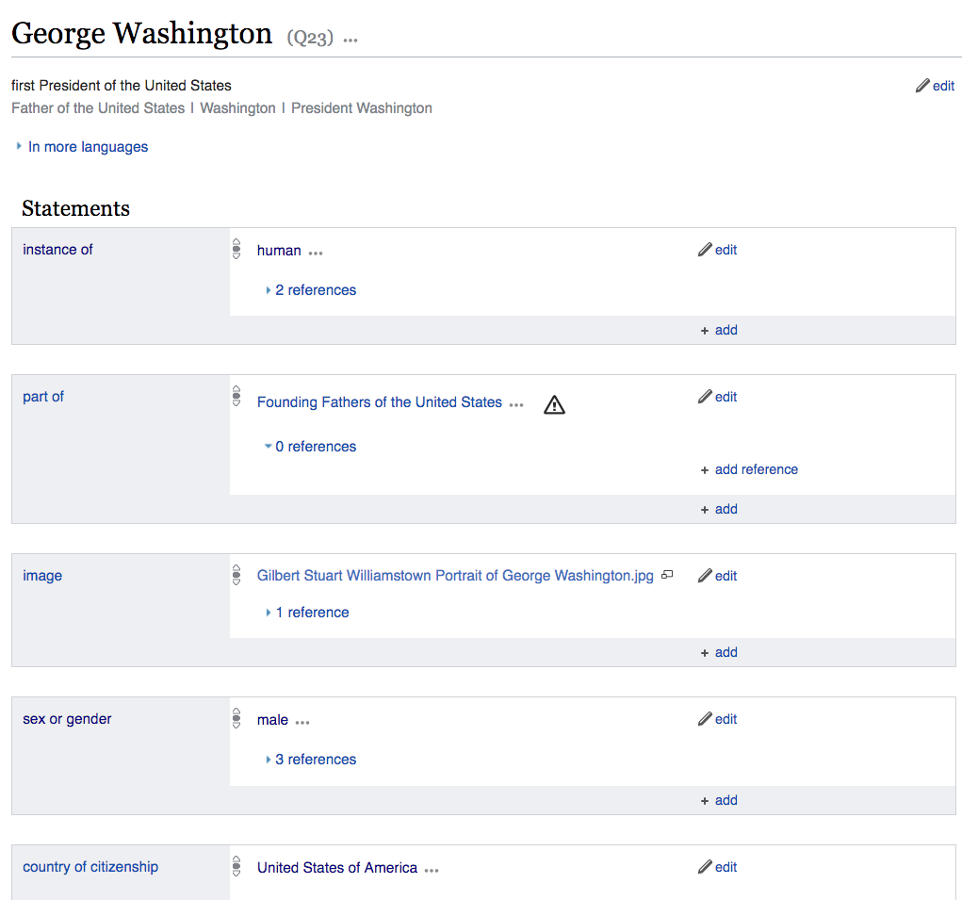
Wikidata item page
Claims capture factual, provable information
Any number of statements can be associated with an item

Slide 18
Wikidata statement triples
Item "George Washington"
Property "instance of"
Value "human"
Q23
P31
Q5
Underneath the surface...
Using symbols makes them language independent (identifiers vs names)
"George Washington"
"place of burial"
"Mount Vernon"
Q23
P119
Q731635
"George Washington"
"LCAuth ID"
"n86140996"
Q23
P244

Slide 19
Wikidata and languages
Labels and descriptions for different languages
Exciting for translation applications
zh 乔治·华盛顿
zh 性質
zh 人類
ms "George Washington"
ms "contoh"
ms "manusia"
es "George Washington"
es "instancia de"
es "ser humano"
de "George Washington"
de "ist ein(e)"
de "Mensch"
en "George Washington"
en "instance of"
en "human"
Q23
P31
Q5

Slide 20
Hands On:
Edit Wikidata hometown item
In a web browser, go to wikidata.org
Enter your hometown in search

Slide 21
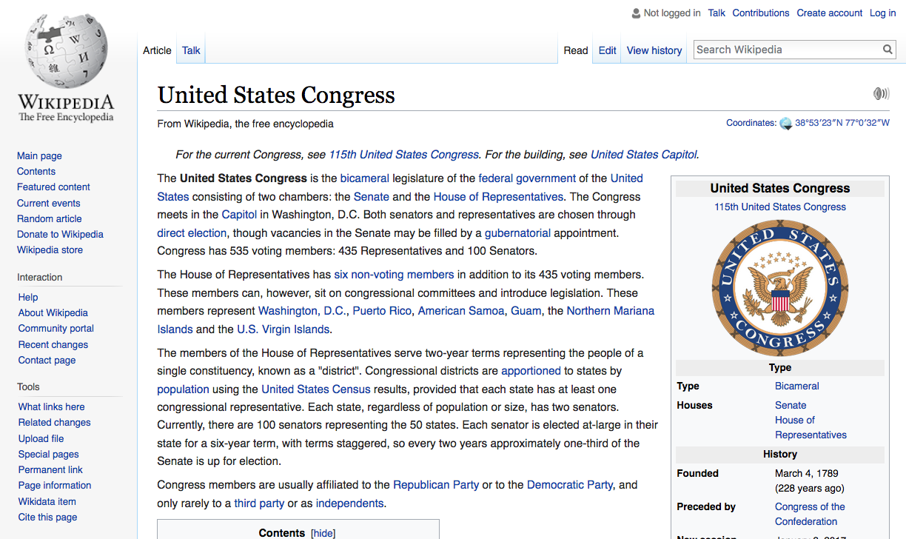
Wikidata link on Wikipedia articles

Slide 22
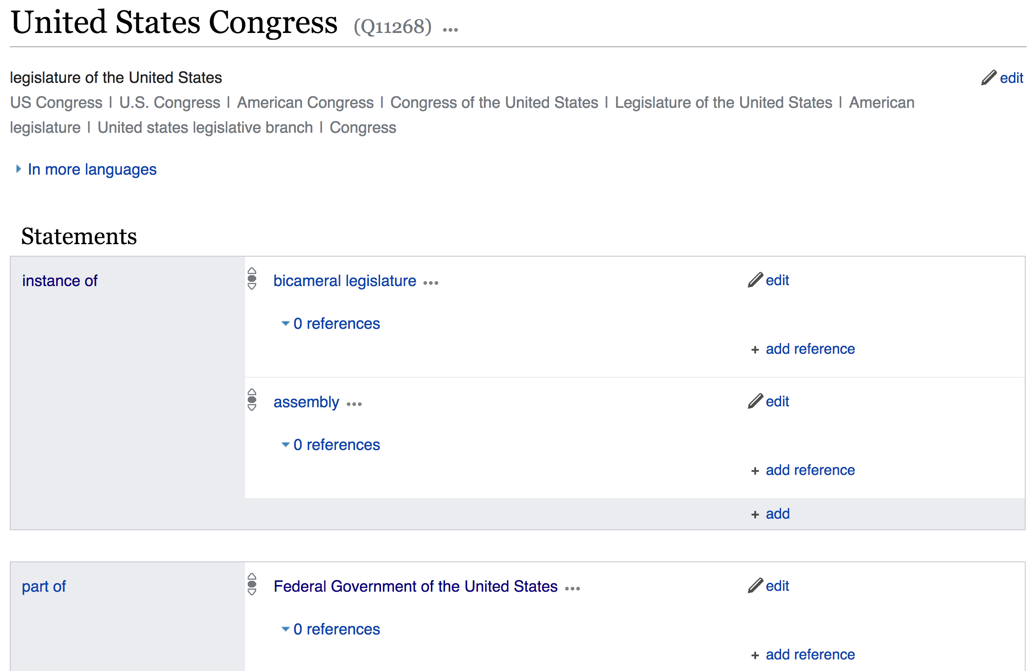
Wikidata stores statements as explicit triples - item + property + value
Item United States Congress
Q11268
Property "instance of"
Value "bicameral legislature"
P31
Q189445

Slide 23
Wikidata statement triples
Claims capture factual, provable information
Using symbols makes them language independent (identifiers vs names)
Item United States Congress
Property "instance of"
Value "bicameral legislature"
Q11268
P31
Q189445

Slide 24
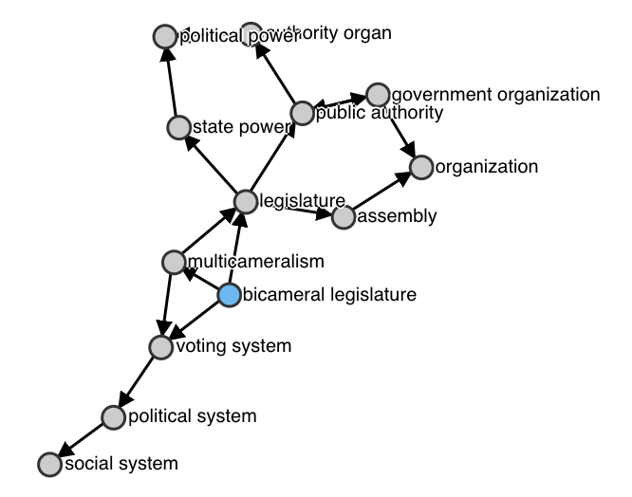
Wikidata statement triples
Relationships are "first class" = very fast to search and sort
Seconds vs minutes to search
Ad hoc data model highly adaptive
Well-suited to the wiki way
Item United States Congress
Property "instance of"
Value "bicameral legislature"
Q11268
P31
Q189445

Slide 25
Wikidata items
Muammar Gaddafi
Muammar Muhammad Abu Minyar al-Gaddafi
Colonel Gaddafi
Kadhafi
Mu‘ammar al Qaḏḏāfi
Moammar Al Qadhafi
Qaḏḏāfi
Gadafi
Kadaffi
Al-Khadafy
Gadaffi
Kaddafi
Muammar al–Gaddafi
Jaddafi
Qaddafy
Muammar Gaddafi
Muhamar Gadaffi
Mu‘ammar al-Qaḏḏafī
Al-Qadhdhaafi
Gadhafi
Qaḏḏafi
Qaḏḏāfī
Muammar Muhammad Abu Minyar al-Gaddafi
Khadafi
Mu‘ammar al-Qaḏḏāfi
Gaddafi
Muammar el Gadafi Muamar al-Gaddafi
Muamar al Gaddafi
Mu‘ammar al Qaḏḏafi
Kadafi
Omar Gadafi
Kaddaffi
Moammar Jaddafi
Muamar Gadafi
Muamar el-Gadafi
Mu‘ammar al Qaḏḏāfī
Al-Qathafi
Mu‘ammar al-Qaḏḏafi
Muamar al Gadafi
Moammar Gadafi
Muammar al-Gaddafi
Muhammad Ghadaffi
Muammar el Gaddafi
Muamar al Gaddafhi
Mu‘ammar al-Qaḏḏāfī
Mu‘ammar al Qaḏḏafī
Khaddafi
Muammar al Gaddafi
Qaḏḏafī
El Kazzafi
Muhamad Gadafi
Muamar al-Gaddafhi
Using identifiers removes language dependence and ambiguity in:
Writing systems (Chinese, Serbian, Kazakh, et al)
Phonetization variations
Spelling variations
Maiden vs. married names
Canonical identifiers help link to external databases
53 Latinized variations!
(May 2017)
Item Muammar Gaddafi
Q19878

Slide 26
Editing Wikidata
Just as with Wikipedia:
Edit button
+add button

Slide 27
Speed, consistency, automation
Wikidata has more than 52 million items
Simple searches take less than a second
Complex queries supported by open standards like SPARQL

Slide 28
Search example - Find all bicameral legislatures
http://query.wikidata.org
Item ?
Property "instance of"
Value "bicameral legislature"
?
P31
Q189445

Slide 29
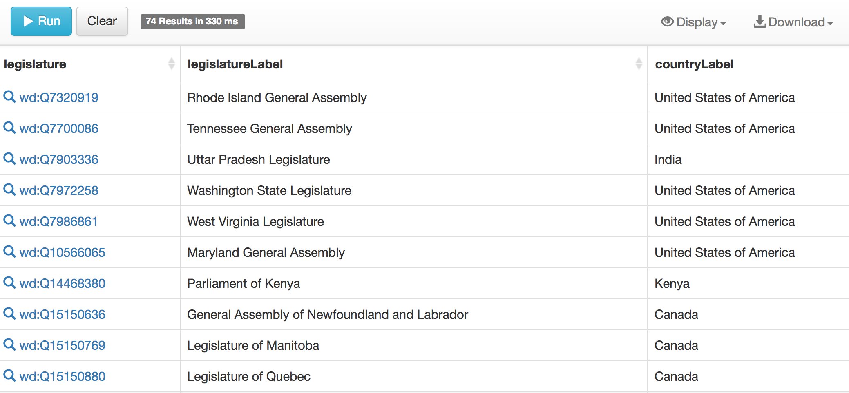
Wikidata Search - Result from Query
52 million items in less than a second

Slide 30
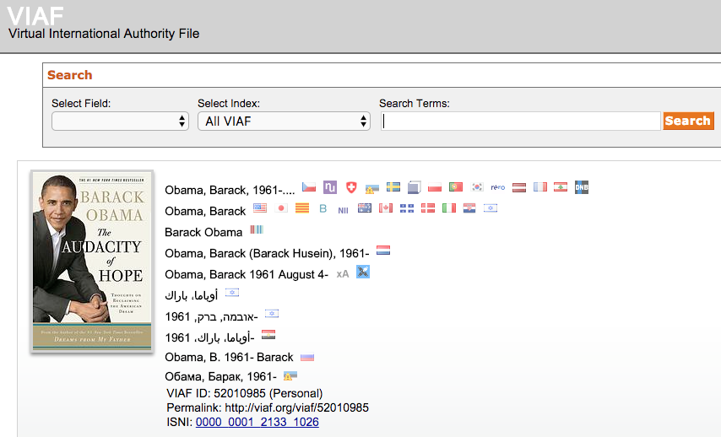
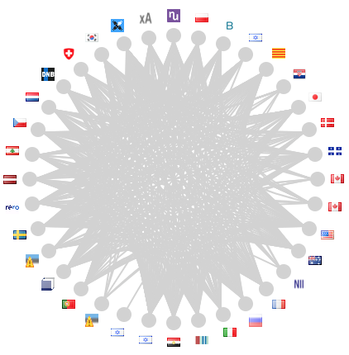
Wikidata items have identifiers - VIAF links back

Slide 31
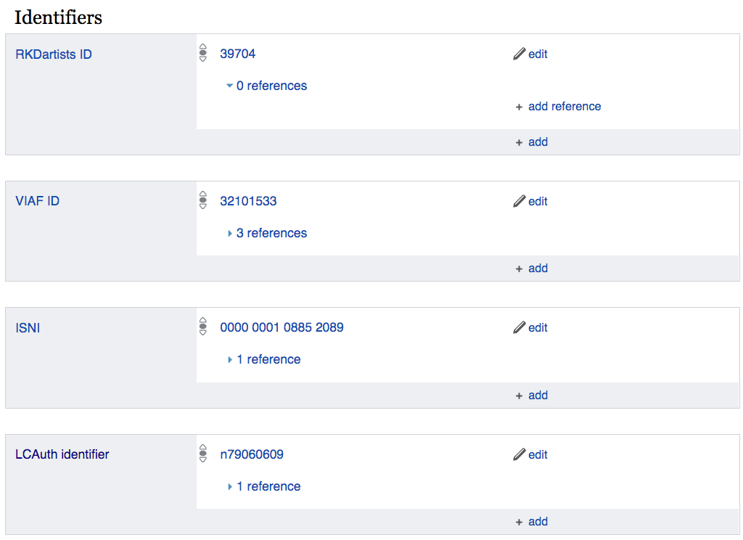
Properties: Identifiers
Indexes into other databases
Authority control
Accession numbers
Catalog identifiers
Stable URLs to other sites

Slide 32
Wikidata items have identifiers - links to external databases
Barack Obama (Q76) has more than 83 identifiers!

Slide 33
Some prominent identifiers - links to external databases
NDLAuth ID (National Diet Library of Japan)
SELIBR (National Library of Sweden Libris)
NLA (Australia) ID
NKCR Czech National Authority Database (National Library of Czech Republic)
RSL ID (person) Russian State Library
IMDB
Dutch National Thesaurus for Author names
Declarator.org - Russian non-governmental database with information on the income of government officials
NUKAT - Center of Warsaw
University Library catalog
CiNii (Scholarly and Academic Information Navigator) Japan
NNDB people ID - Notable Names Database
Politifact
Encyclopedia Britannica ID
CONOR ID (Slovenia)
NYT topic ID
Guardian topic ID Parlement & Politiek ID (Dutch politics site)
Social Networks and Archival Context ID (SNAC)
NARA
California Digital Library
University of Virginia
University of California, Berkeley
WorldCat
VIAF
LC Name Authority File
ISNI
GND (Integrated Authority File)
SUDOC (French universities)
BNF (Bibliotheque France)
MusicBrainz
Bio Directory of Congress
Quora topic ID
C-SPAN person ID
Freebase

Slide 34
OCLC related properties

Slide 35
Wikidata as database of databases
As meta-database, Wikidata doesn't need to hold all the data but can act as a hub for federated searches - search across multiple databases
Wikidata has more than 44 SPARQL endpoints in federation: Europeana, Smithsonian AAM, Getty, Yale Center for British Art, British Museum, et al.
See: SPARQL Federation endpoints

Slide 36
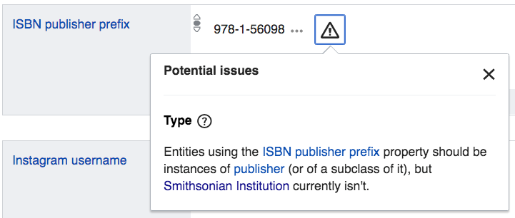
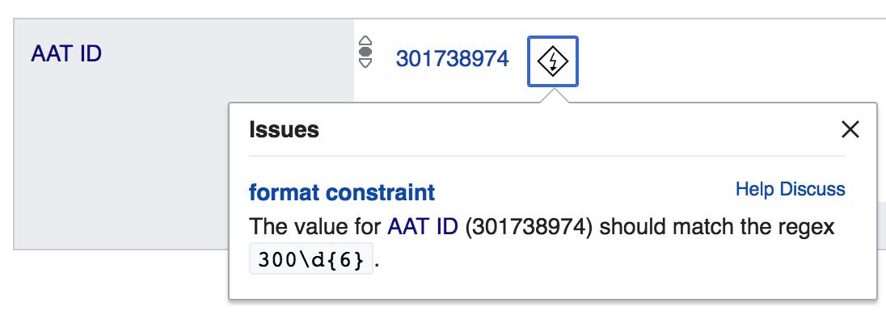
Consistency and bounds checking
Constraint reports/violations provide warnings on logic and bounds

Slide 37
Searching and displaying Wikidata
Querying tools
Presentation
Visualization
APIs and endpoints

Slide 38
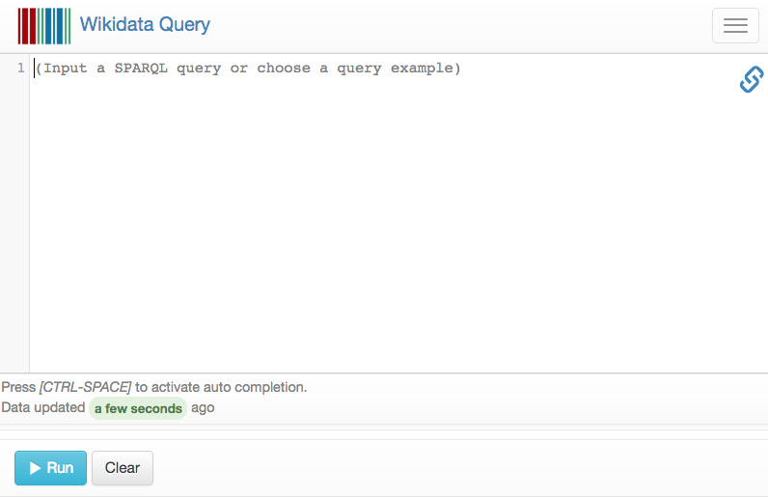
Basic search with Wikidata
SPARQL endpoint at query.wikidata.org
Superficially similar to SQL
One of the busiest endpoints on the Internet
https://wikidata.org/wiki/Wikidata:SPARQL_query_service

Slide 39
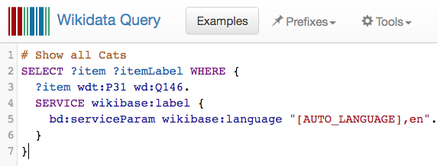
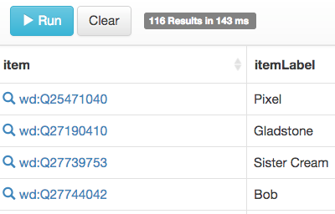
Basic search with Wikidata
SPARQL is an open standard
Try the "Examples" button for lots of interesting searches
Hint: Don't write queries from scratch. Modify existing ones!
Use auto-complete with CTRL-SPACE (Beware Mac users!)
http://tinyurl.com/y7nvjgm9

Slide 40
Hands On:
Run your first Wikidata Query
Visit query.wikidata.org
Choose "Examples" folder
Select "Cats"
Or directly click: http://tinyurl.com/y7nvjgm9
Hit blue triangle button to run!

Slide 41
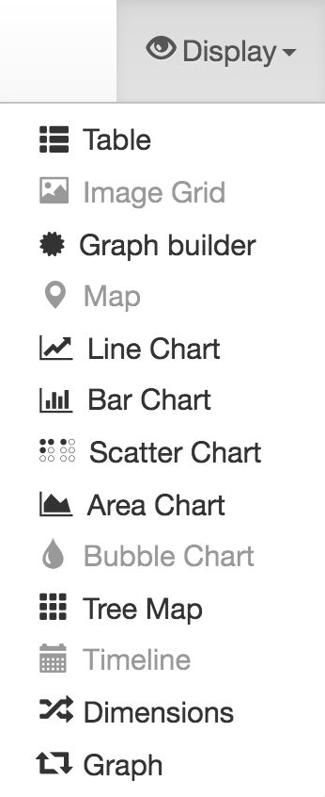
Advanced search with Wikidata
Statistics, graphs, maps via Wikidata
Discover stories in the data:
Example: Where have members of Congress been educated?

Slide 42
Example: Women authors
List all members of Congress who have ever served and examine where they have been educated
?moc wdt:P31 wd:Q5 . #"instances of" humans
?moc wdt:P1157 ?lcbioid . #LC "Congress Bio ID"
?moc wdt:P69 ?school . #grab "educated at"
COUNT the occurrences of each school
ORDER them from highest to lowest
LIMIT it to the top 15 results

Slide 43
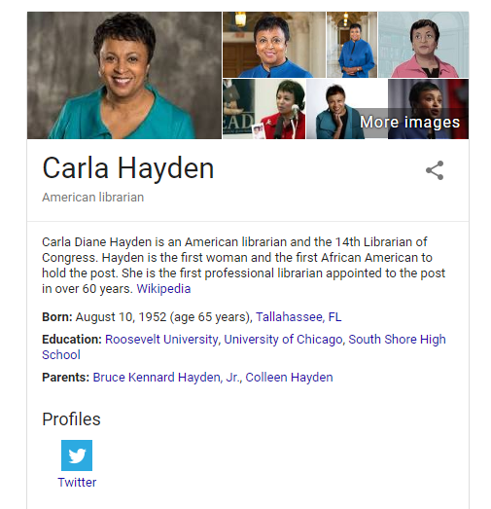
Impact of Wikidata
Google closed their own Freebase project in 2016, in favor of backing Wikidata
Google search results and Knowledge Graph use Wikidata
Schema.org has endorsed using Wikidata

Slide 44
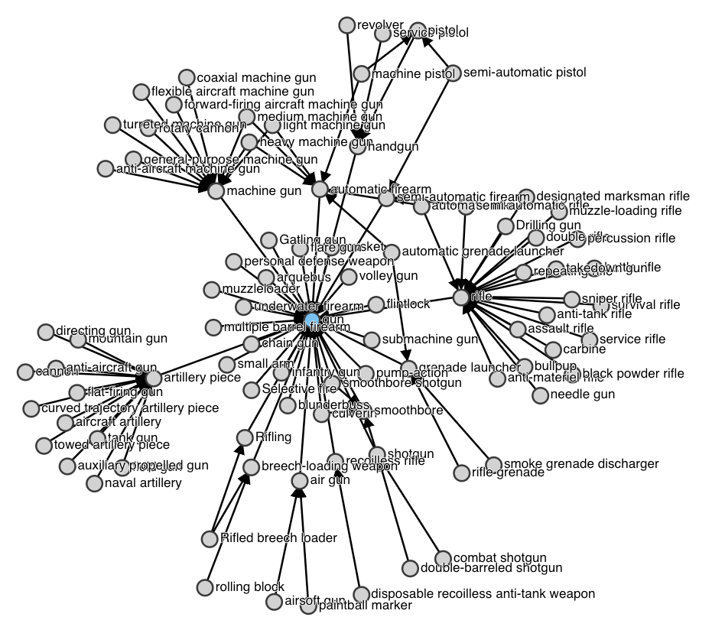
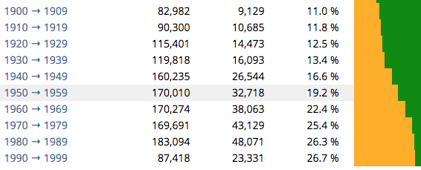
Interesting Wikidata tools
Wikidata Query
Wikidata Graph Builder
Monumental
Reasonator
Vizquery
Gender Gap Tool

Slide 45
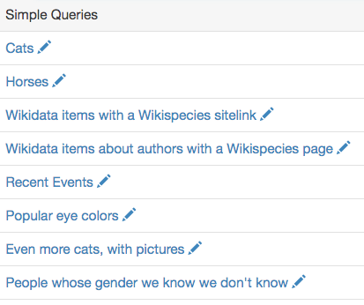
Wikidata Query: SPARQL endpoint
https://query.wikidata.org/
Try example queries

Slide 46
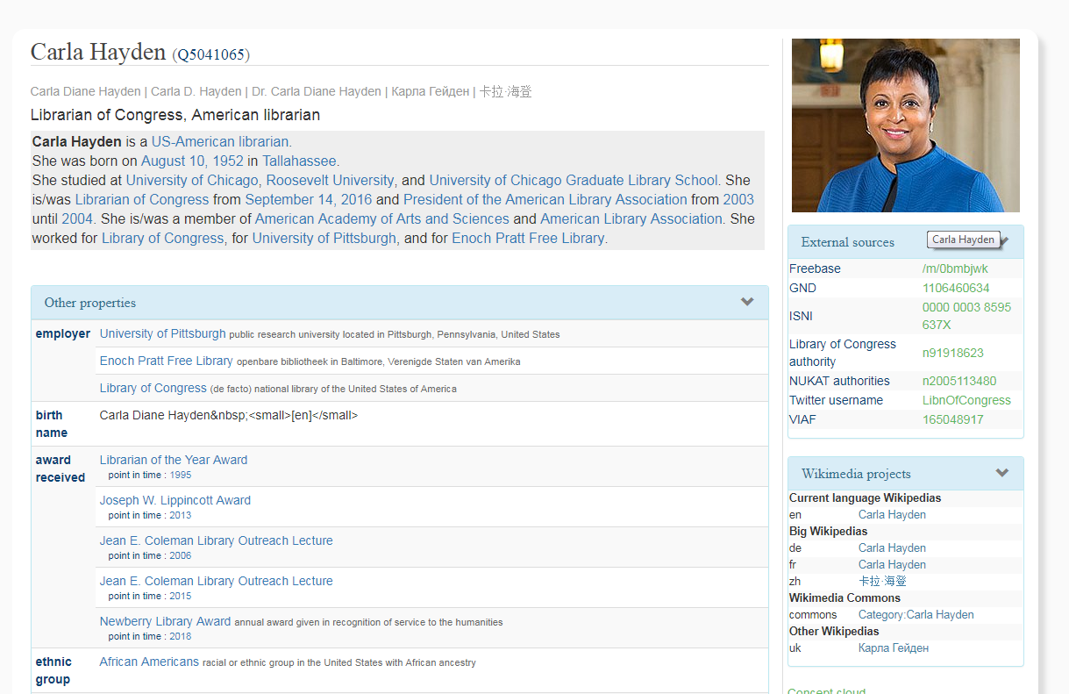
Reasonator: Nicely formatted Wikidata pages
https://tools.wmflabs.org/reasonator/

Slide 47
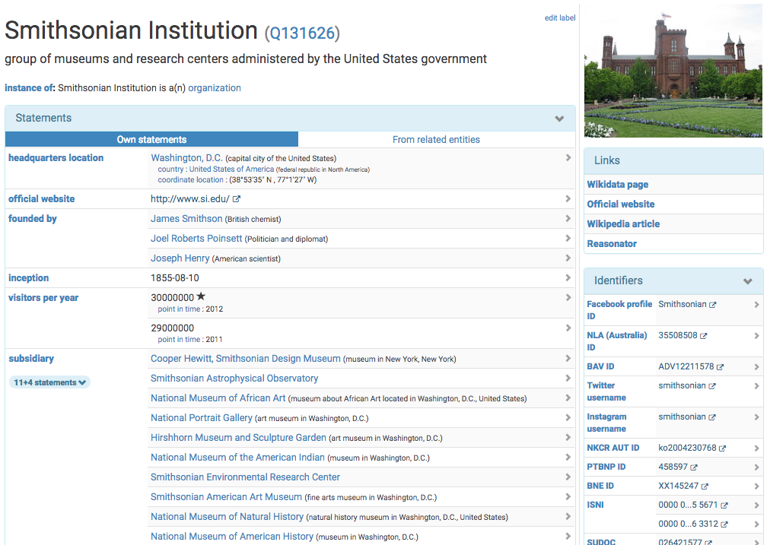
SQID: Browsing Wikidata entries and linkages
https://tools.wmflabs.org/sqid/

Slide 48
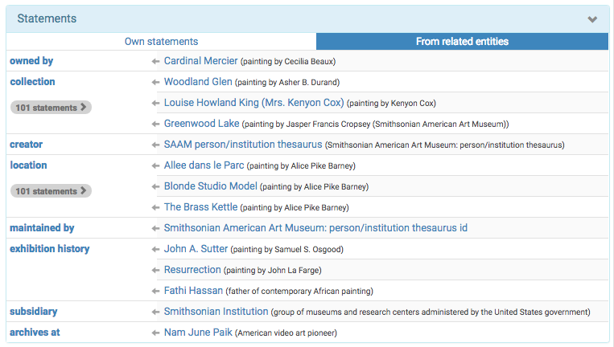
SQID: Browsing Wikidata entries and linkages
https://tools.wmflabs.org/sqid/

Slide 49
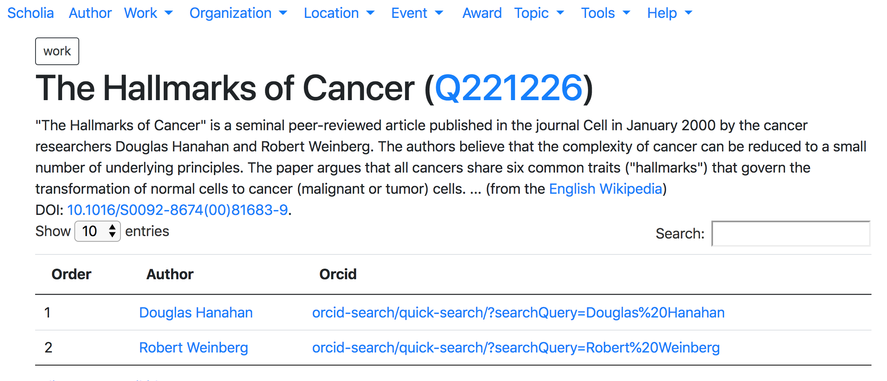
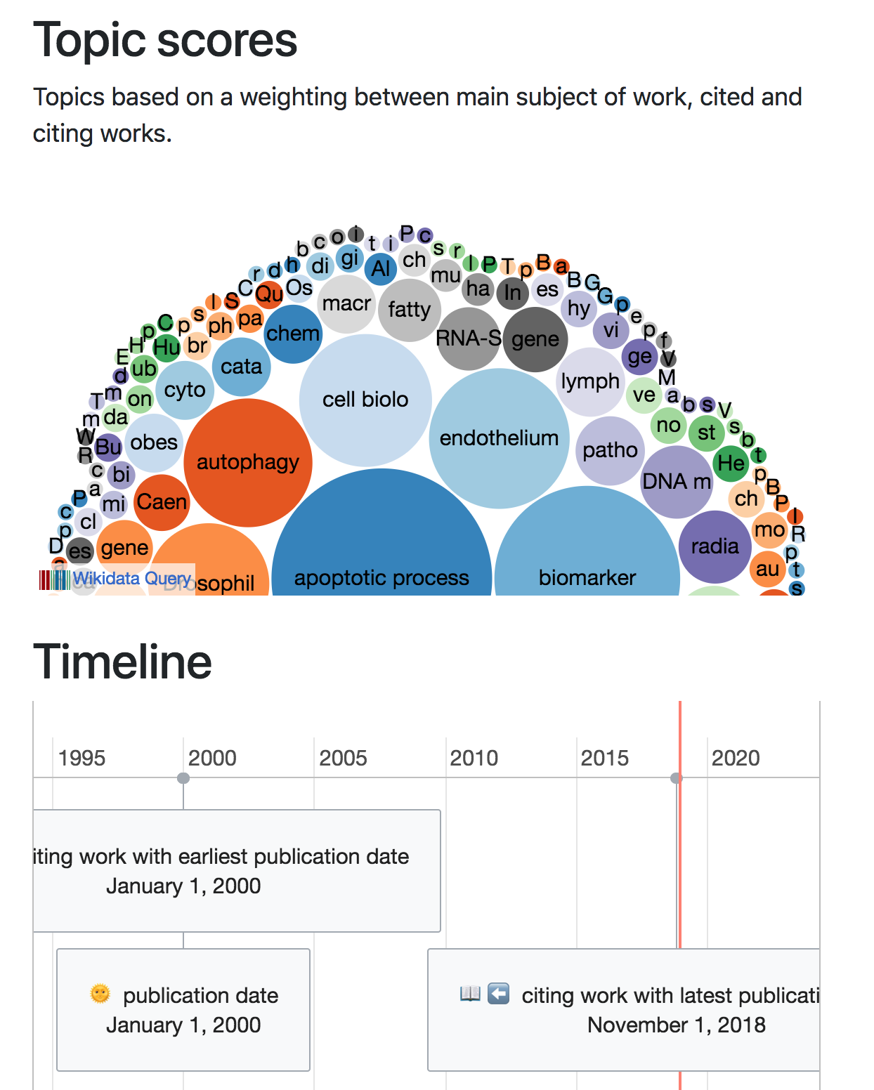
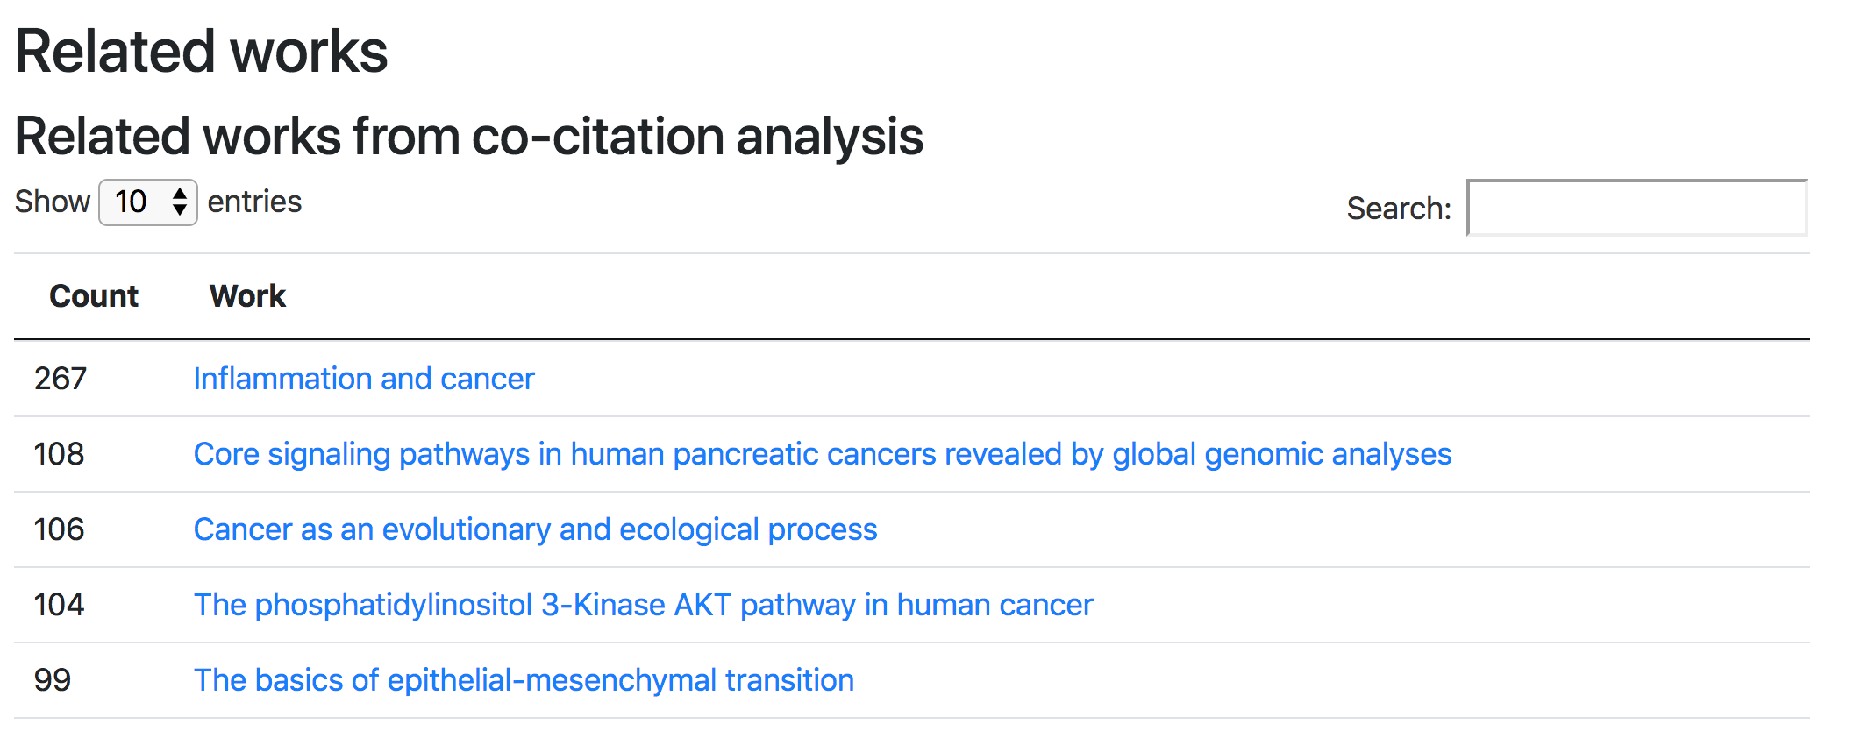
Scholia: Stats and context around scholarly sources
https://tools.wmflabs.org/scholia/

Slide 50
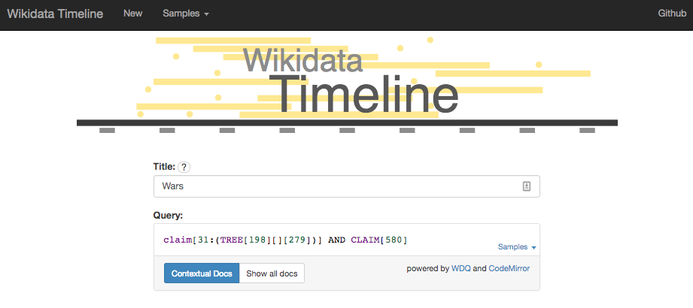
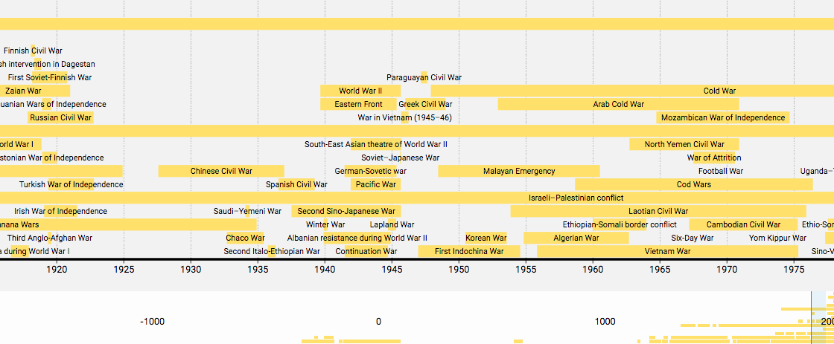
Wikidata Timeline: Queries displayed in linear timelines
https://tools.wmflabs.org/wikidata-timeline

Slide 51
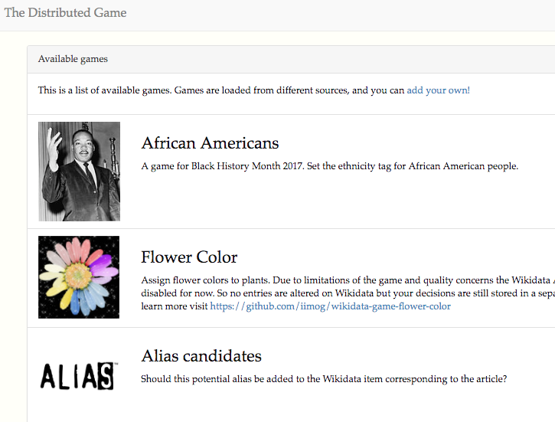
Wikidata Distributed Game: click to contribute
https://tools.wmflabs.org/wikidata-game/distributed/

Slide 52
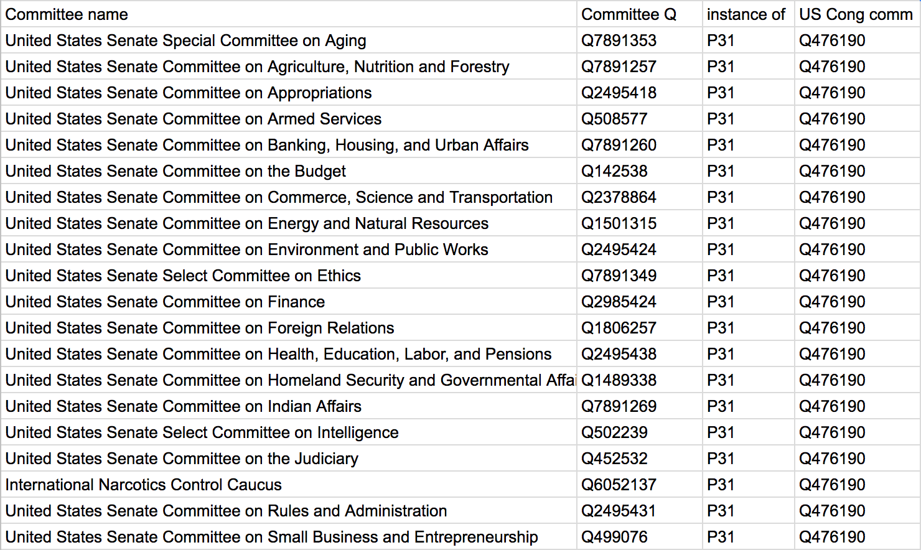
Quickstatements: Bulk upload tables in CSV format
https://tools.wmflabs.org/quickstatements

Slide 53
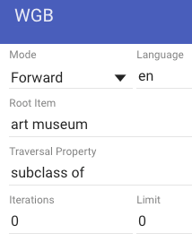
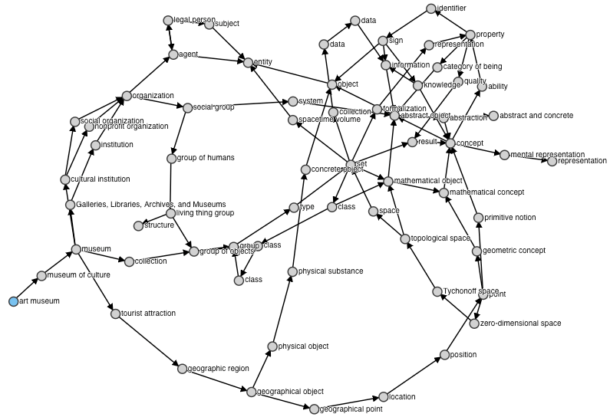
Wikidata Graph Builder: Visualizing relationships
https://angryloki.github.io/wikidata-graph-builder

Slide 54
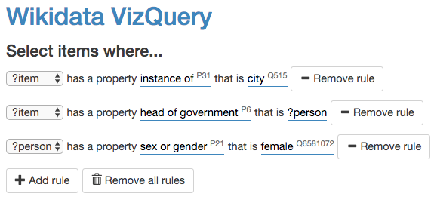
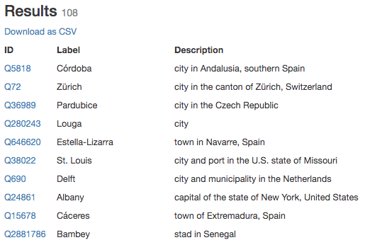
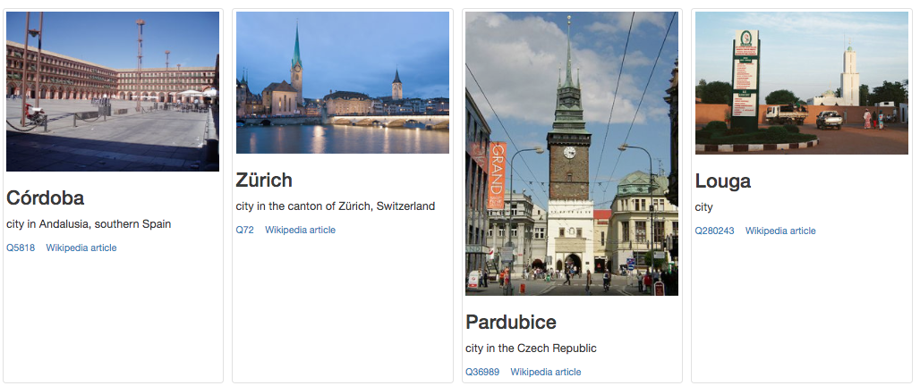
Vizquery: Simple Wikidata item selection
https://tools.wmflabs.org/hay/vizquery/
Much simpler way to do queries

Slide 55
Wikidata In one page
http://bit.ly/wikidata-onepage

