Slide 1
Freebase and the
GoogleKnowledge
Graph

Slide 2
Freebase
Started in 2005 by startup Metaweb
Goal: create an “open, shared database of the world's knowledge”
Freebase online in 2007
Acquired by Google in 2010
Read-only in 2014
Absorbed into Google’s Knowledge Graph
Decommissioned in 2016
2014 dump available as RDF

Slide 3
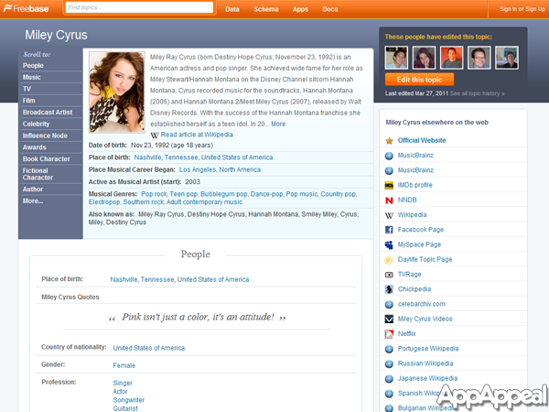
Screenshot

Slide 4
Approach
Initially populated with Wikipedia data
  Crowdsourced updates/additions to schema & data, like Wikipedia
  Tools to upload structured data, both schema & data
Focus on data, not text
  Text mostly in the form of short descriptions
Graph based schema, but syntax and semantics different from RDF
Open source data which could be downloaded initially in a custom format, later in RDF
Business model: sell services using their custom query engine

Slide 5
Freebase Schema
Statistics
  ~1500 types
  ~3,500 properties
  ~130M entities
  ~2B triples
Modeled many relations as object to allow more roles, e.g.
  :bho :spouseOf [a :Marriage with spouse :bho, :mo;
  :start “1992”; :location :chi]
Larger, cleaner and more organizeds than DBpedia

Slide 6
The Last Picture Show
A final dump with 1.9B triples in RDF is available from Google
  See also http://basekb.com/docs/
Used for DARPA Deft program, NIST TAC and other research efforts as a reference KB
  FB relations still used for many evaluations
Data transferred (I think) to Wikidata and/or Google Knowledge graph

Slide 7
Google Knowledge Graph
Freebase was the initial version of the Google knowledge Graph, aka Knowledge Vault
You can query it in a limited way
  Inputs: query string, types, limit
  Outputs: JSON object with ranked list of entities that match, along with types, short description, ID (= freebase ID)
See simple gkg.py example

Slide 8
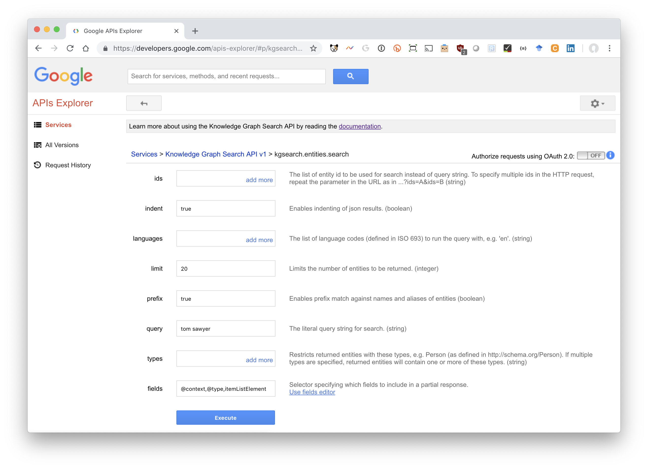
Experiment Online
Try: bit.ly/gkgClinton

Slide 9
Example
Query about Taylor Swift
https://kgsearch.googleapis.com/v1/entities:search?query=taylor+swift&key=API_KEY&limit=1&indent=True

Slide 10
{"@context": { "@vocab": "http://schema.org/",
"goog": "http://schema.googleapis.com/",
"resultScore": "goog:resultScore",
"detailedDescription": "goog:detailedDescription",
"EntitySearchResult": "goog:EntitySearchResult",
"kg": "http://g.co/kg"},
"@type": "ItemList",
"itemListElement": [
{ "@type": "EntitySearchResult",
"result": { "@id": "kg:/m/0dl567",
"name": "Taylor Swift",
"@type": ["Thing", "Person"],
"description": "Singer-songwriter",
"image": {"contentUrl": "https://t1.gstatic.com/images?q=tbn:ANd9GcQm…",
"url": "https://en.wikipedia.org/wiki/Taylor_Swift",
"license": "http://creativecommons.org/licenses/by-sa/2.0"},
"detailedDescription": {"articleBody": "Taylor Alison Swift is an American singer-songwriter …",
"url": "http://en.wikipedia.org/wiki/Taylor_Swift",
"license": "https://en.wikipedia.org/wiki/Wikipedia:Text_of_Creative_..."},
"url": "http://taylorswift.com/" },
"resultScore": 896.576599 } ] }

Slide 11
Tyrannosaurus (Q14332)
m/07hjh: Freebase ID of entity Tyrannosaurus
  Try http://g.co/kg/m/07hjh
  Wikidata property (P646) with label Freebase ID
/g/11r_php4q: Google Knowledge Graph ID
Wikidata has a property (P2671) with label Google Knowledge Graph ID
  Try https://g.co/kg/g/11r_php4q
Only 101 wikidata items have both

Slide 12
Is it the Google knowledge graph?
I don’t know…
Google says it’s now using Wikidata for the knowledge graph
We can only some info. about some entities
Google may have many sources of data it uses to answer/enrich query results
My guess: Wikidata is the backbone of the knowledge graph, but google links additional proprietary info. to many entities

