Slide 1
RDFa:
Embedding RDF Knowledge in HTML
Some content from a presentation by Ivan Herman of the W3c, Introduction
to RDFa, given at the 2011 Semantic Technologies Conference.

Slide 2

What is RDFa?
Serialization of RDF embedded in HTML,
HTML or XML
  Provides set of attributes (the a in RDFa) to use with existing tags to carry RDF metadata
2004: work on developing standards began
2008: RDFa 1.0 a recommendation (but only in XHTML, which failed to launch)
2012-15: RDFa 1.1 recommendation (works in HTML4, HTML5)
See http://rdfa.info/

Slide 3
Principles of RDFa
RDF content specified in XML attributes of tags rather than elements
The XML/HTML tree structure is used as context, when appropriate
Some new attributes are introduced and some existing ones (@href, @rel) reused
When possible, HTML text content used for literal values
➔Same file used by browser & RDF extractor

Slide 4
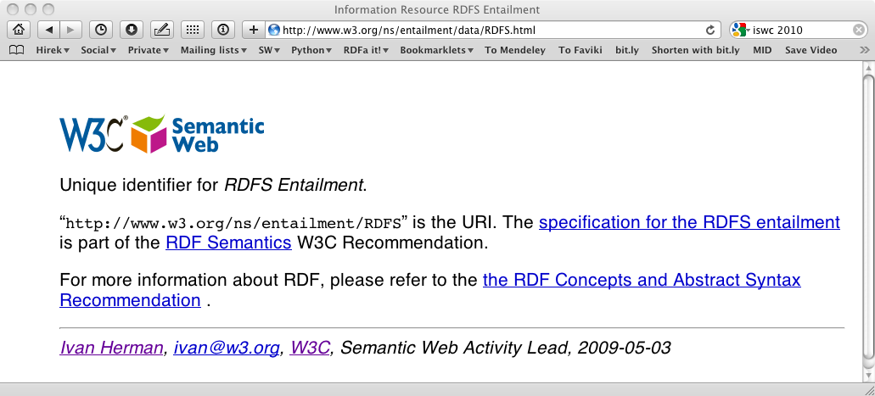
Web page viewed by a person
http://www.w3.org/ns/entailment/data/RDFS.html

Slide 5
The source
<p about="http://www.w3.org/ns/entailment/RDFS"
property="http://purl.org/dc/terms/description">
Unique identifier for <em>RDFS Entailment</em>.</p>

Slide 6
Source and generated RDF…
<p about="http://www.w3.org/ns/entailment/RDFS"
property="http://purl.org/dc/terms/description">
Unique identifier for <em>RDFS Entailment</em>.</p>
<http://www.w3.org/ns/entailment/RDFS>
… .

Slide 7
Source and generated RDF…
<p about="http://www.w3.org/ns/entailment/RDFS"
property="http://purl.org/dc/terms/description">
Unique identifier for <em>RDFS Entailment</em>.</p>
<http://www.w3.org/ns/entailment/RDFS>
<http://purl.org/dc/terms/description>
… .

Slide 8
Source and generated RDF…
<p about="http://www.w3.org/ns/entailment/RDFS"
property="http://purl.org/dc/terms/description">
Unique identifier for <em>RDFS Entailment</em>.</p>
<http://www.w3.org/ns/entailment/RDFS>
<http://purl.org/dc/terms/description>
"Unique identifier for RDFS Entailment." .

Slide 9
The Web page viewed by a person

Slide 10
The source
<a about="http://www.w3.org/ns/entailment/RDFS"
rel="http://www.w3.org/2000/01/rdf-schema#seeAlso"
href="http://www.w3.org/TR/2004/REC-rdf-mt-20040210/">
RDF Semantics.
</a>

Slide 11
Source and generated RDF…
<a about="http://www.w3.org/ns/entailment/RDFS"
rel="http://www.w3.org/2000/01/rdf-schema#seeAlso"
href="http://www.w3.org/TR/2004/REC-rdf-mt-20040210/">
RDF Semantics.
</a>
<http://www.w3.org/ns/entailment/RDFS>
….

Slide 12
Source and generated RDF…
<a about="http://www.w3.org/ns/entailment/RDFS"
rel="http://www.w3.org/2000/01/rdf-schema#seeAlso"
href="http://www.w3.org/TR/2004/REC-rdf-mt-20040210/">
RDF Semantics.
</a>
<http://www.w3.org/ns/entailment/RDFS>
<http://www.w3.org/2000/01/rdf-schema#seeAlso>
… .

Slide 13
Source and generated RDF…
<a about="http://www.w3.org/ns/entailment/RDFS"
rel="http://www.w3.org/2000/01/rdf-schema#seeAlso"
href="http://www.w3.org/TR/2004/REC-rdf-mt-20040210/">
RDF Semantics.
</a>
<http://www.w3.org/ns/entailment/RDFS>
<http://www.w3.org/2000/01/rdf-schema#seeAlso>
<http://www.w3.org/TR/2004/REC-rdf-mt-20040210/> .

Slide 14
Ntriples in HTML ☹
Maybe we can do better, instead of this
<http://www.w3.org/ns/entailment/RDFS>
<http://purl.org/dc/terms/description>
"Unique identifier for RDFS Entailment." .
<http://www.w3.org/ns/entailment/RDFS>
<http://www.w3.org/2000/01/rdf-schema#seeAlso>
<http://www.w3.org/TR/2004/REC-rdf-mt-20040210/> .
Allow URI prefixes and shared subject, like this
@prefix rdfs: <http://www.w3.org/2000/01/rdf-schema#> .
@prefix dcterms: <http://purl.org/dc/terms/> .
<http://www.w3.org/ns/entailment/RDFS>
rdfs:seeAlso <http://www.w3.org/TR/2004/REC-rdf-mt-20040210/> ;
dcterms:description "Unique identifier for RDFS Entailment." .

Slide 15
Turtlizing RDFa
Turtle supports several simplifying ideas
Use compact URIs (CURIE) when possible
  URI with a prefix defined elsewhere, e.g., foaf:mbox
Making use of the natural structure for
  shared subjects
  shared predicates
  creating blank nodes
  etc.

Slide 16
CURIE definition and usage
<html>
…
<p about="http://www.w3.org/ns/entailment/RDFS"
property="http://purl.org/dc/terms/description">
Unique identifier for <em>RDFS Entailment</em>.</p>
…
</html>
can be replaced by:
<html prefix="dcterms: http://purl.org/dc/terms/">
…
<p about="http://www.w3.org/ns/entailment/RDFS"
property="dcterms:description">
Unique identifier for <em>RDFS Entailment</em>.</p>
…
</html>

Slide 17
Details on @prefix in RDFa
Can be anywhere in the HTML tree and is valid for entire sub-tree
  i.e., html element not the only place to have it
The same @prefix attribute can hold several definitions:
  prefix="dcterm: http://purl.org… foaf: http://…”
CURIEs and “real” URIs can usually be mixed
CURIEs cannot be used on @href

Slide 18
Sharing subjects
Basic principle: @about is inherited by children nodes, so no reason to repeat it
<html prefix="dcterms: http://purl.org/dc/terms/
rdfs: http://www.w3.org/2000/01/rdf-schema#">
…
<body about="http://www.w3.org/ns/entailment/RDFS">
…
<p property="dcterms:description">
Unique identifier for <em>RDFS Entailment</em>.</p>
<p>…<a rel="rdfs:seeAlso"
href="http://www.w3.org/TR/2004/REC-rdf-mt-20040210">
RDFS Semantics</a>…</p>

Slide 19
… yielding
@prefix rdfs: <http://www.w3.org/2000/01/rdf-schema#> .
@prefix dcterms: <http://purl.org/dc/terms/> .
<http://www.w3.org/ns/entailment/RDFS>
rdfs:seeAlso <http://www.w3.org/TR/2004/REC-rdf-mt-20040210/> ;
dcterms:description "Unique identifier for RDFS Entailment." .

Slide 20
On reusing literals
Reusing literals is a plus, but you don’t always want to do it
The basic rule says: the (RDF) Literal is the enclosed text from the HTML content
This is fine in 80% of the cases, but…
…it may not be natural in many cases!

Slide 21
Example: dates
<body about=".." prefix="dcterms: http://… xsd: http://…"
<address>
<p property="dcterms:date" datatype="xsd:date">2010-07-05</p>
</address>
</body>
This leads to:
@prefix dcterms: <http://…> .
@prefix xsd: <http://…> .
<..> dcterms:date "2010-07-05"^^xsd:date .
2010-07-05 is official ISO format (for xsd:date)
but “July 5, 2010” is preferred by people

Slide 22
Usage of @content
<body about=".." prefix="dcterms: http://… xsd: http://…"
<address>
<p property="dcterms:date" datatype="xsd:date"
content="2010-07-05">July 5, 2010</p>
</address>
</body>
Also leads to:
@prefix dcterms: <http://…> .
@prefix xsd: <http://…> .
<..> dcterms:date "2010-07-05"^^xsd:date .

Slide 23
On subjects and objects
Here is our rule so far
  @about sets the subject
  @href sets the object
But that is not always good enough
  We may not want to introduce an active link (i.e., "a" element) on the web page
  what about other links in HTML?

Slide 24
We may not always want links…
The RDFa @resource attribute is equivalent to @href
Sets the object, just like @href but is ignored by browsers, e.g.,:
<span about="http://www.ivan-herman.net/foaf#me">
<span rel="rdfs:seeAlso"
resource="http://www.w3.org/People/Ivan/">Activity Lead</span>
</span>

Slide 25
More features
RDFa 1.1 has more features that make it easier to represent knowledge compactly in HTML
These take advantage of the HTML tree context
We’ll skip the details, which you can find in
  RDFa 1.1 Primer
  RDFa 1.1 Core

Slide 26
Authoring RDFa
Some tools already have RDFa facilities:
  e.g., it is possible to add the right DTD to Dreamweaver, Amaya has it at its core, etc.
There are plugins to, e.g., WordPress, to generate RDFa markup
CMS systems (like Drupal 7) may have RDFa built in their publication system
  users generate RDFa whether they know about it or not…

Slide 27
Consuming RDFa
Major search engines (Google, Yahoo) process RDFa for vocabularies they understand can use
There are libraries, distillers, etc., to extract RDFa information
  may be part of RDF development environments like Redland, RDFLib
  see, for further references, http://rdfa.info/wiki/Consume
Facebook’s “social graph” is based on RDFa

Slide 28
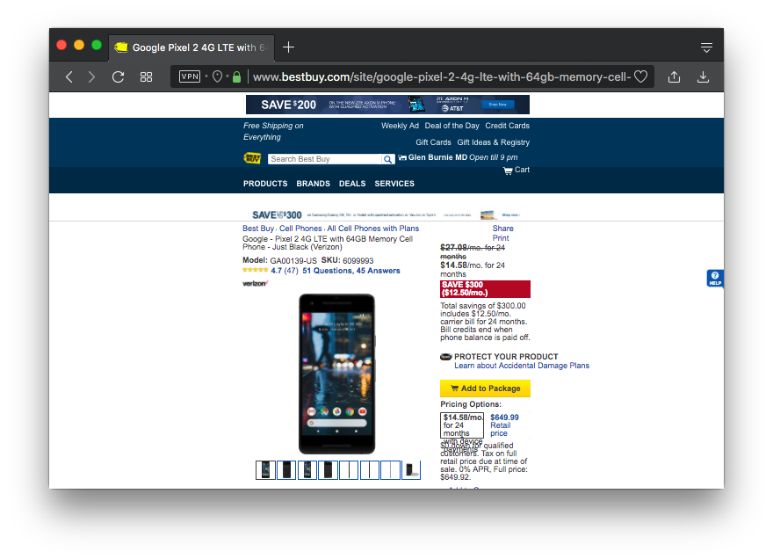
A page from Best Buy
RDFa for Facebook markup, JSON-LD for search engines

Slide 29

FB’s Open Graph Protocol

Slide 30
Publishing RDFa
RDFa+HTML file can just be on a server
  the client extracts the RDF content
Content negotiations can be set up on the server side
  the client gets the format he/she asks for
  the RDF content can either be generated on the fly or stored on the server statically

Slide 31
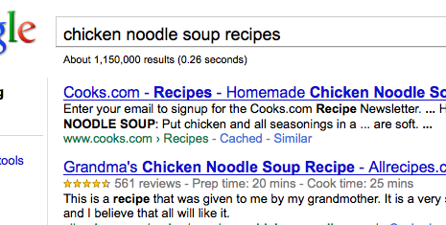
Google’s rich snippets
Embedded metadata (microdata or RDFa) is used to improve search result page
  at the moment only a few vocabularies are recognized, but that is evolving continually

Slide 32
Effects of, e.g., Google or Facebook
A number of popular sites publish RDFa as part of their normal pages:
  Tesco, BestBuy, Slideshare, The London Gazette, Newsweek, MSNBC, O’Reilly Catalog, the White House…
  Creative Commons snippets are in RDFa (e.g., on Flickr)

Slide 33
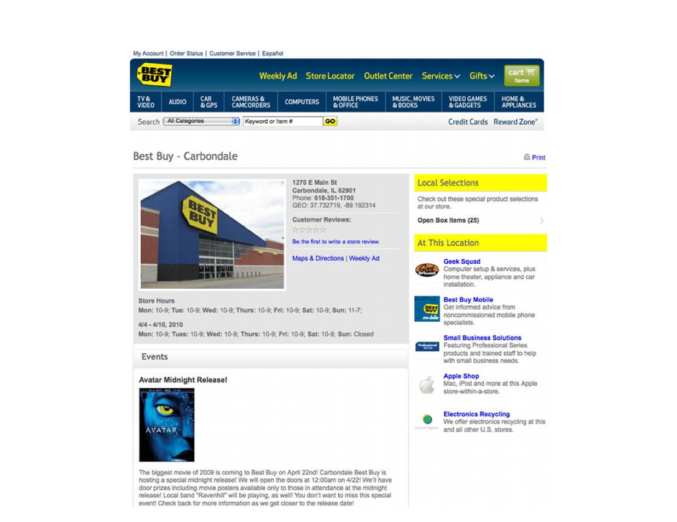
BestBuy example of RDFa use
Courtesy of Jay Myers, BestBuy, SemTech2010 Presentation

Slide 34
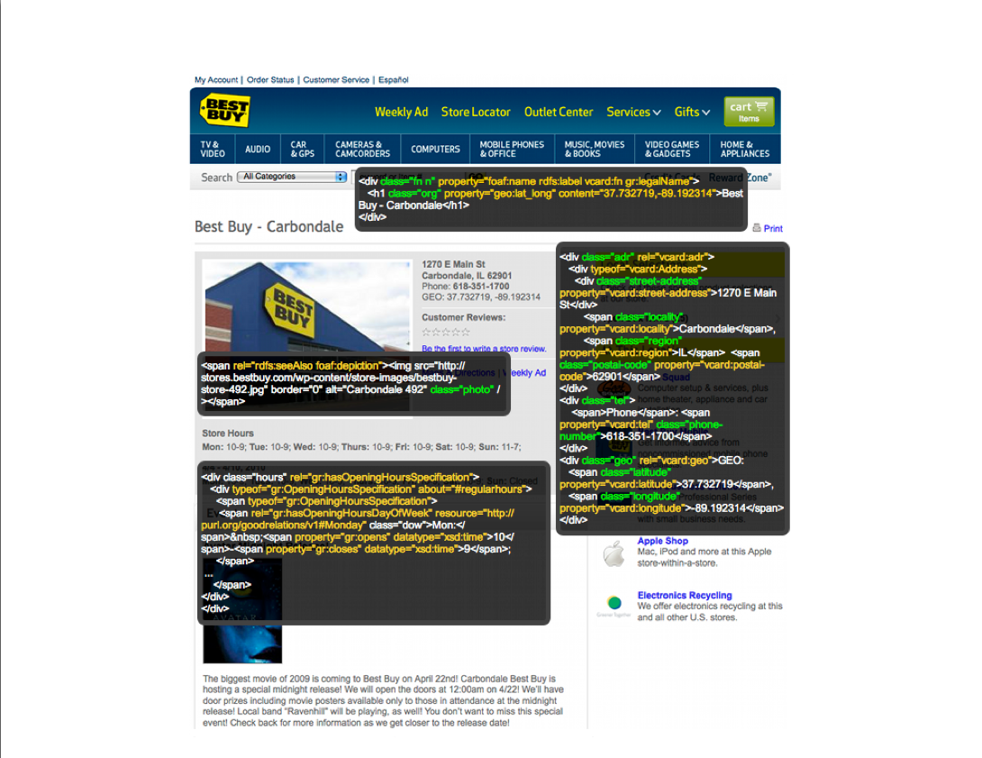
BestBuy example of RDFa Use
Courtesy of Jay Myers, BestBuy, SemTech2010 Presentation

Slide 35
Effects on BestBuy
Reported in a BestBuy blog:
  GoodRelations+RDFa improved Google rank tremendously
  30% increase in traffic on BestBuy store pages
  Yahoo observers a 15% increase in click-through rate
Today, BestBuy uses RDFa for much more than just snippets
  E.g., to locate shops that have certain products on stock…

Slide 36
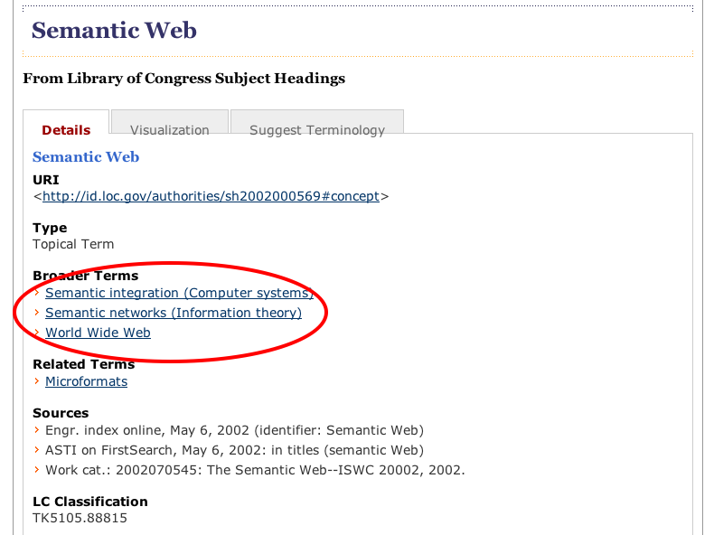
Library of Congress RDFa use

Slide 37
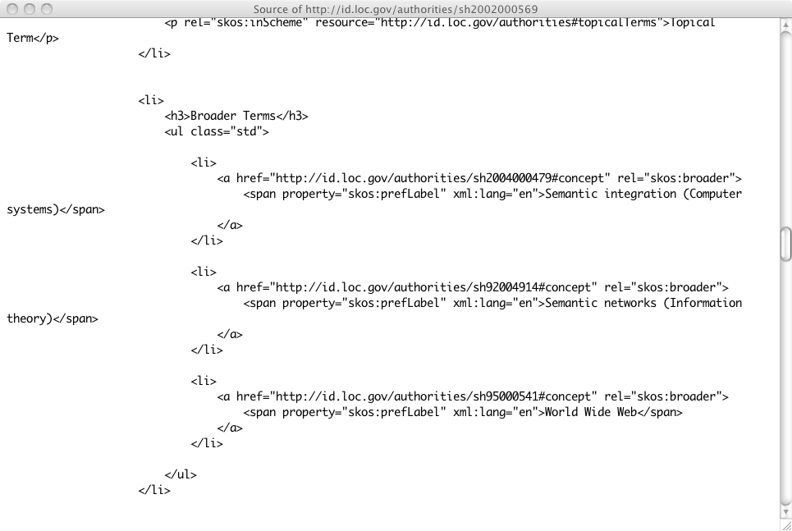
Library of Congress RDFa use

Slide 38
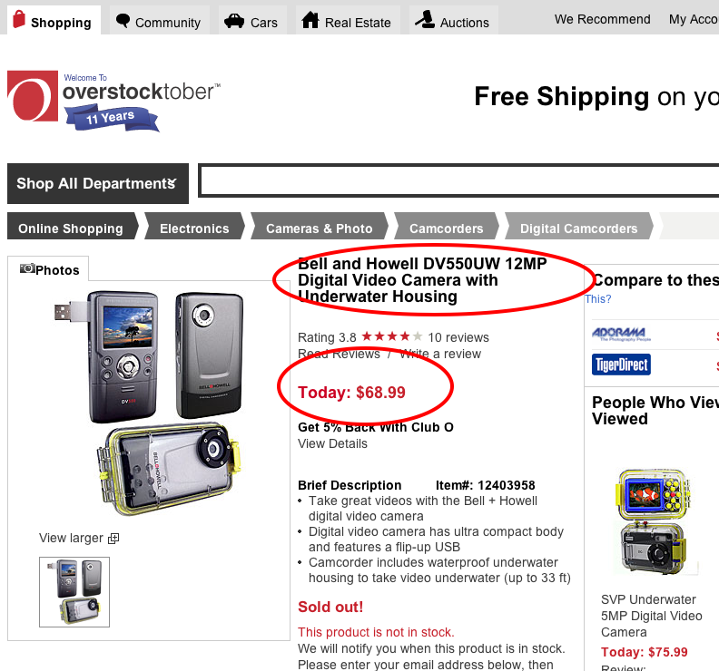
Overstock.com example

Slide 39
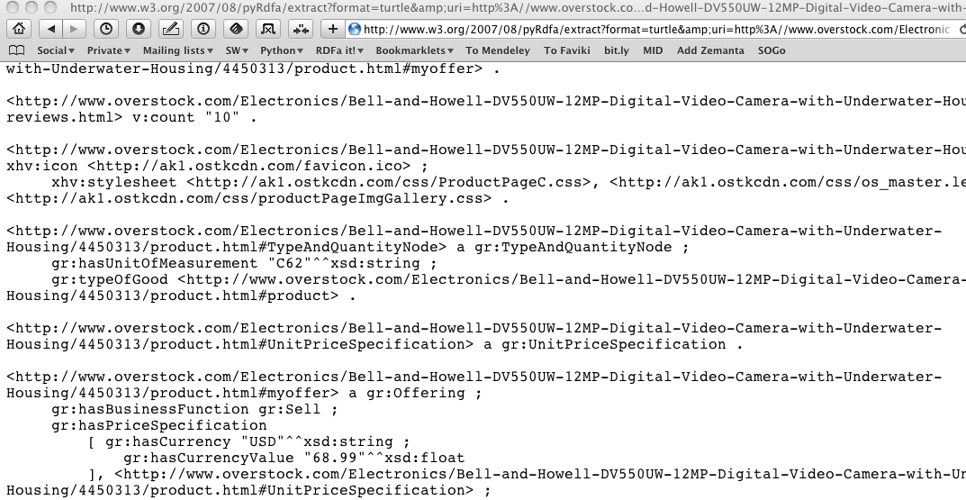
Overstock.com example

Slide 40
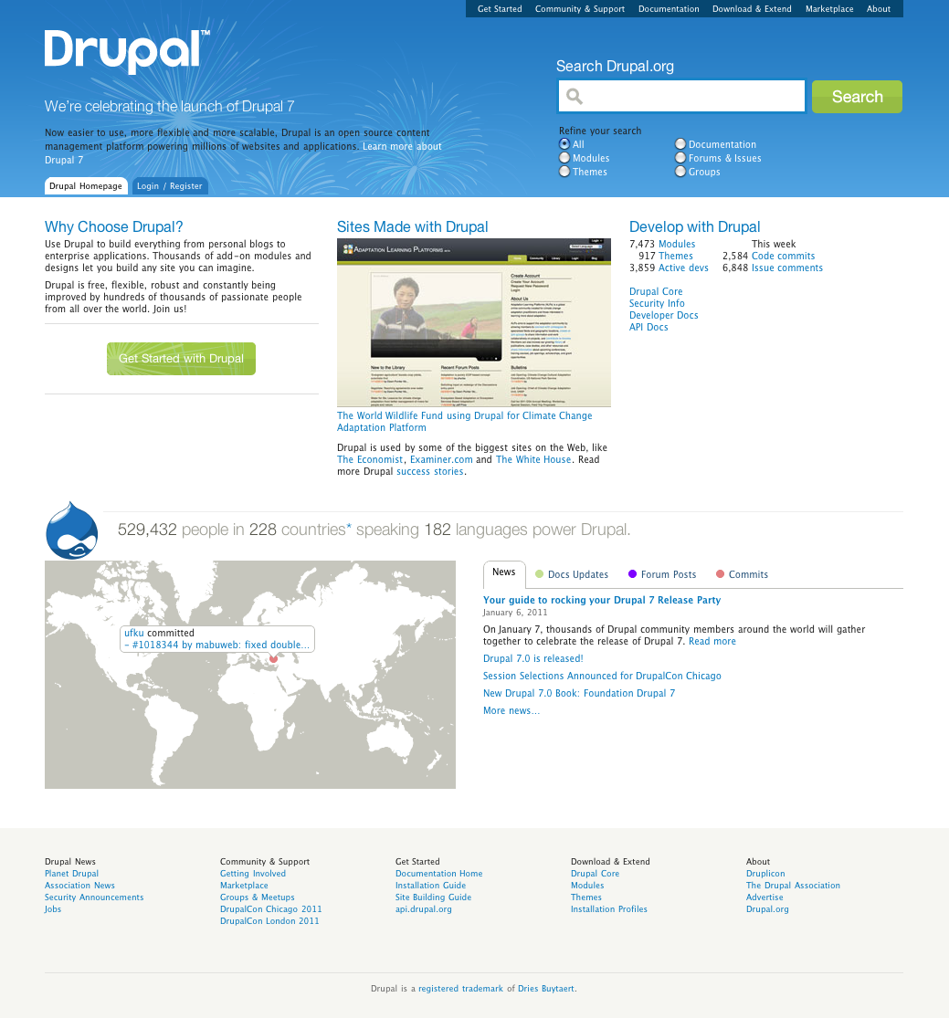
Drupal content management system
RDF support in Drupal v. 7
Major CMS system
Has RDF at his core, pages contain RDFa
In one step millions of pages of additional RDF data!

Slide 41
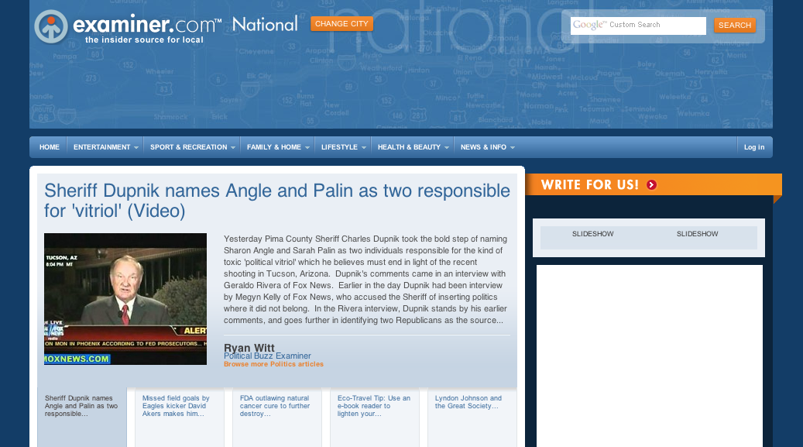
The Examiner.com

Slide 42
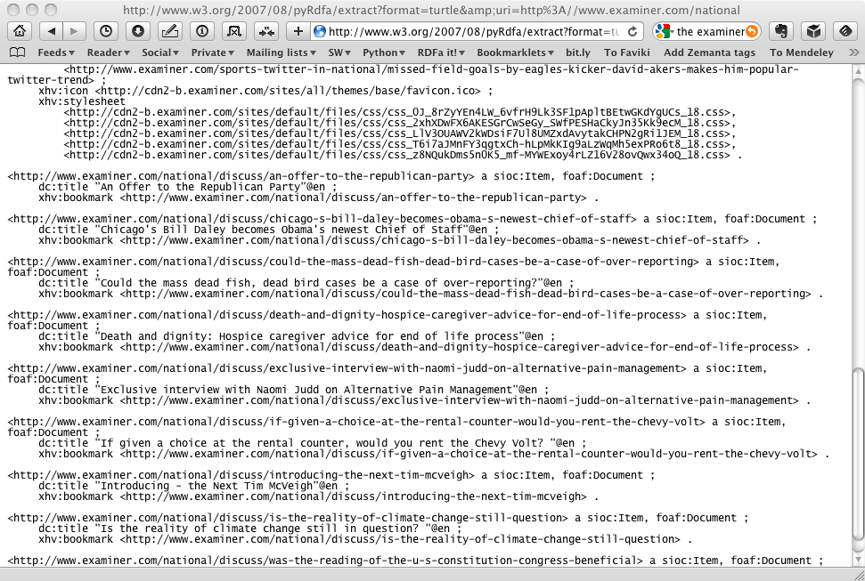
The Examiner.com

Slide 43
Extracting the data
rdfa> python getdata.py "http://www.w3.org/ns/entailment/data/RDFS.html"
@prefix dc: <http://purl.org/dc/terms/> .
@prefix ent: <http://www.w3.org/ns/entailment/> .
…
ent:RDFS a ent:Entailment ;
dc:creator <http://www.ivan-herman.net/foaf#me> ;
dc:date "2010-05-03"^^xsd:date ;
dc:description "Unique identifier for RDFS Entailment" ;
rdfs:comment "The specification for the RDFS entailment is … Semantics W3C Recommendation." ;
rdfs:isDefinedBy <http://www.w3.org/TR/2004/REC-rdf-mt-20040210/#rdfs_entailment> ;
rdfs:seeAlso <http://www.w3.org/TR/2004/REC-rdf-mt-20040210/> .
<http://www.w3.org/ns/entailment/data/RDFS.html> dc:title "Information Resource RDFS Entailment" ;
xhv:stylesheet <http://www.w3.org/StyleSheets/TR/base> .
<http://www.ivan-herman.net/foaf#me> a foaf:Person ;
rdfs:seeAlso <http://www.ivan-herman.net/foaf> ;
foaf:mbox <mailto:ivan@w3.org> ;
foaf:name "Ivan Herman" ;
foaf:title "Semantic Web Activity Lead" ;
foaf:workplaceHomepage <http://www.w3.org> .

Slide 44
getdata.py is very simple
import rdflib, sys
if not (1 < len(sys.argv) < 4):
print 'usage: python getdata.py url [‘json-ld’ | rdfa | rdfa1.1 | microdata | html ]'
print ' eg: python getdata.py "http://www.w3.org/ns/entailment/data/RDFS.html"'
sys.exit(0)
url = sys.argv[1]
format = sys.argv[2] if len(sys.argv) == 3 else 'rdfa1.1’
g = rdflib.Graph()
g.parse(url, format=format)
print g.serialize(format='n3')

Slide 45
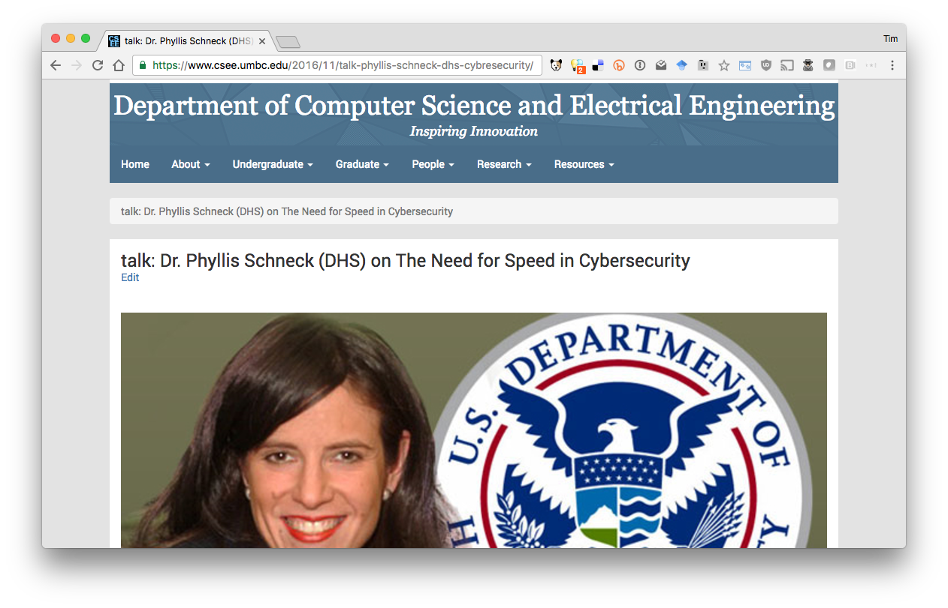
OpenLink Structured Data Sniffer*
* http://osds.openlinksw.com/

Slide 46
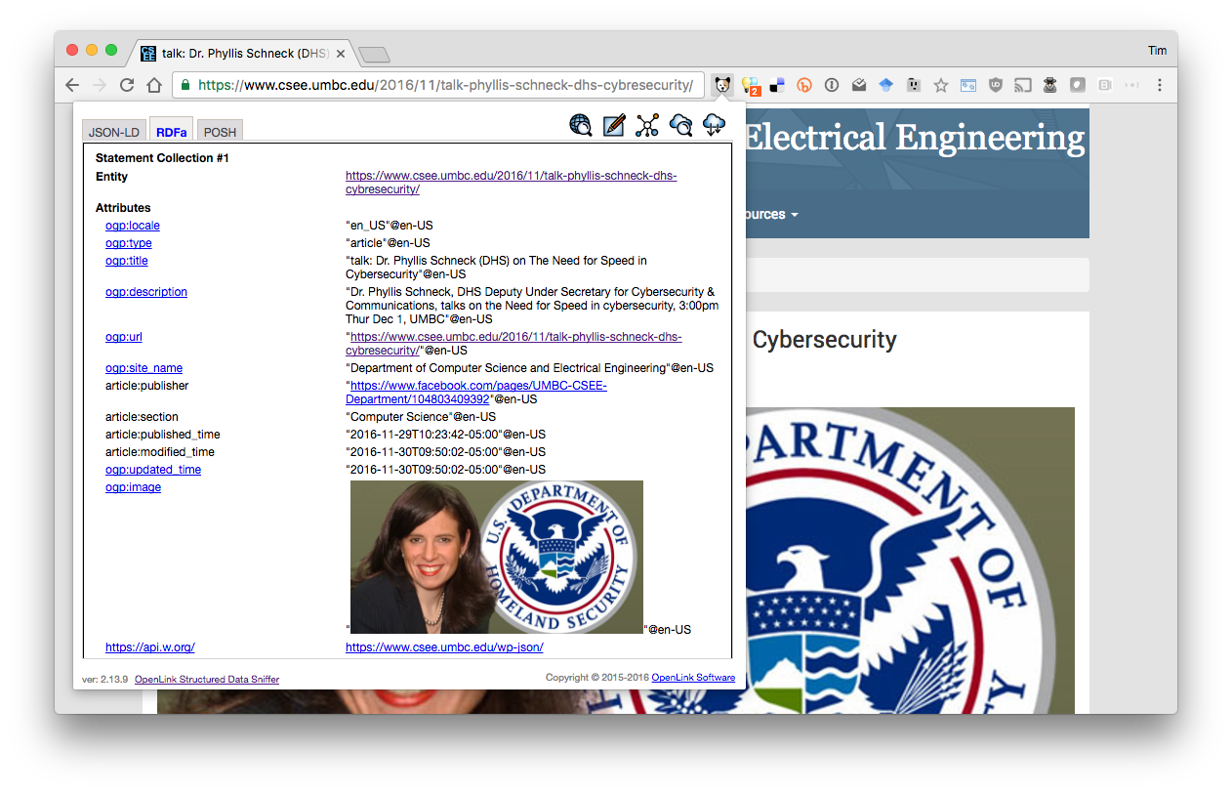
OpenLink Structured Data Sniffer*
* http://osds.openlinksw.com/

Slide 47
Conclusions
Web developers want content providers to add structured data to HTML pages
Content providers are incentivized to do so because their content will be better understood, ranked higher, more useful, etc.
RDFa is most powerful & flexible knowledge markup standard understood by search engines
RDFa is also an alternative serialization of full RDF

