Slide 1

Chapter 2
RDF Syntax 1

Slide 2
RDF Overview
RDF data model
RDF syntax
RDF serializations: XML, Turtle, N3, ntriples
RDF Schema (RDFS)
Semantics of RDF and RDFS
  Axiomatic Semantics
  Operational semantics based on rules
Querying RDF via SPARQL

Slide 3
Introduction
Problem: What does an XML document mean?
  XML is about data structures
  The meaning (semantics) not apparent to machines
RDF is more a data model than a language
  It is realized in many different formats
RDF defines very basic semantics
  RDFS and OWL define more RDF vocabulary for building rich data models
RDF remains domain independent

Slide 4
Example 1
<academicStaffMember> Grigoris Antoniou </academicStaffMember>
<professor> Michael Maher </professor>
<course name="Discrete Mathematics">
<isTaughtBy> David Billington </isTaughtBy>
</course>
What does this mean?
  Are professors also academic staff members?
  If someone teaches a course, are they an academic staff member?
Can’t say in XML, but can specify this in RDFS

Slide 5
Example 2
<course name="Discrete Mathematics">
<lecturer>David Billington</lecturer>
</course>
<lecturer name="David Billington">
<teaches>Discrete Mathematics</teaches>
</lecturer>
<teachingOffering>
<lecturer>David Billington</lecturer>
<course>Discrete Mathematics</course>
</teachingOffering>
Embedding of elements is just a syntactic constraint
No meaning is defined
Meaning is in documentation or viewer’s minds
Does the machine have a mind?

Slide 6
RDF History
An early version was developed in 1995 by R. V. Guha at Apple
Draft versions puvlished by W3C in 1997-1998
W3C recommendation in 1999
RDF 1.1 (2014) is most recent specification

Slide 7
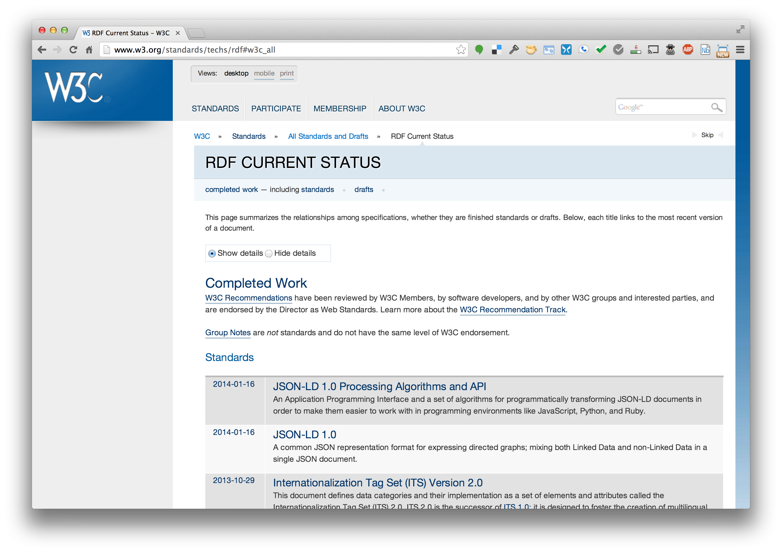
Key RDF documents: standards
http://w3.org/standards/techs/rdf

Slide 8
Topics
Basic concepts of RDF
  Resources, properties, values, statements, triples
  URIs and URIrefs
  RDF graphs
  Literals, qnames
Vocabularies and modeling
  Vocabularies
  Blank nodes, data modeling, types, reification
  Lists, bags, collections
Serialization of RDF graphs
  XML, Turtle, Ntriples
Critique of RDF

Slide 9
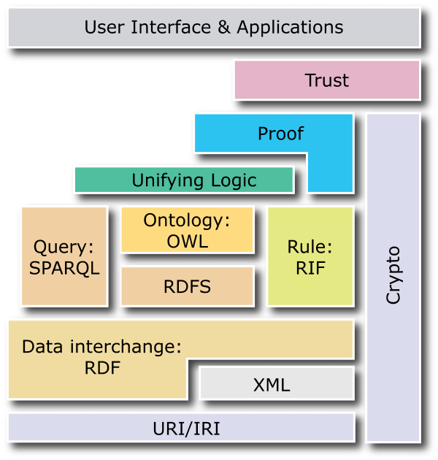
What is RDF?
A data model for representing information (esp. metadata) about resources in the Web
Can represent information about things that can be identified on the Web, even when not retrievable (e.g., a book)
Usecases: provide data for
applications rather than
directly to people

Slide 10
RDF Basics
Core idea: identify resources using Web identifiers and describing resources in terms of simple properties and property values
RDF data model is as a “pure” graph model
To identify resources, RDF uses Uniform Resource Identifiers (URIs) and URI references (URIrefs).
Definition: A resource is anything that is identifiable by a URIref

Slide 11
Example
Consider the following information:
  “there is a Person identified by
  http://www.w3.org/People/EM/contact#me,
  whose name is Eric Miller, whose email
  address is em@w3.org, and whose title is Dr.”

Slide 12
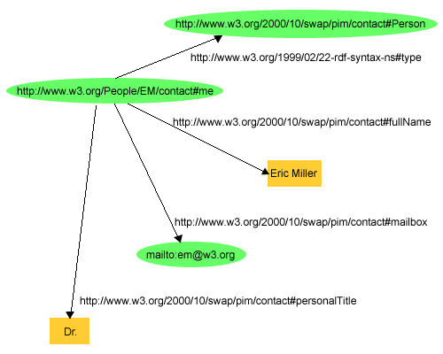
Example (cont’d)

Slide 13
Basics
Resources being described have properties that have values, and resources are described by making statements specifing those properties and values
  The part that identifies the thing the statement is about is the subject
  The part that identifies the property of the subject the statement specifies is the predicate
  The part that identifies the property’s value is the object

Slide 14
Example
http://www.example.org/index.html has a creator whose value is “John Smith”
The subject is the URL http://www.example.org/index.html
The predicate is the word "creator"
The object is the phrase “John Smith”

Slide 15
RDF Triples
RDF statements can be written as triples
Simple ntriples notation: a set of triples terminated by a periods, where URIs are inside angle brackets
      <http://www.example.org/index.html> <http://purl.org/dc/elements/1.1/creator> <http://www.example.org/staffid/85740> .
      <http://www.example.org/index.html> <http://www.example.org/terms/creation-date> "August 16, 1999" .
      <http://www.example.org/index.html> <http://purl.org/dc/elements/1.1/language> "en" .

Slide 16
Graphs: pure
and impure

Slide 17
Pure graph model
A pure graph model consists only of edges between pairs of nodes
  Can be directed or undirected; can be labeled or not
A graph can be represented as an unordered collection of (subject, predicate, object) triples
  If directed, predicate goes from subject to object
Nodes not the subject or object of some triple are not allowed
  (John, likes, Mary),
  (Mary, likes, Bill),
  ( John, hates, Bill)
john
mary
likes
hates
likes
bill

Slide 18
RDF graph model
RDF is like this with a few caveats
  Subjects and predicates are identified by URIs
  Object can be a URI or a literal, i.e., a string or a number
RDF defines some special URIs and gives them specific meaning, like this one for type
  http://www.w3.org/1999/02/22-rdf-syntax-ns#type
RDF has simple conventions for representing both ordered and unordered sequences
and a few other data structures
john
mary
likes
hates
likes
bill

Slide 19
Property graphs
Graph databases have become popular in past 10 years
A common extension of the pure graph model is to allow both nodes and edges to have properties
Simple version: properties are key/value pairs, e.g.
  Age : 25
  Date : “1990-09-21”
We might give the likes edge from John to Mary two properties: start with value “1999-09-1” and end with value “2016-01-11”
  Could mean the likes relation held between those two dates

Slide 20
Some property graph technology
Neo4J is perhaps the most widely
used property graph
OrientDB is another popular system
that support for both a property graph
and relational databases
Apache’s TinkerPop is an open source framework for querying and updating graph databases that is supported by most graph databases
Amazon’s Neptune is a graph database “built for the cloud” supporting both pure RDF and property graphs

Slide 21
URIs and URIREFs

Slide 22
Uniform Resource Identifiers (URIs)
URIs identify resources on the Web
Unlike URLs, they aren’t limited to identifying things with network locations
No organization controls who makes URIs or how they can be used
  Some URI schemes (http: URLs) depend on centralized systems such as DNS name servers
  Others are completely decentralized

Slide 23
URI Reference (URIref)
URIref: URI with optional fragment identifier at end, e.g:
  http://example.org/index.html#section2
Fragment usecase:
  HTML fragments refer to a place in a page
  RDF fragments refer to resources in a RDF graph that the URI denotes, e.g., subjects, predicates or objects
    http://www.w3.org/2004/02/skos/core : vocabulary for describing topics
    http://www.w3.org/2004/02/skos/core#broader : the broader concept in SKOS Core vocabulary
Like URLs, URIrefs may be either absolute or relative
  Note: the empty URI refers to the resource it’s in

Slide 24
URIrefs in RDF
RDF and Browsers use URIrefs to identify things, but interpret URIrefs slightly differently:
  Browsers also use URIrefs to retrieve things
  RDF uses URIrefs only to identify things and these might not even be retrievable
Linked Data best practice is to use HTTP URIs that return RDF data for every URI

Slide 25
Content Negotiation
What does HTTP stand for?

Slide 26
Content Negotiation
What does HTTP stand for?
HTTP == HyperText Transfer Protocol
Lets Web client (browser, program) and server (apache) do many things (e.g., authentication)
Can specify format of data returned, e.g., HTML, XML, RDF serialized in any of several forms, etc.
Getting the same URL, http://dbpedia.org/ resource /Alan_Turing, can produce content good for people or machines

Slide 27
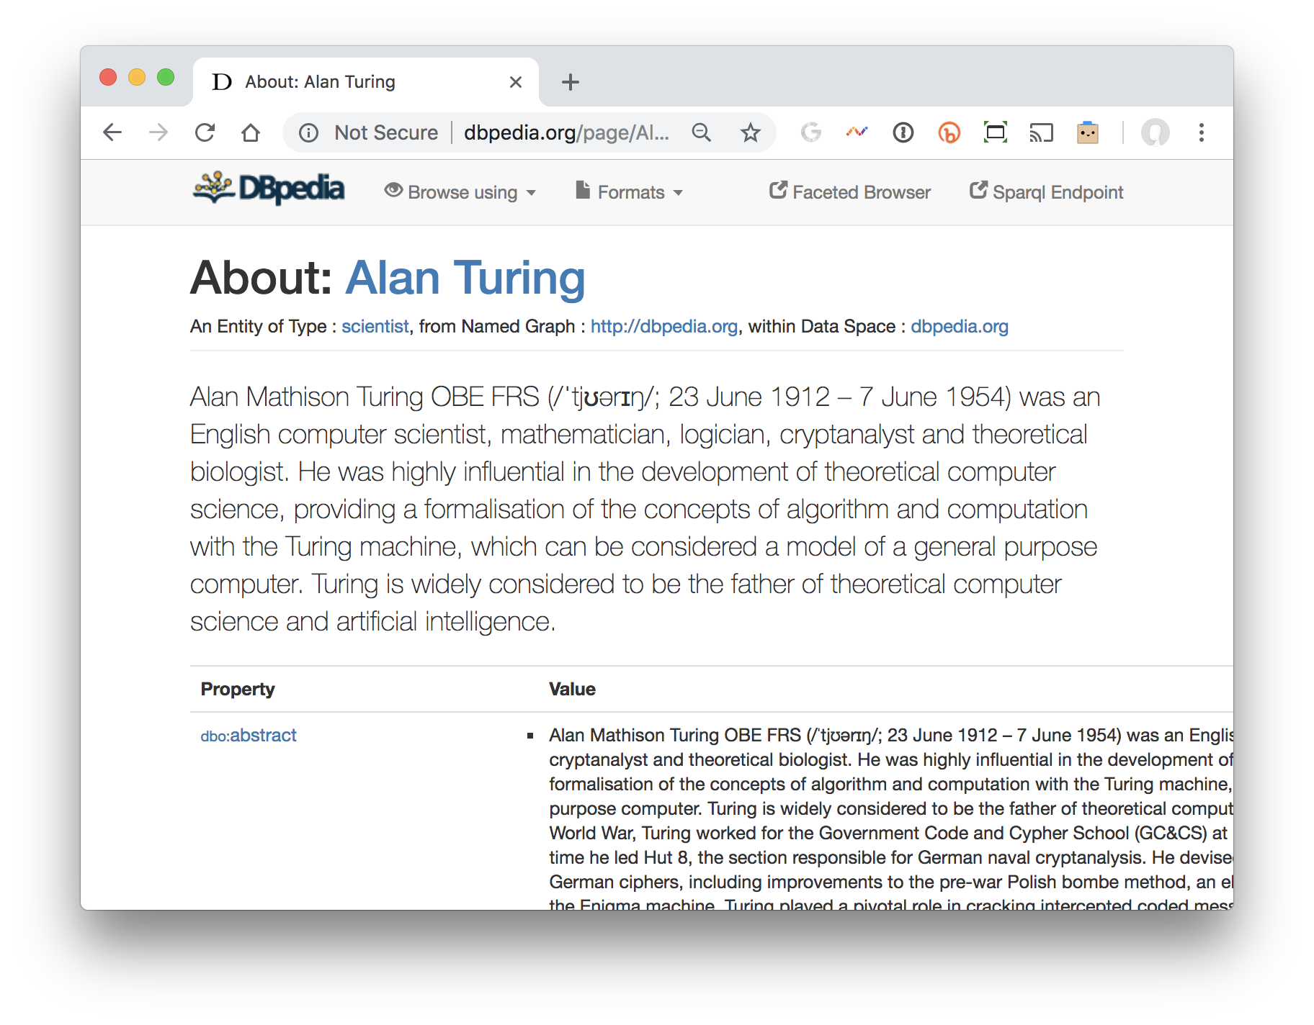
http://dbpedia.org/resource/Alan_Turing

Slide 28
http://dbpedia.org/resource/Alan_Turing
curl –L http://dbpedia.org/resource/Alan_Turing
  -L says “follow redirects”
  Returns default content version, typically html
curl –LH "Accept: application/rdf+xml" <url>
  Follow redirects
  Return content as RDF serialized in xml if possible
curl –LH "Accept: text/turtle, application/rdf+xml, text/ntriples, application/ld+json” <url>
  Specifies 4 possible content forms in preference order

Slide 29
http://dbpedia.org/resource/Alan_Turing
curl -LH "Accept: text/turtle" http://dbpedia.org/resource/Alan_Turing
@prefix dbo: <http://dbpedia.org/ontology/> .
@prefix dbr: <http://dbpedia.org/resource/> .
dbr:Alan_turing dbo:wikiPageRedirects dbr:Alan_Turing .
<http://dbpedia.org/resource/A._Turing> dbo:wikiPageRedirects dbr:Alan_Turing .
dbr:Jack_Copeland dbo:knownFor dbr:Alan_Turing .
dbr:Joan_Clarke dbo:partner dbr:Alan_Turing .
dbr:Robin_Gandy dbo:doctoralAdvisor dbr:Alan_Turing .
dbr:Hilary_Putnam dbo:influencedBy dbr:Alan_Turing .
@prefix rdf: <http://www.w3.org/1999/02/22-rdf-syntax-ns#> .
@prefix yago: <http://dbpedia.org/class/yago/> .
dbr:Alan_Turing rdf:type yago:WikicatBritishCryptographers ,
yago:WikicatEnglishInventors ,
yago:Theorist110706812 ,
yago:Decoder109995398 .
@prefix umbel-rc: <http://umbel.org/umbel/rc/> .
dbr:Alan_Turing rdf:type umbel-rc:PersonWithOccupation .
…

Slide 30
RDF Graphs

Slide 31
RDF Graphs
RDF models statements by nodes and arcs in a graph
A statement is represented by a node for the subject, a node for the object and an arc for the predicate (subject => object)
A node may be identified by a URIref or it can be a literal or a blank node
An arc is identified by a URIref
Note: We will draw RDF graphs as directed graphs
  But an arc can be the subject of an RDF statement
  :has_parent owl:inverseOf :has_child

Slide 32
Example
Consider the following statements:
http://www.example.org/index.html has a creation-date whose value is August 16, 1999.
http://www.example.org/index.html has a language whose value is English.
http://www.example.org/index.html was created by hppt://example.org/staffed/85740

Slide 33
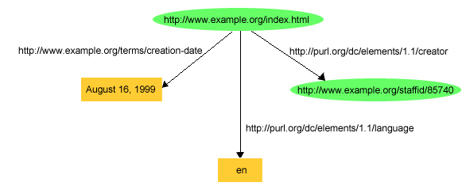
The RDF Graph of the Example
Note: http://purl.org/dc/elements/1.1 is prefix for the Dublin Core vocabulary/ontology
http://www.example.org/… is uses for examples

Slide 34
RDF and Related Data Models
In terms of the relational model, an RDF statement is like a tuple in a relation Graph with columns Subject, Predicate, Object
For first-order logic, an RDF statement is like an atomic formula triple(subj, pred, obj) where triple is a FOL predicate and subj, pred and obj are constants
More common view is to treat the triple’s predicate as a logical predicate: pred(subj, obj)

Slide 35
Literals and QNames

Slide 36
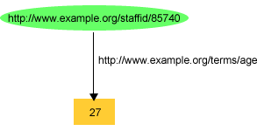
Literals
What is 27? Number or string?
Notes:
Answer: 27 is a plain literal here !!!!!

Slide 37
Plain and Typed Literals
RDF has two kinds of literals: plain and typed
Plain literals have a lexical form (their lexical value) and optionally a language tag, e.g:
  "27" , "Hello world"@en, "Bonjour le monde"@fr
RDF typed literals are formed by pairing a string with a URIref for a particular XMLS datatype, e.g.:
  “27”^^http://www.w3.org/2001/XMLSchema#integer
  ”27"^^xsd:int

Slide 38
Data Types for Literals
In practice, the most widely used data typing scheme is the one by XML Schema
  But any externally defined data typing scheme is allowed in RDF documents
XML Schema predefines many data types
  E.g. Booleans, integers, floating-point numbers, times, dates, etc.

Slide 39
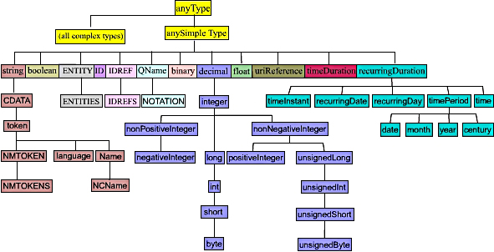
XMLSchema Datatypes
http://www.w3.org/TR/xmlschema-2/

Slide 40
Qnames for URIrefs
The ntriples notation results in very long lines
We can use an XML qualified name (QName)
w/o brackets for a full URI reference
  http://dbpedia.org/page/Alan_Turing
  dbp:Alan_Turing
Qnames have a prefix that’s been assigned to a namespace URI, a colon and a local name
  How to assign a prefix to a URI varies by serialization
The concepts of names and namespaces used in RDF originate in XML

Slide 41
Topics Part 1
Basic concepts of RDF
  Resources, properties, values, statements, triples
  URIs and URIrefs
  RDF graphs
  Literals, qnames
Vocabularies and modeling
  Vocabularies
  Blank nodes, data modeling, types, reification
  Lists, bags, collections
Serialization of RDF graphs
  XML, Turtle, Ntriples
Critique of RDF

