Slide 1
CMSC 491/691
Knowledge Graphs
Administrivia
Fall 2018

Slide 2
Course Objectives
Understand concepts, motivation, goals underling knowledge graphs (KGs)
In-depth understanding of Semantic Web (SW) languages and tools
Ability to create & use ontologies & schemas using SW languages
Understand the different kinds of KG models and capabilities
Create, consume and manipulate KG data
Know alternatives: XML, JSON, Schema.org, Google Knowledge Graph, …
Ability to define and implement a KG project

Slide 3
Grading
Grades will be based on homework, quizzes, exams and a project
5-6 short homework assignments
  Submissions will be via github classroom
Occasional online Blackboard quizzes focused on readings
In class midterm exam near middle of class, comprehensive final at end
Project can be individual or small groups and will have a proposal and final report
Probable weighting: 40% homework, 15% project, 10% quizzes, 15% midterm, 20% final

Slide 4
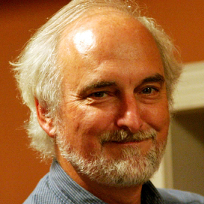
Instructor availability
Instructor: Professor Tim Finin
Pronounced like fine + in, not like fin + in
Office: ITE329, finin@umbc.edu, phone:410-455-3522
Official office hours: by arrangement
Drop in whenever my door is open
Direct general questions (i.e., those that other students may also have and that a Web search can’t answer) to Piazza first
We’ll try to respond to postings on the discussion list or private email messages within 24 hours

Slide 5
Programming, etc.
Homework requires using various systems/tools
We’ll use GitHub for started code & submission
Some will require programming; can be done in any language (e.g., Java, Python); Python preferred
Examples demonstrated in Unix (Linux or MAC OS X); most can be made to work on Windows
A web server on your computer may be useful

Slide 6
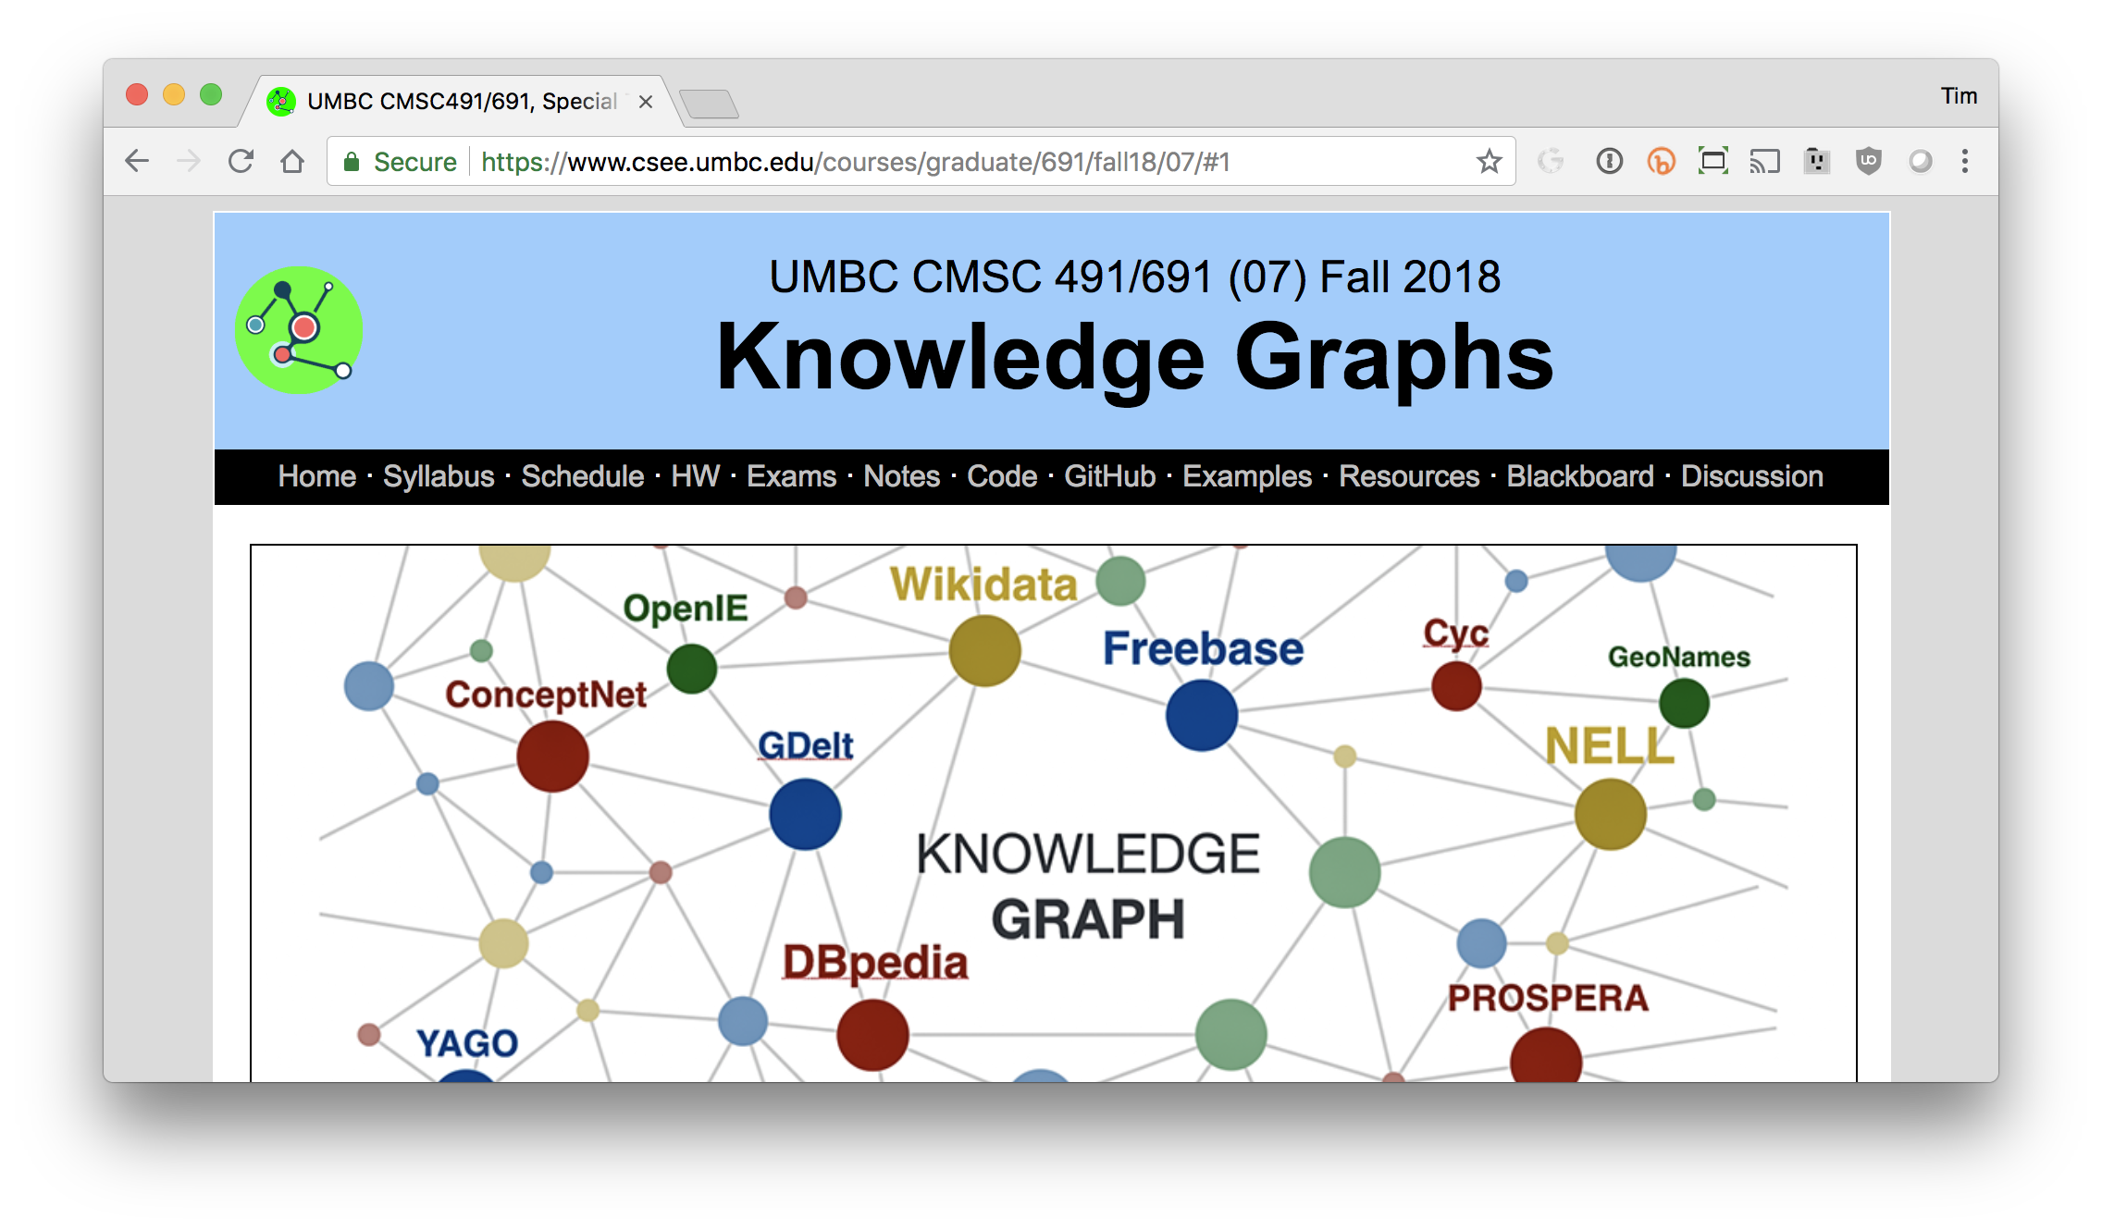
Web Site: http://bit.ly/691f18

