Slide 1
Embedding Knowledge in HTML
Some content from a presentations by Ivan Herman of the W3c

Slide 2
Overview
Why we want to embed structured data in HTML
RDFa
Microdata and schema.org
RDFa lite as an encoding for Microdata
JSON-LD as an encoding for RDF and Microdata
Usecases and examples

Slide 3
HTML is Everywhere
We usually think of HTML as the language of Web pages
But it’s also widely used on/for mobile devices and tablets
  Readily adapts to different screen sizes/orientations
And is the basis of many ebook formats
  E.g. Kindle’s formats, mobi, epub, …
How can we add knowledge to HTML pages?

Slide 4
Adding RDF-like data to HTML
Like to add semi-structured knowledge in HTML
  Humans see and understand regular HTML content (text, images, videos, audio)
  Machines see and understand data markup in XML, RDF or some other format
Possibilities include
  Add a link to separate document with knowledge
  Add new HTML tags
  Embed knowledge as comments, Javascript, etc.
  Distribute knowledge markup throughout HTML as attributes of existing HTML tags

Slide 5
One page, not two
Content providers prefer not to generate multiple page:, one for humans (HTML) and another for machines (RDF)
  RDF serializations are complex
  Requires separate mechanisms for storage, generation, etc.
  Introduces redundancy, which can lead to errors if we change one page but not the other
Simplifies the job of search engines as well

Slide 6
General approach
Two embedding techniques
  Provide/reuse tag attributes to encode the metadata; browsers/apps ignore attributes they don’t understand
  Add a graph for page in JSON-LD
Several approaches have been developed
  Microformats (~ 2005)
  RDFa (~ 2007)
  Microdata (aka schema.org) (~ 2012)
Status 2014/5 (IMHO)
  Microformats still used but future is limited
  RDFa and JSON-LD are preferred encoding of choice
  Schema.org vocabularies getting large uptake

Slide 7

Earliest idea, supplanted by RDFa and Microdata
Reuses HTML attributes like @class, @title
Separate vocabularies developed for common use cases, e.g., address, CV, recipes …
Difficult to mix microformats (no concept of namespaces)
Doesn’t define an RDF representation
  possible to transform via, e.g., XSLT + GRDDL, but transformations are vocabulary dependent

Slide 8
vCard: popular format for “business card” data
Example use case for email
  Sender attaches vCard to email message
  Recipient detaches to contact app
hCard is a Microformat based on vCard
  Allows way to embed vCard data in a web page

Slide 9
BEGIN:VCARD
VERSION:4.0
N:Forrest;Gump;;Mr.;
FN:Forrest Gump
ORG:Bubba Gump Shrimp Co.
TITLE:Shrimp Man
PHOTO;MEDIATYPE=image/gif:http://www.example.com/dir_photos/my_photo.gif
TEL;TYPE=work,voice;VALUE=uri:tel:+1-111-555-1212
TEL;TYPE=home,voice;VALUE=uri:tel:+1-404-555-1212
ADR;TYPE=WORK,PREF:;;100 Waters Edge;Baytown;LA;30314;United States of Amer
ica
LABEL;TYPE=WORK,PREF:100 Waters Edge\nBaytown\, LA 30314\nUnited States of
America
ADR;TYPE=HOME:;;42 Plantation St.;Baytown;LA;30314;United States of America
LABEL;TYPE=HOME:42 Plantation St.\nBaytown\, LA 30314\nUnited States of Ame
rica
EMAIL:forrestgump@example.com
REV:20080424T195243Z
END:VCARD
vCard: popular format for “business card “data
Example use case for email
  Sender attaches vCard to email message
  Recipient detaches to contact app
hCard is a Microformat based on vCard
  Allows way to embed vCard data to a web page

Slide 10
<ul class="vcard">
<li class="fn”>Forrest Gump</li>
<li class="org”>Bubba Gump Shrimp Co.</li>
<li class="tel”>1-111-555-1212</li>
<li><a class="url" href="http:/bubbagump.com/"> http://bubbagump.com/</a></li>
</ul>
vCard: popular format for “business card “data
Example use case for email
  Sender attaches vCard to email message
  Recipient detaches to contact app
hCard is a Microformat based on vCard
  Allows way to embed vCard data to a web page

Slide 11
Microformats => Microdata
Microformat problems:
  Not integrated well into HTML
  Not supported by a standardization body
  Limited vocabulary
Microformats have been supplanted by Microdata

Slide 12
Microdata approach
Defined and supported by Google, Bing, Yahoo and Yandex
Adds new attributes to HTML5 to express metadata
Works well for simple “single-vocabulary” cases, but not well suited for mixing vocabularies or for complex vocabularies
No notion of datatypes or namespaces
Defines a generic mapping to RDF

Slide 13
RDFa approach
Adds new (X)HTML/XML attributes
Has namespaces and URIs at its core
  So mixing vocabulary is easy, as in RDF
Complete flexibility for using literals or URI resources
Is a complete serialization of RDF

Slide 14
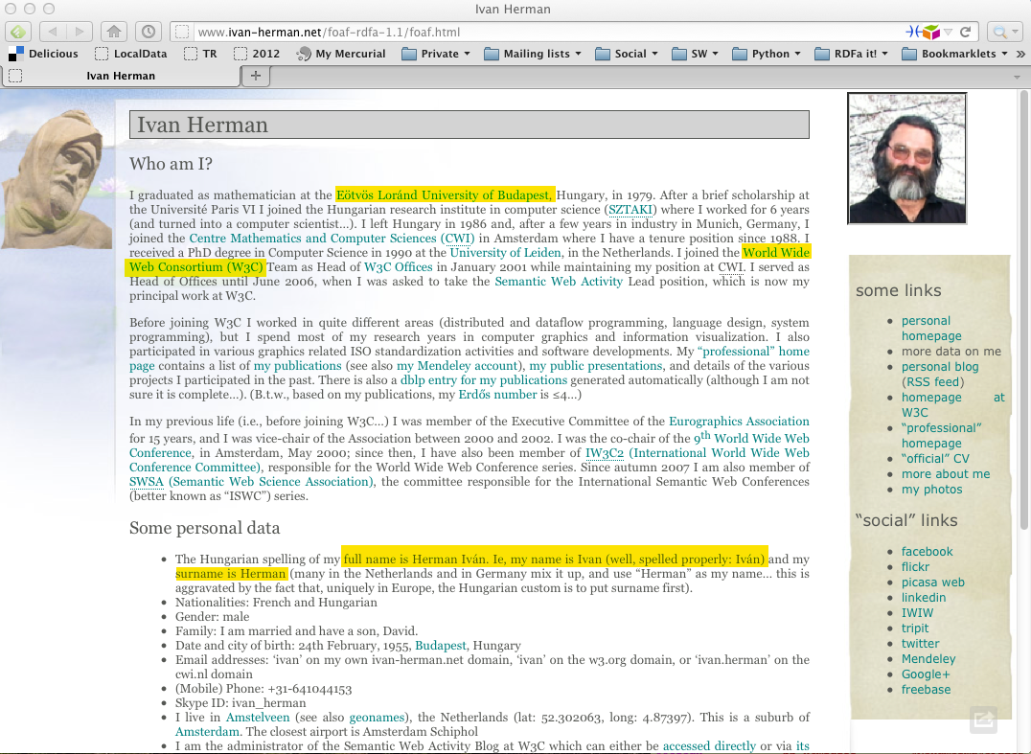

Slide 15
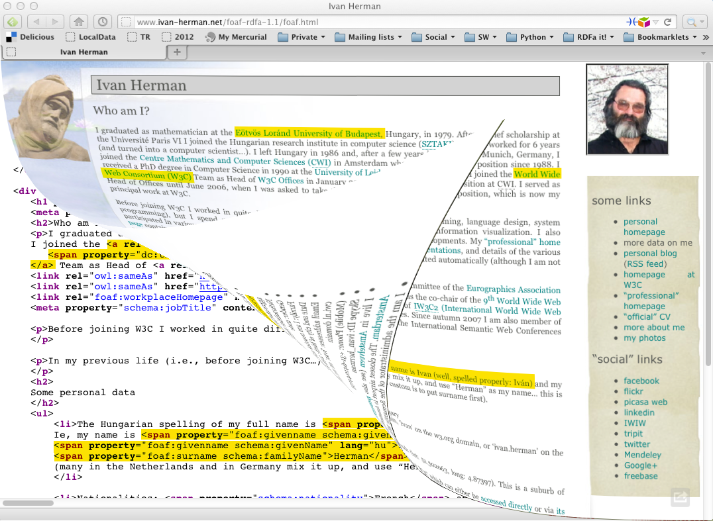

Slide 16
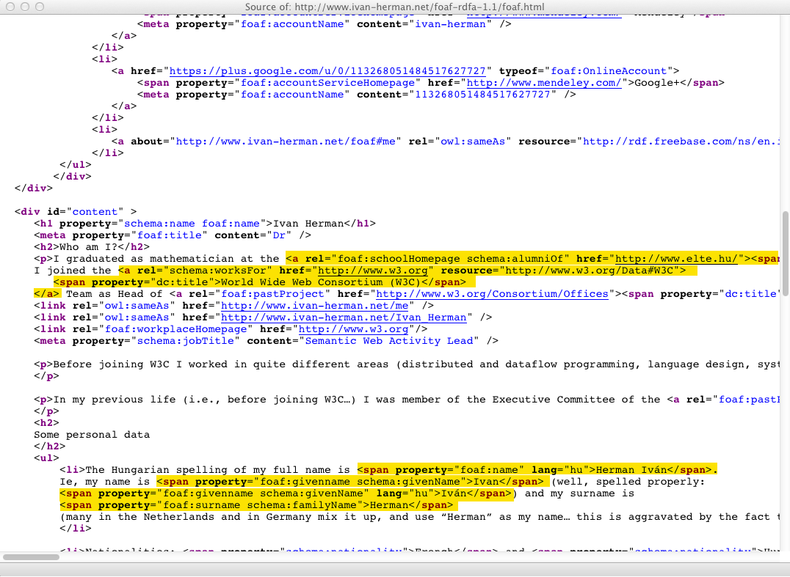

Slide 17
Yielding this RDF
<http://www.ivan-herman.net/foaf#me>
schema:alumniOf <http://www.elte.hu> ;
foaf:schoolHomePage <http://www.elte.hu> ;
schema:worksFor <http://www.w3.org/W3C#data> ;
…
<http://www.elte.hu>
dc:title "Eötvös Loránd University of Budapest" .
…
<http://www.w3.org/W3C#data>
dc:title "World Wide Web Consortium (W3C)”
…

Slide 18
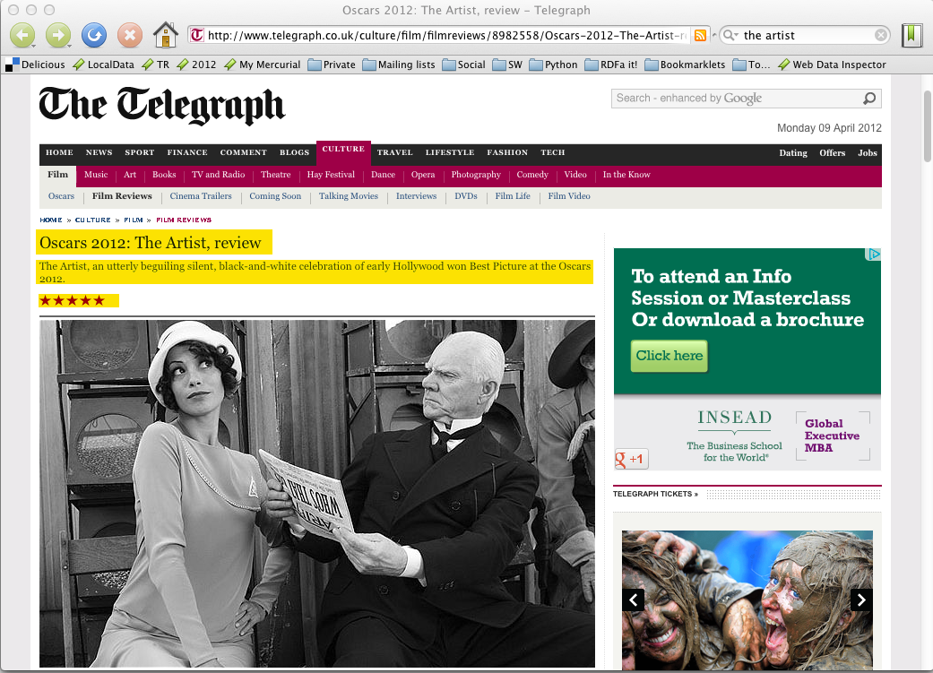

Slide 19
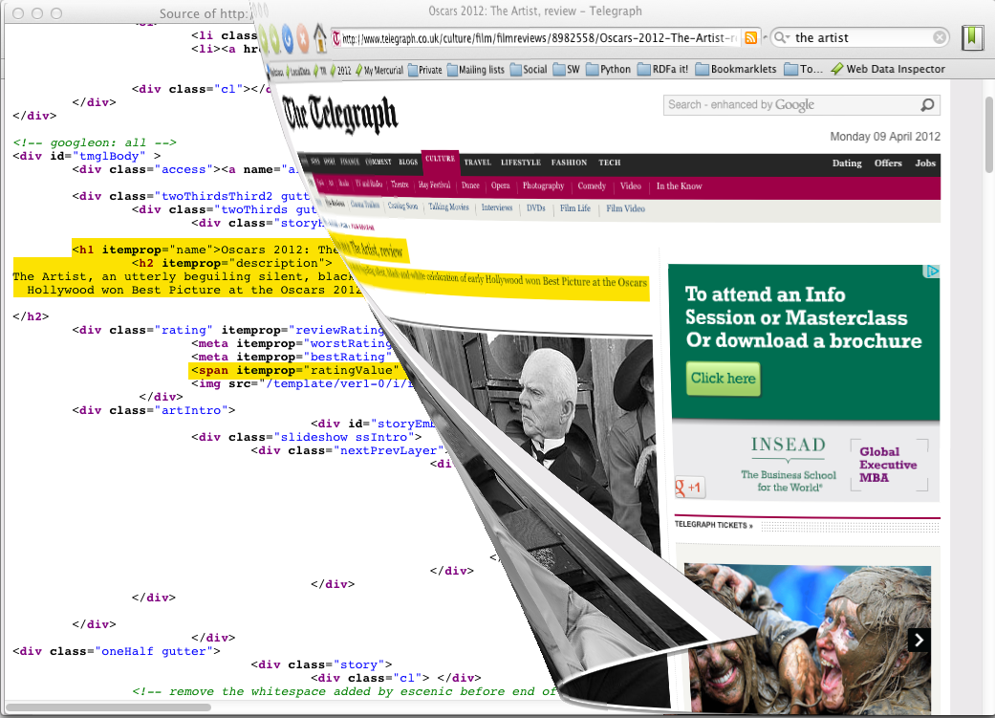

Slide 20
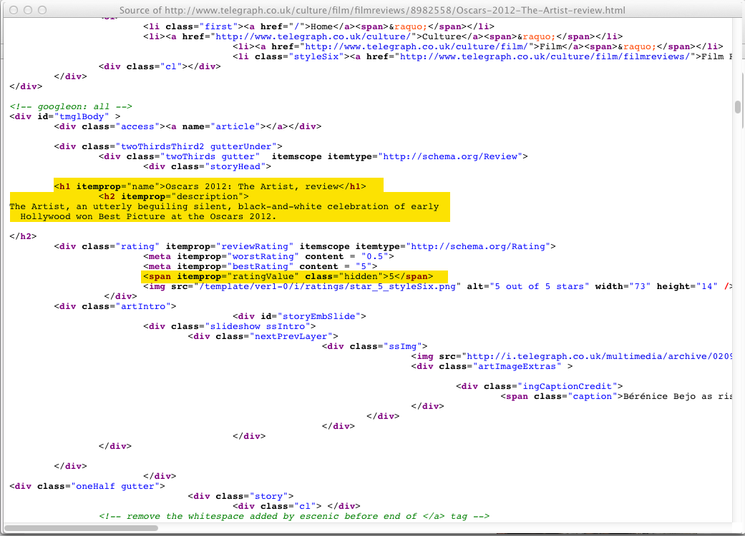

Slide 21
Yielding this RDF
[ rdf:type schema:Review ;
schema:name "Oscars 2012: The Artist, review" ;
schema:description "The Artist, an utterly beguiling…" ;
schema:ratingValue "5" ;
…
]

Slide 22
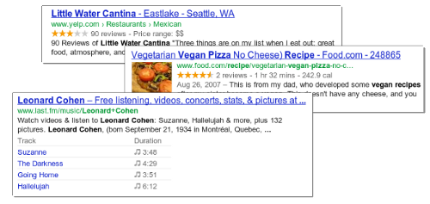
Rich Snippets
Search engines add text under results to preview what’s on page and why it’s relevant
Text often extracted from structured data embedded on the page
See http://bit.ly/RichSN for more information

Slide 23
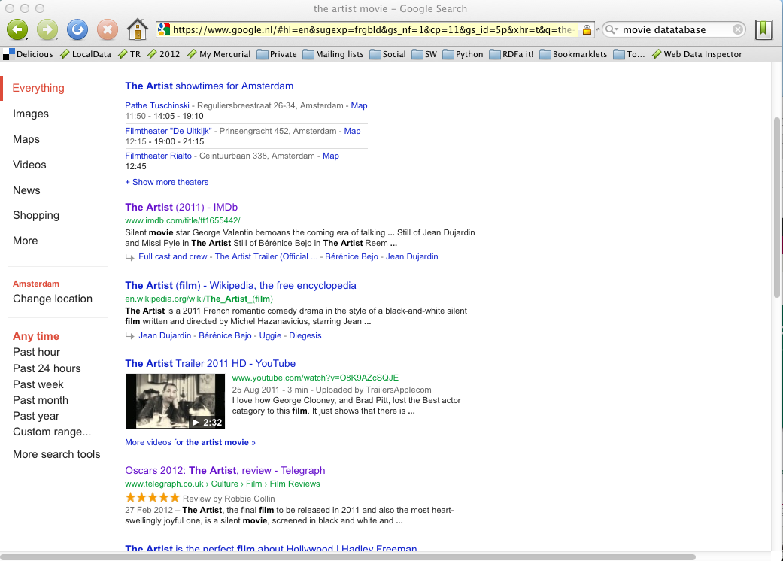

Slide 24
RDFa and Microdata: similarities
RDFa and Microdata are modern options
Both have similar approaches
  Structured data encoded in HTML attributes only – no new elements
  Define some special attributes
    e.g., itemscope for microdata, resource for RDFa
  Reuse some HTML core attributes (e.g., href)
  Use textual content of HTML source, if needed
RDF data can be extracted from both

Slide 25
RDFa and microdata: differences
Microdata optimized for simpler use cases:
  One vocabulary at a time
  Tree shaped data
  Few datatypes
RDFa provides full serialization of RDF in XML or HTML
  Price is extra complexity over Microdata
RDFa 1.1 Lite is a simplified authoring profile of RDFa, very similar to microdata

Slide 26

Amount of structured data on Web?
Web Data Commons project uses Common Crawl data to estimate amount of structured data on Web
Looks for Microdata, RDFa, other formats (e.g., hCalendar, hCard) in URLs parsable as HTML
Oct. 2016 crawl analyzed 3.2B HTML pages:
  1.2B pages (30%) with structured data in 5.6M domains of 34M (17%)
  44B triples about 9B typed entities
Data can be downloaded
Notes:
Hcalendar is a microformat for icalendar data
Hcad is a microformat for vcard data

Slide 27
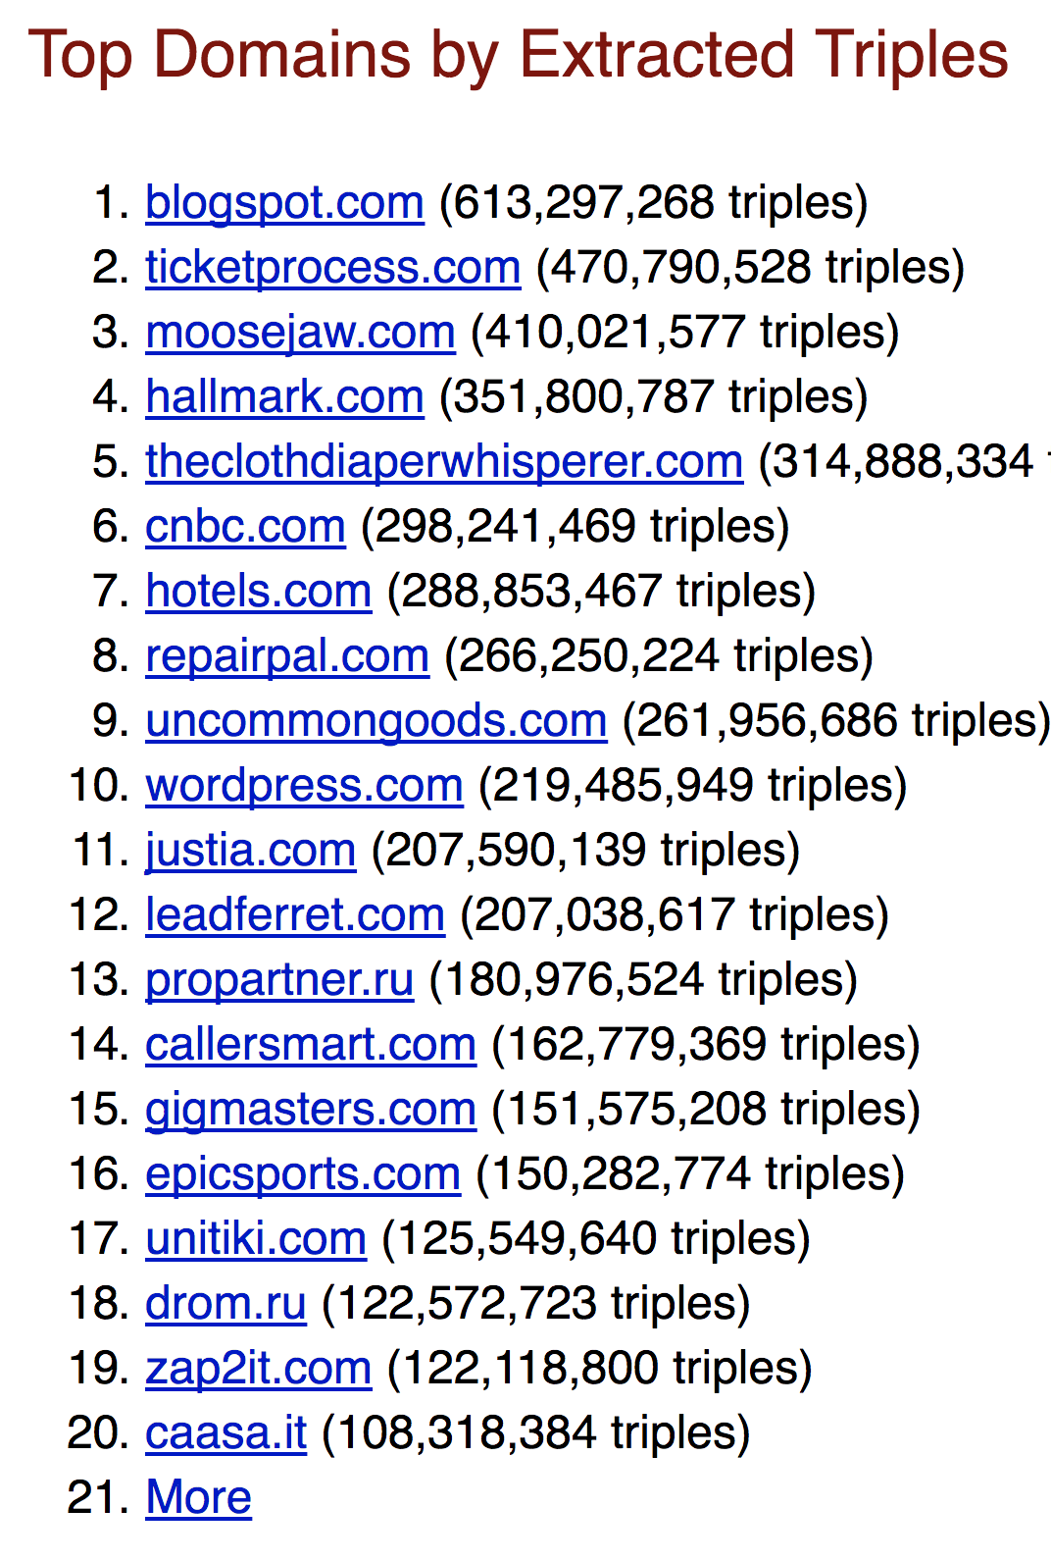
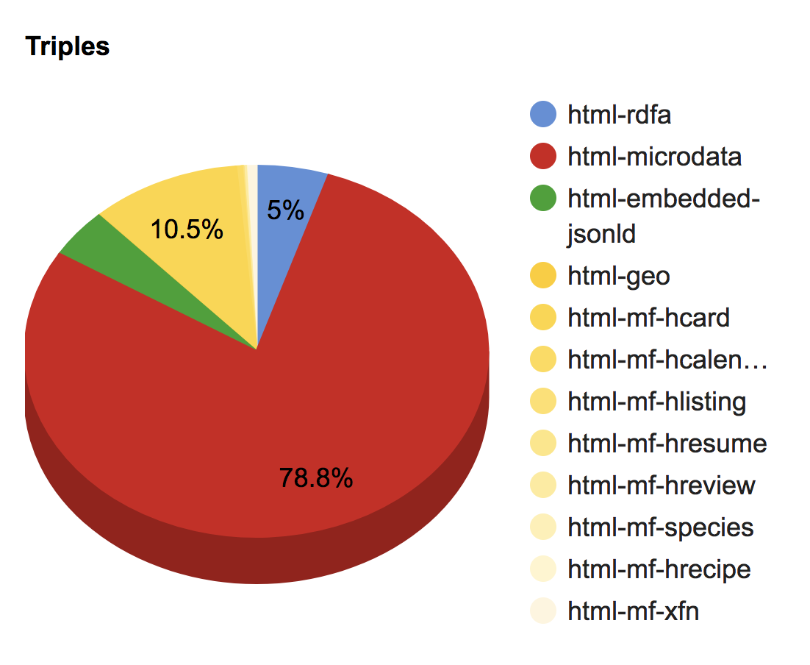
Amount of structured data on Web?
Notes:
Hcalendar is a microformat for icalendar data
Hcad is a microformat for vcard data

Slide 28
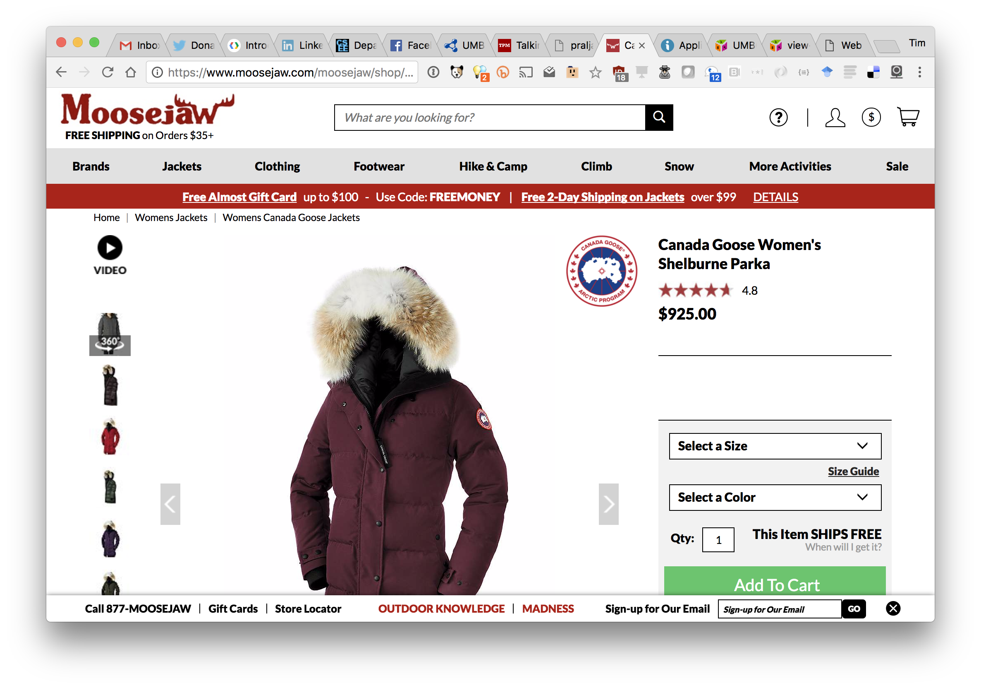

Slide 29
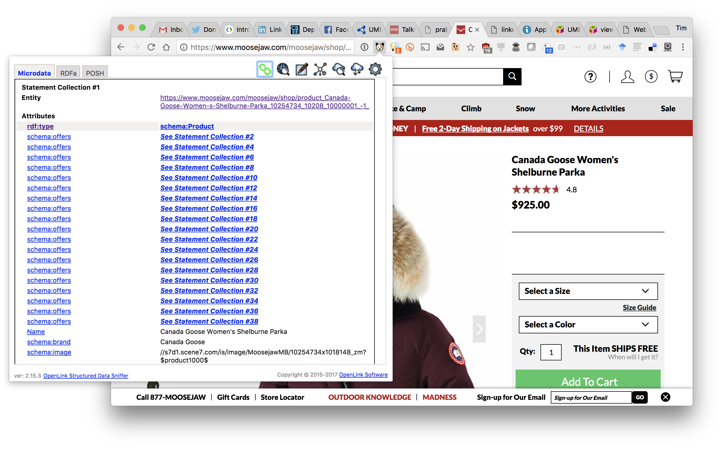

Slide 30
Conclusions
The amount of structured data on the web is growing steadily
Microdata shows the strongest growth
RDFa also common
Microformat data is probably not growing as much

