Slide 1

Chapter 2
Structured Web
Documents in XML
Adapted from slides from Grigoris Antoniou and Frank van Harmelen

Slide 2
Outline
(1) Introduction
(2) XML details
(3) Structuring
  DTDs
  XML Schema
(4) Namespaces
(5) Accessing, querying XML documents: XPath
(6) Transformations: XSLT

Slide 3
Role of XML in the Semantic Web
The Semantic Web involves ideas and languages at a fairly abstract level, e.g.: for defining ontologies, publishing data using them
We also need a practical way of encoding the abstract languages
Today’s Web technology is (still) largely based on XML standards
XML is a (1) source of many key SW concepts and technology bits; (2) potential alternative the SW must improve on; and (3) common serialization for SW data

Slide 4
To paraphrase Jamie Zawinski
Some people, when confronted with a problem, think, "I know, I'll use XML."
Now they have two problems.
“Some people, when confronted with a problem, think "I know, I'll use regular expressions." Now they have two problems.”
-- Wikiquote

Slide 5
History
XML’s roots are in SGML
  Standard Generalized Markup Language
  A metalanguage for defining document markup languages
  Extensible, but complicated, verbose, hard to parse, …
HTML was defines using SGML
  It’s a markup language, not a markup metalanguage
XML proposal to W3C in July 1996
  Idea: simplified SGML could greatly expand the power and flexibility of the Web
Evolving series of W3C recommendations
  Current recommendation: XML 5 (2008)
(1) Introduction

Slide 6
An HTML Example
<h2>Nonmonotonic Reasoning: Context-
Dependent Reasoning</h2>
<i>by <b>V. Marek</b> and
<b>M. Truszczynski</b></i><br>
Springer 1993<br>
ISBN 0387976892
(1) Introduction

Slide 7
The Same Example in XML
<book>
<title>Nonmonotonic Reasoning: Context-Dependent Reasoning</title>
<author>V. Marek</author>
<author>M. Truszczynski</author>
<publisher>Springer</publisher>
<year>1993</year>
<ISBN>0387976892</ISBN>
</book>
(1) Introduction

Slide 8
HTML versus XML: Similarities
Both use tags (e.g. <h2> and </year>)
Tags may be nested (tags within tags)
Human users can read and interpret both HTML and XML representations “easily”
… But how about machines?
(1) Introduction

Slide 9
Problems Interpreting HTML Documents
Problems for an intelligent agent trying to retrieve the names of the authors of the book
  Authors’ names could appear immediately after the title
  or immediately after the word “by” (or “van” if it’s in Dutch)
  Are there two authors or just one, called “V. Marek and M. Truszczynski”?
<h2>Nonmonotonic Reasoning: Context-Dependent Reasoning</h2>
<i>by <b>V. Marek</b> and <b>M. Truszczynski</b></i><br>
Springer 1993<br>
ISBN 0387976892
(1) Introduction

Slide 10
HTML vs XML: Structural Information
HTML documents do not contain structural information: pieces of the document and their relationships.
XML more easily accessible to machines since
  Every piece of information is described
  Relations are defined through the nesting structure
  E.g., <author> tags appear within <book> tags, so they describe properties of a particular book
(1) Introduction

Slide 11
HTML vs XML: Structural Information
A machine processing the XML document would be able to deduce that
  the author element refers to the enclosing book element
  rather than by background knowledge, proximity or other heuristics
XML allows definition of constraints on values
  E.g. a year must be a integer of four digits
(1) Introduction

Slide 12
HTML vs. XML: Formatting
HTML representation provides more than XML representation:
  Formatting of the document is described
Main use of an HTML document is to display information: it must define formatting
XML: separation of content from display
  same information can be displayed in different ways
  Presentation specified by documents using other XML standards (CSS, XSL)
(1) Introduction

Slide 13
HTML vs. XML: Another Example
In HTML
<h2>Relationship matter-energy</h2>
<i> E = M × c^2 </i>
In XML
<equation>
<gloss>Relationship matter energy </gloss>
<leftside> E </leftside>
<rightside> M × c^2 </rightside>
</equation>
(1) Introduction

Slide 14
HTML vs. XML: Different Use of Tags
All HTML documents use the same tags
  HTML tags come from and finite, pre-defined collection
  Define properties for display: font, color, lists …
XML documents can use completely different tags
  XML tags not fixed: user definable tags
  XML is a meta markup language, i.e., a language for defining markup languages
(1) Introduction

Slide 15
XML Vocabularies
Web applications must agree on common vocabularies to communicate and collaborate
Communities and business sectors define their specialized vocabularies
  mathematics (MathML)
  bioinformatics (BSML)
  human resources (HRML)
  Syndication (RSS)
  Vector graphics (SVG)
  …
(1) Introduction

Slide 16
Outline
(1) Introduction
(2) Description of XML
(3) Structuring
  DTDs
  XML Schema
(4) Namespaces
(5) Accessing, querying XML documents: XPath
(6) Transformations: XSLT
(2) XML details

Slide 17
The XML Language
An XML document consists of
a prolog
a number of elements
an optional epilog (not discussed, not used much)
(2) XML details

Slide 18
Prolog of an XML Document
The prolog consists of
an XML declaration and
an optional reference to external structuring documents
<?xml version="1.0" encoding="UTF-16"?>
<!DOCTYPE book SYSTEM "book.dtd">
(2) XML details

Slide 19
XML Elements
Elements are the “things” the XML document talks about
  E.g., books, authors, publishers
An element consists of:
  an opening tag
  the content
  a closing tag
<lecturer> David Billington </lecturer>
(2) XML details

Slide 20
XML Elements
Tag names can be chosen almost freely
The first character must be a letter, underscore, or colon
No name may begin with the string “xml” in any combination of cases
  E.g. “Xml”, “xML”
(2) XML details

Slide 21
Content of XML Elements
Content is what’s between the tags
It can be text, or other elements, or nothing
  <lecturer>
  <name>David Billington</name>
  <phone> +61 − 7 − 3875 507 </phone>
  </lecturer>
If there is no content, then element is called empty; it can be abbreviated as follows:
<lecturer/> = <lecturer></lecturer>
(2) XML details

Slide 22
XML Attributes
An empty element isn’t necessarily meaningless
  It may have properties expressed as attributes
An attribute is a name-value pair inside the opening tag of an element
<lecturer
name="David Billington"
phone="+61 − 7 − 3875 507“ />
(2) XML details

Slide 23
XML Attributes: An Example
<order orderNo="23456“
customer="John Smith"
date="October 15, 2017” >
<item itemNo="a528" quantity="1“ />
<item itemNo="c817" quantity="3“ />
</order>
(2) XML details

Slide 24
The Same Example without Attributes
<order>
<orderNo>23456</orderNo>
<customer>John Smith</customer>
<date>October 15, 2017</date>
<item>
<itemNo>a528</itemNo>
<quantity>1</quantity>
</item>
<item>
<itemNo>c817</itemNo>
<quantity>3</quantity>
</item>
</order>
(2) XML details

Slide 25
XML Elements vs. Attributes
Attributes can be replaced by elements
When to use elements and when attributes is a mostly matter of taste
But attributes cannot be nested
(2) XML details

Slide 26
Further Components of XML Docs
Comments
  A piece of text that is to be ignored by parser
  <!-- This is a comment -->
Processing Instructions (PIs)
  Define procedural attachments
  <?stylesheet type="text/css“ href="mystyle.css"?>
(2) XML details

Slide 27
Well-Formed XML Documents
Constraints on syntactically correct documents:
  Only one outermost element (root element)
  Each element contains opening and corresponding closing tag (except self-closing tags like <foo/>)
  Tags may not overlap
      <author><name>Lee Hong</author></name>
  Attributes within an element have unique names
  Element and tag names must be permissible
    e.g.: can’t use strings beginning with digit “2ndbest”
(2) XML details

Slide 28
The Tree Model of XML Docs
The tree representation of an XML document is an ordered labeled tree:
  There is exactly one root
  There are no cycles
  Each non-root node has exactly one parent
  Each node has a label.
  The order of elements is important
  … but the order of attributes is not
(2) XML details

Slide 29
Tree Model of XML Documents
<email>
<head>
<from name="Michael Maher"
address="michaelmaher@cs.gu.edu.au" />
<to name="Grigoris Antoniou"
address="grigoris@cs.unibremen.de" />
<subject>Where is your draft?</subject>
</head>
<body>
Grigoris, where is the draft of the paper you
promised me last week?
</body>
</email>
(2) XML details

Slide 30
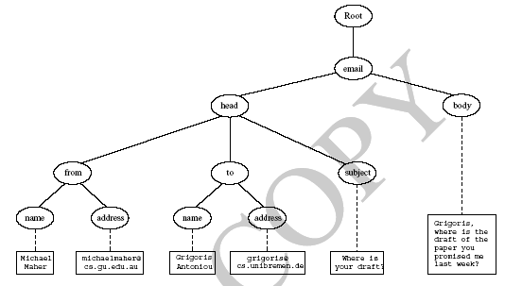
Tree Model of XML Documents
(2) XML details

Slide 31
Outline
(1) Introduction
(2) Description of XML
(3) Structuring
  DTDs
  XML Schema
(4) Namespaces
(5) Accessing, querying XML documents: XPath
(6) Transformations: XSLT

Slide 32
Structuring XML Documents
Some XML documents must follow constraints defined in a “template” that can…
  define all element and attribute names that may be used
  define the structure
      what values an attribute may take
      which elements may or must occur within other elements, etc.
If such structuring information exists, the document can be validated
(3) Structure

Slide 33
Structuring XML Documents
An XML document is valid if
  it is well-formed XML
  respects the structuring information it uses
Ways to define structure of XML documents:
  DTDs (Document Type Definition) came first, was based on SGML’s approach
  XML Schema (aka XML Schema Definition, XSD) is more recent and expressive
  RELAX NG and DSDs are two alternatives
(3) Structure

Slide 34
DTD: Element Type Definition
<lecturer>
<name>David Billington</name>
<phone> +61 − 7 − 3875 507 </phone>
</lecturer>
DTD for above element (and all lecturer elements):
<!ELEMENT lecturer (name, phone) >
<!ELEMENT name (#PCDATA) >
<!ELEMENT phone (#PCDATA) >
(3) Structure: DTDs

Slide 35
The Meaning of the DTD
The element types lecturer, name, and phone may be used in the document
A lecturer element contains a name element and a phone element, in that order (sequence)
A name element and a phone element may have any content
  In DTDs, #PCDATA is only atomic element type and stands for “parsed character data”
<!ELEMENT lecturer (name, phone) >
<!ELEMENT name (#PCDATA) >
<!ELEMENT phone (#PCDATA) >
(3) Structure: DTDs

Slide 36
Disjunction in Element Type Definitions
We say that lecturer elements contains either a name element or a phone element like:
  <!ELEMENT lecturer ( name | phone )>
A lecturer element contains a name element and a phone element in any order
  <!ELEMENT lecturer((name,phone)|(phone,name))>
Do you see a problem with this approach?
(3) Structure: DTDs
Notes:
For free ordering on N elements we need to enumerate all of the N! permutations

Slide 37
Example of an XML Element
<order orderNo="23456"
customer="John Smith"
date="October 15, 2017">
<item itemNo="a528" quantity="1” />
<item itemNo="c817" quantity="3” />
</order>
(3) Structure: DTDs

Slide 38
The Corresponding DTD
<!ELEMENT order (item+)>
<!ATTLIST order
orderNo ID #REQUIRED
customer CDATA #REQUIRED
date CDATA #REQUIRED >
<!ELEMENT item EMPTY>
<!ATTLIST item
itemNo ID #REQUIRED
quantity CDATA #REQUIRED
comments CDATA #IMPLIED >
(3) Structure: DTDs

Slide 39
Comments on the DTD
The item element type is defined to be empty
  i.e., it can contain no elements
+ (after item) is a cardinality operator:
  Specifies how many item elements can be in an order
  ?: appears zero times or once
  *: appears zero or more times
  +: appears one or more times
  No cardinality operator: once
<!ELEMENT order (item+)>
<!ATTLIST
order orderNo ID #REQUIRED
customer CDATA #REQUIRED
date CDATA #REQUIRED >
<!ELEMENT item EMPTY>
<!ATTLIST
item itemNo ID #REQUIRED
quantity CDATA #REQUIRED
comments CDATA #IMPLIED >
(3) Structure: DTDs

Slide 40
Comments on the DTD
In addition to defining elements, we define attributes
This is done in an attribute list containing:
  Name of the element type to which the list applies
  A list of triplets of attribute name, attribute type, and value type
Attribute name: A name that may be used in an XML document using a DTD
(3) Structure: DTDs

Slide 41
DTD: Attribute Types
Similar to predefined data types, but limited …
The most important types are
  CDATA, a string (sequence of characters)
  ID, a name that is unique across the entire XML document (~ DB key)
  IDREF, reference to another element with ID attribute carrying same value as IDREF attribute (~ DB foreign key)
  IDREFS, a series of IDREFs
  (v1| . . . |vn), an enumeration of all possible values
Limitations: no dates, number ranges, etc.
(3) Structure: DTDs

Slide 42
DTD: Attribute Value Types
#REQUIRED
  Attribute must appear in every occurrence of the element type in the XML document
#IMPLIED
  The appearance of the attribute is optional
#FIXED "value"
  Every element must have this attribute
"value"
  This specifies the default value for the attribute
(3) Structure: DTDs

Slide 43
Referencing with IDREF and IDREFS
<!ELEMENT family (person*)>
<!ELEMENT person (name)>
<!ELEMENT name (#PCDATA)>
<!ATTLIST person
id ID #REQUIRED
mother IDREF #IMPLIED
father IDREF #IMPLIED
children IDREFS #IMPLIED >
(3) Structure: DTDs

Slide 44
An XML Document Respecting the DTD
<family>
<person id="bob" mother="mary" father="peter">
<name>Bob Marley</name>
</person>
<person id="bridget" mother="mary">
<name>Bridget Jones</name>
</person>
<person id="mary" children="bob bridget">
<name>Mary Poppins</name>
</person>
<person id="peter" children="bob">
<name>Peter Marley</name>
</person>
</family>
(3) Structure: DTDs

Slide 45
Email Element DTD 1/2
<!ELEMENT email (head,body)>
<!ELEMENT head (from,to+,cc*,subject)>
<!ELEMENT from EMPTY>
<!ATTLIST from
name CDATA #IMPLIED
address CDATA #REQUIRED>
<!ELEMENT to EMPTY>
<!ATTLIST to
name CDATA #IMPLIED
address CDATA #REQUIRED>
(3) Structure: DTDs

Slide 46
Email Element DTD 2/2
<!ELEMENT cc EMPTY>
<!ATTLIST cc
name CDATA #IMPLIED
address CDATA #REQUIRED>
<!ELEMENT subject (#PCDATA) >
<!ELEMENT body (text,attachment*) >
<!ELEMENT text (#PCDATA) >
<!ELEMENT attachment EMPTY >
<!ATTLIST attachment
encoding (mime|binhex) "mime"
file CDATA #REQUIRED>
(3) Structure: DTDs

Slide 47
Interesting Parts of the Email DTD
A head element contains (in order):
  a from element
  at least one to element
  zero or more cc elements
  a subject element
In from, to, and cc elements
  the name attribute is not required
  the address attribute is always required
(3) Structure: DTDs

Slide 48
Interesting Parts of the Email DTD
A body element contains
  a text element
  possibly followed by a number of attachment elements
The encoding attribute of an attachment element must have either the value “mime” or “binhex”
  “mime” is the default value
(3) Structure: DTDs

Slide 49
Remarks on DTDs
A DTD can be interpreted as an Extended Backus-Naur Form (EBNF)
  <!ELEMENT email (head,body)>
  is equivalent to email ::= head body
Recursive definitions possible in DTDs
  <!ELEMENT bintree
  ((bintree root bintree)|emptytree)>
(3) Structure: DTDs

Slide 50
Outline
(1) Introduction
(2) Description of XML
(3) Structuring
  DTDs
  XML Schema
(4) Namespaces
(5) Accessing, querying XML documents: XPath
(6) Transformations: XSLT

Slide 51
XML Schema (XSD)
XML Schema is a significantly richer language for defining the structure of XML documents
Syntax based on XML itself, so separate tools to handle them not needed
Reuse and refinement of schemas => can expand or delete existing schemas
Sophisticated set of data types, compared to DTDs, which only supports strings
XML Schema recommendation published by W3C in 2001, version 1.1 in 2012
(3) Structure: XML Schema

Slide 52
XML Schema
An XML schema is an element with an opening tag like
  <schema
  "http://www.w3.org/2000/10/XMLSchema"
  version="1.0">
Structure of schema elements
  Element and attribute types using data types
(3) Structure: XML Schema

Slide 53
Element Types
<element name="email"/>
<element name="head“
minOccurs="1“
maxOccurs="1"/>
<element name="to" minOccurs="1"/>
Cardinality constraints:
  minOccurs="x" (default value 1)
  maxOccurs="x" (default value 1)
  Generalizations of *,?,+ offered by DTDs
(3) Structure: XML Schema

Slide 54
Attribute Types
<attribute name="id" type="ID“ use="required"/>
<attribute name="speaks" type="Language"
use="default" value="en"/>
Existence: use="x", where x may be optional or required
Default value: use="x" value="...", where x may be default or fixed
(3) Structure: XML Schema

Slide 55
Data Types
Many built-in data types
  Numerical data types: integer, short, etc.
  String types: string, ID, IDREF, CDATA, etc.
  Date and time data types: time, month, etc.
Also user-defined data types
  simple data types, which can’t use elements or attributes
  complex data types, which can use them
(3) Structure: XML Schema

Slide 56
Complex Data Types
Complex data types are defined from existing data types by defining some attributes (if any) and using:
  sequence, a sequence of existing data type elements (order is important)
  all, a collection of elements that must appear (order is not important)
  choice, a collection of elements, of which one will be chosen
(3) Structure: XML Schema

Slide 57
A Data Type Example
<complexType name="lecturerType">
<sequence>
<element name="firstname" type="string"
minOccurs=”0" maxOccurs="unbounded"/>
<element name="lastname" type="string"/>
</sequence>
<attribute name="title" type="string" use="optional"/>
</complexType>
(3) Structure: XML Schema

Slide 58
Data Type Extension
Existing data types can be extended by new elements or attributes. Example:
<complexType name="extendedLecturerType">
<extension base="lecturerType">
<sequence>
<element name="email" type="string"
minOccurs="0" maxOccurs="1"/>
</sequence>
<attribute name="rank" type="string"
use="required"/>
</extension>
</complexType>
(3) Structure: XML Schema

Slide 59
Resulting Data Type
<complexType name="extendedLecturerType">
<sequence>
<element name="firstname" type="string"
minOccurs="0" maxOccurs="unbounded"/>
<element name="lastname" type="string"/>
<element name="email" type="string"
minOccurs="0" maxOccurs="1"/>
</sequence>
<attribute name="title" type="string" use="optional"/>
<attribute name="rank" type="string" use="required"/>
</complexType>
(3) Structure: XML Schema

Slide 60
Data Type Extension
A hierarchical relationship exists between the original and the extended type
  Instances of the extended type are also instances of the original type
  May contain additional information, but neither less information, nor information of wrong type
(3) Structure: XML Schema

Slide 61
Data Type Restriction
An existing data type may be restricted by adding constraints on certain values
Restriction is not the opposite from extension
  Restriction not achieved by deleting elements or attributes
Following hierarchical relationship still holds:
  Instances of restricted type are also instances of original type
  They satisfy at least constraints of original type
(3) Structure: XML Schema

Slide 62
Example of Data Type Restriction
<complexType name="restrictedLecturerType">
<restriction base="lecturerType">
<sequence>
<element name="firstname" type="string"
minOccurs="1" maxOccurs="2"/>
</sequence>
<attribute name="title" type="string"
use="required"/>
</restriction>
</complexType>
(3) Structure: XML Schema

Slide 63
Restriction of Simple Data Types
<simpleType name="dayOfMonth">
<restriction base="integer">
<minInclusive value="1"/>
<maxInclusive value="31"/>
</restriction>
</simpleType>
(3) Structure: XML Schema

Slide 64
Data Type Restriction: Enumeration
<simpleType name="dayOfWeek">
<restriction base="string">
<enumeration value="Mon"/>
<enumeration value="Tue"/>
<enumeration value="Wed"/>
<enumeration value="Thu"/>
<enumeration value="Fri"/>
<enumeration value="Sat"/>
<enumeration value="Sun"/>
</restriction>
</simpleType>
(3) Structure: XML Schema

Slide 65
XML Schema: The Email Example
<element name="email" type="emailType"/>
<complexType name="emailType">
<sequence>
<element name="head" type="headType"/>
<element name="body" type="bodyType"/>
</sequence>
</complexType>
(3) Structure: XML Schema

Slide 66
XML Schema: The Email Example
<complexType name="headType">
<sequence>
<element name="from" type="nameAddress"/>
<element name="to" type="nameAddress"
minOccurs="1" maxOccurs="unbounded"/>
<element name="cc" type="nameAddress"
minOccurs="0" maxOccurs="unbounded"/>
<element name="subject" type="string"/>
</sequence>
</complexType>
(3) Structure: XML Schema

Slide 67
XML Schema: The Email Example
<complexType name="nameAddress">
<attribute name="name" type="string"
use="optional"/>
<attribute name="address"
type="string" use="required"/>
</complexType>
Similar for bodyType
(3) Structure: XML Schema

Slide 68
Outline
(1) Introduction
(2) Description of XML
(3) Structuring
  DTDs
  XML Schema
(4) Namespaces
(5) Accessing, querying XML documents: XPath
(6) Transformations: XSLT

Slide 69
Namespaces
XML namespaces provide uniquely named elements & attributes in an XML document
XML document may use > 1 DTD or schema
Since each was developed independently, name collisions can occur
Solution: use different prefix for each DTD or schema
  prefix:name
Namespaces even more important in RDF
(4) Namespaces

Slide 70
An Example
<vu:instructors xmlns:vu="http://www.vu.com/empDTD"
xmlns:gu="http://www.gu.au/empDTD"
xmlns:uky="http://www.uky.edu/empDTD" >
<uky:faculty uky:title="assistant professor"
uky:name="John Smith"
uky:department="Computer Science"/>
<gu:academicStaff gu:title="lecturer"
gu:name="Mate Jones"
gu:school="Information Technology"/>
</vu:instructors>
(4) Namespaces

Slide 71
Namespace Declarations
Namespaces declared within elements for use in it and its children (elements and attributes)
A namespace declaration has form:
  xmlns:prefix="location"
  location is the URL of the DTD or XML schema
If no prefix specified: xmlns="location" then the location is used as the default prefix
We’ll see this same idea used in RDF
(4) Namespaces

Slide 72
Outline
(1) Introduction
(2) Description of XML
(3) Structuring
  DTDs
  XML Schema
(4) Namespaces
(5) Accessing, querying XML docs: XPath
(6) Transformations: XSLT

Slide 73
Addressing & Querying XML Documents
In relational databases, parts of a database can be selected and retrieved using SQL
  Also very useful for XML documents
  Query languages: XQuery, XQL, XML-QL
The central concept of XML query languages is a path expression
  Specifies how a node or set of nodes, in the tree representation, can be reached
Useful for extracting data from XML
(5) XPath

Slide 74
XPath
XPath is core for XML query languages
Language for addressing XML document parts
  Operates on the tree data model of XML
  Has a non-XML syntax
Versions
  XPath 1.0 (1999) is widely supported
  XPath 2.0 (2007) more expressive subset of Xquery
  XPath 3.1 (2017) current version, more features
(5) XPath

Slide 75
Types of Path Expressions
Absolute (starting at the root of the tree)
  Syntactically they begin with the symbol /
  It refers to the root of the document (one level above document’s root element)
Relative to a context node
(5) XPath

Slide 76
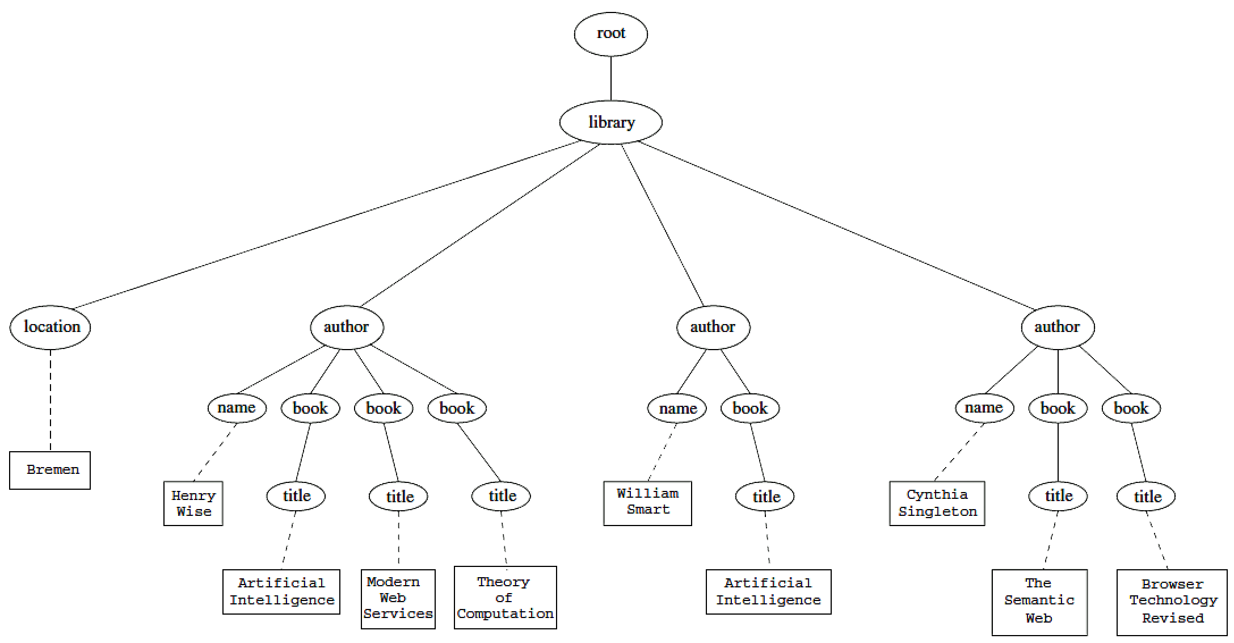
An XML Example
<library location="Bremen">
<author name="Henry Wise">
<book title="Artificial Intelligence"/>
<book title="Modern Web Services"/>
<book title="Theory of Computation"/>
</author>
<author name="William Smart">
<book title="Artificial Intelligence"/>
</author>
<author name="Cynthia Singleton">
<book title="The Semantic Web"/>
<book title="Browser Technology Revised"/>
</author>
</library>
(5) XPath

Slide 77
Tree Representation
<library location="Bremen">
<author name="Henry Wise">
<book title="Artificial Intelligence"/>
<book title="Modern Web Services"/>
<book title="Theory of Computation"/>
</author>
<author name="William Smart">
<book title="Artificial Intelligence"/>
</author>
<author name="Cynthia Singleton">
<book title="The Semantic Web"/>
<book title="Browser Technology Revised"/>
</author>
</library>
(5) XPath

Slide 78
Examples of Path Expressions in XPath
Q1: /library/author
  Addresses all author elements that are children of the library element node immediately below root
  /t1/.../tn, where each ti+1 is a child node of ti, is a path through the tree representation
Q2: //author
  Consider all elements in document and check whether they are of type author
  Path expression addresses all author elements anywhere in the document
(5) XPath

Slide 79
Examples of Path Expressions in XPath
Q3: /library/@location
  Addresses location attribute nodes within library element nodes
  The symbol @ is used to denote attribute nodes
Q4: //book/@title="Artificial Intelligence”
  Adresses all title attribute nodes within book elements anywhere in the document that have the value “Artificial Intelligence”
(5) XPath

Slide 80
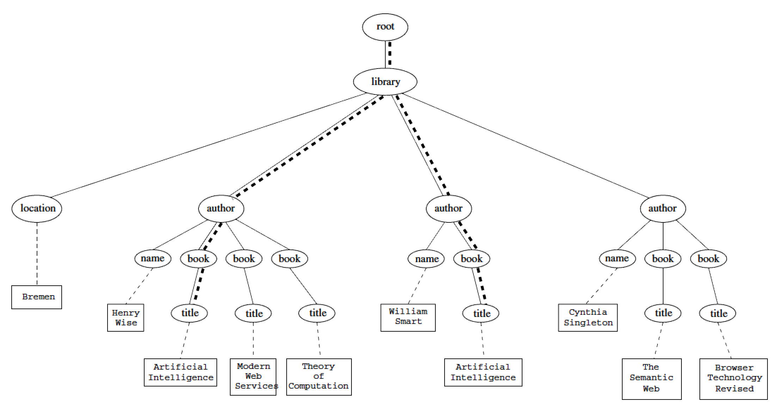
Tree Representation of Query 4
//book/@title="Artificial Intelligence”
(5) XPath

Slide 81
Examples of Path Expressions in XPath
Q5: /book[@title="Artificial Intelligence"]
  Addresses all books with title “Artificial Intelligence”
  A test in brackets is a filter expression that restricts the set of addressed nodes.
  Note differences between Q4 and Q5:
    Query 5 addresses book elements, the title of which satisfies a certain condition.
    Query 4 collects title attribute nodes of book elements
(5) XPath

Slide 82
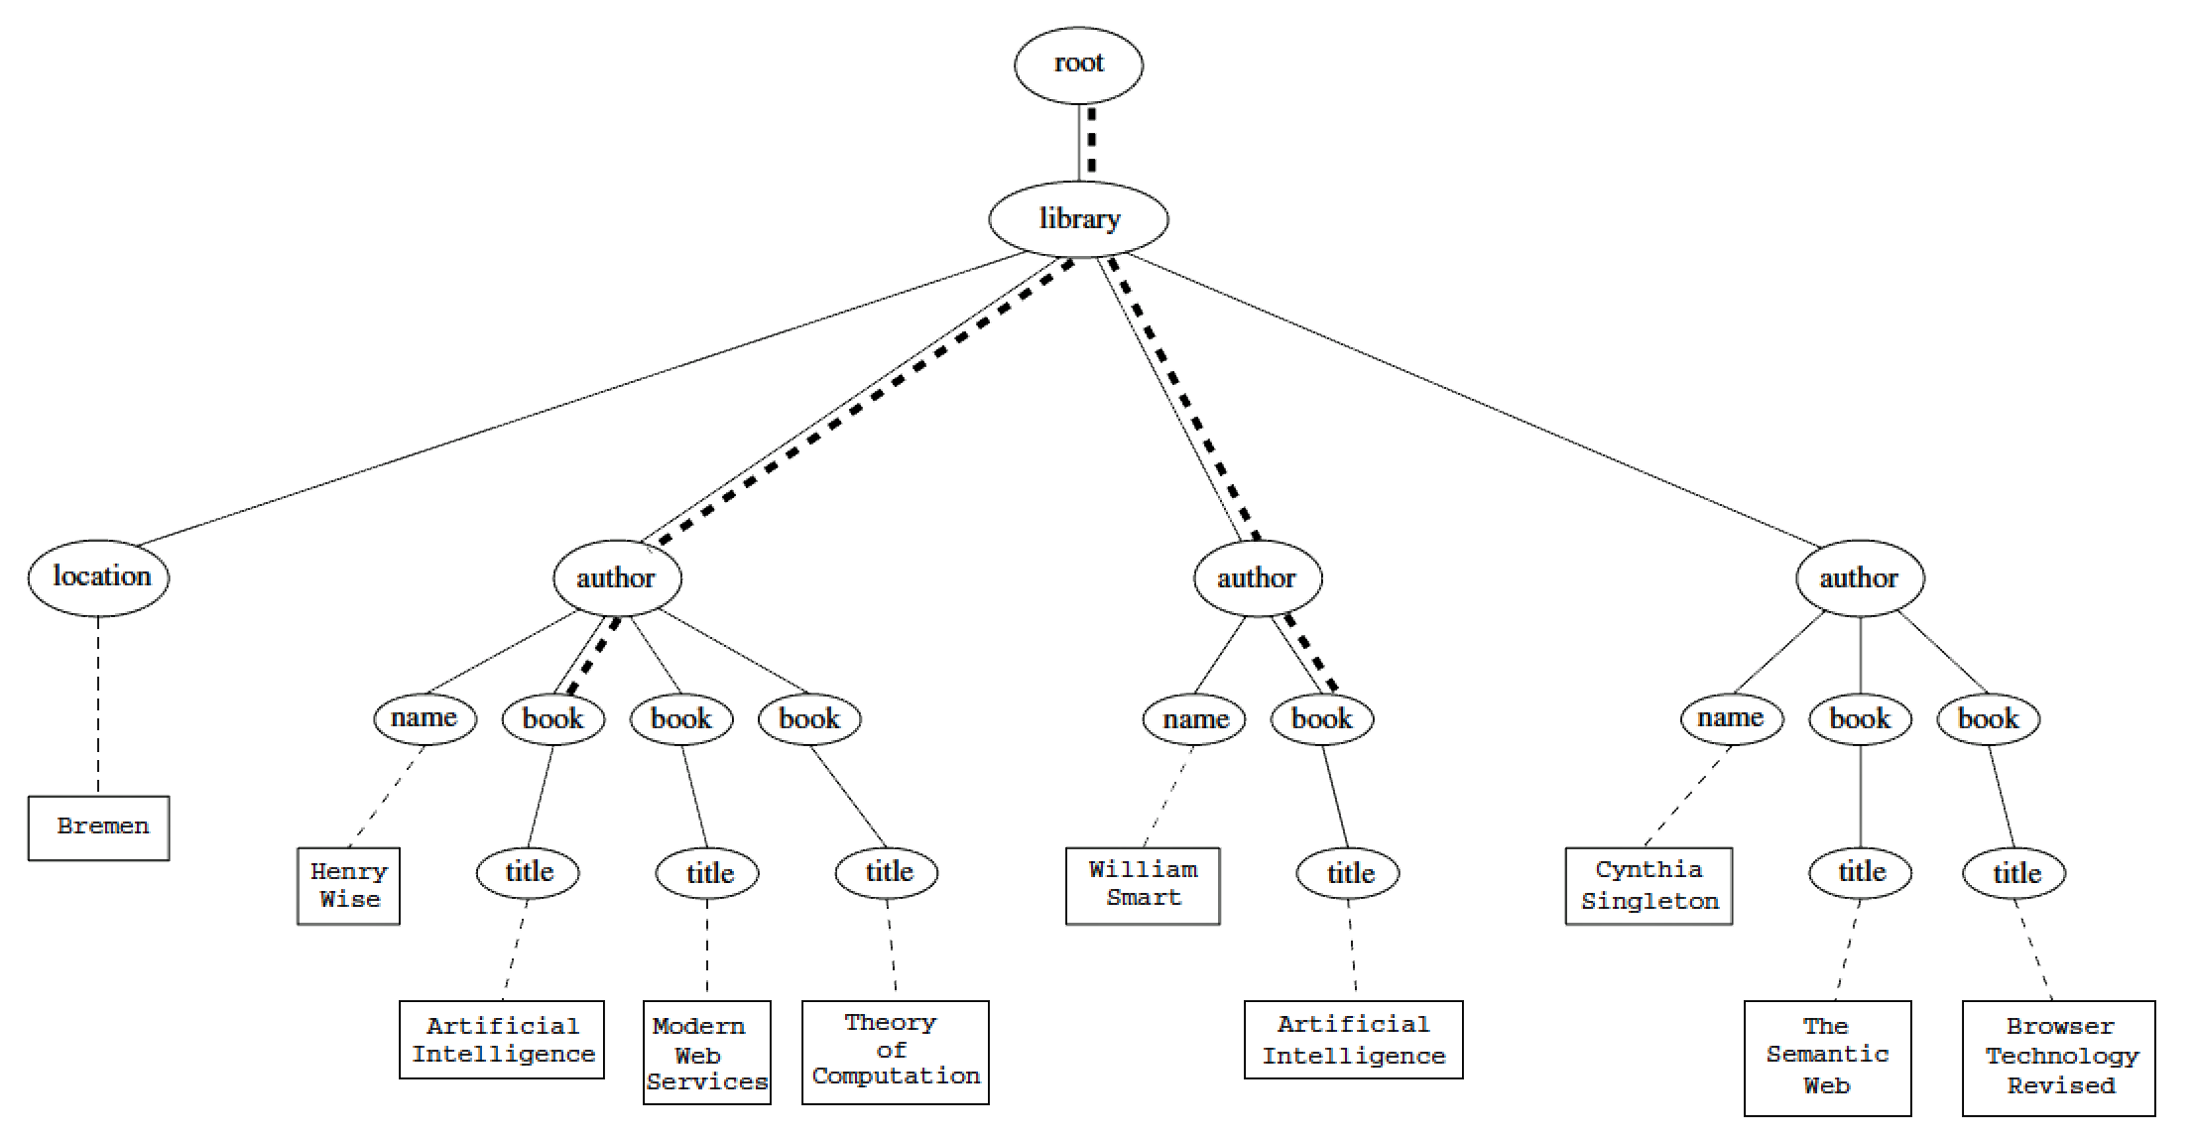
Tree Representation of Query 5
/book[@title="Artificial Intelligence"]
(5) XPath

Slide 83
Examples of Path Expressions in XPath
Q6: Address first author element node in the XML document
//author[1]
Q7: Address last book element within the first author element node in the document
//author[1]/book[last()]
Q8: Address all book element nodes without a title attribute
//book[not @title]
(5) XPath

Slide 84
General Form of Path Expressions
A path expression consists of a series of steps, separated by slashes
A step consists of
  An axis specifier,
  A node test, and
  An optional predicate
(5) XPath

Slide 85
General Form of Path Expressions
An axis specifier determines the tree relationship between the nodes to be addressed and the context node
  E.g. parent, ancestor, child (the default), sibling, attribute node
  // is such an axis specifier: descendant or self
(5) XPath

Slide 86
General Form of Path Expressions
A node test specifies which nodes to address
  The most common node tests are element names
  E.g., * addresses all element nodes
  comment() addresses all comment nodes
(5) XPath

Slide 87
General Form of Path Expressions
Predicates (or filter expressions) are optional and are used to refine the set of addressed nodes
  E.g., the expression [1] selects the first node
  [position()=last()] selects the last node
  [position() mod 2 =0] selects the even nodes
XPath has a more complicated full syntax.
  We have only presented the abbreviated syntax
(5) XPath

Slide 88
Outline
(1) Introduction
(2) Description of XML
(3) Structuring
  DTDs
  XML Schema
(4) Namespaces
(5) Accessing, querying XML documents: XPath
(6) Transformations: XSLT

Slide 89
Displaying XML Documents
  <author>
  <name>Grigoris Antoniou</name>
  <affiliation>University of Bremen</affiliation>
  <email>ga@tzi.de</email>
  </author>
may be displayed in different ways:
  Grigoris Antoniou Grigoris Antoniou
  University of Bremen University of Bremen
  ga@tzi.de ga@tzi.de
Idea: use an external style sheet to transform an XML tree into an HTML or XML tree
(5) XSLT transformations

Slide 90
Style Sheets
Style sheets can be written in various languages
  E.g. CSS2 (cascading style sheets level 2)
  XSL (extensible stylesheet language)
XSL includes
  a transformation language (XSLT)
  a formatting language
  Both are XML applications
(5) XSLT transformations

Slide 91
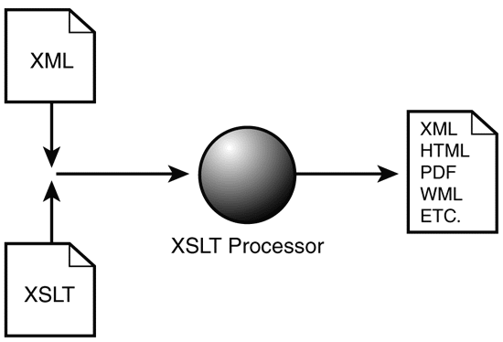
XSL Transformations (XSLT)
XSLT specifies rules to
transform XML docu-
ment to
  another XML document
  HTML document
  plain text
Output document may use same DTD/schema, or completely different vocabulary
XSLT can be used independently of formatting language
(5) XSLT transformations

Slide 92
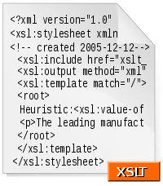
XSLT Use Cases
Move data & metadata from one
XML representation to another
Share information between appli-
cations using different schemas
Processing XML content for ingest into a program or database
The following example show XSLT used to display XML documents as HTML
(5) XSLT transformations

Slide 93
XSLT Transformation into HTML
  <author>
  <name>Grigoris Antoniou</name>
  <affiliation>University of Bremen</affiliation>
  <email>ga@tzi.de</email>
  </author>
<xsl:template match="/author">
<html>
<head><title>An author</title></head>
<body bgcolor="white">
<b><xsl:value-of select="name"/></b><br>
<xsl:value-of select="affiliation"/><br>
<i><xsl:value-of select="email"/></i>
</body>
</html>
</xsl:template>
(5) XSLT transformations

Slide 94
Style Sheet Output
  <author>
  <name>Grigoris Antoniou</name>
  <affiliation>University of Bremen</affiliation>
  <email>ga@tzi.de</email>
  </author>
<xsl:template match="/author"> <html>
<head><title>An author</title></head>
<body bgcolor="white">
<b><xsl:value-of select="name"/></b><br>
<xsl:value-of select="affiliation"/><br>
<i><xsl:value-of select="email"/></i>
</body>
</html></xsl:template>
<html>
<head><title>An author</title></head>
<body bgcolor="white">
<b>Grigoris Antoniou</b><br>
University of Bremen<br>
<i>ga@tzi.de</i>
</body>
</html>
(5) XSLT transformations

Slide 95
Observations About XSLT
XSLT documents are XML documents
  XSLT sits on top of XML
The XSLT document defines a template
  In this case, an HTML document with placeholders for content to be inserted
xsl:value-of retrieves value of an element and copies it into output document
  It places some content into the template
(5) XSLT transformations

Slide 96
A Template
<html>
<head><title>An author</title></head>
<body bgcolor="white">
<b>...</b><br>
...<br>
<i>...</i>
</body>
</html>
(5) XSLT transformations

Slide 97
Auxiliary Templates
We may have an XML document with details of several authors
It is a waste of effort to treat each author element separately
In such cases, a special template is defined for author elements, which is used by the main template
(5) XSLT transformations

Slide 98
Example of an Auxiliary Template
<authors>
<author>
<name>Grigoris Antoniou</name>
<affiliation>University of Bremen</affiliation>
<email>ga@tzi.de</email>
</author>
<author>
<name>David Billington</name>
<affiliation>Griffith University</affiliation>
<email>david@gu.edu.net</email>
</author>
</authors>
(5) XSLT transformations

Slide 99
Example of an Auxiliary Template (2)
<xsl:template match="/">
<html>
<head><title>Authors</title></head>
<body bgcolor="white">
<xsl:apply-templates select="author"/>
<!-- apply templates for AUTHORS children -->
</body>
</html>
</xsl:template>
(5) XSLT transformations

Slide 100
Example of an Auxiliary Template (3)
<xsl:template match="authors">
<xsl:apply-templates select="author"/>
</xsl:template>
<xsl:template match="author">
<h2><xsl:value-of select="name"/></h2>
<p> Affiliation:<xsl:value-of select="affiliation"/><br/>
Email: <xsl:value-of select="email"/> </p>
</xsl:template>
(5) XSLT transformations

Slide 101
Multiple Authors Output
<html>
<head><title>Authors</title></head>
<body bgcolor="white">
<h2>Grigoris Antoniou</h2>
<p>Affiliation: University of Bremen<br/>
Email: ga@tzi.de</p>
<h2>David Billington</h2>
<p>Affiliation: Griffith University<br/>
Email: david@gu.edu.net</p>
</body>
</html>
(5) XSLT transformations

Slide 102
Explanation of the Example
xsl:apply-templates element causes all children of context node to be matched against selected path expression
  e.g., if current template applies to /, then element xsl:apply-templates applies to root element
  i.e., the authors element (/ is located above root)
  If current context node is authors element, then element xsl:apply-templates select="author" causes template for author elements to be applied to all author children of authors element
(5) XSLT transformations

Slide 103
Explanation of the Example
It is good practice to define a template for each element type in the document
  Even if no specific processing is applied to certain elements, the xsl:apply-templates element should be used
  E.g. authors
In this way, we work from the root to the leaves of the tree, and all templates are applied
(5) XSLT transformations

Slide 104
Processing XML Attributes
Suppose we wish to transform to itself the element:
<person firstname="John" lastname="Woo"/>
Wrong solution:
  <xsl:template match="person">
  <person firstname="<xsl:value-of select="@firstname">"
  lastname="<xsl:value-of select="@lastname">"/>
  </xsl:template>
(5) XSLT transformations

Slide 105
Processing XML Attributes
Not well-formed because tags are not allowed within the values of attributes
We wish to add attribute values into template
  <xsl:template match="person">
  <person
  firstname="{@firstname}"
  lastname="{@lastname}" />
  </xsl:template>
(5) XSLT transformations

Slide 106
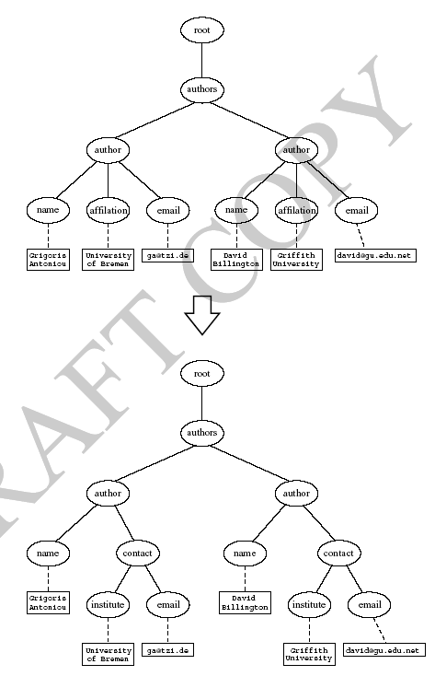
Transforming an XML Document to Another
(5) XSLT transformations

Slide 107
Transforming an XML Document to Another
<xsl:template match="/">
<?xml version="1.0" encoding="UTF-16"?>
<authors>
<xsl:apply-templates select="authors"/>
</authors>
</xsl:template>
<xsl:template match="authors">
<author>
<xsl:apply-templates select="author"/>
</author>
</xsl:template>
(5) XSLT transformations

Slide 108
Transforming an XML Document to Another
<xsl:template match="author">
<name><xsl:value-of select="name"/></name>
<contact>
<institution>
<xsl:value-of select="affiliation"/>
</institution>
<email><xsl:value-of select="email"/></email>
</contact>
</xsl:template>
(5) XSLT transformations

Slide 109
How to apply XSLT transforms
When a modern browsers loads an XML file, it will will apply a linked XSLT and display the results (hopefully HTML!)
Use an external Web service
Use an XML editor
Use a module or library for your favorite programming language

Slide 110
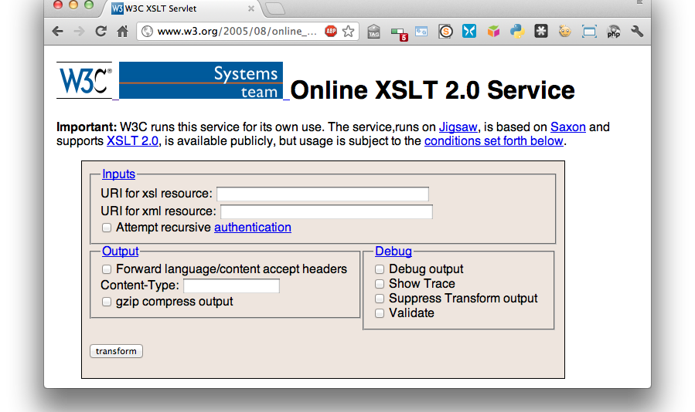
An XSLT Web Service
http://www.w3.org/2005/08/online_xslt/

Slide 111
CD Catalog example
<?xml-stylesheet type="text/xsl" href="cdcatalog.xsl"?>
<catalog>
<cd>
<title>Empire Burlesque</title>
<artist>Bob Dylan</artist>
<country>USA</country>
<company>Columbia</company>
<price>10.90</price>
<year>1985</year>
</cd>
<cd>
<title>Hide your heart</title>
<artist>Bonnie Tyler</artist>
<country>UK</country>
<company>CBS Records</company>
…
</cd> …
<xsl:template match="/">
<html> <body>
<h2>My CD Collection</h2>
<table border="1">
<tr bgcolor="#9acd32">
<th align="left">Title</th>
<th align="left">Artist</th>
</tr>
<xsl:for-each select="catalog/cd">
<tr>
<td><xsl:value-of select="title"/></td>
<td><xsl:value-of select="artist"/></td>
</tr>
</xsl:for-each>
</table>
</body> </html>
</xsl:template>
</xsl:stylesheet>
See http://bit.ly/VQfLVV

Slide 112
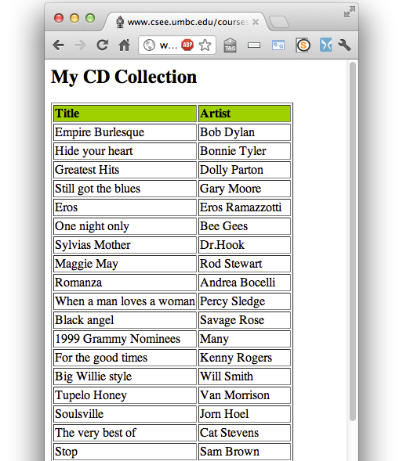
Viewing an XML file in a Browser
~> curl –L https://www.csee.umbc.edu/courses/graduate/691/fall17/01/examples/xml/cdcatalog/cdcatalog.xml
<?xml version="1.0" encoding="ISO-8859-1"?>
<?xml-stylesheet type="text/xsl" href="cdcatalog.xsl"?>
<catalog>
<cd>
<title>Empire Burlesque</title>
<artist>Bob Dylan</artist>
<country>USA</country>
<company>Columbia</company>
<price>10.90</price>
<year>1985</year>
</cd>
<cd>
<title>Hide your heart</title>
<artist>Bonnie Tyler</artist>
<country>UK</country>
<company>CBS Records</company>
<price>9.90</price>
<year>1988</year>
</cd>
...

Slide 113
XML Summary
XML is a metalanguage that allows users to define markup
XML separates content and structure from formatting
XML is (one of the) the de facto standard to represent and exchange structured information on the Web
XML is supported by query languages

Slide 114
Comments for Discussion
The nesting of tags has no standard meaning
Semantics of XML documents is not accessible to machines and may or may not be for people
Collaboration and exchange supported if there is underlying shared understanding of vocabulary
XML is well-suited for close collaboration where domain or community-based vocabularies are used and less so for global communication
Databases went from tree structures (60s) to relations (80s) and graphs (10s)

