Slide 1

The Fat-Free Alternative to XML

Slide 2
JSON as an XML Alternative
JSON is a light-weight alternative to XML for data-interchange
JSON = JavaScript Object Notation
  It’s really language independent
  Most programming languages can easily read it and instantiate objects or some other data structure
Defined in RFC 4627, IETF, July 2006
http://json.org/ has more information

Slide 3
JSON TL;DR
Lightweight data-interchange format
Easy for humans to read and write
Easy for machines to parse and generate
Not tied tied to Javascript or Web

Slide 4
Example
{"firstName": "John",
"lastName" : "Smith",
"age" : 25,
"address" :
{"streetAdr” : "21 2nd Street",
"city" : "New York",
"state" : "NY",
”zip" : "10021"},
"phoneNumber":
[ {"type" : "home",
"number": "212-555-1234"},
{"type" : "fax",
"number” : "646-555-4567"} ]
}
This is a JSON object with five key-value pairs
Objects are wrapped by curly braces
There are no object IDs
Keys are strings
Values are numbers, strings, objects or arrays
Arrays/lists are wrapped by square brackets

Slide 5
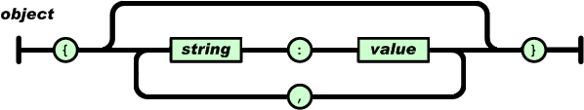
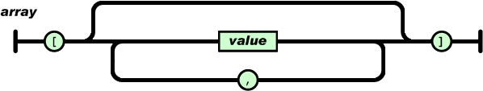
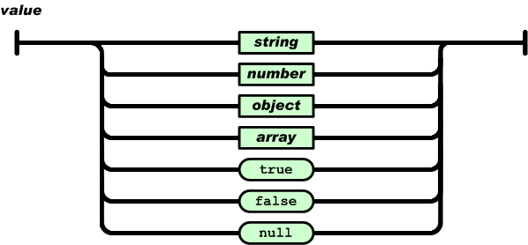
Simple BNF

Slide 6
Evaluation
JSON is simpler and more compact than XML
  No closing tags, but if you compress XML and JSON the difference is not so great
  XML parsing is hard because of its complexity
JSON has a better fit for OO systems than XML
JSON is not as extensible as XML
Preferred for simple data exchange by many
Less syntax, no semantics
Schemas? We don’t need no stinkin schemas!*
Transforms? Write your own

Slide 7
JSON-LD
JSON-LD is a W3C recommendation for representing RDF data as JSON objects
{"@context": {
"name": "http://xmlns.com/foaf/0.1/name",
"homepage": {
"@id": "http://xmlns.com/foaf/0.1/workplaceHomepage",
"@type": "@id"
},
"Person": "http://xmlns.com/foaf/0.1/Person"
},
"@id": "http://me.markus-lanthaler.com",
"@type": "Person",
"name": "Markus Lanthaler",
"homepage": "http://www.tugraz.at/"
}

Slide 8
Many popular systems use JSON
MongoDB is an open-source database for JSON objects
  Very popular NoSQL database
  A NoSQL DB is one that uses a model not based on relational tables
Elastic Search is a popular, scalable information retrieval engine that uses JSON as its native representation

Slide 9
Example: JSON in Python
>>> import json
>>> x = json.load(open('example.json'))
>>> x
{u'lastName': u'Smith', u'age': 25, u'phoneNumber': [{u'type': u'home', u'number': u'212-555-1234'}, {u'type': u'fax', u'number': u'646-555-4567'}], u'firstName': u'John', u'address': {u'streetAdr': u'21 2nd Street', u'state': u'NY', u'zip': u'10021', u'city': u'New York'}}
>>> x['address']['state']
u'NY'
>>> print json.dumps(x, sort_keys=True, separators=(',',':'), indent=2)
{"address":{
"city":"New York",
"state":"NY",
"streetAdr":"21 2nd Street",
"zip":"10021”},
"age":25,
"firstName":"John",
"lastName":"Smith",
"phoneNumber":[
{ "number":"212-555-1234",
"type":"home”},
{"number":"646-555-4567",
"type":"fax” } ] }
>>>
Python’s JSON package reads and writes json from/to files and strings
Maps JSON objects to Python dictionaries
Maps JSON arrays to python lists
Dump (write to file) and dumps (write to string) functions can do simple pretty printing

Slide 10
JSON vs. XML
JSON: The Fat-Free Alternative to XML
  json.org page laying out the case for JSON over XML
Stop Comparing JSON and XML
  Blog post arguing that they're very different things with their own areas of applicability
XML ⬄JSON
  There are many web tools and software packages that can convert between simple xml and json representations, e.g.: this one

Slide 11
Worse is Better?
JSON vs. XML can be viewed as an example of “Worse is Better”
In 1989 Dick Gabriel headed a company that had the best commercial version of Lisp
  Lisp was considered by programming language experts to be superior to the much more popular C
  Cf. today: Scheme vs. Python (w.r.t. mutable lists)
Gabriel explained it as worse is better
  software that's limited, but simple to learn/use, and flexible, can be more popular to most users

