Slide 1
An overview of
Semantic Web Languages and Technologies

Slide 2
Semantic Web Technologies
W3C “recommendations”
  RDF, RDFS, RDFa, OWL, SPARQL, RIF, R2R, etc…
Common tools and systems -- commercial, free and open sourced
  Ontology editors, triple stores, reasoners, etc.
Common ontologies and data sets
  Foaf, DBpedia, SKOS, PROV, etc.
Infrastructure systems
  Search, ontology metadata, linking services
Non W3C: Schema.org, Freebase, …

Slide 3
Common KR languages
Knowledge representation and reasoning (KR&R) has always been an important part of AI & other disciplines
Many approaches have been developed, implemented and evolved since the 1960s
Most were one-offs, used only by their developers
Starting in the 1990s, there was an interest in developing a common KR language to support knowledge reuse and distributed KB systems
The Semantic Web languages (e.g., OWL) are a current generation of this idea
  There are currntly no other widely used KR languages

Slide 4
Questions
Database (DB) vs. knowledge base (KB)?
  TL;DR: DBs have facts, KBs have general knowledge and (maybe) facts
  DBs typically have simple schemas (knowledge) and lots of data (facts)
  KBs have complex schemas (aka ontologies) and may or may not have a lot of instances (data)
KBs support inference, e.g.,
  parent(?x,?y) => person(?x), person(?y), child(?y,?x), oldr(?X,?y), ?x≠?y
  Parent(john,mary) => person(john), child(mary,john), …

Slide 5
Questions
What’s the impact of using different structures to represent data or knowledge?
Natural language
Relations vs. graphs vs. objects
Logic vs. rules vs. procedures
Neural networks
Tensors

Slide 6
Questions
What’s our “semantic” model for facts and knowledge?
Classical logic is a common choice
  man(socrates), ∀x man(x) => mortal(x)
  Classical logic has limitations: facts and relations and “rules” are either (always) True of False
May need to represent and reason with probabilistic or fuzzy facts and knowledge
May need to handle dynamic facts or knowledge

Slide 7
Semantic Web Technologies
Basic approach uses classical logic for underlying semantics
+ Simple, well understood, good reasoning
algorithms
- No probabilities, adding extensions (e.g., for time)
adds complexity
Knowledge represented as a graph
+ Simple, good tool support
- May be too simple

Slide 8
Two Semantic Web Notions
The semantic web
  Idea of a web of machine understandable information
  Agnostic about the technology used to support it
  May involve more AI (e.g., NLP)
  Human end users in the center
The Semantic Web
  The current vision of a semantic web as defined by the W3C community: a web of data
  Using W3C supported standards, i.e., RDF, OWL, SPARQL, XML, RIF, etc.
  By machines for machines with human oriented applications on top

Slide 9
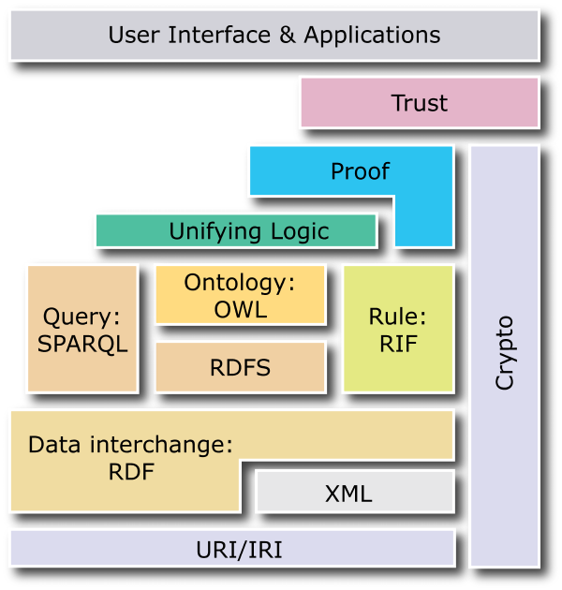
W3C Semantic Web Stack

Slide 10
RDF is the first SW language
Graph
XML Encoding
RDF
Data Model
<rdf:RDF ……..>
<….>
<….>
</rdf:RDF>
Good for people, viz, graph DBMS
Good for
Machine
Processing
Triples
stmt(docInst, rdf_type, Document)
stmt(personInst, rdf_type, Person)
stmt(inroomInst, rdf_type, InRoom)
stmt(personInst, holding, docInst)
stmt(inroomInst, person, personInst)
JSON Encoding
{"@context":{
"name": "http://…/name",
"Person": "http://…/Person"}
"@type": "Person",
"name": "Markus Lanthaler"
}
Good For Reasoning and
Databases
RDF is a simple language for building graph based representations

Slide 11
The RDF Data Model
An RDF document is an unordered collection of statements, each with a subject, predicate and object (aka triples)
A triple can be thought of as a labelled arc in a graph
Statements describe properties of web resources
Resource are objects that can be pointed to by a URI:
  a document, a picture, a paragraph on the Web, …
  E.g., http://umbc.edu/~finin/cv.html
  a book in the library, a real person (?)
  isbn://5031-4444-3333
Properties themselves are also resources (URIs)

Slide 12
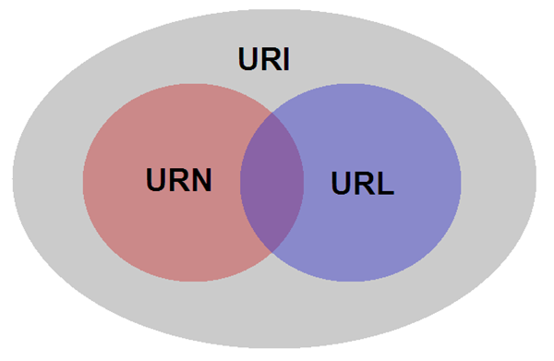
URIs are a foundation
URI = Uniform Resource Identifier
  "The generic set of all names/addresses that are short strings that refer to resources"
  URLs (Uniform Resource Locators) are a subset of URIs, used for resources that can be accessed on the web
URIs look like URLs, often with fragment identifiers pointing to a document part:
  http://foo.com/bar/mumble.html#pitch

Slide 13
URIs are a foundation
URIs are unambiguous, unlike natural language terms -- the web provides a global namespace
We can use a URI to denote something, e.g., a concept, entity, event or relation
We usually assume references to the same URI are to the same thing

Slide 14
What does a URI mean?
Sometimes URIs denote a web resource
  http://umbc.edu/~finin/finin.jpg denotes a file
  We can use RDF to make assertions about the resource, e.g., it’s an image and depicts a person with name Tim Finin, …
Sometimes concepts in the external world
  E.g., http://umbc.edu/ denotes a particular university located in Baltimore
  This is done by social convention
Cool URIs don’t change
  http://www.w3.org/Provider/Style/URI

Slide 15
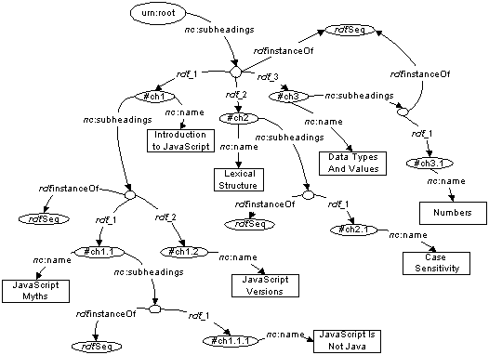
The RDF Graph
An RDF document is an unordered collection of triples
The subject of one triple can be the object of another
The result is a directed,
labelled graph
A triple’s object can
also be a literal, e.g.,
a string
Graphs are simpler
that relational tables
or objects
This is both a plus
and a minus

Slide 16
Simple RDF Example
http://umbc.edu/
~finin/talks/idm02/
dc:Title
“Intelligent Information Systems
on the Web”
dc:Creator
bib:Aff
http://umbc.edu/
bib:email
bib:name
“Tim Finin”
“finin@umbc.edu”

Slide 17
Serialization
A graph is an abstract model, we’ll need to serialize it as text for many reasons, e.g., display, editing, exchange
There are several standard RDF serializations, the three most important are: XML, Turtle and ntriples
Most Semantic Web tools can read or write in any of these serializations

Slide 18
XML encoding for RDF
<rdf:RDF xmlns:rdf="http://www.w3.org/1999/02/22-rdf-syntax-ns#"
xmlns:dc="http://purl.org/dc/elements/1.1/"
xmlns:bib=http://daml.umbc.edu/ontologies/bib/>
<rdf:Description rdf:about="http://umbc.edu/~finin/talks/idm02/">
<dc:title>Intelligent Information Systems on the Web</dc:title>
<dc:creator>
<rdf:Description>
<bib:Name>Tim Finin</bib:Name>
<bib:Email>finin@umbc.edu</bib:Email>
<bib:Aff rdf:resource="http://umbc.edu/" />
</rdf:Description>
</dc:creator>
</rdf:Description>
</rdf:RDF>

Slide 19
Note the prefix declarations
<rdf:RDF xmlns:rdf="http://www.w3.org/1999/02/22-rdf-syntax-ns#"
xmlns:dc="http://purl.org/dc/elements/1.1/"
xmlns:bib=http://daml.umbc.edu/ontologies/bib/>
<rdf:Description rdf:about="http://umbc.edu/~finin/talks/idm02/">
<dc:title>Intelligent Information Systems on the Web</dc:title>
<dc:creator>
<rdf:Description>
<bib:Name>Tim Finin</bib:Name>
<bib:Email>finin@umbc.edu</bib:Email>
<bib:Aff rdf:resource="http://umbc.edu/" />
</rdf:Description>
</dc:creator>
</rdf:Description>
</rdf:RDF>

Slide 20
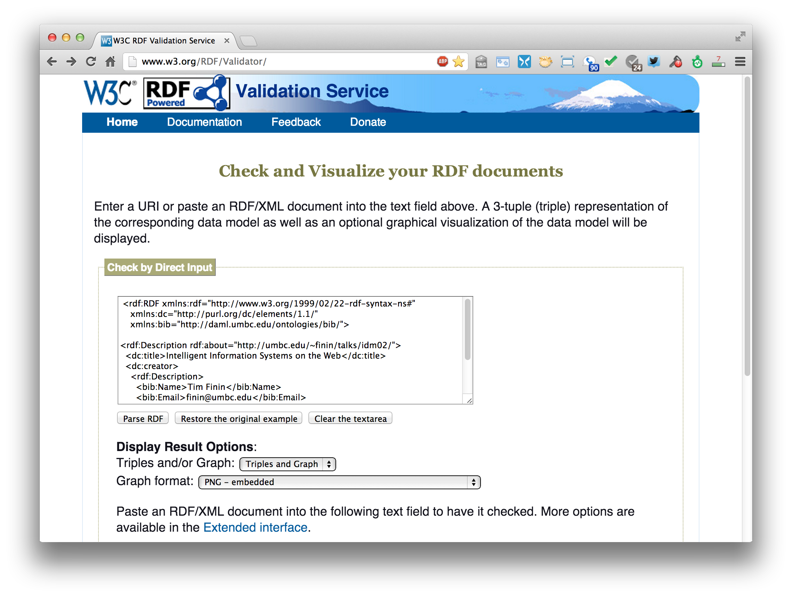
An RDF validation service
http://www.w3.org/RDF/Validator/

Slide 21
Easy to convert between serializations
Most software tools can read and write different serializations
rdf2rdf is a simple handy utility for converting from one RDF serialization to another
Any23 is an open source library, web service and command line tool that extracts structured data in RDF format from a variety of Web documents

Slide 22
N-triple representation
RDF can be encoded as a set of triples
  <subject> <predicate> <object> .
  <http://umbc.edu/~finin/talks/idm02/> <http://purl.org/dc/elements/1.1/title> "Intelligent Information Systems on the Web" .
  <http://umbc.edu/~finin/talks/idm02/> <http://purl.org/dc/elements/1.1/creator> _:node17i6ht38ux1 .
  _:node17i6ht38ux1 <http://daml.umbc.edu/ontologies/bib/Name> "Tim Finin" .
  _:node17i6ht38ux1 <http://daml.umbc.edu/ontologies/bib/Email> "finin@umbc.edu" .
  _:node17i6ht38ux1 <http://daml.umbc.edu/ontologies/bib/Aff> <http://umbc.edu/> .

Slide 23
N3/Turtle notation for RDF
N3 is a compact notation for RDF that is easier for people to read, write and edit
It’s just syntactic sugar
Aka Notation 3, developed by TBL himself
But, XML is largely unreadable and even harder to write
Turtle is a W3C standard that covers most of N3

Slide 24
Turtle Example
@prefix rdf: http://www.w3.org/1999/02/22-rdf-syntax-ns# .
@prefix dc: http://purl.org/dc/elements/1.1/ .
@prefix bib: http://daml.umbc.edu/ontologies/bib/ .
<http://umbc.edu/~finin/talks/idm02/>
dc:title "Intelligent Information Systems on the Web" ;
dc:creator
[ bib:Name "Tim Finin";
bib:Email "finin@umbc.edu"
bib:Aff: "http://umbc.edu/" ] .

Slide 25
Triple Notes
RDF triples have one of two forms:
  <URI> <URI> <URI>
  <URI> <URI> <quoted string>
Triples are also easily mapped into logic
  <subject> <predicate> <object> becoming:
    <predicate>(<subject>,<object>)
    With type(<S>,<O>) becoming <O>(<S>)
  Example:
    subclass(man,person)
    sex(man,male)
    domain(sex,animal)
    man(adam)
    age(adam,100)
Triples are easily stored and managed in DBMS
  Flat nature of a triple a good match for relational DBs
; Note: we’re not
; showing the actual
; URIs for clarity

Slide 26

A usecase: FOAF
FOAF (Friend of a Friend) is a simple ontology to describe people and their properties and social networks
  See the foaf project page: http://www.foaf-project.org/
In 2008 we crawled the web and found > 1M valid RDF FOAF files.
  Most were from http://liveJournal.com/blogging system which encoded basic user in FOAF
  Apache currently use FOAF for open source commiters
  See http://xmlns.com/foaf/spec/ for the vocabulary specification
<foaf:Person>
  <foaf:name>Tim Finin</foaf:name>
  <foaf:mbox_sha1sum>2410…37262c252e</foaf:mbox_sha1sum>
  <foaf:homepage rdf:resource="http://umbc.edu/~finin/" />
  <foaf:img rdf:resource="http://umbc.edu/~finin/images/passport.gif" />
</foaf:Person>

Slide 27
FOAF Vocabulary
Basics
Agent
Person
name
nick
title
homepage
mbox
mbox_sha1sum
img
depiction (depicts)
surname
family_name
givenname
firstName
Personal Info
weblog
knows
interest
currentProject
pastProject
plan
based_near
workplaceHomepage
workInfoHomepage
schoolHomepage
topic_interest
publications
geekcode
myersBriggs
dnaChecksum
Documents & Images
Document
Image
PersonalProfileDocument
topic (page)
primaryTopic
tipjar
sha1
made (maker)
thumbnail
logo
Online Accts
OnlineAccount
OnlineChatAccount
OnlineEcommerceAccount
OnlineGamingAccount
holdsAccount
accountServiceHomepage
accountName
icqChatID
msnChatID
aimChatID
jabberID
yahooChatID
Projects & Groups
Project Organization
Group member
membershipClass fundedBy
theme

Slide 28
FOAF: why RDF? Extensibility!
FOAF vocabulary has 50+ basic terms for simple facts about people
FOAF files can use other RDF terms too: RSS, MusicBrainz, Dublin Core, Wordnet, Creative Commons, blood types, starsigns, …
RDF gives freedom of independent extension
  OWL provides fancier data-merging facilities
Freedom to say what you like, using any RDF markup you want, and have RDF crawlers merge your FOAF documents with other’s and know when you’re talking about the same entities
After Dan Brickley, danbri@w3.org

Slide 29
No free lunch!
Must plan for lies, mischief, mistakes, stale data, slander, idiosyncratic terms
Dataset is out of control, distributed, dynamic
Importance of knowing who-said-what
  Anyone can describe anyone
  We must record data provenance
  Modeling and reasoning about trust is critical
Legal, privacy and etiquette issues emerge
Welcome to the real world
After Dan Brickley, danbri@w3.org

Slide 30
More RDF Vocabulary
RDF has terms for describing lists, bags, sequences, simple datatypes, etc.
RDF is a “pure” graph representation language
  Nodes and edges are simple objects
  Both have identifiers that are URIs
Suppose we want to associate a probability with an edge, e.g.,
  (:flipper rdf:type :mammal) :probability 0.9
  (:flipper rdf:type :fish) :probability 0.1

Slide 31
Property graphs?
  RDF is a “pure” graph model with only labeled nodes and edges
  Many popular graph databases implement property graphs (e.g., Neo4j)
  Nodes and edges can have one or more properties, whose values are literals or maybe lists of literals
Results in a more compact graph
But, as we’ll see, introduces some limitations

Slide 32
More RDF Vocabulary
RDF also can describe triples through reification
Enabling statements about statements
  :flipper rdf:type :mammal .
All non-literals have to be URIs
RDF uses prefixes for readability
We can specify what a null prefix means
If we don’t it means “in this file”
https://prefix.cc/ is one service for looking up prefixes

Slide 33
More RDF Vocabulary
RDF also can describe triples through reification
Enabling statements about statements
  :flipper rdf:type :mammal .
  _:s1 rdf:type rdf:Statement .
  _:s1 rdf:subject :flipper .
  _:s1 rdf:predicate :type .
  _:s1 rdf:object :mammal .
  _:s1 :probability 0.9
The underscore prefix is special
It introduces blank nodes
We’ll talk about this in more detail later
For now, think of it as introducing “a new, nameless thing”

Slide 34
More RDF Vocabulary
RDF also can describe triples through reification
Enabling statements about statements
  :flipper rdf:type :mammal .
  _:s1 a rdf:Statement;
  rdf:subject :flipper;
  rdf:predicate :type;
  rdf:object :mammal;
  :probability 0.9 .

Slide 35
More RDF Vocabulary
RDF also can describe triples through reification
Enabling statements about statements
  :john bdi:believes _:s.
  _:s rdf:type rdf:Statement.
  _:s rdf:subject <http://ex.com/catalog/widgetX>.
  _:s rdf:predicate cat:salePrice .
  _:s rdf:object "19.95" .

Slide 36
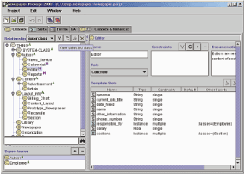
RDF Schema (RDFS)
RDF Schema adds taxonomies for
classes & properties
  subClass and subProperty
and some metadata.
  domain and range
  constraints on properties
Several widely used
KB tools can import
and export in RDFS
Stanford Protégé KB editor
Java, open sourced
extensible, lots of plug-ins
provides reasoning & server capabilities

Slide 37
RDFS Vocabulary
RDFS introduces the following terms and gives each a meaning w.r.t. the rdf data model
Terms for classes
  rdfs:Class
  rdfs:subClassOf
Terms for properties
  rdfs:domain
  rdfs:range
  rdfs:subPropertyOf
Special classes
  rdfs:Resource
  rdfs:Literal
  rdfs:Datatype
Terms for collections
  rdfs:member
  rdfs:Container
  rdfs:ContainerMem-bershipProperty
Special properties
  rdfs:comment
  rdfs:seeAlso
  rdfs:isDefinedBy
  rdfs:label

Slide 38
RDF and RDF Schema
<rdfs:Property rdf:ID=“name”>
<rdfs:domain rdf:resource=“Person”>
</rdfs:Property>
<rdfs:Class rdf:ID=“Chair”>
<rdfs:subclassOf rdf:resource=
“http://schema.org/gen#Person”>
</rdfs:Class>
rdfs:Class
rdfs:Property
rdf:type
rdf:type
rdf:type
g:Person
rdfs:domain
<rdf:RDF
xmlns:g=“http://schema.org/gen”
xmlns:u=“http://schema.org/univ”>
<u:Chair rdf:ID=“john”>
<g:name>John Smith</g:name>
</u:Chair>
</rdf:RDF>
rdfs:subclassOf
u:Chair
g:name
rdf:type
g:name
John Smith

Slide 39
RDFS supports simple inferences
New and
Improved!
100% Better
than XML!!
An RDF ontology plus some RDF statements may imply additional RDF statements
Not true of XML data
Note that this is part of the data model and not of the accessing or processing code
@prefix rdfs: <http://www...>.
@prefix : <…genesis.n3>.
:parent rdfs:domain :Person;
  rdfs:range :Person.
  :mother
  rdfs:subProperty parent;
  rdfs:domain :Woman.
  :eve :mother :cain.
:parent a rdf:Property.
:Person a rdf:Class.
:Woman rdfs:subClassOf Person.
:mother a rdf:Property.
:eve a :Person;
a :Woman;
:parent :cain.
:cain a :Person.

Slide 40
N3 example
Here’s how you declare a namespace.
<> Is an alias for the URI of this document.
This defines the “empty prefix” as refering to “this document”
@prefix rdf: <http://www.w3.org/1999/02/22-rdf-syntax-ns#>.
@prefix rdfs: <http://www.w3.org/2000/01/rdf-schema#>.
@prefix : <#> .
<> rdfs:comment “This is an N3 example”.
:Person a rdfs:Class.
:Woman a rdfs:Class; rdfs:subClassOf :Person.
:eve a :Woman; :age “100”.
:sister a rdf:Property; rdfs:domain :Person;
rdfs:range :Woman.
:eve :sister [a :Woman; :age 98].
:eve :believe {:eve :age “100”}.
[is :spouse of [is :sister of :eve]] :age 99.
:eve.:sister.:spouse :age 99.
“person is a class”. The “a” syntax is sugar for rdf:type property.
“Woman is a class and a subclass of person”. Note the ; syntax.
“eve is a woman whose age is 100.”
“sister is a property from person to woman”
“eve has a sister who is a 98 year old woman”. The brackets introduce an anonymous resource.
“eve believes that her age is 100”. The braces introduce a reified triple.
“the spouse of the sister of eve is 99”.
“the spouse of the sister of eve is 99”.

Slide 41
Is RDF(S) better than XML?
Q: For a specific application, should I use XML or RDF?
A: It depends…
XML's model is
  a tree, i.e., a strong hierarchy
  applications may rely on hierarchy position
  relatively simple syntax and structure
  not easy to combine trees
RDF's model is
  a loose collections of relations
  applications may do database-like search
  not easy to recover hierarchy
  easy to combine relations in one big collection
  great for the integration of heterogeneous information

Slide 42
W3C Semantic Web Stack

Slide 43
Problems with RDFS
RDFS too weak to describe resources in detail, e.g.
  No localised range and domain constraints
    Can’t say that the range of hasChild is person when applied to persons and dog when applied to dogs
  No existence/cardinality constraints
    Can’t say that all instances of person have a mother that is also a person, or that persons have exactly two parents
  No transitive, inverse or symmetrical properties
    Can’t say isPartOf is a transitive property, hasPart is the inverse of isPartOf or touches is symmetrical
We need RDF terms providing these and other features.

Slide 44
W3C’s Web Ontology Language (OWL)
DARPA project, DAML+OIL, begat OWL
OWL released as W3C recommendation 2/10/04
See the W3C OWL pages for overview, guide, specification, test cases, etc.
Three layers of OWL are defined of decreasing levels of complexity and expressiveness
  OWL Full is the whole thing
  OWL DL (Description Logic) introduces restrictions
  OWL Lite is an entry level language intended to be easy to understand and implement
Owl 2 became a W3C recommendation in 2009

Slide 45
OWL ↔ RDF
An OWL ontology is a set of RDF statements
  OWL defines semantics for certain statements
  Does NOT restrict what can be said; documents can include arbitrary RDF
  But no OWL semantics for non-OWL statements
Adds capabilities common to description logics, e.g., cardinality constraints, defined classes, equivalence, disjoint classes, etc.
Supports ontologies as objects (e.g., importing, versioning, …
A complete OWL reasoning is significantly more complex than a complete RDFS reasoner.

Slide 46
Embedding Semantic Data in HTML
Embedding semantic data in HTML allows documents to be understood by people and machines
  RDFa is a ‘standard’ for embedding RDF in HTML as tag attributes
  JSON-LD is a ‘standard’ for embedding RDF in a simple json-compatibl serialization
Facebook looks for embedded RDFa state-ments using its opengraph (og) vocabulary
Bestbuy embeds produce info in RDFa

Slide 47
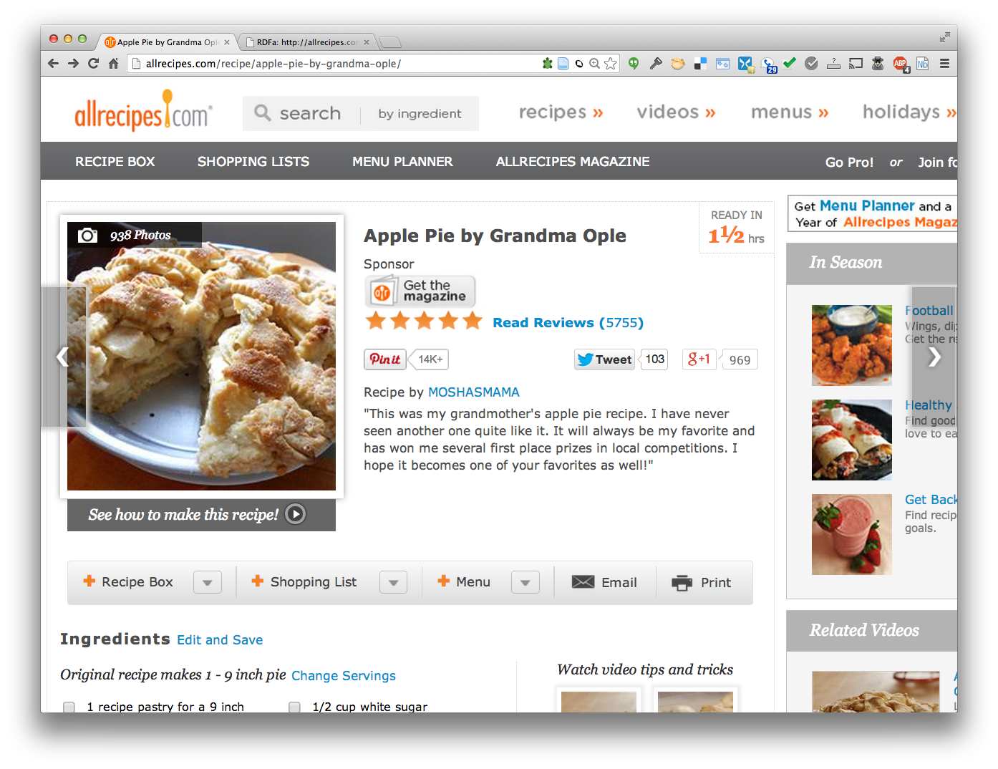
Detecting semantic data via a browser

Slide 48

Detecting semantic data via a browser
Plugin shows up if RDFa detected. Shows statements if clicked.
http://bit.ly/gturtle
Plugin shows up if Schema.org statements detected. Shows statements if clicked. http://bit.ly/sdotoch

Slide 49
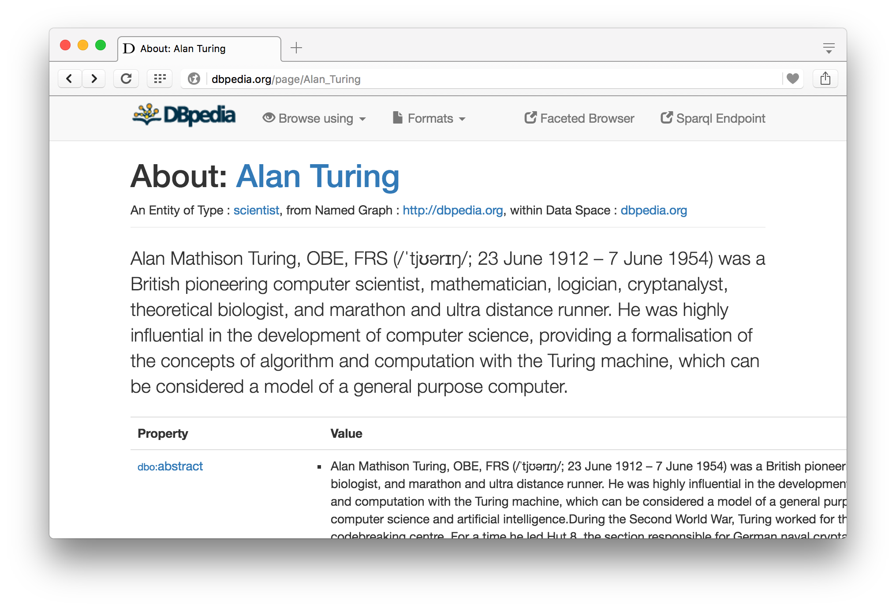
Semantic Data Browser/Query
Notes:
Click on the images to view this page in your browser

Slide 50
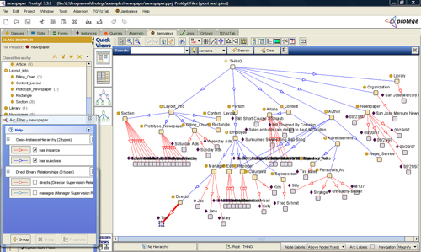
Ontology Editor
There are a number of editors available for creating and editing ontologies and data
We recommend using Protégé, a java-based free system developed at Stanford
  Good support for
  reasoning
  Lots of plugins

Slide 51
Triple Stores
A triple store is a database for RDF triples
It usually has a native API and often accepts SPARQL queries
It might do reasoning, either in an eager manner (as triples are loaded) or on demand (to answer queries), etc
Some stores focus on scalability and others on flexibility and features
We’ll look at several, including Sesame, Apache Jena and stardog

Slide 52
Frameworks and Libraries
There are frameworks, libraries and packages for most programming languages
Jena is a very comprehensive Java framework originally developed by HP and now Apache
Others are available for Python, Ruby, C#, Perl, PHP, Prolog, Lisp, etc.

Slide 53
Conclusion
There’s quite a bit of technology needed to support the Semantic Web
This has been a brief tour
We’ll cycle back on these and explore them in more detail
And give you a chance to use and experiment with them

