Slide 1
Introduction to the
Semantic Web

Slide 2
Questions
What is the Semantic Web?
Why do we want it?
How will we do it?
Who will do it?
When will it be done?

Slide 3
“XML is Lisp's bastard nephew, with uglier syntax and no semantics. Yet XML is poised to enable the creation of a Web of data that dwarfs anything since the Library at Alexandria.”
-- Philip Wadler, Et tu XML? The fall of
the relational empire, VLDB, Rome,
September 2001.

Slide 4
“The web has made people smarter. We need to understand how to use it to make machines smarter, too.”
-- Michael I. Jordan, paraphrased
from a talk at AAAI, July 2002
by Michael Jordan (UC Berkeley)

Slide 5
“The Semantic Web will globalize
knowledge representation, just as the WWW globalized hypertext”
-- Tim Berners-Lee

Slide 6

Web is our greatest knowledge source
Notes:
The Web is the greatest source of general knowledge available today.

Slide 7
But it has limitations
Notes:
The Web is the greatest source of general knowledge available today.

Slide 8

Designed for people, not machines

Slide 9
Designed for people, not machines
Content is mostly text, spoken language, images and videos
Easy for people to understand
But hard for machines
Machines need access to this knowledge too

Slide 10
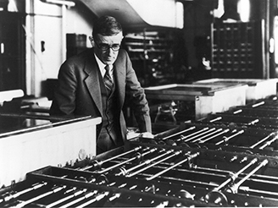
Access via information retrieval
Vannevar Bush envisioned a hypertext/IR system in 1945

Slide 11
Access is primarily via information retrieval
Key-word queries→ranked document list
We still need to read the documents or watch the videos
We often want an answer to a question: where is the Census Big Data Day event
And so do our machines and apps
Vannevar Bush envisioned a hypertext/IR system in 1945

Slide 12
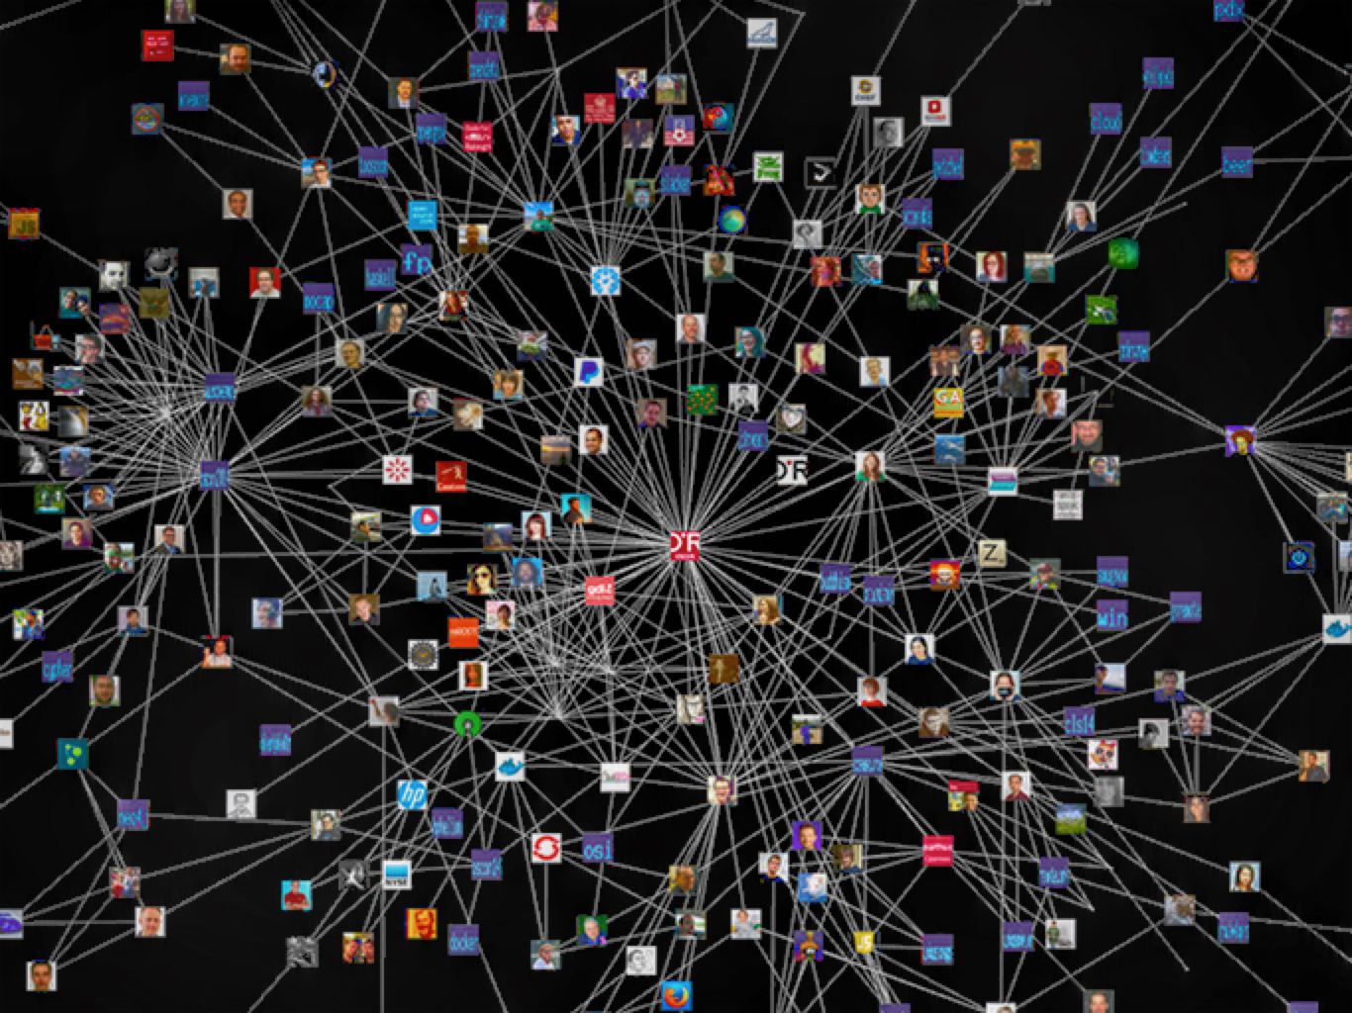
We need to add knowledge graphs

Slide 13
We need to add knowledge graphs
High quality semi-structured information about entities and relations
Represented and accessed via Web standards
Easily integrated, fused and reasoned with

Slide 14
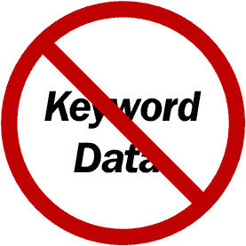
State of the Art?
Google is a good example, but Microsoft, IBM, Apple and Facebook all have similar capabilities
2010 Google acquired MediaWeb and its Freebase KB
2014: Freebase: 1.2B facts about 43M entities
2015+: Google knowledge graph, updated by text IE
DBpedia open source RDF KB is another
800M facts about 4.6M subjects from English Wikipedia, data also available in 21 other languages
Helps integrate 90B facts from 1000 RDF datasets in the linked data cloud

Slide 15
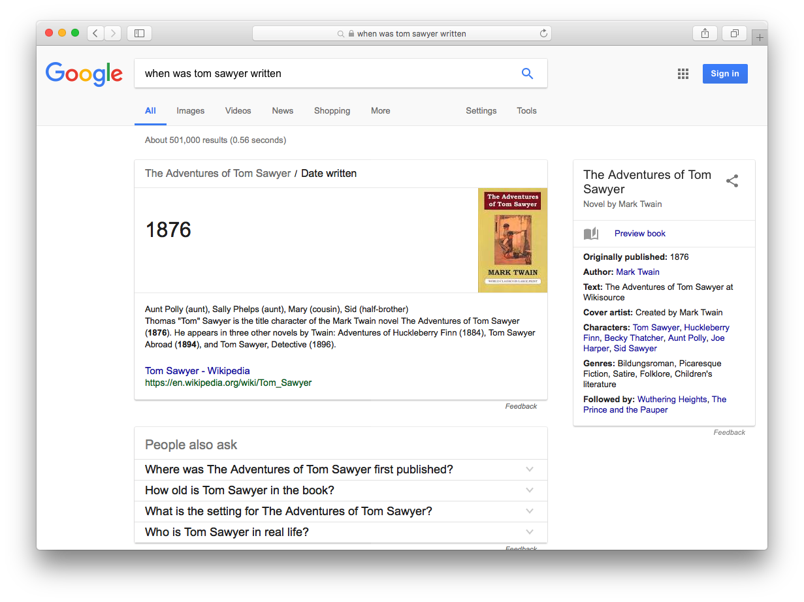
Ask: When was Tom Sawyer written?

Slide 16
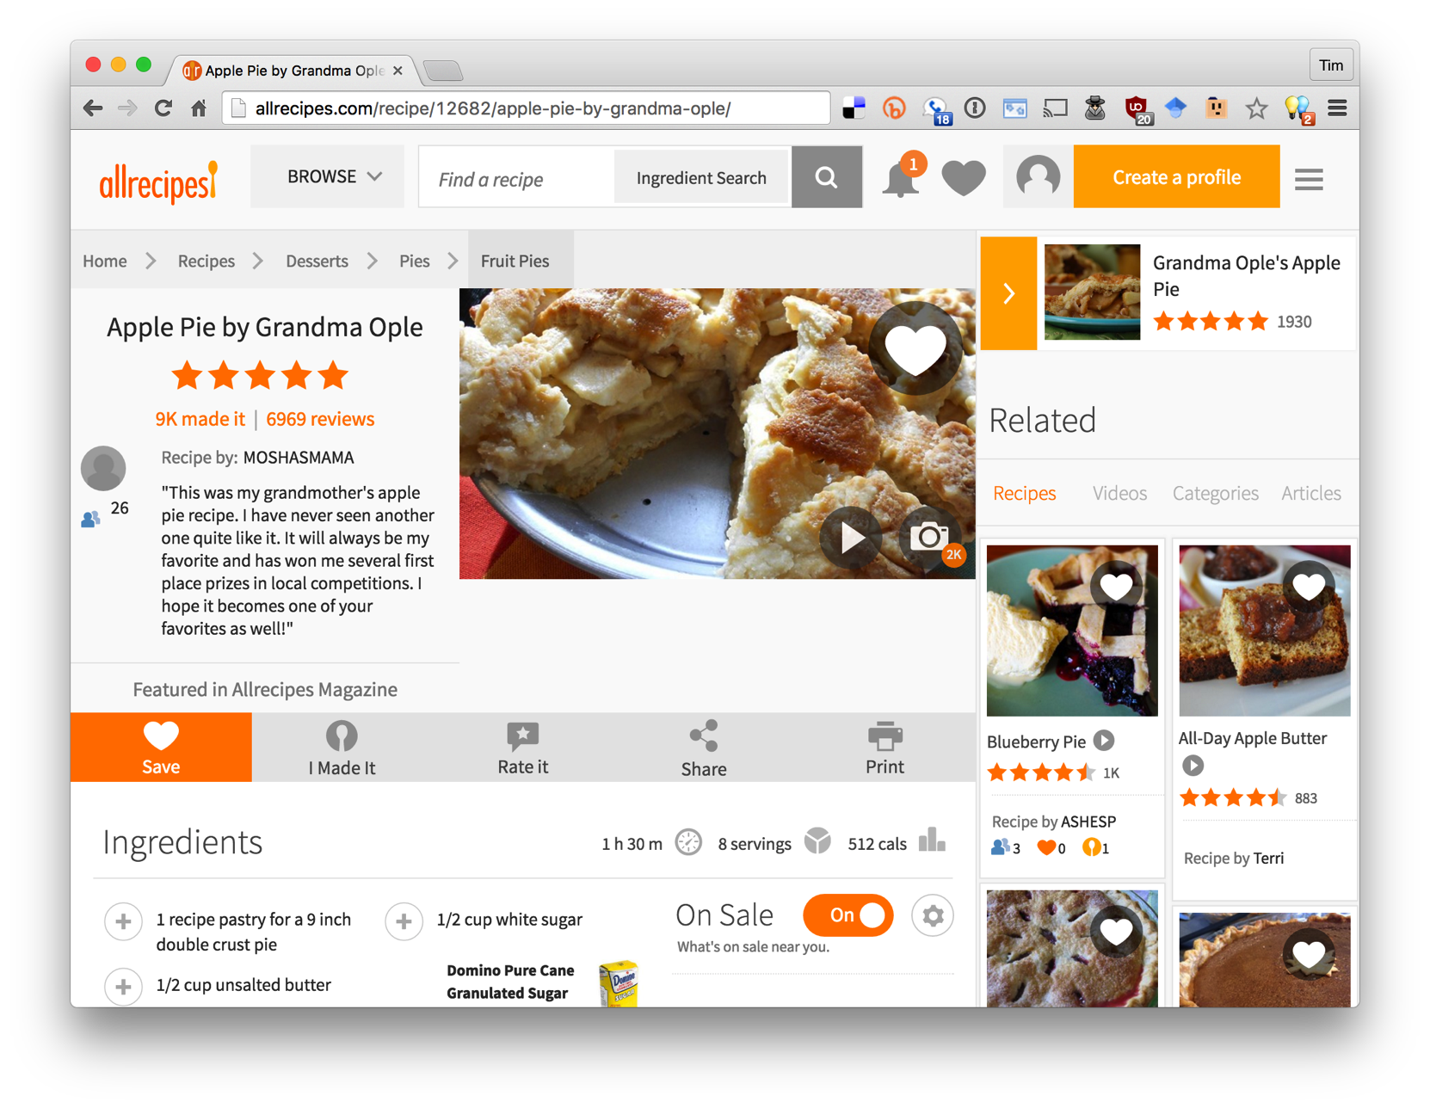
Notes:
As a separate, but related example of using data on the web, many sites not embed semantic data on web pages. The data is represented in an RDF-compatible graph format using terms defined in common ontologies found at schema.org.

Slide 17
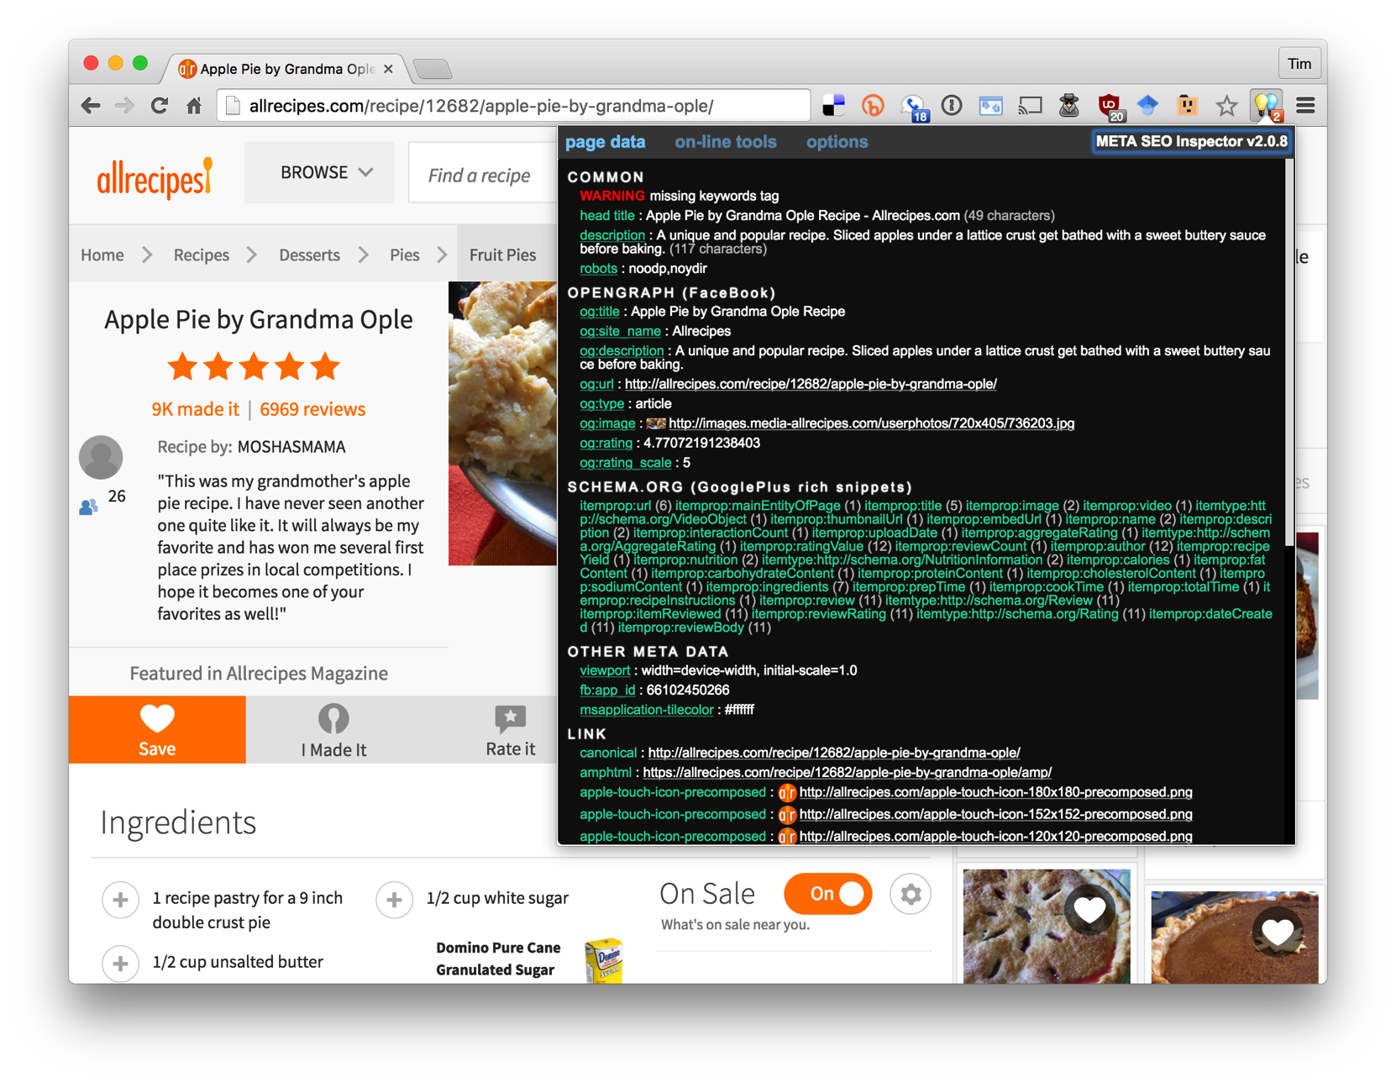
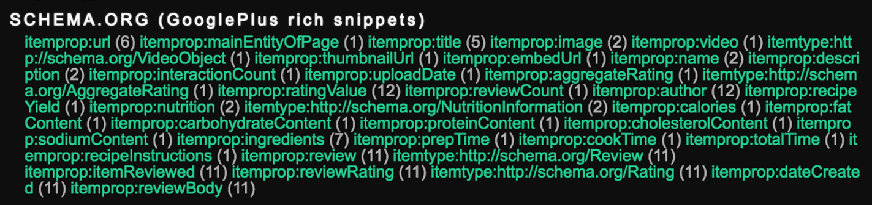
Almost all commercial recipe sites embed semantic data about their recipes in an RDF-compatible form using terms from the schema.org ontology.
Search engines read and use this data to better under-stand the semantics of the page content

Slide 18
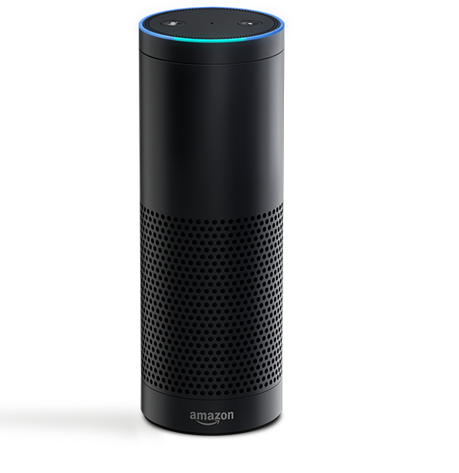
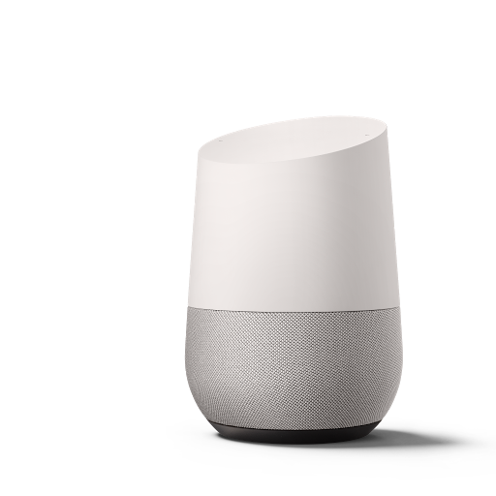

Conversational Bots
Voice-driven conversational systems like Amazon Echo and Google Home use knowledge graphs to help understand our requests

Slide 19
Where does the knowledge come from?
Initial knowledge graphs like DBpedia and Freebase started with data from Wikipedia and encoded it in custom ontologies
Semantic Web technologies are an open source way to encode the knowledge
They are and will continue to evolve
A current focus is on extracting information from text of source documents, e.g., journal articles, Newswire, social media, etc.

Slide 20
Why Web Based?
The web is like a universal acid, eating through and consuming everything it touches.
  Web principles and technologies are equally good for wireless/pervasive computing
The semantic web is our first serious attempt to provide semantics for XML sublanguages
It will provide mechanisms for people and machines (agents, programs, web services) to come together.
  In all kinds of networked environments: wired, wireless, ad hoc, wearable, etc.

Slide 21
Who invented the Web?

Slide 22
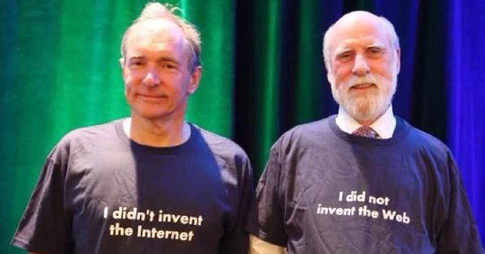
Who invented the Web?

Slide 23

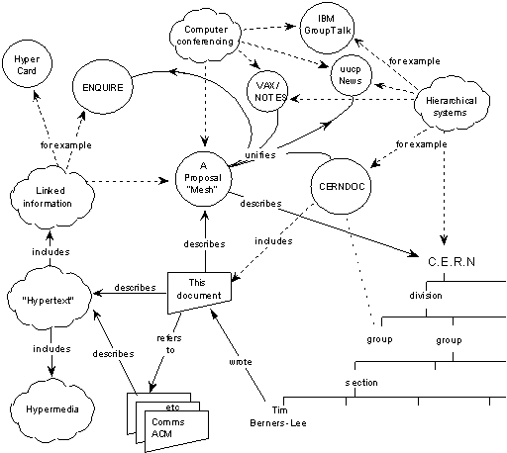
Origins
Tim Berners-Lee’s original 1989 WWW proposal described a web of relation-ships among named
objects unifying many info. management tasks.
Capsule history
Guha’s MCF (~94)
XML+MCF=>RDF (~96)
RDF+OO=>RDFS (~99)
RDFS+KR=>DAML+OIL (00)
W3C’s SW activity (01)
W3C’s OWL (03)
http://www.w3.org/History/1989/proposal.html

Slide 24
W3C’s Semantic Web Goals
Focus on machine consumption:
  "The Semantic Web is an extension of the current web in which information is given well-defined meaning, better enabling computers and people to work in cooperation."
  -- Berners-Lee, Hendler and Lassila, The Semantic Web, Scientific American, 2001

Slide 25
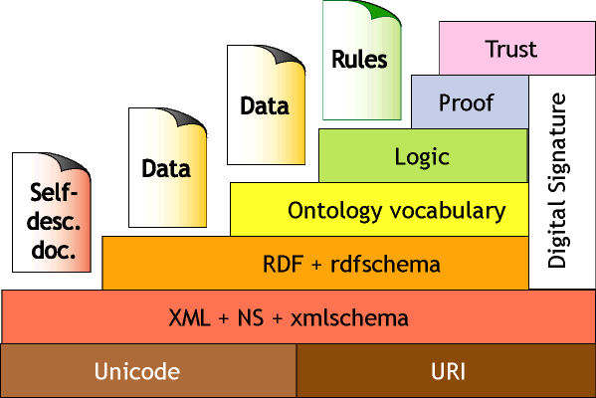
TBL’s semantic web vision, circa 2000

Slide 26
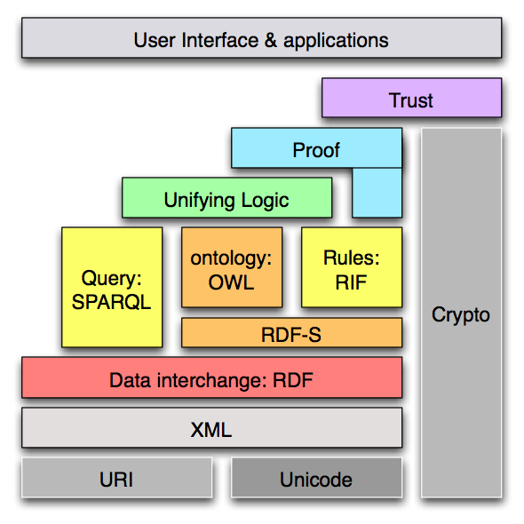
Semantic web stack 2006

Slide 27
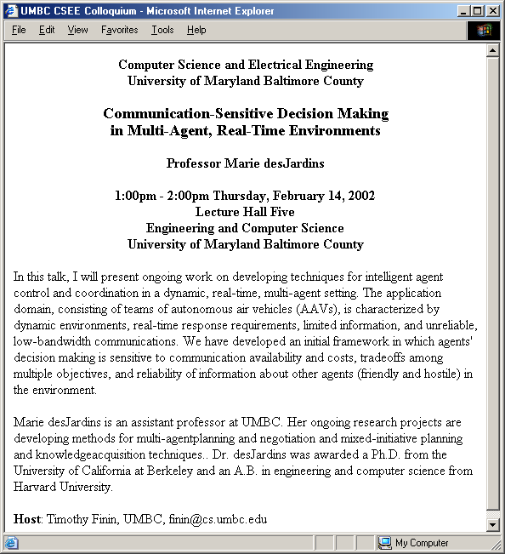
Why is this hard?
after Frank van Harmelen
and Jim Hendler

Slide 28
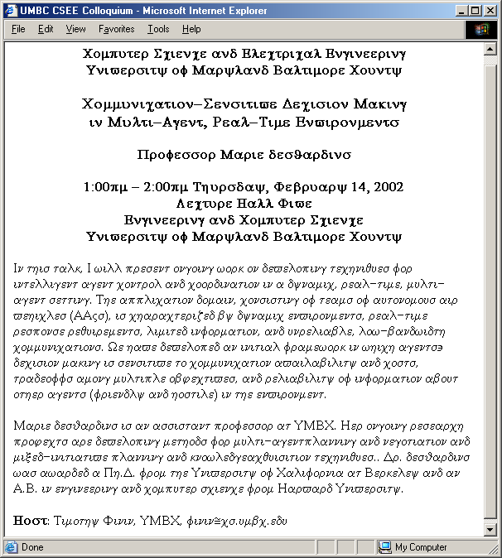
What a web page looks like to a machine…
after Frank van Harmelen
and Jim Hendler

Slide 29
OK, so HTML is not helpful
Maybe we can tell the machine what the different parts of the text represent?
title
speaker
time
location
abstract
biosketch
host

Slide 30
XML to the rescue?
XML fans propose creating a XML tag set to use for each application.
For talks, we can choose <title>, <speaker>, etc.
<title>
</title>
<speaker>
</speaker>
<time>
</time>
<location>
</location>
<abstract>
</abstract>
<biosketch>
</biosketch>
<host>
</host>
after Frank van Harmelen and Jim Hendler

Slide 31
XML ≠ machine accessible meaning
But, to your machine, the tags still look like this….
The tag names carry no meaning.
XML DTDs and
Schemas have little or no semantics.
<τιτλε>
</τιτλε>
<σπεακερ>
</σπεακερ>
<τιμε>
</τιμε>
<λοχατιον>
</λοχατιον>
<αβστραχτ>
</αβστραχτ>
<βιοσκετχη>
</βιοσκετχη>
<ηοστ>
</ηοστ>
after Frank van Harmelen and Jim Hendler

Slide 32
XML Schema helps
<?xml version="1.0" encoding="utf-8"?>
<xs:schema xmlns:xs="http://www.w3.org/2001/XMLSchema">
<xs:element name="book">
<xs:complexType>
<xs:sequence>
<xs:element name="title" type="xs:string"/>
<xs:element name="author" type="xs:string"/>
<xs:element name="character" minOccurs="0" maxOccurs="unbounded">
<xs:complexType>
<xs:sequence>
<xs:element name="name" type="xs:string"/>
<xs:element name="friend-of" type="xs:string" minOccurs="0"
maxOccurs="unbounded"/>
<xs:element name="since" type="xs:date"/>
<xs:element name="qualification" type="xs:string"/>
</xs:sequence>
</xs:complexType>
</xs:element>
</xs:sequence>
<xs:attribute name="isbn" type="xs:string"/>
</xs:complexType>
</xs:element>
</xs:schema>
XML Schemas provide a simple mechanism to define shared vocabularies.
XML Schema file
<τιτλε>
</τιτλε>
<τιτλε>
</τιτλε>
<σπεακερ>
</σπεακερ>
<σπεακερ>
</σπεακερ>
<τιμε>
</τιμε>
<τιμε>
</τιμε>
<λοχατιον>
<λοχατιον>
</λοχατιον>
</λοχατιον>
<αβστραχτ>
<αβστραχτ>
</αβστραχτ>
</αβστραχτ>
<βιοσκετχη>
<βιοσκετχη>
</βιοσκετχη>
</βιοσκετχη>
<ηοστ>
</ηοστ>
<ηοστ>
</ηοστ>
after Frank van Harmelen and Jim Hendler

Slide 33
But there are many schemas
<?xml version="1.0" encoding="utf-8"?>
<xs:schema xmlns:xs="http://www.w3.org/2001/XMLSchema">
<xs:element name="book">
<xs:complexType>
<xs:sequence>
<xs:element name="title" type="xs:string"/>
<xs:element name="author" type="xs:string"/>
<xs:element name="character" minOccurs="0" maxOccurs="unbounded">
<xs:complexType>
<xs:sequence>
<xs:element name="name" type="xs:string"/>
<xs:element name="friend-of" type="xs:string" minOccurs="0"
maxOccurs="unbounded"/>
<xs:element name="since" type="xs:date"/>
<xs:element name="qualification" type="xs:string"/>
</xs:sequence>
</xs:complexType>
</xs:element>
</xs:sequence>
<xs:attribute name="isbn" type="xs:string"/>
</xs:complexType>
</xs:element>
</xs:schema>
<?xml version="1.0" encoding="utf-8"?>
<xs:schema xmlns:xs="http://www.w3.org/2001/XMLSchema">
<xs:element name="book">
<xs:complexType>
<xs:sequence>
<xs:element name="title" type="xs:string"/>
<xs:element name="author" type="xs:string"/>
<xs:element name="character" minOccurs="0" maxOccurs="unbounded">
<xs:complexType>
<xs:sequence>
<xs:element name="name" type="xs:string"/>
<xs:element name="friend-of" type="xs:string" minOccurs="0"
maxOccurs="unbounded"/>
<xs:element name="since" type="xs:date"/>
<xs:element name="qualification" type="xs:string"/>
</xs:sequence>
</xs:complexType>
</xs:element>
</xs:sequence>
<xs:attribute name="isbn" type="xs:string"/>
</xs:complexType>
</xs:element>
</xs:schema>
XML Schema file 1
XML Schema file 42
<τιτλε>
</τιτλε>
<title>
</title>
<σπεακερ>
</σπεακερ>
<speaker>
</speaker>
<τιμε>
</τιμε>
<time>
</time>
<λοχατιον>
<location>
</λοχατιον>
</location>
<αβστραχτ>
<abstract>
</αβστραχτ>
</abstract>
<βιοσκετχη>
<biosketch>
</βιοσκετχη>
</biosketch>
<ηοστ>
</ηοστ>
<host>
</host>
after Frank van Harmelen and Jim Hendler

Slide 34
There’s no way to relate schema
<?xml version="1.0" encoding="utf-8"?>
<xs:schema xmlns:xs="http://www.w3.org/2001/XMLSchema">
<xs:element name="book">
<xs:complexType>
<xs:sequence>
<xs:element name="title" type="xs:string"/>
<xs:element name="author" type="xs:string"/>
<xs:element name="character" minOccurs="0" maxOccurs="unbounded">
<xs:complexType>
<xs:sequence>
<xs:element name="name" type="xs:string"/>
<xs:element name="friend-of" type="xs:string" minOccurs="0"
maxOccurs="unbounded"/>
<xs:element name="since" type="xs:date"/>
<xs:element name="qualification" type="xs:string"/>
</xs:sequence>
</xs:complexType>
</xs:element>
</xs:sequence>
<xs:attribute name="isbn" type="xs:string"/>
</xs:complexType>
</xs:element>
</xs:schema>
<?xml version="1.0" encoding="utf-8"?>
<xs:schema xmlns:xs="http://www.w3.org/2001/XMLSchema">
<xs:element name="book">
<xs:complexType>
<xs:sequence>
<xs:element name="title" type="xs:string"/>
<xs:element name="author" type="xs:string"/>
<xs:element name="character" minOccurs="0" maxOccurs="unbounded">
<xs:complexType>
<xs:sequence>
<xs:element name="name" type="xs:string"/>
<xs:element name="friend-of" type="xs:string" minOccurs="0"
maxOccurs="unbounded"/>
<xs:element name="since" type="xs:date"/>
<xs:element name="qualification" type="xs:string"/>
</xs:sequence>
</xs:complexType>
</xs:element>
</xs:sequence>
<xs:attribute name="isbn" type="xs:string"/>
</xs:complexType>
</xs:element>
</xs:schema>
XML Schema file 1
XML Schema file 42
<τιτλε>
</τιτλε>
<title>
</title>
<σπεακερ>
</σπεακερ>
<speaker>
</speaker>
<τιμε>
</τιμε>
<time>
</time>
<λοχατιον>
<location>
</λοχατιον>
</location>
<αβστραχτ>
<abstract>
</αβστραχτ>
</abstract>
<βιοσκετχη>
<biosketch>
</βιοσκετχη>
</biosketch>
<ηοστ>
</ηοστ>
<host>
</host>
Either manually or automatically.
XML Schema is weak on semantics.

Slide 35
An Ontology level is needed
XML
Ontology
256
<?xml version="1.0" encoding="utf-8"?>
<xs:schema xmlns:xs="http://www.w3.org/2001/XMLSchema">
<xs:element name="book">
<xs:complexType>
<xs:sequence>
<xs:element name="title" type="xs:string"/>
<xs:element name="author" type="xs:string"/>
<xs:element name="character" minOccurs="0" maxOccurs="unbounded">
<xs:complexType>
<xs:sequence>
<xs:element name="name" type="xs:string"/>
<xs:element name="friend-of" type="xs:string" minOccurs="0"
maxOccurs="unbounded"/>
<xs:element name="since" type="xs:date"/>
<xs:element name="qualification" type="xs:string"/>
</xs:sequence>
</xs:complexType>
</xs:element>
</xs:sequence>
<xs:attribute name="isbn" type="xs:string"/>
</xs:complexType>
</xs:element>
</xs:schema>
Ontologies add
  Structure
  Constraints
  mappings
imports
imports
XML Ontology 1
XML Ontology 42
<?xml version="1.0" encoding="utf-8"?>
<xs:schema xmlns:xs="http://www.w3.org/2001/XMLSchema">
<xs:element name="book">
<xs:complexType>
<xs:sequence>
<xs:element name="title" type="xs:string"/>
<xs:element name="author" type="xs:string"/>
<xs:element name="character" minOccurs="0" maxOccurs="unbounded">
<xs:complexType>
<xs:sequence>
<xs:element name="name" type="xs:string"/>
<xs:element name="friend-of" type="xs:string" minOccurs="0"
maxOccurs="unbounded"/>
<xs:element name="since" type="xs:date"/>
<xs:element name="qualification" type="xs:string"/>
</xs:sequence>
</xs:complexType>
</xs:element>
</xs:sequence>
<xs:attribute name="isbn" type="xs:string"/>
</xs:complexType>
</xs:element>
</xs:schema>
<?xml version="1.0" encoding="utf-8"?>
<xs:schema xmlns:xs="http://www.w3.org/2001/XMLSchema">
<xs:element name="book">
<xs:complexType>
<xs:sequence>
<xs:element name="title" type="xs:string"/>
<xs:element name="author" type="xs:string"/>
<xs:element name="character" minOccurs="0" maxOccurs="unbounded">
<xs:complexType>
<xs:sequence>
<xs:element name="name" type="xs:string"/>
<xs:element name="friend-of" type="xs:string" minOccurs="0"
maxOccurs="unbounded"/>
<xs:element name="since" type="xs:date"/>
<xs:element name="qualification" type="xs:string"/>
</xs:sequence>
</xs:complexType>
</xs:element>
</xs:sequence>
<xs:attribute name="isbn" type="xs:string"/>
</xs:complexType>
</xs:element>
</xs:schema>
=
<>
We need a way to define ontologies in XML
So we can relate them
So machines can understand (to some degree) their meaning

Slide 36
Semantic Web
Use Semantic Web Technology to publish shared data & knowledge
Semantic web technologies allow machines to share data and knowledge using common web language and protocols.
~ 1997
Semantic Web beginning

Slide 37
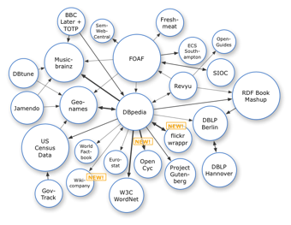
Semantic Web => Linked Open Data
Use Semantic Web Technology to publish shared data & knowledge
2007
Data is inter-
linked to support inte-
gration and fusion of knowledge
LOD beginning

Slide 38
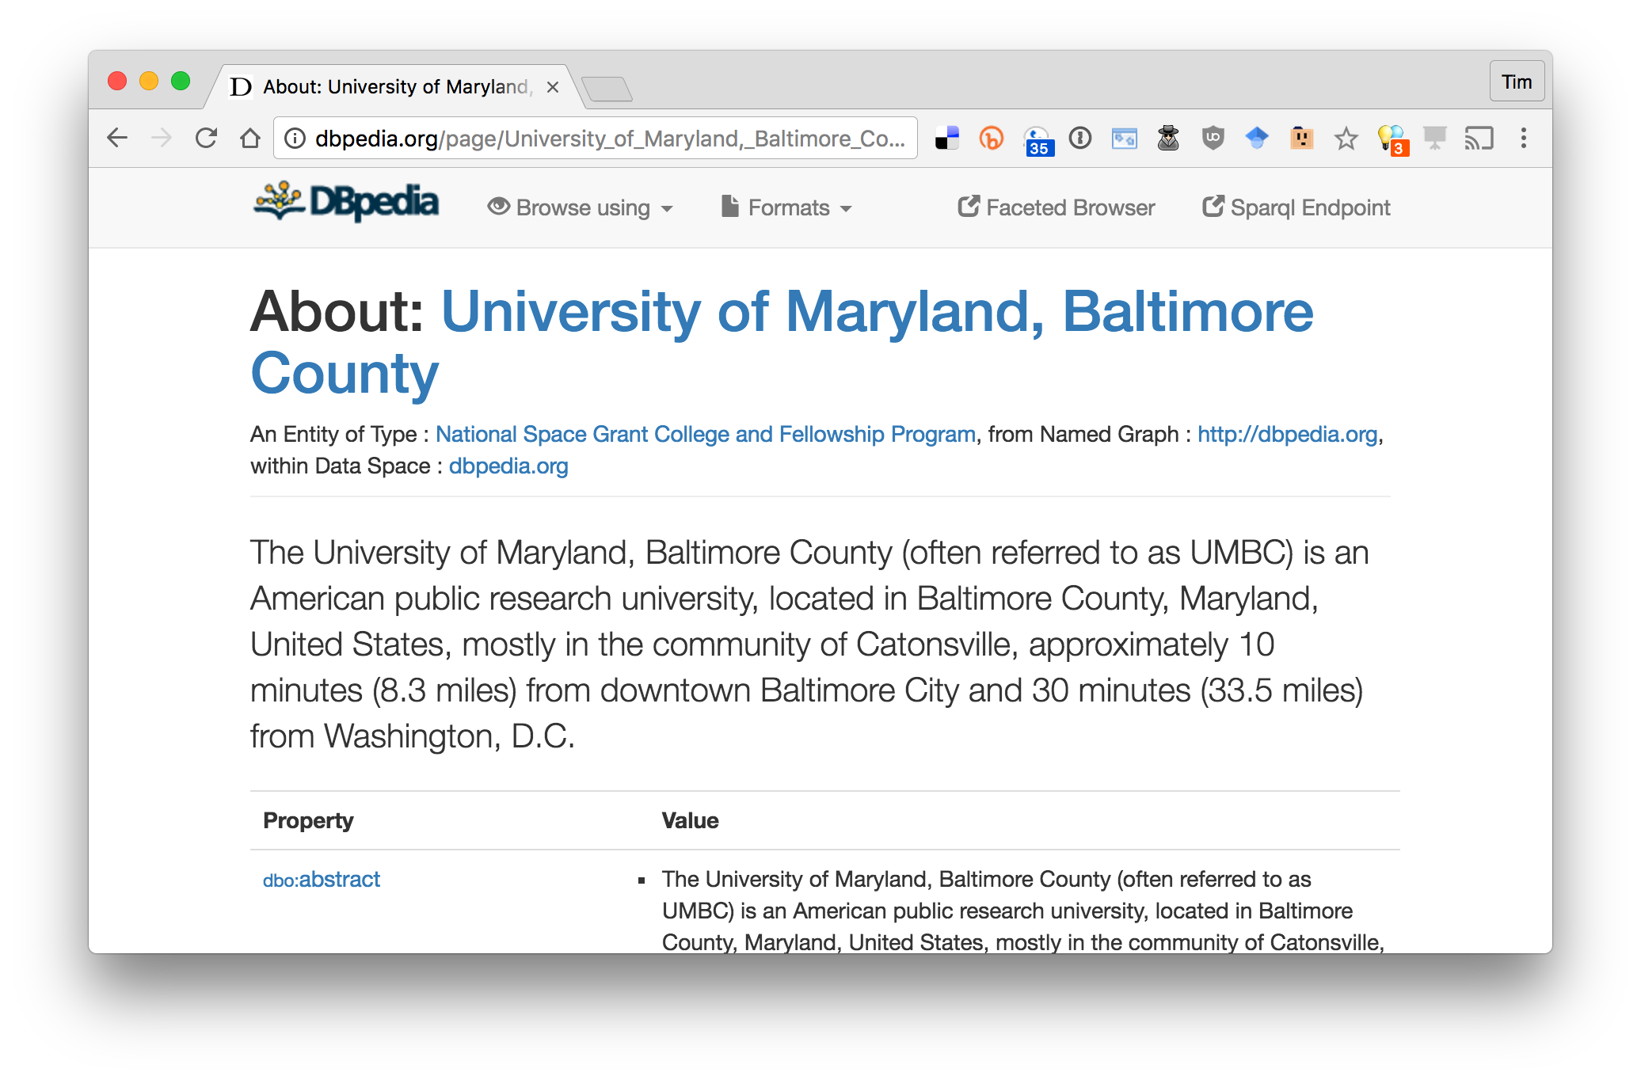
The node in the center is DBpedia
http://dbpedia.org/page/University_of_Maryland,_Baltimore_County

Slide 39
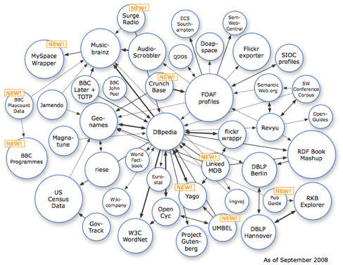
Semantic Web => Linked Open Data
Use Semantic Web Technology to publish shared data & knowledge
2008
Data is inter-
linked to support inte-
gration and fusion of knowledge
LOD growing

Slide 40
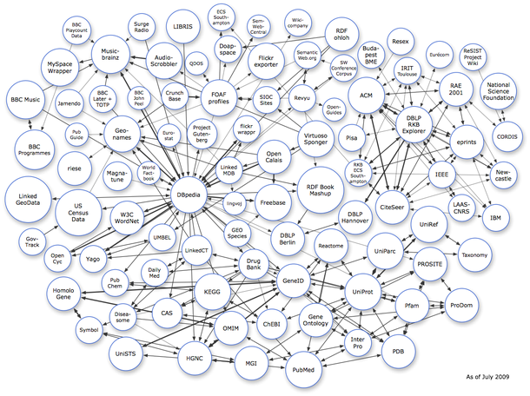
Semantic Web => Linked Open Data
Use Semantic Web Technology to publish shared data & knowledge
2009
Data is inter-
linked to support inte-
gration and fusion of knowledge
… and growing

Slide 41
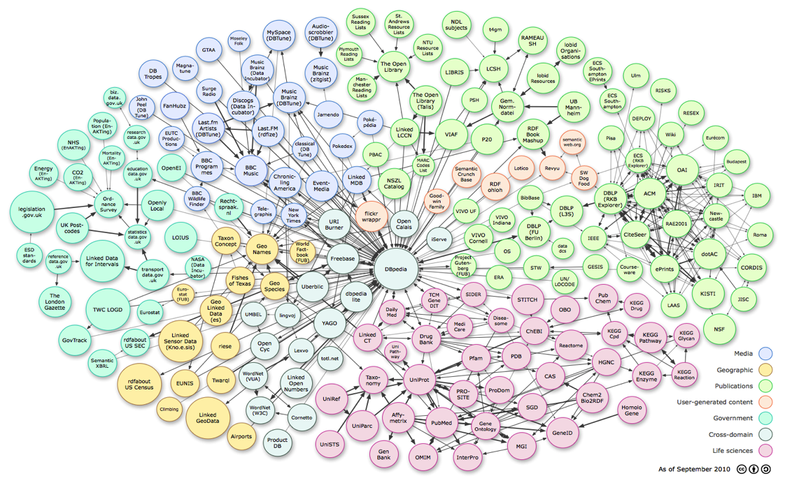
Linked Open Data
Use Semantic Web Technology to publish shared data & knowledge
LOD is the new Cyc: a common source of background
knowledge
Data is inter-
linked to support inte-
gration and fusion of knowledge
2010
…growing faster

Slide 42
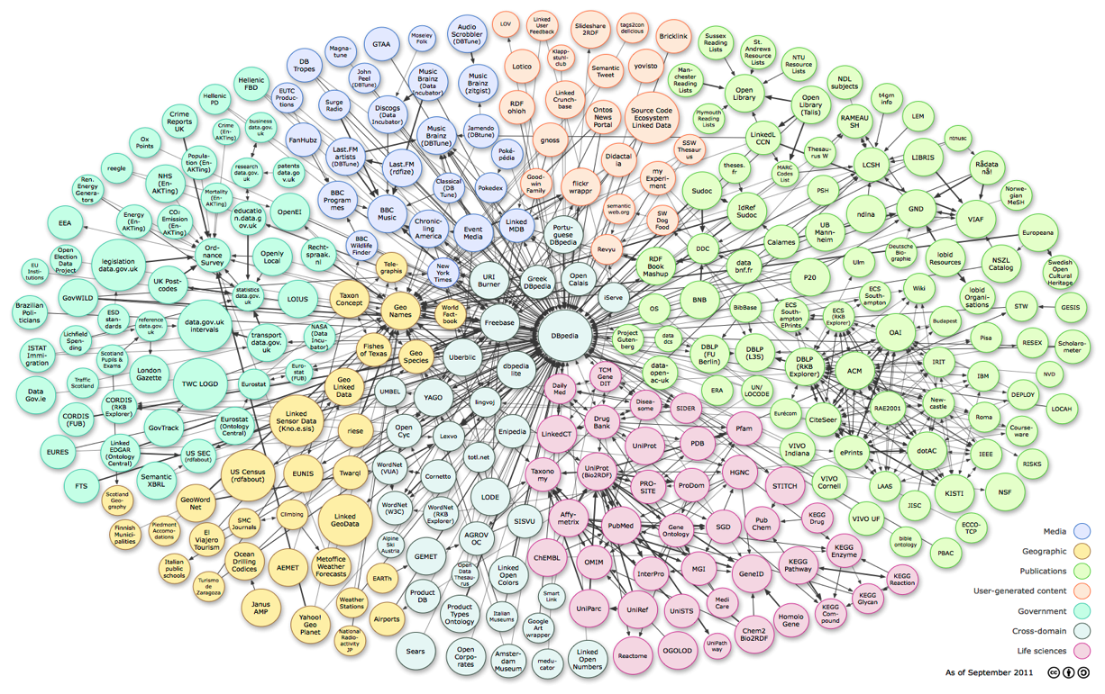
Linked Open Data
Use Semantic Web Technology to publish shared data & knowledge
LOD is the new Cyc: a common source of background
knowledge
Data is inter-
linked to support inte-
gration and fusion of knowledge
2011: 31B facts in 295 datasets interlinked by 504M assertions on ckan.net

Slide 43
Semantic Web: 1, 2, 3
Traditionally, all languages are divided into three parts:
Syntax: legal forms that make up the sentences in a language
Semantics: mapping of sentences to meaning (perhaps truth theoretic)
Pragmatics: everything else (how to do things with language, knowledge of world, etc.)

Slide 44
1: Syntax
Use URIs* to denote classes, properties, objects, relations
  http://live.dbpedia.org/resource/Alan_Turing
  http://schema.org/Person
  http://www.w3.org/1999/02/22-rdf-syntax-ns#type
Use strings for literals
Use triples to make statements
  dbpedia:Alan_Turing rdfs:type schema:Person .
  “Alan Turing is a Person”
*URI = Uniform Resource Identifier

Slide 45
2: Semantics
Semantics maps URIs to the things they denote in “the world”
Some of this in in your mind or in how you write your program
The meaning of some URIs allow automatic inference
  Parent relation is inverse of the child relation
  schema:parent owl:inverse schema:children

Slide 46
3: Pragmatics
Semantics is more than just about truth (statements that assert things)
We also have to account for commands, requests, questions, context, etc.
  Some of this is handled by Web protocols (GET, POST)
  Some by special SQ protocols (e.g., SPARLQ for queries and updates)
  Some by having reference KBs of the world (e.g., DBpedia) to help identify common entities

Slide 47
Where are we
The W3C version of the open semantic web has been growing steadily
The languages and standards are being used in government and industry
  BBC uses RDF to make up much of its content online
  Google and Facebook detect AND MAKE USE OF (some) RDF embedded in html pages
  Google, Yahoo, Microsoft and Yandex formed Schema.org to develop useful vocabularies
  Data.gov has many datasets in RDF

Slide 48
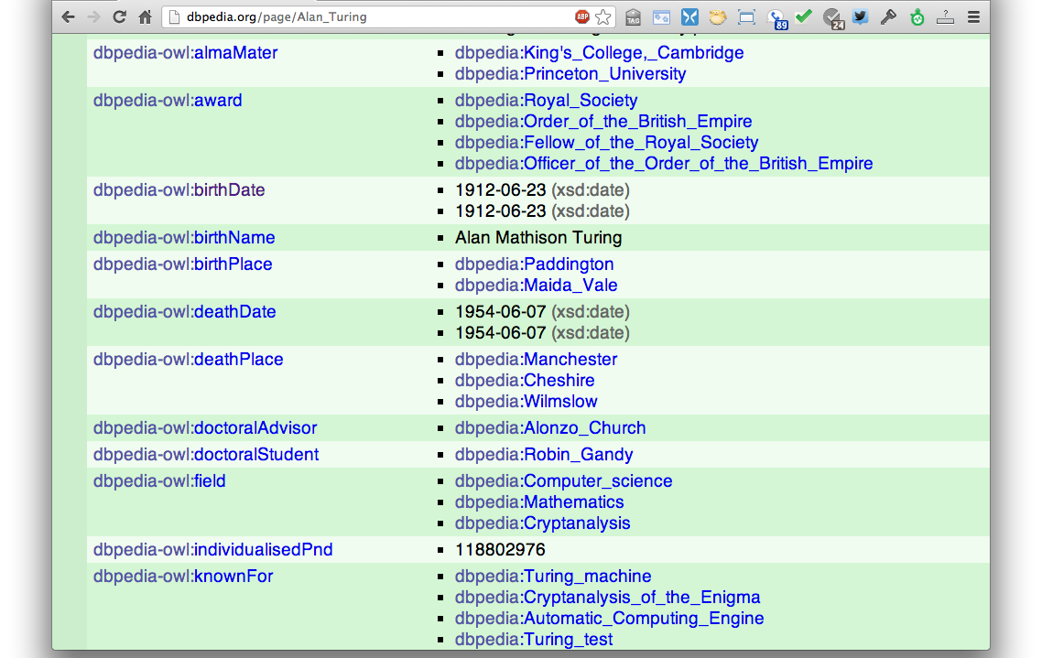
DBpedia
Wikipedia data in RDF
dbpedia:Alan_Turing dbpedia-owl:doctoralAdvisor dbpedia:Alonzo_Church .

Slide 49
Wikidata
Wikidata aims to create a free rdf-like KB about the world that can be read/edited by humans & machines
  Wikimedia project started in April 2012 with external funding
Wikidata clients use the repository, e.g., to populate Web pages or Wikipedia infoboxes
Based on ideas from Semantic MediaWiki and Freebase

Slide 50
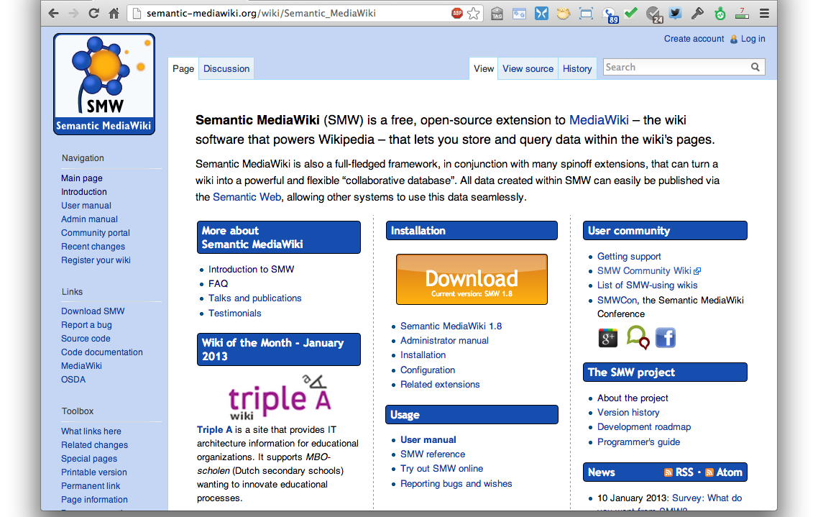
Semantic Media Wiki
Open source since 2005
Store infobox info in a KB

Slide 51
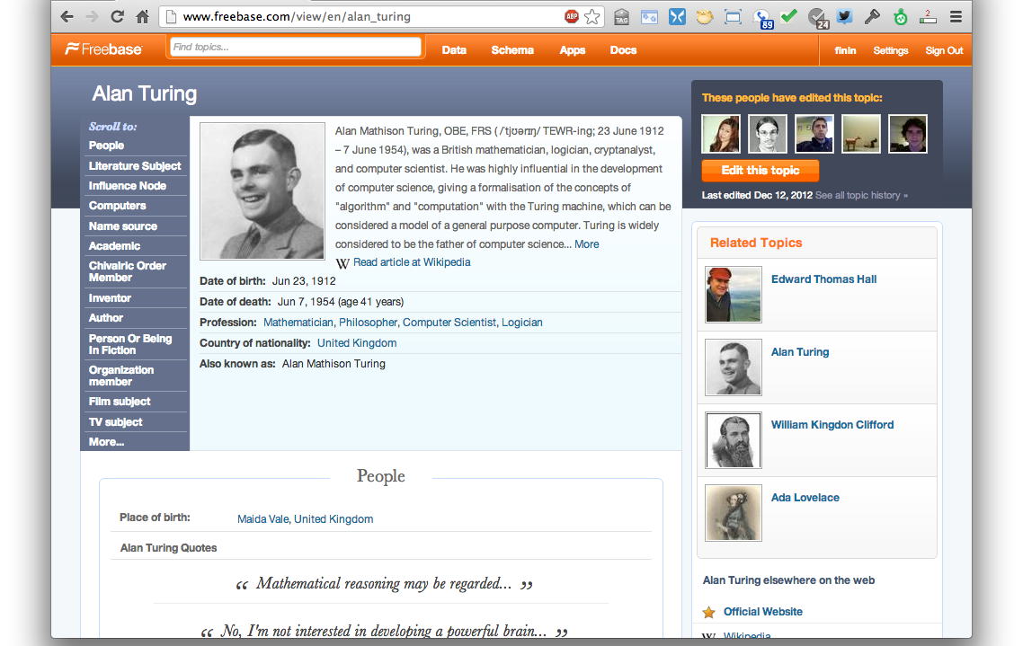
Freebase
Acquired by Google in 2010
“An entity graph of people, places and things, built by a community that loves open data”

Slide 52
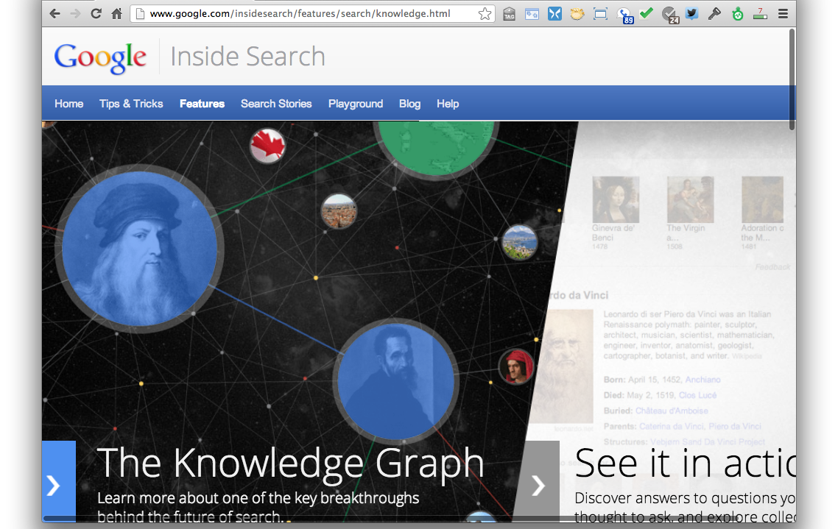
Google Knowledge Graph
Google’s slogan for the knowledge graph: “things, not strings”

Slide 53
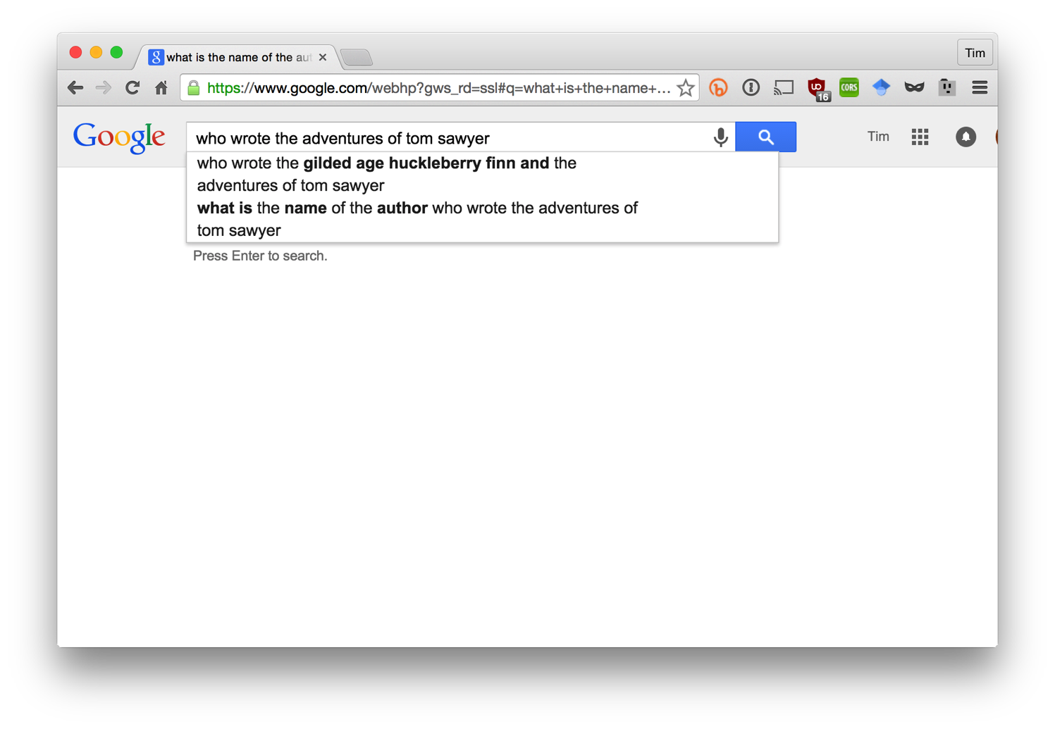
Who wrote Tom Sawyer?

Slide 54
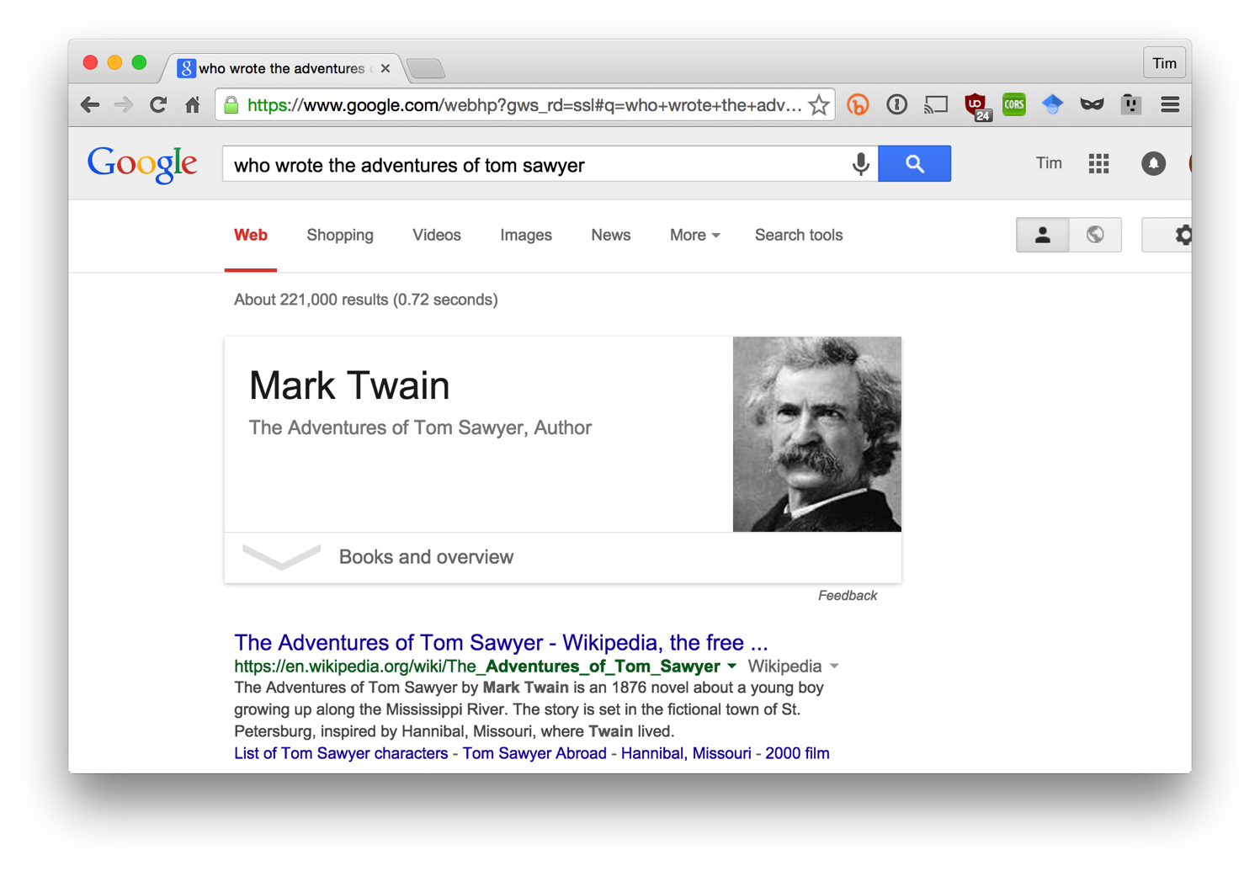
Who wrote Tom Sawyer?

Slide 55
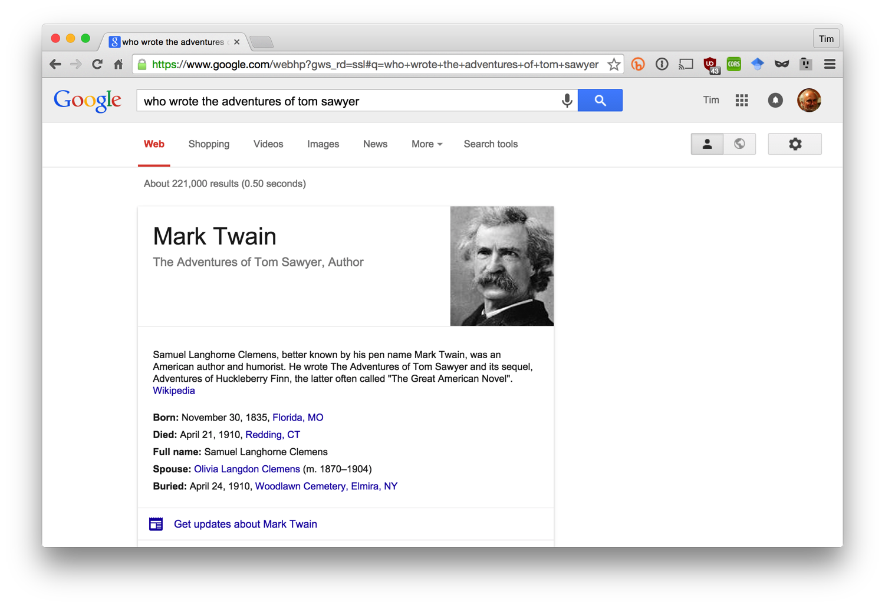
Who wrote Tom Sawyer?

Slide 56
Notes:
As a separate, but related example of using data on the web, many sites not embed semantic data on web pages. The data is represented in an RDF-compatible graph format using terms defined in common ontologies found at schema.org.

Slide 58
Almost all commercial recipe sites embed semantic data about their recipes in an RDF-compatible form using terms from the schema.org ontology.
Search engines read and use this data to better under-stand the semantics of the page content

Slide 59
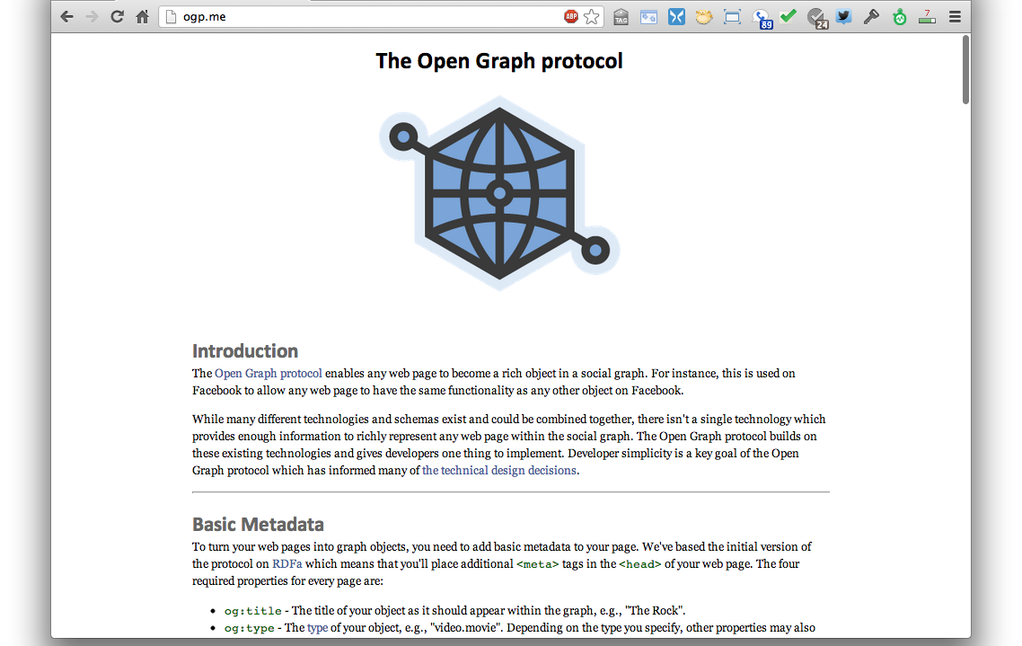
Facebook Open Graph
Annotate your web pages in RDFa
=> object in the FB graph

Slide 60
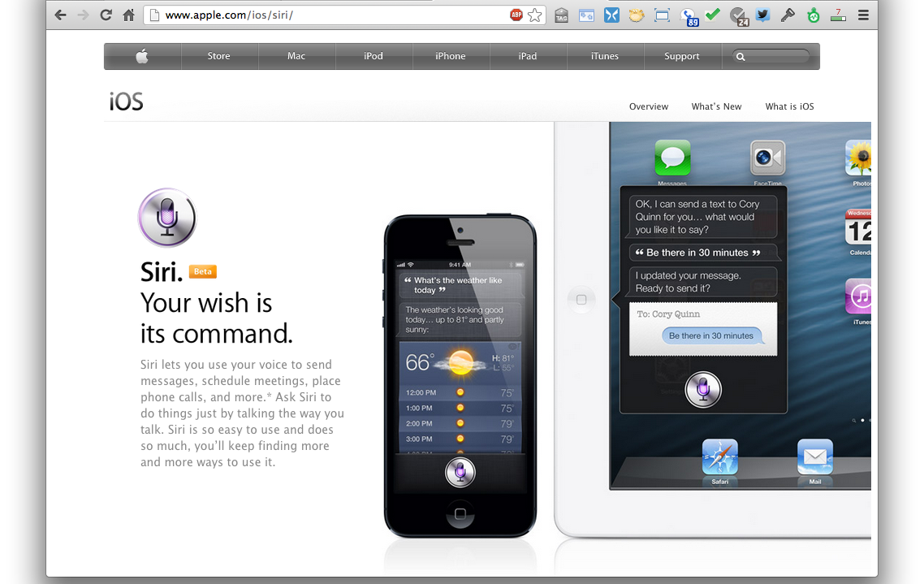
Apple’s SIRI
speech => text => entities => task
SIRI engineers from AI/SW community
SIRI needs lots of semantic data about entities in the world

Slide 61
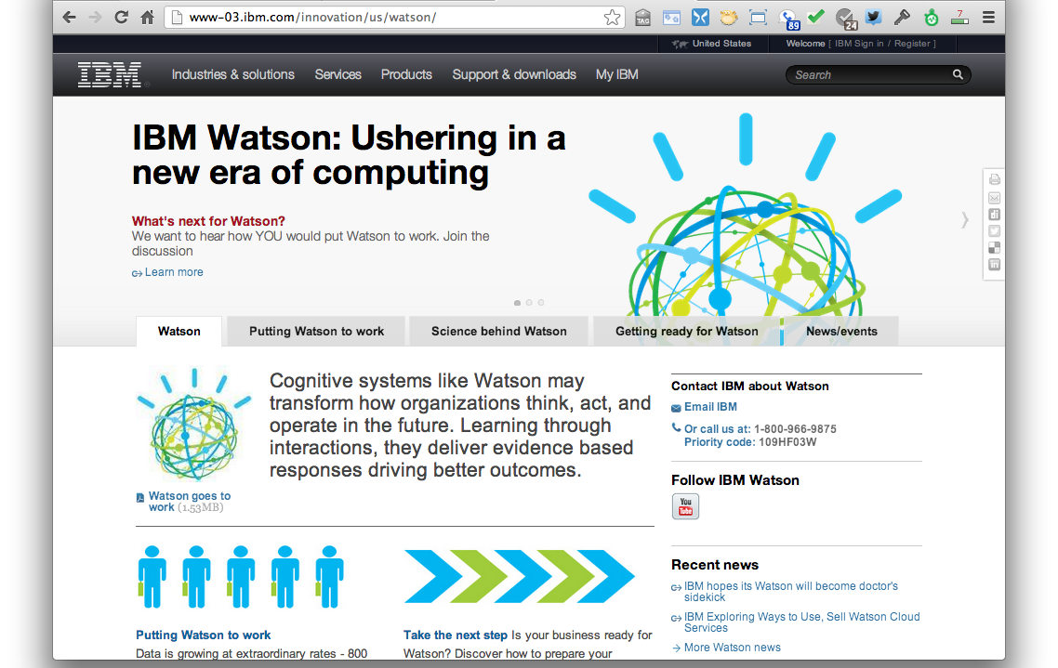
IBM’s Watson
IBM used Semantic Web technology and data in Watson, see http://bit.ly/X44alE

Slide 62
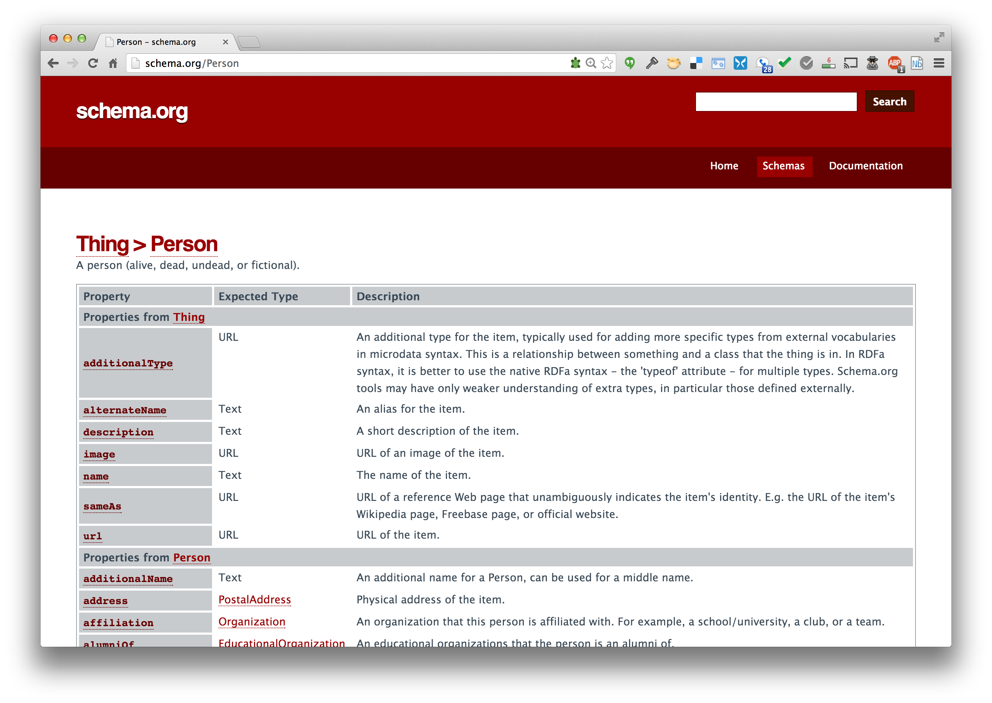
Schema.org
Embed in HTML using RDFa to make machine understand-able statements
A collection of useful ontologies

Slide 63
Summary
The Web has made us smarter by sharing information and knowledge as text, audio and images
Machines should also be able to use the Web to publish & retrieve information & knowledge
Human forms of knowledge are hard for machines to understand and generate
The Semantic Web is a collection of languages, ontologies, software tools, services and KBs that are designed to support machines

