Slide 1
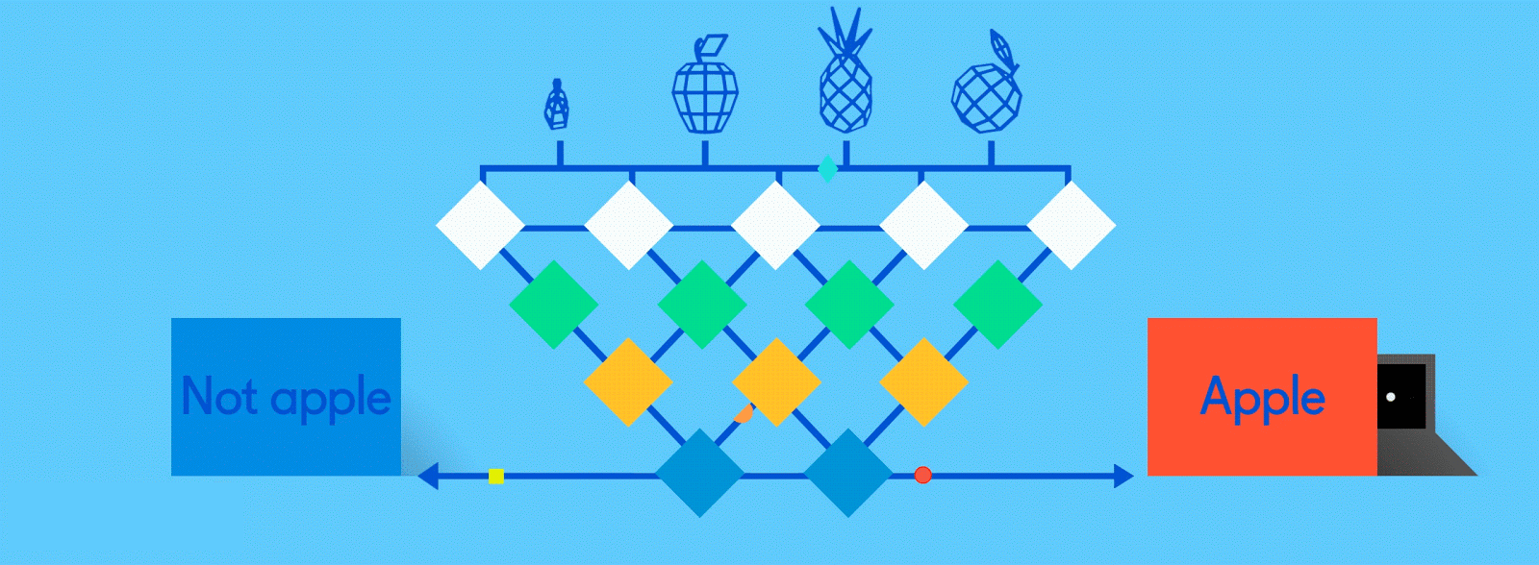
Neural Networks for Machine Learning demonstrations

Slide 2
Neural Network Architectures
Current focus on large networks with different “architectures” suited for different kinds of tasks
Feedforward Neural Network
CNN: Convolutional Neural Network
RNN: Recurrent Neural Network
LSTM: Long Short Term Memory
GAN: Generative Adversarial Network

Slide 3
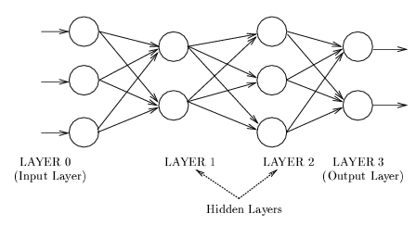
Feedforward Neural Network
Connections allowed from a node in layer i only to nodes in layer i+1
  i.e., no cycles or loops
Simple, widely used architecture.
downstream nodes tend to successively abstract features from preceding layers
http://playground.tensorflow.org/

Slide 4
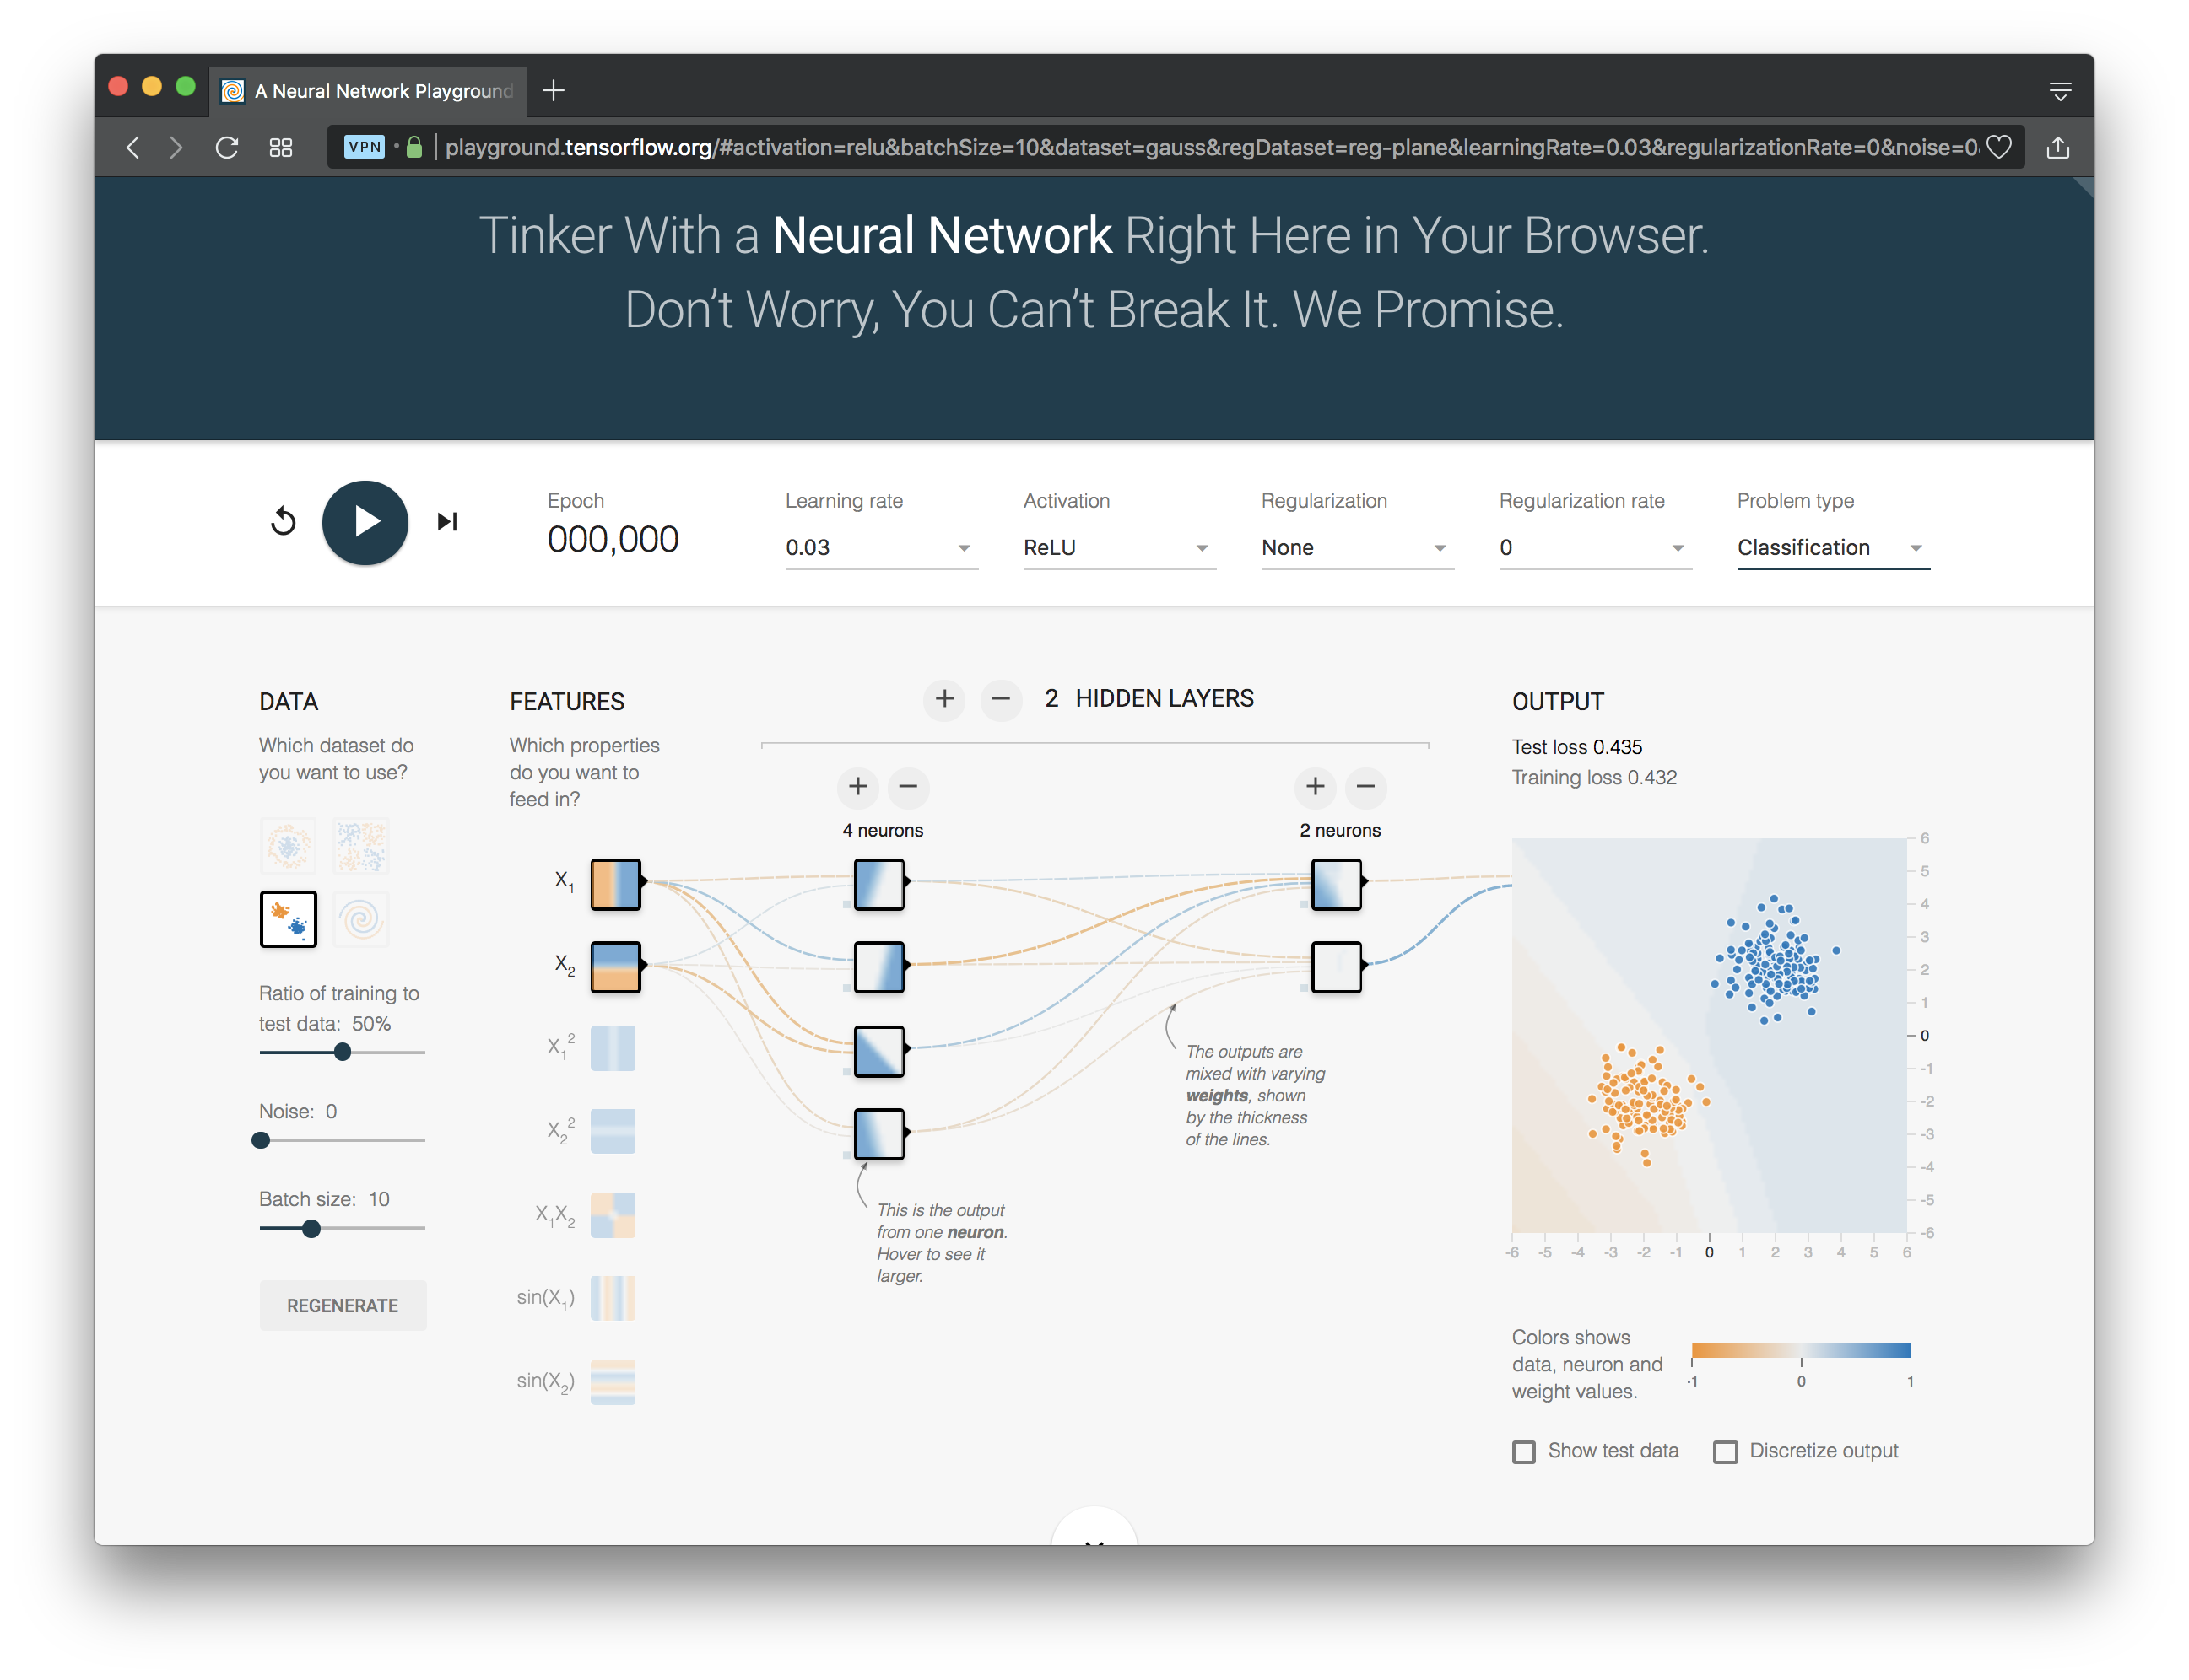
http://playground.tensorflow.org/

Slide 5
CNN: Convolutional Neural Network
Good for image processing: classification, object recognition, automobile lane tracking, etc.
Classic demo: learn to recognize hand-written digits from MNIST data with 70K examples

Slide 6
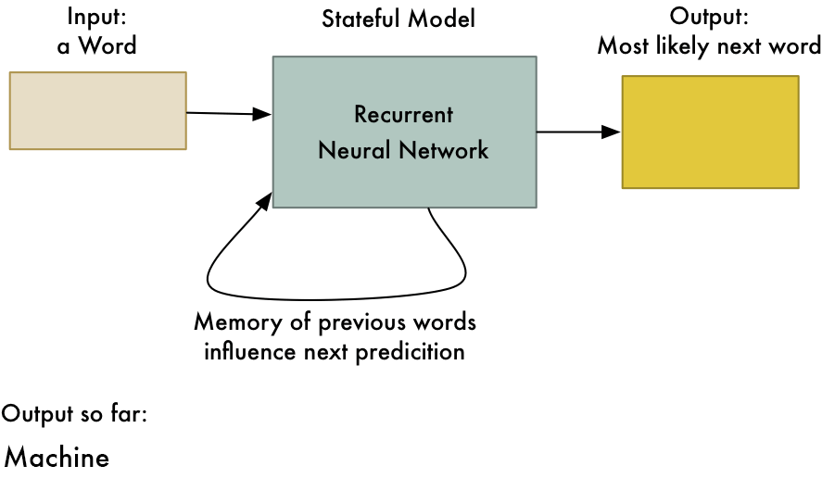
RNN: Recurrent Neural Networks
Good for learning over sequences of data, e.g., a sentence orf words
LSTM (Long Short Term Memory) a popular architecture
gif from Adam Geitgey

Slide 7
Deep Learning Frameworks
Popular open source deep learning frame-works use Python at top-level; C++ in backend
  TensorFlow (via Google)
  PyTorch (via Facebook)
  MxNet (Apache)
  Caffe (Berkeley)
Keras: popular API works with the first two and provides good support at architecture level
Notes:
Demo: MNIST CNN
Demo: RNN sentiment

Slide 8
Scikit-learn
We’ll look at using sicikit-learn’s feed forward model on the iris dataset

Slide 9
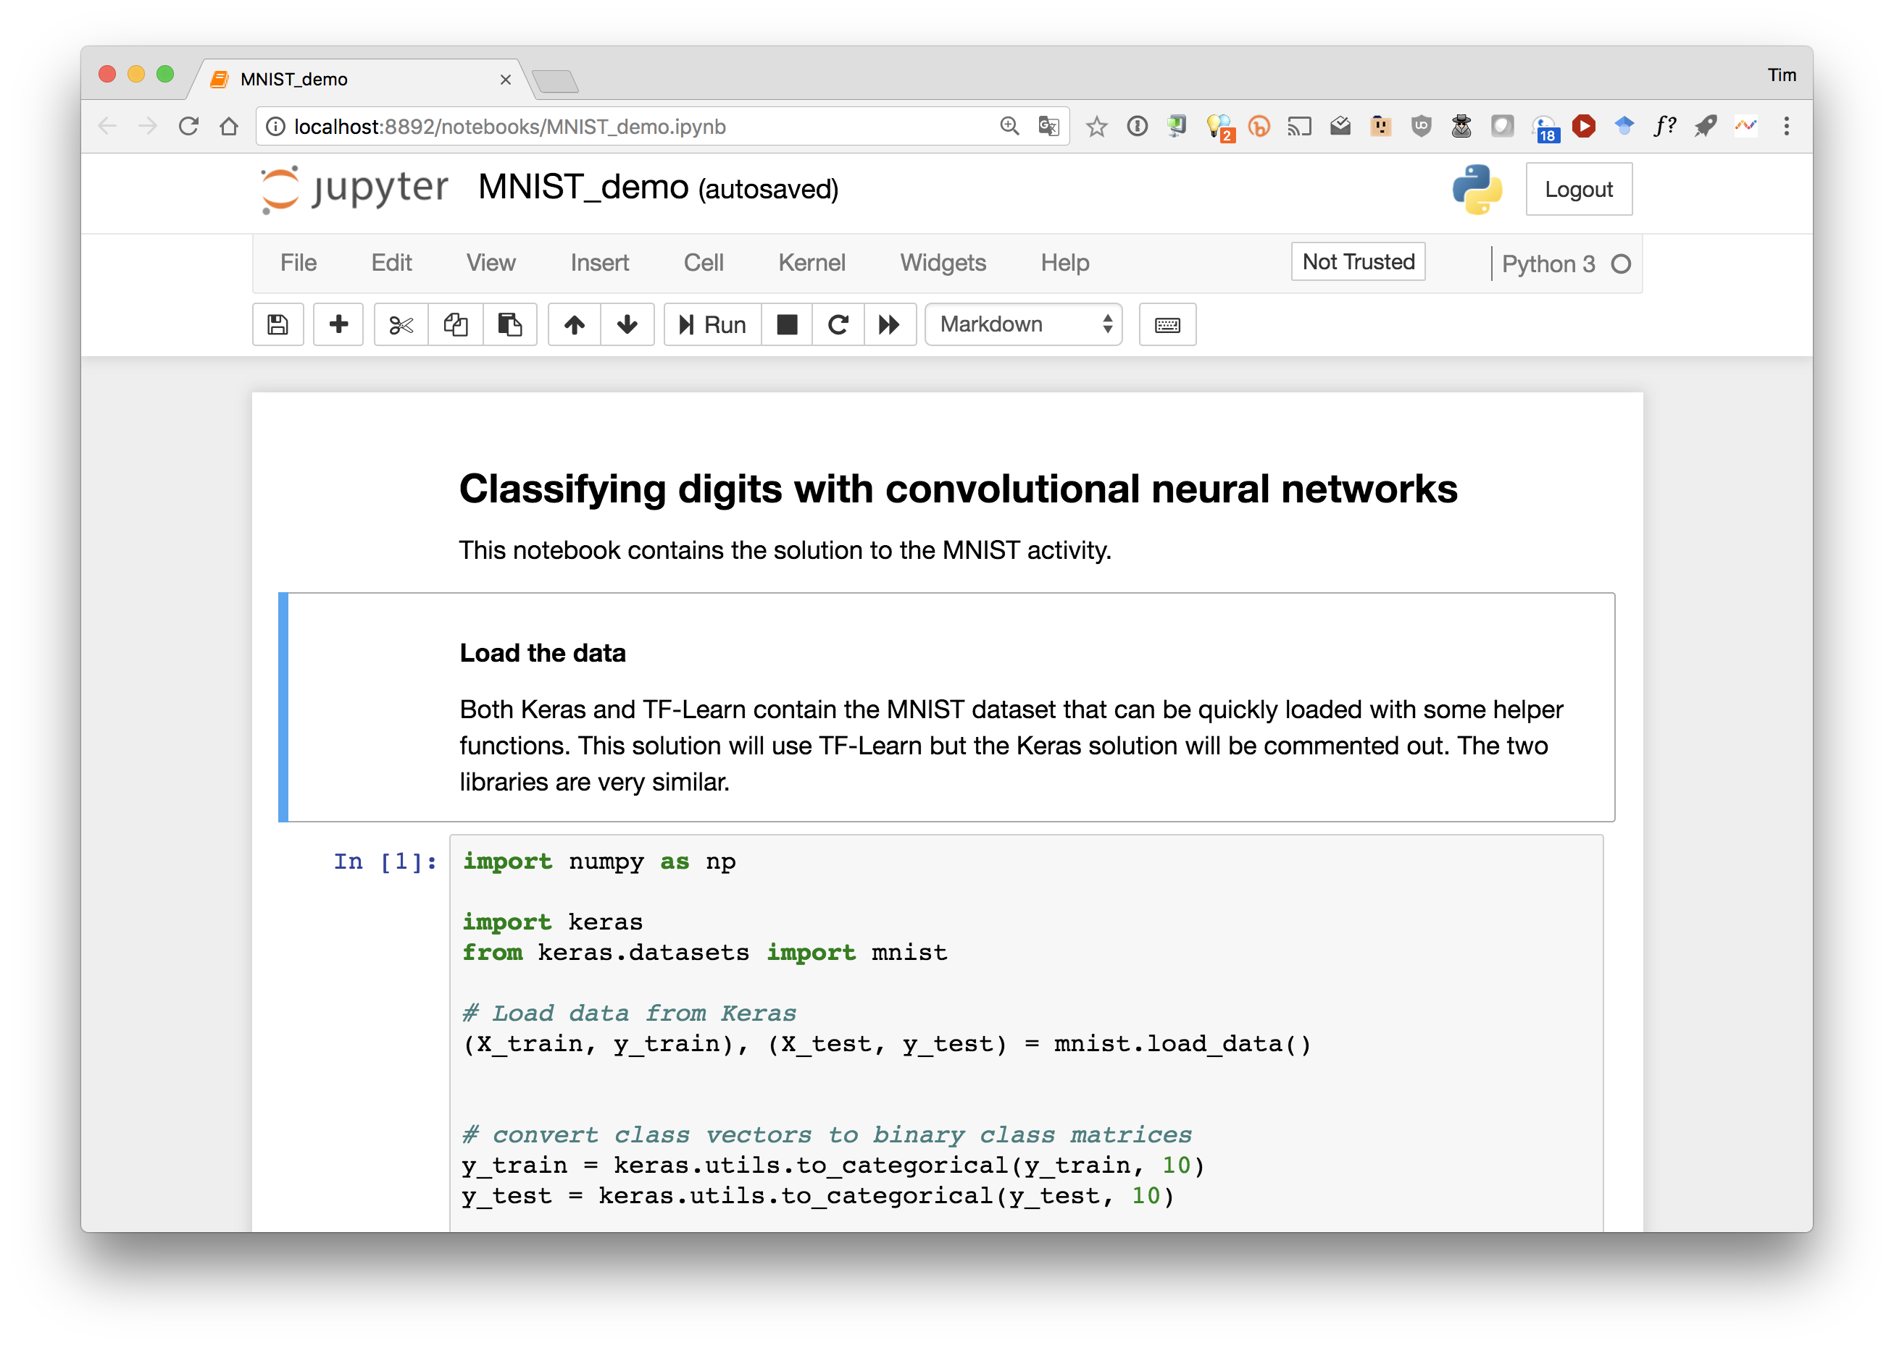

Slide 10
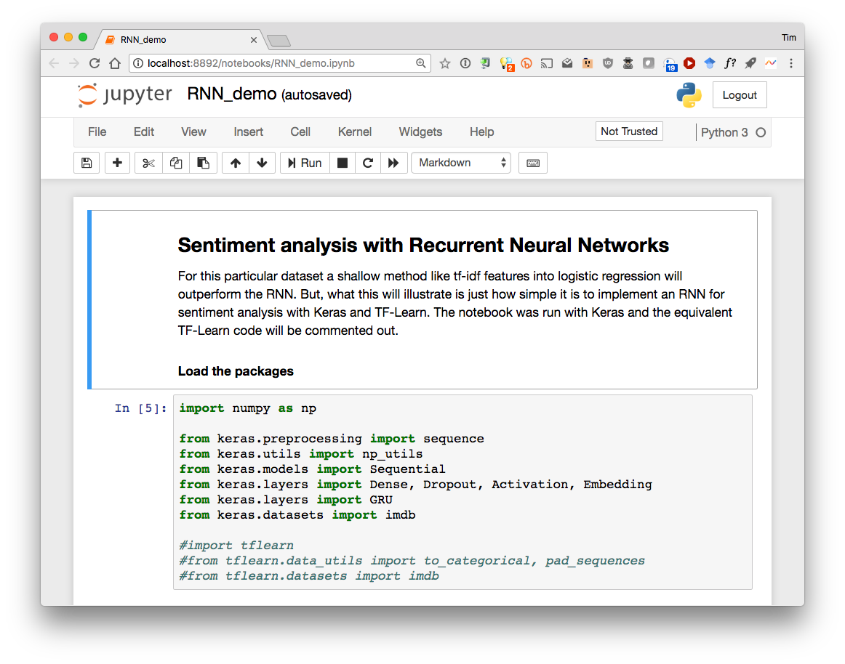

Slide 11
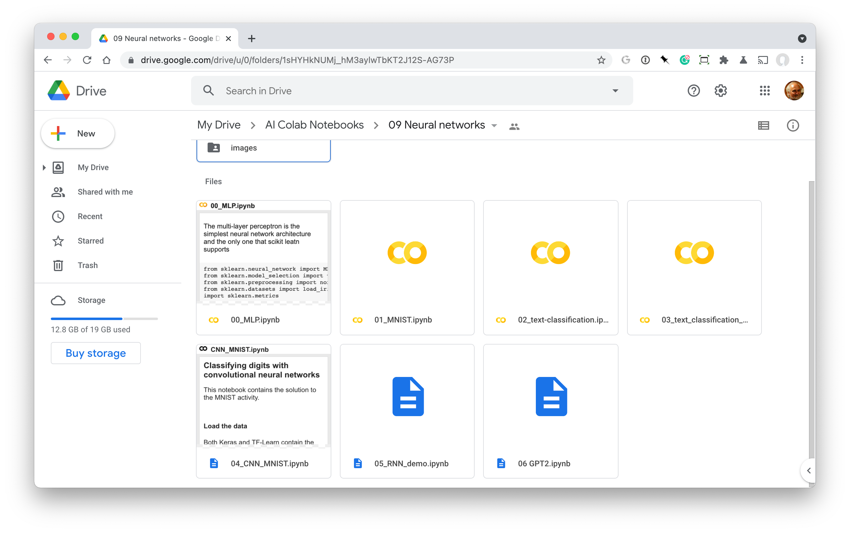
09 Neural Networks

